Slide 1
Use of Color on Pharmaceutical Packaging and Labeling
March 7, 2005
Eric B. Sheinin, Ph.D.
USP
Chief Science Officer

Slide 2
U.S. Pharmacopeia
Private, non-profit, standards-setting organization
Established in 1820 by physicians to establish quality for drug products
Legally enforceable standards of quality, strength, purity, packaging, labeling, storage, and nomenclature
Mission to promote public health through the safe use of medicines

Slide 3
Reasons USP does not support color-coding
Color-coding could encourage healthcare professionals to rely solely on the color in selecting a product rather than reading the label.
USP Medication Error Reporting Programs (MER and MEDMARX) have received reports where color similarities in labeling and packaging have caused or contributed to medication errors.
There are only a limited number of colors in the spectrum, thus shades of color would likely begin to look similar to certain people.
Some individuals are colorblind and cannot distinguish a difference in certain colors.
Certain colors, in poor lighting, could begin to look like others and the products could be confused.

Slide 4
USP Reporting Programs
USP- ISMP Medication Errors Reporting (MER) Program
Spontaneous reporting by any health professional from any setting
  9,000 reports since 1991
  Reports are enriched by dialogue with the reporter
MEDMARXSM
  Anonymous, facility-based reporting by hospitals and their related health systems (inpatient and outpatient)
  Used as part of the internal quality improvement program
  840,000 reports since 1998

Slide 5
Color Coding Errors MER Program
11/15/1994 – 12/15/2004 (n = 360)
Category Index | # Of Records | Percent (%)
A | 181 | 50.3
B | 101 | 28.1
C | 58 | 16.1
D | 3 | 0.8
E | 7 | 1.9
F | 2 | 0.6
H | 4 | 1.1
I | 4 | 1.1
Total | 360

Slide 6
Severity of Error
Category Index | Number of Records | Percent (%)
A (No Harm) | 181 | 50.3
B-D (Error, No Harm) | 162 | 45.0
E-I (Error, Harm) | 17 | 4.7
Total records | 360

Slide 7
Node (Phase of the Medication Use Process where the error initiated)
Node | Number of Records | Percent (%)
Prescribing | 1 | 2
Dispensing | 37 | 74
Administering | 12 | 24
Total unique records | 50

Slide 8
Leading products – Error, harm (E-I)
Generic Name
Heparin Sodium
Albuterol Sulfate
Dantrolene Sodium
Magnesium Sulfate
Potassium Chloride for Injection Concentrate
Warfarin Sodium

Slide 9
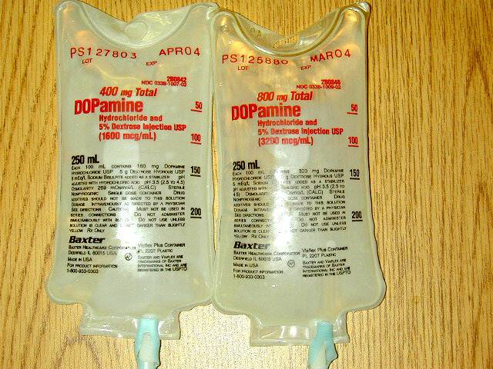
Same Color Packaging Different Strengths

Slide 10
Harmful Errors
Nitrous Oxide given instead of Oxygen
Potassium Chloride instead of Heparin
Sufentanyl 75 mcg by mistake instead of 75 mcg Fentanyl

Slide 11
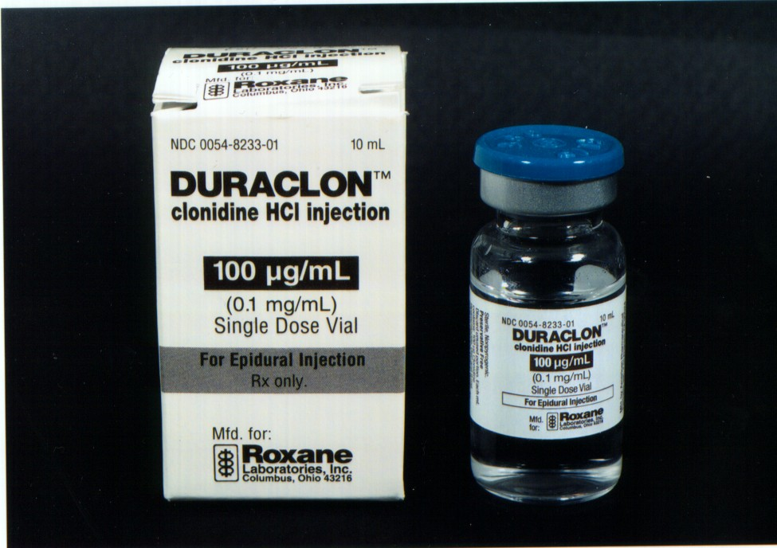
Black and White Labeling

Slide 12
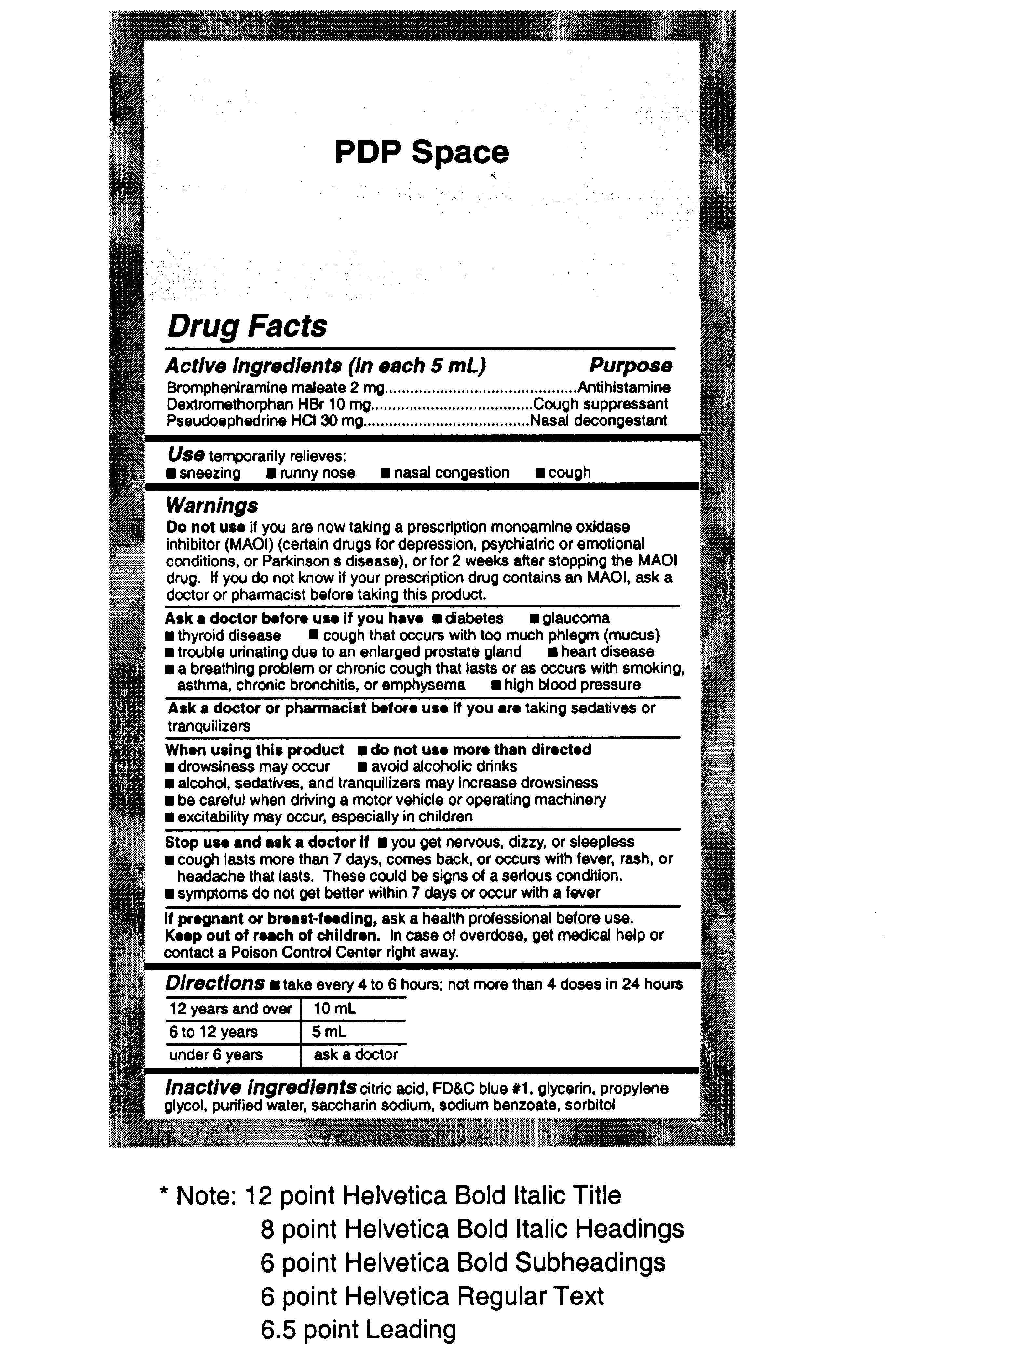
OTC Drugs
Official 1999
Standardizes format and content of OTC labeling
  Specific headings and subheadings in a standardized order
  Standardized graphical features
  Minimum standards for type size and spacing
Principle Display Panel (PDP) reserved for manufacturer trade dress
Notes:
Standardized graphical features include type style, point size and use of bullets to introduce key information

Slide 13
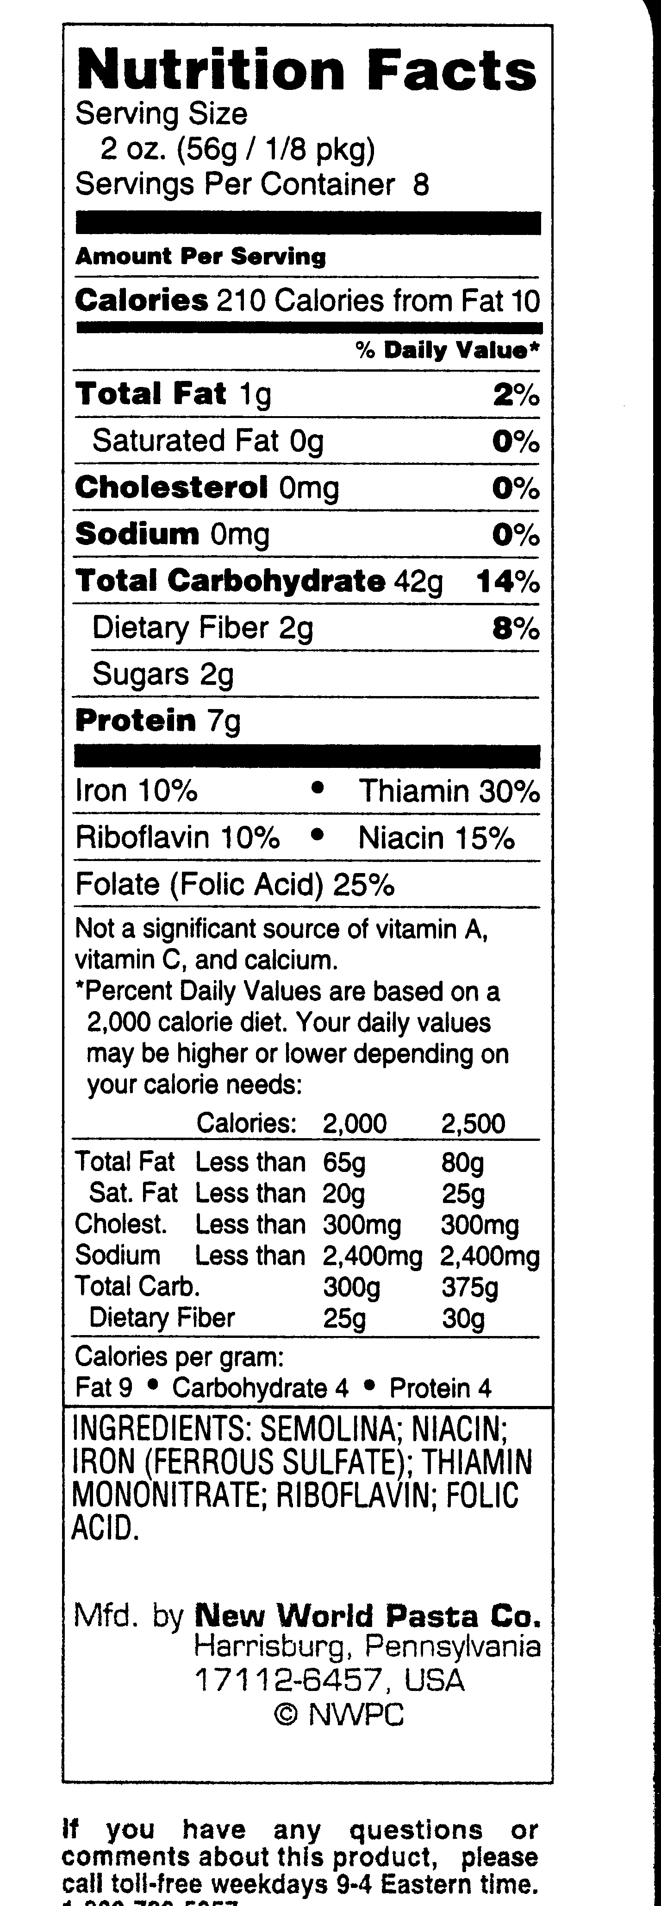
Food Labeling
Official 1999
Nutrients appear in the order as required
Food labels printed must show the net contents in both metric (grams, kilograms, milliliters, liters) and U.S. Customary System (ounces, pounds, fluid ounces) terms. For example, Net contents 1 gal (3.79 L)
Notes:
The area of the principal display panel (calculated in square inches or square centimeters) determines the minimum type size that is permitted for the net quantity statement (see next question).
There are conspicuousness and prominence requirements:
Choose a print style that is prominent, conspicuous and easy to read. The letters must not be more than three times as high as they are wide, and lettering must contrast sufficiently with the background to be easy to read. Do not crowd the net quantity statement with artwork or other labeling (minimum separation requirements are specified in the regulation).
www.cfsan.gov

Slide 14
Color-coding
USP supports the suggestion that the use of color-coding for pharmaceutical products to prevent medication errors be used cautiously and on a case-by-case basis

Slide 15
THANK YOU

