Slide 1
CEDPS and CDIGS:
A Tale of Two (Globus) Projects
Jennifer M. Schopf
Argonne National Laboratory
University of Chicago
jms@mcs.anl.gov

Slide 2
SciDAC Center for Enabling
Distributed Petascale Science
Argonne National Laboratory
Fermi National Accelerator Laboratory
Lawrence Berkeley National Laboratory
University of Southern California
University of Wisconsin
www.cedps.net
PI: Ian Foster
Director: Jennifer Schopf, ANL jms@mcs.anl.gov

Slide 3
SciDAC in a Nutshell
Advance scientific discovery esp. as related to HPC resources, PetaScale computing
3 institutes and 10 Centers for Enabling Technologies funded, as well as many Scientific Application Partnerships
Center for Enabling Distributed Petascale Science
  CEDPS – “seds” (silent P)
  DOE SciDAC Center for Enabling Technology
  July 1, 2006 – June 30, 2011, $2.4M/yr
  Collaboration between 5 sites
    Argonne National Laboratory
    Fermi National Laboratory
    Lawrence Berkeley National Laboratory
    USC Information Sciences Institute
    University of Wisconsin Madison

Slide 4
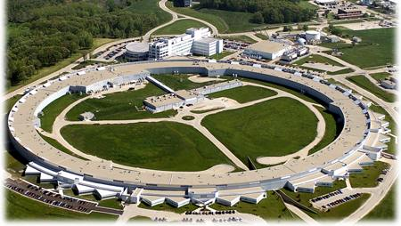
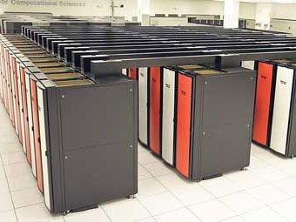
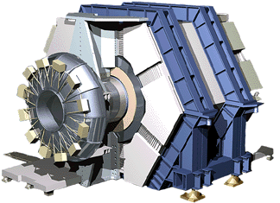
The Petascale Data Challenge
U
U
U
Remote
distributed users
DOE facilities generate
many petabytes of data
(2 petabytes = all U. S.
academic research libraries!)
U
U
Remote users (at labs
universities, industry)
need data!
U
Massive data
U
Rapid, reliable access
key to maximizing
value of $B facilities
U
DOE
facilities

Slide 5
Bridging the Divide (1):
Move Data to Users
When & Where
Needed
A
“Deliver this 100
Terabytes to
locations A, B, C
by 9am tomorrow”
B
C
Fast: >10,000x
faster than
usual Internet
Reliable: recover
from many failures
Predictable: data
arrives when scheduled
Secure: protect expensive resources & data
Scalable: deal with many
users & much data

Slide 6
Bridging the Divide (2):
Allow Users to Move
Computation
Near Data
A
“Perform my
computation F on
datasets X, Y, Z”
Science services:
provide analysis
functions near
data source
Flexible: easy
integration of functions
Secure: protect expensive resources & data
Scalable: deal with many
users & much data
X
F
Y
Z

Slide 7
Bridging the Divide (3):
Troubleshoot
End-to-End
Problems
A
“Why did my data
transfer (or remote
operation) fail?”
B
C
Identify & diagnose failures & performance
problems
Instrument: include
monitoring points in
all system components
Monitor: collect data in
response to problems
Diagnose: identify the
source of problems

Slide 8
Data Services in CEDPS
Ann Chervenak, ISI, is the CEDPS Data lead
  And these slides are adapted from hers
Develop tools and techniques for reliable, high-performance, secure, and policy-driven placement of data within a distributed science environment
Data placement and distribution services that implement different data distribution and placement behaviors
Managed Object Placement Service—enhancement to today’s GridFTP—that allows for management of:
  Space
  Bandwidth
  Connections
  Other resources needed to endpoints of data transfers

Slide 9
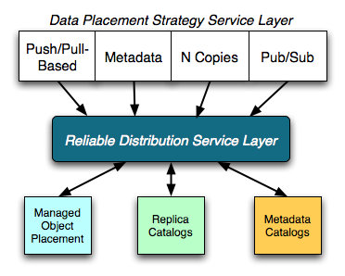
CEDPS Data Services
Data Placement Strategy Layer
  Decide where to place objects and replicas in the Grid environment
  Policy-driven, based on needs of application
  Effectively creates a placement workflow that is then passed to the Reliable Distribution Service Layer for execution
Reliable Distribution Service Layer
  Responsible for carrying out the distribution or placement “plan” generated by higher-level service
  Provide feedback to higher level placement services on the outcome of the placement workflow
  Call on lower-level services to coordinate

Slide 10
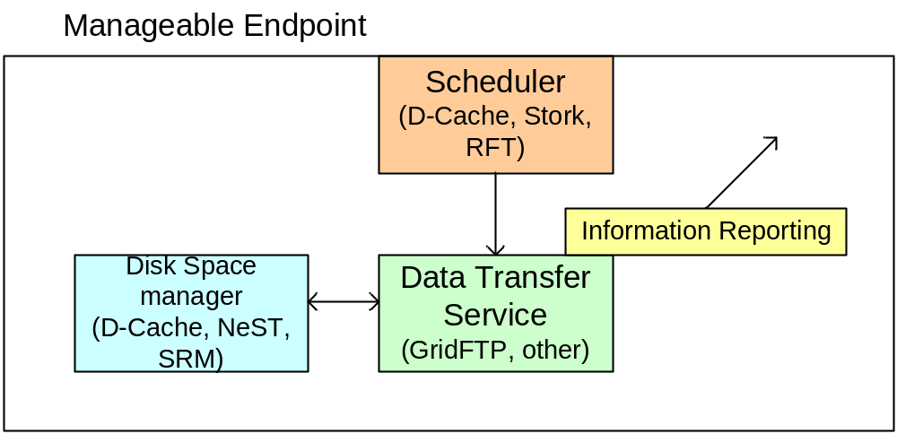
Managed Object Placement Service
Data Transfer Service (e.g., GridFTP)
Disk Space Manager: for doing local storage allocation (NeST, D-Cache, SRM)
Connection Management: incoming and outgoing
Scheduler (C-Cache, Stork, RFT): includes queue
  Eventually interact with both endpoints of transfer

Slide 11
Science Services in CEDPS
Kate Keahey, ANL, is the CEDPS Science Services lead
Develop tools and techniques for construction, operation, and provisioning of scalable science services
Service construction tools that make it easy to take application code (whether simulation, data analysis, command line program, or library function) and wrap it as a remotely accessible service
Service provisioning tools that allow dynamic management of the computing, storage, and networking resources required to execute a service, and the configuration of those resources to meet application requirements.
Services to move computation to data

Slide 12
Scalable Science Services
Service-enabling applications is too hard for application developers
  Community may already have a required data analysis function, typically implemented as a standalone (parallel or sequential) program or library
  Turning this existing implementation into a service is arduous and time-consuming
  Process involves knowledge about the mechanics of service container implementation and Grid mechanisms
Solution: Formalize and automate this process in service wrapping tools
  Automate the process of embedding application code into an Application Hosting Service (AHS)

Slide 13
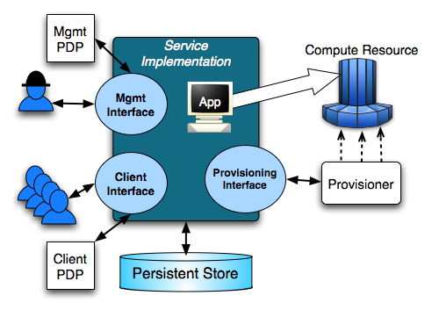
Service Construction:
Application Hosting Environment
  An AHS involves
    An application-specific service interface to analysis code
    A management interface that allows the service provider to monitor and control the AHSs execution
  The AHS interacts with external policy decision points (PDPs) for policy enforcement and provisioners for service scalability

Slide 14
Service Provisioning with Variance
If the load on a service varies significantly over time, then the number of resources allocated to the service must also vary
Solution: Introduce provisioning tools that
  Allow a service provider to specify desired performance levels, while other system components
  Monitor service behavior
  Dynamically add and remove resources applied to service activity, so as to adapt to varying service load

Slide 15
Troubleshooting in CEDPS
Brian Tierney, LBNL, is the CEDPS TS lead
Develop tools and techniques for failure detection and diagnosis in distributed systems
Better logs and logging services to understand application and service behavior
Better diagnostic tools to discover failures and performance faults, and for notification of these errors

Slide 16
Logs and Log Management
Logging and monitoring data is hard to find and manage
  Data scattered across sites and within a site
  No agreed on “standards” for what logs should look like
  Large volumes of data are possible
    A heavily loaded GridFTP server with all network and disk I/O instrumented generates 1.1 GB of log data per hour
Introduce “Best Practices” for logging
  Then implement for GT, Condor, and others
Log collection service
  Work to deploy on OSG as first case
Log management functions
  Provide for turning logging on and off, moving log data back to the user for analysis, deleting old log data, etc.

Slide 17
Automatic Failure Detection
Automated failure detection for infrastructure services
  Distributed systems often run many services with little or no 24-7 support
  Failures are discovered only when user tasks fail
Solution: Deploy monitoring information providers to gather behavior data on resources and services
  Use this data to warn system administrators of faults and to study how fault behaviors change over time.
Extend MDS4 Trigger Service
Create a NetLogger-based event-driven monitoring system to gather runtime data from services and applications

Slide 18
Performance Degradation Detection
Performance degradation is often overlooked
  Many systems have long running services used by different users at different times, and no single group tracking behavior
Solution: Develop and apply analysis functions to archived background monitoring and event-driven log data
Track executions dynamically and compare them to past behaviors and service guarantees
  When service behavior degrades or deadlines are threatened the proper services or users can be notified to take action
Develop analysis components to examine end-to-end bottleneck analysis and detection, trend analysis, and alarm generation

Slide 19
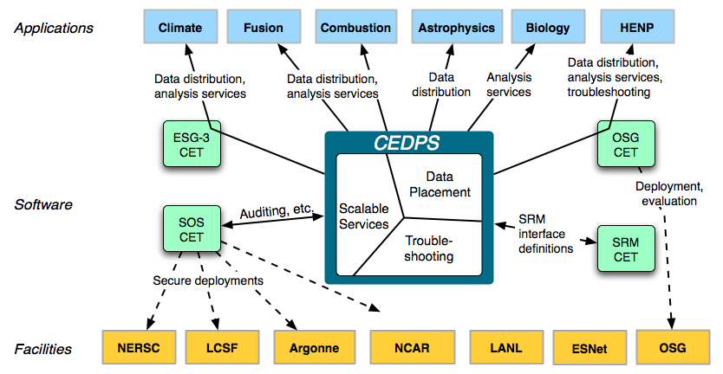
Work with Applications
Strong collaborations with DOE applications, SciDAC software centers, and DOE facilities
NSF &
international
projects

Slide 20
Work with Applications
Earth Systems Grid
  Data work
  Error and warning alpha tester
Open Science Grid
  Data services for ATLAS and CMS
  Services work with STAR
  Logging service Alpha tester
Second Wave
  LIGO (OSG) – Data focus
  Fusion- FACETS – Scalable services focus
  DANCE – Scalable services focus
  Combustion – Troubleshooting focus
  GADU – Scalable services and data focus

Slide 21
Community Driven Improvement of Globus Software (CDIGS)
University of Chicago
University of Southern California
www.cdigs.org
PIs: Ian Foster, Carl Kesselman
Director: Dan Fraser, UC/ANL
fraser@mcs.anl.gov
(until recently, Lisa Childers, UC/ANL)

Slide 22
Community Driven Improvement of Globus Software (CDIGS)
A National Science Foundation Office of Cyberinfrastructure Project
  Awarded Dec 2005, 5 years
Collaboration between
  USC Information Sciences Institute
  University Chicago
Four high level goals
  Evolve and enhance Globus functionality, performance, scalability and robustness
  Improve usability and manageability so as to decrease the cost and complexity of deploying, operating and using Globus infrastructure
  Support major NSF users and communities
  Expand the Globus community

Slide 23
Goal #1
Evolving and Enhancing Globus
Enhancements to software components to address user requirements for functionality, performance, and robustness
Across all areas of the toolkit
  Improvements in GRAM performance and robustnes
  Creation of a new attribute-based authorization framework
  Release of the workspace service for virtual machine management
  Enhancements to the performance and functionality of information services
And of course bug fixes and basic support
  In 2005, we resolved 667 bugzilla issues, including both feature requests and error reports.

Slide 24
Goal #2: Improving Usability
Target on two end user communities
System administrator- responsible for deploying and maintaining a Globus based Grid infrastructure
  Overhauled the software packaging- simplifying the installation and configuration process of the toolkit
  Streamlining the installation requirements for individual components
  Greatly improved documentation targeted towards the system administrator
End user – working with Globus services or developing aps
  Continued improvement of content, coverage, and readability of Globus documentation
  Availability of a number of user-centric tools that have significantly reduced the barrier to entry for new and existing users and developers
    Introduce service development environment, part of Incubator projects

Slide 25
Goal #3: Supporting Users
Work with key NSF user communities and technical meetings
  BIRN, GEON, LEAD, LIGO, OSG, TeraGrid, etc
Presentation of numerous talks and tutorials to other groups
  DOE (ESG, Fusion, etc)
  International (EGEE, UK eScience, etc)
  Large community meetings (GGF/OGF, SC, etc)
Authoring of many technical articles and much documentation
Creation and presentation of the Globus roadmap
Globus software releases, as well as contributions to other releases such as VDT

Slide 26
Outreach
Over 100 letter writers supported the CDIGS proposal
To date, outreach has been somewhat ad hoc
  “Intro to Globus” talks
  Half-day and full day overviews
  Hands on tutorials
  Component-centric work as well
Currently developing a more coordinated plan to interact with outreach for many large projects and centers, and better focus our efforts

Slide 27
Upcoming Outreach To Note
RoadMap Meeting2 in the process of being planned
  Wider scope of attendees
  Looking at ways to get more detailed feedback
Tutorials and presentations planned for
  OGF 20 (May, Manchester)
  TG 2007* (June, Wisc)
  CHEP (Sept, Canada)
  OGF21 (Oct, West Coast),
  SC2007* (Nov, Reno) and others
Currently taking visit requests at outreach@globus.org
  *proposed

Slide 28
Goal #4: Expanding the Community of Globus Contributors
Creation of the dev.globus community process
  Provides an open forum for discussion and enhancement of current Globus
Enabling the integration of ~20 new components from the US and Europe as “incubators”

Slide 29
Globus Development Environment
Based on Apache Jakarta
  Individual development efforts organized as projects
  Consensus-based decision making
Control over each project in the hands of its most active and respected contributors (committers)
Globus Management Committee (GMC) providing overall guidance and conflict resolution

Slide 30
Common Infrastructure
Code repositories (CVS, SVN)
Mailing lists
  *-dev, *-user, *-announce, *-commit
Issue tracking (bugzilla)
  Including roadmap info for future development
Wikis
License (Apache 2)
Known interactions for people accessing your project

Slide 31
Current Technology Projects
Common runtime projects
  C Core Utilities, C WS Core, CoG jglobus, Core WS Schema, Java WS Core, Python Core, XIO
Data projects
  Data Replication, GridFTP, OGSA-DAI, Reliable File Transfer, Replica Location
Execution projects
  GRAM, GridWay, MPICH-G2
Information services projects
  MDS4
Security Projects
  C Security, CAS/SAML Utilities, Delegation Service, GSI-OpenSSH, MyProxy

Slide 32
Non-Technology Projects
Distribution Projects
  Globus Toolkit Distribution
  Process was used for April 4.0.2 & 4.0.3 releases
Documentation Projects
  GT Release Manuals
Incubation Projects
  Incubation management project
  And any new projects wanting to join

Slide 33
Incubator Process in dev.globus
Entry point for new Globus projects
Incubator Management Project (IMP)
  Oversees incubator process form first contact to becoming a Globus project
  Quarterly reviews of current projects
  Process being debugged by “Incubator Pioneers”
http://dev.globus.org/wiki/Incubator/ Incubator_Process

Slide 34
“Escalation”
Globus Projects
Incubator Projects
C
B
Globus Toolkit
Proposal
Toolkit
Inclusion
Rules
D
A
Any Grid Project

Slide 35
Current Incubator Projects dev.globus.org/wiki/Welcome# Incubator_Projects
Distributed Data Management (DDM)
Dynamic Accounts
Grid Authentication and Authorization with Reliably Distributed Services (GAARDS)
Grid Development Tools for Eclipse (GDTE)
GridShib
Grid Toolkit Handle System (gt-hs)
Higher Order Component Service Architecture (HOC-SA)
Introduce
Local Resource Manager Adaptors (LRMA)
Metrics
MEDICUS
OGCE
Portal-based User Registration Service (PURSe)
ServMark
UCLA Grid Portal Software (UGP)
Workflow Enactment Engine Project (WEEP)
Cog Workflow
Virtual Workspaces

Slide 36
We’ve Just had Our First Escalation!
GridWay Meta Scheduling Project
Iganacio Llorente, Universided Complutense de Madrid
Provides scheduling functionality similar to that found on local DRM (Distributed Resource Management) systems
Advanced scheduling capabilities on a Grid consisting of Globus services
  Dynamic discovery & selection
  Opportunistic migration
  Support for the definition of new scheduling policies
Detection and recovery from remote and local failures
Straightforward deployment that does not require new services apart from those provided by the Globus Toolkit: MDS, GRAM, GridFTP and RFT

Slide 37
CDIGS Summary
Evolve and enhance Globus functionality, performance, scalability and robustness
Improve usability and manageability so as to decrease the cost and complexity of deploying, operating and using Globus infrastructure
Support major NSF users and communities
Expand the Globus community

Slide 38
Key CDIGS and CEDPS Overlap
A large portion of CEDPS participants are also funded under CDIGS, and vice versa
Goal is complementary programs
  Actively working on cross-over discussions
  Management
    Ian Foster is PI on both and provides general direction
    I’m director of CEDPS and lead CDIGS outreach
    Dan is director of CDIGS and a participant in CEDPS data area
    Ann Chervenak is CEDPS data lead, and oversees several CDIGS components, many others like this

Slide 39
Cross Over: Functionality
CEDPS is a “traditional” project with pre- defined deliverables
  http://cedps.net/wiki/images/2/20/ CEDPS_management_plan.pdf
CDIGS is focusing on community and support
  New functionality funded by CDIGS comes from published roadmaps and community requests - http://snipurl.com/18c0q
  Deliverables are community defined
  Much new functionality is released to the broader community form a variety of funding sources

Slide 40
Cross Over: Outreach
CEDPS will heavily leverage CDIGS outreach
Also working with SciDAC outreach center

Slide 41
For More Information
Jennifer Schopf
  jms@mcs.anl.gov
  http://www.mcs.anl.gov/~jms
CEDPS
  http://www.cedps.net
CDIGS
  www.cdigs.org
Dev.globus
  http://dev.globus.org
Globus Main Website
  http://www.globus.org

