Slide 1
CNES-CLS Dynamical modelling of GPS orbits
and
SLR Residuals
Sylvain Loyer (CLS)
Félix Perosanz (CNES)
Hugues Capdeville (CLS)
IGS Analysis Center Workshop, 2-6 June 2008, Miami, USA

Slide 2
CNES-CLS IGS Analysis Center: igsac-cnes.cls.fr
GRGS
IERS/CRC
GPS
IGS
IGN
CNES
CLS
BDL
OMP
DORIS
IDS
OCA
UPF
GINS software
SLR
ILS
INSU
SHOM
VLBI
OB
IVS
ESGT
OP
Submission & evaluation started July 2007
joined officially IGS ACs week 1478
IGS Analysis Center Workshop, 2-6 May 2008, Miami, USA

Slide 3
Motivation of this study
Several months of evaluation of CNES-CLS products indicate that the main discrepancies are on orbit products :
around 3.5 – 4 cm WRMS3D vs IGS final orbits
a systematic scale of around 1 ppb (~2.64 cm at GPS altitude) exhibits between CNES-CLS and IGS orbits
Pole and station coordinate solutions are very comparable to any other AC.
We wanted to investigate the source of the scale vs IGS :
  dynamic parameters modeling (i.e. SRP parameterization)
  dynamic modeling (i.e. ALBEDO force model)
using SLR observations.
IGS Analysis Center Workshop, 2-6 May 2008, Miami, USA

Slide 4
SLR tracking of SV35 and 36
SLR residual analysis is supposed to give an independent evaluation of the precision and accuracy of the computed orbit
(up to a level of ~ 5 mm)
In the framework of GRGS team activities SLR data are routinely processed using the GINS software (ILS, EIGEN gravity field modeling,…)
Questions :
  Origin of a systematic bias between SLR data and IGS and ACs orbits solutions ?
  What is the impact on GPS orbits of considering or not ALBEDO forces in the orbit computation ?
  Is the orbital precision derived from the statistical distribution of SLR residuals consistent with the expected value ?
IGS Analysis Center Workshop, 2-6 May 2008, Miami, USA

Slide 5
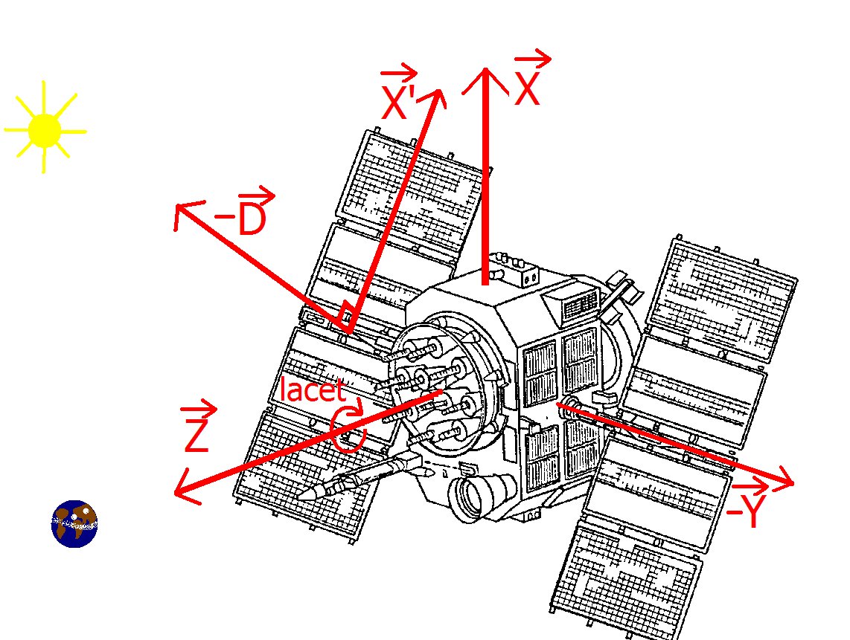
Dynamical model and processing strategy
Full description available at : http://igscb.jpl.nasa.gov/igscb/center/analysis/grg.acn
(see also Jim Ray’s presentation in this session)
Main significant differences:
  48h Arc length ; 15mn data rate ; real ambiguities
  Radiation pressure :
    Solar direct + Earth albedo and IR flux
    GINS Box and wing model (19 planar surfaces)
    Nominal satellite attitude (no yaw steering model)
    Empirical parameters (6+6 per arc) :
      1 scale/arc in factor of solar pressure
      1 {Y}-bias/arc
      1/rev. sin & cos in {X’} {D}
    Albedo and IR :
      Systematic ~ 5. 10⁻¹⁰ m/s/s mainly in {Z}
      Flux from ECMWF 6h grids
      Include overcast and umbra effects
IGS Analysis Center Workshop, 2-6 May 2008, Miami, USA

Slide 6
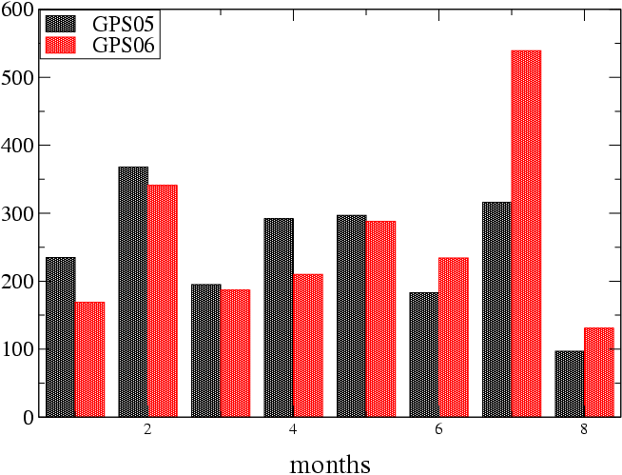
SLR data set and SLR processing strategy
Data from 10 October 2007 to 10 may 2008 ; (2099/1983) valid normals points for GPS(35/36).
Data weigthing : station quality factor
+ from LAGEOS residuals analysis
+ uncertainties from ITRF2005 coord.
Fixed IGS or GRG orbits + one SLR bias per station
IGS Analysis Center Workshop, 2-6 May 2008, Miami, USA

Slide 7
SLR CoM offset
CoM offsets :
XY values : 862.6 mm / -524.5 mm
(values in millimeters) | GPS35 | GPS36
ILRS Z axis (radial)(recomanded) (see also A. Davis & J. Trask, 08/2007). | 669.5 | 671.7
Used Z axis (« old » values) used in this study. | 658.4 | 658.4
Differences | 11.1 | 13.3
IGS Analysis Center Workshop, 2-6 May 2008, Miami, USA

Slide 8
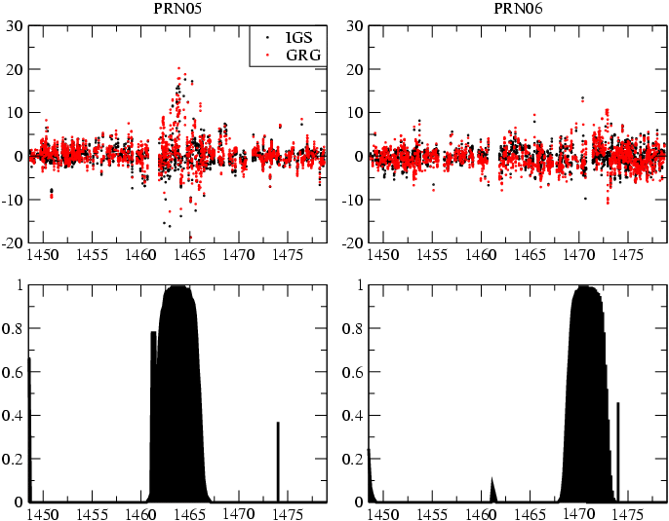
Statistics on SLR residuals
(cm) GRG IGS | GPS35 2.88 (1983) 2.44 (1983) | GPS36 2.45 (2099) 1.98 (2099) | Global
GRG IGS | 1.72 (1516) 1.46 (1516) | 1.97 (1656) 1.77 (1656) | Non-eclips periods
GRG IGS | 4.65 (467) 3.57 (467) | 3.65 (459) 2.27 (459) | Eclips periods
IGS Analysis Center Workshop, 2-6 May 2008, Miami, USA

Slide 9
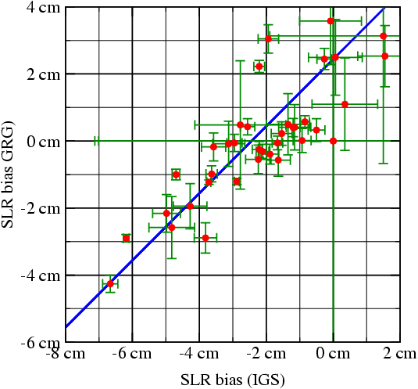
SLR adjusted biases
SLR bias differences :
IGS=GRG -2.4 cm (0.91 ppb)
GRG bias nearest
from 0 cm
(i.e. compatible with Laser Station calibration)
IGS Analysis Center Workshop, 2-6 June 2008, Miami, USA

Slide 10
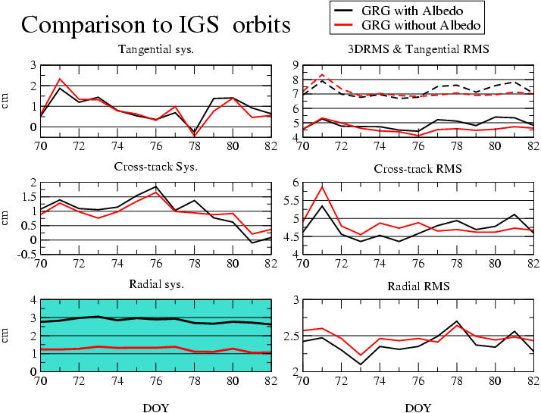
Dynamic impact of Albedo force.
1.6 cm (0.6 ppb) in syst. radial with nearly no change
for other statistics.
IGS Analysis Center Workshop, 2-6 May 2008, Miami, USA

Slide 11
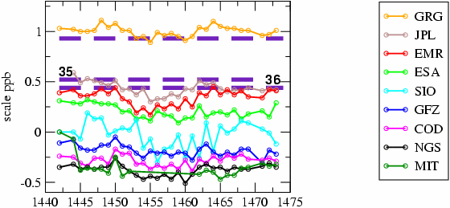
All values together…
CoM
offsets
}
Albedo
JPL ESA and GRG use an Albedo model in their orbit processing.
(Scales computed by G. Gendt & T. Nishan)
IGS Analysis Center Workshop, 2-6 June 2008, Miami, USA

Slide 12
CONCLUSIONS
SLR bias still not compatible with IGS scale
Discrepancies between ACs remain large (1 ppb)
CNES-CLS orbit closer to « old » CoM offset value
Albedo forces explain 0.6 ppb of the scale
and maybe part of scale discrepancies between ACs.
CNES-CLS scale is less than 0.5 ppb relatively to Laser data
ACs with Albedo modeling (except EMR) are closer to current laser CoM offset value
Radial error of CNES-CLS orbits increase SLR RMS by 2.5 mm
IGS Analysis Center Workshop, 2-6 May 2008, Miami, USA

Slide 13
Orbits vs IGS Combined orbit: TX = 2 +/- 1.5 mm ; TY = 0.3 +/- 1 mm ; TZ = -2 +/- 3 mm RX = -17 +/- 35 uas ; RY = -75 +/- 65 uas ; RZ = 38 +/- 60 uas Scale = 1 + /- 0.05 ppb ; WRMS3D : 3.2 +/- 0.35 cm
Stations vs IGS05 (bias + rms) Nord = 0 +/- 2.5 mm ; Est = 0 +/- 1 mm ; Up = 0 +/- 6 mm
Pôle vs IGS solution (bias + rms) Xp = 5 +/- 25 uas ; Yp = 43 +/- 30 uas ; LOD = -1.5 +/- 32 usec Xprate = -56 +/- 90 uas/day ; Yprate = -6.5 +/- 90 uas /day
=> Main discrepancy concern orbits scale and WRMS.
IGS Analysis Center Workshop, 2-6 June 2008, Miami, USA

