Slide 1


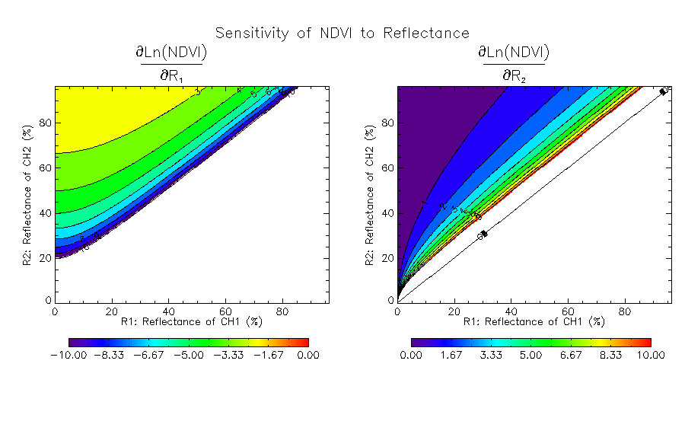
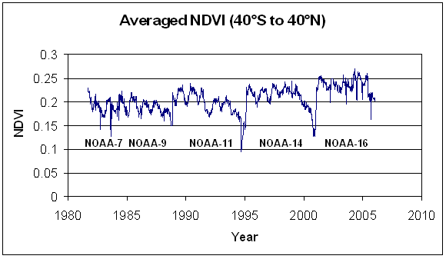
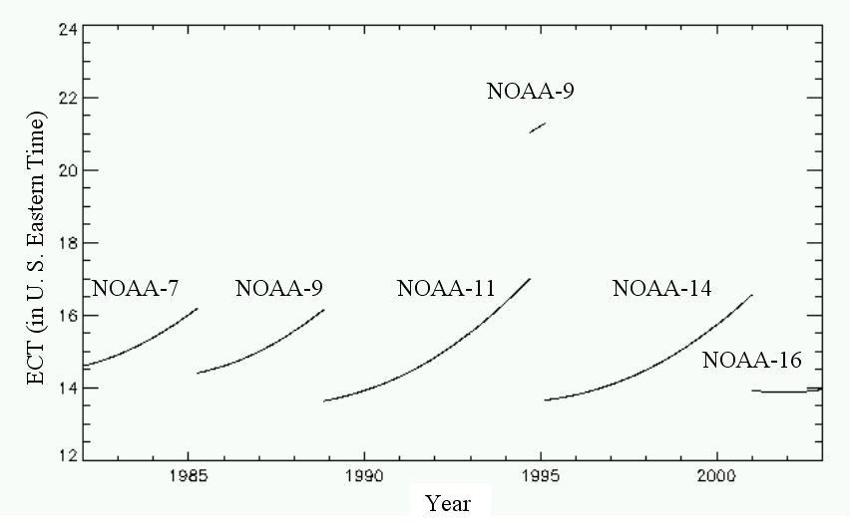
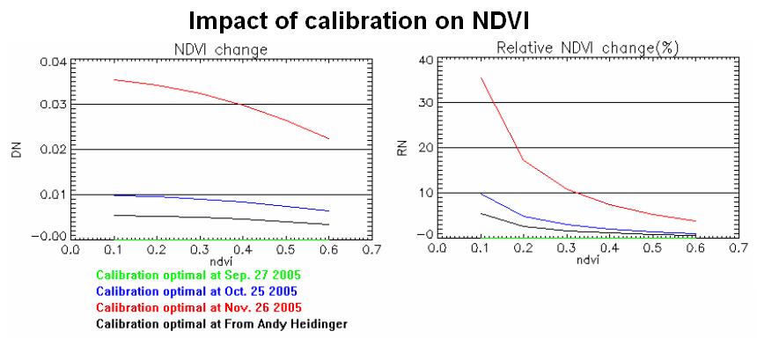
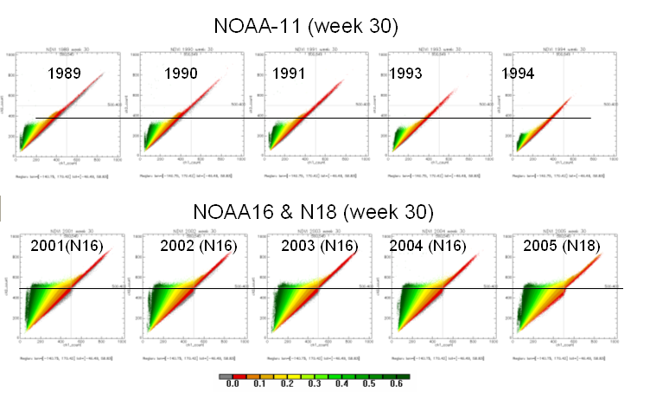
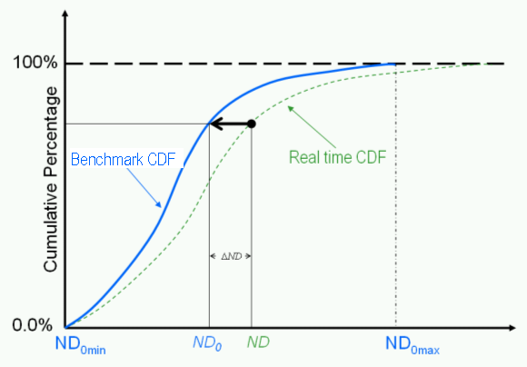
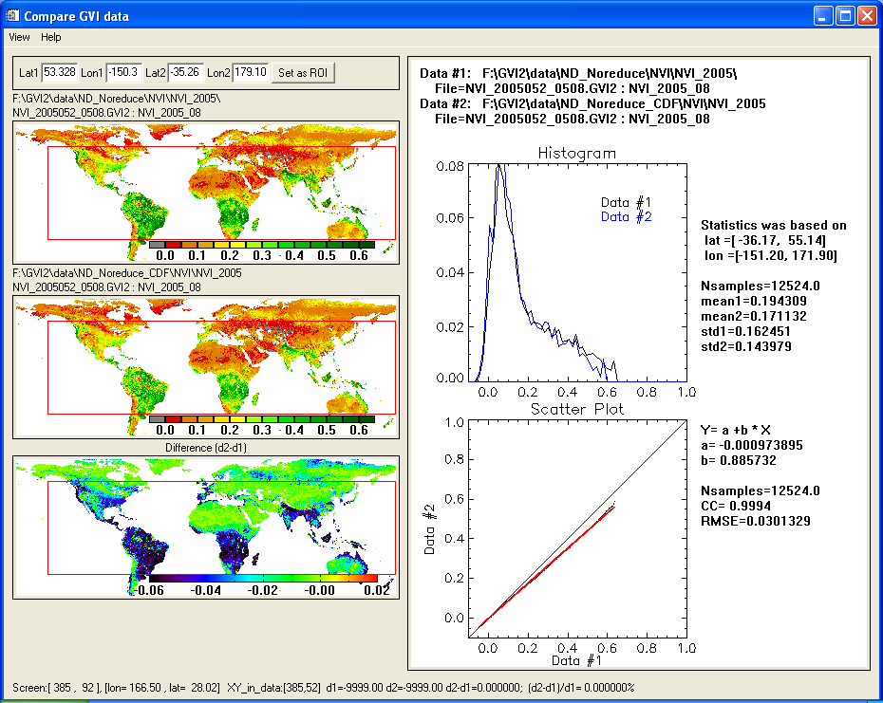
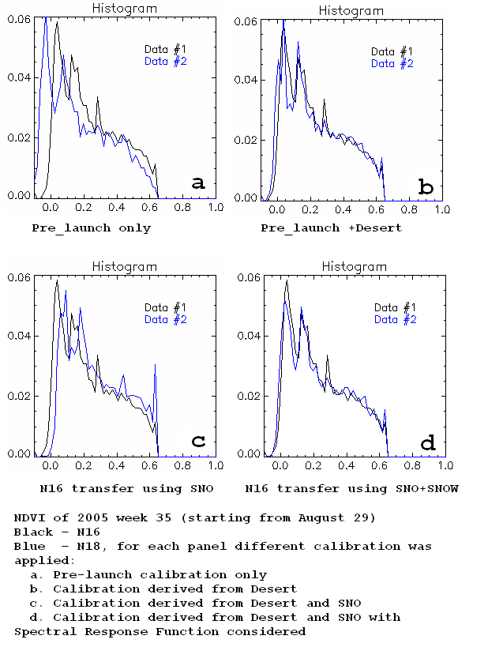
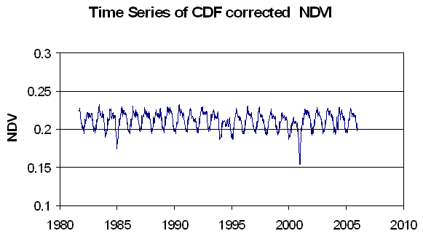

Effect of post-launch calibration of VIS channels on NDVI
Wei Guo^{1,2}, Dan Tarpley¹, Felix Kogan¹, Changyong Cao¹, Xiaongqian Wu¹, Le Jiang^{1,2} , and Jerry Sullivan¹
¹ NOAA/NESDIS/Center for Satellite Applications and Research, 5200 Auth Rd, MD, 20746
² I.M. Systems Group Inc. 3401 Bexhill Place Kensington MD 20895
Abstract:
During the last two decades, Normalized Difference Vegetation Index (NDVI) and NDVI-based products, derived from the Advanced Very High Resolution Radiometer (AVHRR) on the NOAA polar-orbiting satellites, have proven to be useful for monitoring vegetation health, drought, fire risk, etc. The historical records of NDVI and related products dating back to 1981 are available at NOAA/NESDIS. In addition to the natural variation of vegetation, bias and variability related to instrument calibration, spectral response functions of AVHRR channels and satellite drift are present in this long-term dataset. This paper investigate the sensitivity of NDVI to instrument calibration. It was found: 1) calibration affects mostly the low NDVI, 2) It is the ratio of degradation rates that affects NDVI stability. The possible method to remove the signal related to satellite drift was also presented.
Impact of calibration on NDVI
Usually the calibration equation can be presented in the form:
R_{i} = S_{i} * F_{i}*( C_{i} – Cd_{i}) (1)
Where,
i, refers to the CH1 or CH2; C is the count value, Cd is the dark count;
F is the coefficient to convert count to reflectance, which is determined by pre-launch instrument calibration ;
S is degradation rate; R is the calibrated reflectance;
The definition of NDVI is:
NDVI= (R₂ –R₁) /(R₂+R₁) (2)
Where,
R1 and R2 are the Reflectance of CH1 and CH2
From equation 1 and 2, we have,
NDVI = (B-1)/(B+1) (3)
Where,
B= S₂/S₁ * [F₂/F₁ *(C₂-Cd₂)/(C₁-Cd₁)]
From equation (3), NDVI depends on the ratio of calibration parameters S₂/S₁, instead of each individual degradation rate (S₂ or S₁).
Using equation 3, the impact of 4 sets of calibration parameters on NDVI was evaluated (Figure 4). These calibration parameters were derived for NOAA-18 satellite at different times. Figure 4 shows the calibration mainly affects low NDVI values. It may change NDVI by 40% if NDVI < 0.1, but only 5% for NDVI >0.6.
Sensitivity Study
The sensitivity study verifies that the low NDVI is more sensitive to the calibration (Figure 6) . The gradient of NDVI become bigger when R2:R1 is closer to 1, where NDVI is smaller (see Figure 3). For large NDVI, the calibration derived from desert (low NDVI) may not work well. Additional correction may be required to adjust those bias.
Issue:
NDVI derived from AVHRR provides useful information on global vegetation. However, the long term NDVI time series (Figure 1) shows non-natural signal. NDVI observed at the beginning of each satellite life is much higher than at the end. This trend highly correlated with equatorial cross time (ECT) or satellite drift (Figure 2), It was also found the NDVI is not on the same level for different satellites. For the purpose of monitoring the global vegetation change, it is desirable to remove such bias from long term NDVI time series.
Degradation of AVHRR VIS channels and Post-launch Calibration
The NDVI in Figure 1 was calculated by using post-launch calibrated reflectance of AVHRR CH1 and CH2. Both these channels may degrade over time. Figure 3 shows the scatter plots of observed count values of CH1 and CH2 for week 30 (July). For NOAA-11, (upper), from year 1989 to 1994, the points on the scatter plots gradually diminished to left-bottom corner, which means the effective ranges of count values decreased over time. However, for NOAA-16, (bottom), from 2001 to 2004, such change was not obvious. It was noticed that the local time for NOAA 16 observation was around 14 pm, the drifting was much less than the other NOAA satellites. Thus, besides the degradation of instrument itself, the satellite drifting plays important role in creation of bias.
Figure 1. Averaged NDVI of land pixels between 40S and 40N.
Figure 6. Sensitivity of NDVI with the change of radiance of channel 1 and 2.
Remove the trend related to satellite drift
By assuming the vegetation over globe does not have significant change over the last two decades, the statistical properties of global NDVI, such as mean, standard deviation, distribution, should remain the same from year to year for a particular calendar week. Then Cumulative Distribution Function (CDF) can be used to remove the trend related to satellite drift. The basic concept is: for a particular week, select several years as “standard years”, calculate “standard CDF” from these years; then adjust NDVI of an individual week so that its CDF matches the standard CDF. Figure 7 shows how the CDF method works. The time series of CDF corrected NDVI is shown in Figure 8. This method successfully compensates for sensor change and satellite orbital drift. Local vegetation anomalies retained in corrected data (Figure 9). The bias between satellites was also removed. It is very simple and can be applied to NDVI observed by a new instrument. The disadvantage of this method is it removes the possible long-term NDVI trends.
Figure 2. Equator Crossing Time for NOAA7,9,11,14, and 16.
The post-launch calibration method we used is based on an assumption: for bright targets without vegetation, (for example Libyan desert), the albedo of visible channels is invariant. NOAA calibration team periodically estimate the degradation of AVHRR visible channels and provides post-launch calibration parameters.
Figure 4. Effect of various calibration parameters on NDVI.
SNO adjusted calibration
The NOAA calibration team also provided other adjusted calibration based on Simultaneous Nadir Observation (SNO) method. Figure 5 compared the histogram plot of NOAA-18 NDVI fields, which applied different adjusted calibration parameters with that of NOAA-16 NDVI. For NOAA-16, we have 4 years data, which is long enough to derive stable post-launch calibration from observation over desert. While, for NOAA-18, we only have 7 months data. The goal was to calibrate NOAA-18 visible channels against NOAA-16 by using SNO method. By using calibration derived from desert target, the histogram plot (Fig.5b) matches better than using pre-launch calibration only (Fig.5a). The adjusted calibration derived from SNO method with spectral response function considered (Fig. 5d) further improved the accuracy.
Figure 5 confirms that calibration mainly affects the low NDVI values.
Figure 7. Adjust NDVI field by CDF method.
Figure 8. Time series of NDVI corrected by CDF method.
Figure 9. Comparison between NDVI and CDF corrected NDVI.
Figure 3. Scatter plot of CH1 vs. CH2. The color shows NDVI values of corresponding points. Unlike NOAA-7,9,11,14, for the NOAA16, the maximum CH2 count values for each NDVI level did not decrease much during the 4 years period.
Figure 5. Histogram plots of NDVI derived from NOAA-16 and NOAA-18.
Presented on AGU West Pacific Geophysics Meeting, 24-27 July 2006 Beijing China

