Slide 1
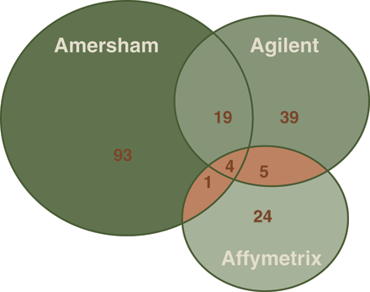
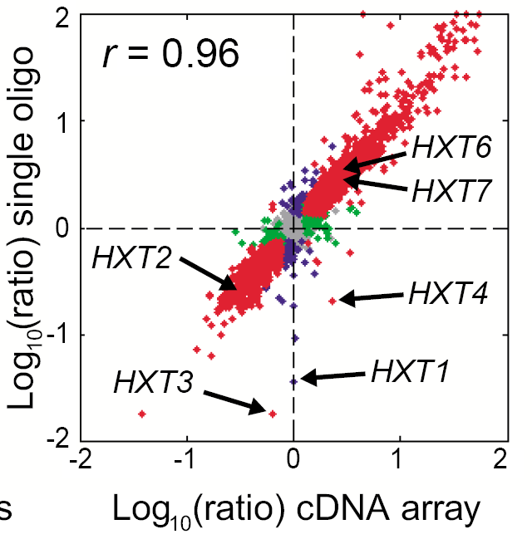

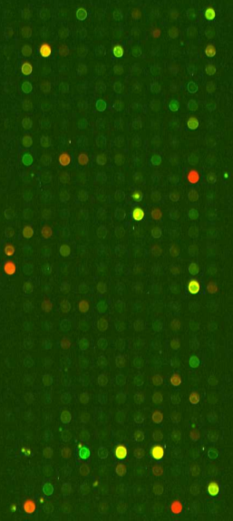
The MAQC (Microarray Quality Control) Project:
Calibrated RNA Samples, Reference Datasets, and QC Metrics and Thresholds
Leming Shi¹, Felix W. Frueh², Uwe Scherf³, Raj K. Puri⁴, Scott A. Jackson⁵, Heather C. Harbottle⁶, Janet A. Warrington⁷, Jim Collins⁸, David Dorris⁹, Lu Zhang¹⁰, Laurence Lamarcq¹¹, Yaping Zong¹², Timothy J. Sendera¹³, Shawn C. Baker¹⁴, Gavin M. Fischer¹⁵, Bud Bromley¹⁶, David J. Dix¹⁷, Marc Salit¹⁸, Zoltan Szallasi¹⁹, Ernest S. Kawasaki²⁰, Charles Wang²¹, Roderick V. Jensen²², Jing Han⁴, Federico M. Goodsaid², Gene A. Pennello³, Thomas A. Cebula⁵, Joseph E. LeClerc⁵, Weida Tong¹, James C. Fuscoe¹, Tucker A. Patterson¹, Tao Han¹, Lei Guo¹, Hong Fang¹, James J. Chen¹, Yvonne P. Dragan¹, William Slikker, Jr.¹, Daniel A. Casciano¹. ¹NCTR, FDA, Jefferson, AR; ²CDER, FDA, Rockville, MD; ³CDRH, FDA, Rockville, MD; ⁴CBER, FDA, Bethesda, MD; ⁵CFSAN, FDA, Laurel, MD; ⁶CVM, FDA, Laurel, MD; ⁷Affymetrix, Santa Clara, CA; ⁸Agilent, Palo Alto, CA; ⁹Ambion, Austin, TX; ¹⁰Applied Biosystems, Foster City, CA; ¹¹BD Clontech, Palo Alto, CA; ¹²Full Moon BioSystems, Sunnyvale, CA; ¹³GE Healthcare, Chandler, AZ; ¹⁴Illumina, San Diego, CA; ¹⁵Stratagene, La Jolla, CA; ¹⁶ViaLogy, Altadena, CA; ¹⁷NHEERL, EPA, Research Triangle Park, NC; ¹⁸NIST, Gaithersburg, MD; ¹⁹Harvard, Boston, MA; ²⁰NCI, Bethesda, MD; ²¹UCLA, Los Angeles, CA; ²²UMass, Boston, MA. Leming.Shi@fda.hhs.gov
ABSTRACT
Selection of RNA Samples
A
B
MAQC Meeting
May 2-3, 2005 @ FDA/CDER
FDA’s Critical Path Initiative identifies pharmacogenomics and toxicogenomics as key opportunities in advancing medical product development and personalized medicine, and the “Guidance for Industry: Pharmacogenomic Data Submissions” has been released. Microarrays represent a core technology in pharmacogenomics and toxicogenomics; however, before this technology can successfully and reliably be used in clinical practice and regulatory decision-making, standards and quality measures need to be developed.
The Microarray Quality Control (MAQC) project currently involves six FDA Centers, major providers of microarray platforms and RNA samples, EPA, NIST, academic laboratories, and other stakeholders. The MAQC project aims to establish QC metrics and thresholds for objectively assessing the performance achievable by various microarray platforms and evaluating the advantages and disadvantages of various data analysis methods. Two RNA samples will be selected for three species, human, rat, and mouse, and differential gene expression levels between the two samples will be calibrated with both microarrays and QRT-PCR. The resulting microarray datasets will be used for assessing the precision and cross-platform/laboratory comparability of microarrays, and the QRT-PCR datasets will enable evaluation of the nature and magnitude of any systematic biases that may exist between microarrays and QRT-PCR. The availability of the calibrated RNA samples combined with the resulting microarray and QRT-PCR datasets, which will be made readily accessible to the microarray community, will allow individual laboratories to more easily identify and correct procedural failures. The MAQC project will help improve the microarray technology and foster its proper applications in discovery, development and review of FDA regulated products.
Everyone is invited to participate in the MAQC project.
Two RNA samples for each species (Human, Mouse, and Rat)
Starting with one species (Human).
Criteria for RNA sample selection:
  Available in large quantity
  Reproducibility in production
  High quality
  Accessibility (commercial sources)
  Wide gene presence
  Large fold changes for a number of genes
Options for RNA sample selection:
1. Two universal reference RNAs
2. Two tissue-specific RNAs
3. Two cell lines
4. Combination
To select two RNA samples
To design the MAQC Main Study (microarrays)
To select 1,000 genes for QRT-PCR verification
E. Marshall, Science 306, 630 (2004); P.K. Tan et al., Nucleic Acids Res 31, 5676 (2003).
Hughes TR et al., Nature Biotechnology, 19(4), 342 (2001)
MAQC Main Study
June-August, 2005
~1000 hybridizations
Figure 1. Conflicting results have been reported in the literature regarding the cross-platform comparability, and, hence, the reliability of microarray technology.
The Microarray Community Is Facing Two Major Challenges:
Biology
(Interpretation)
Gene
List
Log Ratio
Log Intensity
Other
Metric
The MAQC Pilot Study:
Selecting Two RNA Samples for the MAQC Main Study
r²~0.80
r>0.97
How to ensure the experimental proficiency of individual laboratories in comparison to the achievable performance of the microarray technology
How to objectively assess the merits of various data analysis methods
Consistency
80%
(L)
…
Four Candidate RNA Samples:
A. Ambion Brain RNA
B. Ambion Liver RNA
C. Clontech UHRR (Universal Human Reference RNA)
D. Stratagene UHRR (Universal Human Reference RNA)
Four Platforms:
1. Affymetrix
2. Agilent
3. GE Healthcare
4. Illumina
Six Test Sites (7 datasets):
1. Affymetrix (Affymetrix)
2. Agilent (Agilent)
3. Ambion (Affymetrix and GEHC)
4. Illumina (Illumina)
5. NCTR (Agilent)
6. UMass Boston (GEHC)
Achievable by Microarrays!
r²~0.20
?
r<0.93
Inconsistency
20%
(L)
…
Because there is a lack of
• Calibrated RNA samples
• Reliable benchmark datasets
Five (5) replicates per sample per test site for one-channel platforms, resulting in 20 hybridizations per site per platform.
For Agilent platform, 6 sample-pairs were performed in 5 replicates, resulting in 30 hybridizations per test site (Agilent and NCTR).
160 hybridizations
Reality in Many Studies/Labs!
Note: Numbers shown here are for illustration purpose only.
Figure 3. Establishing microarray QC metrics and thresholds
CONCLUSIONS
MAQC
Calibrated
RNA Samples
Advantages of Calibrated RNA Samples:
  Consistent profiling of an identical pair of samples
  Data sharing and comparison made possible
  Establishment of Standard Operating Procedures (SOPs)
  Quality control/assurance (preventing procedural failures)
Benefits of Reference Datasets:
  Achievable performance on each platform
  Precision, reproducibility, accuracy, and robustness
  Cross-laboratory and cross-platform concordance
  QC metrics and thresholds
  Evaluation of the merits of data analysis methods
Guidelines for Regulatory Review of PGx Data Submissions
A
B
ArrayTrack:
MAQC Data Centralization/Distribution
Identification and correction of procedural failures
Microarrays
QRT-PCR
Other Technologies
MAQC Pilot Study datasets (160 arrays) have been submitted to NCTR. Data were centralized within ArrayTrack and distributed to 11 sites selected for performing independent data analysis of the 7 datasets:
Microarray
Datasets
QRT-PCR
Datasets
User
http://edkb.fda.gov/maqc/
Precision
Cross-platform/lab
comparability
Accuracy
Systematic biases
1. Affymetrix
2. Agilent
3. Ambion
4. Applied Biosystems
5. Clontech
6. GE Healthcare
7. Illumina
8. NCTR
9. NIST
10. Stratagene
11. UMass Boston
QC Metrics & Thresholds
Views expressed in this presentation are those of the presenters and not necessarily those of the U.S. FDA.
Validation of data analysis methods
Figure 2. An Overview of the MAQC Project
http://edkb.fda.gov/webstart/arraytrack/

