Slide 1
Fuzzy Forecast Verification
Giving credit to close forecasts
Beth Ebert
Centre for Australian Weather and Climate Research
Melbourne, Australia
Thanks to Felix Ament, Tatjana Bähler, Nigel Roberts, Barbara Casati, Uli Damrath, Fred Atger, Urs Germann, Mike Kay, Susanne Theis, Daniela Rezacova, Mike Baldwin

Slide 2
Outline
Motivation
What is fuzzy verification?
Framework for fuzzy verification
Demonstration – WRF high resolution rain forecast
Comparison with entity-based (CRA) approach
Spatial Verification Methods Intercomparison Project

Slide 3
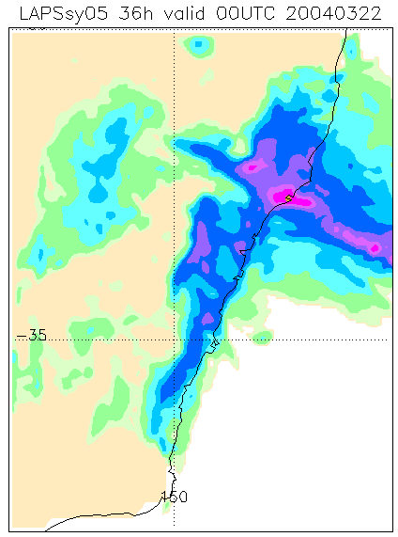
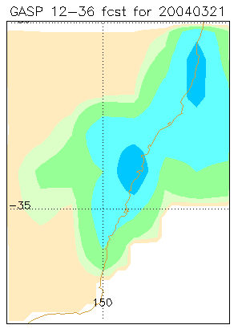
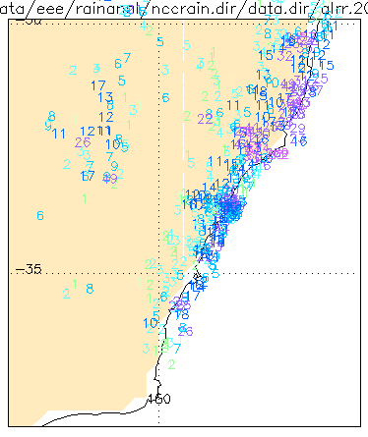
High vs. low resolution
Which rain forecast would you rather use?
Mesoscale model (5 km) 21 Mar 2004
Global model (100 km) 21 Mar 2004
Observed 24h rain
Sydney
Sydney
RMS=13.0 mm
RMS=4.6 mm
Notes:
Although high resolution forecasters usually look more realistic, and in fact may give more useful information in terms of intensities and even placement of significant weather, they rarely verify better against the observations than low resolution forecasts using standard scores.

Slide 4
What makes a useful forecast?
Resembles the observations on the broader scale
Predicts an event somewhere near where it was observed
Predicts the event over the same area (i.e., with the same frequency) as observed
Has a similar distribution of intensities as the observations
Looks like what a forecaster would have predicted if she'd had knowledge of the observations
Notes:
Many criteria could be used to define a "good" forecast. Some may be more important than others for certain applications.

Slide 5
"Fuzzy" verification methods
Don't require an exact match between forecasts and observations
  Reduces "double penalty" - event predicted where it did not occur, no event predicted where it did occur
  Rewards "close" forecasts
Addresses uncertainties
  Unpredictable scales
  Uncertainty in observations
fcst
obs
fcst
obs
10
10
3
10
Hi res forecast
RMS ~ 4.7
POD=0, FAR=1
TS=0
Low res forecast
RMS ~ 2.7
POD~1, FAR~0.7
TS~0.3
Notes:
Impossibility of exact match of high resolution forecasts with observations means that requiring an exact match to get a good score no longer makes sense.

Slide 6


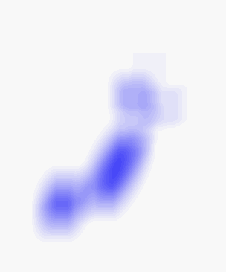
Why "fuzzy"?
observation
forecast
Squint your eyes!

Slide 7
"Fuzzy" verification methods
Look in a space / time neighborhood around the point of interest
  Evaluate using categorical, continuous, probabilistic scores / methods
observation
t - 1
forecast
t
Frequency
t + 1
Value (e.g. temperature)
Notes:
Fuzzy methods give a neighborhood of points to verify instead of a single matched point. Since they are unconcerned about the precise location of the data inside the neighborhood the fuzzy approach acts like a filter, to filter out scales which are than the size of the neighborhood.

Slide 8
"Fuzzy" verification methods
First (?) suggested by H. Brooks at 1998 Mesoscale Verification workshop
  Brooks et al. (1998)
  Zepeda-Arce et al. (2000), Weygandt et al. (2004)
  Atger (2001)
  Damrath (2004)
  Casati et al. (2004)
  Germann and Zawadski (2004)
  Theis et al. (2005)
  Rezacova et al. (2007)
  Roberts and Lean (2007)
Notes:
Many recently developed fuzzy verification methods, all with slightly different approaches and metrics. Each uses a different decision model to specify what makes a good forecast.

Slide 9
A mini tour of some fuzzy verification methods…

Slide 10
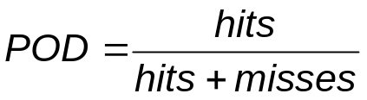
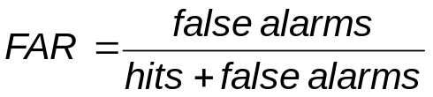
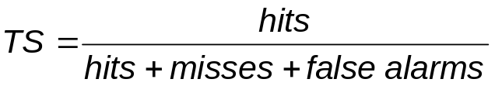
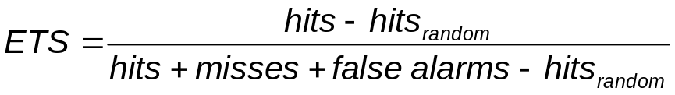
Spatial verification 101
Contingency Table
 | Observed
 | yes | no
yes | hits | false alarms
no | misses | correct negatives
Misses
Predicted
False
alarms
Hits
Forecast
Observed

Slide 11
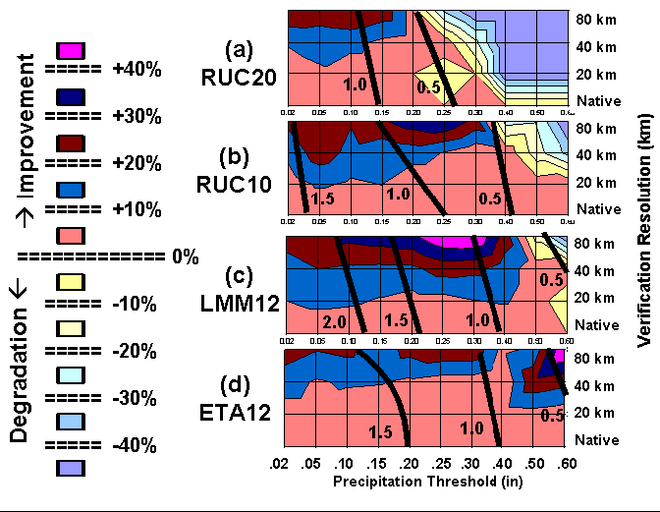
Upscaling
(e.g. Weygandt et al. 2004)
Average the forecast and observations to successively larger grid resolutions, then verify
% change in ETS
Notes:
Upscaling measures the similarity between the forecasts and observations as the scale is increased. These results are for mesoscale model predictions of 6h precipitation over the Great Plains of the US during the IHOP experiment in June 2002.

Slide 12
Spatial multi-event contingency table
(Atger, 2001)
Experienced forecasters interpret output from a high resolution deterministic forecast in a probabilistic way
← "high probability of some heavy rain near Sydney", not "62 mm of rain will fall in Sydney"
Sydney
The deterministic forecast is mentally "calibrated" according to how "close" the forecast is to the place / time / magnitude of interest.
Very close → high probability
Not very close → low probability
Notes:
This fuzzy method quantifies the way forecasters judge high resolution forecasts.

Slide 13
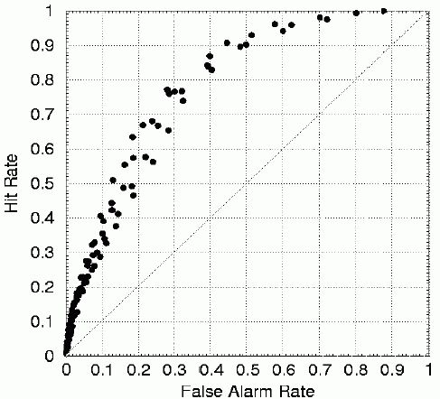
Spatial multi-event contingency table
(Atger, 2001)
Verify using the Relative Operating Characteristic (ROC)
  Measures how well the forecast can
  separate events from non-events
  based on some decision threshold
Decision thresholds to vary:
magnitude (ex: 1 mm h⁻¹ to 20 mm h⁻¹)
distance from point of interest (ex: within 10 km, .... , within 100 km)
timing (ex: within 1 h, ... , within 12 h)
anything else that may be important in interpreting the forecast
single threshold
Notes:
In the figure here, decision thresholds based on both the rain threshold and the spatial distance from the point of interest are varied.

Slide 14
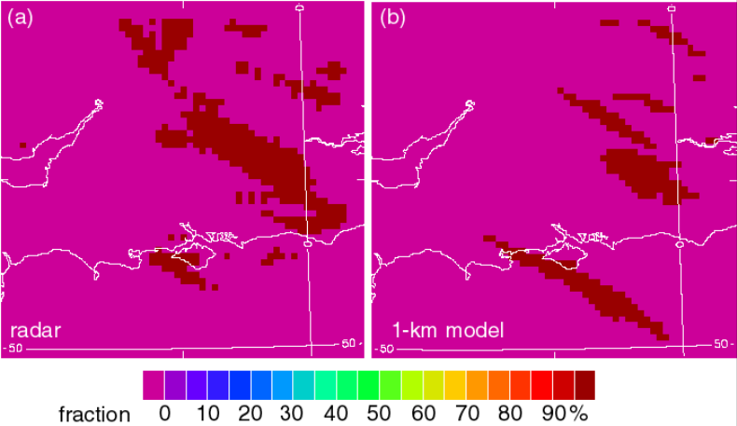
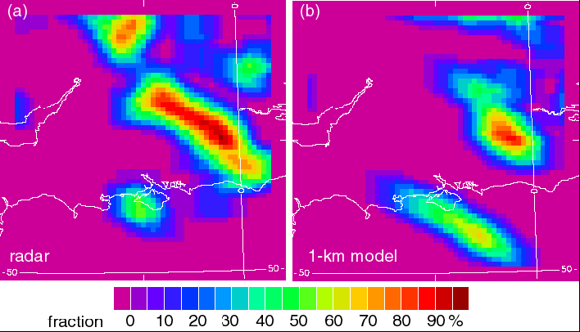
Fractions Skill Score
(Roberts and Lean, 2008)
Verifies forecasts on a variety of spatial scales, with a view to determining which scales have sufficient accuracy.
Compares the fractional coverage of events in windows surrounding the observations and forecasts
P_{obs} 1x1
P_{fcst} 1x1
P_{obs} 35x35
P_{fcst} 35x35
Fraction of pixels with rain accumulation ≥ 4 mm in 1x1 km windows (top) and in 35x35 km windows (bottom)
Notes:
"The spatial scales we are interested in, and the spatial scales we verify on, should be compatible. We judge forecasts by eye over a variety of scales by saying that they are good at getting a large feature like a front in the right place, but are not quite so accurate for organized thunderstorms and poorer still for individual showers." (N. Roberts NWP report, 2005).

Slide 15
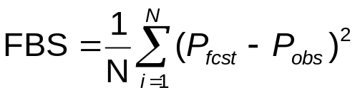
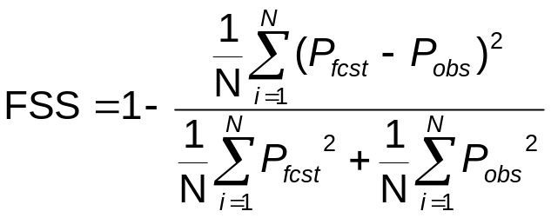
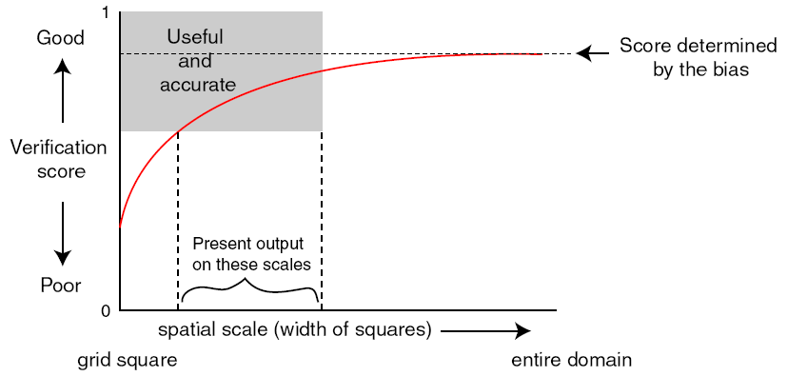
Fractions Skill Score
(Roberts and Lean, 2008)
Fractions Brier score
Fractions skill score
Notes:
A range of scales at which the forecast is both useful and meets minimum accuracy requirements can be determined by plotting the score as a function of spatial scale.

Slide 16

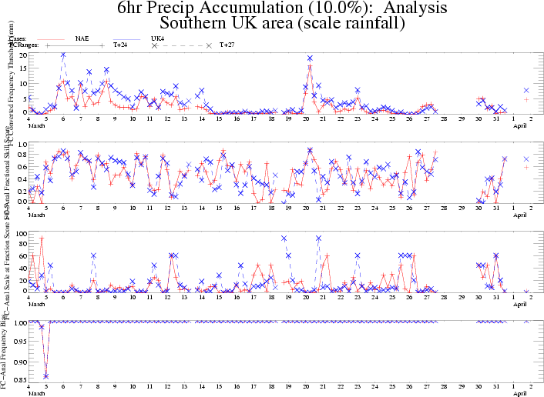
How we are using it
10% threshold
12.5 mm
FSS
0.5
L(FSS>0.5)
20 km
Freq. Bias
Courtesy of Marion Mittermaier

Slide 17
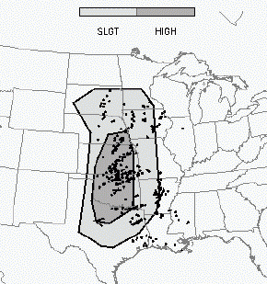
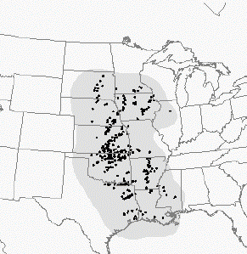
Practically perfect hindcasts
(Brooks et al. 1998)
If the forecaster had all of the observations in advance, what would the "practically perfect" forecast look like?
  Apply a smoothing function to the observations to get probability contours, choose appropriate yes/no threshold
SPC convective outlook Practically Perfect hindcast
Notes:
Rare events are, by nature, difficult to predict accurately and difficult to observe accurately (for example, tornadoes). Forecasts often given as watch or warning regions. Standard verification doesn't work well. Most of warning region is false alarm, even when the event occurs in the region. Observations of non-events generally not reported. Persistence or climatology aren't really appropriate reference forecasts for skill scores.

Slide 18
Practically perfect hindcasts
(Brooks et al. 1998)
How do the forecast and the Practically Perfect hindcast perform when verified against the observations, and how do the two scores compare?
Forecast was ¾ of the way to being "practically perfect"
SPC convective outlook Practically Perfect hindcast
threat score=0.34 threat score=0.48
Notes:
Relative performance is quite a useful way to judge a verification score.

Slide 19
Where is this all leading to?
Notes:
These different approaches all use neighborhoods in some way

Slide 20
Fuzzy verification framework
Fuzzy methods use one of two approaches to compare forecasts and observations:
single observation – neighborhood forecast
(user-oriented)
neighborhood observation – neighborhood forecast
(model-oriented)
observation
forecast
observation
forecast
Notes:
The single observation – neighborhood forecast is user-oriented (e.g. how good was the forecast at the place where I live?)
The neighborhood observation – neighborhood forecast is model-oriented (e.g. compares models and observations on consistent scales)

Slide 21
Fuzzy verification framework
Treatment of forecast data within a window:
  Mean value (upscaling)
  Occurrence of event* somewhere in window
  Frequency of event in window → probability
  Distribution of values within window
* Event defined here as a value exceeding a given threshold, for example, rain exceeding 1 mm/hr

Slide 22
Example: Multi-category contingency table
Compares occurrence of event in forecast with observed occurrence of event
observation
forecast
Hit = at least one forecast event in vicinity of observed event
Notes:
There is more to this method, but the first part of it is shown here to illustrate one possible treatment of observed and forecast data in the window.

Slide 23

Example: Fractions skill score
Compares fractional coverage in forecast with fractional coverage in observations
observation
forecast
Notes:
There is more to this method, but the first part of it is shown here to illustrate one possible treatment of observed and forecast data in the window.

Slide 24
Moving windows
Accumulate scores as windows are moved through the domain
observation
observation
observation
observation
forecast
forecast
forecast
forecast

Slide 25
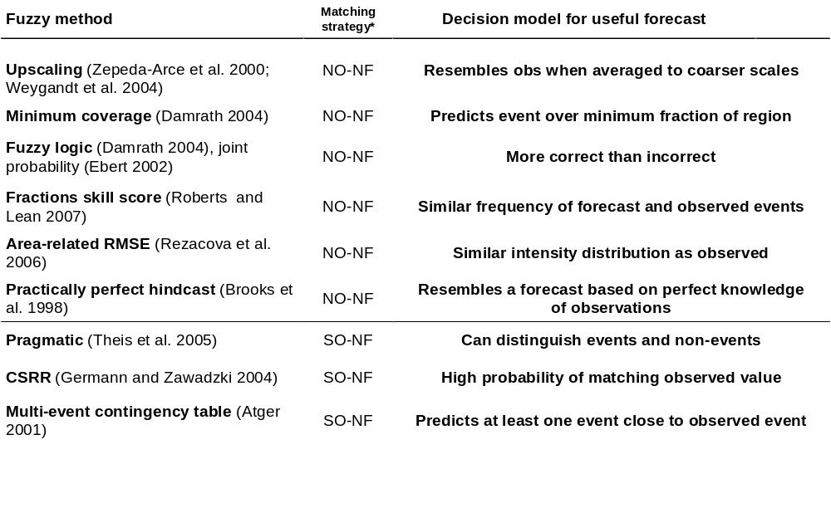
Decision models
*
*
*
*
*NO-NF = neighborhood observation-neighborhood forecast,
SO-NF = single observation-neighborhood forecast
Notes:
The various methods differ in:
(1) their matching strategy (SO-NF and NO-NF)
(2) their decision models for what makes a good forecast
The methods with the red asterisks are the methods demonstrated in this presentation.

Slide 26
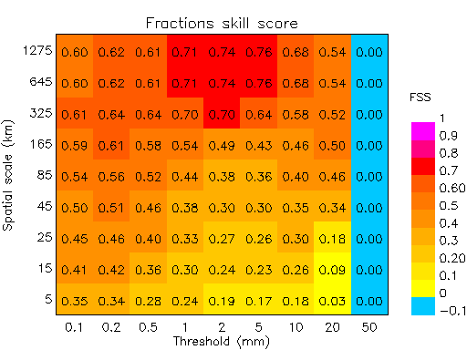
Multi-scale, multi-intensity approach
Forecast performance depends on the scale and intensity of the event
Spatial
scale
Intensity
Notes:
Using plotting approach similar to that used by Barbara Casati. Red-pink colors indicate good performance, yellows and blues indicate poor performance.

Slide 27
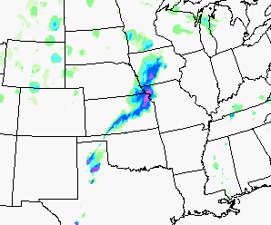
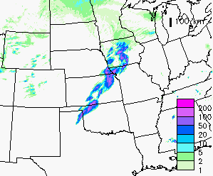
Case study – 13 May 2005
Stage II
WRF ARW
(0.01 in/hr)
24 h forecast of 1 hr rainfall from WRF/ARW model @ 4 km resolution
(Spring Program 2005 data courtesy of Mike Baldwin)
ETS_{≥0.01in}= 0.17 , ETS_{≥0.10in}= 0.24
Notes:
Most people would say that this was a very good forecast, yet the ETS was only 0.17, and the maximum grid-scale value of ETS was 0.24 using a rain threshold of 0.10 in.

Slide 28
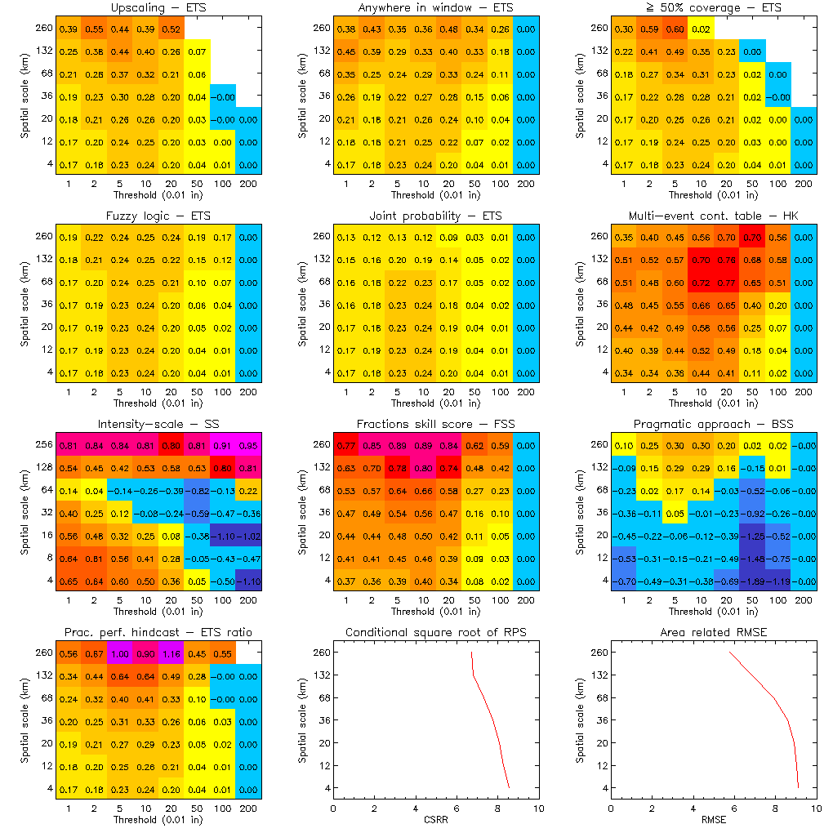

Fuzzy verification framework
good performance
poor performance
Notes:
Using the framework all of the fuzzy methods can be run and displayed together. Two of the methods do not use thresholds but rather evaluate all intensities at once. Some things to note:
(1) Different fuzzy verification methods suggest different levels of skill.
(2) The intensities and spatial scales at which the maximum skill is obtained varies by method.
The reason for these differences lie in the way the scores are constructed, and the nature of the decision models for what makes a "useful" forecast. The next several slides examine the results from some of the fuzzy verification methods in more detail.
One other thing: Barbara Casati's (2004) intensity-scale method is included among the fuzzy techniques, but it is unique in two ways: It uses discrete rather than overlapping windows and therefore tends to be a bit noisier, and it *separates* individual scales rather than filtering them. In this sense it is not strictly fuzzy.

Slide 29
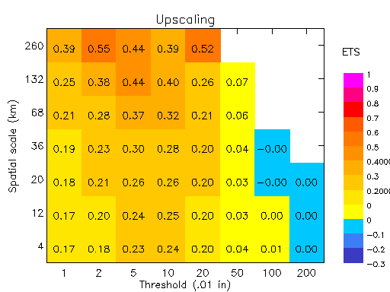
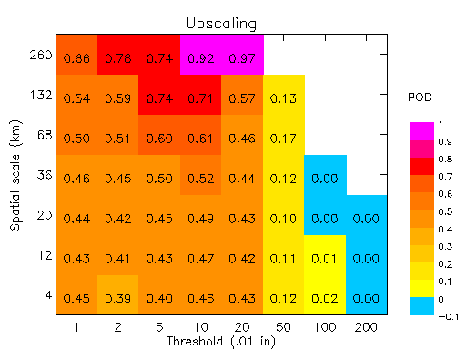
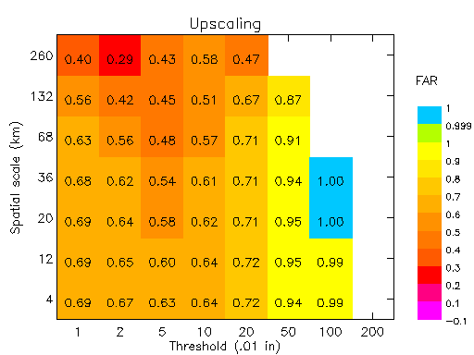
Upscaling
Decision model – Useful forecast resembles observations when averaged to coarser scales
POD
ETS
FAR
Notes:
Upscaling generally shows better forecast performance as the scales are averaged to coarser resolution. Not only categorical scores can be used here, but also continuous scores such as RMSE and correlation. Both hits (see POD) and false alarms (see FAR) improve with scale, leading to higher values of ETS.

Slide 30
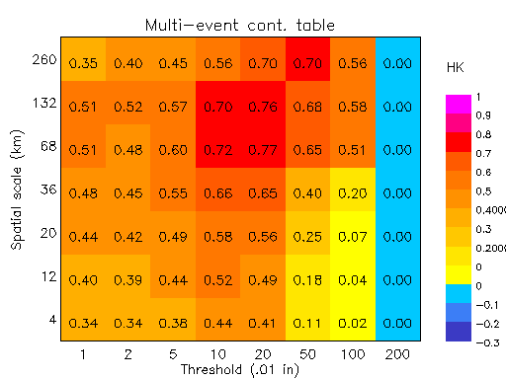
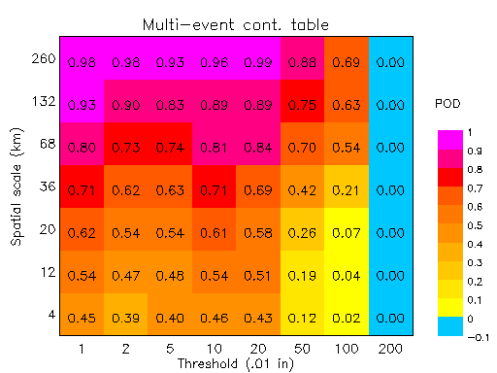
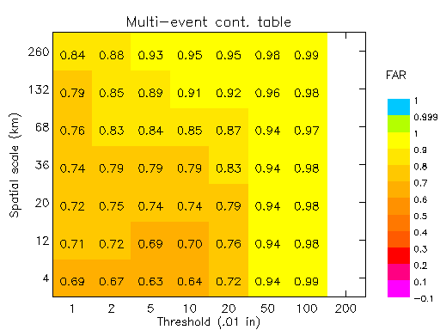
Multi-scale contingency table
Decision model – Useful forecast predicts at least one event close to the observed event
POD
HK
FAR
Notes:
Plot Hanssen and Kuipers score (also known as True Skill Statistic) rather than ETS because that is related to the area under the ROC curve (the original way multi-scale contingency table results were presented). These results show that the relative skill at predicting at least one event close to the observed event is best for heavier rain rates and larger scales.

Slide 31
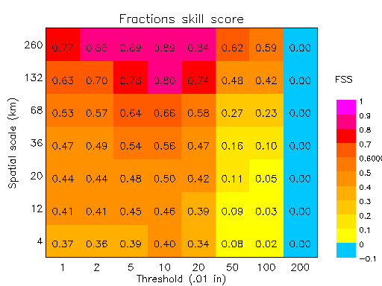
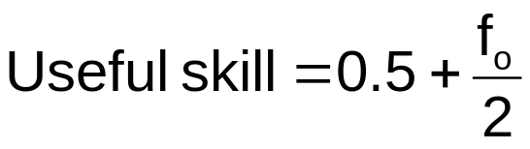
Fractions Skill score
Decision model – Useful forecast has similar frequency of fcst and obs events within a region
FSS
Notes:
The Fractions skill score uses a probabilistic verification approach.

Slide 32
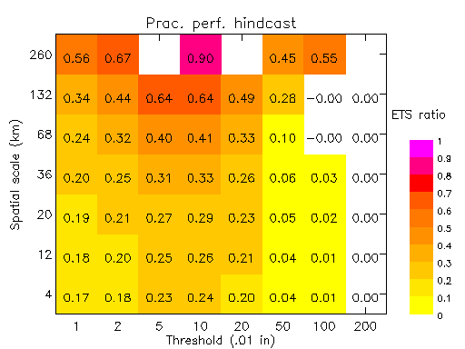
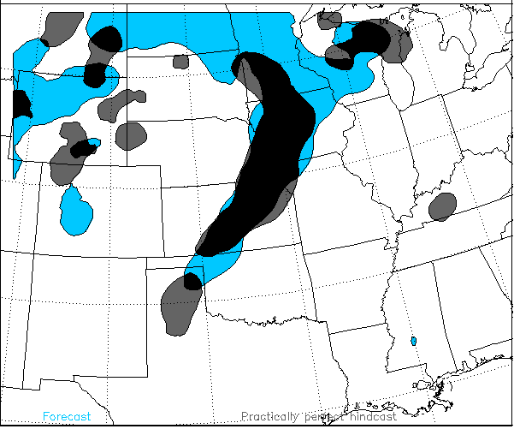
Practically Perfect hindcast
Decision model – Useful forecast resembles one drawn from knowledge of observations
ETS_{fcst}/ ETS_{PP}
Forecast
Practically Perfect hindcast
Notes:
The ratio of ETS for the forecast to ETS for the Practically Perfect hindcast is one way to summarize the relative performance of the forecast. However, since ETS can be improved by overforecasting when the rain pattern is offset from the observations (see Baldwin and Kain, WAF 2006) sometimes this ratio becomes greater than 1 at large scales. The solution to this is probably not to report ETS ratios at the large scales.

Slide 33
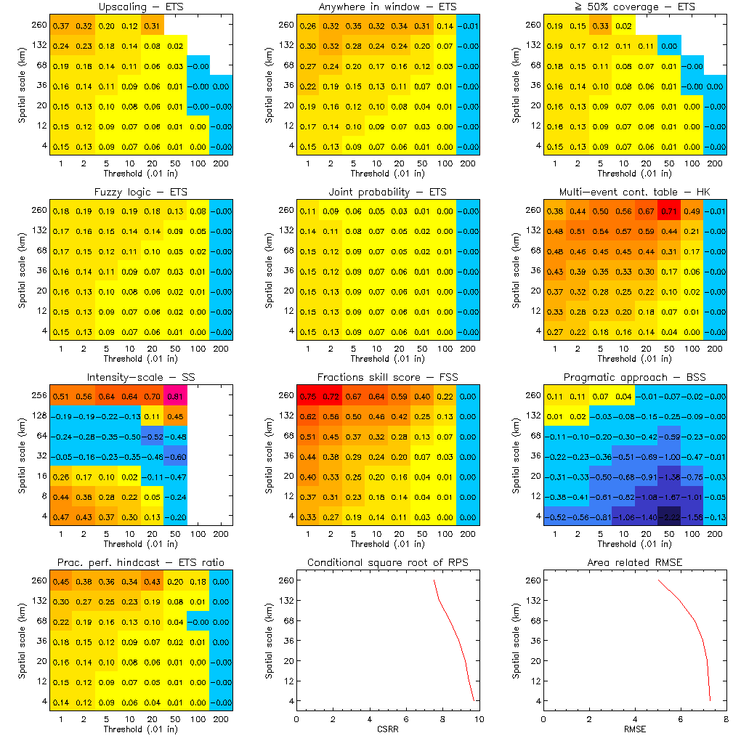
Aggregate results for 9 SPC 2005 test cases
good performance
poor performance
Notes:
Like most verification, fuzzy verification is probably most useful when aggregated over a large number of cases – a month, a season, all similar synoptic situations in a dataset, etc. Careful aggregation and stratification of samples are really the keys to getting the most out of diagnostic verification.

Slide 34
Advantages of fuzzy verification
Knowing which scales have skill suggests the scales at which the forecast should be presented and trusted
Can give good results for forecasts that verify poorly using exact-match approach
Results match with our intuition when decision models are considered
Suitable for discontinuous / messy fields like precipitation
Can be used to compare forecasts at different resolutions
Multiple decision models and metrics
  Direct approach → verification of intensities
  Categorical approach → verification of binary events
  Probabilistic approach → verification of event frequency

Slide 35
Weaknesses and limitations
Less intuitive than object-based methods
Imperfect scores for perfect forecasts for methods that match neighborhood forecasts to single observations
Information overload if all methods invoked at once
  Let appropriate decision model(s) guide the choice of method(s)
Even for a single method …
  there are lots of numbers to look at
  evaluation of scales and intensities with best performance depends on metric used (CSI, ETS, HK, etc.). Be sure the metric addresses the question of interest!

Slide 36
How do fuzzy verification methods compare with object-oriented verification methods?

Slide 37
Entity-based approach for verifying high resolution forecasts
Define entities using a threshold
Horizontally translate the forecast until a pattern matching criterion is met
Displacement is the vector difference between the original and final locations of the forecast
Compare properties of whole objects
Observed
Forecast
Notes:
Entity and object-oriented approaches have a lot of appeal because they are so intuitive.

Slide 38
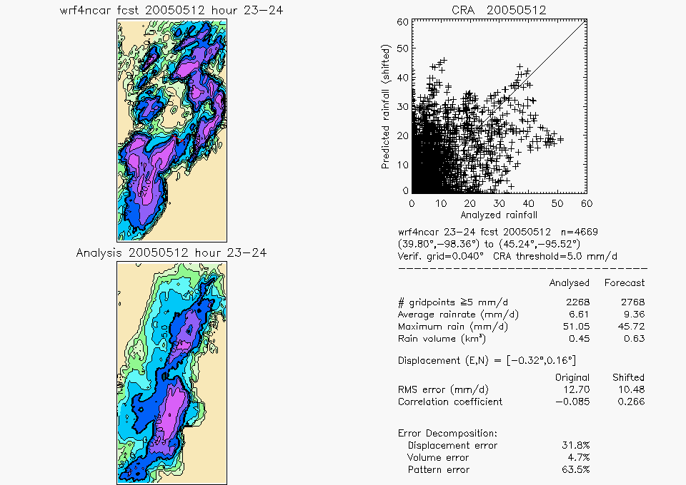
CRA verification of rain system
(0.01 in)
Notes:
This nice looking WRF forecast was verified using a CRA threshold of 5 mm, and the matching forecast and observed rain blobs were fairly clear. Only the largest CRA is shown here, although several others were verified.

Slide 39
Comparison of verification strategies
Fuzzy verification
Handles messy fields and discrete objects
Assessment across multiple scales
Fairly intuitive
Completely objective
Can be extended to time domain
Offers many decision models
Entity-based verification
Handles discrete objects only
Holistic assessment on scale of object
Very intuitive
Some choice of parameters
Can be extended to time domain
Gives location error and total error decomposition

Slide 40

Spatial Verification Intercomparison Project
Begun February 2007
The main goals of this project are to:
Obtain an inventory of the methods that are available and their capabilities
Identify methods that may be useful in operational settings
Identify methods that might be useful for providing automated feedback into forecasting systems
Identify methods that are particularly useful for specific applications (e.g., model diagnostics, hydrology, aviation)
Identify where there may be holes in our capabilities and more work is needed
Identify areas where future research efforts should focus

Slide 41
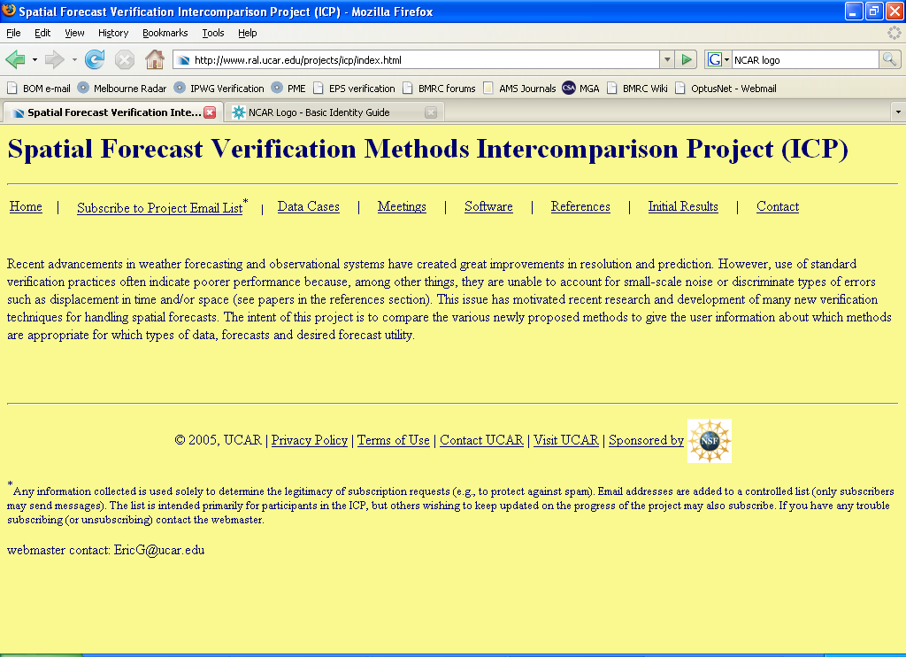
Spatial Verification Intercomparison Project
http://www.ral.ucar.edu/projects/icp/index.html
  Test cases
  Preliminary results
  References
  Code!
Notes:
Still time to join project if interested.

Slide 42
Spatial Verification Intercomparison Project
Object-oriented verification methods:
  Method for Object-based Diagnostic Evaluation (MODE)
  Contiguous Rain Area (CRA)
  Procrustes shape analysis
  Composite approach (Nachamkin)
  Cluster analysis (Marzban)
  Structure Amplitude Location (SAL)
Neighborhood and filtering methods:
  Fuzzy (neighborhood) verification methods
  Fractions skill score (FSS)
  Intensity-scale
Field methods:
  Bias-corrected ETS (Mesinger)
  Forecast Quality Measure (FQM, Keil and Craig)
  Forecast Quality Index (FQI, Basu)

Slide 43
Spatial Verification Intercomparison Project
What types of information does the method give?
  Is the method able to identify performance at separate scales?
  Does the method provide information on:
    Location errors?
    Intensity errors and distributions?
    Structure errors?
  Can the method identify timing errors?
  Is the method “diagnostic” regarding sources of model error?
  Does this approach have the ability to provide info about false alarms and misses?
Are there any undesirable behaviors shown by the method?
  Could a forecast be hedged to artificially improve its score using this method?
  Does the method do anything that is counter-intuitive?
  Does the method have selectable parameters?
  Is the method strongly sensitive to selected parameters?

Slide 44
Spatial Verification Intercomparison Project
Specific questions regarding implementation:
  Can the results be easily aggregated across cases?
  Is the method amenable to different user applications (hydrology, aviation, etc.)?
  Could the method be used in operational settings (e.g., computer time issues, data availability)?
  Could the method be used to give automated feedback (e.g., for calibration) into a forecasting system?
  Could the method be used for other types of variables (e.g., wind, turbulence)?
  Is the method sensitive to missing data?
  Is the method sensitive to the size of the domain?

Slide 45

Thank you!
Fuzzy verification paper published in latest Meteorological Applications
Paper and code (IDL) available from
http://www.bom.gov.au/bmrc/wefor/staff/eee/beth_ebert.htm
Notes:
Web site is my home page in BMRC - can get there from the Bureau of Meteorology's home page.

Slide 46
References for original fuzzy methods
Atger, F., 2001: Verification of intense precipitation forecasts from single models and ensemble prediction systems. Nonlin. Proc. Geophys., 8, 401-417.
Brooks, H.E., M. Kay and J.A. Hart, 1998: Objective limits on forecasting skill of rare events. 19th Conf. Severe Local Storms, AMS, 552-555.
Casati, B., Ross, D.B. Stephenson, 2004: A new intensity-scale approach for the verification of spatial precipitation forecasts, Met. App., 11, 141-154.
Damrath, U., 2004: Verification against precipitation observations of a high density network – what did we learn? Intl. Verification Methods Workshop, 15-17 September 2004, Montreal, Canada.
Ebert, E.E., 2002: Fuzzy verification: Giving partial credit to erroneous forecasts. NCAR/FAA Verification Workshop: Making Verification More Meaningful, NCAR, Boulder, Colorado, 30 July - 1 August 2002.
Germann, U. and I. Zawadzki, 2004: Scale dependence of the predictability of precipitation from continental radar images. Part II: Probability forecasts. J. Appl. Meteorol., 43, 74-89.
Rezacova, D., Z. Sokol and P. Pesice, 2007: A radar-based verification of precipitation forecast for local convective storms. Atmos. Res., 83, 211-224.
Roberts, N.M. and H.W. Lean, 2008: Scale-selective verification of rainfall accumulations from high-resolution forecasts of convective events. Mon. Wea. Rev..
Theis, S.E., A. Hense and U. Damrath, 2005: Probabilistic precipitation forecasts from a deterministic model: a pragmatic approach. Meteorol. Appl., 12, 257-268.
Weygandt, S.S., A.F. Loughe, S.G. Benjamin and J.L. Mahoney, 2004: Scale sensitivities in model precipitation skill scores during IHOP. 22nd Conf. Severe Local Storms, Amer. Met. Soc., 4-8 October 2004, Hyannis, MA.
Zepeda-Arce, J., E. Foufoula-Georgiou, and K.K. Droegemeier, 2000: Space-time rainfall organization and its role in validating quantitative precipitation forecasts. J. Geophys. Res., 105 (D8), 10,129-10,146.
Notes:
Many of these references are non-standard

Slide 47
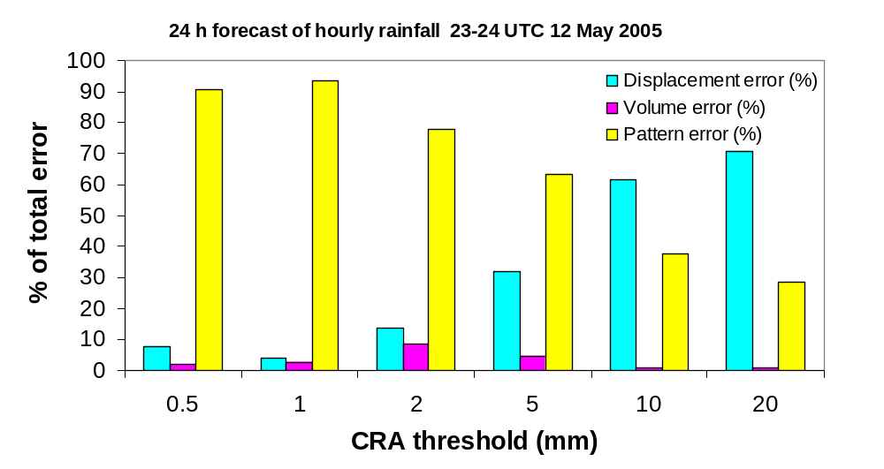
Threshold-dependent results
Notes:
It would be possible to apply scale and intensity dependent verification to entity- and object-based verification. For example, the previous forecast was verified using a range of CRA thresholds, and the relative error components were plotted as a function of this threshold. In principle the CRAs could also be thresholded according to their size and the verification results plotted as intensity-scale quilts similar to the other fuzzy methods.

