Slide 1
Exclusive ΦΦ in E690
G. Gutierrez
FNAL-E690 Collaboration
Small-X and Diffraction Physics Conference
FERMILAB, Sep 2003

Slide 2

Introduction
First peak observed by BNL-MPS ('78), in π– p → ΦΦn at 22.6 GeV/c (147 events).
But this reaction should be suppressed by Okubo-Zweig-Iizuka (OZI) rule! (in strange particle production gluons should bridge the gap.)
OZI forbidden → gluon bound states? In this case, useful for understanding gluon dynamics.
BNL-MPS search for ΦΦ resonant states:
• 1203 events in '82, first PWA
• 3650 events in '85, refined PWA, found three 2⁺⁺ resonances
• 6650 events in '88, 3 states, all with I^{G}J^{PC}=0⁺2⁺⁺ and LS=02, 20, 22.
K-matrix fit:
f₂(2010): m=2011 ± 60 MeV Γ=202 ± 60 MeV
f₂(2300): m=2297 ± 28 MeV Γ=149 ± 40 MeV
f₂(2340): m=2339 ± 60 MeV Γ=202 ± 70 MeV
annihilation at rest :
CERN JETSET '94 in → ΦФ, antiproton beam at 1.4 GeV/c.
• Preliminary PWA shows 2⁺⁺ predominance.
• BW behavior of the 2⁺_{D0} wave, with parameters M=2231±2 MeV, Γ=70±10 MeV.

Slide 3
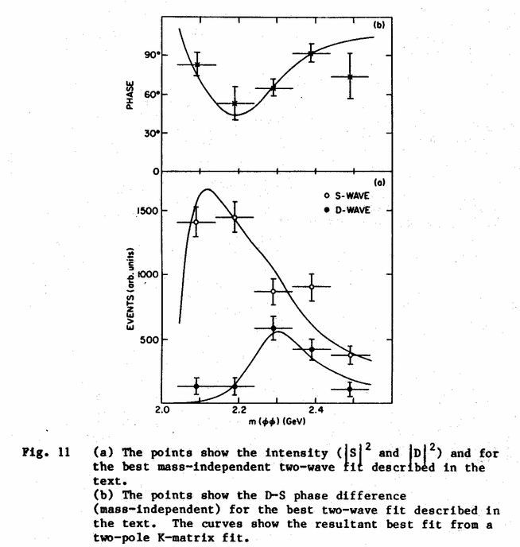
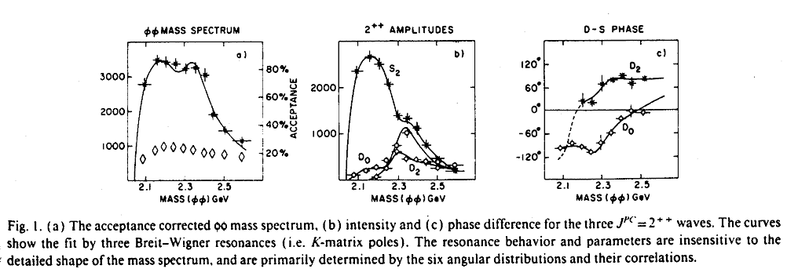
Introduction
The three BNL-MPS waves

’88 PWA with 6652 events

f₂(2010): m=2011 ± 60 MeV Γ=202 ± 60 MeV
f₂(2300): m=2297 ± 28 MeV Γ=149 ± 40 MeV
f₂(2340): m=2339 ± 60 MeV Γ=202 ± 70 MeV
’82 PWA, 1203 events

Slide 4
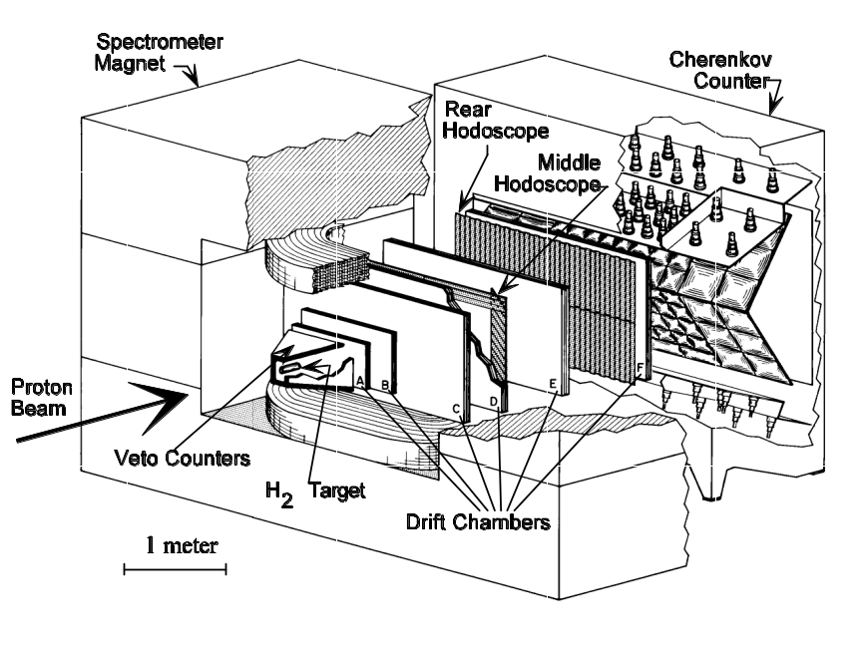
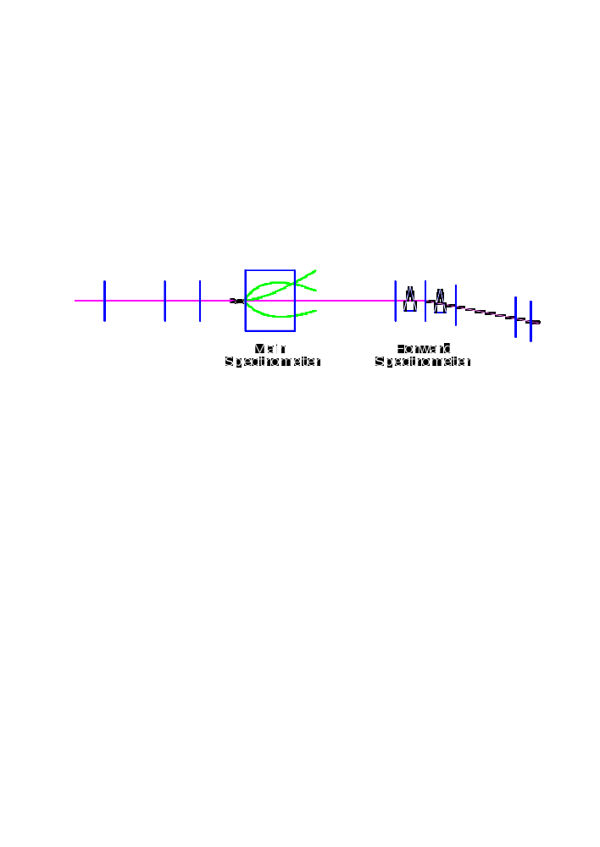
E690 Spectrometer
• Beam: 800 GeV protons, Δp/p ≤ 1.5e⁴
• Target: Liquid Hidrogen, (2% int. length)
• Main Spectrometer
• Forward Spectrometer
• Cherenkov Counter
• Time Of Flight System
• Vetoes System

Slide 5
E690 Collaboration
Columbia University
A.Gara, B.C.Knapp
Fermi National Accelerator Laboratory
D.Christian, G.Gutierrez, E.Gottschalk, A.Wehmann
Lawrence Livermore National Laboratory
E.P.Hartouni
University of Guanajuato
J.Felix, G.Moreno, M.A.Reyes
University of Massachussetts
M.C.Berisso, M.N.Kreisler, S.Lee, K.Markianos, M.H.L.S.Wang, D.Wesson

Slide 6
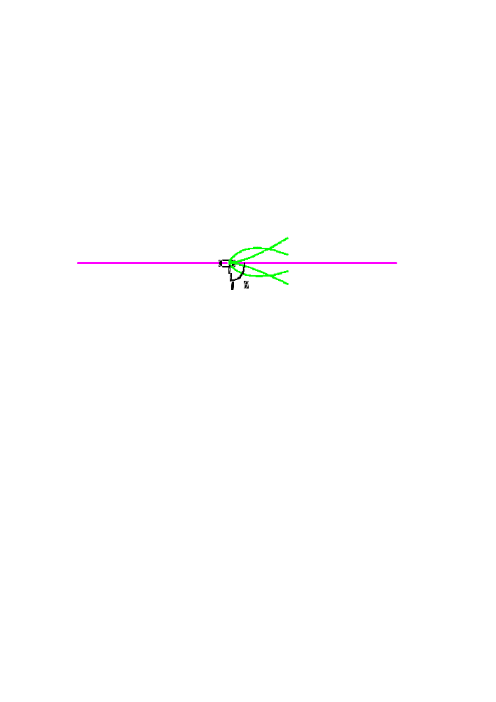
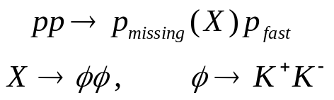
Data Selection
Reaction:
• 1 primary vertex inside H₂ target
• 5 tracks assigned to primary vertex, 3+, 2–
• Invariant mass 1.0124≤m_{KK}≤1.0264 GeV/c²
• Use E-P conservation to find missing proton, |MM²–m_{p}²|≤2 GeV²/c⁴
• At least one track Č-identified as K
• Kinematical cut on momentum of p_{missing} to ensure it is out of detector:
P_{z}≤0.250 GeV/c or arctan(P_{t}/P_{z})≥45

Slide 7
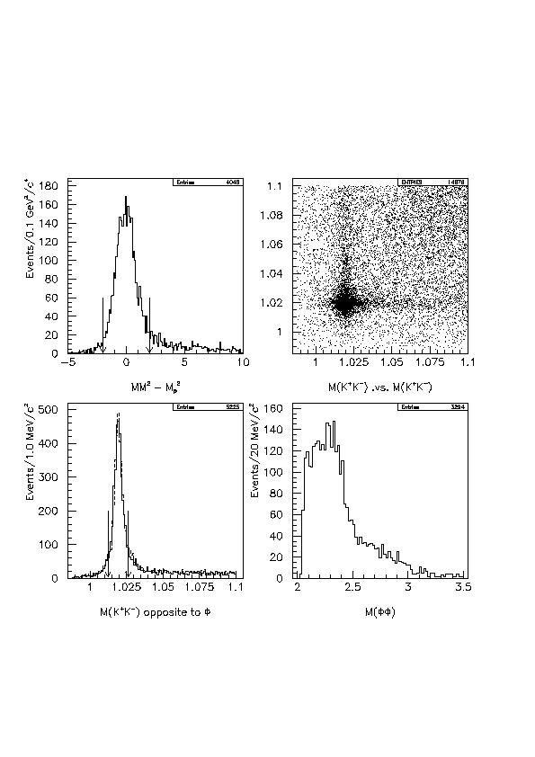
ΦΦ Invariant mass
• (UL) Missing mass squared, minus proton mass squared
• (UR) K⁺K– , C1 vs. C2
• (LL) K⁺K– invariant mass opposite to Φ, for both pairs
• (LR) ΦΦ invariant mass. 99.6% of events have only one combination per event in this plot.

Slide 8
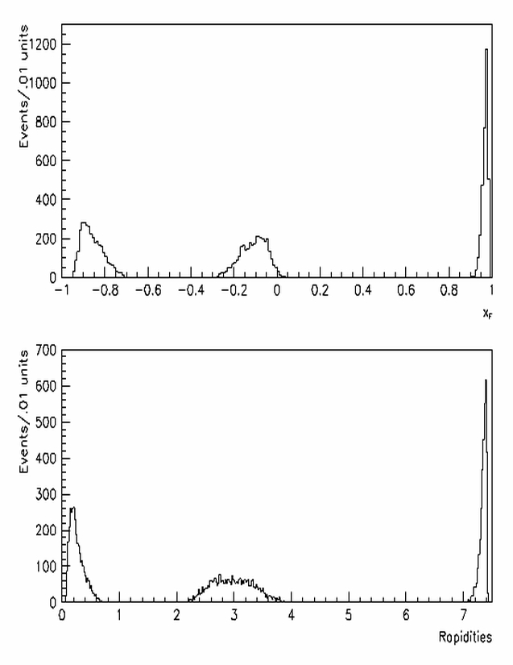
x_{F} and rapidities
Plots of x_{F} and rapidity distributions for the slow proton (left), X system,
and fast proton (right), show that the X system is centrally produced.

Slide 9
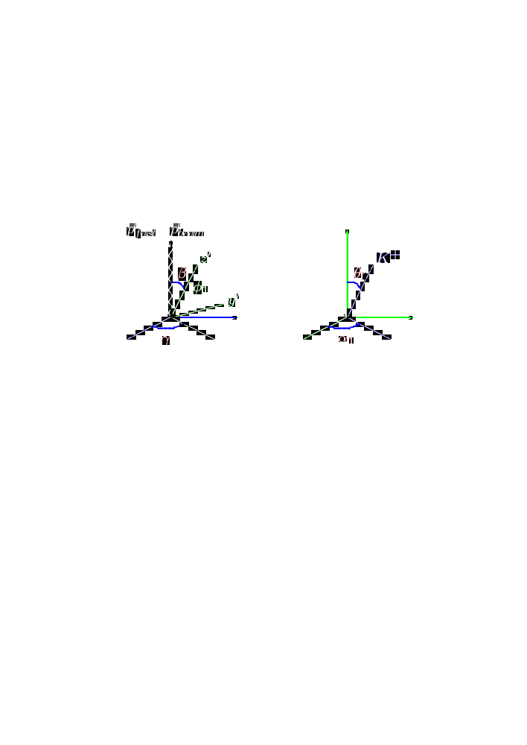








Reference Frames
We need 6 angles to define the spin and angular momentum of the ΦΦ system, each Φ decaying to a K⁺K– pair.
Using the protons' momentum transfer measured in the pp CM system, the GJ angles for one of the Φ's in the X rest system are defined with respect to the following axis:
beam momentum transfer
The GJ angles for the K⁺ from Φ₁ in the Φ₁ rest system are defined with respect to the following axis:
in direction
perpendicular to plane

Slide 10

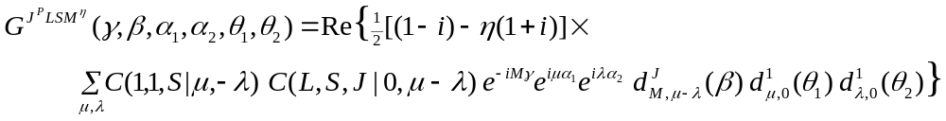

Waves in the reflectivity basis
Base vectors for an allowable combination of:
J ΦΦ total angular momentum
L orbital angular momentum
S spin
M
P parity
η reflectivity
are given by
I=0 and C=+ for the ΦΦ system. Bose statistics require that L+S=even.
There are 54 waves with 0≤J≤4, 0≤L ≤3, 0 ≤S ≤2, 0 ≤M ≤2; 14 of these have M=0.
We use maximum likelihood to find the wave amplitudes

Slide 11
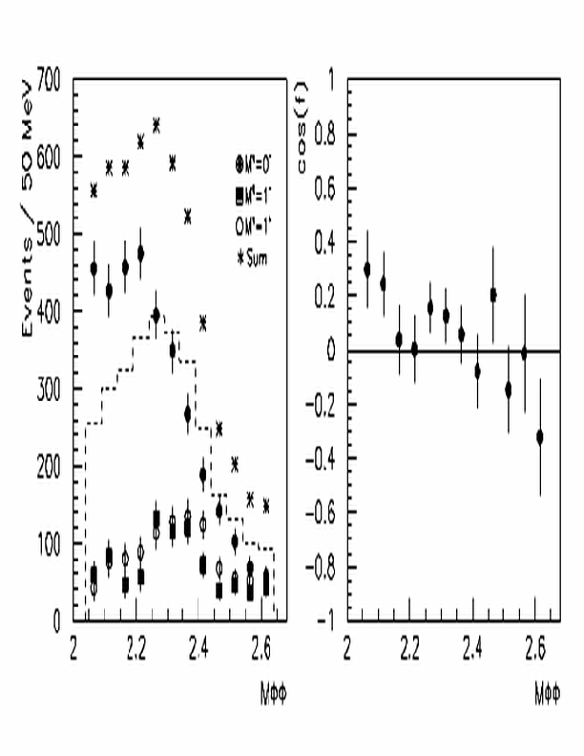
Partial Wave Analysis
We tried all 54 waves one by one to find the best fit. Then, added a second and third wave and selected the best fit with waves following from bin to bin.
The result of this procedure is that we need three waves to describe the data, all of them with J^{PC}LS=2⁺⁺02, with different total angular momentum projections, M=0,1.
Two of these three waves have η=–1, and interfere with a phase of about –90°.
The wave with M=0 predominates at threshold, and the two M=1 waves have similar distributions.

Slide 12
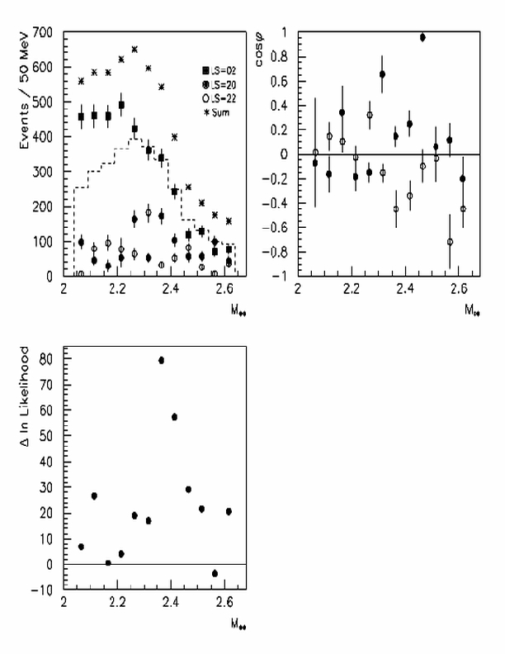
Comparison of results using the three BNL-MPS waves
For comparison, we tried the three BNL waves in the PWA.
As one can see here, there is not continuity in amplitudes and phases, and the BNL solution turns out to be up to 80 log L units bigger than our preferred solution.

Slide 13
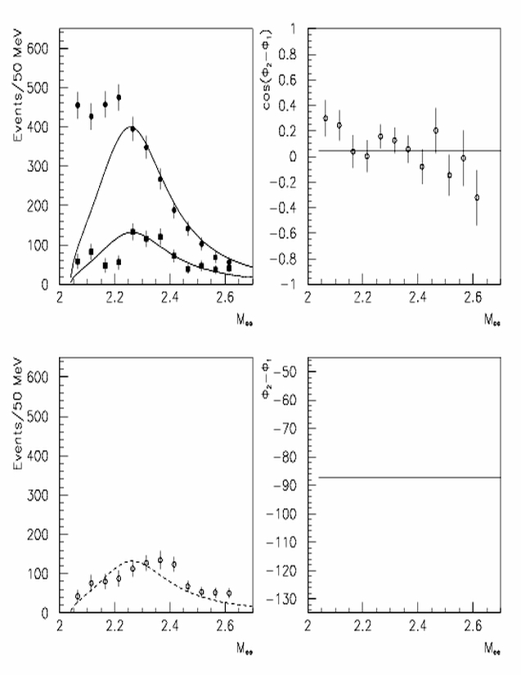
Resonances from wave amplitudes: One BW fit
We fitted the wave amplitudes following Morgan and Pennington's approach:
• use Jost functions to parameterize the S-matrix,
• assume two channel decays, XX and ΦΦ,
• X is assumed to be a low mass scalar – π – (ρ₁ ~ 1),
• BW: two k–poles in sheets II and III,
• production amplitudes are real numbers.
From a one BW fit we find:
M_{R}=2.249 ± 0.015 GeV, Γ_{R}=0.340 ± 0.027 GeV.

Slide 14
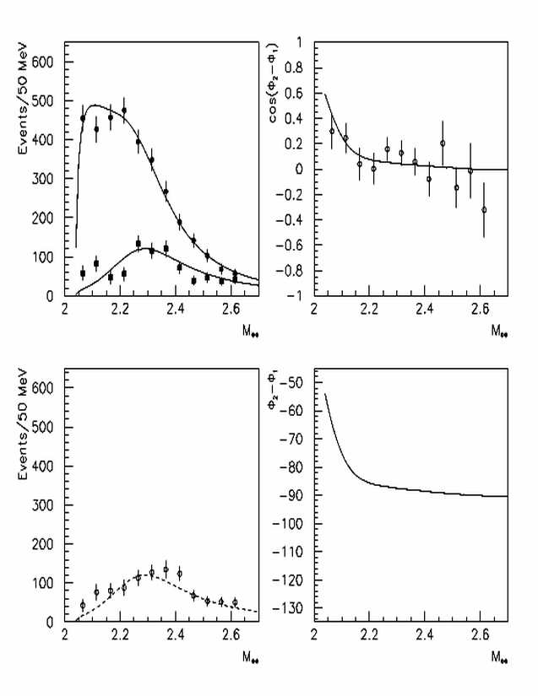
Two BW fit
Data needs another BW type pole below threshold to describe the J_{z}=0 wave amplitude.
• for |J_{z}|≠0 production is only via ΦΦ,
• for |J_{z}|=0 production is via XX and ΦΦ,
A two BW fit gives, for the BW above threshold:
M_{R}= 2243 ± 15 (stat) ± 10 (syst) MeV, Γ_{R}= 368 ± 33 (stat) ± 30 (syst) MeV
The BW pole would be m₀≈2.30 GeV.
For the BW pole below threshold, our fit gives:
M_{R} ≈1.9 GeV, Γ_{R} ≈300 MeV
but we need data on other channel to fix its parameters. (More channels? ?)

Slide 15
Conclusions
We report on the analysis of the centrally produced ΦΦ system
• PWA shows we need three waves, all of them 2⁺⁺02 with
|J_{z}|^{η}= 0–, 1–, 1⁺, to describe the data
• We only see one of the 2⁺⁺ waves seen by BNL-MPS
• A fit to the wave amplitudes a la M&P shows a BW like structure
above threshold with
M_{R} = 2243 ± 15 (stat) ± 10 (syst) MeV
Γ_{R} = 368 ± 33 (stat) ± 30 (syst) MeV
• The J_{z}=0 wave amplitude can be described only if there is another
pole below threshold ...
• ... but we need data on other channels to fix its parameters.

