Slide 1


One On One Mentoring
Project Choice
Mentoring Initiative

Slide 2
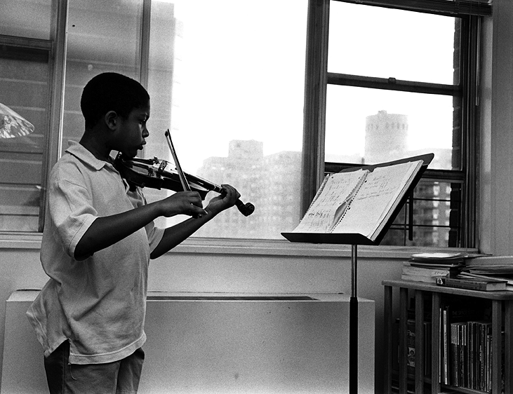
Introduction
The Mentoring Initiative is a program of the Department of Children and Families. This Initiative combines two existing, successful program (One on One Mentoring and Project Choice), and partners then to maximize outcomes for adolescents in care
The Mentoring Initiative provides adolescents with a caring, positive adult role model, referred to as a Mentor, who can become a permanent support in the youth’s life

Slide 3

Philosophy
There is a documented effect that comes from partnering adolescents with a positive, caring, committed adult. This effect includes youth making healthy life choices, and forming lasting relationships with the adult
This partnership provides the youth, referred to as a mentee, with a broader view of their future and a solid opportunity to achieve personal success

Slide 4

Program
Goal
The desired outcome is a life long, permanent connection to a caring and supportive adult.

Slide 5

Who Should be a Mentee?
One on One Mentoring
Mentees are:
Project Choice Mentees are:
Committed youth ages 14-21
Youth who have a desire to participate in this program
Adjudicated youth, ages 13-18
Youth who have a desire to participate in this program

Slide 6
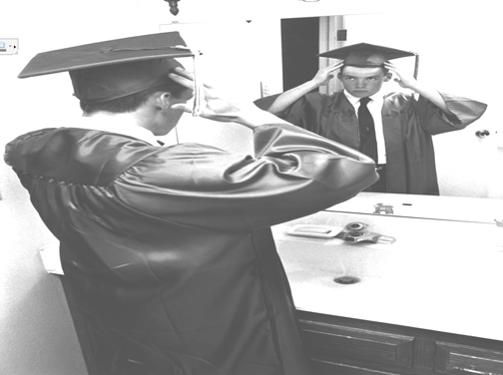
What is a Mentor?
A Mentor is a VOLUNTEER*
A Mentor is over the age of 21
A Mentor is someone who is able to consistently give their time to a Mentee in accordance with the program design of the Mentoring Initiative
A Mentor has a means of providing transportation to the mentee for community based activities
A Mentor is someone who had completed a background check: DMV, Criminal, and Protective Services
A Mentor is someone who has completed a mentoring Initiative training course
*Mentors volunteer their own time and are not paid
or subsidized for their time

Slide 7

What is
the Mentors Role?
One on One Mentoring
Mentors maintain contact with their Mentees, in person, at least 3 times per month
Mentors make weekly telephone calls to their Mentees
Mentors collaborate with the Mentee’s caretaker and DCF Worker about plans, visits, outings etc.
Project Choice
Mentors maintain contact with their Mentees for a minimum of 2 hours per week
Mentors make weekly contact in person and/or by phone to their Mentees
Mentors collaborate with the Mentees caretaker and DCF worker about plans, visits, outings, etc.

Slide 8
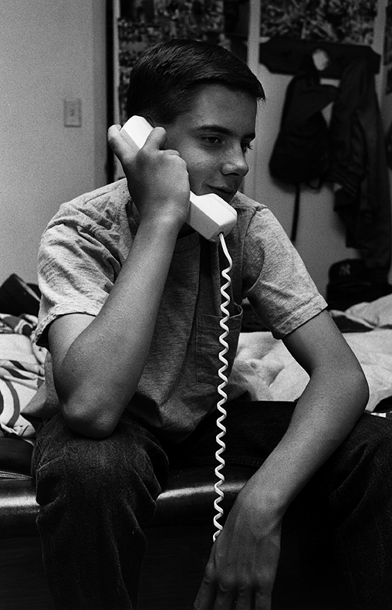
Each Area Office has a contracted provider who is responsible for accepting referrals for prospective mentees, recruiting, training and supporting mentors, and matching mentors and mentees. The provider is also responsible for maintain regular monthly contact with the mentee and the mentor, organizing quarterly events, and an annual recognition event. The contracted provider serves the towns covered by the respective Area Office. This means that any youth, regardless of which Area Office they come from, can be referred to the provider covering the town they reside in.
How Can I Get a Mentor?

Slide 9
Who to Call
  Agency Program Liaisons:
  One on One Mentoring – Luis Felix, 860-723-7256
  Project Choice – Dave Norman, 860-638-2444
Contracted One on One Mentoring Providers (ages 14-21):
  Bridgeport Area Office Towns - Hall Neighborhood House, 203-334-3900
  Danbury Area Office Towns - Family & Children’s Aid, 203-790-8183
  Greater/Metro New Haven, Middletown, and Meriden Area Office Towns – Children’s Community Programs 203-786-6403
  Hartford Area Office Towns – TBA
  Manchester Area Offices Towns – Kidsafe CT 860-872-1918
  New Britain Area Office Towns – Klingberg Family Services, 860-832-5578.
  Norwalk and Stamford Area Office Towns – Domus Foundation 203-324--4277
  Norwich Area Office Towns – Catholic Charities 860-443-5328
  Torrington Area Office Towns – Torrington Area Youth Service Bureau 860-496-0356
  Waterbury Area Office Towns – Waterbury Youth Service System 203-573-0264
  Willimantic Area Office Towns – Access Agency 860-774-0418, x3608
  Statewide, serving LGBTQ youth – True Colors 860-649-7386
Contracted Volunteer Mentoring Providers (ages 8-21):
  Danbury Area Office Towns –Danbury Youth Services 203-748-2936

