Slide 1

KOJAK and SCALASCA
Jack Dongarra
University of Tennessee and
Oak Ridge National Laboratory

Slide 2

KOJAK
Software package for automatic performance analysis of parallel applications
  Message passing and threads (MPI, OpenMP, SHMEM, CAF)
  Parallel performance
  CPU and memory performance
Collaborative research project between
  Forschungszentrum Jülich, Germany
  University of Tennessee, USA
URLs
http://www.fz-juelich.de/zam/kojak/
http://icl.cs.utk.edu/kojak/

Slide 3
Automatic off-line trace analysis
Automatic search for patterns of inefficient behavior
Quantification of significance
Data distillation
Guaranteed to cover the entire trace
Low-level
event trace
Problem
Call tree
Reduction
High-level
profile
≡
System

Slide 4
Late sender pattern
process
MPI_SEND
MPI_RECV
B
ENTER
EXIT
SEND
RECV
Message
Link
idle
A
time

Slide 5
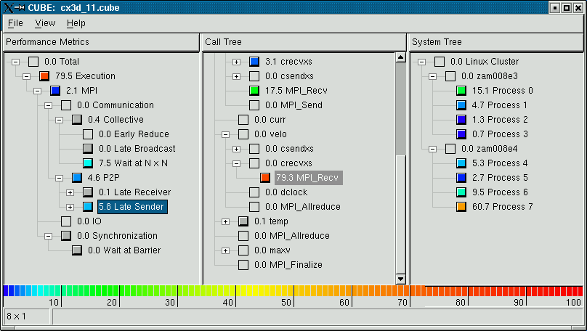
Analysis report
Which type of
problem?
Where in the source code?
Which call path?
Which process /
thread ?

Slide 6


SCALASCA
Follow-up project to KOJAK
Started January 2006
Funded by Helmholtz Initiative and Networking Fund
Objective: develop a highly scalable version of KOJAK
  Basic idea: parallelization of analysis
  Current focus: single-threaded MPI-1 applications
URL http://www.scalasca.org/

Slide 7
Parallel analysis with Scalasca
Instrumentation
Source code
Automatic multilevel
instrumentation
Executable
Unified defs +
mappings
Measurement
Execution on
parallel machine
Local trace files
Parallel trace
analyzer
Analysis
Runtime
summary report
Trace analysis
report
Profile browser
CUBE

Slide 8
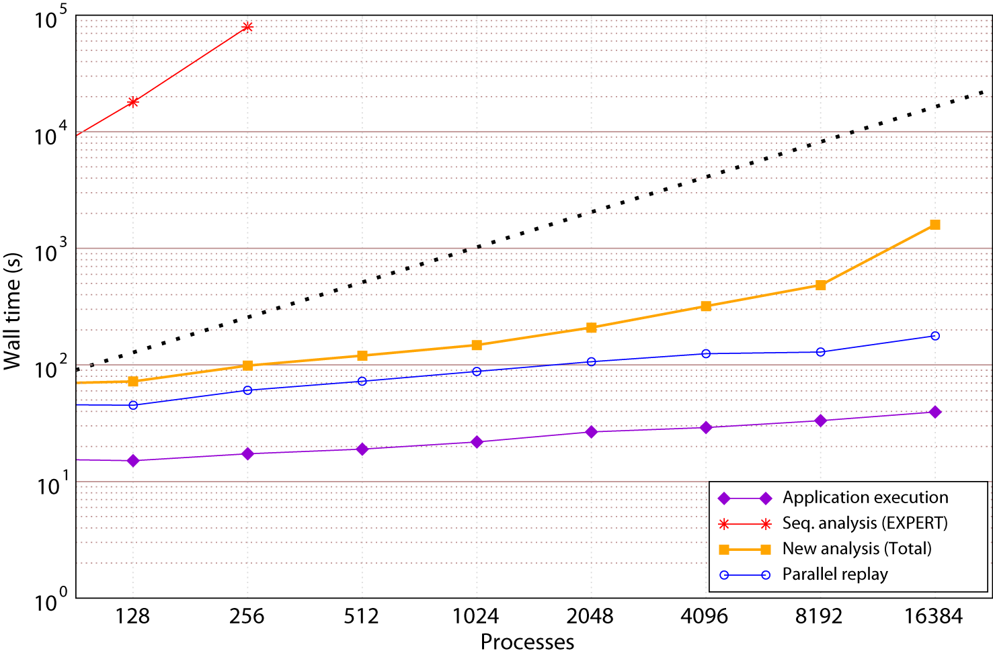
Results: SMG2000

Slide 9
Integrated Tools for high productivity
Virtual Institute for High-Productivity Supercomputing (VI-HPS)
  Funded by the Helmholtz Association of German research centers
Focus on productivity
  Advanced programming tools for integrated performance analysis and debugging
  Training and support
VI-HPS partners and tools
  Forschungszentrum Jülich, Germany (KOJAK, SCALASCA)
  RWTH Aachen University, Germany (training, support)
  Technische Universität Dresden, Germany (VAMPIR)
  University of Tennessee (PAPI, KOJAK)

Slide 10
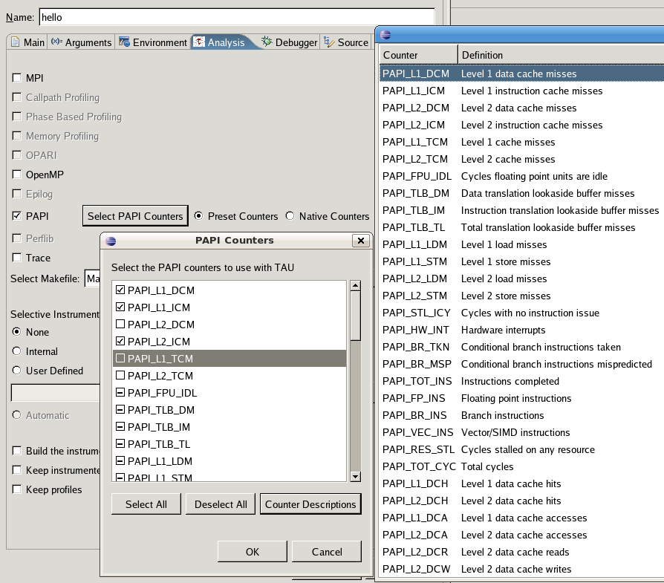
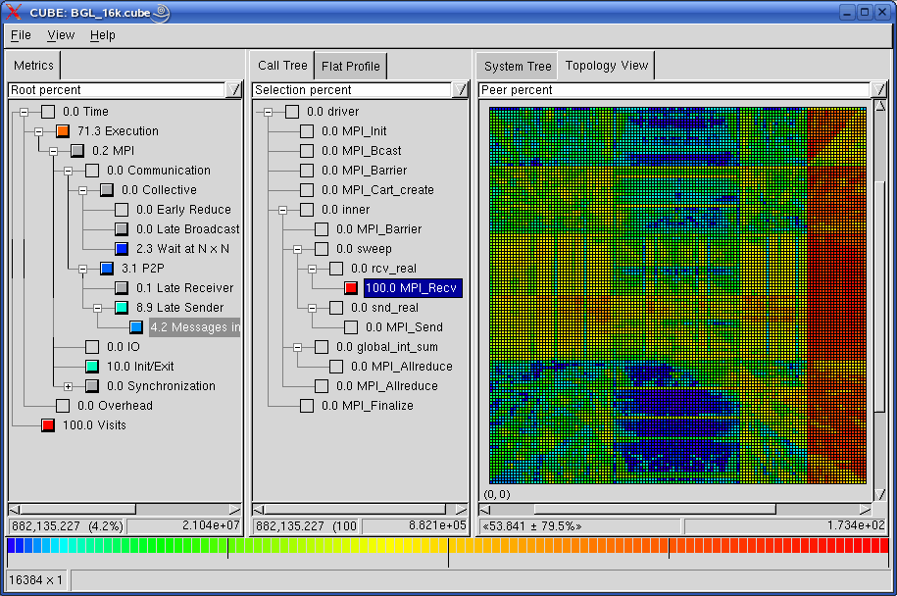


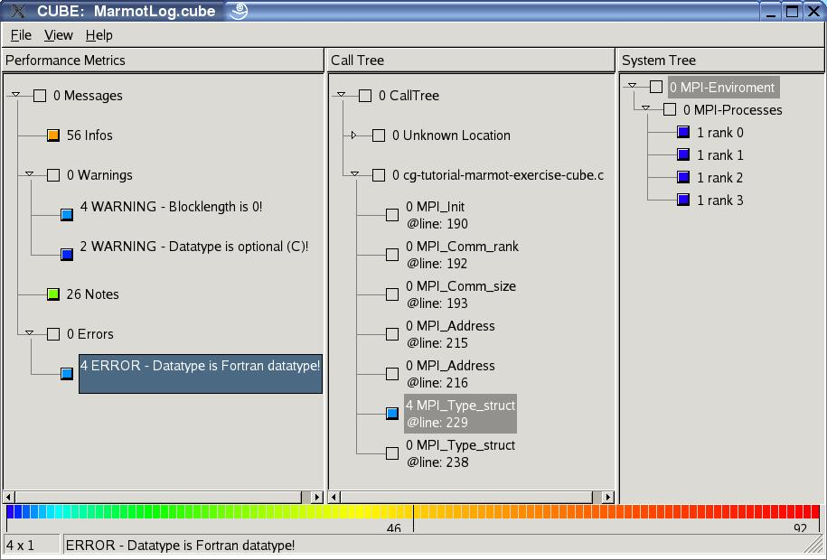
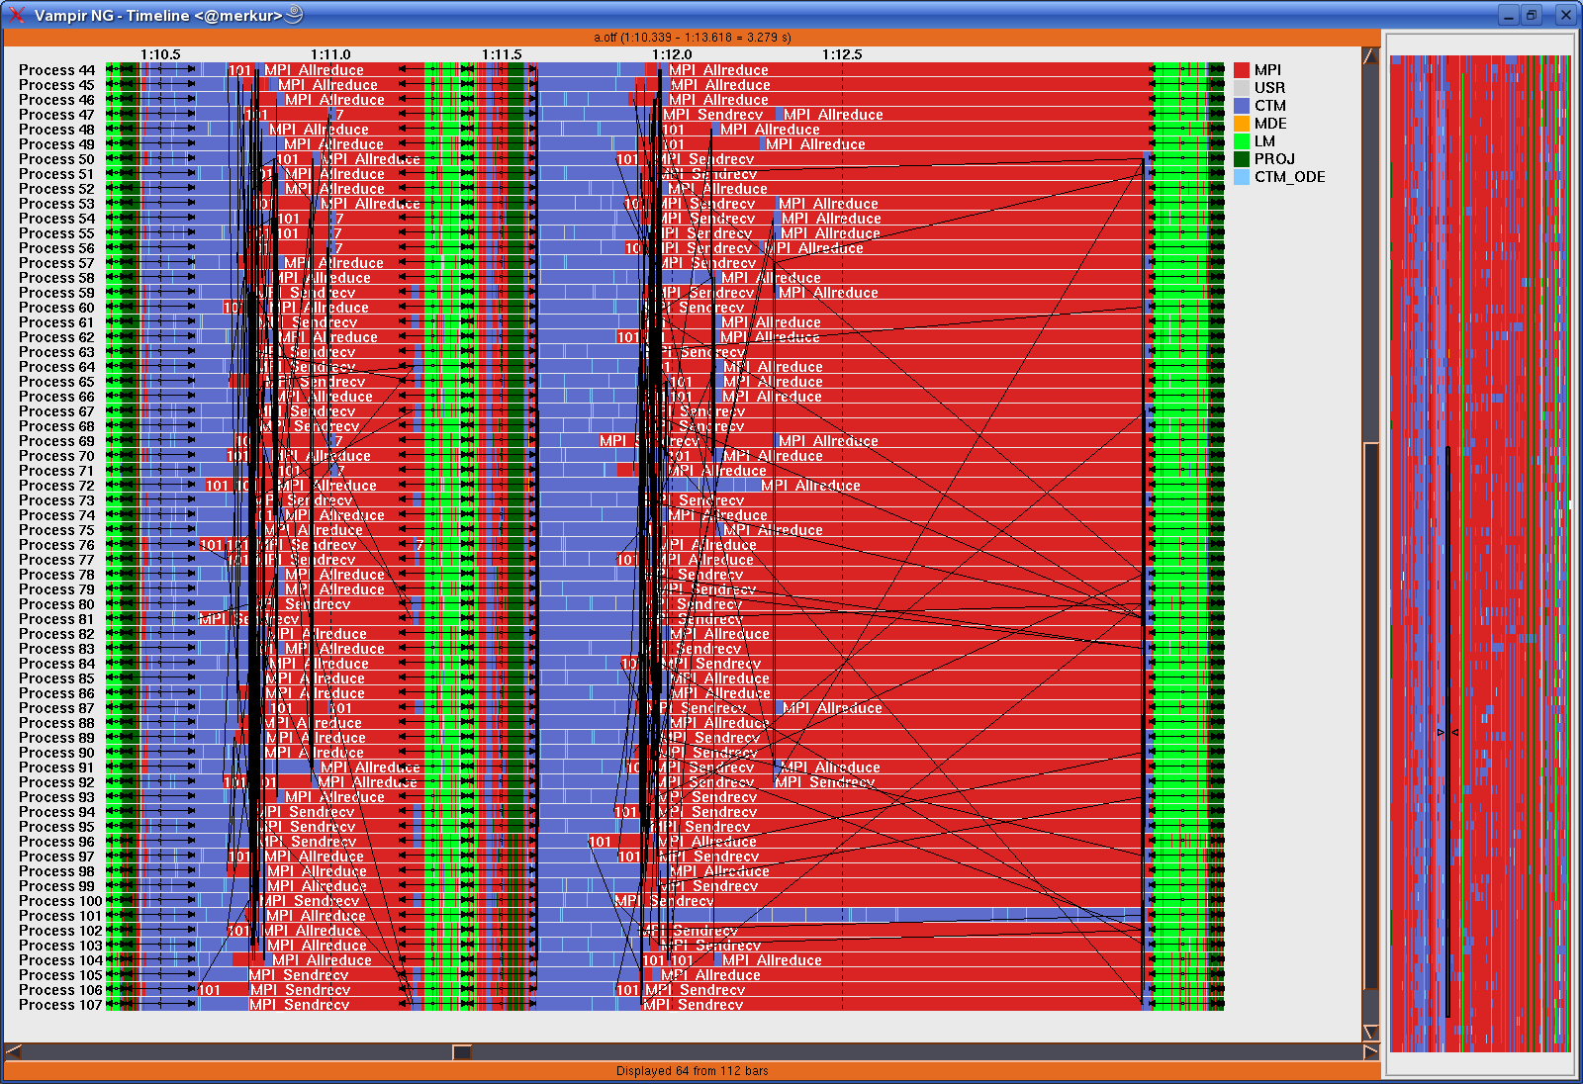


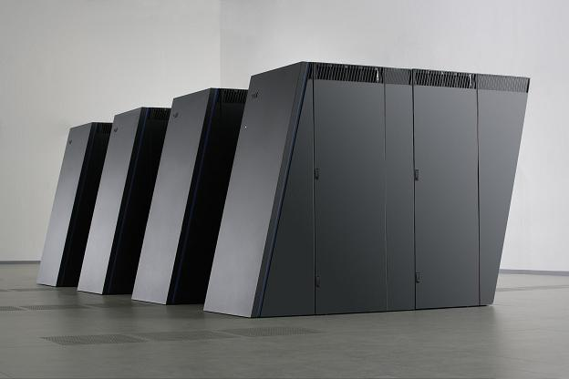
High productivity development cycle
PAPI
KOJAK /
SCALASCA
Hardware
monitoring
Automatic
trace
analysis
MARMOT
VAMPIR
Error
correction
Visual trace
analysis
Execution
Optimization

Slide 11
Contacts
Jack Dongarra, Shirley Moore,
Karl Fuerlinger, and Fengguang Song
University of Tennessee and Oak Ridge National Laboratory
Daniel Becker, Markus Geimer,
Bernd Mohr, Felix Wolf, and Brian Wylie
Forschungszentrum Jülich, Germany

