Slide 1


Identified particle spectra from pp, dA and AA collisions
Julia Velkovska
Quark Matter 2004
January 15

Slide 2
Outline
This talk focuses on:
  Identified particles
  Mid-rapidity
  Intermediate p_{T}
Results not covered in this talk:
  PHOBOS: Important measurement at very low m_{T} from AuAu + broad momentum range π,K,p dAu spectra
    Talk by G.Veres
  BRAHMS – broad momentum range π,K,p spectra measured vs rapidity (AuAu and dAu)
    Talks by D. Ourdane, Z. Yin

Slide 3
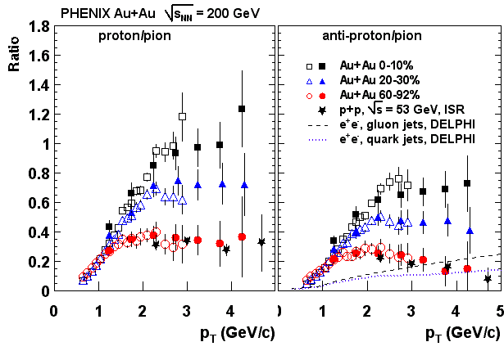
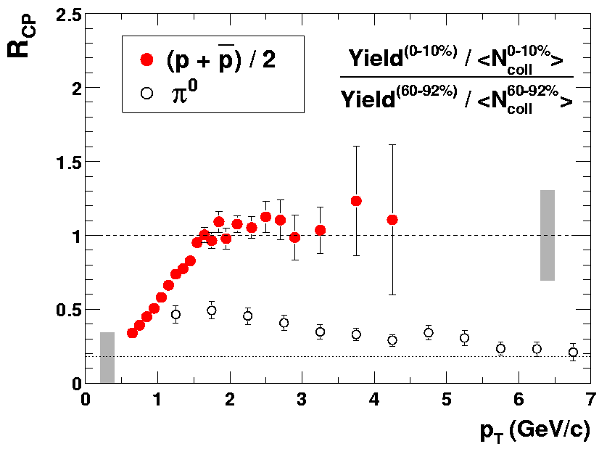
Motivation: the baryon “anomaly”
Phys. Rev. Lett 91, 172301 (2003).
Peripheral: consistent
with standard fragmentation
Central: a factor ~ 3 higher than peripheral, e⁺e⁻ and ISR pp data
Pions are suppressed at high pT in central Au+Au collisions
No apparent proton suppression for 2-4 GeV/c
  different production mechanism ?

Slide 4
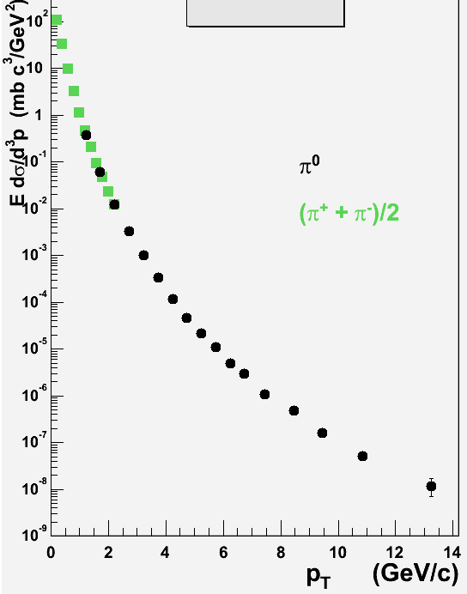

Start “simple”: pions in p+p collisions
_{pp @200 GeV}
soft production:
exponential
preliminary
hard scattering:
power-law “tail”
Charged pion data:
Poster M.Harvey

Slide 5
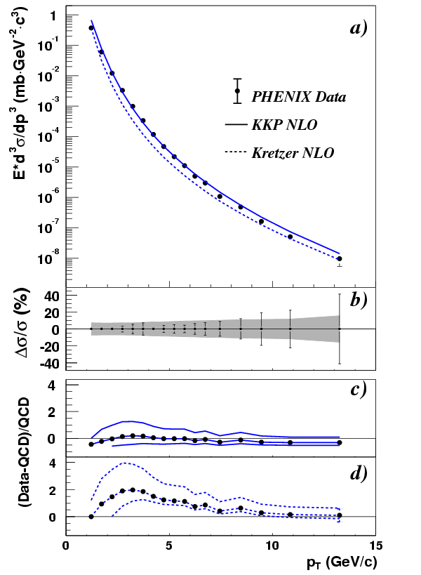
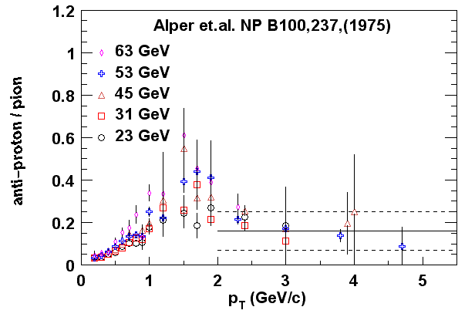
pQCD description in pp
Phys. Rev. Lett. 91, 241803 (2003) .
pQCD calculations work
Note:
fragmentation function
input from experiment
Soft to hard transition in p/π ratio

Slide 6
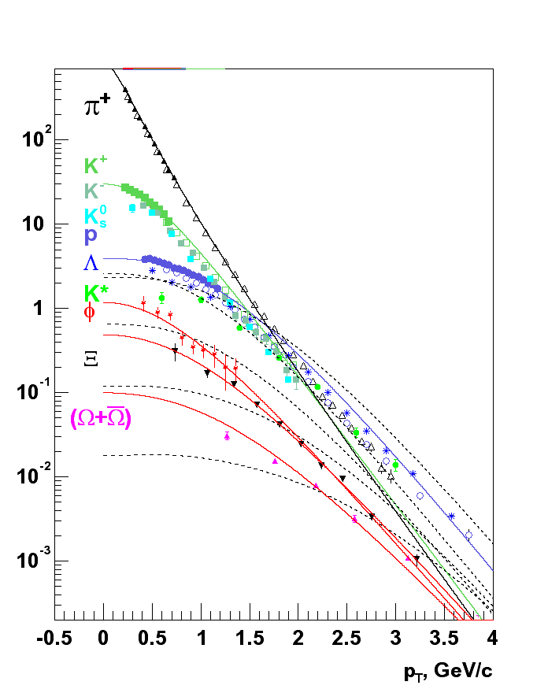
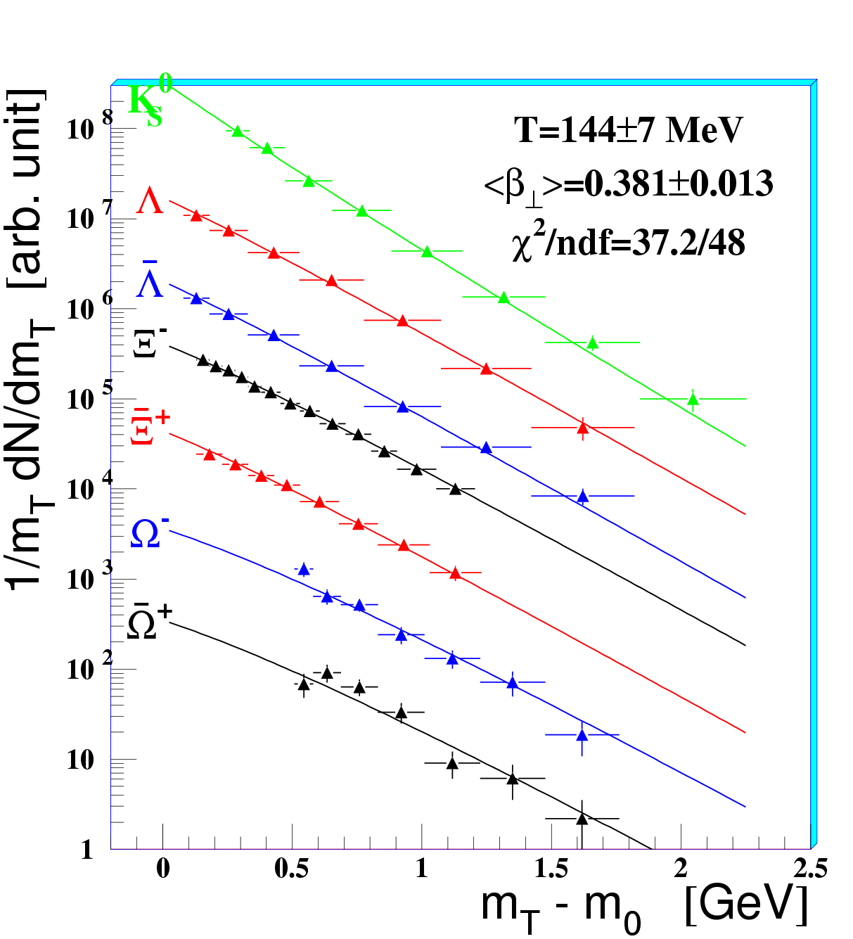
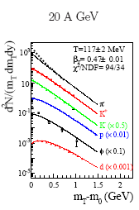
Nuclear modifications: Soft physics
NA57
STAR
NA49
Collective radial flow described by hydrodynamics from 20AGeV PbPb
to top RHIC energy

Slide 7
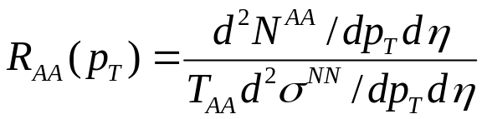
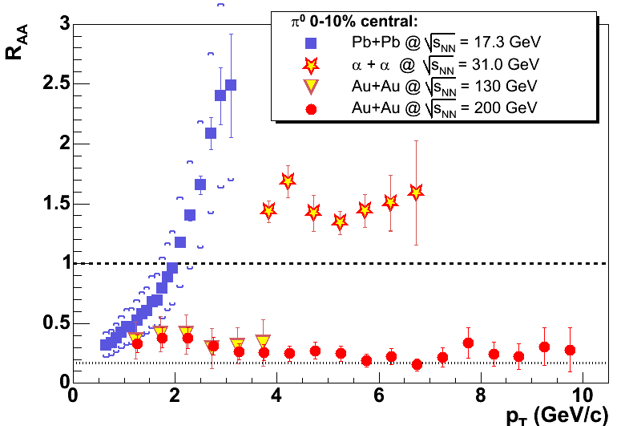
Nuclear modifications to hard scattering
Large Cronin
effect at SPS
and ISR
Suppression at RHIC
Is the suppression due to the medium?
(initial or final state effect?)

Slide 8
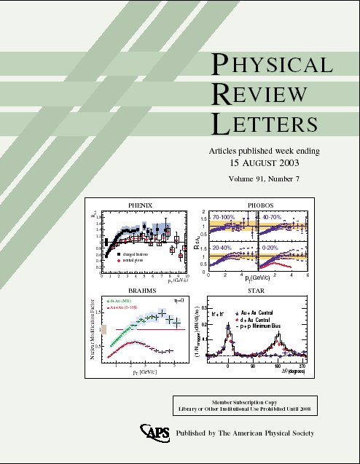
The null result on the cover of PRL: dAu
The suppression
of hadrons at
mid-rapidity is due to the medium
produced in the
collisions.
(final state)

Slide 9
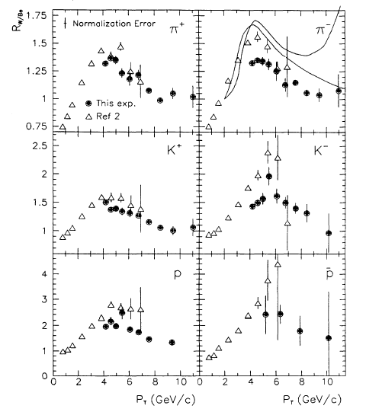
But what happens to the protons ?
Can Cronin effect produce the enhanced p/π ratio in AuAu ?
What is Cronin effect? Theorists seem to agree:
  “Initial state multiple scattering leading to pt broadening.”
Why is it different for protons and pions ?
  “Nobody really knows.”
P.B. Straub et al., PRL 68 (1992)
FNAL experiments measuring R (W / Be)
for identified particles at sqrt(s) of 27.4 and 51.3 GeV.
P.B.Straub et al., Phys.Rev.Lett., 68,452(1992)

Slide 10
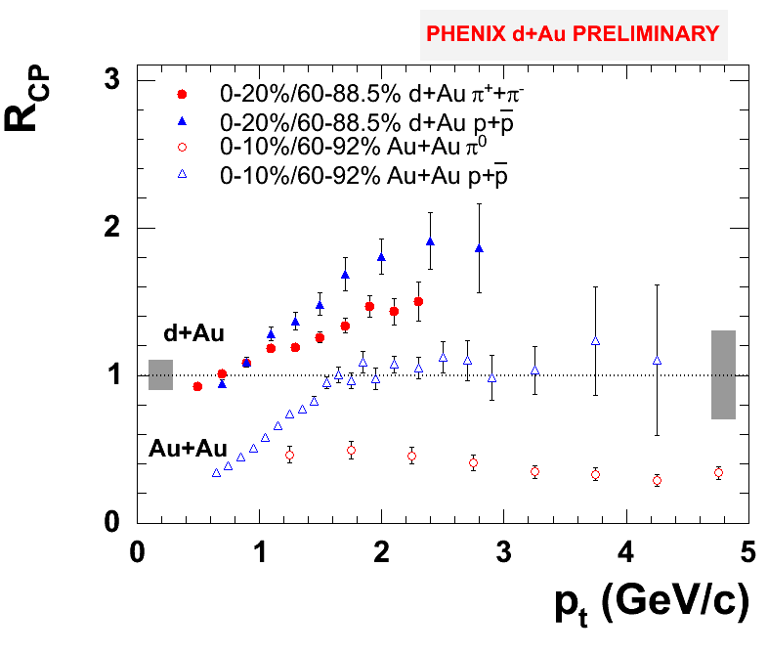
Cronin effect for protons and pions
Protons exhibit stronger Cronin enhancement
Not enough to account for
factor of 3 increase
of p/π in central AuAu

Slide 11
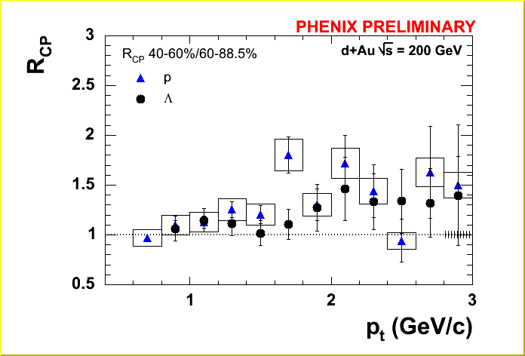
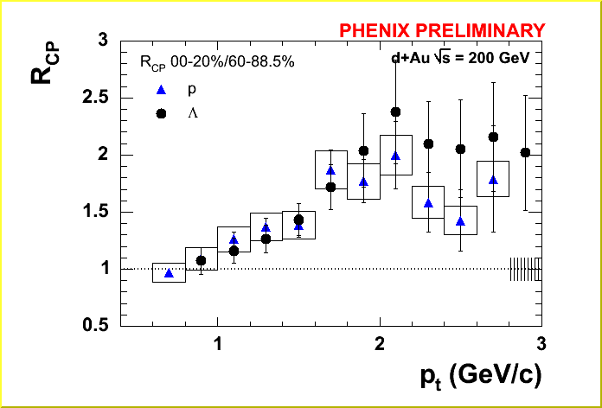
Does strangeness “matter” ?
Does Cronin enhancement depend on strangeness content ? Compare p and Λ.
Talk: D. Kotchetkov: Friday,Parallel 2
Poster: A. Taranenko

Slide 12
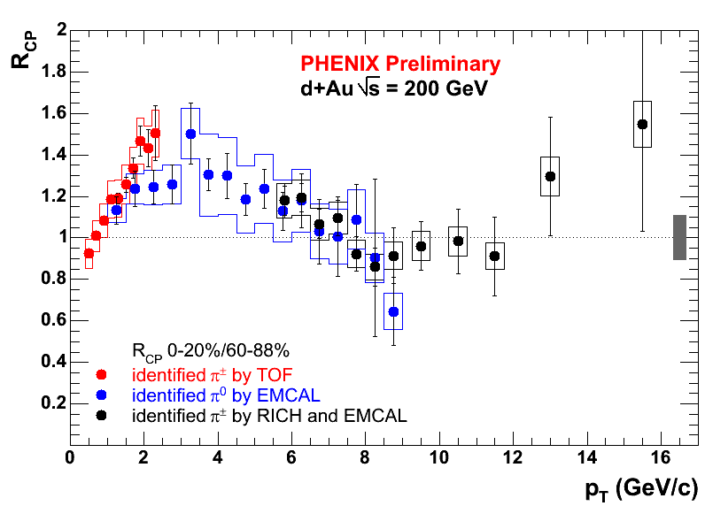
Cronin effect for pions at high pt
The effect disappears at high pt
Poster by J.Jia

Slide 13
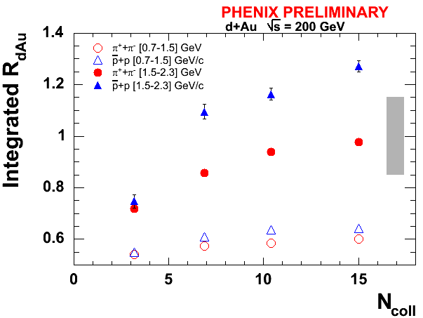
Centrality dependence of Cronin effect
Similar centrality dependence for all particle species
Enhancement grows with Ncoll and tends to saturate
  See Talk by Felix Mathatias : Parallel 1,Thursday

Slide 14
Cronin effect summary
Mass dependence:
  π < p ~ Λ
  or is it baryon/meson ?
Flavor depdendence:
  Does not depend on strangeness content: p ~ Λ
Centrality dependence:
  Increases with Ncoll
  Tends to saturate
Pt depdendence:
  Limited to pt <8 GeV/c
Seems insufficient to explain the mid-pt baryon enhancement in AuAu

Slide 15
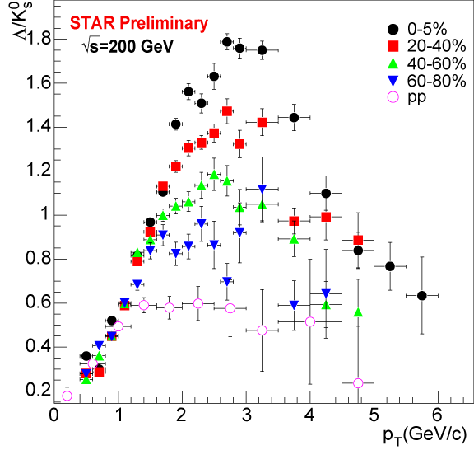
Strange baryon/meson ratios
The mid-pT anomaly not unique to p/π
Λ/K⁰_{s} has a peak at ~ 3GeV/c
Height depends on centrality
Peripheral – above pp
data

Slide 16
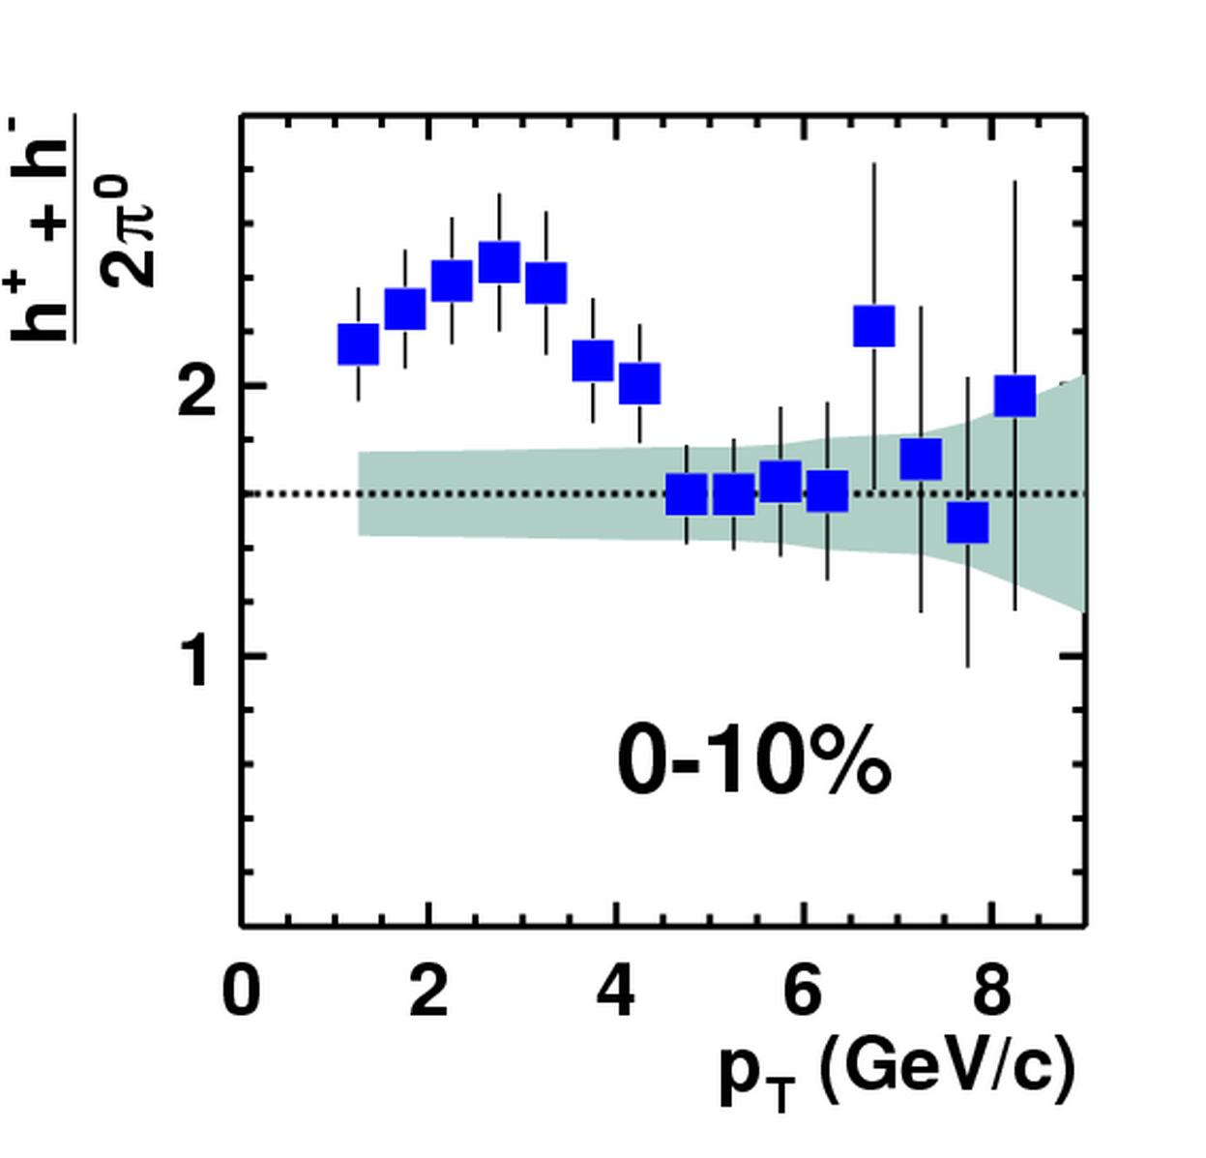
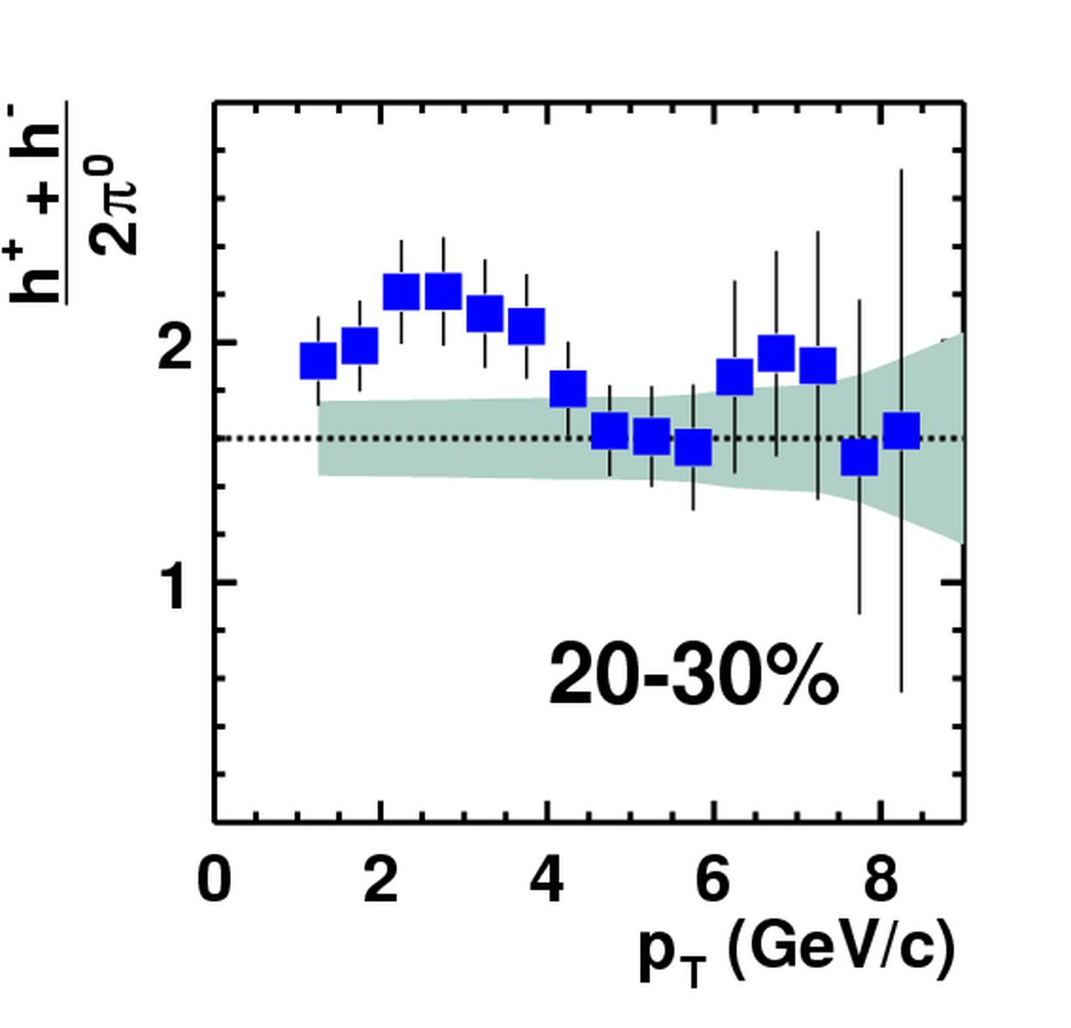
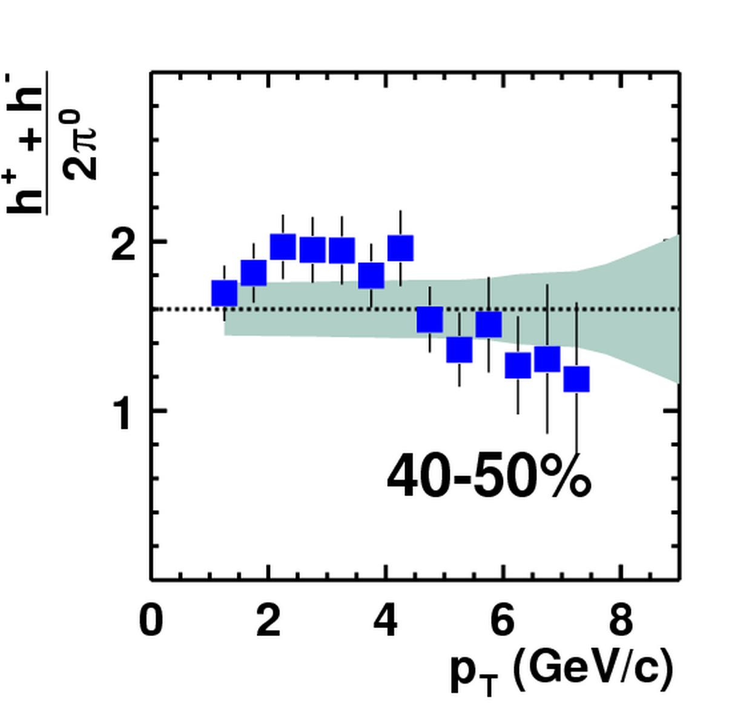
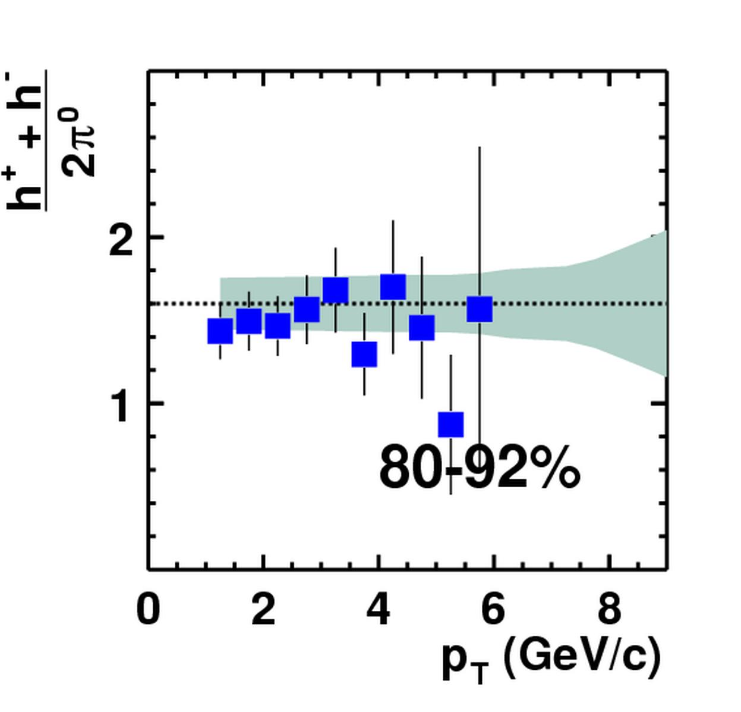

The proton “bump” in the h/π ratios
Au+Au @ 200AGeV
Expectation (pp, e⁺e⁻): h/π ≈ 1.6
Above 5 GeV/c
and in peripheral
collisions: recover standard fragmentation
nucl-ex/0310005
Talk: C.Klein-Boesing

Slide 17
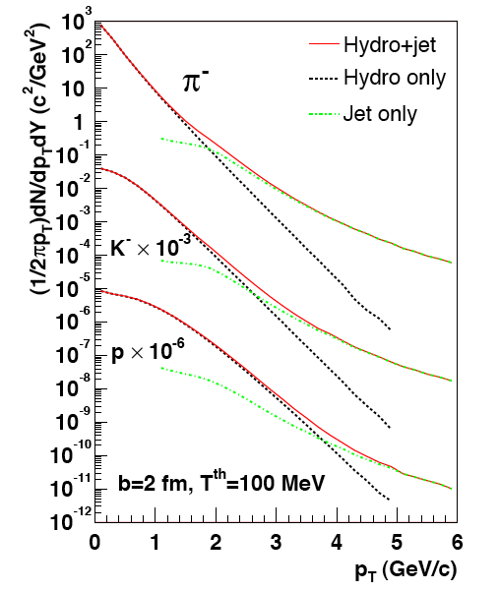
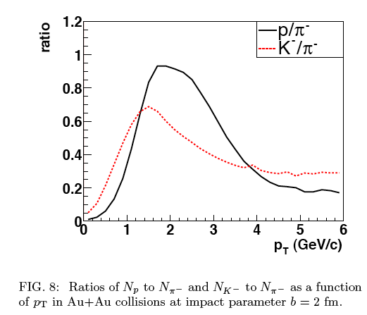
Hydro + Jet Model
Hydrodynamics can describe the spectra up to ~ 2 GeV/c.
Jet contributions > 2 GeV/c.
Needed detailed comparison with data (e.g. centrality dependence) .
Proton enhancement (with respect to the pions) is a mass effect.
Hirano, Nara nucl-th/0307015

Slide 18
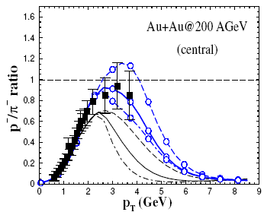
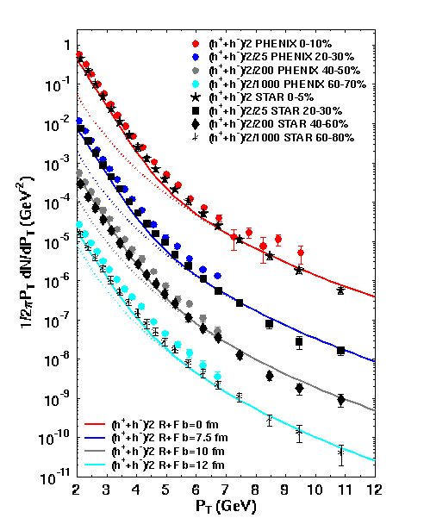
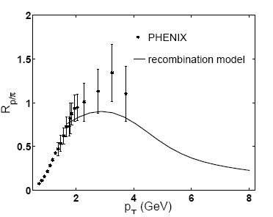
Coalescence/recombination models
Greco, Ko, Levai: Phys.Rev.Lett. 90 (2003) 202302
describe particle ratios and spectra:
p_{T}(baryons) >p_{T}(mesons)>p_{T}(quarks)
Fries et al: Phys.Rev. C68 (2003) 044902
Hwa & Yang
nucl-th/0401001

Slide 19
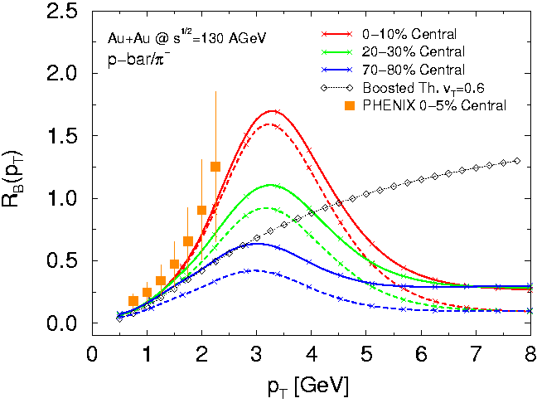
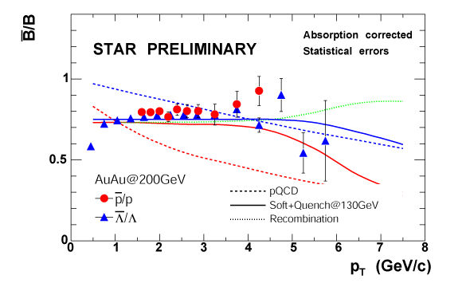
Another non-perturbative mechanism: Baryon junctions
Baryon Junction
Vitev, Gyulassy
PRC 65, 041902, 2002
Predicted centrality
dependence of p/π ratio
and anti-baryon/baryon
ratio
Notes:
BJ: it invokes a topological gluon configuration with jet quenching.
gluon junctions produce copious baryons at intermediate pT (pion is suppressed by jet quenching).
Parton recombination : the competition between recombination and fragmentation of partons.

Slide 20
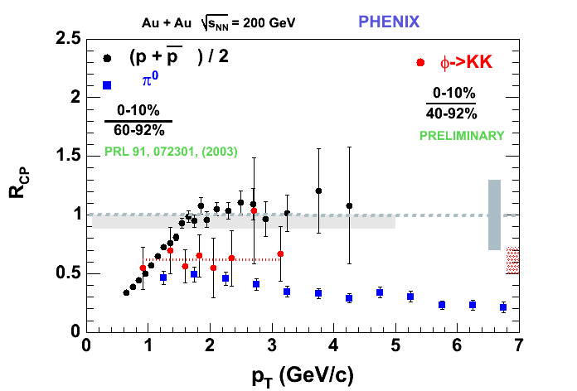
Centrality scaling of mesons and baryons:
N_{coll} errors
correlated
12% syst. error
uncorrelated
Line at 0.62
fit to φ data
Difference between R_{CP} of p+p and φ
beyond the systematic error

Slide 21
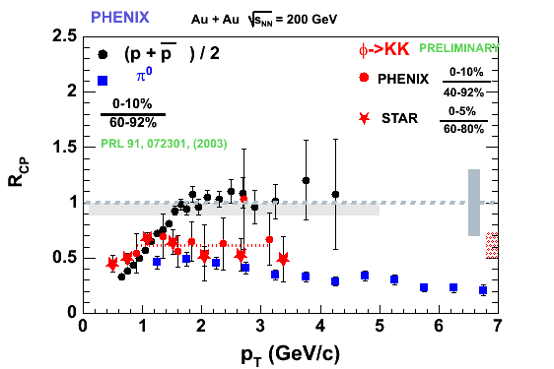
Compare φ scaling across experiments
Remarkable agreement between PHENIX and STAR

Slide 22
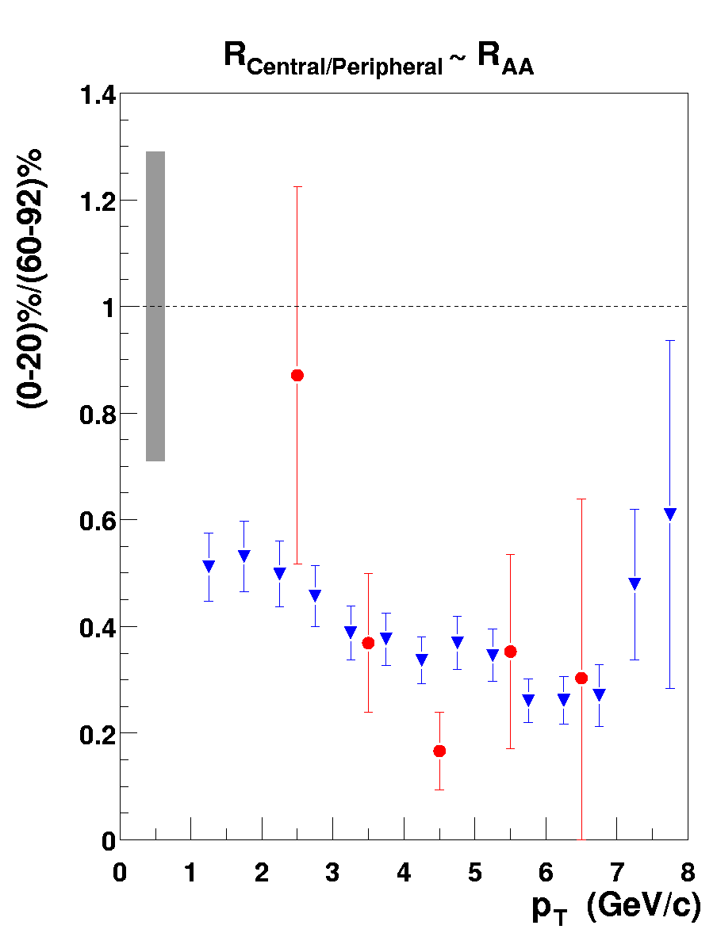
The η meson: high-pt comparison with π⁰
Phenix preliminary AuAu @200GeV
Adding η into the mix: agrees with π⁰ within errors
  poster S.Mioduszewski : High pT 8

Slide 23

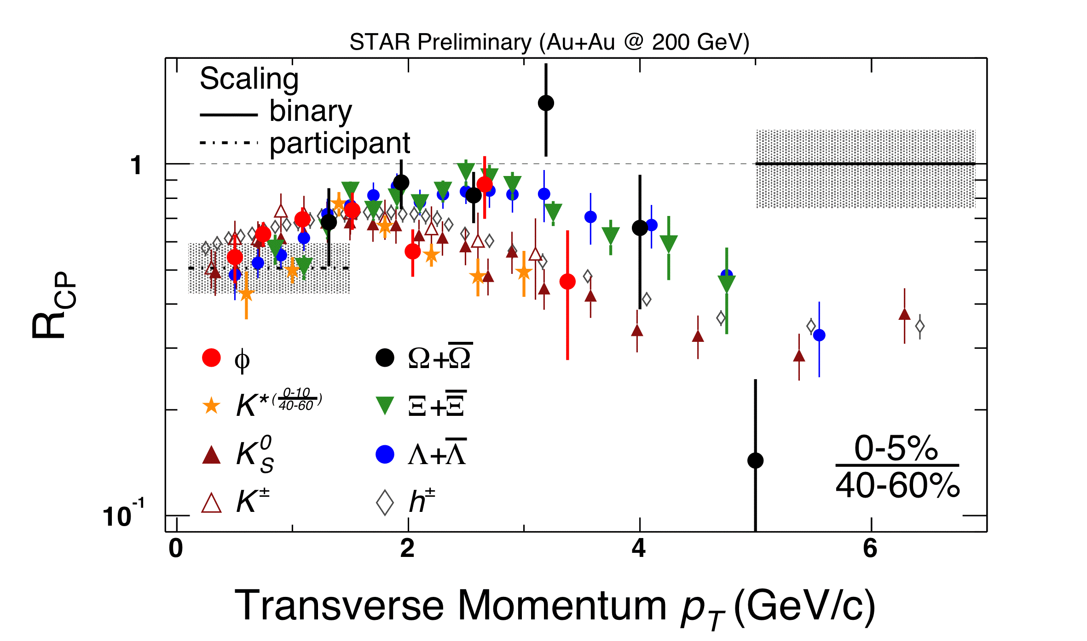
Centrality scaling of mesons and baryons :
Talk byM.Lamont
Tuesday, Parallel 1
Compilation of R_{cp} results from STAR
follows baryon/meson distinction (independent of mass)

Slide 24
Baryons and mesons are different

Slide 25
Do soft and hard partons recombine, or is it just soft+soft ?
Explore correlations with leading
baryons and mesons

Slide 26
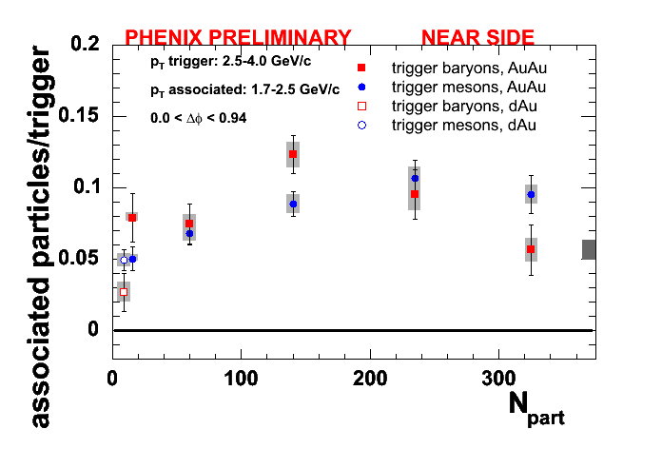
Do mid-p_{T} baryons have jet-like correlations ?
jet partner equally likely for trigger baryons & mesons
no significant decrease with centrality!
See talk by Anne
Sickles: Friday Parallel 1

Slide 27
Conclusions
Intermediate p_{T} with distinct baryon dynamics from AuAu data
Cronin effect shows (weak) mass dependence:
  Is it enough to explain the large p/π ratio in AuAu ?
  Need better theoretical understanding
The suppression/non-suppression at mid-p_{T} follows baryon/meson lines (not mass effect)
Mid-p_{T} leading baryons show jet-like correlations
  Soft-soft recombination models excluded
  Need to recombine hard-soft

Slide 28
Experimental Outlook
The RHIC experiments are taking AuAu data (as I speak)
High statistics run:
  Expect much smaller error bars on the singles measurements
  Expand (with enough statistics) v2 and correlation mesurements
Provide data that will help in understanding the hadronization process

Slide 29
EXTRA

Slide 30
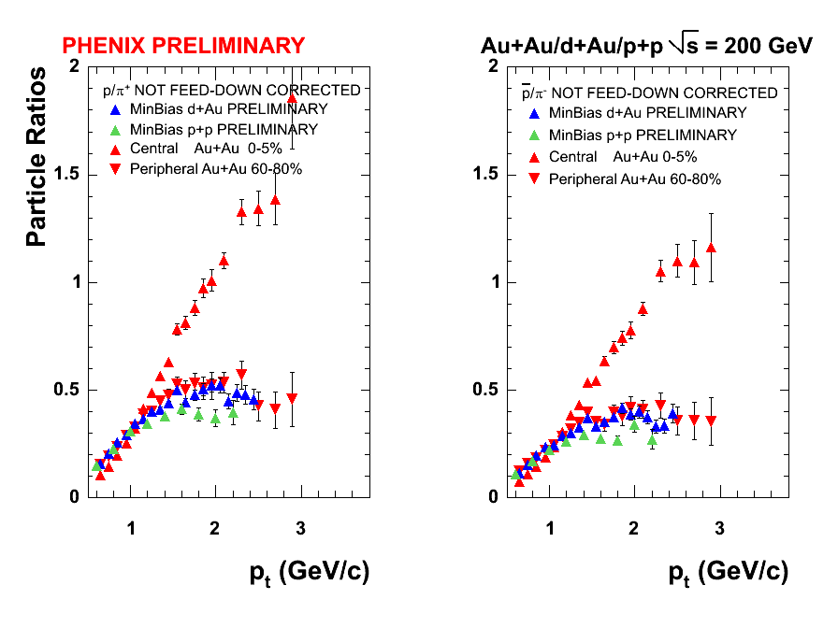
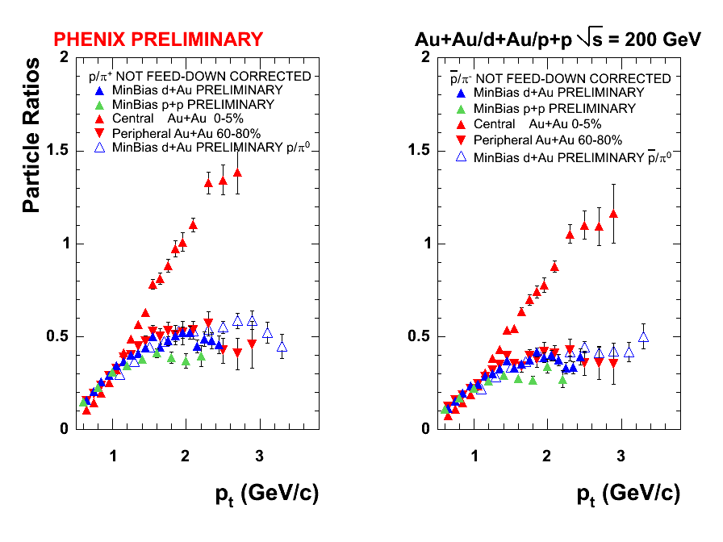
System size dependence of p/π ratio
Peripheral AuAu and dAu agree
pp data ~ 25% lower :
different Cronin enhancement for protons and pions
Caveat: (anti)proton data not feed-down corrected

Slide 31
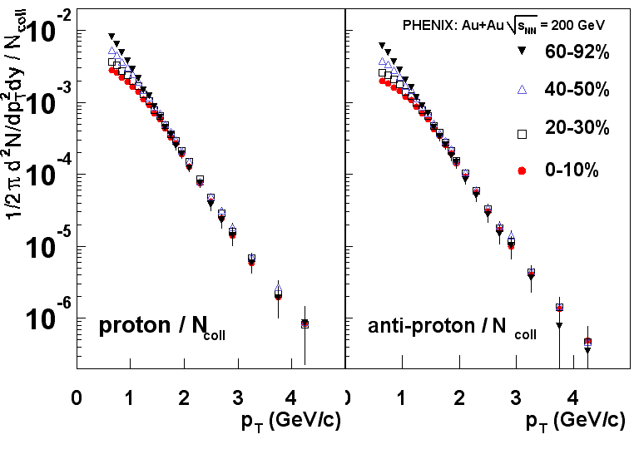

Slide 32
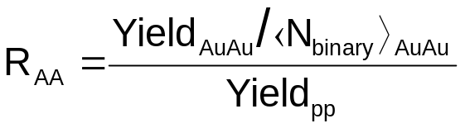
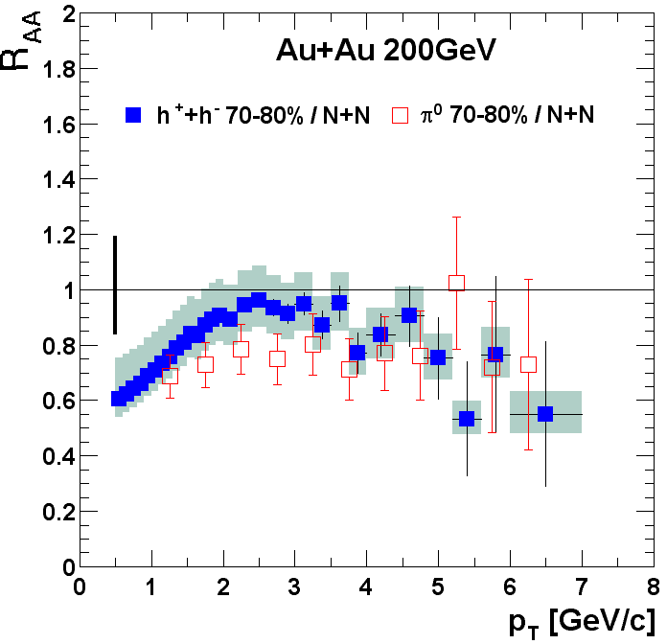
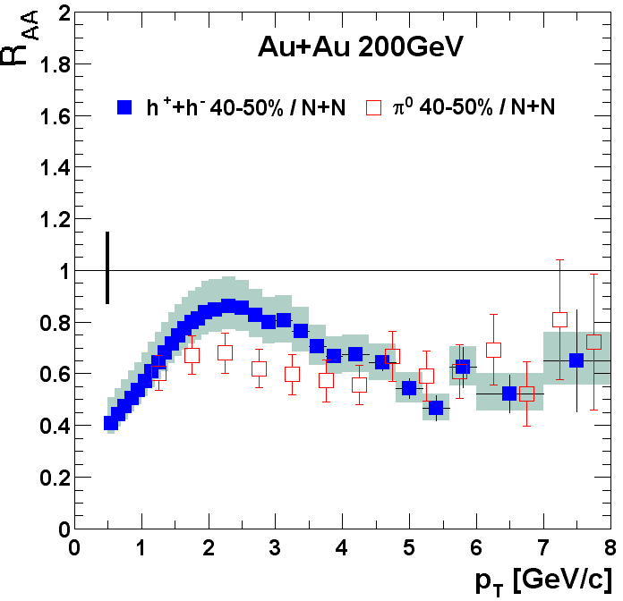
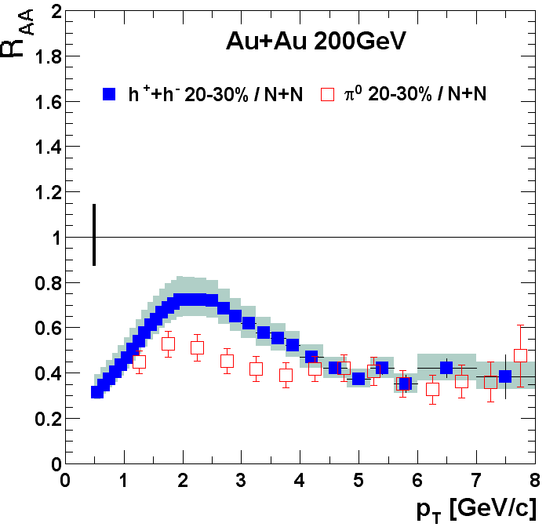
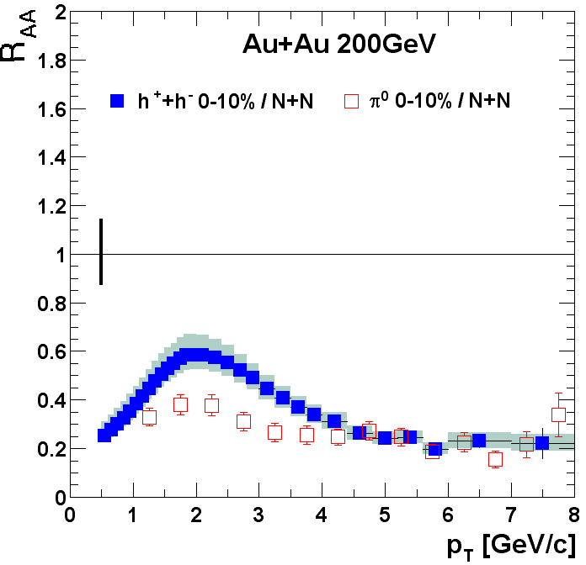
R_{AA} for π⁰ and charged hadron
PHENIX AuAu 200 GeV
π⁰ data: PRL 91 072301 (2003), nucl-ex/0304022.
charged hadron (preliminary) : NPA715, 769c (2003).

Slide 33
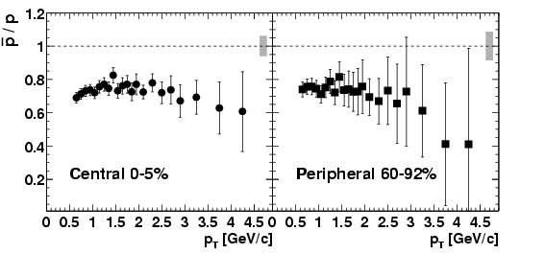
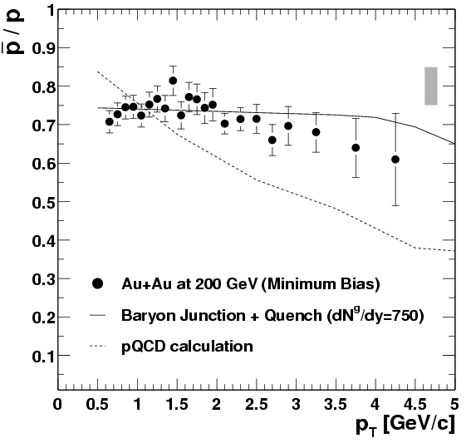
p/p ratio vs. p_{T}
Constant within the experimental errors
Baryon
Junction
Vitev, Gyulassy
NPA 715, 779c (2003)
Minimum bias
pQCD

Slide 34
