Slide 1
EO sampling technique for femtosecond beam characterization
Jinhao Ruan
A0 Photon Injector
Fermi lab

Slide 2
Outline
Motivation
Current EO Techniques and Limitation
  Principle
  Characteristics
  Current status and limitation
Our plan

Slide 3
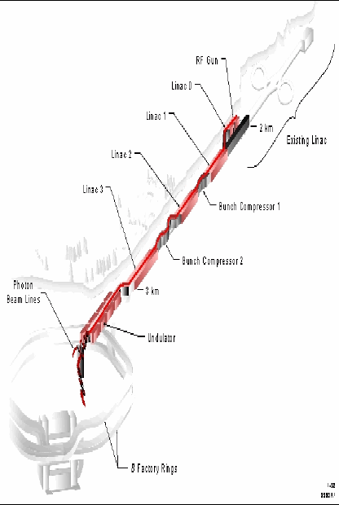
Motivation
Long Term goal:
Short Term goal:
LCLS: 200 fs FWHM @ 15 GeV
LUX: 30 fs FWHM @ 3 GeV
Bunch length @ A0 right now 4-5 ps (rms)
Emittance exchange experiment by Tim Koeth
Bunch length less than 1 ps (rms)
New Muon lab’s design will produce 300 µm bunch length (~ 1 ps rms)
ILC’s design may require 150 µm bunch length (~ 0.5 ps rms)

Slide 4
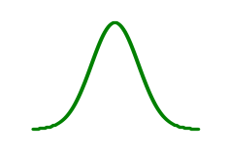
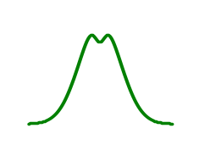
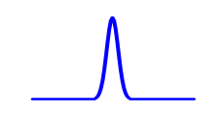
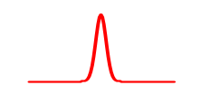
Principle of EOS
Pockel’s effect (ZnTe)
(001)
By detecting this phase shift we will know the electrical field
Z(110)
p
p
Probe laser
Scanning Delay sampling
Spectral decoding
Temporal decoding
Spatial decoding
P1
P2
e beam
By detecting the optical pulse we are hoping to get electron bunch information

Slide 5
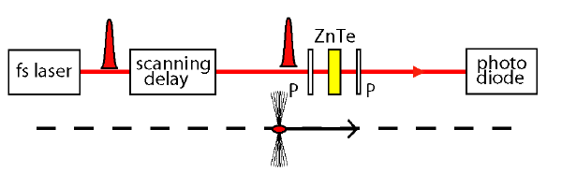
Scanning Delay (SD) sampling
The bunch profile is sampled by changing the delay between e-bunch and a femptosecond laser pulse
Commonly used in THz spectroscopy (pump probe)
Technically simple, highest resolution
M. J. Fitch et al PRL 87, 34801, 2001
J. Van Tilborg et al PRL 96, 14801, 2006

Slide 6
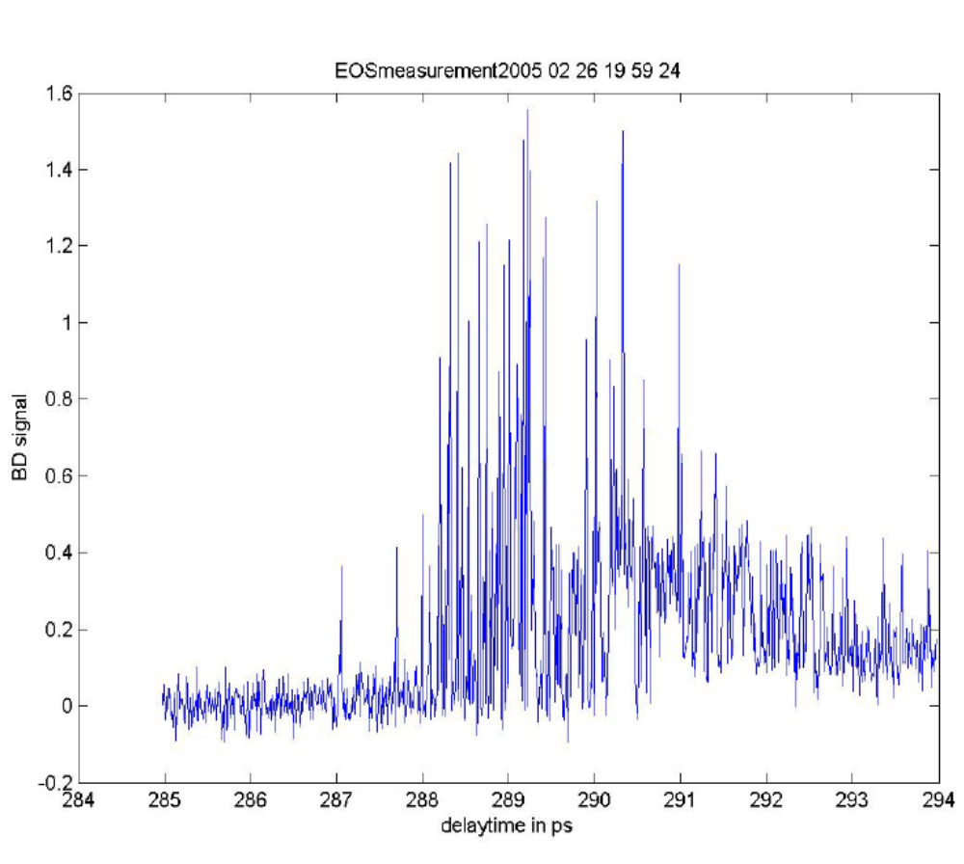
Scanning Delay (SD) sampling
No bunch length measurable due to jitter (energy jitter from bunch compressor, Laser synchronization etc)
In order to see the bunch structure the jitter between pump and probe must be very small
From G. Berden, DESY

Slide 7
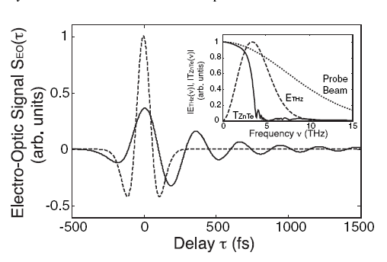
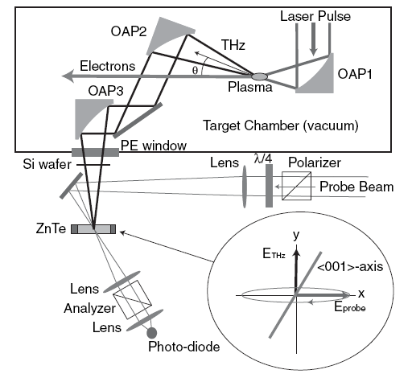
Scanning Delay sampling
Very recently J. Tilborg in LBNL is able to resolve a 50 fs electron bunch produced by laser acceleration.
J. Tilborg et al PRL 96, 14801, 2006

Slide 8
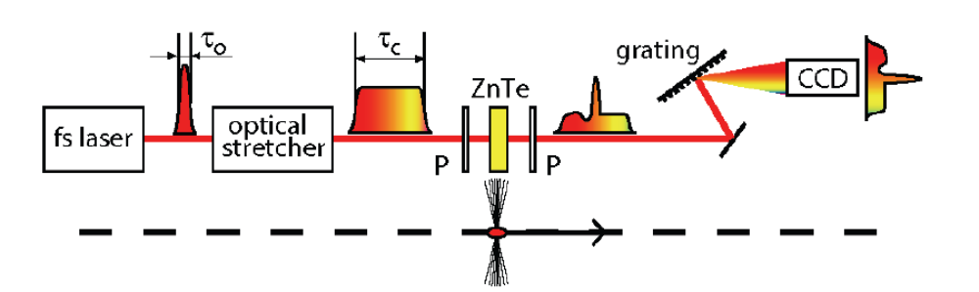
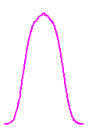
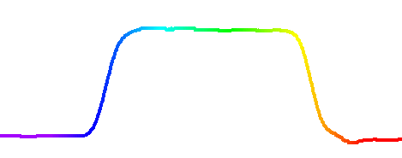
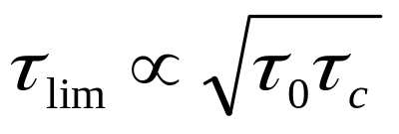
Spectral Decoding
Coulomb field
e⁻ bunch
Electron beam THz field
EO crystal
Chirped
probe pulse
~fs
t_{c}
t_{o} = unchirped pulse duration
The laser pulse is stretched spectrally (chirped), the longitudinal structure is therefore encoded in the spectrum
Single shot experiment
The instantaneous bandwidth of the chirped pulse needs to be sufficient to represent the e-bunch structure
I. Wilke et al PRL 88, 124801, 2002

Slide 9
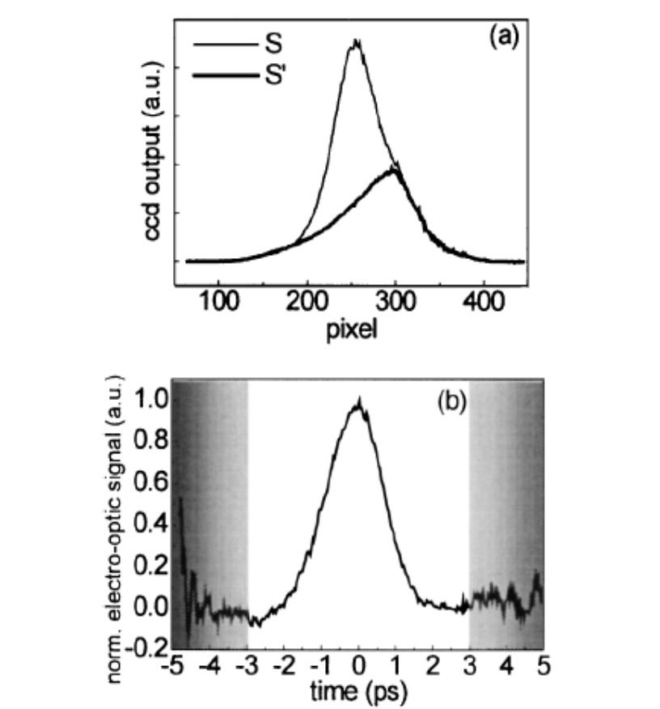
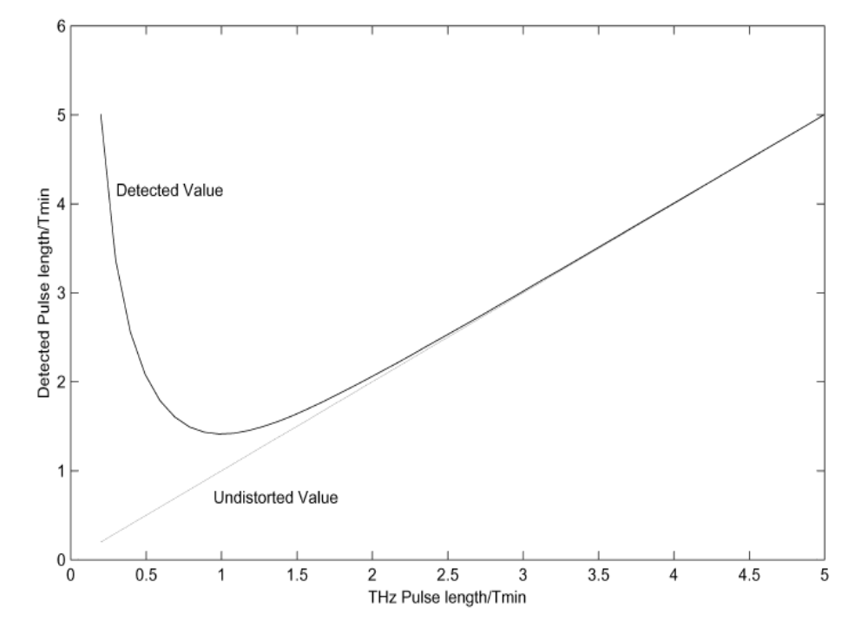
Spectral Decoding
I. Wilke et al PRL 88, 124801, 2002
J. Fletcher Optics Express 10, 1425, 2003
fundamental time resolution limit, T_{min} = √t_{o} t_{c}
e.g.#1 t_{o} = 30 fs, t_{c} = 20 ps, T_{min} = 770 fs
e.g.#2 t_{o} = 4 fs, t_{c} = 3 ps, T_{min} = 110 fs

Slide 10
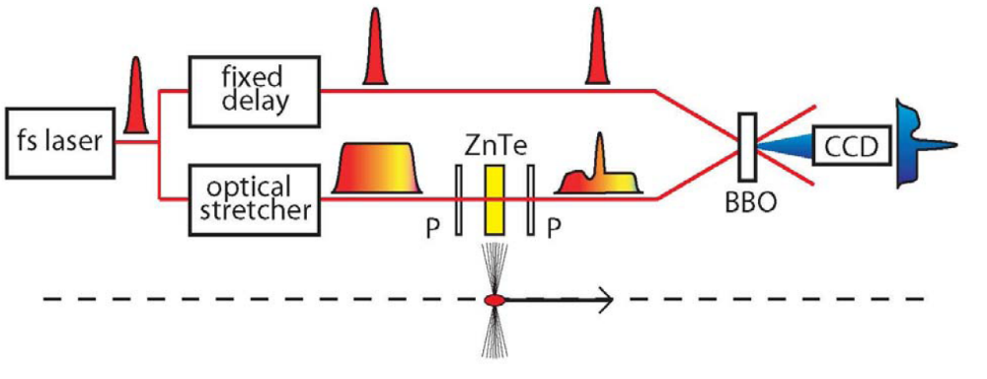
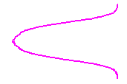
Temporal Decoding
~fs
The chirped laser pulse behind the EO crystal is measured by another short laser pulse using single shot cross correlation technique
1 mJ laser pulse energy necessary
CCD
Second-harmonic
generation crystal
Cross-correlated
beam
G. Berden et al PRL 93, 114802, 2002

Slide 11
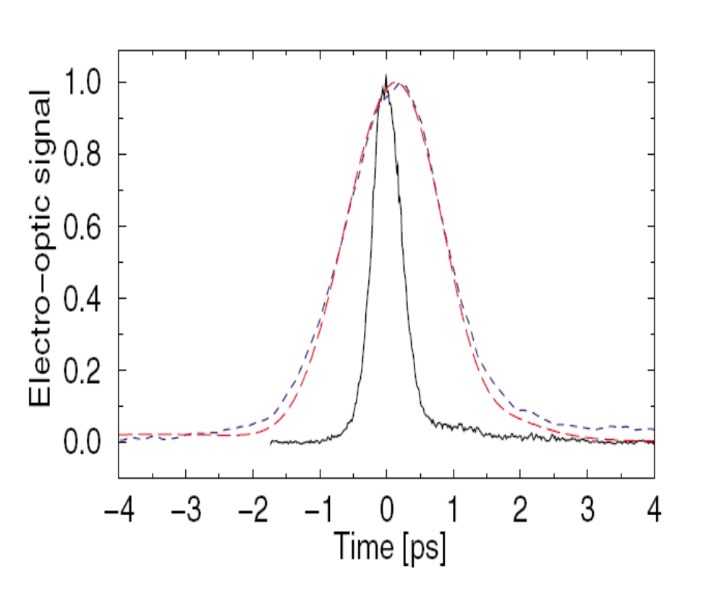
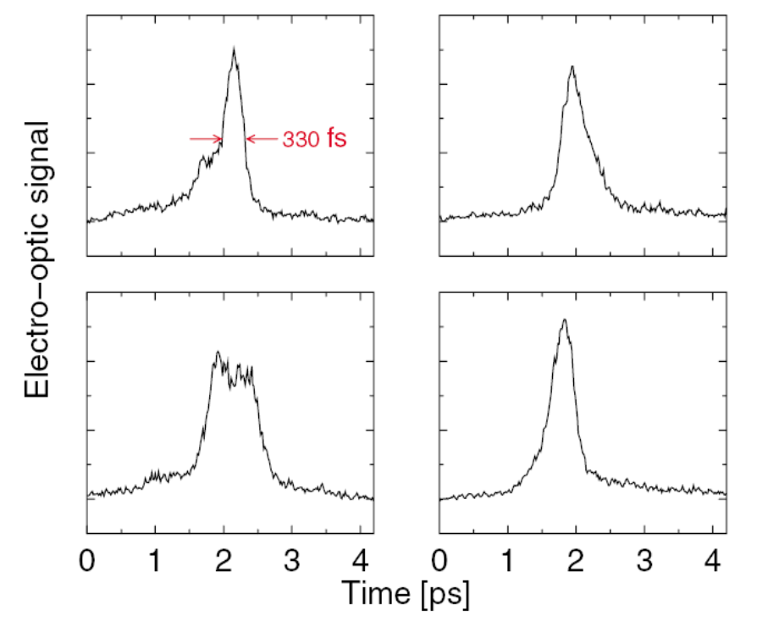
Temporal Decoding
Spectral decoding
temporal decoding
G. Berden et al PRL 93, 114802, 2004
FELIX, Holland

Slide 12
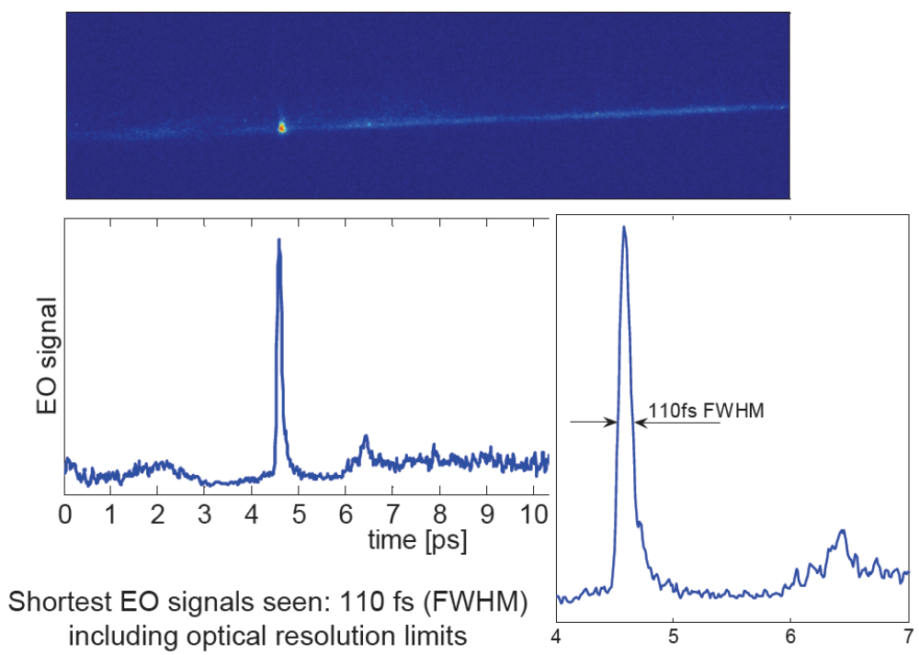
Temporal Decoding
DESY, Germany

Slide 13
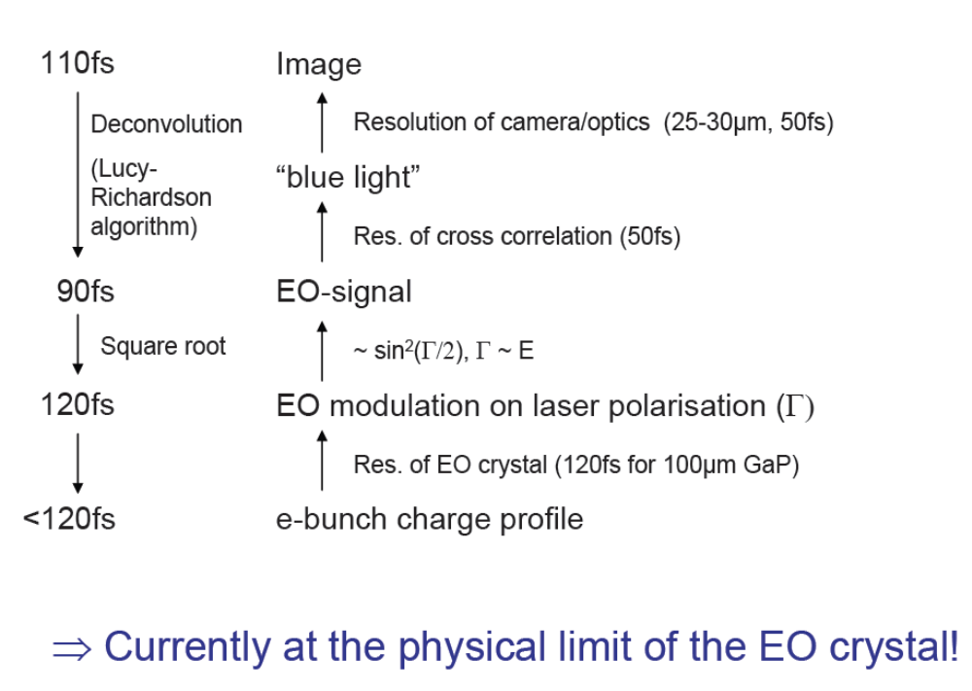
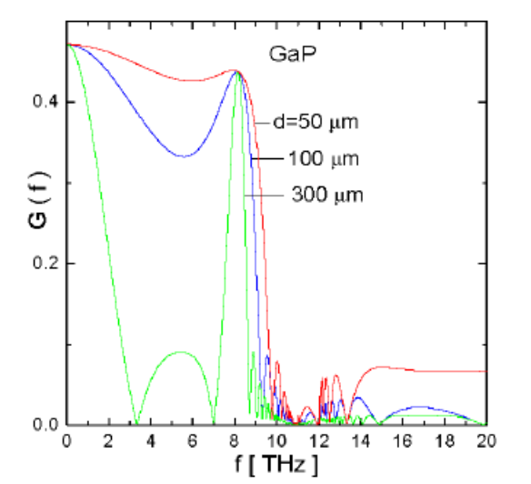
Temporal Decoding
From B. Steffen's talk at FLS’s workshop, DESY’s situation

Slide 14
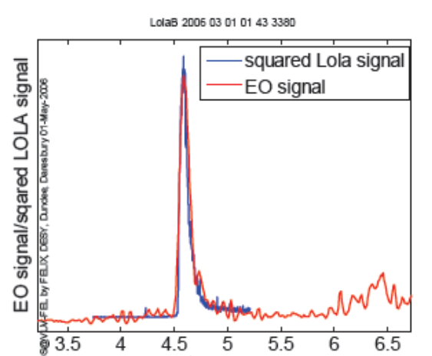
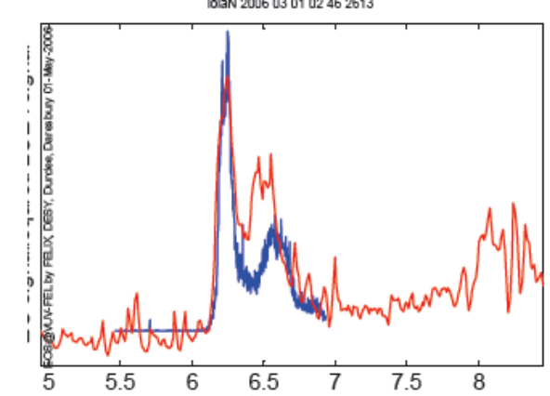
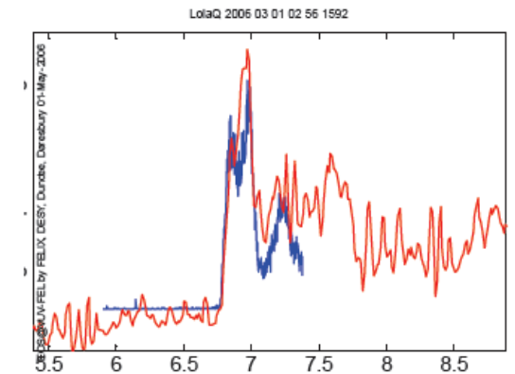
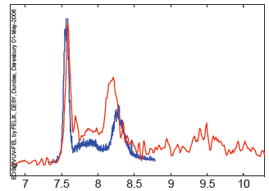
Temporal Decoding
EO at first bunch and LOLA at second bunch
Time (ps)
Time (ps)
Compressed
ACC 1° overcompression
Time (ps)
Time (ps)
ACC 2° overcompression
ACC 3° overcompression
Preliminary unpublished data by G. Steffen in DESY

Slide 15
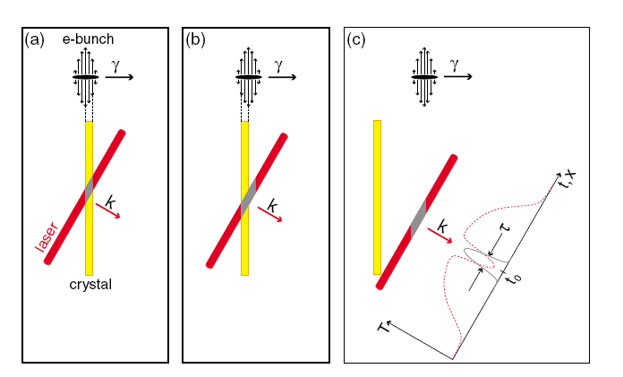
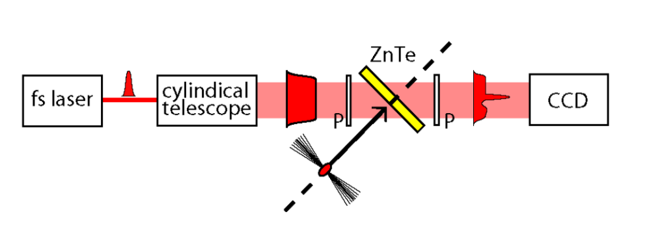
Spatial Decoding
The femtosecond laser pulse is focused as a line image to the crystal and passes the crystal at an angle
The bunch length is transferred to the spatial structure of the laser
A. J. Cavalieri et al PRL 94, 114801, 2002

Slide 16
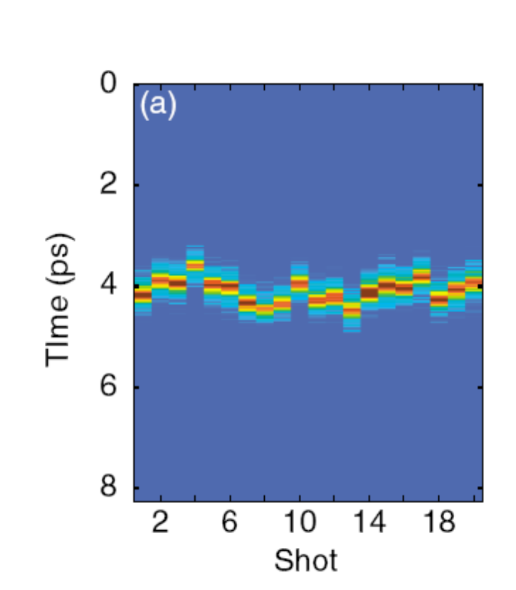
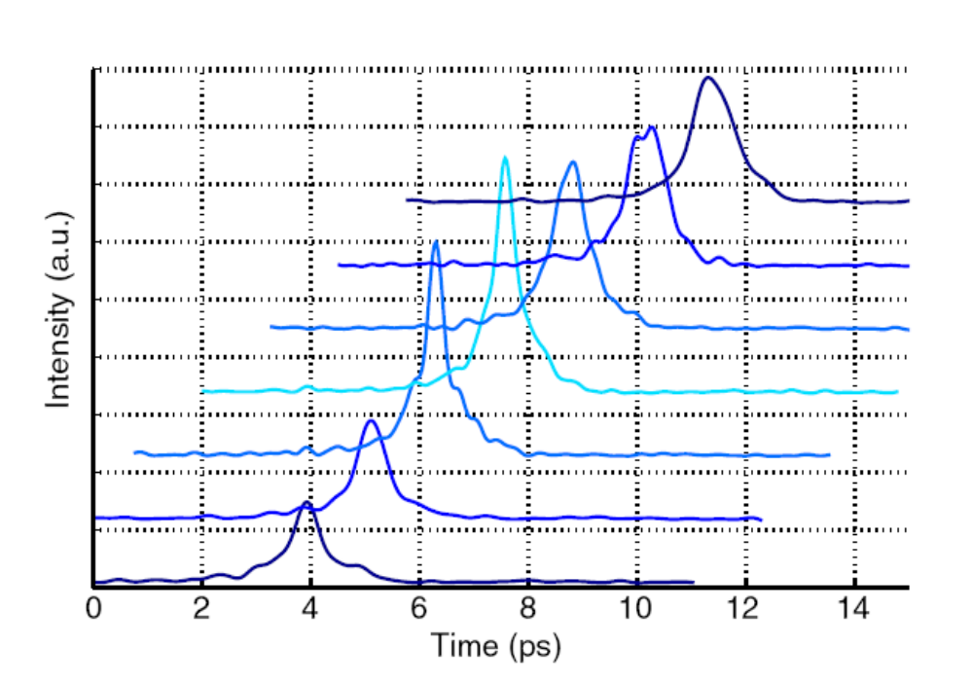
Spatial Decoding
A. J. Cavalieri et al PRL 94, 114801, 2002
SLAC, USA

Slide 17
Comparison
 | SD sampling | Spectral decoding | Temporal decoding | Spacial decoding
Pros | Simple laser system Arbitrary time windows High resolution | Simple laser system Single shot measurement High repetition rate | Large time window High resolution (110fs) Single shot measurement | Simple laser system Single shot measurement high resolution (160 fs) High repetition rate
Cons | No single shot measurement Very high requirement on Jitter between e-bunch and laser | Limited resolution (400 fs) Distorted signal for e-bunches < 200fs | Complex laser system (mJ laser pulse energy) Low repetition rate | More complex imaging optics Good for clocking but tough to get the e-bunch information

Slide 18
Current effort
 | Method | Laser source | Crystal used | Best resolution achieved
DESY, Germany | EO Sampling Spectral decoding Temporal decoding Spacial decoding | Ti:sapphire Amplified Ti:sapphire | ZnTe GaN | 110 fs
FELIX, Holland | EO Sampling Spectral decoding Temporal decoding | Ti:sapphire Amplified Ti:sapphire | ZnTe | 110 fs
SLAC | Spacial decoding | Ti:sapphire | ZnTe | 300 fs
BNL | Spectral decoding | Ti:sapphire | ZnTe | 730 fs
LBNL | EO Sampling | Ti:sapphire | ZnTe | 50 fs
ANL | EO Sampling Spectral decoding Temporal decoding | Ti:sapphire Amplified Ti:sapphire | ZnTe | No real e-bunch test yet. Off line Eo experiment ~ 280 fs
Fermi | EO Sampling | Nd:YAG glass | LiTaO₃ | Unable to resolve direct field

Slide 19
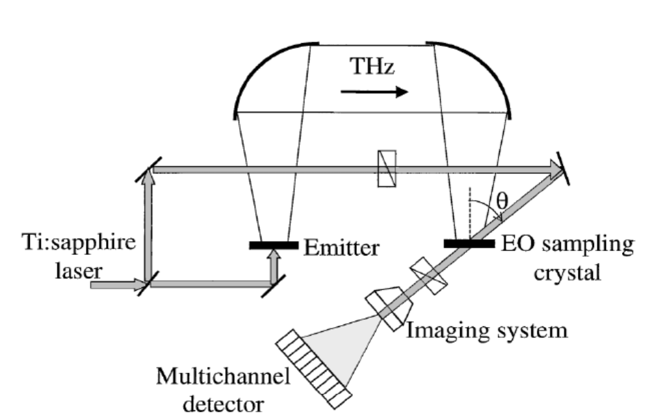
Our Plan
FNAL
Spatial Decoding setup
Jinhao Ruan (A0)
Jamie Santucci (A0)
Cheng-yan Tan (AD)
Vic Scarpine (Instrumentation)
Randy
Thurman-Keup (Instrumentation)
ANL
Yuelin Li (APS)
John Power (AWA)
NIU
P. Piot
Tim Maxwell
Initial off-line EO experiment setup

Slide 20
Our Plan
Stage | Plan | Time | How | Goal
1 | Background study; optical layout; Safety training | 1 month | Email communication | Everything ready for EO experiment
2 | Reproduce Dr. Li’s setup in AWA laser room | 2-3 month | At least 1 day per week in AWA | EO experiment successful done on laser induced THz signal
3 | Getting Ti-sa pulse into cave in AWA EO experiment on OTR signal EO experiment on e-beam (out side the Vac) | 2-3 month | 1 day per week in AWA | EO experiment done for e-beam outside the vacuum

Slide 21
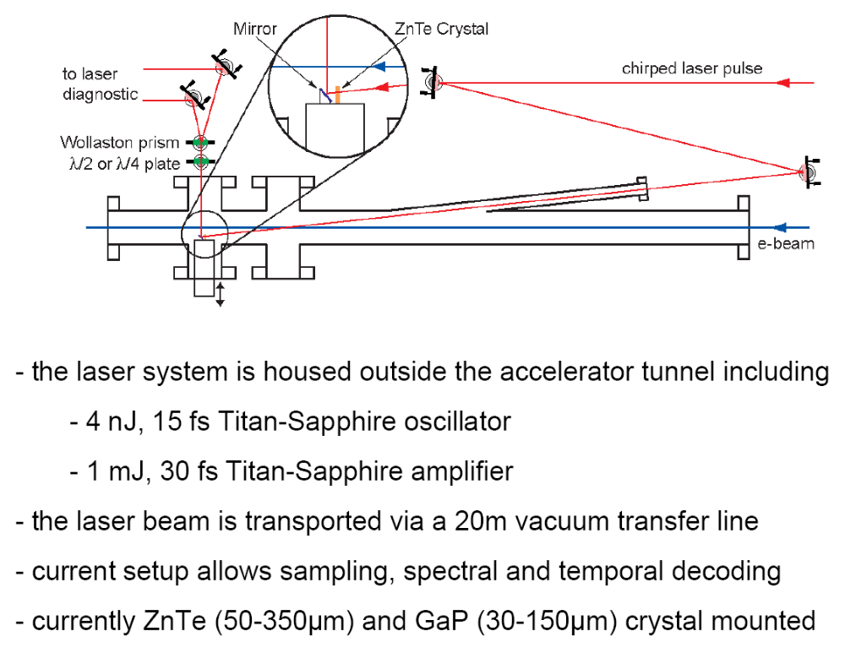
EO setup in DESY

