Slide 1
NIKHEF Hall probes performance
Paul Balm
Nov 15, 2000
Dutch Fist Meeting

Slide 2
Outline
The solenoid
  design and field
Hall probe system
  probe locations: where and why
  survey: where are they really?
  calibration
Performance testing
  Calibration: |B|
  Alignment
Conclusion

Slide 3

The D0 Solenoid
superconducting magnet, 2T field
2.7 m long, 60 cm radius, ~5 kAmps
field uniformity of 0.5% for tracks within the solenoid
muon steel (toroid) is used as return yoke
Manufactured by Toshiba, Yokohama, Japan - and don’t underestimate that…
Installed in DAB in 1997

Slide 4
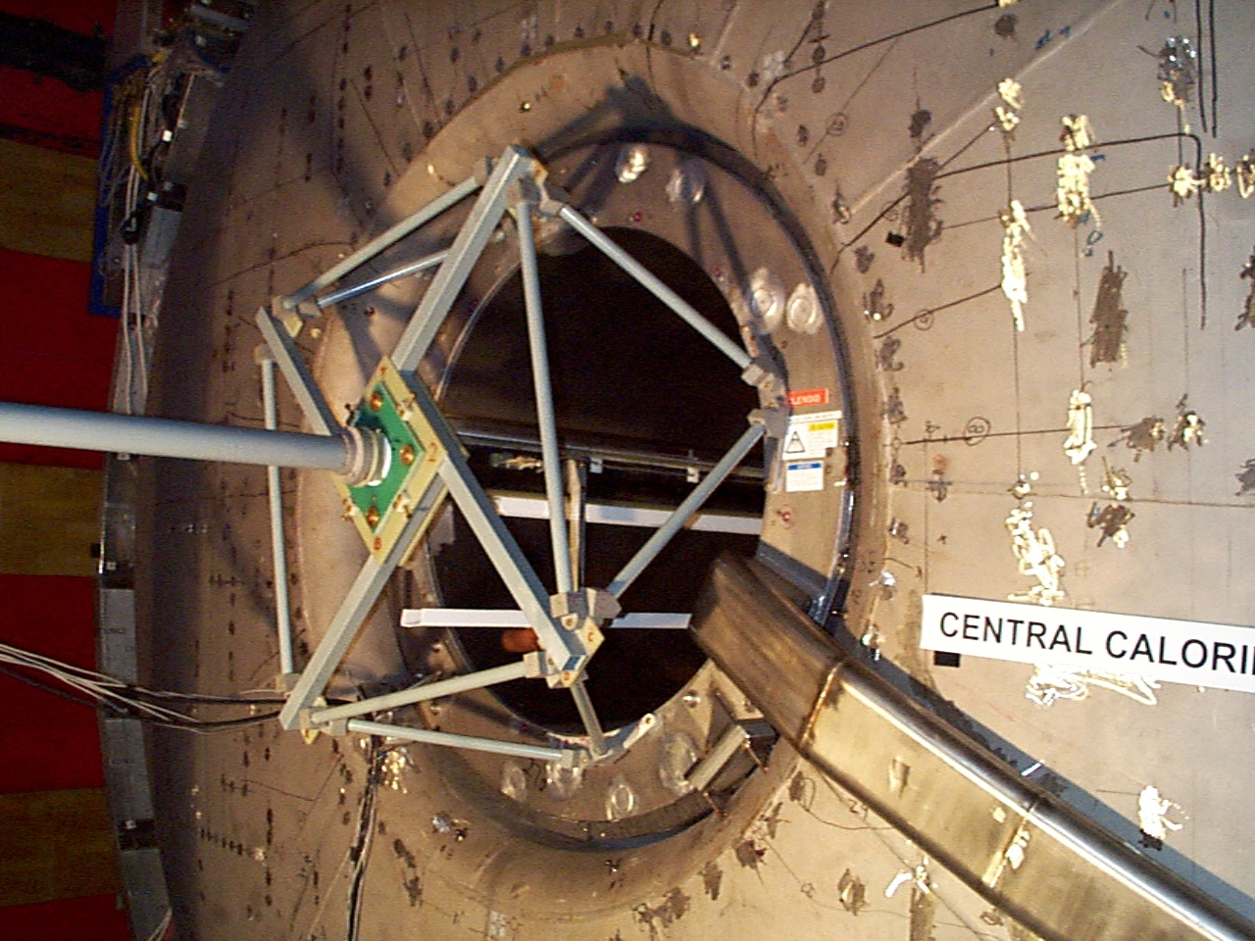

Slide 5
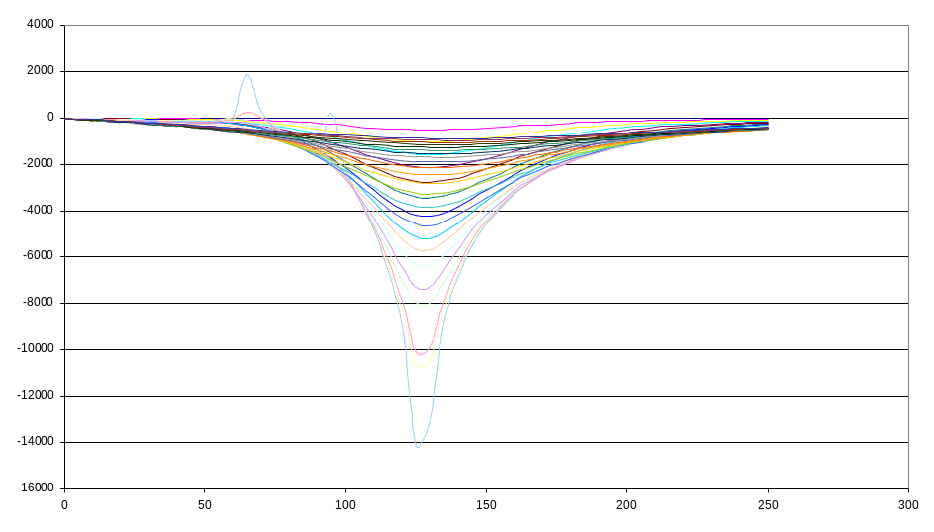
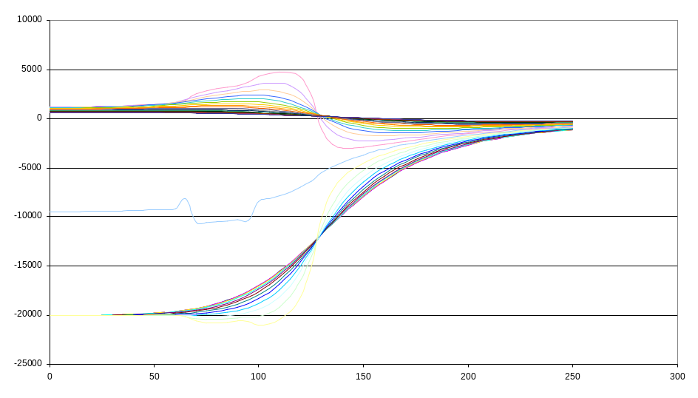
Solenoid design and field
Design focused on producing uniform field in the tracker volume (obviously…): Coils not evenly distributed
1T Br 0 T
2T Bz 0 T
z = 0
sol. ctr.
z = 130 cm
sol. edge
z = 0
sol. ctr.
z = 130 cm
sol. edge

Slide 6
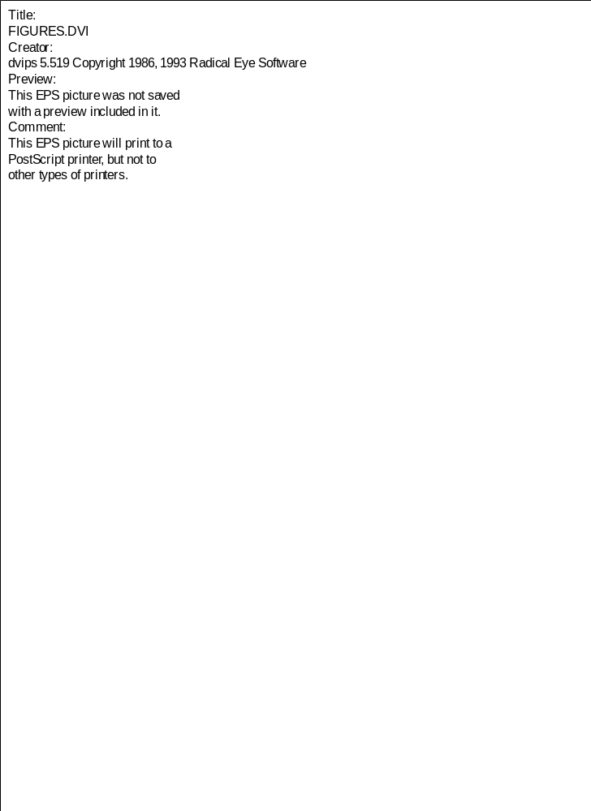
Hall probe locations
Each probe measures field in 3D plus temp.
Locations: measure
  centerfield, field at point of min. gradient, return field
Use “fieldmap” for precise field meas.
Use Hall probes for meas. of deviations
location of probes

Slide 7
Survey
survey: [verb] to determine and delineate the form, extent, and position of by taking linear and angular measurements and by applying the principles of geometry and trigonometry
VStar: A digital camera with a hard-drive and evaluation software
  Recognize “targets” in photos
  Determine (x,y,z) of each target with ~10 micron accuracy
At least three targets per surface, allows reconstruction of plane:
  top planes of probes on strips, tops and sides of mounting blocks
Figure out all orientations and positions

Slide 8
Calibration
Performed at CERN by Felix Bergsma
Each probe rotated in field
  field of 1.5 T
  temperature ~20 deg C
  Bx, By, Bz cross-terms accounted for
Output is calibration routine and a set of calibration constants

Slide 9
Performance plots
plots of |B|
  not using survey data - positions taken at average radius and nominal z
plots of components
  survey data used, positions accurate to the order of microns
  some assumptions in interpretation of survey data - I have attempted to plot these as well\
They are on the web:
http://www-d0.fnal.gov/~balm/hallprobes/tests

Slide 10
Conclusion
Hall probe data credible
  more study may prove interesting
Installation is complete
  apart from one cable into MCH
  we’re still not sure where to go with our data…
Documentation is mandatory (D0 note)
  quite extensive webpages already exist:
  http://www-d0.fnal.gov/~balm/hallprobes
  this talk in on there too

