Slide 1

BNL, April 22, 2008
Hydrodynamical behaviour in heavy ion collisions within parton cascade calculations
Zhe Xu
with A. El, O. Fochler, C. Greiner and H. Stöcker

Slide 2
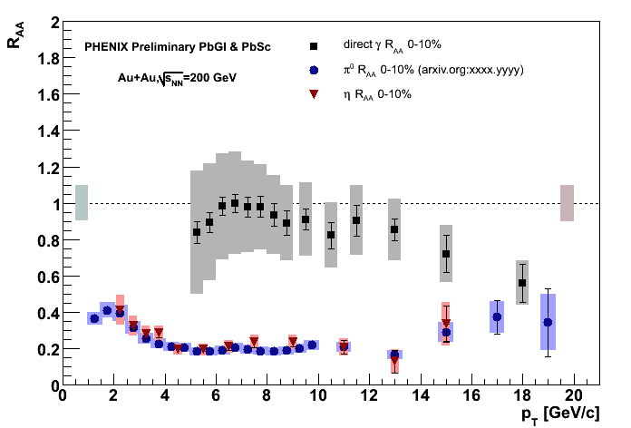
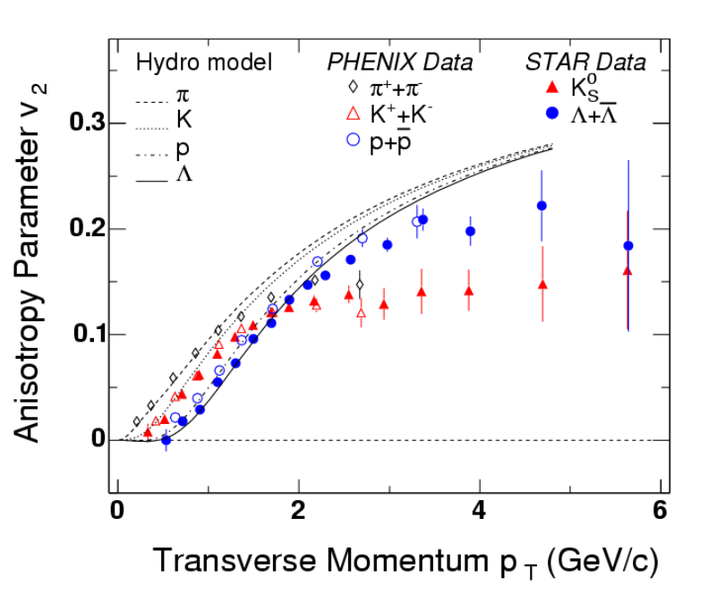
Three body effects in parton cascades!
Fast Thermalization from QCD: 3-2 important
Equilibr. time: short in 2-3
Elliptic flow v₂: high in 2-3
Viscosity: small ~ 0.08
Hard probe: R_{AA} ~ 0.1
collisional 2-2 vs. radiational 2-3 energy loss
P.Huovinen et al., PLB 503, 58 (2001)

Slide 3
BAMPS: Boltzmann Approach of MultiParton Scatterings
A transport algorithm solving the Boltzmann-Equations for on-shell partons with pQCD interactions
(Z)MPC, VNI/BMS, AMPT
new development ggg gg
Elastic scatterings are ineffective in thermalization !
Inelastic interactions are needed !
Xiong, Shuryak, PRC 49, 2203 (1994)
Dumitru, Gyulassy, PLB 494, 215 (2000)
Serreau, Schiff, JHEP 0111, 039 (2001)
Baier, Mueller, Schiff, Son, PLB 502, 51 (2001)

Slide 4
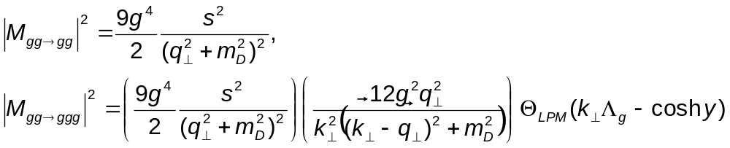
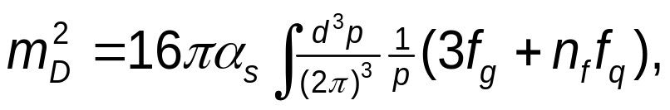
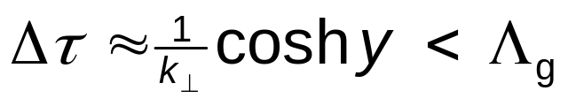
screened partonic interactions in leading order pQCD
J.F.Gunion, G.F.Bertsch, PRD 25, 746(1982)
T.S.Biro at el., PRC 48, 1275 (1993)
S.M.Wong, NPA 607, 442 (1996)
screening mass:
LPM suppression: the formation time
Λ_{g}: mean free path

Slide 5
Results from the simulations

Slide 6
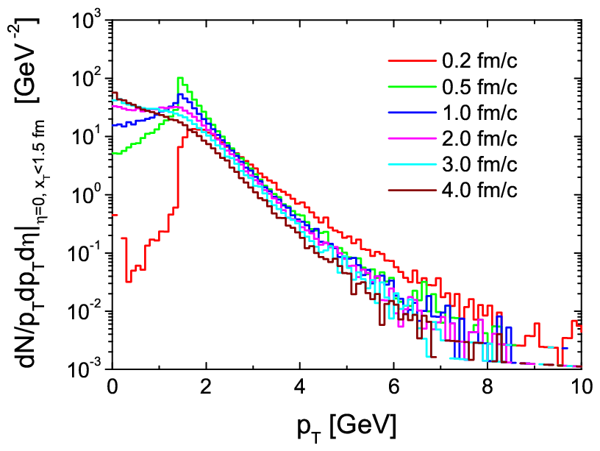
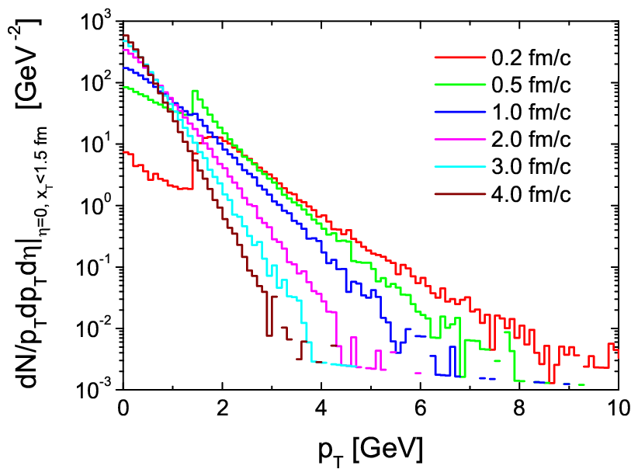
p_{T} spectra
at collision center: x_{T}<1.5 fm, Δz < 0.4 t fm of a central Au+Au at s^{1/2}=200 GeV
Initial conditions: minijets p_{T}>1.4 GeV; coupling α_{s}=0.3
simulation pQCD, only 2-2
simulation pQCD 2-2 + 2-3 + 3-2
3-2 + 2-3: thermalization!
Hydrodynamic behavior!
2-2: NO thermalization

Slide 7
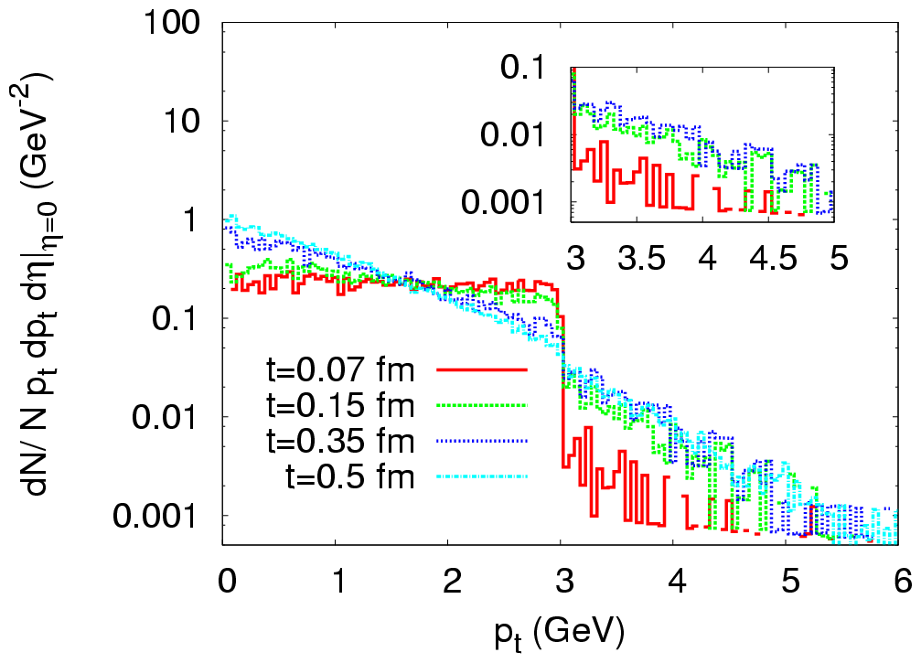
p_{T} spectra
Initial conditions: Color Glass Condensate Q_{s}=3 GeV; coupling α_{s}=0.3
A,El, ZX and C.Greiner, arXiv: 0712.3734 [hep-ph], published in NPA
ggg gg !
This 3-2 is missing in
the Bottom-Up scenario
(Baier et al.).

Slide 8
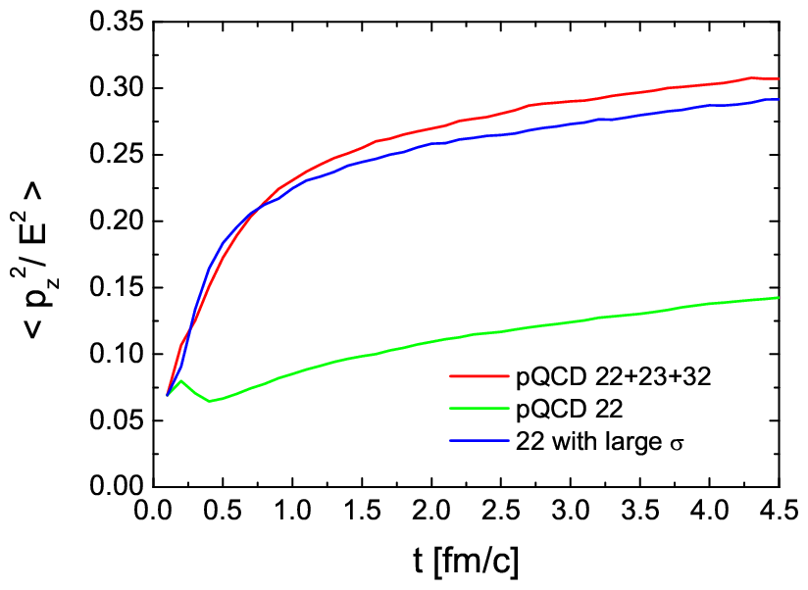

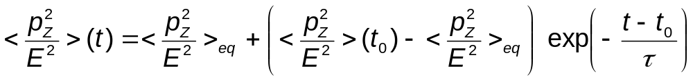
time scale of thermalization
Theoretical Result !
τ = time scale of kinetic equilibration.

Slide 9
What determines
the equilibration time scale τ ?

Slide 10
screened partonic interactions in leading order pQCD
J.F.Gunion, G.F.Bertsch, PRD 25, 746(1982)
T.S.Biro at el., PRC 48, 1275 (1993)
S.M.Wong, NPA 607, 442 (1996)
screening mass:
LPM suppression: the formation time
Λ_{g}: mean free path

Slide 11
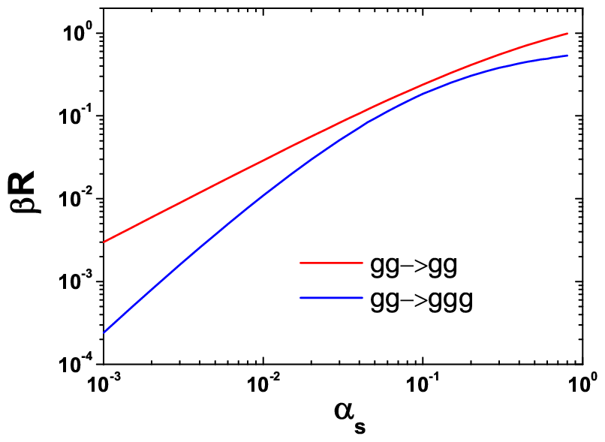
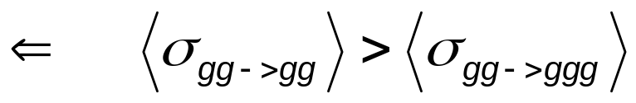
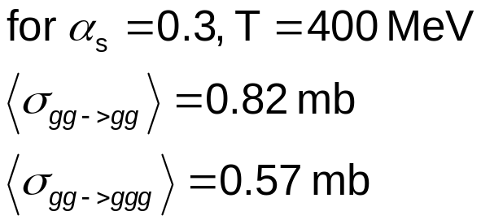
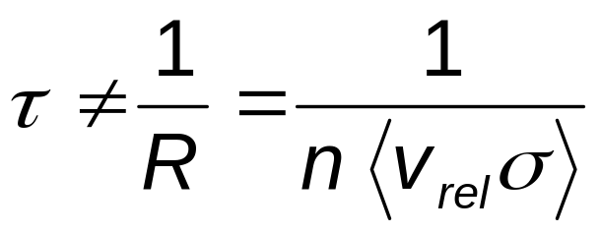
Cross section does not determine τ!

Slide 12
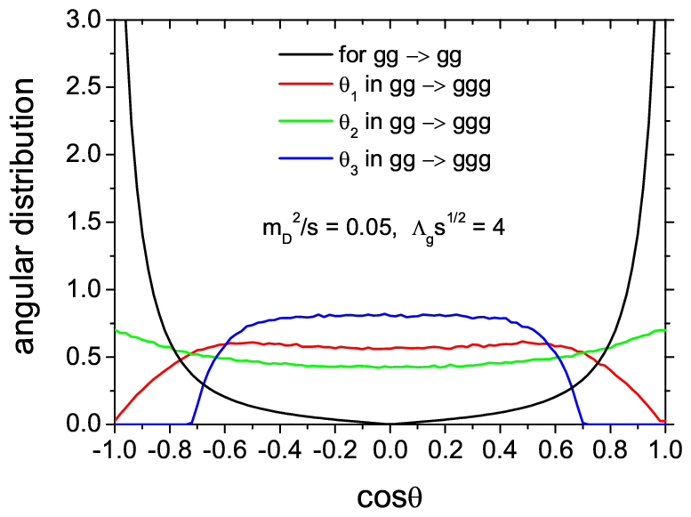
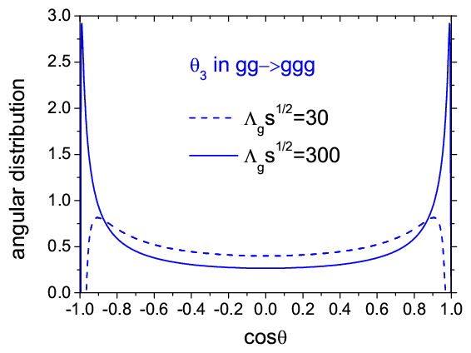
distribution of collision angles
at RHIC energies
gg gg: small-angle scatterings
gg ggg: large-angle bremsstrahlung

Slide 13
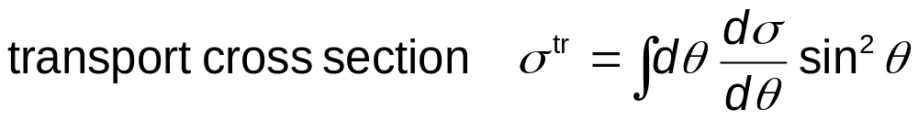
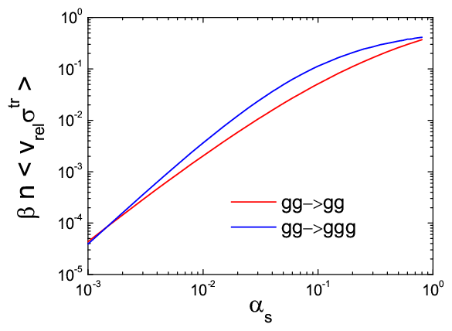
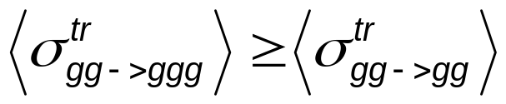
BUT, this is not the full story !

Slide 14
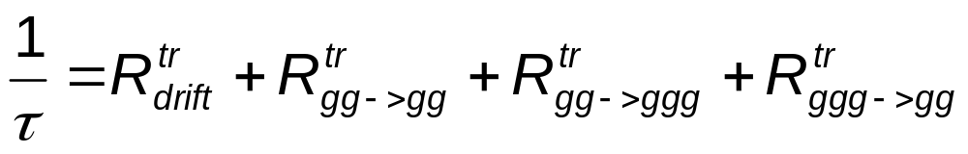
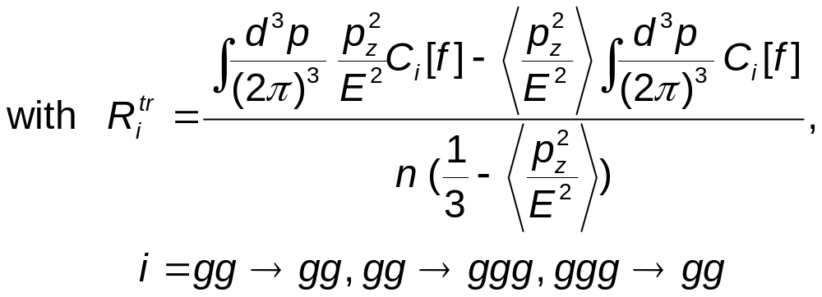
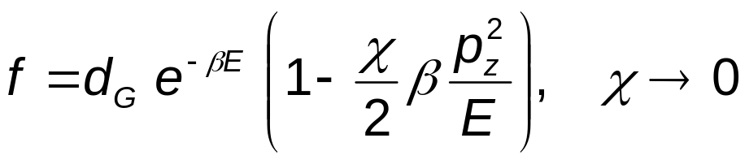
Transport Rates
ZX and C. Greiner, PRC 76, 024911 (2007)
Transport rate is the correct quantity describing kinetic
equilibration.
Transport collision rates have an indirect relationship
to the collision-angle distribution.
assume

Slide 15
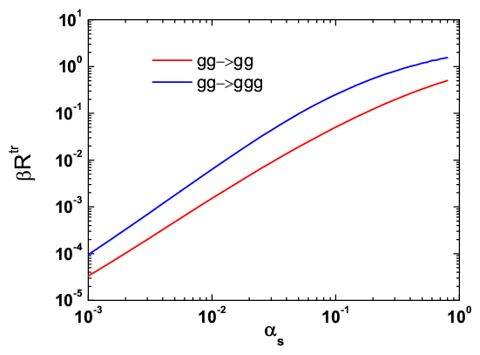
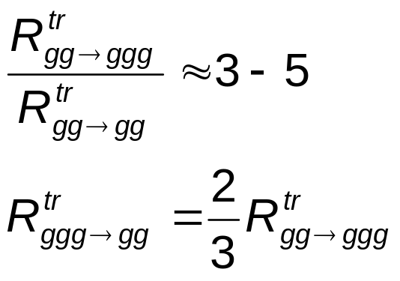
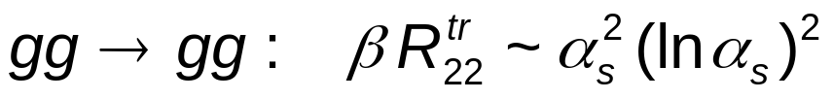
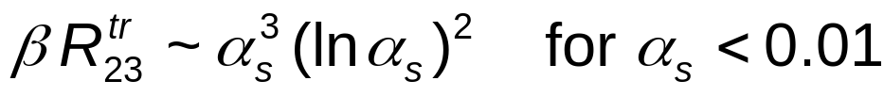
Transport Rates
Large Effect of gg->ggg !

Slide 16
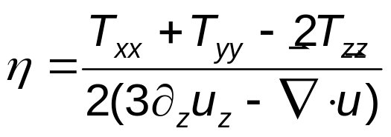
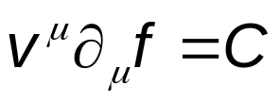
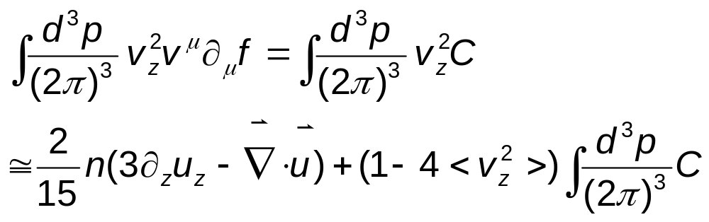
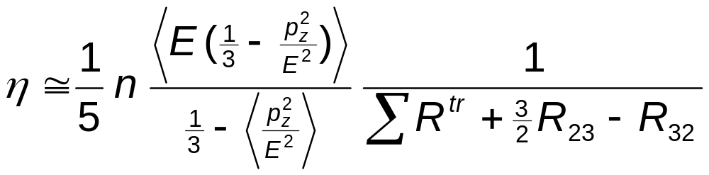
Shear Viscosity η
From Navier-Stokes approximation
From Boltzmann-Eq.
relation between η and R^{tr}

Slide 17
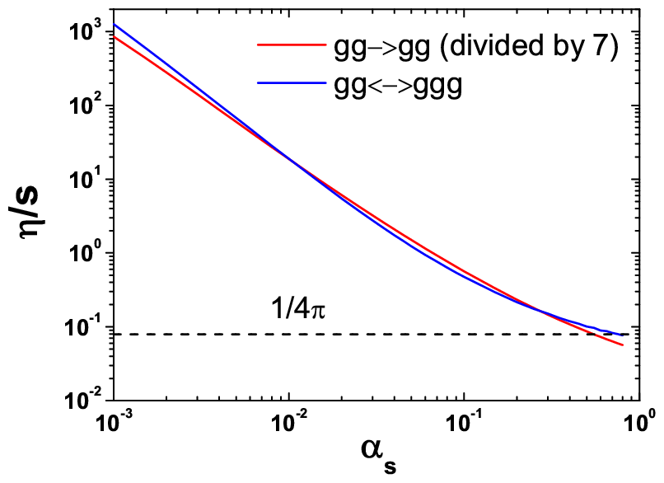
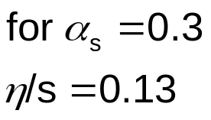
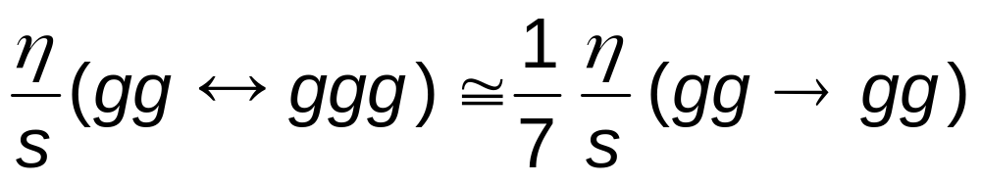
Ratio of shear viscosity to entropy density in 2-3
AdS/CFT
RHIC
ZX and C.Greiner, arXiv: 0710.5719 [nucl-th], to be published in PRL.

Slide 18
Hydrodynamical behavior within
the parton cascade
transverse energy
elliptic flow
shear viscosity

Slide 19
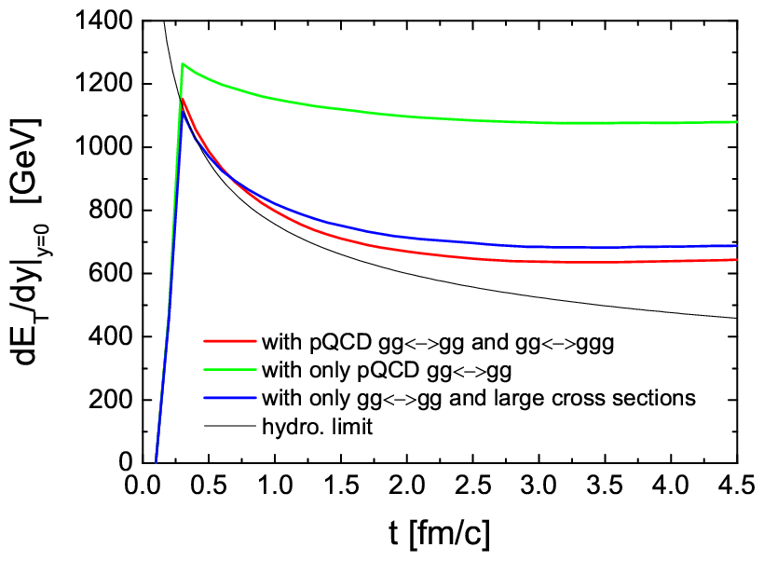
total transverse energy per rapidity at midrapidity y=0

Slide 20
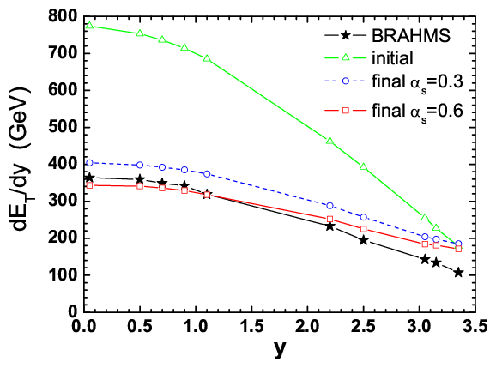
Rapidity dependence of total transverse energy

Slide 21
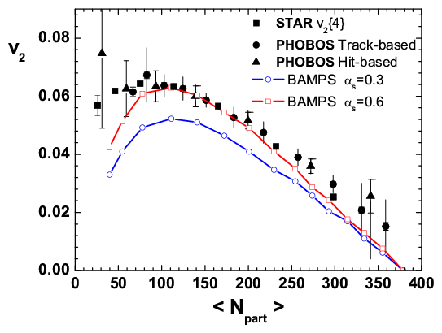
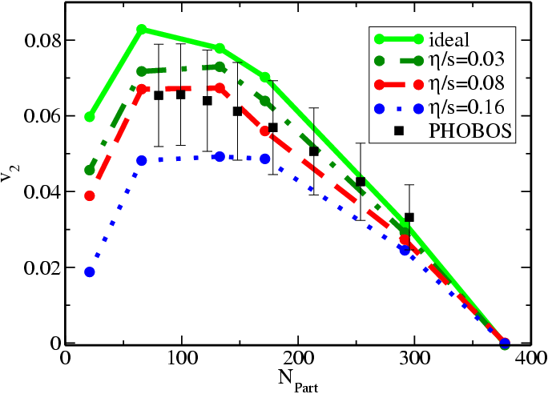
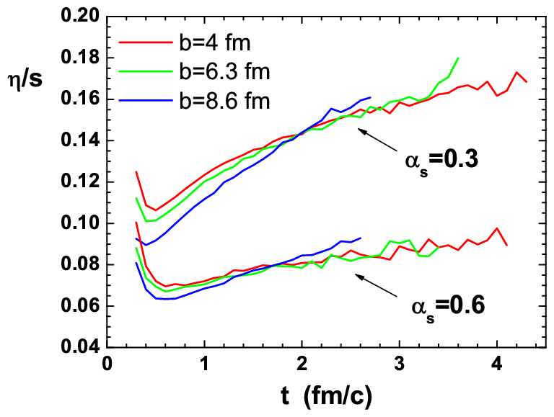
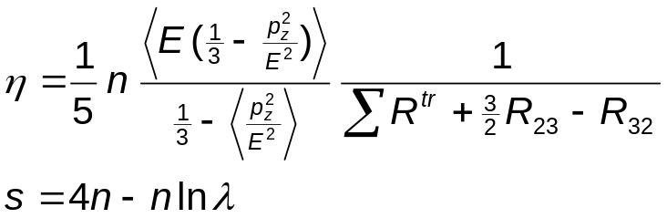
Elliptic Flow and Shear Viscosity in 2-3 at RHIC
2-3 Parton cascade BAMPS
ZX, Greiner, Stöcker, arXiv: 0711.0961 [nucl-th]
viscous hydro.
Romatschke, PRL 99, 172301,2007
η/s at RHIC > 0.08

Slide 22
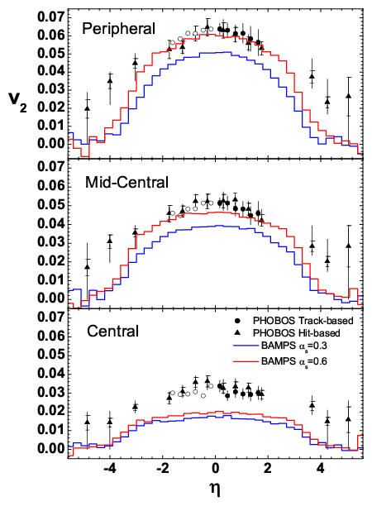
Rapidity Dependence of v₂: Importance of 2-3! BAMPS ZX,G,S
see also:
L.W.Chen, et al., PLB 605, 95 (2005)
C.Nonaka, et al., JPG 31, 429 (2005)
T.Hirano, et al., PLB 636, 299 (2006)
J.Bleibel, et al., PRC 76, 024912 (2007);
PLB 659, 520 (2008)
Hama, et al., arXiv: 0711.4544 [hep-ph]
A.K.Chaudhuri, arXiv: 0801.3180

Slide 23
Hard probe
jet quenching

Slide 24
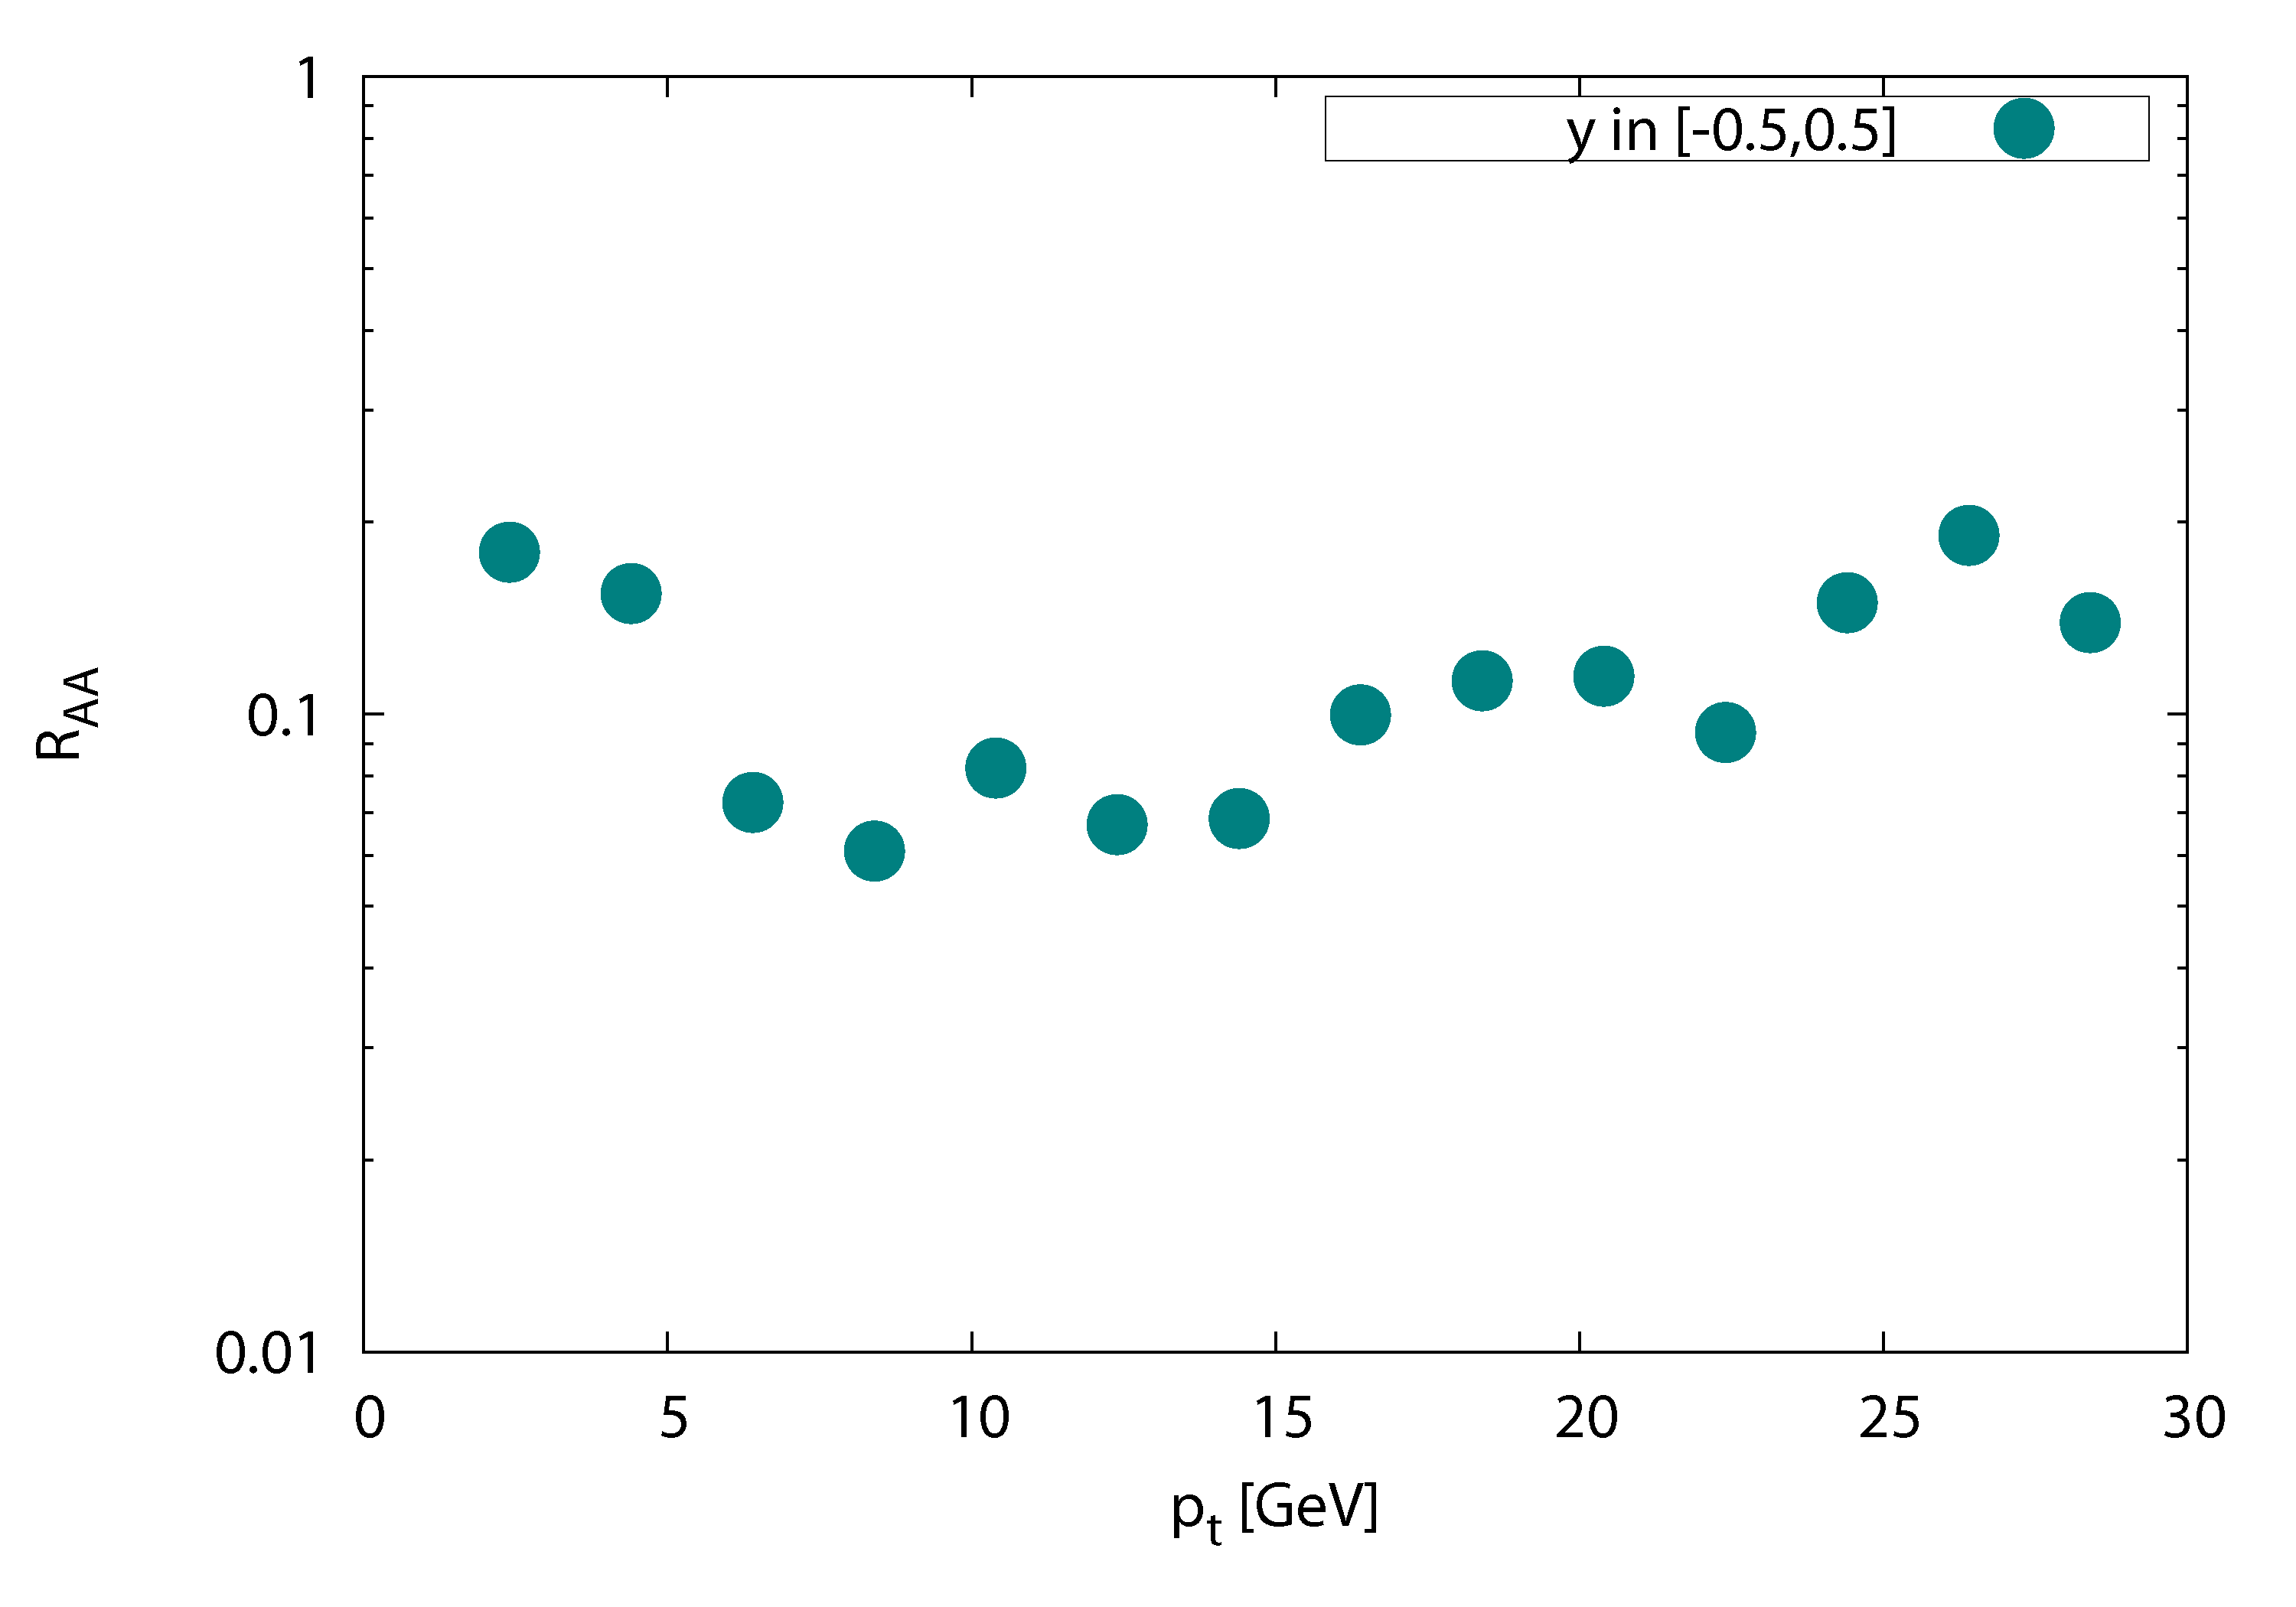

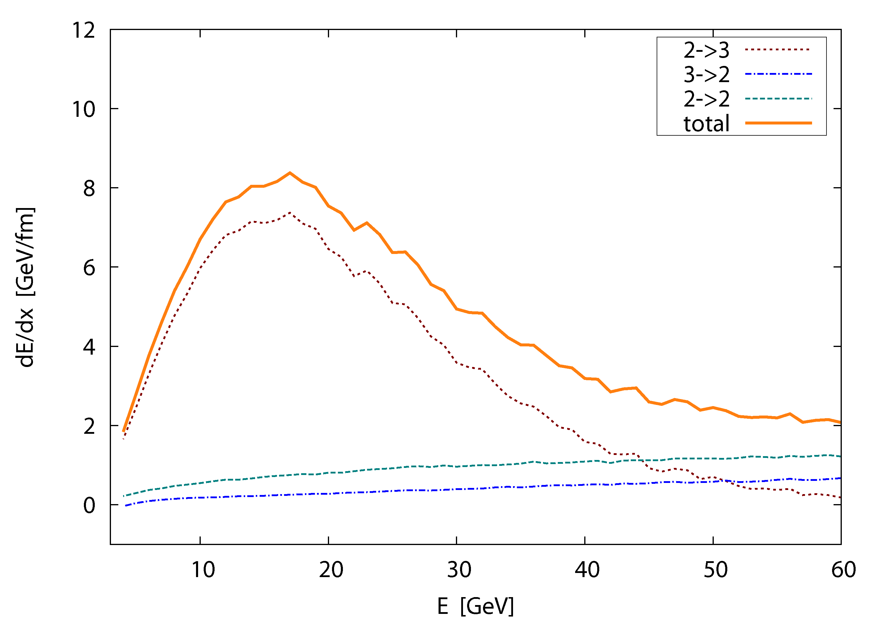
first realistic 3d results on jet-quenching with BAMPS
nuclear modification factor
central (b=0 fm) Au-Au at 200 AGeV
R_{AA} ~ 0.1
cf. S. Wicks et al.
Nucl.Phys.A784, 426
O. Fochler
2-3
dE/dx, static medium (T = 400 MeV)
2-2

Slide 25
Summary
Inelastic pQCD interactions (23 + 32) explain:
Fast Thermalization
Large Collective Flow
Small shear Viscosity of QCD matter at RHIC
Part of energy loss (for very high energy parton collisional energy loss due to 2-2 dominates.)
Initial conditions, hadronization and afterburning determine
how imperfect the QGP at RHIC & LHC can be.

Slide 26
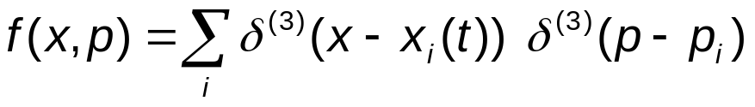
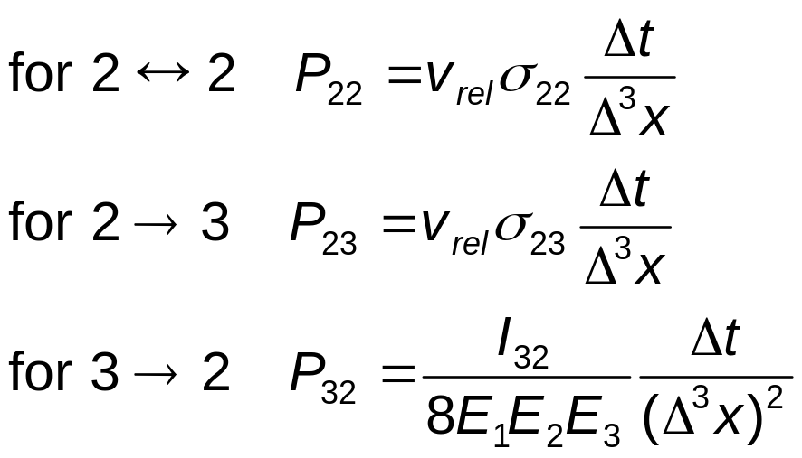
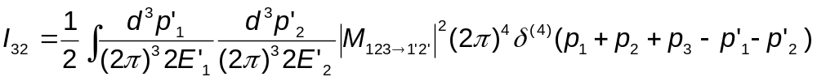
Stochastic algorithm
Z. Xu and C. Greiner, PRC 71, 064901 (2005)
cell configuration in space
for particles in Δ³x with momentum p₁,p₂,p₃ ...
Δ³x
interaction probability:

Slide 27
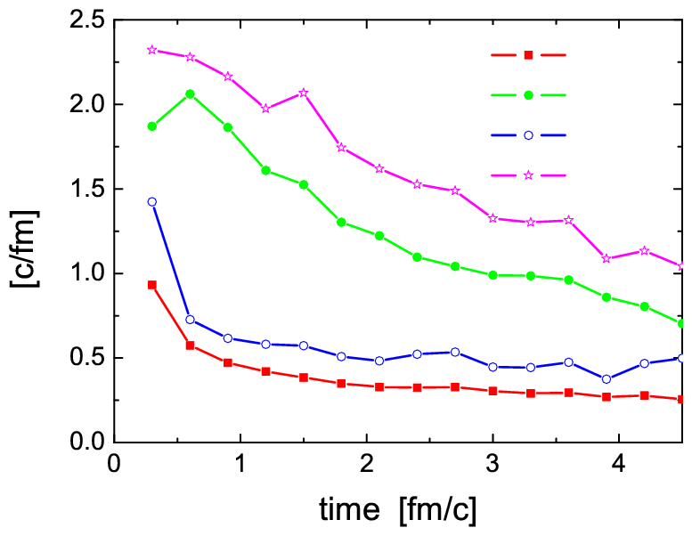
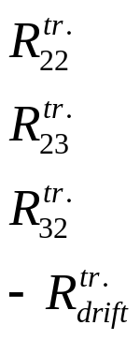
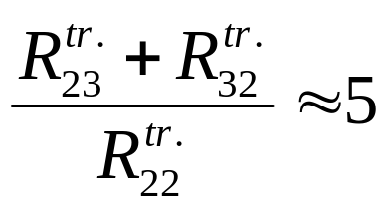
The drift term is large.
gg<−>ggg interactions are essential for kinetic equilibration!

Slide 28
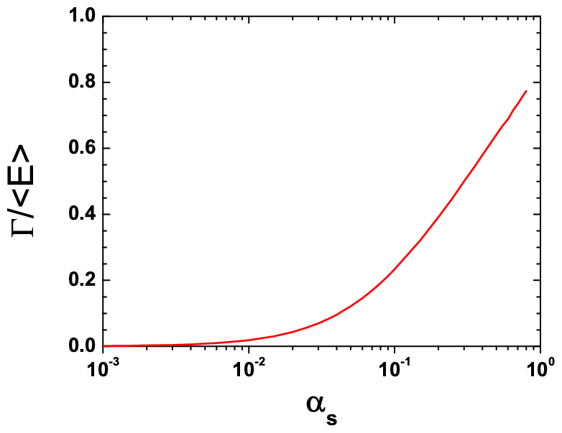

Slide 29
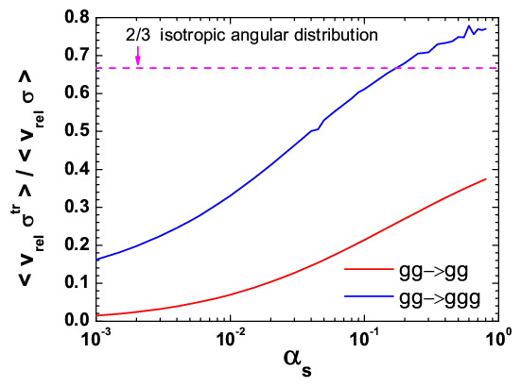

Slide 30


transverse flow velocity of local cell in the
transverse plane of central rapidity bin
Au+Au b=8.6 fm
using BAMPS
=c

Slide 31


Slide 32
Outlook
Collective Flow v₂,v₄,v₆ (Zhe Xu)
Jet Quenching (Oliver Fochler)
Mach Cone (Ioannis Bouras)
Dependence on initial conditions (Luan Cheng)
Transport coefficients (Felix Reining)
Parton Cascade vs. Viscous Hydrodynamics (Andrej El)
Hadronization and afterburning (Petersen, Burau, Xu)
HBT
Ridge
Quarks, Heavy Quarks, Direct Photon
Entropy production
LHC predictions
Many body interactions: 3 −> 3, 2 <−> 4, ...
Including fields, coherent effects (Björn Schenke, Xu)

Slide 33



Hard probes of the medium
high energy particles are promising probes of the medium created in AA-collisions
nuclear modification factor
relative to pp (binary collision scaling)
experiments show approx. factor 5 of suppression in hadron yields
QM 2008, T. Awes

Slide 34



due to the fact that a 2->3 process brings one more particle
toward isotropy than a gg->gg process.

Slide 35


Thermalization driven by plasma instabilities
Refs.:
Mrowczynski;
Arnold, Lenaghan, Moore, Yaffe;
Rebhan, Romatschke, Strickland;
Bödeker, Rummukainen;
Dumitru, Nara;
Berges, Scheffler, Sexty.
Dumitru, Nara, Strickland, PRD 75, 025016 (2007)
Dumitru, Nara, Schenke, Strickland, arXiv:0710.1223

Slide 36
QCD thermalization using
parton cascade
VNI/BMS: K.Geiger and B.Müller, NPB 369, 600 (1992)
S.A.Bass, B.Müller and D.K.Srivastava, PLB 551, 277(2003)
ZPC: B. Zhang, Comput. Phys.Commun. 109, 193 (1998)
MPC: D.Molnar and M.Gyulassy, PRC 62, 054907 (2000)
AMPT: B. Zhang, C.M. Ko, B.A. Li, and Z.W. Lin, PRC 61, 067901 (2000)
BAMPS: Z. Xu and C. Greiner, PRC 71, 064901 (2005); 76, 024911 (2007)

Slide 37




Stochastic algorithm
P.Danielewicz, G.F.Bertsch, Nucl. Phys. A 533, 712(1991)
A.Lang et al., J. Comp. Phys. 106, 391(1993)
collision rate per unit phase space for incoming particles
p₁ and p₂ with Δ³p₁ and Δ³p₂:
Δ³x
collision probability (Monte Carlo)

Slide 38



Initial conditions in heavy ion collisions
Glauber-type: Woods-Saxon profile, binary nucleon-nucleon collision
minijets production with p_{t} > p₀
for a central Au+Au collision at RHIC
at 200 AGeV using p₀=1.4 GeV

