Slide 1

Director’s Report to the
National Advisory Council
on Drug Abuse
May 20, 2004

Slide 2
Director’s Report to the
National Advisory Council on Drug Abuse
What’s New at NIH?
Budget Update
NIDA Program Reviews
Recent NIDA Activities

Slide 3
What’s New at NIH?

Slide 4

Update on
NIH ROADMAP Activities

Slide 5
What Has NIDA Done to Ensure Participation
of Substance Abuse Researchers
on the NIH Roadmap?
Dr. Condon named NIDA’s representative for
the Roadmap
Program officers have contacted potential grantees to
encourage them to submit grants for Roadmap RFAs
To date, ~ 44 NIDA researchers have applied
for Roadmap funds
Created a page on NIDA website that highlights
opportunities from the roadmap relevant to NIDA
Periodic staff meetings with NIDA Director to review
progress and plan strategies
~

Slide 6
Report of the
National Institutes of Health
Blue Ribbon Panel on Conflict of Interest Policies
A Working Group of the Advisory Committee to the Director
National Institutes of Health

Slide 7
Budget Update

Slide 8
NIDA BUDGET
(Thousands)
2003
Actual
2004
Estimate
2005
P.B.
NonAIDS
$659,431
$677,808
$703,328
AIDS
$301,514
$312,979
$315,732
TOTAL
$960,945
$990,787
$1,019,060
Increase Over
Prior Year
+8.2%
+3.0%
+2.9%

Slide 9
NIDA Program Reviews

Slide 10
NIDA’s Response to
Reports and Recommendations of
Blue Ribbon Task Force on
Health Services Research
Clinical Trials Network (CTN)
Workgroup
Workgroup on HIV/AIDS

Slide 11

Health Services Research
Task Force Members
Co-Chairs:
Thomas McLellan, PhD,
Constance Weisner, DrPH, MSW
Andrea Barthwell, MD Richard Frank, PhD
Caryn Blitz, PhD Warren Hewitt, MS
Rick Catalano, PhD James Inciardi, PhD
Mady Chalk, PhD Marguerita Lightfoot, PhD
Linda Chinnia, MEd Isaac Montoya, PhD
Lorraine Collins, PhD Claire Sterk, PhD
Wilson Compton, MD, MPE Janet Wood, MBA, MEd
Michael Dennis, PhD

Slide 12
NIDA’s Initial Goals Based on the
Blue Ribbon Report
# 1 Implement a standard definition of Health Services Research
#2 Increase research on organizational, management, and economic issues to enhance policy, programs and practices
#3 Lead and collaborate in the development of standards for evidence-based practice
#4 Evaluate causal associations

Slide 13
Rec #1: Defining Health Services Research
A multidisciplinary field that examines how:
social factors,
financing systems,
organizational structures and processes,
health technologies and
personal beliefs and behaviors
access to and utilization of healthcare,
quality and cost of healthcare, and
our health and well-being.
affect
Ultimately, the goals of health services research are to
identify the most effective ways to organize, manage,
finance, and deliver high quality care

Slide 14
Rec #2: Enhance Practices Through Research on Organization, Management, and Economic Issues
Early Responses:
Collaborating with CSAP on their Strategic Prevention Framework to study changes in the organization of prevention systems nationwide.
Encouraging applications under existing PAs:
  Economic Evaluation of Drug Abuse Treatment and Prevention Services for HIV/AIDS (PA-02-164)
  Economics of Drug Abuse Treatment and Prevention Services (PA-01-013)
  Services Research in the National Drug Abuse Clinical Trials Network (PA-03-011)

Slide 15
Rec #3: Lead and collaborate in the development of standards for evidence-based practice
Early Responses:
Leadership in DHHS (SAMHSA and NIH), Department of Justice, and Department of Education Workgroup to Standardize Measures of Program Effectiveness
State Agency RFA to encourage Research on Diffusion of Evidence-Based Practices (and similar future initiative for community based treatment and prevention agencies)
Collaboration of CTN and SAMHSA’s ATTCs to BLEND research and practice in order to implement research-based interventions more widely

Slide 16
Rec #4: Evaluate Causal Associations
Early Responses:
Encouraging experimental designs where feasible:
  In studies conducted in collaboration with CSAP
  In criminal justice studies, such as the Criminal Justice-Drug Abuse Treatment Studies (CJ-DATS)
  In Department of Education demonstration studies, such as the new drug testing programs
Scientific meeting on new methods to test causal inferences (in conjunction with the NIDA, NIMH, NIAAA, SAMHSA, AHRQ, and HRSA Conference)

Slide 17
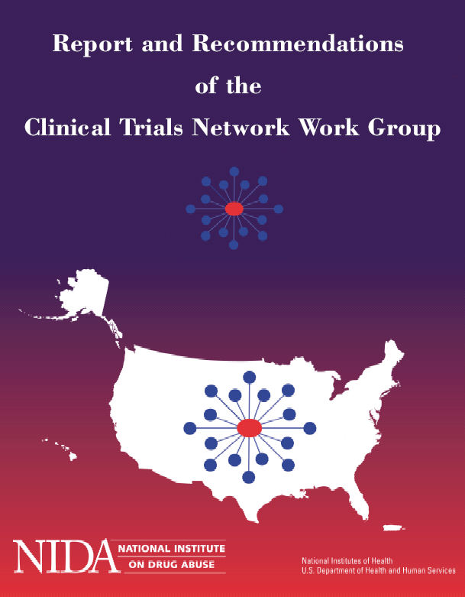
Clinical Trials Network
Work Group Members
Chair: David Rosenbloom, Ph.D
Richard R. Boozin, Ph.D.
Kathleen Burlew, Ph.D.
Nancy Hamilton, M.P.A., CAP, CCJAP
Steven C. Hayes, Ph.D
Yasmin Hurd, Ph.D.
Ron Jackson, M.S.W.
Herbert D. Kleber, M.D.
Thomas R. Kosten, M.D.
Curtis Wright, M.D., M.P.H.

Slide 18
NIDA’s Response to Recommendations: Main Issues
Mission
Organization
Operations
Dissemination
Collaborations

Slide 19
NIDA’s Response to Recommendations: Main Issues
Mission:
    use as research platform: genetics, HIV/HCV
    use as training platform: training supplements
    use for priority studies (e.g bup/hepatotoxicity)
Organization:
    Director and deputy director,
    consolidation of coordinating centers (data monitoring and management); competitive selection
    size of CTN, RFA for competitive renewals and new nodes will be released in summer 2004

Slide 20
NIDA’s Response to Recommendations: Main Issues (cont)
Operations:
    GCP: MUST
    Review of protocols (protocol review board (PRB) and Data Safety Monitoring Board (DSMB))
Dissemination: collaborations with DESPR and OSPC
Collaborations with NIAAA and NIMH

Slide 21
National Advisory Council on Drug Abuse
Workgroup on HIV/AIDS
Report on Findings and Recommendations
WORKGROUP MEMBERS
Council Members David Vlahov, Ph.D. Claire E. Sterk, Ph.D. Jose Szapocznik, Ph.D Consultants to Council Judith Auerbach, Ph.D. Carl Dieffenbach, Ph.D. Paul Volberding, M.D. Taha Taha, MBBS, Ph.D. Walter Ling, M.D. | NIDA Staff Members Jack Blaine, M.D. Wilson Compton, M.D. Henry (Skip) Francis, M.D. Barry Hoffer, M.D., Ph.D. David Shurtleff, Ph.D. Frank Vocci, Ph.D. Bill Grace, Ph.D. Other NIH Institute Staff Members Kendall Bryant, Ph.D. Jonathan Kagan, Ph.D. Ellen Stover, Ph.D.

Slide 22
HIV/AIDS Workgroup Recommendations: Main Issues
Organization
Portfolio should reflect HIV epidemic
Priority setting
Collaborations with other divisions
Notes:
I’m not sure if this is a good idea– but you could give the major results right up front.
This would be a good place to note that the recommendations related to scientific areas, for the most part, are a matter of recommending more or less emphasis and that NIDA does a pretty good job of covering the areas.

Slide 23
HIV/AIDS Workgroup Recommendations: Organization
Current organization promotes conflict in mission and should consider bringing AIDS into OD office
Separate coordination of HIV and AIDS activities and medical consequences portfolio
(1) NIDA reorganization in progress –dissolved CAMCODA and brought AIDS coordination to OD
(2) Steven Gust, Ph.D. named Acting Director, AIDS Research
(3) National search for a permanent Director in progress – announcement closes June 11, 2004.
Notes:
I’m not sure if this is a good idea– but you could give the major results right up front.
This would be a good place to note that the recommendations related to scientific areas, for the most part, are a matter of recommending more or less emphasis and that NIDA does a pretty good job of covering the areas.

Slide 24
HIV/AIDS Workgroup Recommendations: HIV epidemics
Need more focus on unique dimensions of drug use as they relate to HIV/AIDS
Need to be guided by HIV epidemiology; advances in HIV treatment & prevention
The Consequences of Drug Abuse
and Addiction Disproportionately
Affect Minority Populations
Proportion of Estimated* Adult/Adolescent AIDS Cases
by Exposure Category and Year of Diagnosis,
1985 - 2000, United States
100
6
4
1
70
12
15
23
60
Men who have sex with men (MSM)
80
11
16
50
60
Percent
Percent of Cases
50
40
Injection drug use (IDU)
40
30
70
65
20
Heterosexual contact
20
10
MSM & IDU
26
0
0
Population
Drug Abuse/
IDUs with
1986
1988
1990
1992
1994
1996
1998
2000
Dependence *
HIV-AIDS **
Year of Diagnosis
White
Black
Hispanic
Other
Source: Centers for Disease Control and Prevention (CDC)
Sources: * 2002 NSDUH, DHHS, SAMHSA, 2003.
** CDC HIV/AIDS Surveillance Report 2002.
Notes:
I’m not sure if this is a good idea– but you could give the major results right up front.
This would be a good place to note that the recommendations related to scientific areas, for the most part, are a matter of recommending more or less emphasis and that NIDA does a pretty good job of covering the areas.

Slide 25
HIV/AIDS Workgroup : Priorities and Collaborations
NIDA’s planning process and priority setting process need improvement
Limited collaborations with other divisions
(1) increase expertise of HIV/AIDS in divisions and CTN
*(2) create a working group for evaluation or priorities and for inclusion of HIV/HCV in relevant RFA and PA
*(3) Create a document to define what should be labeled as AIDS related research
* Waiting for new director to implement
Notes:
I’m not sure if this is a good idea– but you could give the major results right up front.
This would be a good place to note that the recommendations related to scientific areas, for the most part, are a matter of recommending more or less emphasis and that NIDA does a pretty good job of covering the areas.

Slide 26
NIDA Reorganization
Objectives:
Respond to the Report of the National Advisory Council
on Drug Abuse Workgroup on HIV/AIDS to better integrate
HIV/AIDS with drug abuse and addiction studies
Realignment of other programs in keeping with NIDA
priorities, particularly on adolescents and prevention
Create a new Division…
to better integrate clinical neurobiology with
human development and behavioral therapies
to take advantage of advances in imaging to better
understand the neurobiological underpinnings
of drug abuse and addiction

Slide 27


NIDA
National Institute on Drug Abuse
Office of the Director
Director, AIDS Research
Population-Based
Health Interventions
Unit
Nora D. Volkow, MD
Director
Special Populations Office
Timothy P. Condon, Ph.D.
Deputy Director
Medical
Consequences Unit
EEO
Laura S. Rosenthal
Associate Director
for Management
Developmental Unit
Office of
Extramural
Affairs
Office of Planning
& Resource
Management
Office of
Science Policy &
Communications
Center for the
Clinical Trials
Network
Teresa Levitin, PhD
Laura Rosenthal
Timothy Condon, PhD
Betty Tai, PhD
Division of
Basic Neurosciences
& Behavior Research
Division of
Pharmacotherapies &
Medical Consequences
of Drug Abuse
Division of
Epidemiology,
Services &
Prevention Research
Intramural
Research
Program
Division of Clinical
Neuroscience,
Development &
Behavioral
Treatment
David Shurtleff, PhD
Medical Consequences Branch
Wilson Compton, MD, MPE
Barry Hoffer, MD, PhD
Increased emphasis on:
Proteomics/Genetics
Pain Management/ Sensitivity of HIV patients to Addictive Analgesics
Frank Vocci, PhD
Joseph Frascella, PhD
Clinical Etiology Branch
Behavioral Therapies
Development Branch

Slide 28
Other NIDA Program Reviews in Progress
Medications Development Program
Purpose: To comprehensively review NIDA’s current medications development research portfolio and to provide recommendations for
current and future research objectives
Workgroup Members:
Chair: Peter Kalivas, Ph.D.
Bankole Johnson, M.D., Ph.D.
Herb Kleber, M.D.
George F. Koob, Ph.D.
Mary Jeanne Kreek, M.D.
Bertha Madras, Ph.D.
Eric Nestler, M.D., Ph.D.
Scott Reines, M.D., Ph.D.
Raymond White, Ph.D.
Status: First Meeting
Held May 18-19, 2004

Slide 29
Other NIDA Program Reviews in Progress
  Minority Health Disparities
Purpose: To comprehensively review NIDA’s current minority health research portfolio and to provide recommendations for current and future research objectives
Workgroup Members:
Chair: Jose Szapocznik, Ph.D.
Rodolfo Arredondo, Jr. Ed.D.
Allyn Howlett, Ph.D.
James S. Jackson, Ph.D.
Patricia Molina, M.D., Ph.D.
Beny Primm, M.D.
Beverly Watts Davis, B.S.
Status: Additional
Workgroup Members
Being Recruited

Slide 30
Recent NIDA Activities

Slide 31
Response to New NIDA PAs and RFAs
Number of
Applications
Prevention Research (Children and Adolescents)
22
34
56
26
31
Novel Approaches to Phenotyping Drug Abuse (RFA)
Behavioral and Cognitive Processes in Adolescent Drug Abuse (RFA)
Animal Models of Adolescent Drug Abuse (RFA)
Prevention Research for the Transition to Adulthood (RFA)
Consequences of Marijuana Use on the Developing Brain (RFA)
Treatment Interventions
19
Medications Development for Cannabis-Related Disorders (RFA)

Slide 32
Response to New NIDA PAs and RFAs
Number of
Applications
HIV/HCV
9
34
42
8
Drug Abuse Aspects of HIV/AIDS and Other Infections (PA)
HIV/AIDS and Other Infections Among Drug Users in the
Criminal Justice System (RFA)
HIV/AIDS Prevention, Treatment, and Related Health Issues for
Highly Vulnerable Youth (RFA)
Targeted Integrative Research in Drug Abuse and HIV/AIDS in
Pregnancy (RFA)
Training
Research Education Grants in Drug Abuse and Addiction (PA)

Slide 33
NIDA PAs and RFAs Just Issued
Collaborative Clinical Trials in Drug Abuse (PAR-04-073)
Epidemiology of Drug Abuse (PA-04-100)
Developmental Centers for Translational Research on the
Clinical Neurobiology of Drug Addiction (RFA-DA-05-003)

Slide 34
PAs and RFAs Recently Issued With
Other NIH Components/Agencies
5 New PAs and
5 New RFAs (Totaling $3 Million)
Focus predominantly on:
GENETICS
CO-MORBIDITY
HIV/AIDS
SERVICES (with SAMHSA)

Slide 35
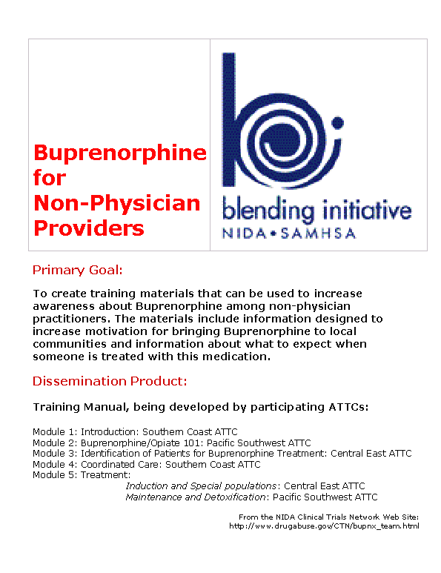

Slide 36
Highlights of Recent
Meetings and Events

Slide 37
Recent Congressional Hearings
In Which NIDA Played A Role
Measuring the Effectiveness of Addiction Treatment
(House Government Reform Subcommittee on Criminal Justice, Drug Policy
and Human Resources – Representative Mark Souder [R-IN], Chairman)
Fiscal Year 2005 NIH Budget
(Senate Appropriations Subcommittee on Labor, HHS and Education –
Senator Arlen Specter [R-PA], Chairman)
Marijuana and Medicine: The Need for a
Science-Based Approach
(House Government Reform Subcommittee on Criminal Justice, Drug Policy
and Human Resources – Representative Mark Souder [R-IN], Chairman)
Substance Abuse and Mental Health
(House Appropriations Subcommittee on Labor, HHS and Education–
Representative Ralph Regula [R-OH], Chairman)

Slide 38
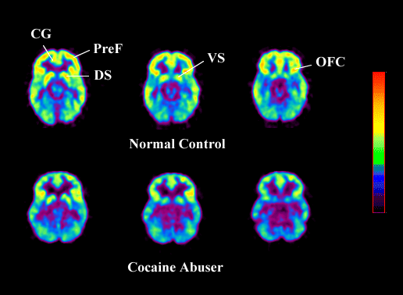

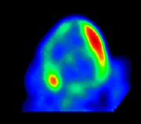
Document: ADDICTION AS A MEDICAL DISEASE
Decreased Brain Metabolism in Drug Abuser
High
Control Cocaine Abuser
Decreased Heart Metabolism in Heart Disease Patient
Low
Healthy Heart
Diseased Heart
Sources: From the laboratories of Drs. N. Volkow and H. Schelbert

Slide 39
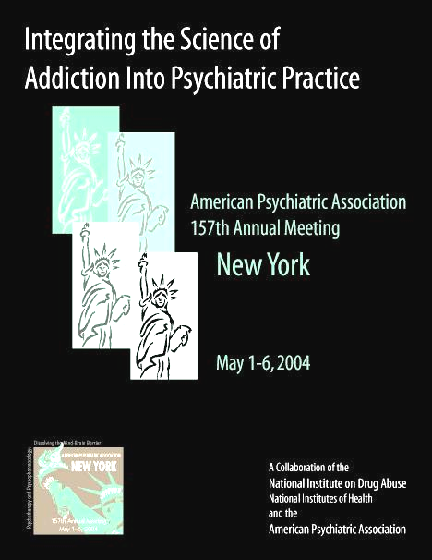
American Psychiatric Association
Annual Meeting
NIDA-Sponsored
Research Track
Including:
7 Major Lectures
11 Symposia
9 Issues Workshops

Slide 40

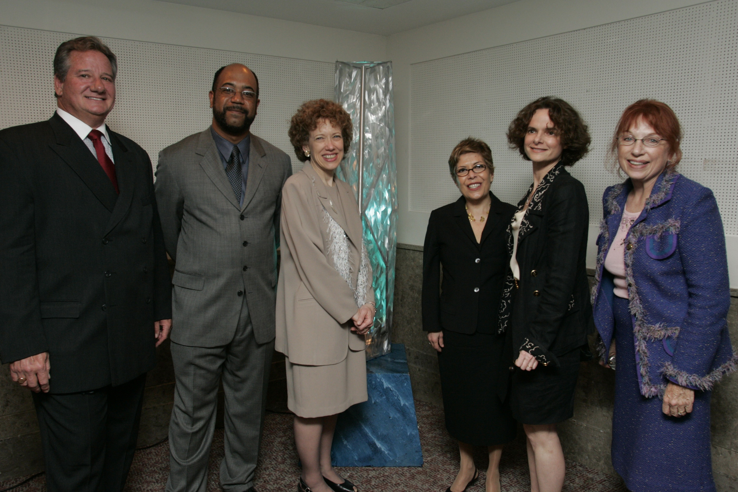
8th Annual PRISM Awards Event
Hollywood Palladium – Los Angeles, CA
May 8, 2004
PRISM Event Premiered
on Capitol Hill
May 12, 2004
Aired on FX May 16, 2004

