Slide 1
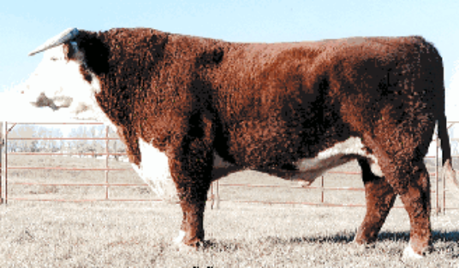
Breeds of Beef Cattle
Developed by:
Richard Coffey, Extension Swine Specialist, University of Kentucky
Kevin Laurent, Extension Associate, University of Kentucky
Warren Beeler, Kentucky Department of Agriculture
Edited for Georgia by Frank B. Flanders
Georgia Agriculture Education Curriculum Office
March 2002

Slide 2
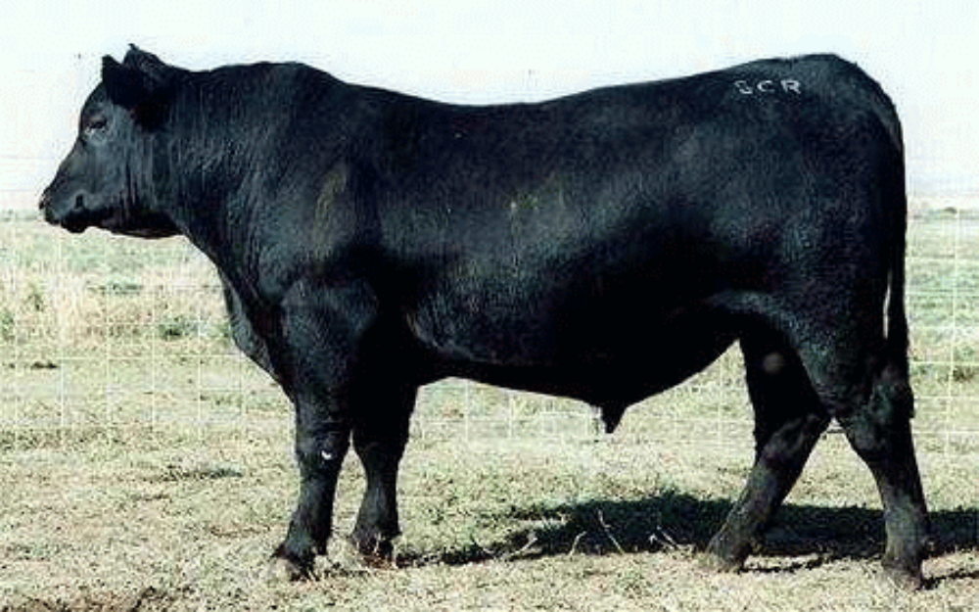
Angus Bull

Slide 3
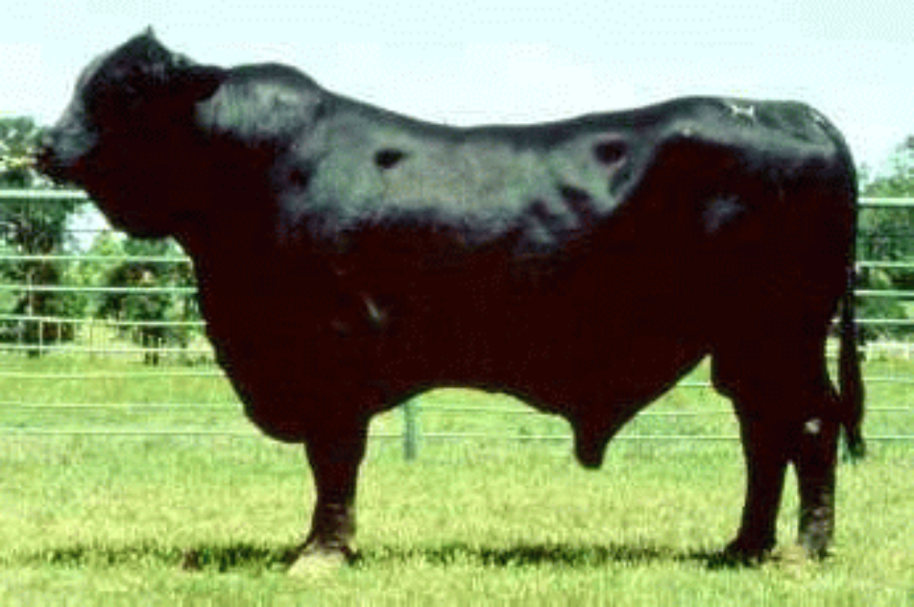
Brangus Bull

Slide 4
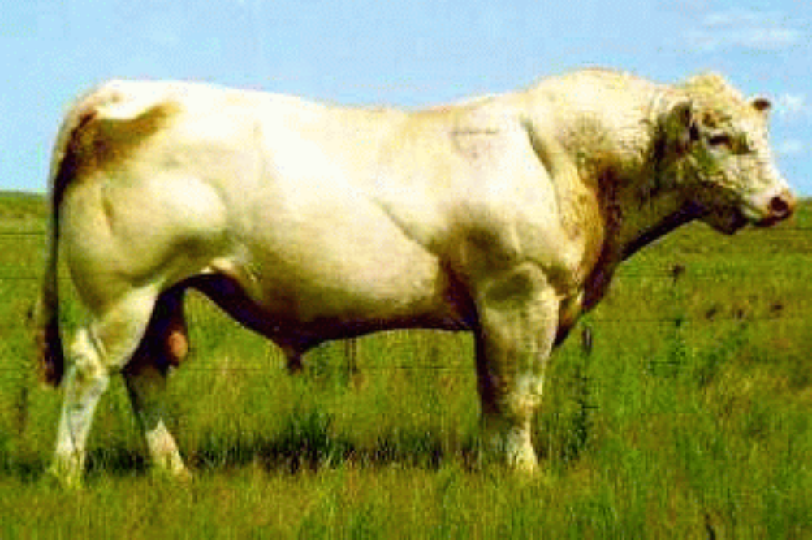
Charolais Bull

Slide 5
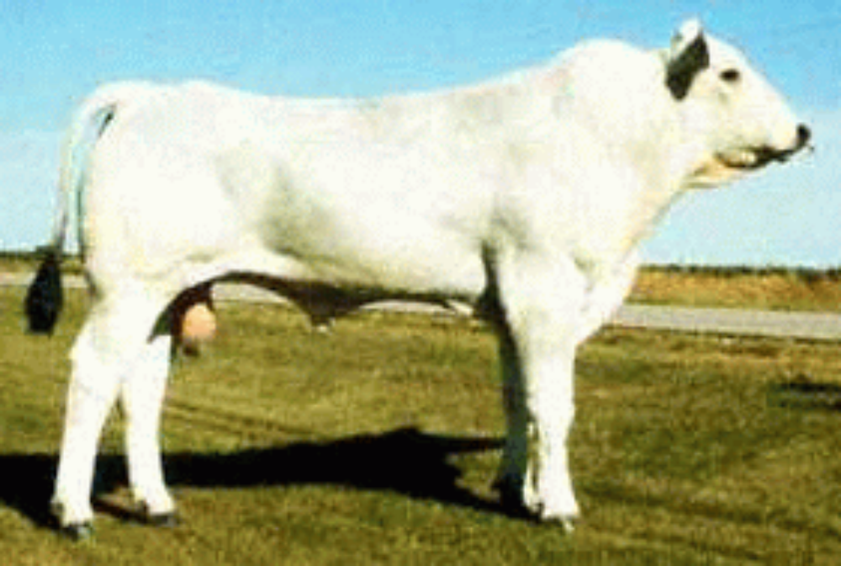
Chianina Bull

Slide 6
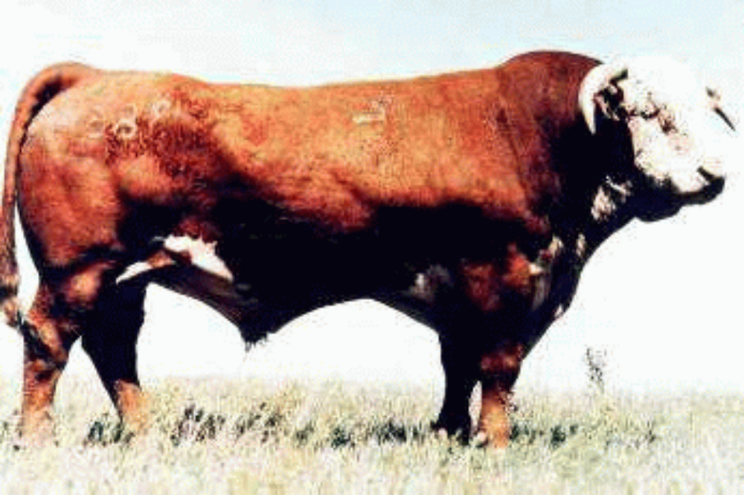
Hereford Bull

Slide 7
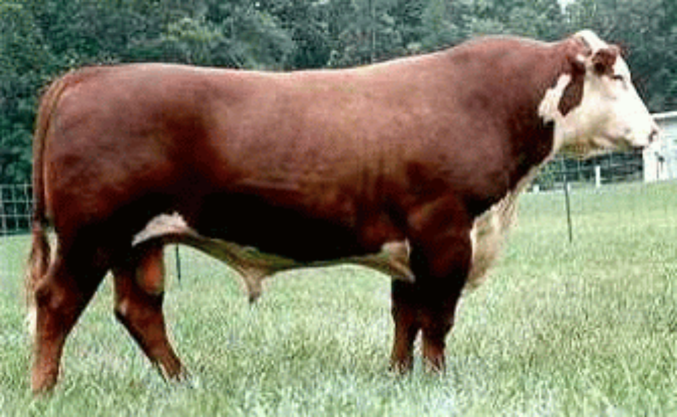
Polled Hereford Bull

Slide 8
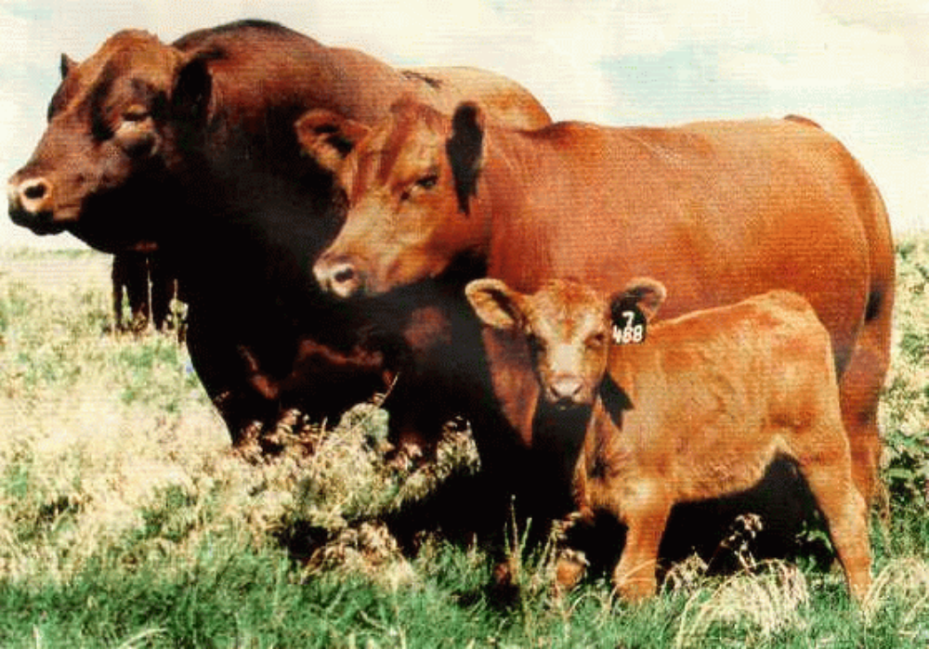
Red Angus Bull, Cow, & Calf

Slide 9
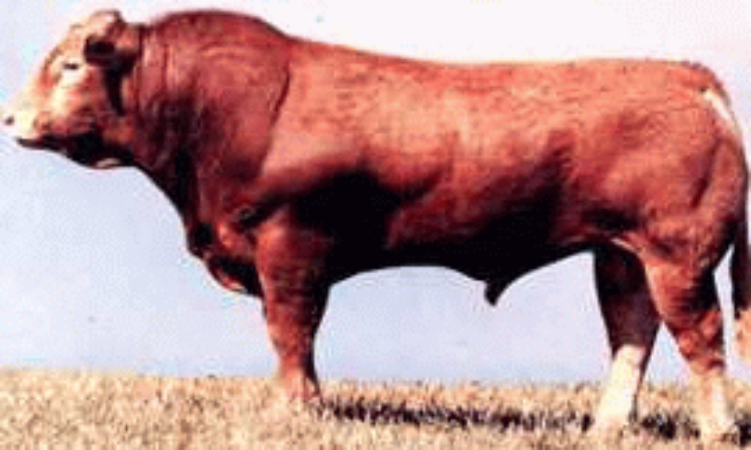
Limousin Bull

Slide 10
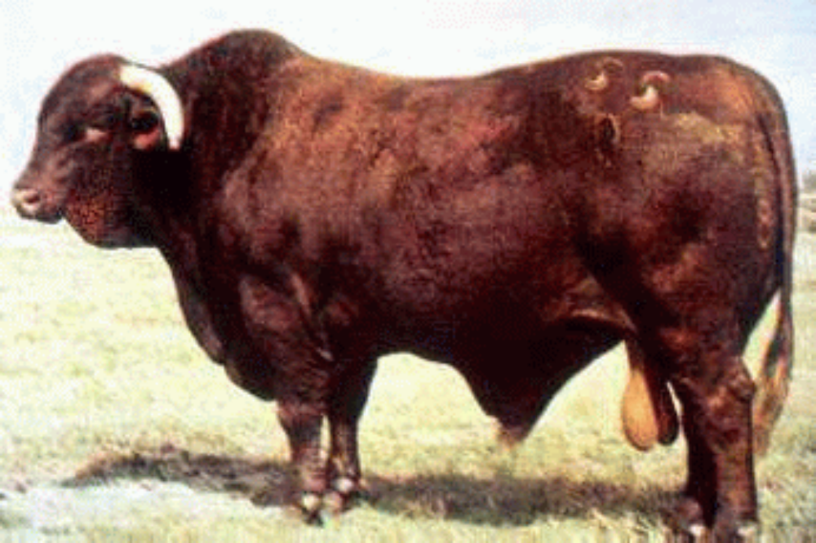
Santa Gertrudis Bull

Slide 11
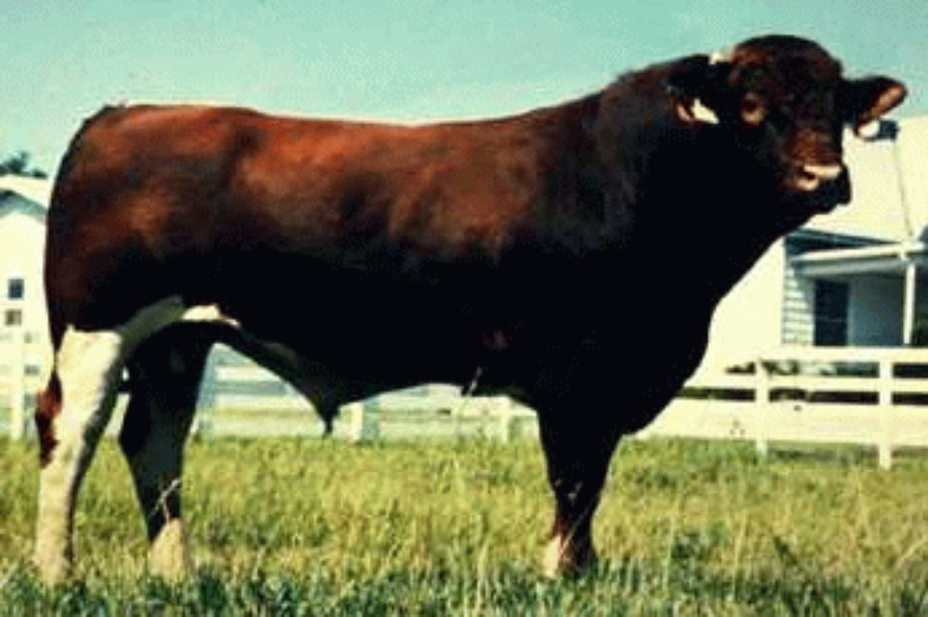
Maine Anjou Bull

Slide 12
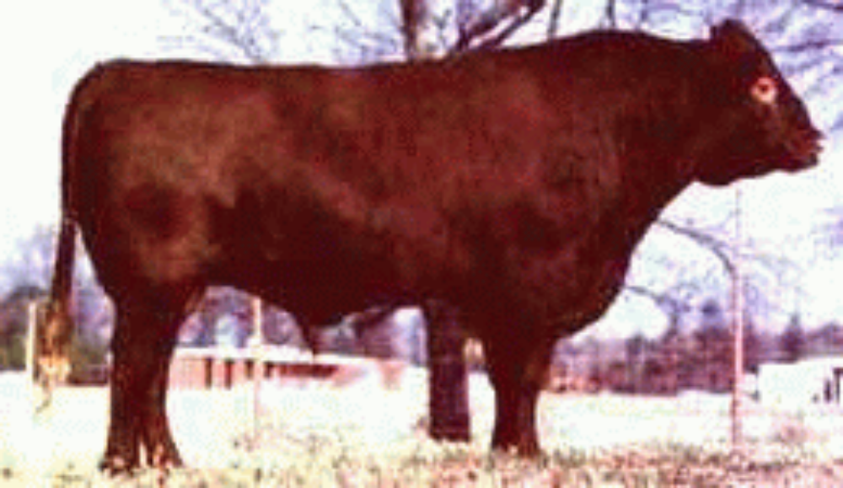
Red Poll Bull

Slide 13
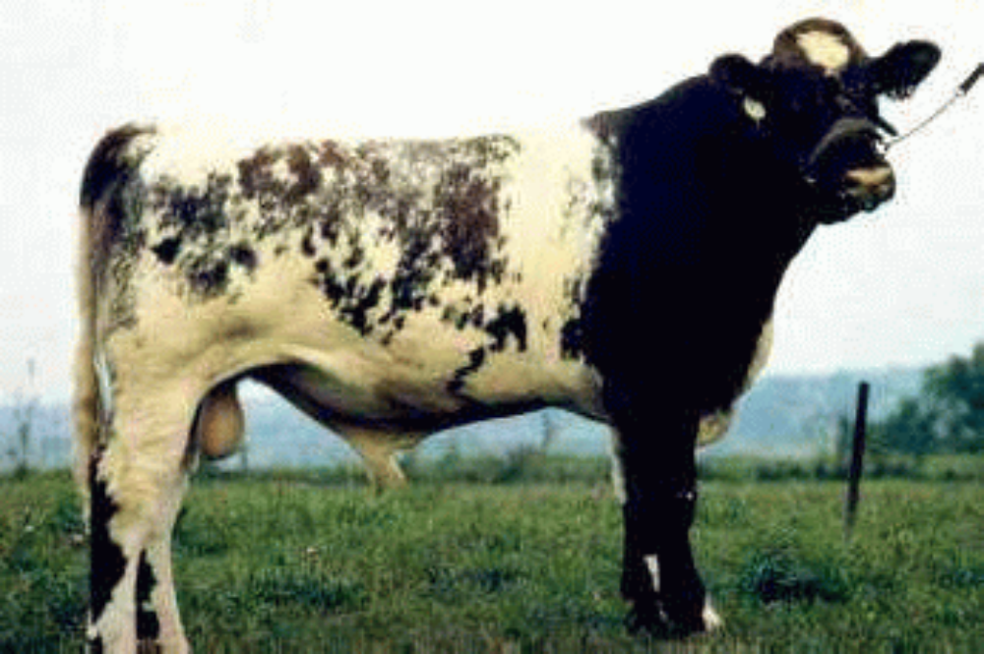
Shorthorn Bull

Slide 14
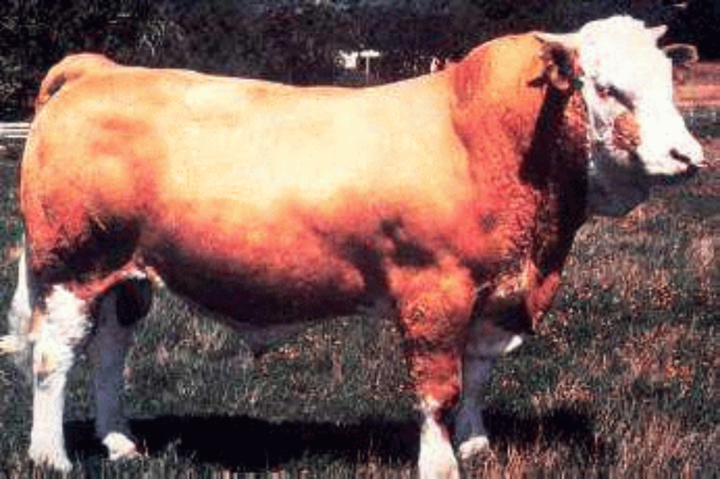
Simmental Bull

Slide 15
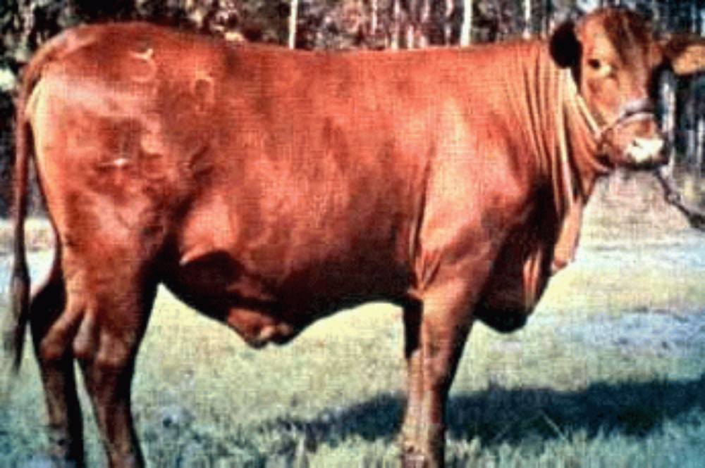
Santa Gertrudis Heifer

Slide 16
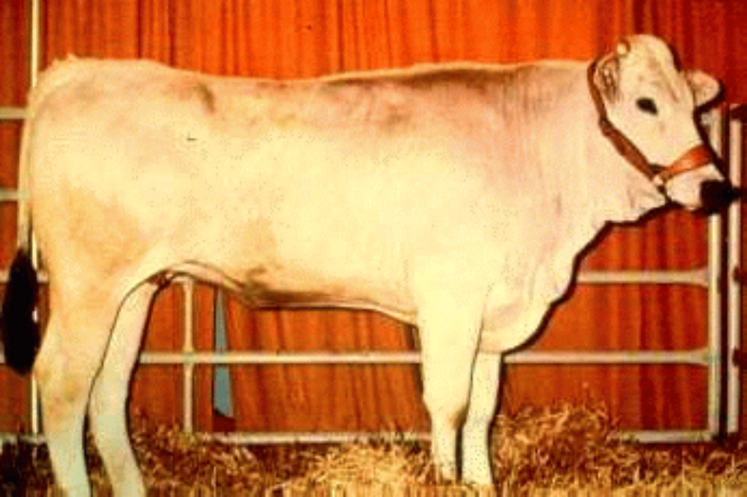
Chianina Heifer

Slide 17
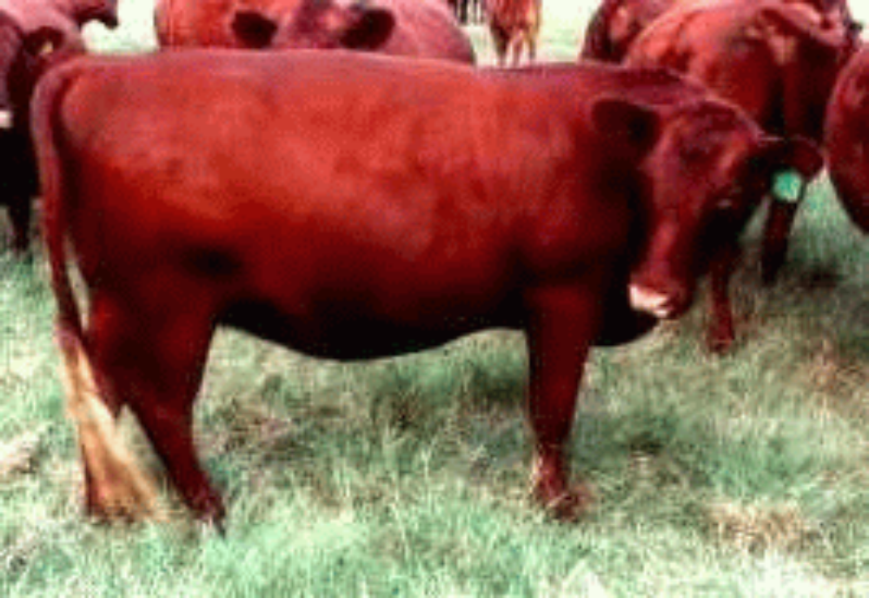
Red Poll Cow

Slide 18
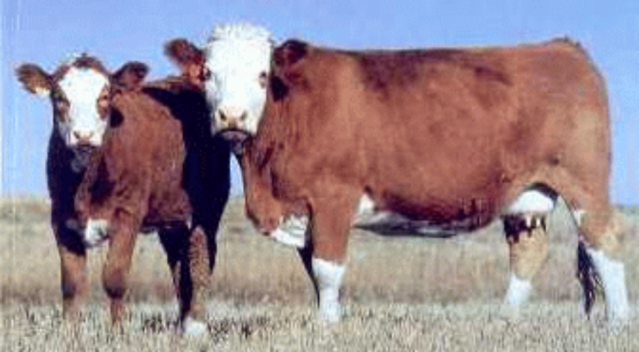
Simmental Cow & Calf

Slide 19
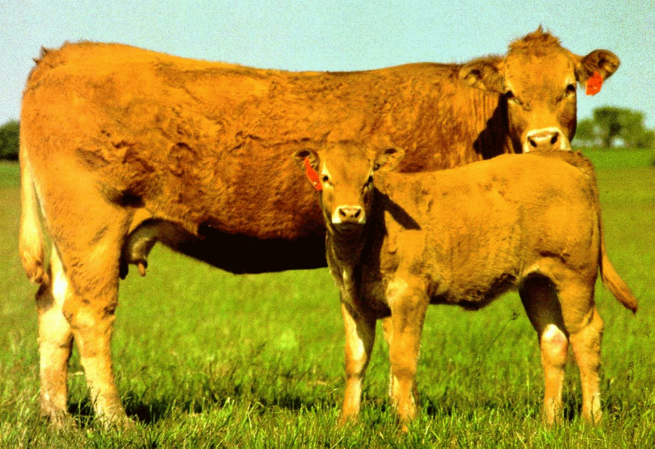
Limousin Cow & Calf

Slide 20
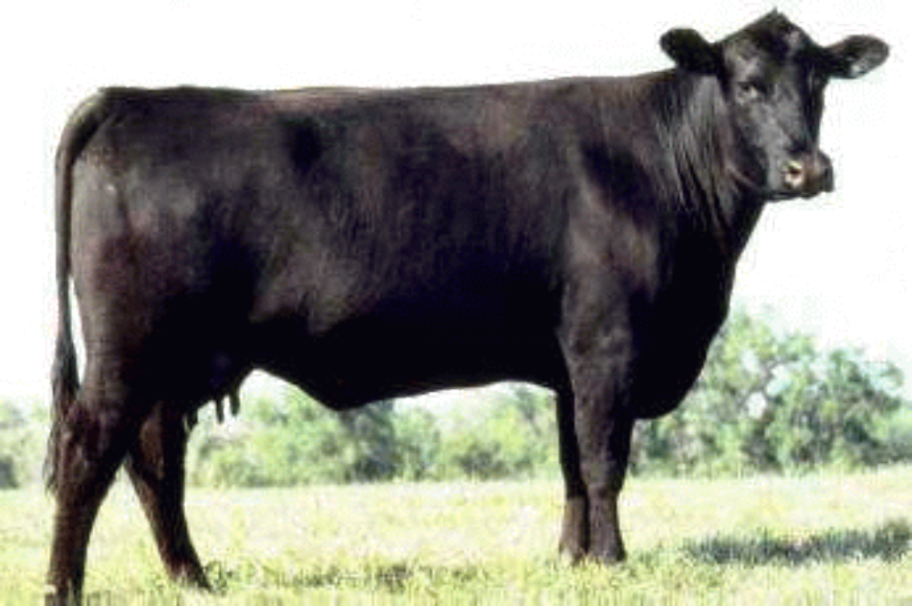
Angus Cow

Slide 21
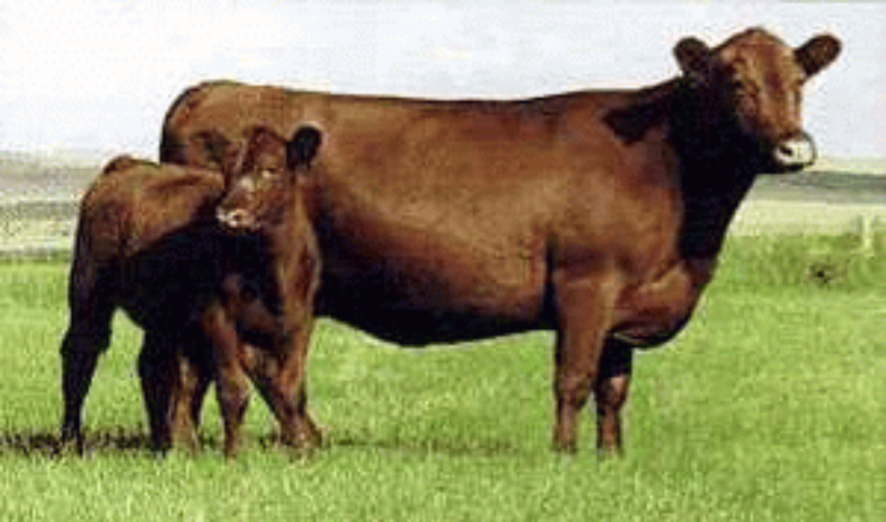
Red Angus Cow & Calf

Slide 22
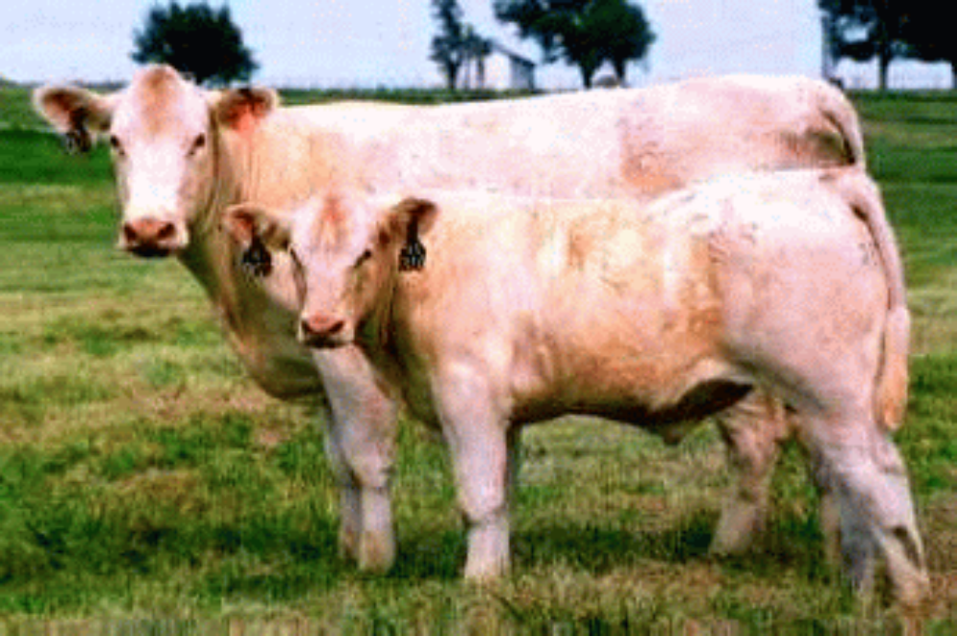
Charolais Cow & Calf

Slide 23
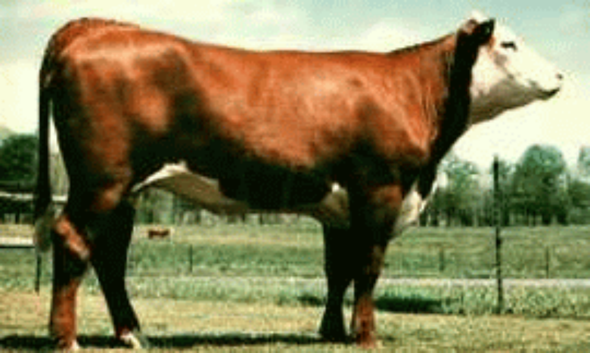
Polled Hereford Heifer

Slide 24
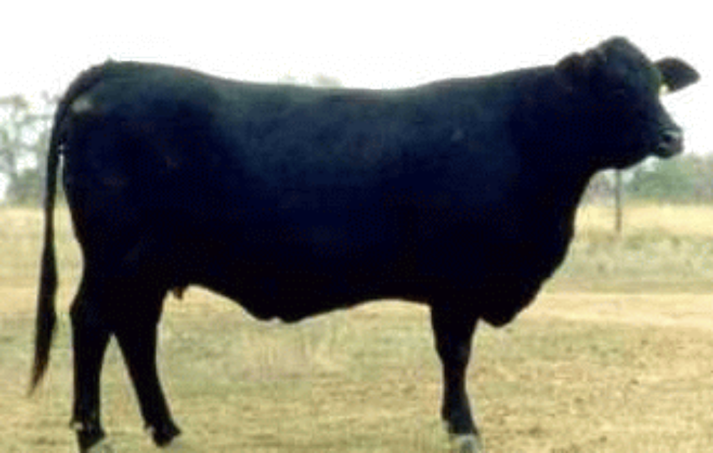
Brangus Cow

Slide 25
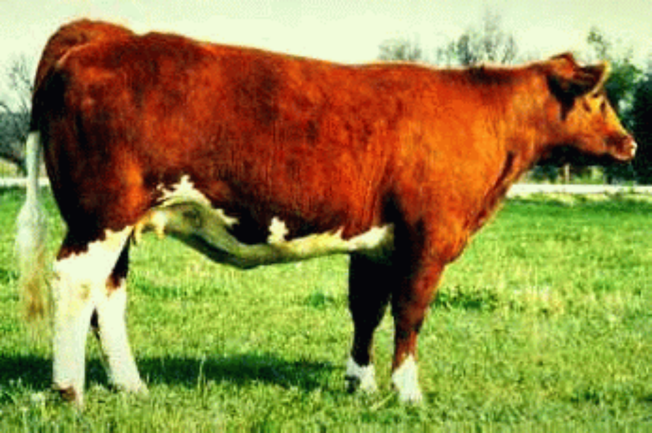
Maine Anjou Cow

Slide 26
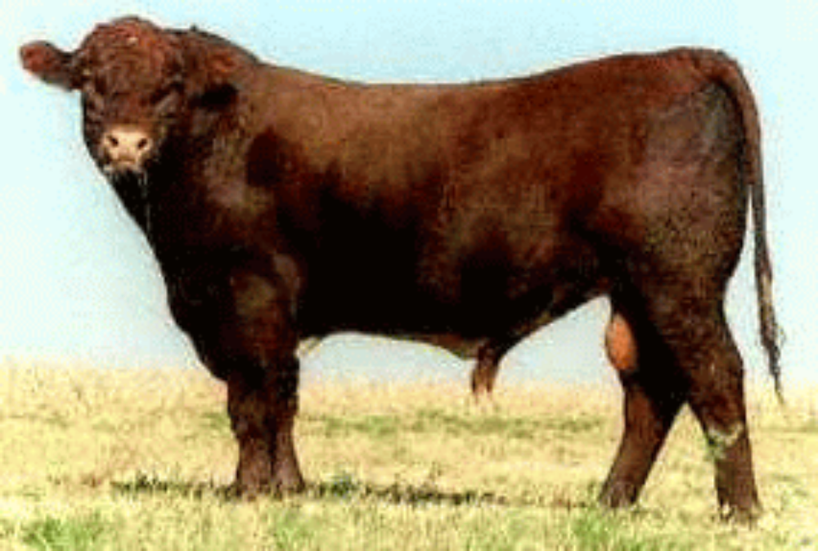
Shorthorn Bull

Slide 27
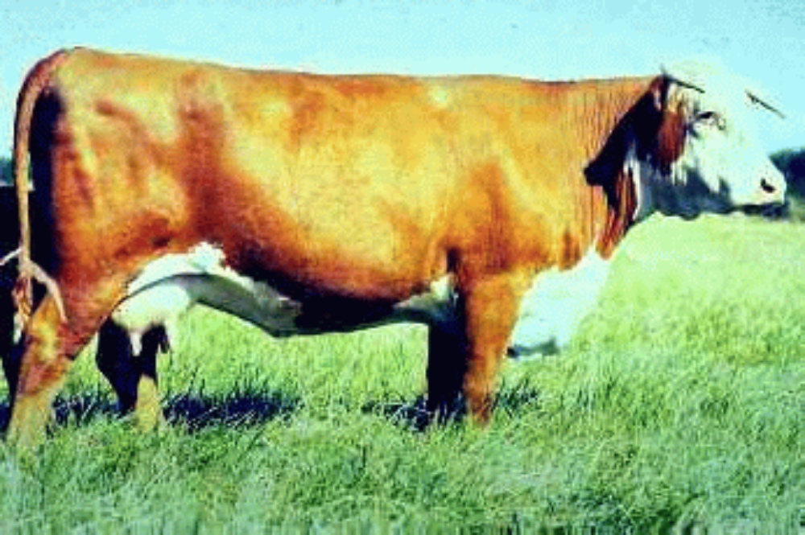
Hereford Cow

Slide 28
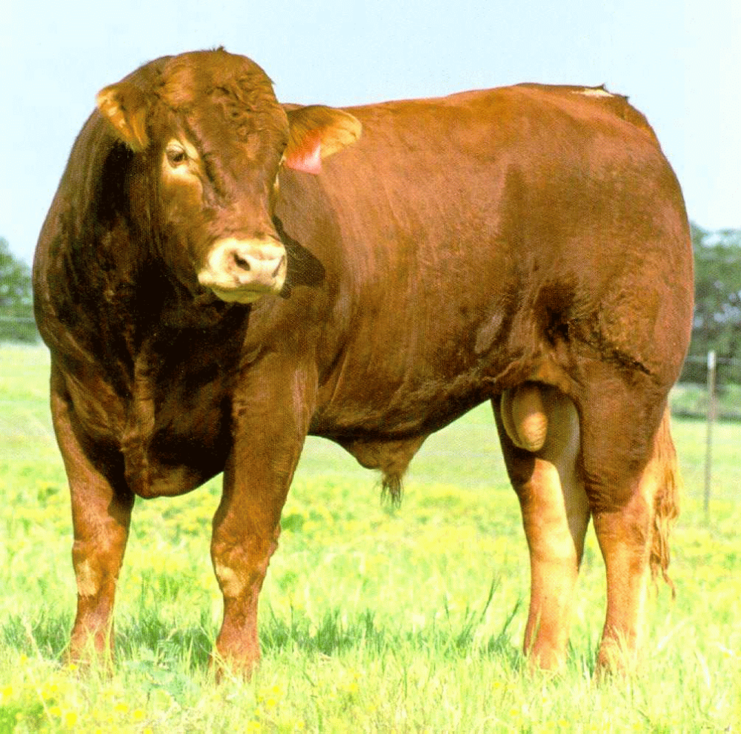
Limousin Bull

Slide 29
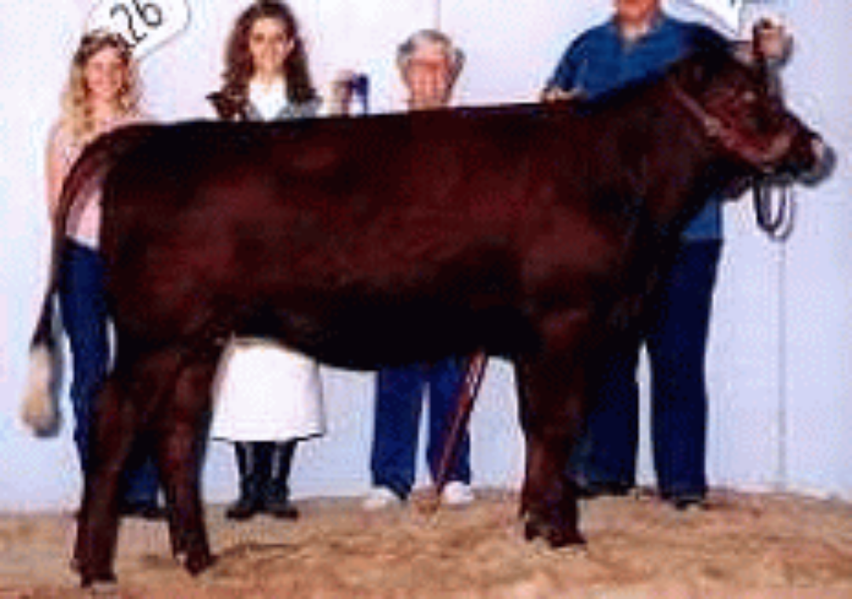
Red Poll Heifer

Slide 30
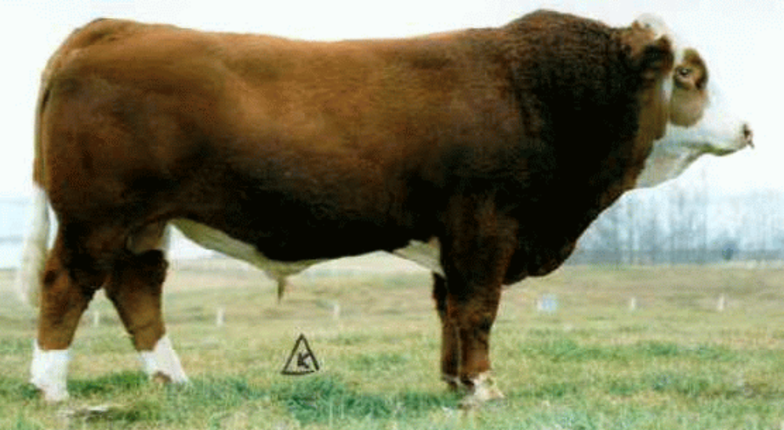
Simmental Bull

Slide 31
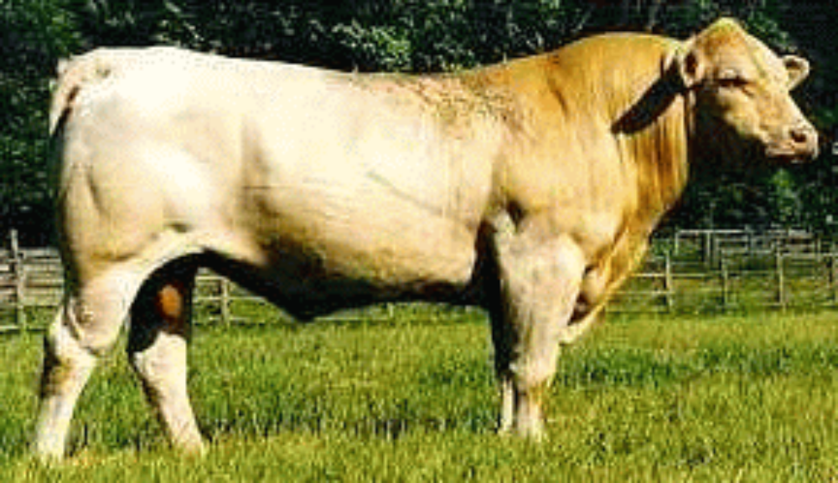
Charolais Bull

Slide 32
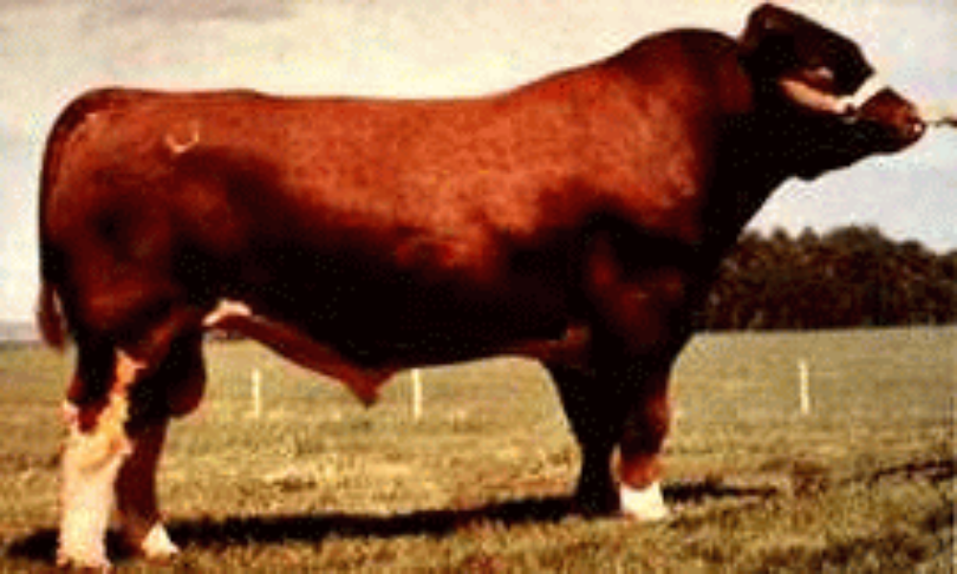
Maine Anjou Bull

Slide 33
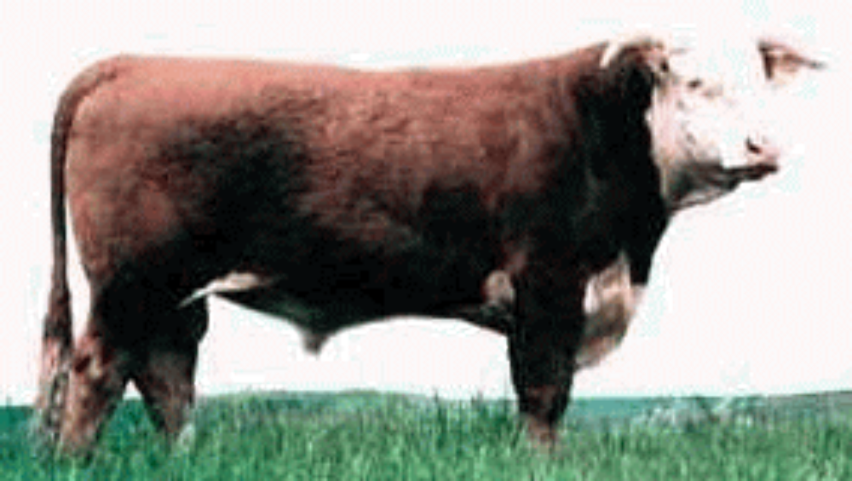
Hereford Bull

Slide 34
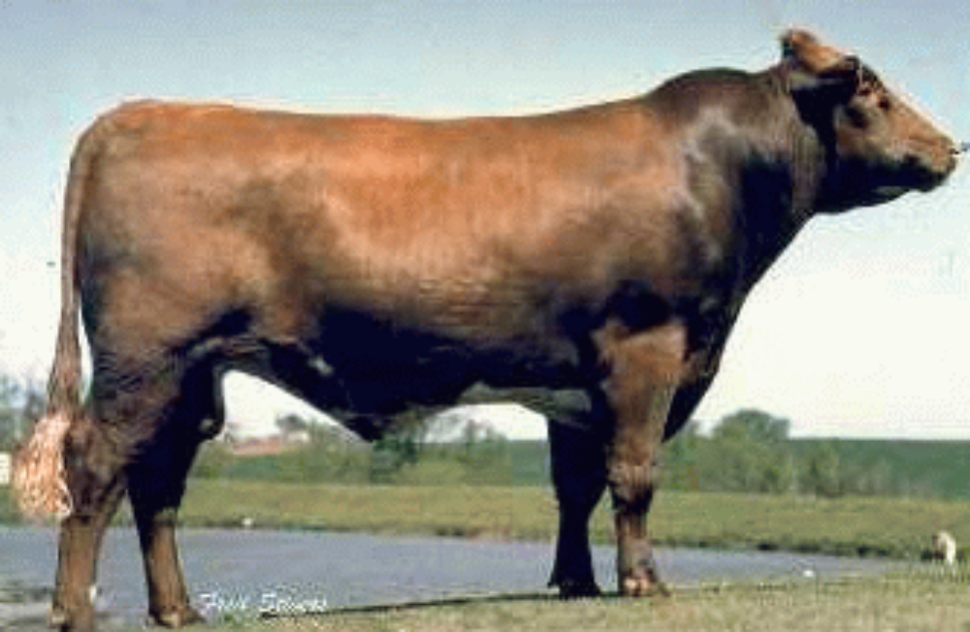
Shorthorn Bull

Slide 35
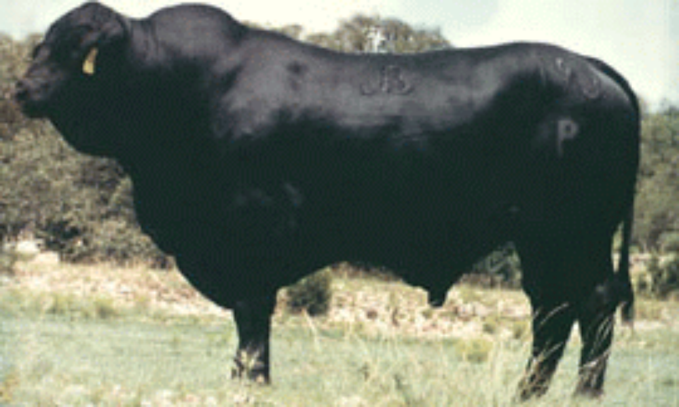
Brangus Bull

Slide 36
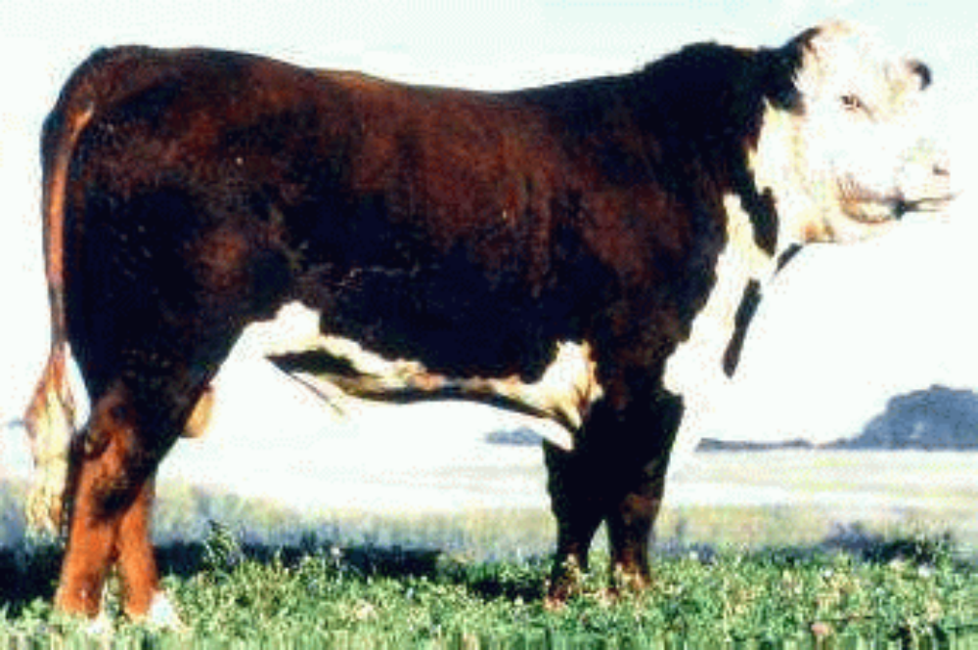
Polled Hereford Bull

Slide 37
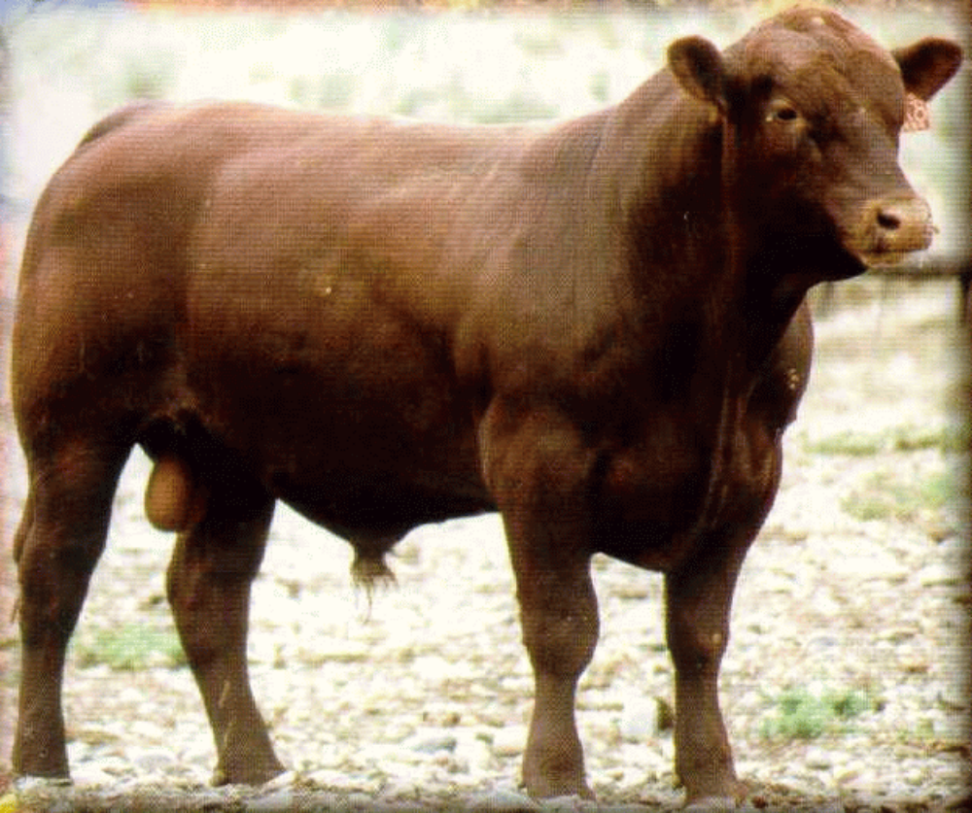
Red Angus Bull

Slide 38
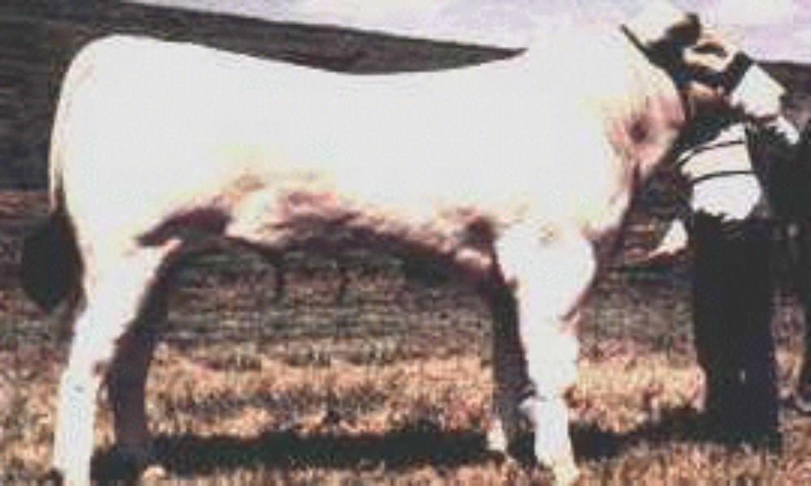
Chianina Bull

Slide 39
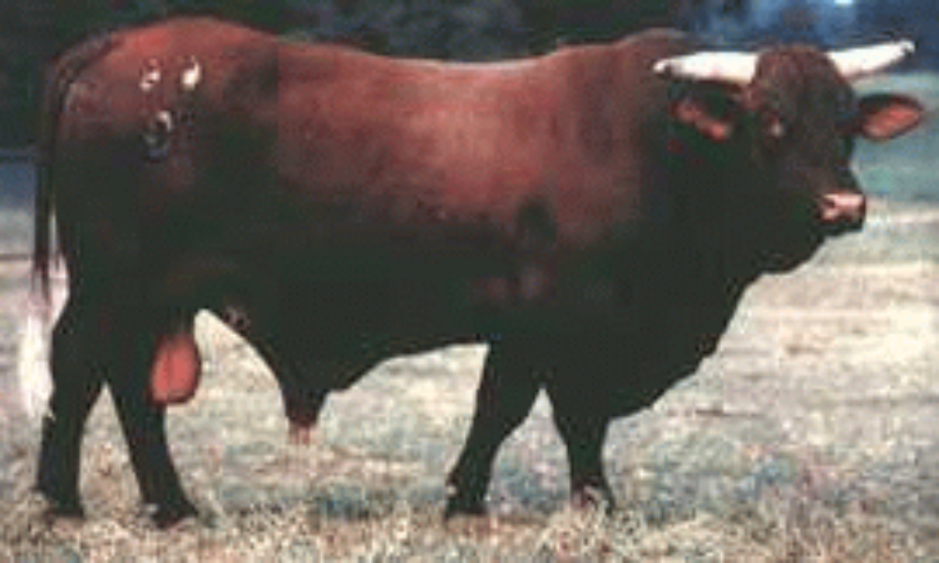
Santa Gertrudis Bull

Slide 40
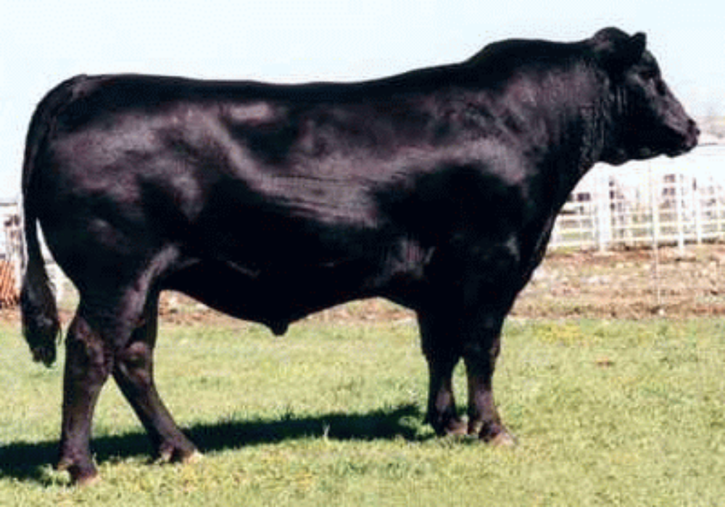
Angus Bull

