Slide 1
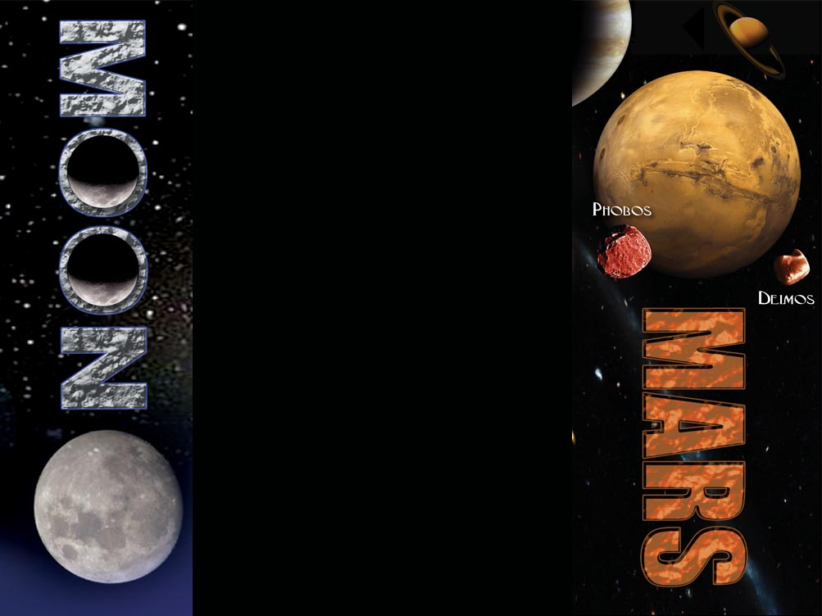

Engineering Deans’ Conference 2006
Habitable Systems & Structures

Slide 2
Topics
Architecture & Habitation
Habitable Systems
Inflatable Structures
Thermal Control
Space Radiation

Slide 3
Architecture, Habitation & Integration
Kriss Kennedy

Slide 4
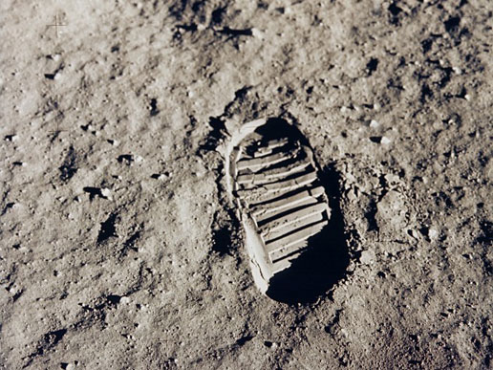
Architecture, Habitation & Integration
Lead and Support Architectural Studies and Assessments of Lunar/Mars Mission Planning
Lead Spacecraft Design and Analysis
  Led the JSC Multi-Center Lunar Lander Design Team
Perform Systems Engineering Planning
Perform Technology Integration
  Habitat Autonomy Test
Perform Integrated Tests and Evaluations
Manage the Advanced Integration Facility in B29
  Lunar Habitat Mockups
Manage the Vertical Habitation Facility in B220

Slide 5
Habitation Systems
Short Duration Mission - For mission durations of a few days to couple of weeks, crews can share personal quarters by rotating shifts, as is done when the Space Shuttle carried Spacelab.
Medium Duration Mission - For mission durations up to six months, crews require their own private personal quarters for sleeping as well as private recreation (reading and communication with relatives), and will require more volume for grooming and personal hygiene.
Long Duration Mission - For mission durations of six months or more, crews essentially require all the necessary "comforts of home."
Notes:
Systems Integration is to perform system-level integration and integrated testing of technology products prior to delivery to the customer. Testing of breadboards and prototypes will require a project test plan. Test results will be provided in the Transition Package.

Slide 6
Historical Habitation Volumes
1000
Skylab
ISS
Mir
100
Salyut 7
Total Pressurized Volume
(m3)/crew
STS
10
Apollo
Apollo
LEM
CM
Mercury
Soyuz
1
Vostok
Gemini
Voskhod
0.1
1
10
100
1000
Mission Duration (days)
Notes:
Systems Integration is to perform system-level integration and integrated testing of technology products prior to delivery to the customer. Testing of breadboards and prototypes will require a project test plan. Test results will be provided in the Transition Package.

Slide 7
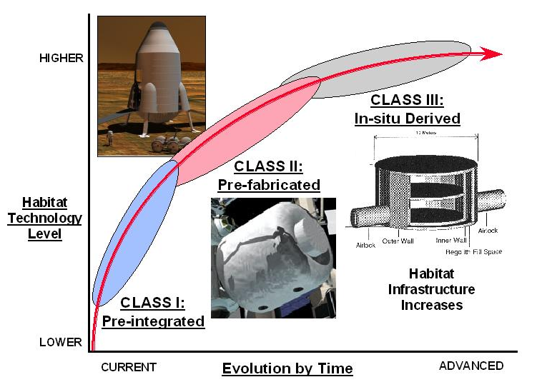
Space Habitation
CLASS I: Pre-integrated
CLASS II: Pre-Fabricated – Space/Surface Assembled
CLASS III: In-Situ Derived and Constructed
Notes:
Take away message: SE&I is not just for flight hardware programs and projects. In fact SE&I is crucial to the successful infusion and transition of technology products that meets the needs of the customer on time.

Slide 8
Habitation Elements & Interfaces
Power Supply
Thermal Control
External Systems
Environmental Control & Life Support
Control Systems
Human Accommodations
Airlock / EVA
Power
Structure
Data Mang’t
Communications
External Support Structure
Communications
Notes:
Systems Integration is to perform system-level integration and integrated testing of technology products prior to delivery to the customer. Testing of breadboards and prototypes will require a project test plan. Test results will be provided in the Transition Package.

Slide 9
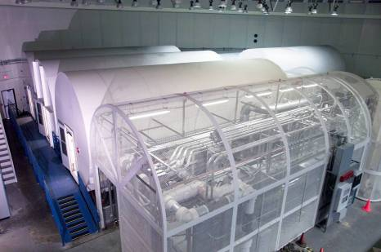
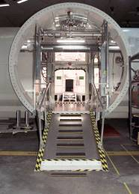
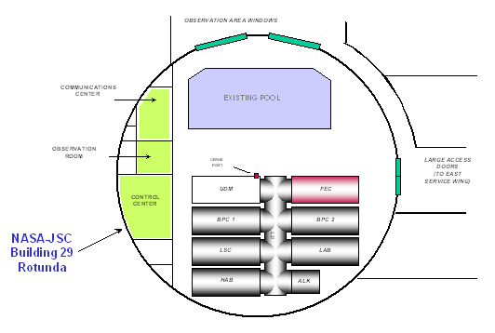
Advanced Integration Facility (AIF)
B29 Habitability Lab – Horizontal Chambers
Advanced Integration Facility (AIF) is a multi-chamber surface habitat simulator
Ensure cross-cutting of systems integration and concepts, enabling technology, and flight demos
Capable of providing end-to- end testing of ECLS systems
Improved habitat design
Better living accommodations for the crew at Lunar Outpost

Slide 10
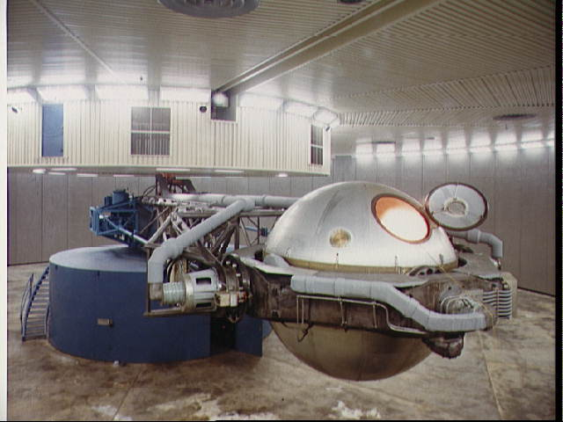
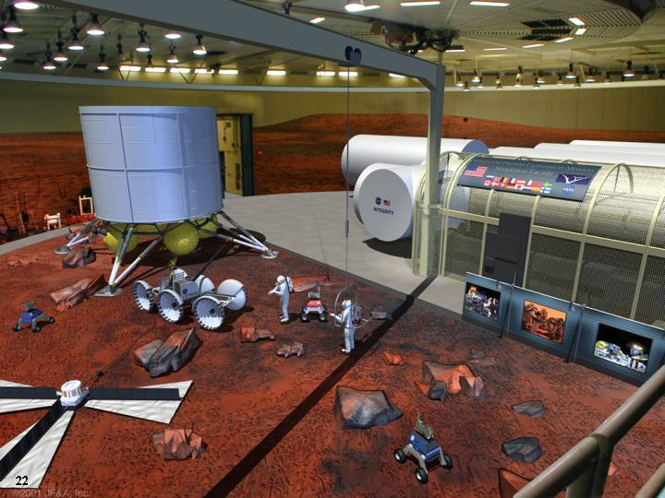
Horizontal Habitation Laboratory – B29
Horizontal Habitat Laboratory
B29 Fully outfitted laboratory.
(Accommodates evaluations, validations, requirements, volumetric analysis, testing, etc)
Utilities Distribution Module
Test Prep Area
High Bay Lab
Interconnecting Transfer Tunnel
Lab West
Lab East
Habitation Chamber
Airlock

Slide 11
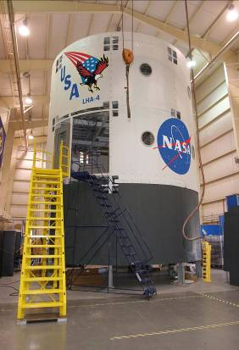
Vertical Habitation Laboratory – B220
Vertical Axis Habitat Laboratory
  B220 Vertical Axis Mockup structure upgrades are in progress
  24.6 ft dia x 3 stories

Slide 12
Technical Challenges
Technical Issues for Advanced Habitats include (but are not limited to):
Develop composite structures that can be deployed and operated in space and on planetary bodies for 10-20 year life time.
Develop inflatable structures that can be packaged, deployed and operated in space and on planetary bodies for 10-20 year life time.
Develop ISRU-derived structures, manufacturing processes and construction techniques that can be packaged, deployed and operated in space and on planetary bodies for 10-20 year life time.
Integrate diagnostic and habitat health monitoring through out the habitat.
Integrated self-repairing skins for habitat structures.
Integrated design techniques that incorporate advanced systems into the habitat skin/structure and incorporates techniques to adjust resources within the habitat to automatically protect the crew based on the sensed environmental conditions
Notes:
Take away message: SE&I is not just for flight hardware programs and projects. In fact SE&I is crucial to the successful infusion and transition of technology products that meets the needs of the customer on time.

Slide 13
Habitable Systems
Robert Howard

Slide 14
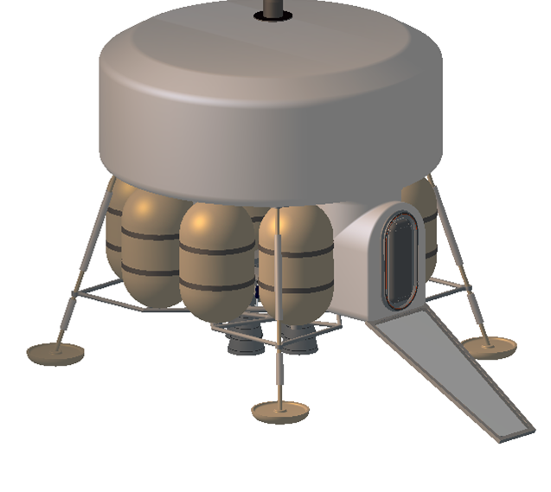
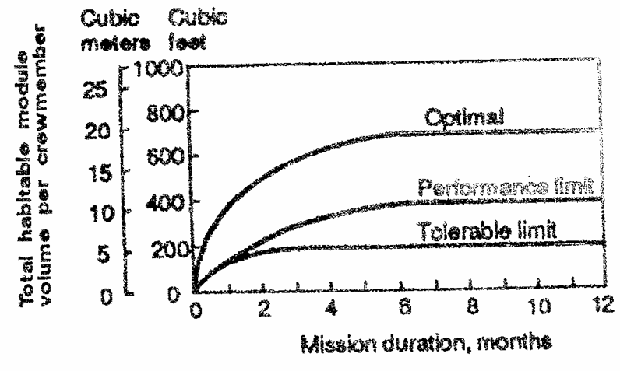

Areas of Relevant Research
Human Confinement Studies
Most spacecraft volumetric habitability studies are based on 1960s era research
Significant opportunities for research in the area of long duration surface habitats
What are the key volume drivers for human habitation on the Moon and Mars?
  Confinement
  Task allocation
  Maintenance
  Dust Mitigation and Removal
  Psychology
  Other?

Slide 15
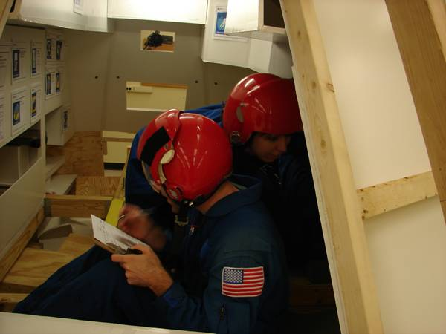
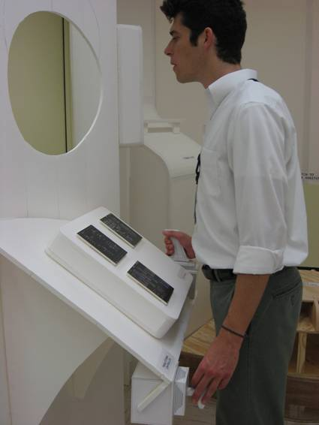
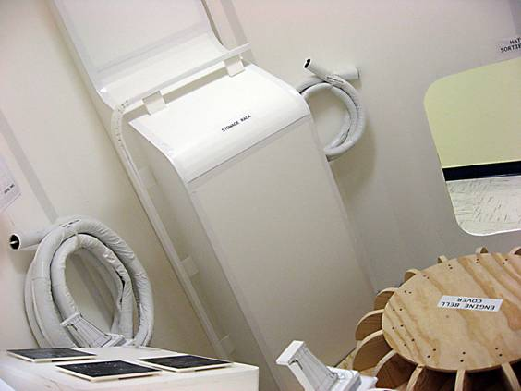
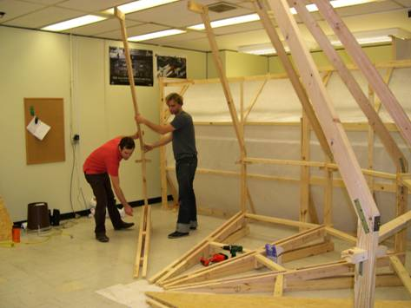
Areas of Relevant Research
Lunar Mockup Studies
Low fidelity mockups are an inexpensive way to explore outpost architectures, system/subsystem design, habitability, assembly ops, and more aspects of the Lunar vision
Student design teams can be tasked to develop lunar concepts that subsequent teams then turn into full-scale mockups
Research units can conduct numerous studies utilizing mockups to advance NASA lunar concepts

Slide 16
Inflatable Structures
Gary R. Spexarth

Slide 17
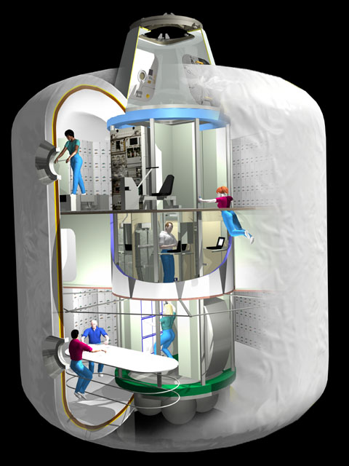
ISS TransHab
Hatch Door
Level 4: Pressurized Tunnel
Inflatable Shell
Central Structural
Core
Level 3: Crew Health Care
20” Window (2)
Level 2: Crew Quarters and Mechanical Room
Integrated
Water Tank
Soft Stowage
Array
Level 1: Galley and Wardroom
Wardroom Table

Slide 18
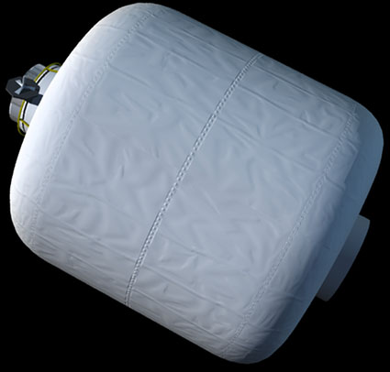
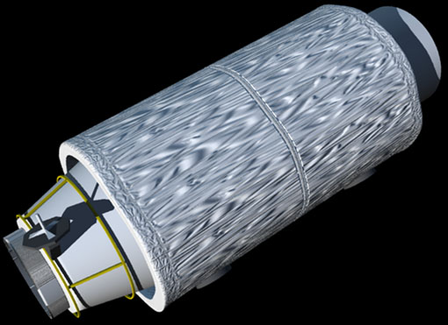
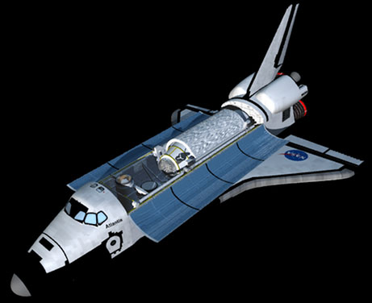
TransHab Deployment Sequence
Module
Inflated
Inflation
Launch Package

Slide 19
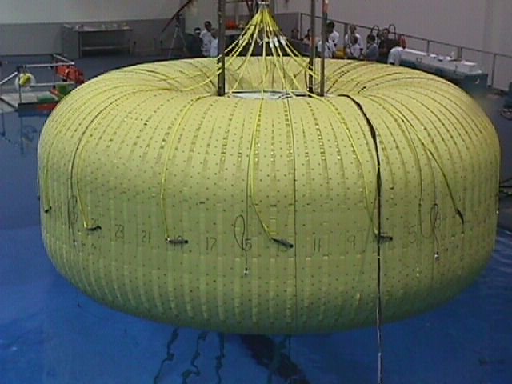
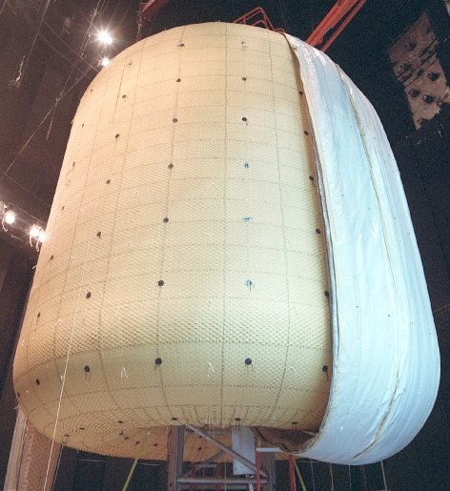
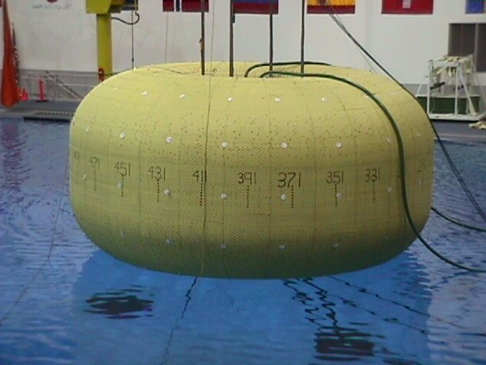
JSC Inflatable Structural Testing
May 1998
September 1998
December 1998

Slide 20
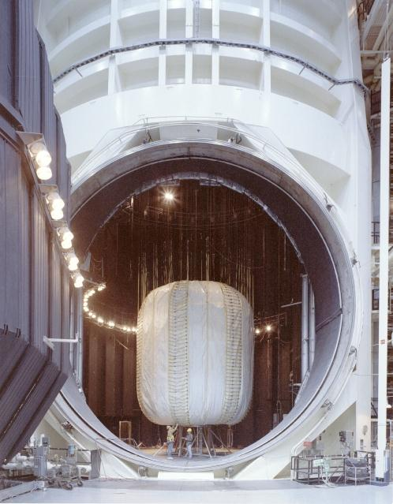
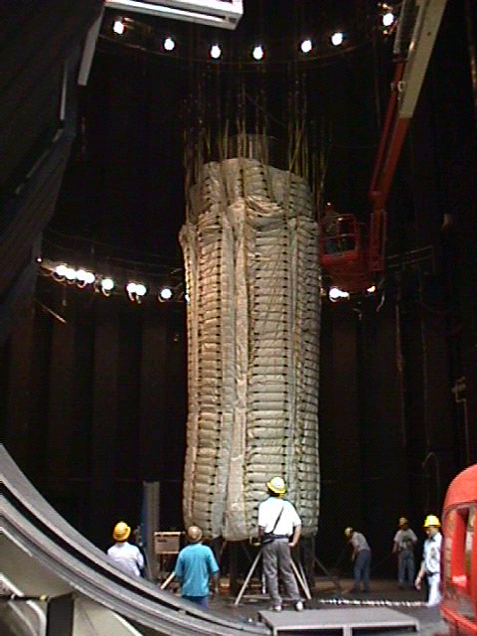
JSC Inflatable Folding Test

Slide 21
Inflatable Structure Challenges
Material properties after long-term exposure to the extreme environments of space
  Radiation
  Long-term loading (creep)
Self-healing bladders
Thermal insulation (multi-layer insulation) performance after being folded…covered with moon dust, etc.
Integration of floors in a gravitational environment
Re-location of subsystems, once inflated (plumbing and electrical lines, etc.)

Slide 22
Thermal Control
David Wertheimer

Slide 23
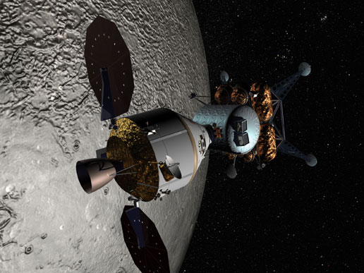
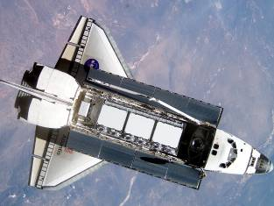
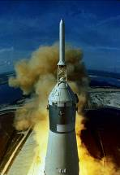
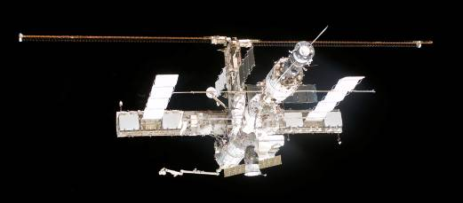
Active Thermal Control Systems
Background
Typically a pumped single phase fluid loop
Acquire heat from air and equipment
Transport heat within the vehicle
Reject energy into space
Common components include: air-liquid HXs, condensing HXs, flat plate HXs, cold plates, centrifugal pumps, radiators, sublimators, spray boilers, flow boilers

Slide 24
Active Thermal Control Systems
Challenges for the Future
Long duration condensing heat exchangers
Heat pumps for space applications
Sublimators with longer operational lives
Radiator performance on the Moon and Mars
  Coatings
  Temperature extremes
  Dust
  CO₂ environments
Micrometeoroid and orbital debris protection for radiators
Long life components including pumps, quick disconnects, instrumentation, and valves

Slide 25
Space Radiation
Tamra George

Slide 26
The Space Radiation Analysis Group (SRAG) maintains a comprehensive set of codes and models allowing the rapid, precise evaluation of radiation exposures for design evaluation, mission/timeline planning, real-time evaluation and event mitigation, and flight support.
Environmental Models provide characterization of conditions encountered in space allowing a predictive rather than reactive position to be taken with regard to space radiation exposures.
Radiation Transport describes the interaction of radiation fields with matter, including the human body. These models allow accurate characterization of the changes in radiation fields within structures (vehicles, habitats, etc.), enabling evaluation of time-and-location specific exposure profiles for astronauts in any mission phase.
As-Built Design Evaluations allow the prediction of radiation exposure in a way wholly consistent with the as-built hardware and thus the actual exposure scenario. This coupling of precise transport and actual geometry allows a reliable reproducible characterization of exposure scenario, eliminating any uncertainty introduced by simplified or approximated shield geometry.
Mission Optimization is the optimization of trajectory and timeline in order to maintain radiation exposure As Low As Reasonably Achievable (ALARA) in accordance with NASA regulation and federal law.

Slide 27
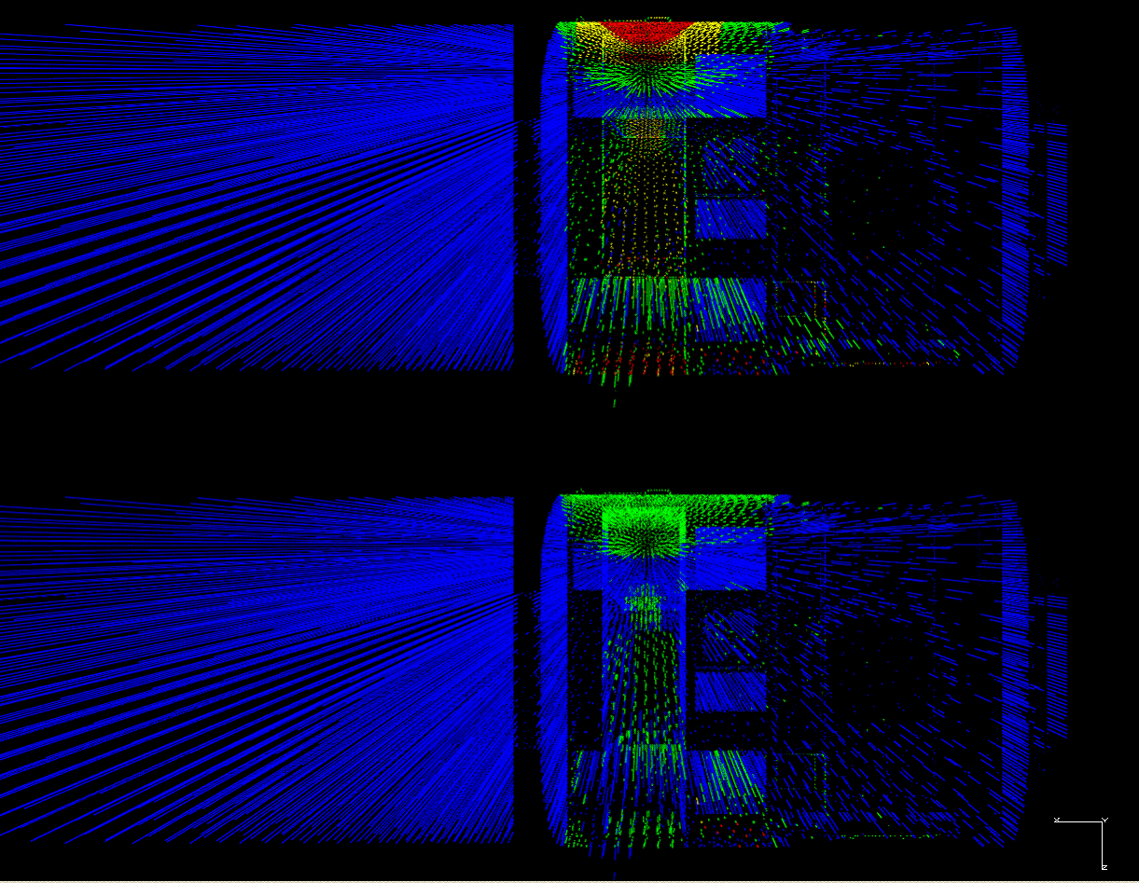
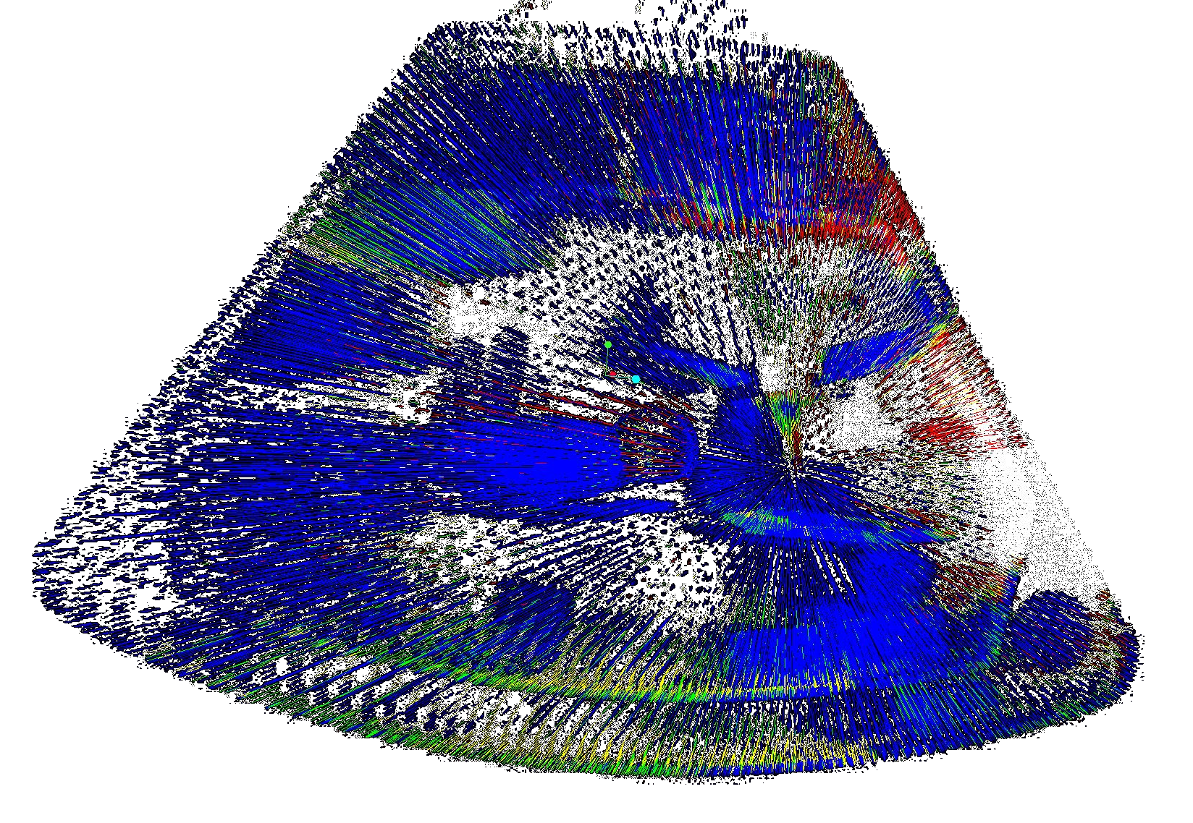
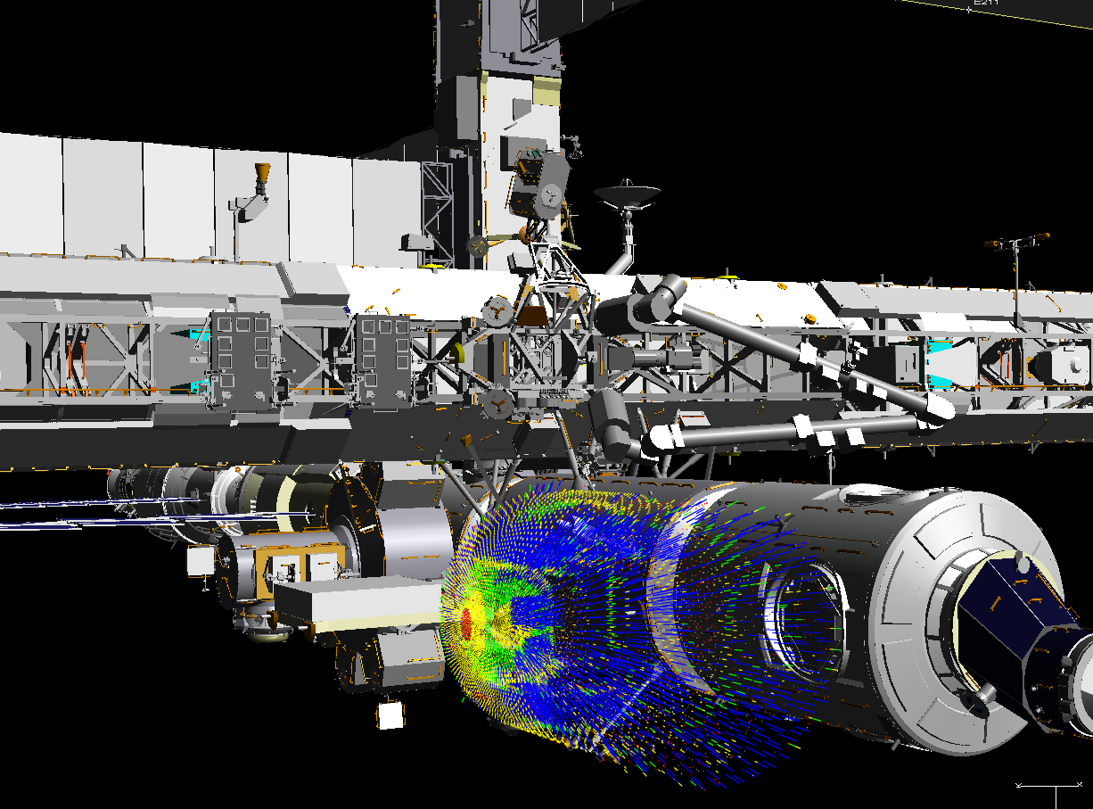

Left Pictures: ISS Node2 Element Images w/and w/o shielding applied
Bottom Right Picture: CEV design analysis
Bottom Left: Evaluation of ISS crew exposure for operations
space radiation analysis group

Slide 28
SRAG utilizes these codes and models for CEV analysis and operational concept design. Shielding becomes more important for Lunar and Mars missions that are outside the Earth’s protective magnetosphere. Best opportunity for implementing ALARA inside vehicles and habitats is during the design process, allowing for operational flexibility.
CHALLENGES:
Transport codes / nuclear physics of radiation interactions
environment models
real-time data correlations
Neutron contributions to exposure within structures
Human geometry / Exposure quantity definition (effective dose?)
COLLABORATIONS:
Modeling and analysis supporting pro-active (planning) approach to radiation safety for space operations derived largely from the efforts of university collaborations. Active collaborations:
University of Tennessee
University of Houston
University of Milan, Italy
CERN, Geneva
SWRI (South-West Research Institute), Boulder Co.

Slide 29
DISCUSSIONS

Slide 30
Advanced Habitation Challenges
Protection and Safety of Crew
  Micro-meteorite Protection
    Use Regolith or built-in shield?
  Radiation Protection
    Use Regolith, water, built-in shield, etc?
  Medical Health Care
Psychology of Long-Term Confinement & Isolation
  Volume per Crew, Functional Spaces, Human Factors & Architecture
    Larger the better – but must account for launch vehicle and mass constraints.
Advanced Materials for Structures
  Composites, Inflatables, In-Situ Resource Utilization (ISRU) Derived
Vehicle/Habitat Health Monitoring
Long duration condensing heat exchangers
Heat pumps for space applications
Sublimators with longer operational lives
Radiator performance on the Moon and Mars
  Coatings
  Temperature extremes
  Dust
  CO₂ environments
Micrometeoroid and orbital debris protection for radiators
Long life components including pumps, quick disconnects, instrumentation, and valves
Material properties after long-term exposure to the extreme environments of space
  Radiation
  Long-term loading (creep)
Self-healing bladders
Thermal insulation (multi-layer insulation) performance after being folded…covered with moon dust, etc.
Integration of floors in a gravitational environment
Structural & thermal interface contact with rocky surface
Re-location of subsystems, once inflated (plumbing and electrical lines, etc.)
How much volume is really required
  Pressurized vs Habitable
Design layouts / Habitability – Inexpensive Mockups
Radiation:
Transport codes / nuclear physics of radiation interactions
environment models
real-time data correlations
Neutron contributions to exposure within structures
Human geometry / Exposure quantity definition (effective dose?)

