Slide 1

Enforcement Case EC 2004-051
Respondent: Scott Van Deventer
Site Location: Caribou Lake, T 3 R12 WELS, Piscataquis County

Slide 2

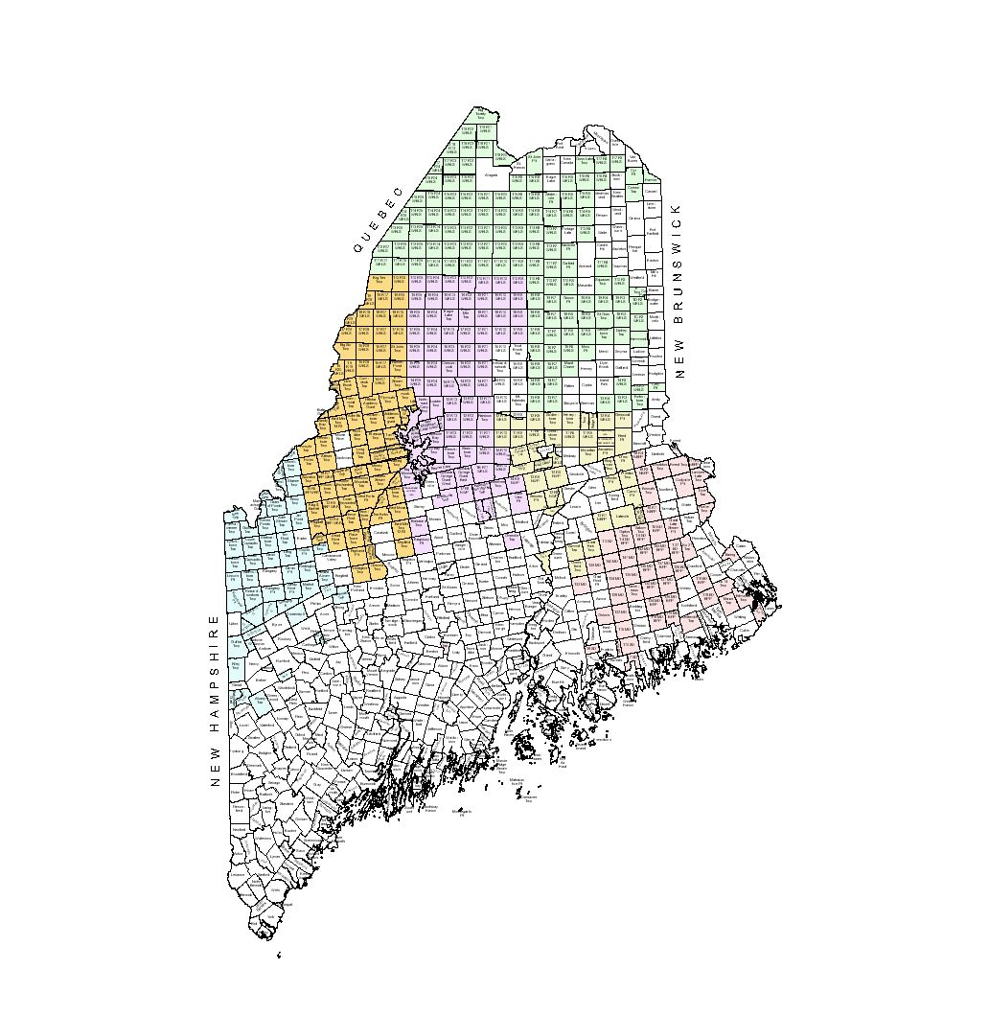
Location

Slide 3
Background Information
Prior Development: pre-Commission nonconforming seasonal camp adjacent to Caribou Lake
October 1994: BP 8826 authorized the construction of a 24 foot by 36 foot seasonal camp and installation of a combined sewage disposal system. The previously existing camp was to be converted to a boat house and have all plumbing fixtures removed.

Slide 4
Summary of Violations
December 2004: Commission staff conducted a site inspection and observed that Van Deventer constructed a 24 foot by 48 foot seasonal camp instead of the previously proposed and approved 24 foot by 36 foot camp. In addition, the plumbing fixtures had not been removed from the original camp, which was proposed and approved to be converted to a boat house. The camp has continued to be used for habitation and also expanded in size from its original footprint of 225 feet to approximately 1,500 sq. ft.

Slide 5
Summary of Violations
Staff also observed a large area had been cleared between the original camp and the new camp approved in BP 8826, such that the existing clearing exceeds 13,000 sq. ft.

Slide 6
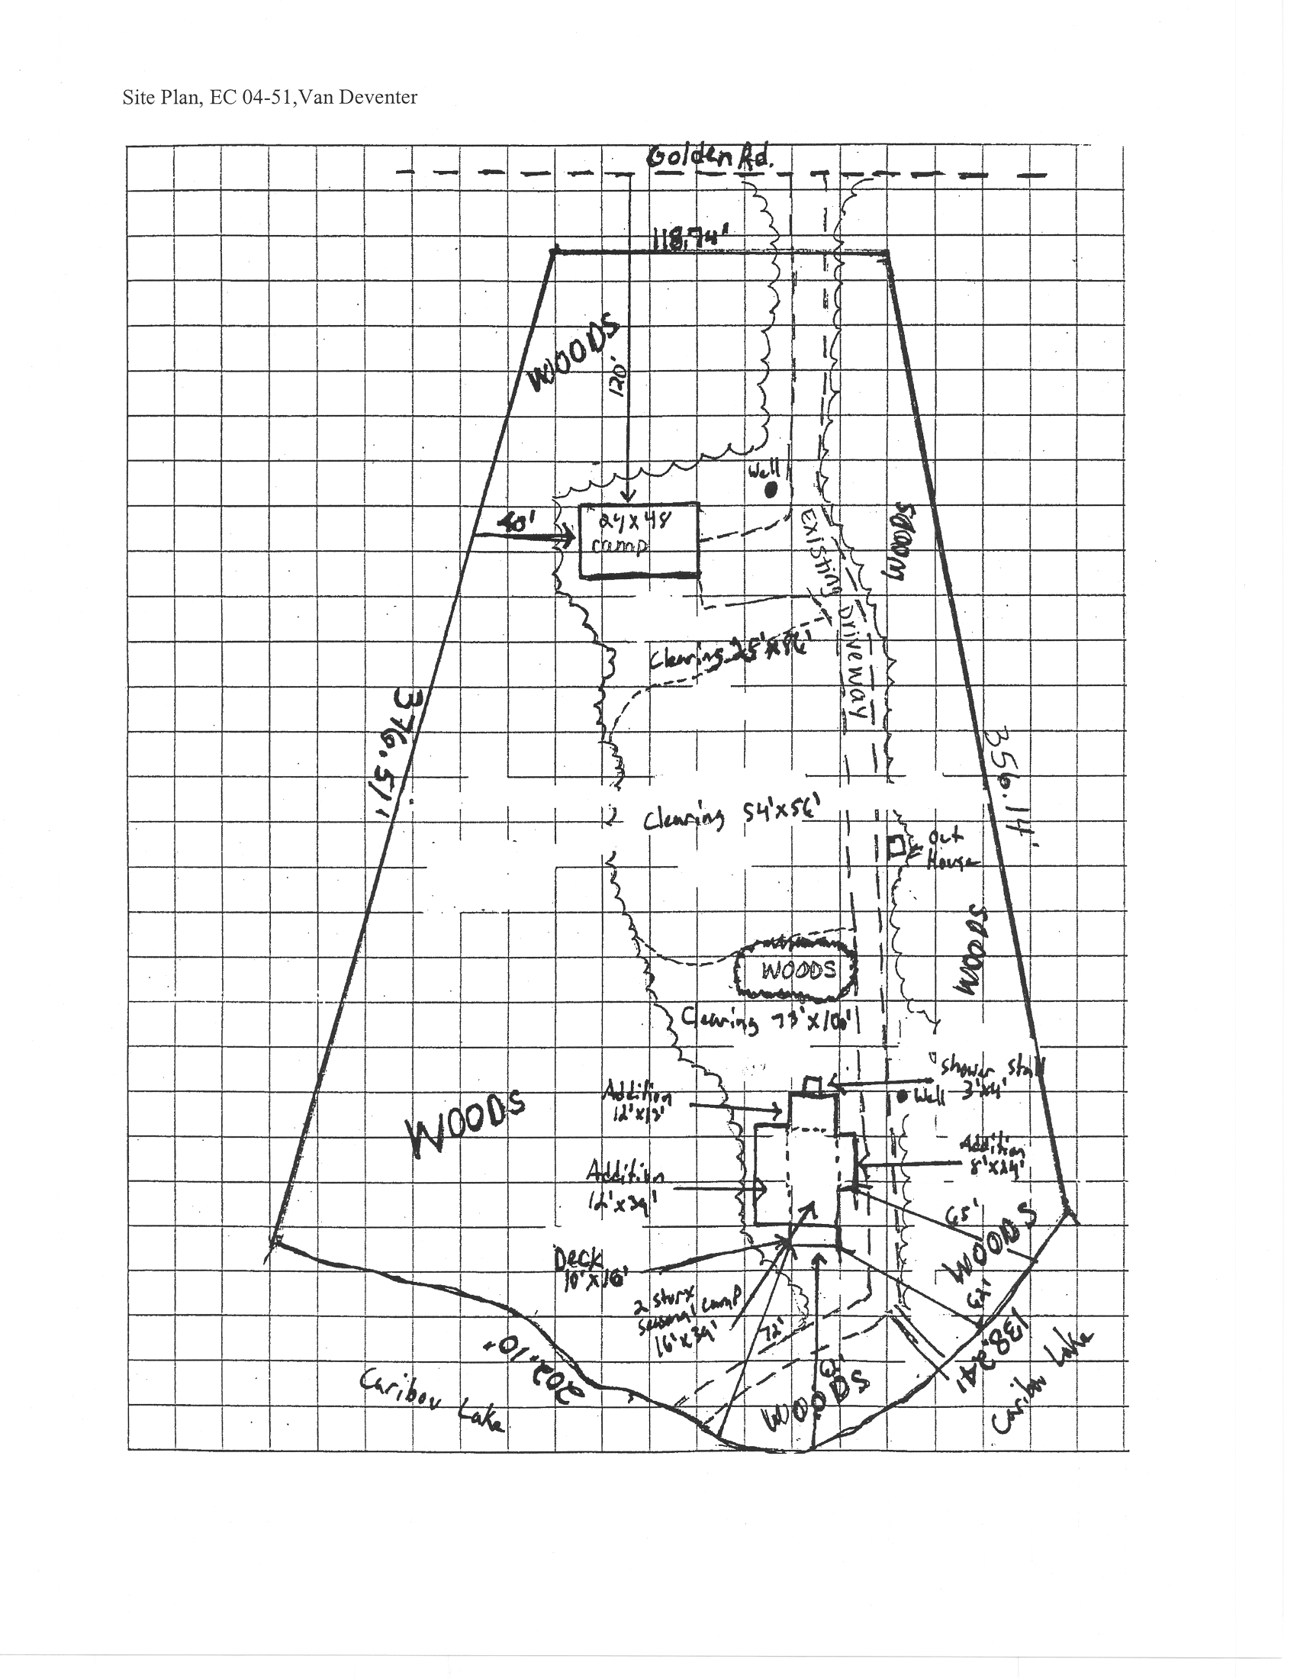
Site Plan

Slide 7
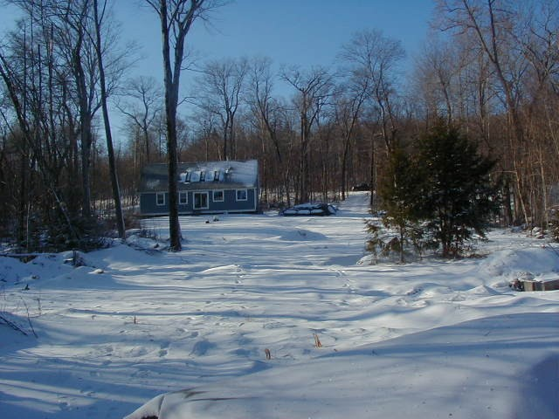
Camp

Slide 8
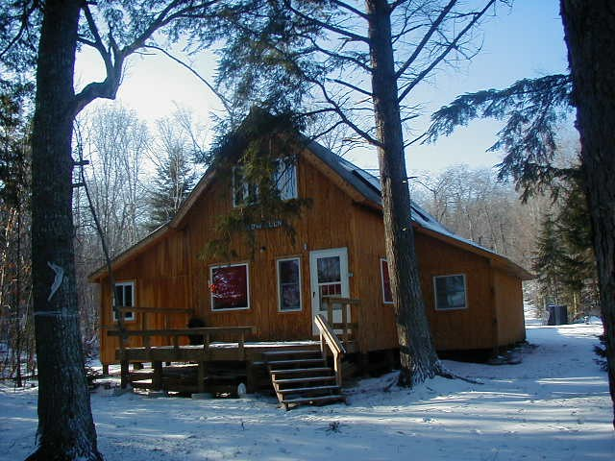
Pre-Commission camp

Slide 9
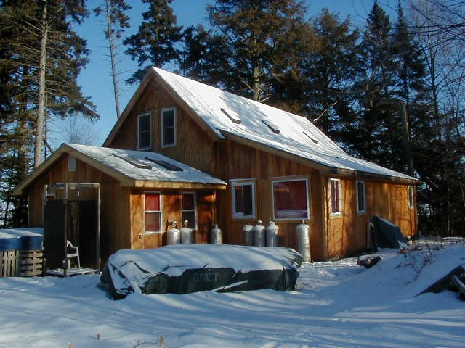
Pre-Commission camp

Slide 10
Settlement Conditions
Pay a civil penalty of $750.
By August 30, 2005, bring the property and improvements into full compliance with the Commission’s permit requirements and standards; apply for an after-the-fact Amendment to Building Permit BP 8826 to reflect the actual dimensions of the camp and to relocate and convert the expanded pre-Commission camp to a garage with attached bunkhouse. In the event permit approval is denied for a water supply system to the structure, all internal plumbing shall be removed.

Slide 11
Settlement Conditions
By August 30, 2005, re-establish and maintain a well vegetated buffer of trees and shrubs within the existing 13,000 sq. ft. clearing, as well as that area of the lot where the pre-Commission camp was located.

Slide 12
Conclusion
Staff believe this agreement is a fair resolution and consistent with your Compliance and Enforcement Policy and request that you ratify the agreement.

