Slide 1
Alternate Care Facilities
Lewis Rubinson, MD, PhD
Public Health Seattle and King County

Slide 2
Select Crucial Disaster Response Functions: ACFs
Medical surge for emergencies
Establishing temporary medical collection points until evacuation outside of region can be completed
Population screening
Medication and vaccine distribution

Slide 3
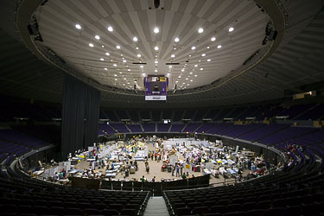
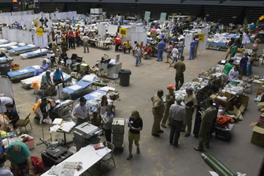
Conceptual Foundation
Acute Care Center (SBCCOM)
Providing Mass Medical Care with Scarce Resources (AHRQ)
Federal Medical Stations & National Disaster Medical System (DHHS)
Communities with real-life experience (Houston, Louisiana, Florida)

Slide 4
Scope of Medical Care
Provide medical care for non-life threatening conditions
    Care that cannot be delivered by overwhelmed health sectors
    Non-complex care to offload patients from health system which can focus on complex patient care
Provision of medical care in non-medical buildings of convenience
    Urgent care
    Non-complex “inpatient care”
    End of life care
    Home health/long-term care
    “Medical needs sheltering”
    Large-scale exposure screening

Slide 5
Many Independent ACFs or Several Regional ACFs?
Large Regional ACFs
  “Inpatient” capacity ~ 250-750 pts
  Up to 3 facilities (regionally distributed)
  Few large facilities rather than many smaller facilities
    Advantage: logistics, security, staffing, co-habitation with shelters, resource commitment shared among many institutions
    Disadvantage: Accessibility

Slide 6
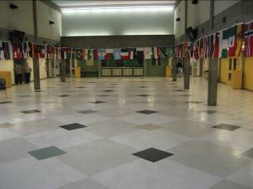
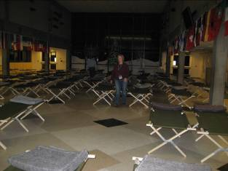
ACF King County Experience
Medical Needs Shelter
Opened within 10 hrs of decision
~ 50 pts over several days
Sheltered 36/42 long-term care pts
Staff, equipment, communications

Slide 7
Concept of Operations- Work plan
ACF Function | Planning Body | Timeline
Staffing Model and Structure | 0.5 FTE hired in 06/07 | Complete by 12/07
Pharmacy Dispensing and Rx Refill | ACF Pharmacy Task Force | Ongoing thru Fall
“Inpatient Care” | ACF Inpatient Task Force | Fall thru Winter
 | Healthcare Coalition Palliative Care Workgroup | Ongoing thru Fall
Medical Needs Sheltering | Multiple internal/ external groups | Ongoing
Urgent Care | ACF Task Force on Urgent Care | Fall thru Winter
Discharge Planning/ Healthcare system connections | ACF Task Force on Discharge Planning | Fall thru Winter
Mass Fatalities | Onora Lien | Fall

Slide 8
Many Independent ACFs?
Advantage: Accessibility, independent control of operations
Disadvantage: Limited sharing of resources, increased logistics burden, more difficult regional coordination with partnering agencies

Slide 9
Equipment
Current evaluations and procurements:
Bulk oxygen systems
Bed options
Communications equipment
Future evaluations and procurements:
Medical equipment (DME)
Disposable medical equipment
Non-medical essential materiel
Current funding source gap to equip ACFs to operate at proposed patient volumes
Current funding anticipated to require at least 3-5 years to have ~ 2000 “inpatient” capacity

Slide 10
Staffing
PHSKC staff
Expansion of Public Health Reserve Corps
PNEMA, EMAC, Federal assets
- Insufficient administrative and clinical staff to operate an ACF

Slide 11
Recommendations
Executive Council approval to further develop a regional Alternate Care Facilities strategy for King County
Coalition staff will present a draft ACF budget and staffing proposal at the Executive Council meeting in September

