Slide 1
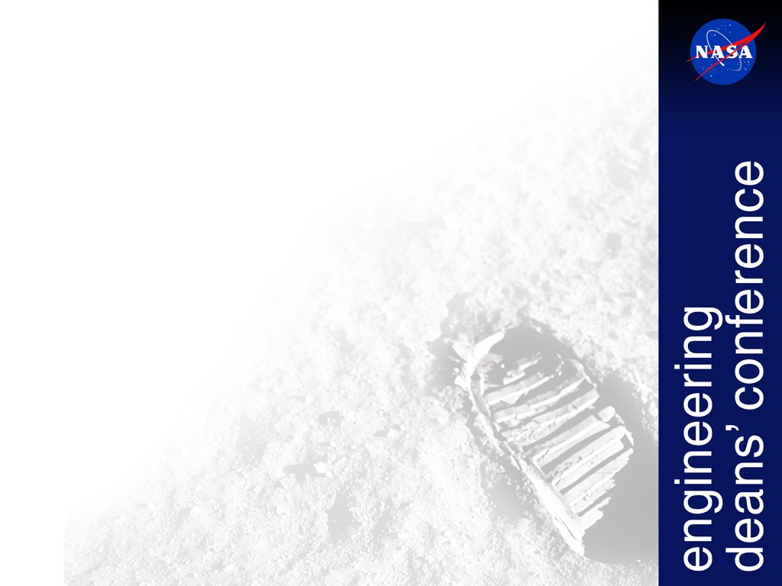
Welcome
to
Advancing Technology
and Education
for a Human Base on
the Moon and
Footprints on Mars...

Slide 2
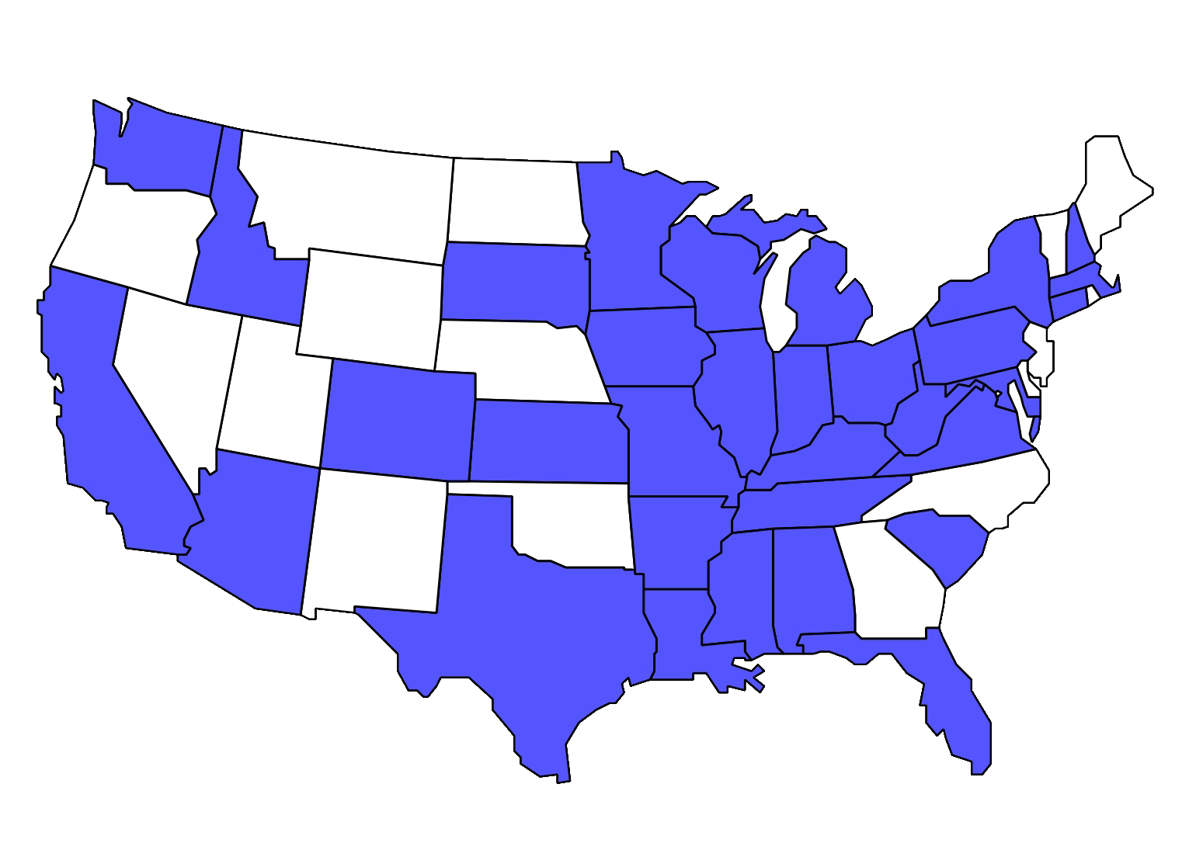

Slide 3
Safety Information
In an emergency, call 281-483-3333 from your cell phone
OR
From a phone in the Gilruth Center call 33333.
If you have any questions or need help, please call:
Helen Lane 281-513-6820
Kam Lulla 281-853-5652
Terri Jones 281-507-0592
Kathy Weisskopf 281-797-1699

Slide 4
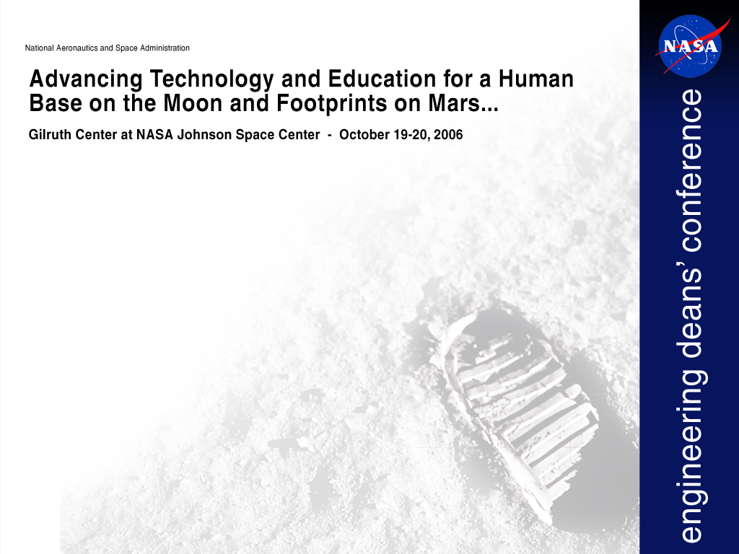
Thursday, October 19th
7:30 a.m. – 8:30 a.m. Registration/Breakfast
8:30 a.m. – 8:40 a.m. Welcome and Overview of Agenda for the Day
Helen Lane, Manager, University Research and Affairs
8:40 a.m. – 8:55 a.m. Center Director’s Welcome
Mike Coats, Director, Johnson Space Center
8:55 a.m. – 9:00 a.m. Introduction of the Keynote Speaker
Helen Lane
9:00 a.m. – 9:30 a.m. Keynote Speaker
Lance Davis, Executive Director, National Academy of Engineering, Washington, D.C.
9:30 a.m. – 10:00 a.m. Constellation Program
Mark Geyer, Deputy Manager
10:00 a.m. – 10:15 a.m. Break
10:15 a.m. – 10:45 a.m. Lunar Surface Operations
Carlos Noriega, Director, Advanced Projects Office
10:45 a.m. – 11:15 a.m. Lunar Habitat Challenges
Larry Toups, Lead for Habitation
11:15 a.m. – 11:45 a.m. Engineering Challenges
Nancy Currie, Deputy Director, Engineering Directorate
11:45 a.m. - 12:15 p.m. Human Systems Engineering
Dane Russo, Principal Scientist for Habitability and Environmental Factors
12:15 p.m. – 1:15 p.m. Lunch
1:15 p.m. – 3:45 p.m. Breakout sessions (details on back)
3:45 p.m. – 4:00 p.m. Break
4:00 p.m. – 5:00 p.m. Wrap-up/discussions on breakout sessions
5:00 p.m. – 7:00 p.m. Aerospace Industry Forum and Exhibition
Boeing, Futron, Honeywell, Jacobs Engineering, Lockheed-Martin, NASA Education,
NASA Technology Transfer, Space Alliance Technology Outreach Program,
University of Texas Medical Branch, Wyle Labs

Slide 5
Breakout session topics: Please see your information packet for room locations.
Thursday, October 19th
1:15 p.m. – 3:45 p.m. Breakout sessions
Habitable systems and structures
This theme includes interplanetary and surface habitable structure technologies; inflatables, heat-rejection systems; radiation/thermal monitoring and mitigation; human-systems integration technologies; habitat/airlock structures.
Extra Vehicular Activity (EVA) and mobility systems and operations
This theme includes advanced suits for EVA; including advances in life support and suit materials; and robotic systems for mobility and operations.
Surface environments and In-situ resources
This theme includes mitigation and utilization (for example Moon dust) of surface environmental conditions and utilization of surface resources.
Human life support systems and health care
This theme includes closed-loop life support regeneration technologies; real-time environmental monitoring (radiation, air, and water); and on-site hardware for human health monitoring, medical diagnosis and treatment as well as countermeasures (exercise etc.).
Avionics and communications systems
This theme includes avionic advancements in minimizing volume, mass, power consumption technologies; communication systems on ground and ground-to-planetary surfaces; and planetary surface communication systems and technologies.
Aerosciences and flight mechanics
This theme includes flight mechanics for all mission modes in interplanetary space: trajectories; rendezvous and docking; guidance, navigation and control; entry aerodynamics and aerothermodynamics.
Friday, October 20th
9:00 a.m. – 11:00 a.m. Technical Interchanges at Johnson Space Center Laboratories/Facilities -
Please see your information packet for arrangements.

