Slide 1

Office of Generic Drugs
Director’s Update
Generic Pharmaceutical Association/FDA Meeting
Gary J. Buehler, R.Ph.
Director
June 26, 2003

Slide 2

Topics
Workload
Priorities
Goals
Plans

Slide 3
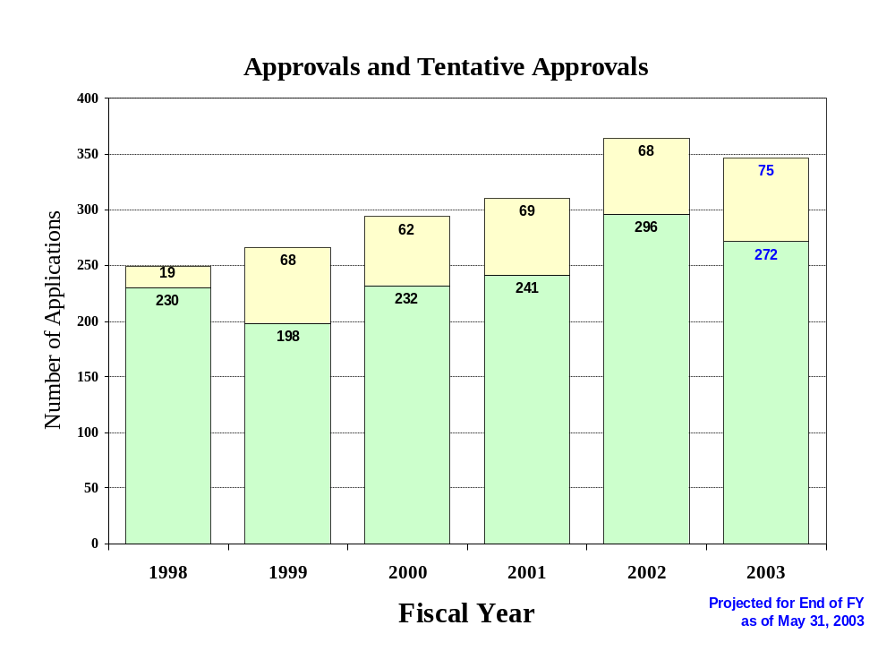

Slide 4
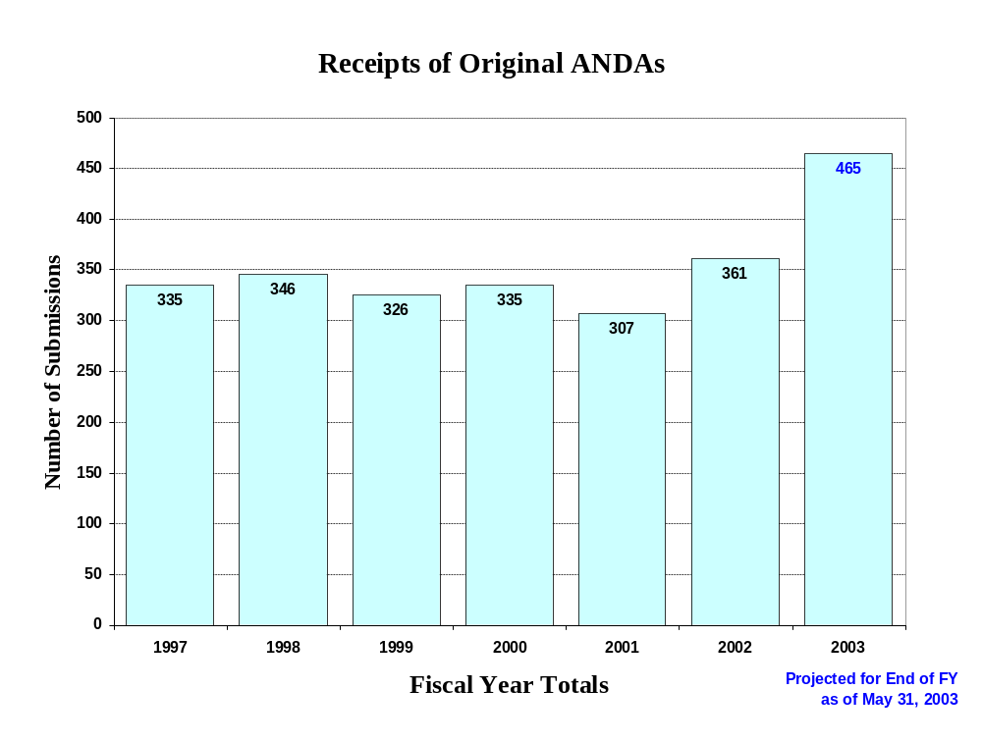

Slide 5
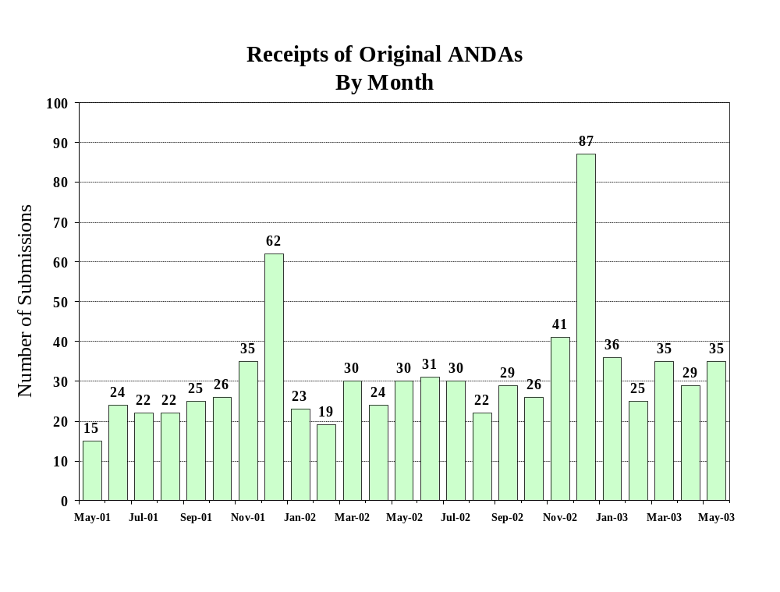

Slide 6
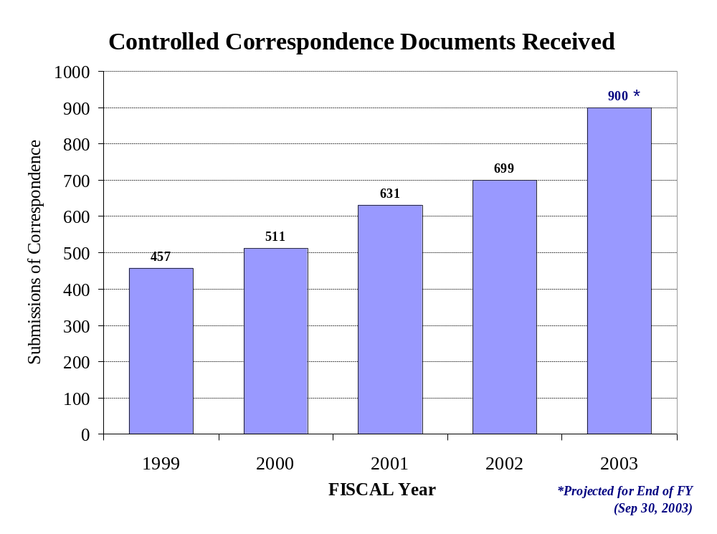

Slide 7
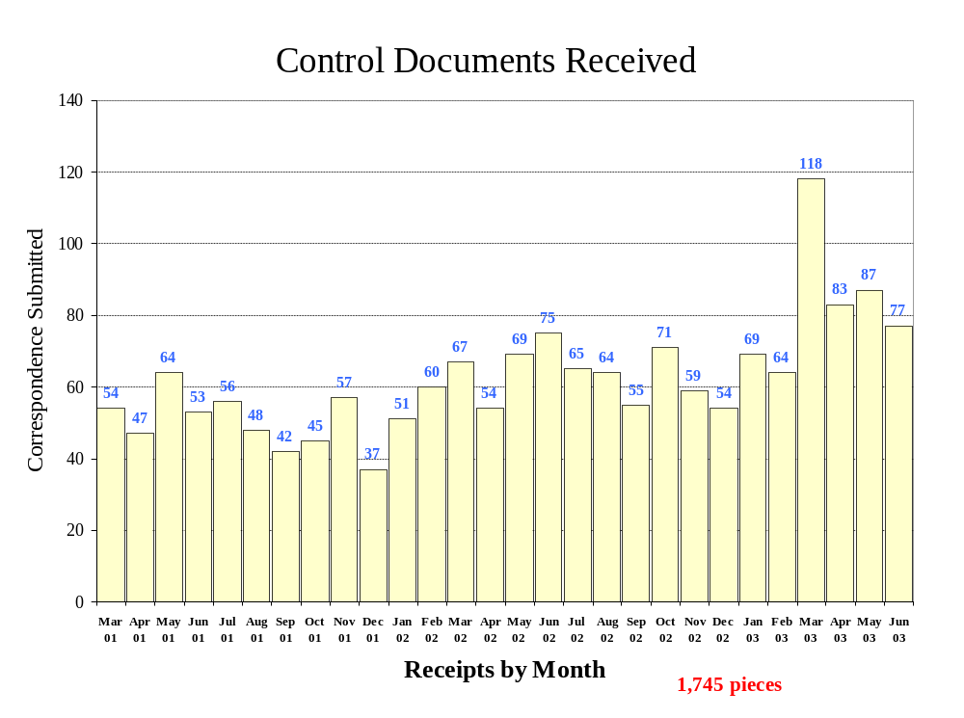

Slide 8
Controlled Correspondence
Same reviewers that review ANDAs respond to Controlled Correspondence
We realize there is a backlog
Many firms submit multiple requests
We are hiring new reviewers but it could take some time to clear backlog

Slide 9
Dispute Resolutions
Informal
  Within division
  Division Director
  Office Director
Formal
  Per guidance

Slide 10

Commissioner’s Priorities
Improve efficiency of review process
  Increase early communication (during first cycle)
  Provide additional guidance for preparing quality, complete applications

Slide 11

Commissioner’s Priorities (cont’d.)
  Increase number of first cycle approvals
  Decrease the total time to approval
  Hasten generic products to market

Slide 12
Resource Increase
$13 million proposed for FY04
Hire 40 new reviewers
Initiate targeted research
Improve the efficiency of the review process

Slide 13
OGD Generic Drug Quality Awareness Program
Help consumers get accurate information about generic drugs
Ensure that consumers are aware that FDA-approved generic drugs are safe, effective and bioequivalent to “brand name” counterpart
Counter the existing bias against generic drugs

Slide 14
OGD Goals
GPRA (Govt. Performance & Results Act)
  Percent of original applications acted upon within 180 days
    Not compatible with achieving 1st cycle approvals
    OGD has met goal very successfully

Slide 15

Short Term Plans...
Meet regularly with GPhA to discuss timely issues
Improve communication during the review process
Hire and train more reviewers

Slide 16

Long Term Plans...
Look critically at our review process
Identify where possible, avenues to expedite generic approvals, especially for first generics
Initiate research programs to address inadequate or onerous BE methods for certain products

Slide 17

Conclusion
We want to work with the generic industry
We want to identify where we can improve
We recognize the work invested in your applications

Slide 18

We, at OGD, are very proud of the role we play, as the generic industry should be proud of the role they play, in making quality, lower cost drugs available.

