Slide 1

Anomalies in Heavy Flavor Jets at CDF
G.Apollinari-Fermilab
For the CDF Collaboration
Les Rencontres de Physique de la Vallée d’Aoste
LaThuile
March 5th,2004

Slide 2
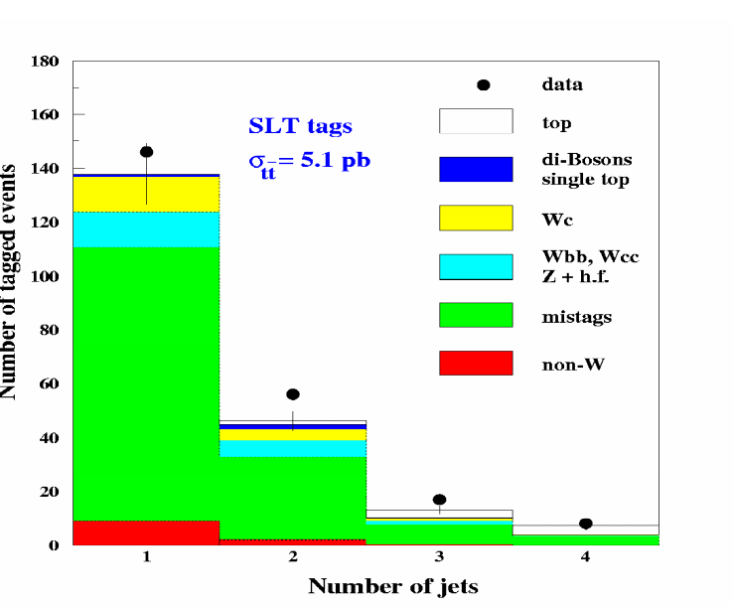

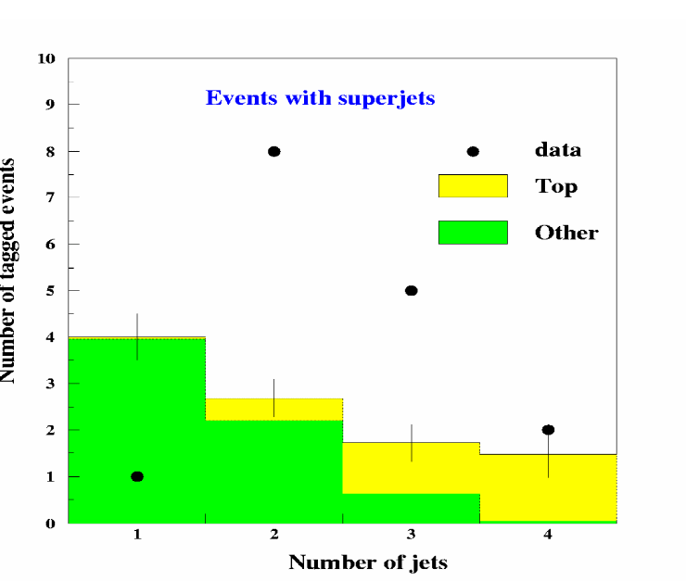
Anomaly in W+2,3 jet Events at CDF
PRD 65, 052007(2002)
CDF Data sample used in top quark measurements
Heavy Flavor Ident. (tagging) methods b c
  SECVTX 43% 9%
  JPB 43% 30%
  Soft Lepton Tagging 6.4% 4.6%
Supertag (or superjet): jet containing both a SECVTX and an SLT tag.
Primary
Lepton
E_{T}
SECVTX
SLT

Slide 3
The kinematic of the anomalous W+2,3 jets events has a 10⁻⁶ probability of being consistent with the SM simulation - PRD 64, 032004 (2002)
Superjets modeled by postulating a low mass, strong interacting object which decays with a semileptonic branching ratio of ~ 1 and a lifetime of ~1 ps - hep-ph/0109020
No limit on the existence of a charge –1/3 scalar quark with mass smaller than 7 GeV/c² (the supersymmetric partner of the bottom quark, b_{s}, is a potential candidate) - PRL 86, 4463 (2001).
This analysis is intended to search for evidence either supporting or disfavoring this hypothesis.
hep-ph/0007318 and hep-ph/0401034 use it to resolve the discrepancy between the measured and predicted values of R for 5 < √s < 10 GeV and for 20 < √s < 209 GeV at e⁺ e⁻ colliders
If light b_{s} existed, Run I has produced 10⁹ pairs; why didn’t we see them ?

Slide 4
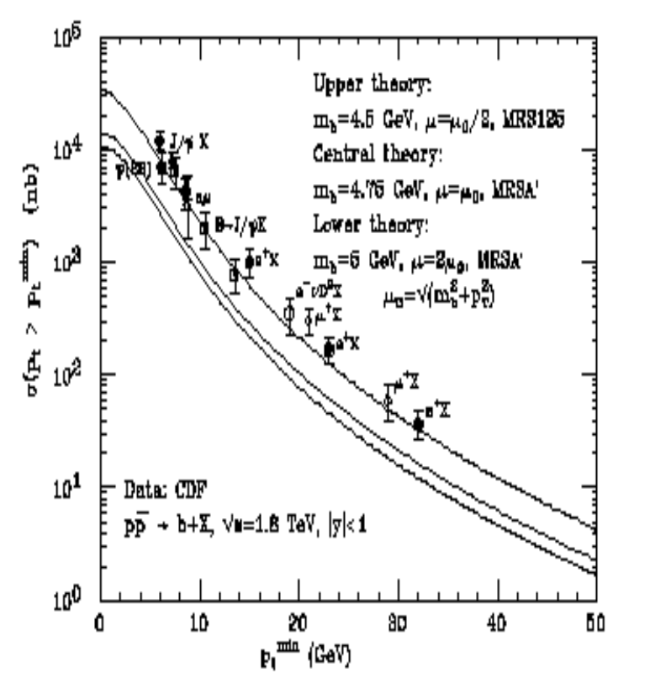
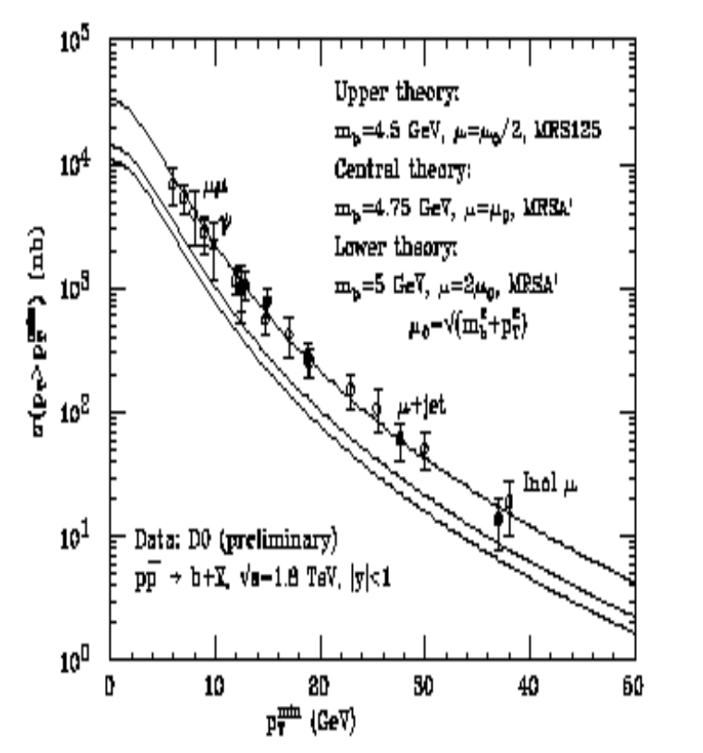
PRL 86, 4231 (2001) uses it in conjunction with a light gluino which decays to b b_{s} to explain the difference of a factor of 2 between the measured single-b production cross section and the NLO prediction.
Necessary but not sufficient condition
  NLO not robust

Slide 5
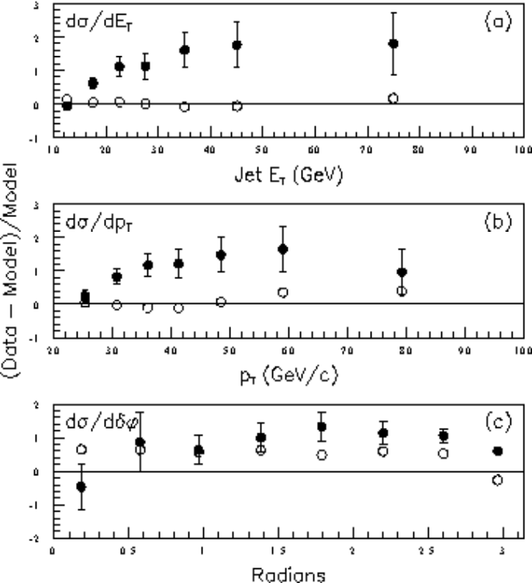
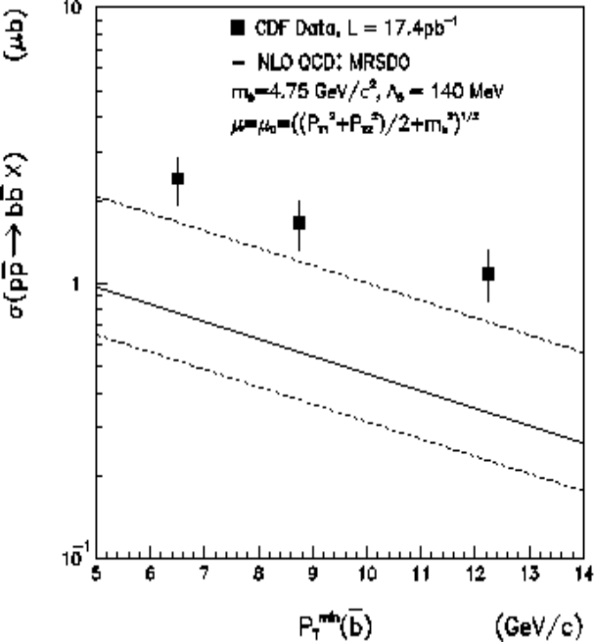
However….
Some interesting CDF & DǾ disagreements between Data and Simulation:
  b+μ Production Cross-Section: σ_{bb} . BR
    Data are 1.5 times larger than NLO calculation, LO and NLO calculations are comparable
    PRD 53, 1051 (1996)
  bb→ μ⁺μ⁻ Correlations: σ_{bb} . BR²
    Data are 2.2 times larger than NLO calculation, LO and NLO calculations are within a few percent
    PRD 55, 2547 (1997)
    Phys.Lett. B 487, 264 (2000)
Hint: Data-Simulation discrepancy could increase with the number of leptons in the final state
  Other necessary but not sufficient condition
Notes:
The open circles are the model prediction for a renormalization scale of mu/2 minus the model prediction for m divided by model

Slide 6
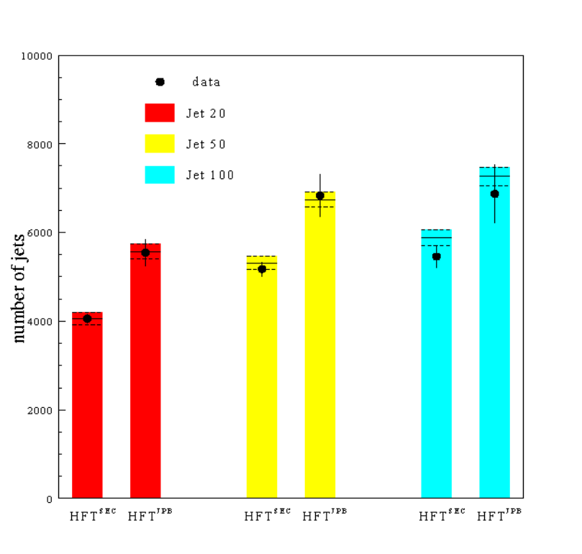
Situation
The NLO calculation of p p → b_{s}b_{s} predicts σ_{bs} = 19.2 μb for a squark mass of 3.6 GeV/c² (Prospino MC generator program) .
    σ_{bb} = 48.1 μb (NLO)
    σ_{cc} = 2748.5 μb (NLO)
We have used a generic jets data sample with E_{T}>15 GeV and |η|<1.5 (corresponding to partons with E_{T} larger than 18 GeV) to calibrate the simulation by using measured rates of SECVTX and JPB.
Can easily “bend” any Heavy Flavor generator or NLO calculation to explain in terms of SM processes an additional 10% production of scalar quarks
PRD 64, 032002 (2001)
σ_{bs} = 84 nb (Prospino MC)
σ_{bb} = 298 nb (NLO)
σ_{cc} = 487 nb (NLO)

Slide 7
Strategy
σ (nb) b_{s}(%) tuned QCD σ/ σ_{QCD}
b c b_{s} total b c total
generic jets tuned 298 487 84 869 10% 382 487 869
σ (nb) b_{s}(%) tuned QCD σ/ σ_{QCD}
b c b_{s} total b c total
generic jets tuned 298 487 84 869 10% 382 487 869 1
g. j. t. x BR 110 102 84 296 28% 141 102 243 1.2
σ (nb) b_{s}(%) tuned QCD σ/ σ_{QCD}
b c b_{s} total b c total
generic jets tuned 298 487 84 869 10% 382 487 869 1
g. j. t. x BR 110 102 84 296 28% 141 102 243 1.2
g. j. t. x BR² 41 22 84 147 57% 52 21 73 2
σ (nb) b_{s}(%) tuned QCD σ/ σ_{QCD}
b c b_{s} total b c total
generic jets tuned 298 487 84 869 10% 382 487 869 1
g. j. t. x BR 110 102 84 296 28% 141 102 243 1.2
g. j. t. x BR² 41 22 84 147 57% 52 21 73 2
g .j. x BR tuned 110 102 84 296 28% 194 102 296 1
(or lep-trig. evts)
σ (nb) b_{s}(%) tuned QCD σ/ σ_{QCD}
b c b_{s} total b c total
generic jets tuned 298 487 84 869 10% 382 487 869 1
g. j. t. x BR 110 102 84 296 28% 141 102 243 1.2 CS
g. j. t. x BR² 41 22 84 147 57% 52 21 73 2
g .j. x BR tuned 110 102 84 296 28% 194 102 296 1
(or lep-trig. evts)
lep-trig. evts. x BR 41 22 84 147 57% 72 21 93 1.5 SS
#2
Data in presence of a b_{s} with 100% s.l. BR
Prediction in tuned simulation with b & c quarks only
vs.
#4
#5
Could tune generic jets and absorb the b_{s} production into the b-quark production…..
…and then require the presence of a Semileptonic decay (in b-decay a SLT is produced in 37% of the cases, while in c-decay a SLT is produced in 21% of the cases) to start seeing a deviation from the tuned expectation…
…and see an even larger deviation (~2) when 2 Semileptonic decays are requested in the generic jet sample. This approach, however, would be open to arguments on the Lepton Identification Efficiency.
Alternatively, to avoid problems with the Lepton ID efficiency, the data can be tuned to the QCD Simulation AFTER the Semileptonic decay has taken place (this data sample corresponds to the Lepton-trigger data sample) using SECVTX and JPB tags. The tuning would avoid σ_{bb} theoretical uncertainties and uncertainties in the triggering lepton …
…and require a second SLT in the event to define the Signal Sample (SS) …
The Control Sample is used to calibrate the SLT efficiency in the simulation and a comparison between the S.S. and the C.S. could have a discrepancy of ~30%.

Slide 8
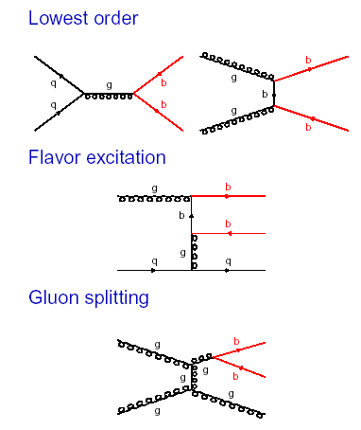
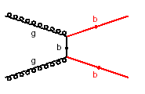
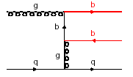
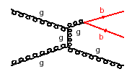
Models to predict Heavy Flavor Production
HERWIG vs Exact NLO Calculation
LO – Born term
NLO – Virtual Emission
Scattering with 2 b-partons in the final state
Scattering produces a gluon recoiling against 1 or 2 b-hadrons in the final state
b
Gluon splitting
Flavor Excitation
Parton shower
Structure function
Notes:
In herwig si va a ordini superioni in frammentazione emettendo gluoni

Slide 9
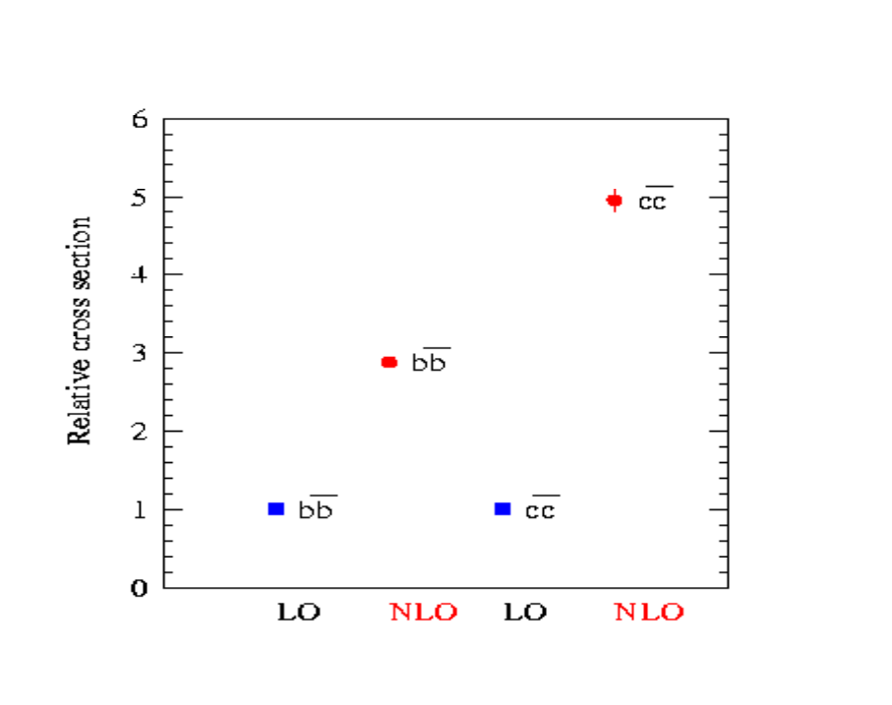
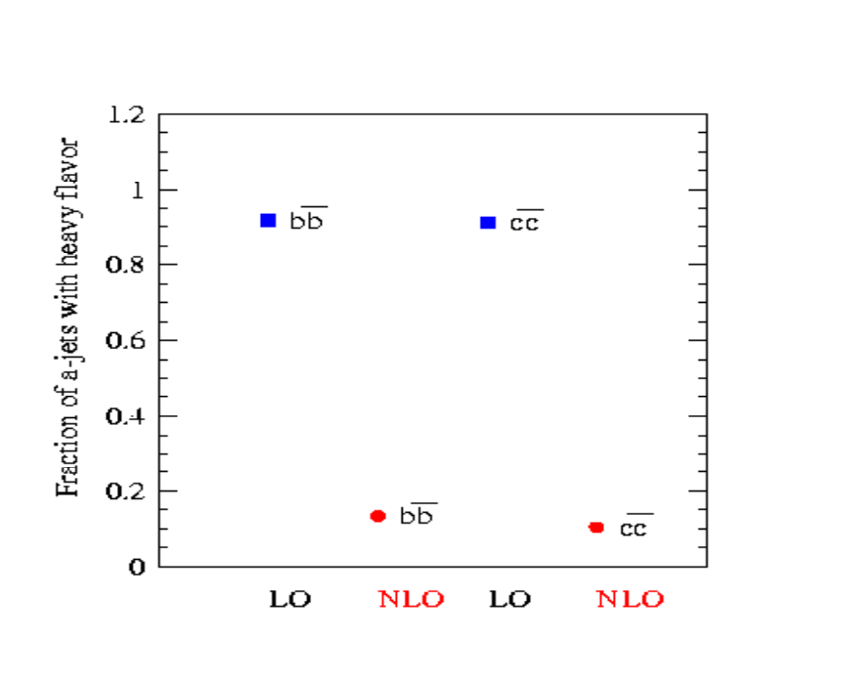
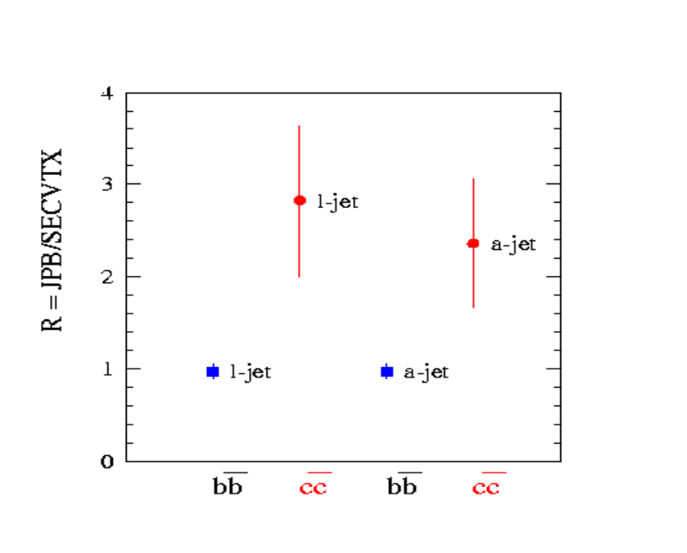
HERWIG vs Exact NLO Calculation
NLO/LO terms can be different for different models (NLO/LO~4 for HERWIG, NLO/LO~2 for NLO Calc.).
HERWIG
Exact NLO
Fraction of away h.f. jets in detector acceptance is different for LO vs. NLO terms
Use tools to disentangle bb from cc production

Slide 10
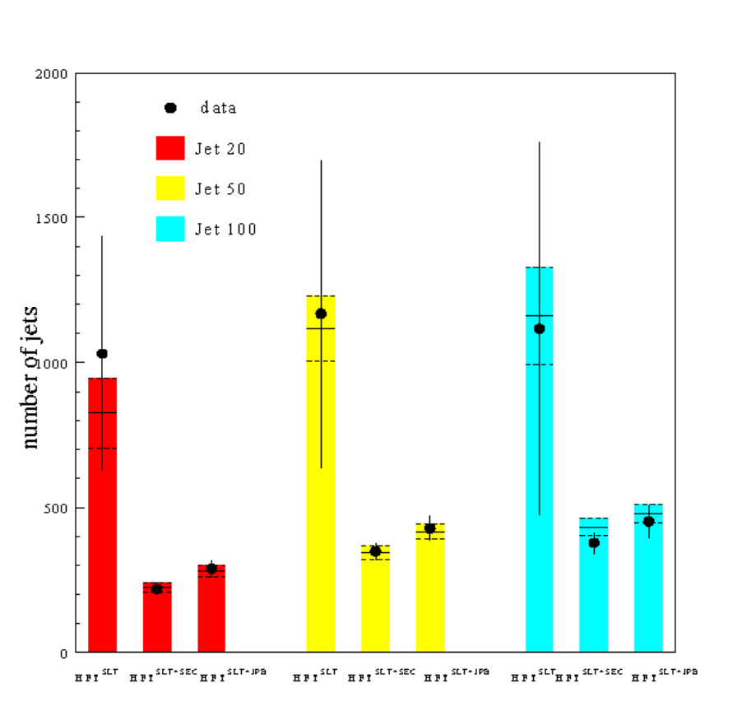
Generic Jet Control Sample
The simulation of the SLT algorithm uses efficiencies derived from the data (conversions, Z’s and ψ mesons decays) .
Use generic-jet data to calibrate and cross-check the efficiency for finding SLT tags and supertags.
Efficiency for finding supertags empirically corrected by 15%
σ (nb) b_{s}(%) tuned QCD σ/ σ_{QCD}
b c b_{s} total b c total
generic jets tuned 298 487 84 869 10% 382 487 869 1
g. j. t. x BR 110 102 84 296 28% 141 102 243 1.2
g. j. t. x BR² 41 22 84 147 57% 52 21 73 2
#2

Slide 11
Signal Sample
Use sample enriched in Heavy Flavor content
  Events with 2 or more jets with E_{T} > 15 GeV and at least two SVX tracks (taggable,|η|<1.5)
  one electron with E_{T}> 8 GeV or one muon with p_{T} > 8 GeV/c contained in one of the jets
Counting Experiment:
  Determine the b- and c-quark composition of the data by counting the number of SECVTX, and JPB tags on both the lepton- and away-jets
  Check the semileptonic branching ratio of Heavy Flavor hadrons by counting the number of a-jets with a SLT and in the data and in the simulation
_{away jet}
_{lepton jet}
_{l}

Slide 12
Tuning the Simulation to the data
“Kitchen Dirty Work” :
  Mistags evaluated with parameterization (10%)
  SECVTX-JPB tagging efficiencies measured in data (6%)
  SLT Efficiency uncertainty (10%)
  Simulated supertag efficiency (SECVTX+SLT or JPB+SLT) is corrected for the data-to-simulation scale factor measured in the generic-jet sample (85±5%).
  Take care of tagging rates in the fraction of lepton-trigger events with no h.f. using a parameterized probability of finding a tag due to heavy flavor in generic-jet data.
_{away jet}
_{lepton jet}
_{l}

Slide 13
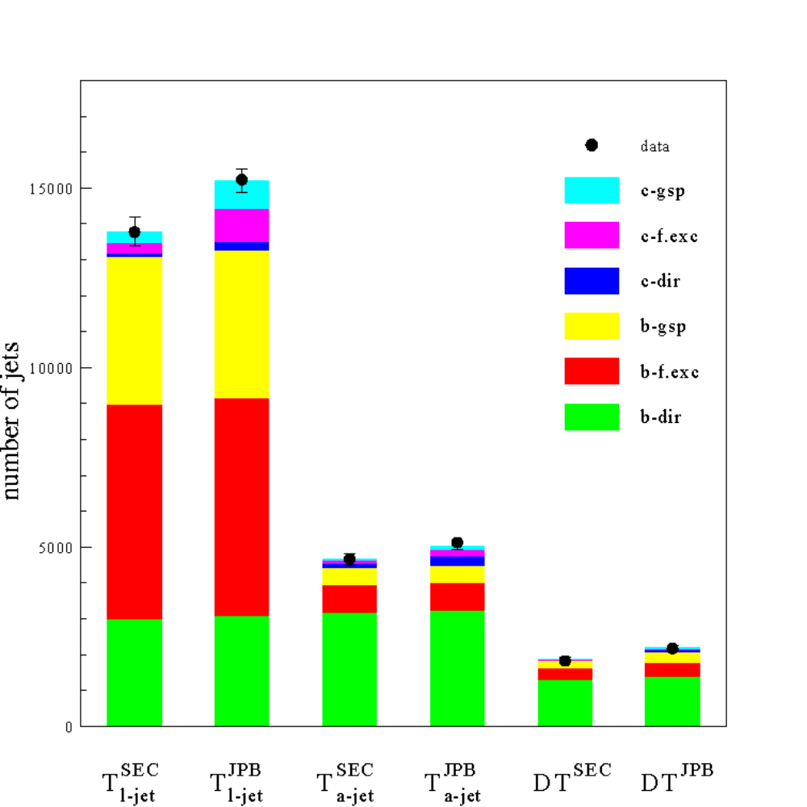
Tuned HERWIG
F_{hf} = (45.3±1.9)% for e
F_{hf} = (59.7±3.6)% for μ
NLO Calculation
Addressed Issues
b-quark fragmentation
k_{T} factorization (CASCADE)
Berger’s model (gluinos)
Single b cross sections derived from 2 b cross sections using NLO prediction
σ (nb) tuned QCD σ/ σ_{QCD}
g .j. x BR tuned 110 102 84 296 28% 194 102 296 1
(or lep-trig. evts)
lep-trig. evts. x BR 41 22 84 147 57% 72 21 93 1.5 SS
#4
Notes:
Addition intrinsic kt kick may improve agreement with data.

Slide 14
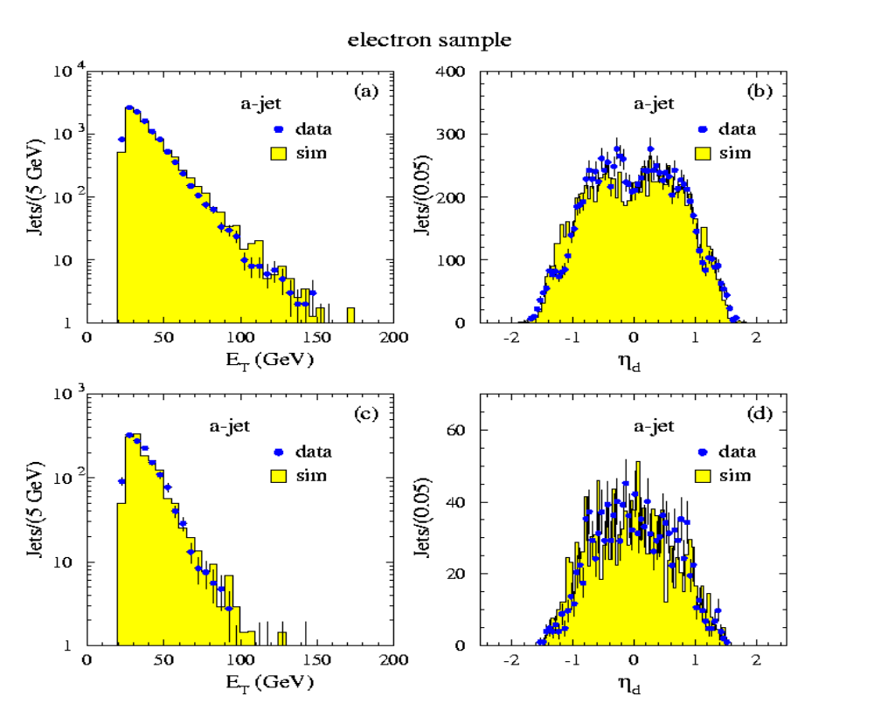
Kinematic Variables Data-Simulation Comparison
_{a-jet}
_{a-jet with SECVTX tags}

Slide 15
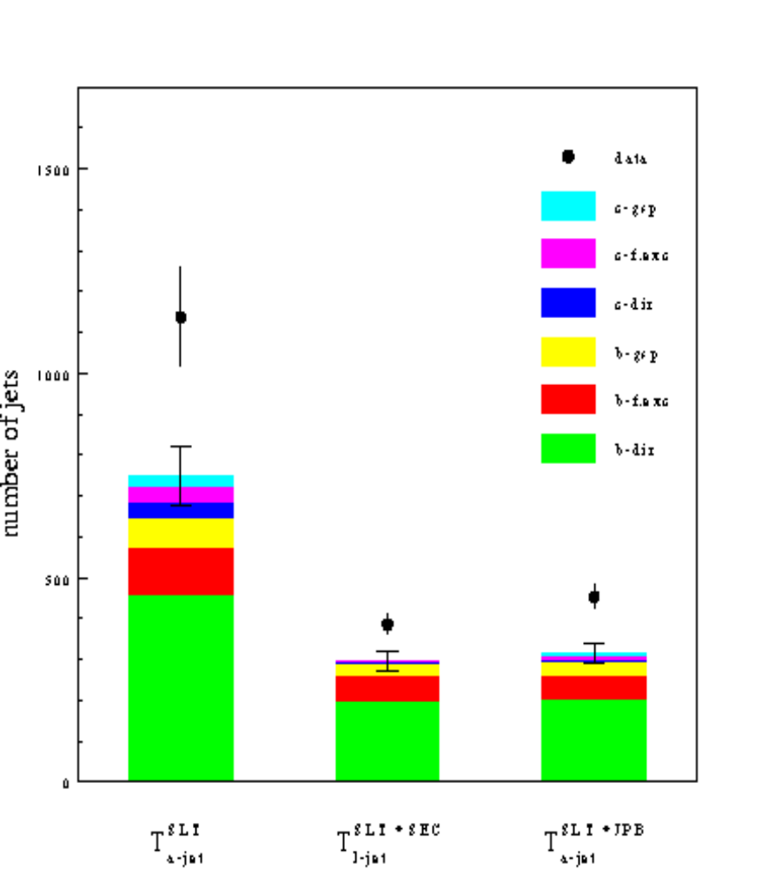
Comparison of a-jets with SLT tags in the data and the tuned simulation
SEEN 1137±140.0 (±51.0 STAT.)
EXPECTED 746.9±75.0 (SYST)
SEEN 453±29.4 (±25 STAT.)
EXPECTED 316.5±25.4 (SYST)
~3 σ discrepancy, with errors dominated by systematic effects
σ (nb) b_{s}(%) tuned QCD σ/ σ_{QCD}
g .j. x BR tuned 110 102 84 296 28% 194 102 296 1
(or lep-trig. evts)
lep-trig. evts. x BR 41 22 84 147 57% 72 21 93 1.5 SS
#5
Notes:
_{Effetto 3 sigma sistematico}
_{Equalmente diviso}
_{Efficienza SLT 10%}
_{Sottrazione fondo 10%}
Vediamo se possone esserre piu’ grosse

Slide 16
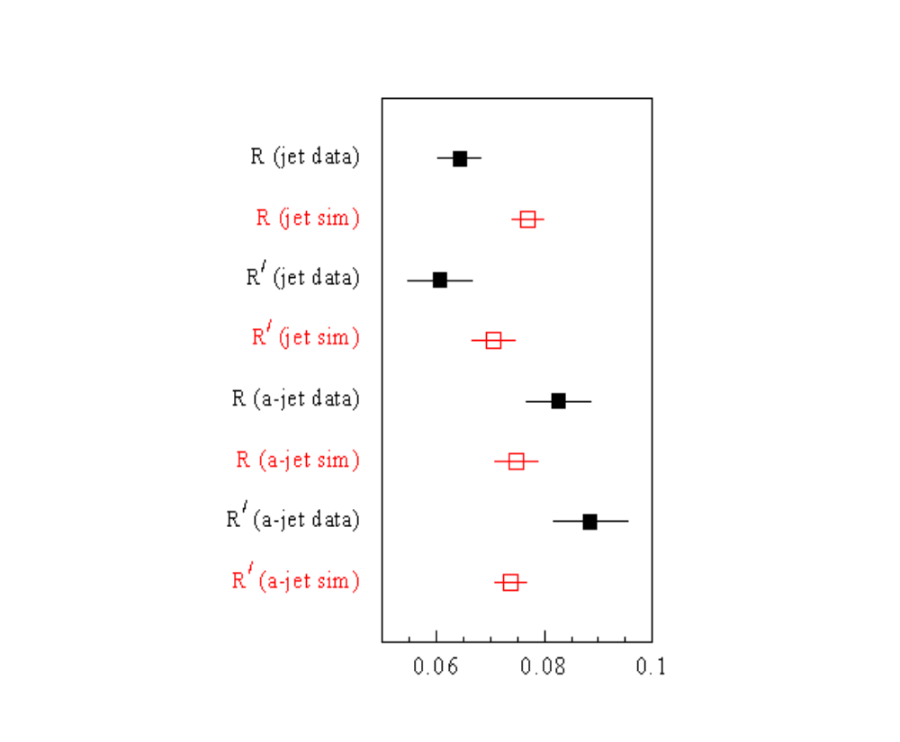
Supertags
Data-Simulation comparison for the yield of R (R’), the ratio of number of jets with a SECVTX (JPB) and SLT tag – supertags - to that with a SECVTX (JPB) tag in the generic jet sample and in the Lepton-trigger sample.
  The tuned QCD Simulation predicts the same yield of supertags in generic jet and lepton-trigger jets
  Data show a ~30% discrepancy between supertags in generic jets and lepton-trigger jets.
    Systematic uncertainties in the SLT simulated efficiency would shift in the same direction the yield R in the generic jets sample and lepton-trigger sample.
Notes:
MC is OK In dati different, but simile errore sistematico

Slide 17
Uncertainty on Mistags and SLT Tagging Efficiency on Heavy Flavors
SLT mistags and tagging efficiency have been determined historically on data (PRD - 64, 032002) with conservative errors of 10% .
The availability of a tuned simulation can be used to reduce the previous estimate of the SLT mistags and tagging efficiency systematic errors.
Fit observed rates of SLT tags in generic jets with
  P_{f} x fakes +P_{hf} x h.f.
The fit returns P_{f} =1.017±0.013 and P_{hf} =0.981±0.045, ρ = -0.77
Using this result the SLT expectation in in the SS away-jets is 1362±28 whereas 1757±104 are observed (3.8 σ)
This discrepancy cannot come from obvious prediction deficiencies
observed pred. fakes. pred. h.f.
SLT’s in g. jets 18885 15570±1557 3102 ±403
SLT’s in g. jets with SECVTX 1451 999 ±60 508 ±51
SLT’s in g. jets with JPB 2023 856 ±86 1175 ±71
SLT ‘s in a-jets (lep-trig.) 1757 619 ±62 747 ± 75

Slide 18
Conclusions
We have measured the heavy flavor content of the inclusive lepton sample by comparing rates of SECVTX and JPB tags in the data and the simulation
We find good agreement between the data and the simulation tuned within the experimental and theoretical uncertainties
We find a 50% excess of a-jets with SLT tags due to heavy flavor with respect to the simulation; the discrepancy is a 3 σ systematic effect due to the uncertainty of the SLT efficiency and background subtraction. However, comparisons of analogous tagging rates in generic-jet data and their simulation do not support any increase of the efficiency or background subtraction beyond the quoted systematic uncertainties

Slide 19
Conclusions
A discrepancy of this kind and size is expected, and was the motivation for this study, if pairs of light scalar quarks with a 100% semileptonic branching ratio were produced at the Tevatron
The data cannot exclude alternate explanations for this discrepancy
Previously published measurements support the possibility, born out of the present work, that approximately 30% of the presumed semileptonic decays of heavy flavor hadrons produced at the Tevatron are due to unconventional sources

Slide 20
Support Slides

Slide 21
Tuning the Simulation to the data
Fit parameters | Constraints | Error
c dir norm | b dir/c dir ≈ 1 | 14%
b flav exc norm | b/c ≈0.5 | 28%
c flav exc norm
b gluon split norm | 1.40 | 0.19
c gluon split norm | 1.35 | 0.36
Ke norm
Kμ norm
SECVTX scale factor, b | 1.0 | 6%
SECVTX scale factor, c | 1.0 | 28%
JPB scale factor | 1.0 | 6%
SECVTX | lepton side
 | away side
 | Both
JPB | lepton side
 | away side
 | Both
Use 6 fit parameters corresponding to the direct, flavor excitation and gluon splitting production cross sections evaluated by Herwig for b- and c-quarks
K_{e} and K_{μ} account for the luminosity and b-direct production
The parameters bf, bg, c, cf, cg account for the remaining production cross sections, relative to the b-direct production

Slide 22
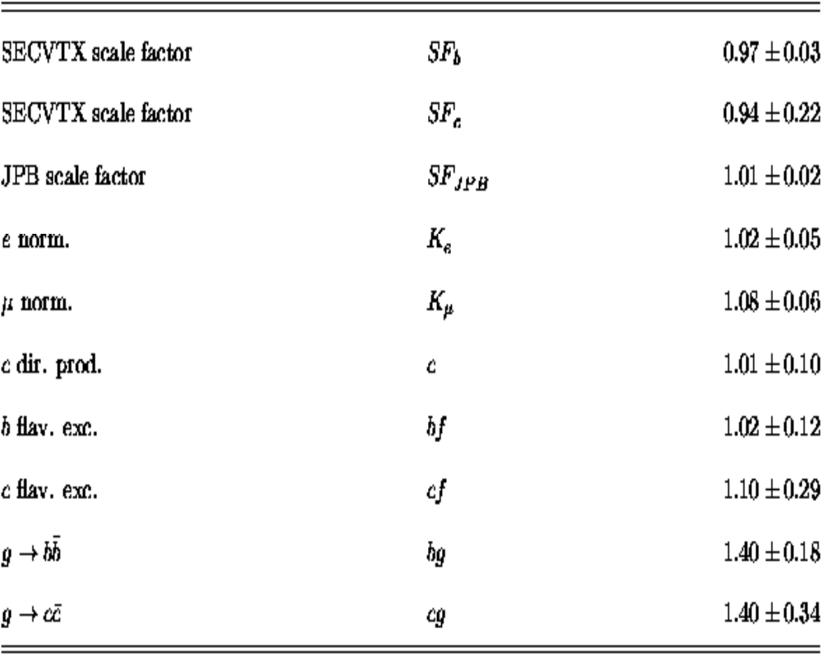
Fit results
χ²/DOF=4.6/9
σ (nb) b_{s}(%) tuned QCD σ/ σ_{QCD}
g .j. x BR tuned 110 102 84 296 28% 194 102 296 1
(or lep-trig. evts)
lep-trig. evts. x BR 41 22 84 147 57% 72 21 93 1.5 SS
#4

Slide 23

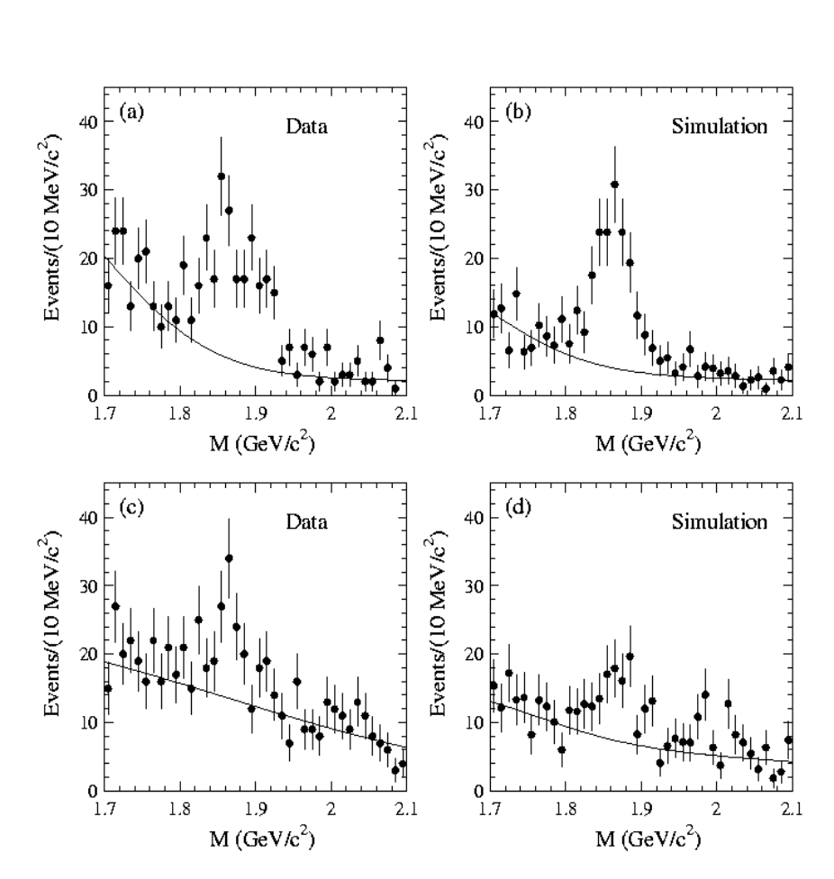

b-purity (cross-check)
l-D⁰ : 126.0 ± 15.5 in the data and 139.9 ± 15.0 in the simulation
l-D± : 73.7 ± 17.8 (data) and 68.5 ± 14.1 (simulation).
J/ψ: 90.8 ± 10.1 (data) and 101.9 ± 11.4 (simulation)
Ratio of the b-purity in the simulation to that in the data is 1.09 ± 0.11
  Discrepancy between observed and predicted number of a-jets with SLT tags due to heavy flavor is not due to an underestimate of the bb contribution

Slide 24
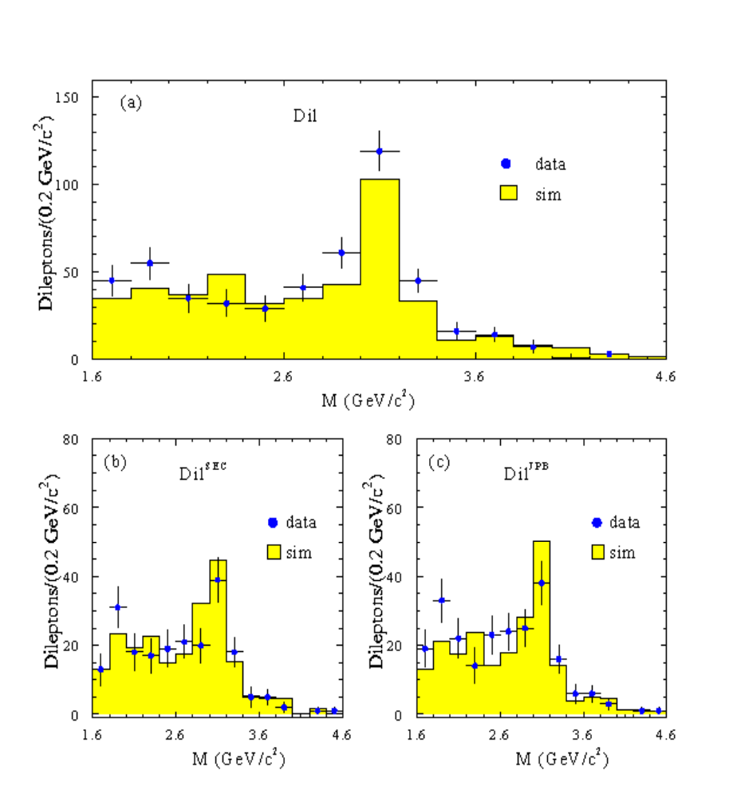
b-purity (cross-check)
2.6 < m_{ee}< 3.6 GeV/c²
2.9 < m_{μμ}< 3.3 GeV/c²
SS dileptons (with 10% error) used to estimate and remove bkg. to OS dileptons due to misidentified leptons.
259 ± 17.2 and 209.2 ± 23.7 (before tagging)
89.7 ± 10.5 and 100.5 ± 12.4 (SECVTX)
90.8 ± 10.1 and 101.9 ± 11.4 (JPB)

Slide 25
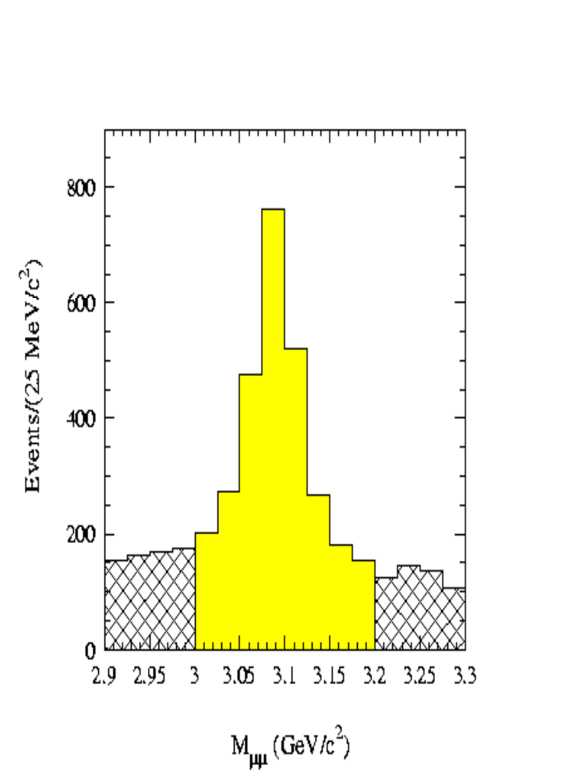
J/ψ mesons from B-decays
In generic-jet data we do not have any excess of jets with SLT tags or supertags
We do observe an excess after enriching the b-purity of the QCD data by requiring a lepton-jet
We study a sample of jets recoiling J/ψ mesons from B-decays. We use the same J/ψ μμ data set and selection used for the measurement of the J/ψ lifetime and fraction from B-decays
1163 J/ψ over a background of 1179 events estimated from the side-bands (SB)

Slide 26
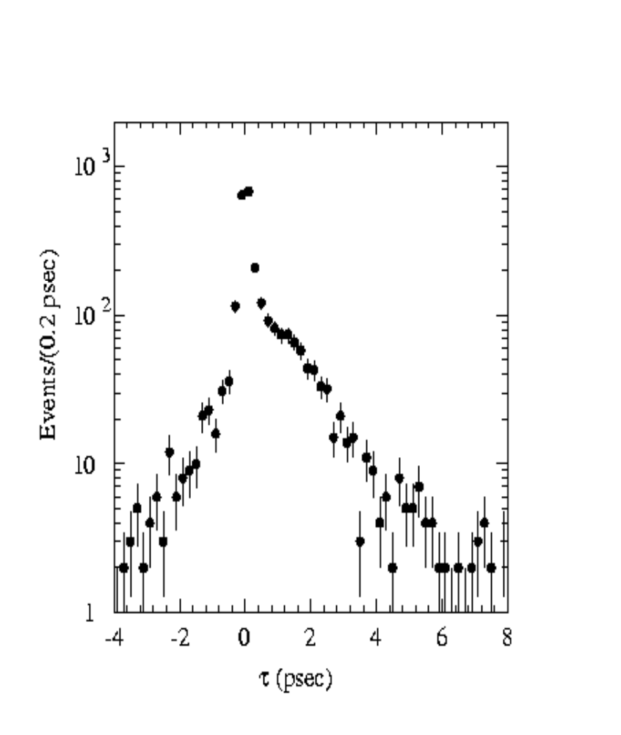
J/ψ lifetime
The number of J/ψ mesons from B-decays is N_{ψ}= (ψ⁺−ψ⁻)-(SB⁺–SB⁻) =561, which is 48% of the initial sample
In the 572 away-jets we find 48.0 ± 15.1SECVTX, 61.7 ± 17.3 JPB tags, and –9.4 ± 14.4 SLT tags
In the simulation we expect 8.1 ± 1.1 SLT tags
The observed number of SLT tags is 1.2 σ lower than the prediction rather than 50% larger as in the inclusive lepton sample.

Slide 27
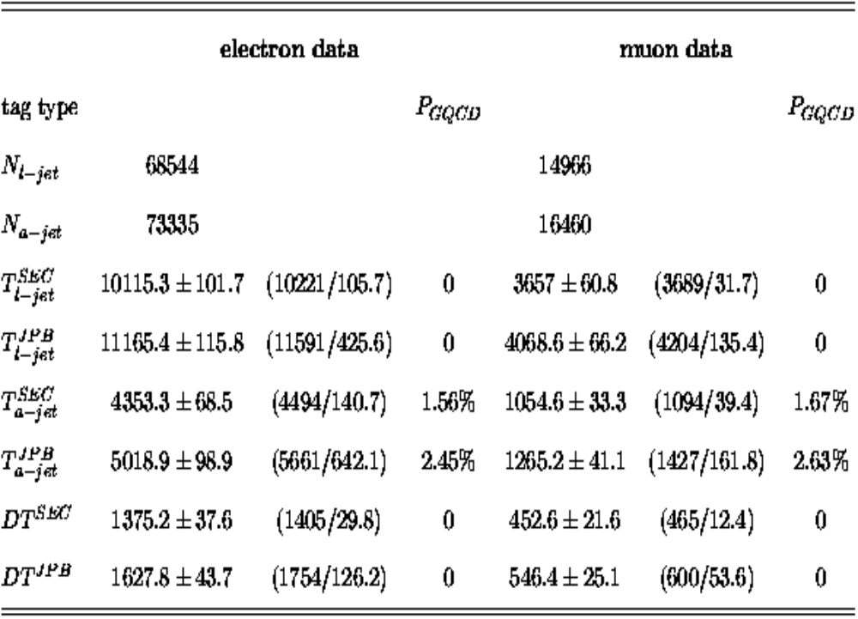

Data

Slide 28
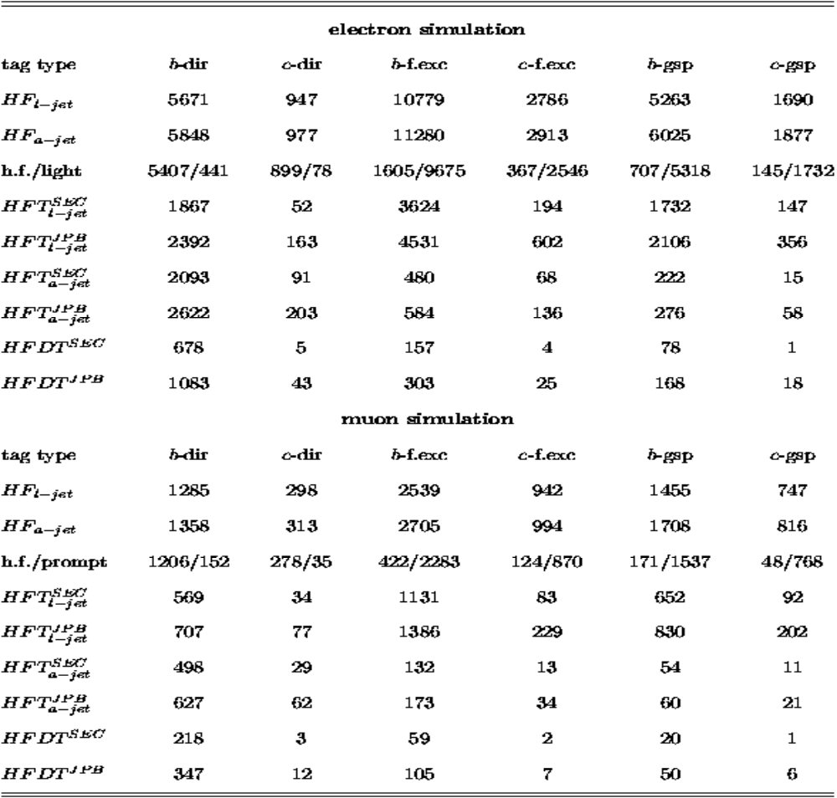
Heavy flavors in the simulation are identified at generator level

Slide 29
Fit of the simulation to the data
Use 6 fit parameters corresponding to the direct, flavor excitation and gluon splitting production cross sections evaluated by Herwig for b and c-quarks
K_{e} and K_{μ} account for the luminosity and b-direct production
The parameters bf, bg, c, cf, cg account for the remaining production cross sections, relative to the b-direct production
The ratio of b to c direct production constrained to the default value (about 1) within 14%
the ratio of b to c flavor excitation constrained to the default value (about 0.5) with a 28% uncertainty
bg constrained to (1.4±0.19)
cg constrained to (1.35±0.36)
The tagging efficiencies are also fit parameters, and are constrained to their measured values within their uncertainties (6% for b-quarks, 28% for c-quarks)

Slide 30
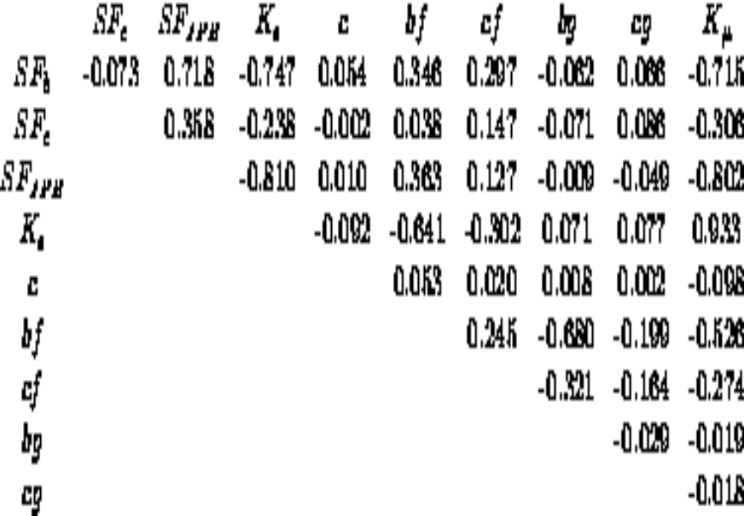
Fit result-parameter corr. coeff.
_{For}

Slide 31
NLO and Herwig calculations
However, in this specific analysis we are interested in comparing rates of a-jet with heavy flavor (signaled by SLT or SECVTX tags) in events in which the l-jet has also heavy flavor
These jet have | η|<1 and corresponds to partons with E_{T} > 18 GeV
In this case Herwig evaluates that the gluon splitting+flavor excitation contribution are 40% of the Born contribution and not a factor of 3 higher
For this type of kinematics, the ratio of the NLO to Born calculations is also of the order of 1.1-1.3. In addition, for this topology, the NLO calculation depends little on the choice of μ, and it appears to meet general criteria of robustness.

Slide 32
NLO and Herwig calculations
Herwig ignores interference terms between the Born approximation and the NLO diagrams, and evaluates a gluon splitting+flavor excitation contribution which is a factor of 3 larger than the Born approximation.
In the NLO calculation the contribution of the Born cross section and of the gluon splitting+flavor excitation are approximately equal using the renormalization scale μ; when using the scale the scale μ/2,the NLO calculation gets closer to Herwig.
The fact that the ratio between NLO and Born is about two and is not stable as a function of the renormalization scale is taken by the experts as an indication that NNLO corrections are important
The relevance of the Herwig result, which models the data, is the indication that the effect of NNLO correction should be that of canceling the interference terms

Slide 33
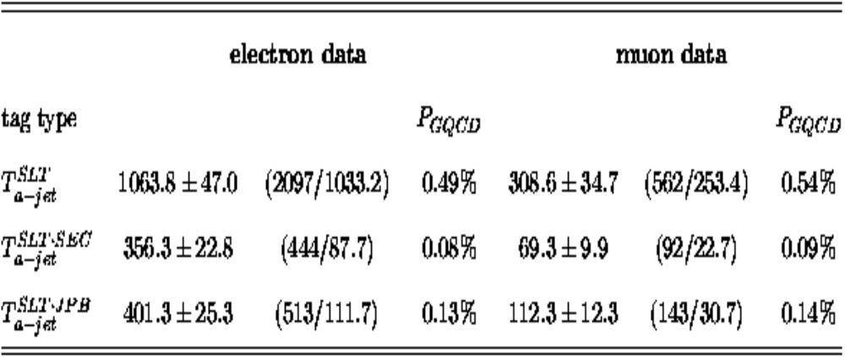
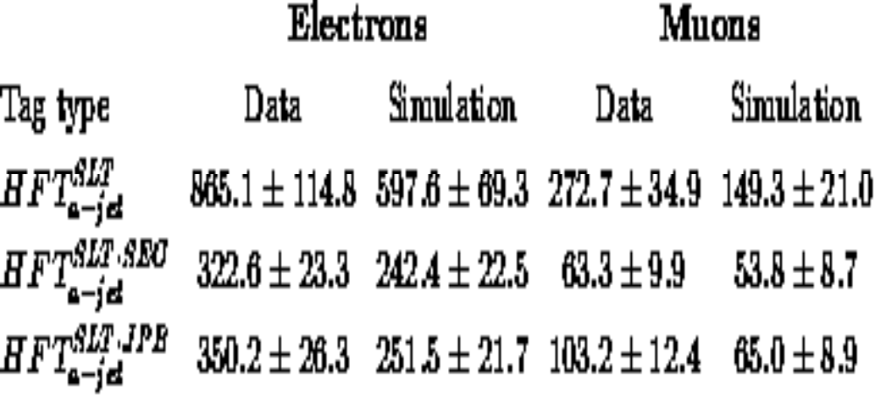
away-jets with SLT tags

