Slide 1



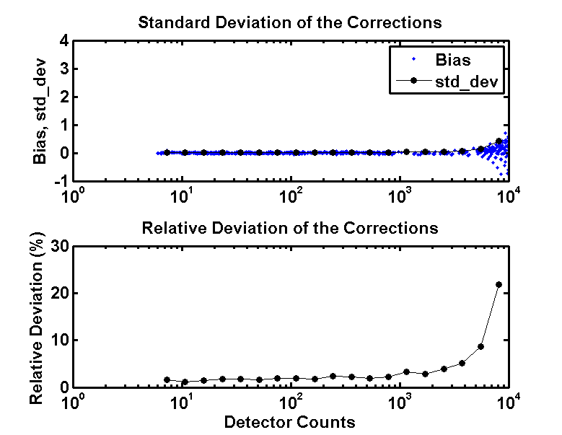
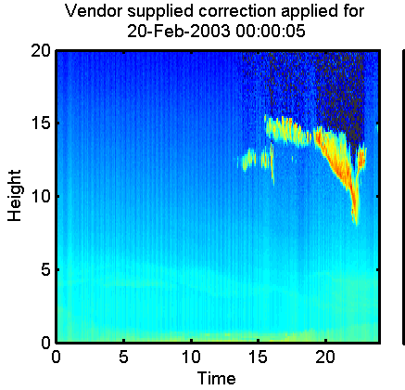
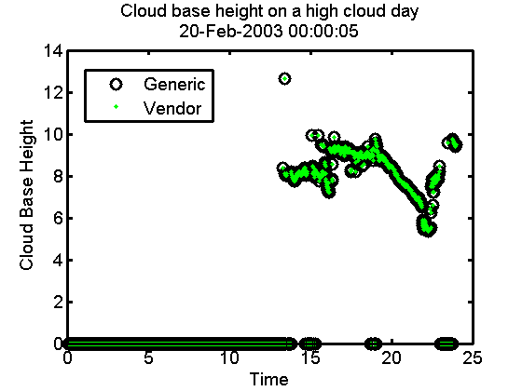
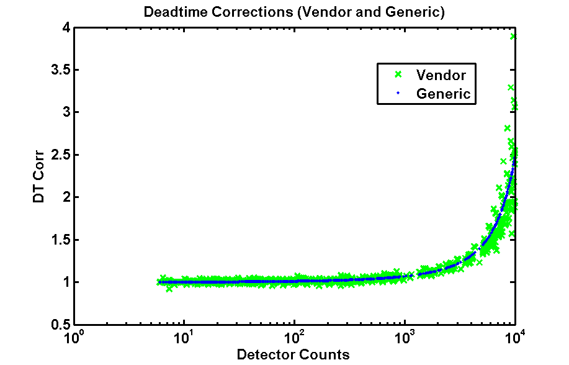
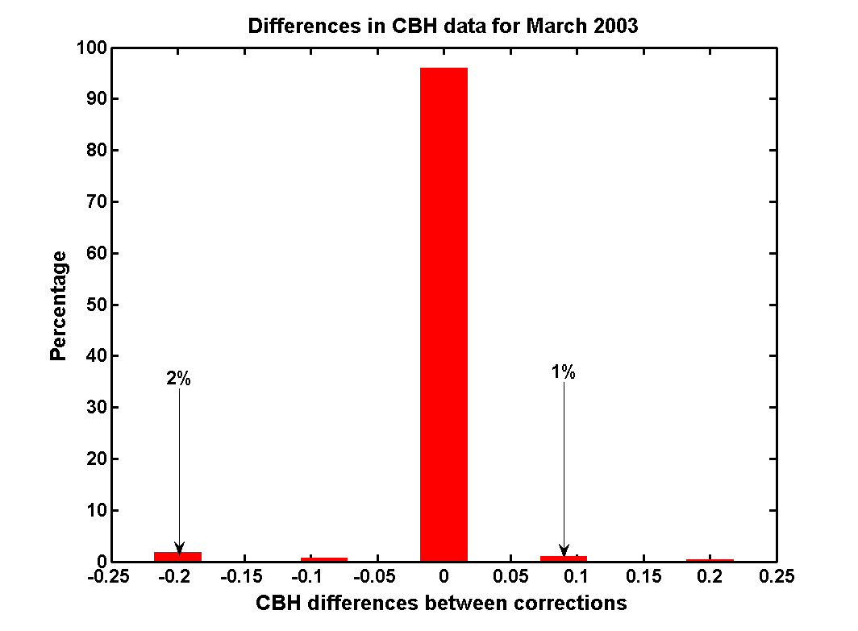
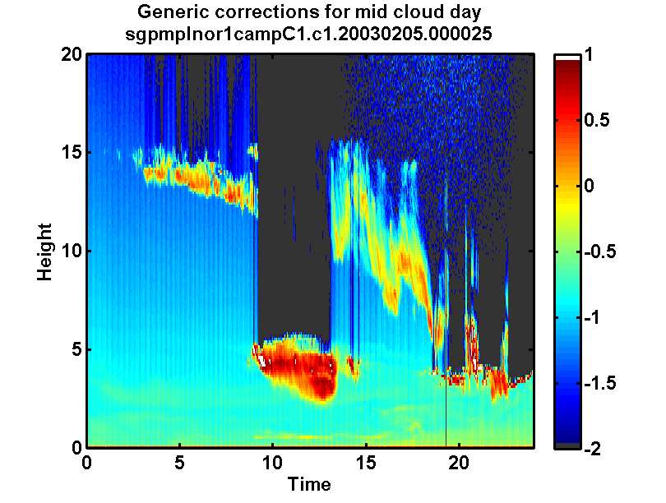
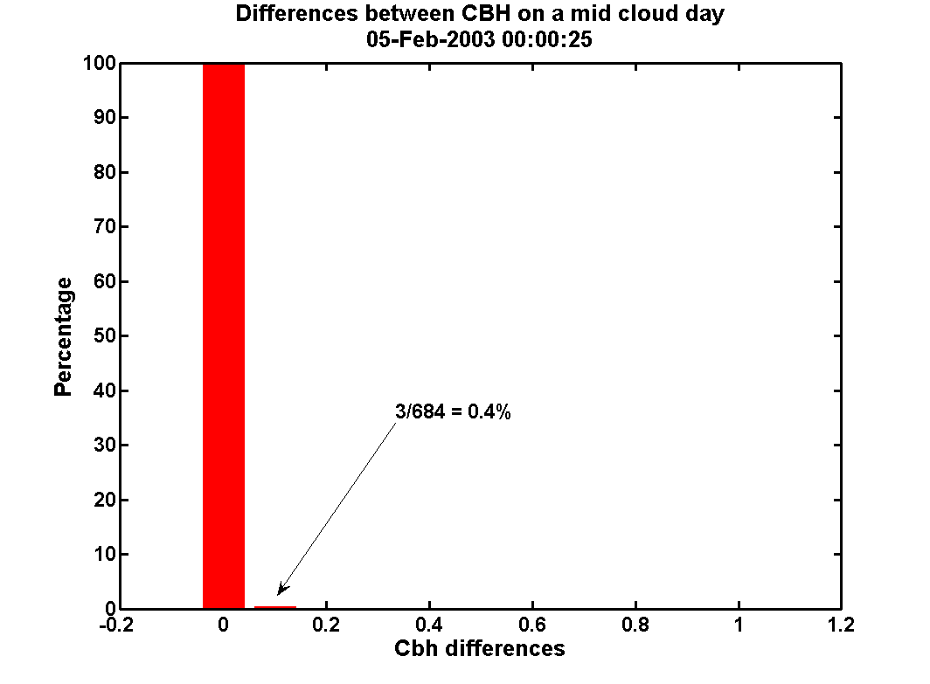
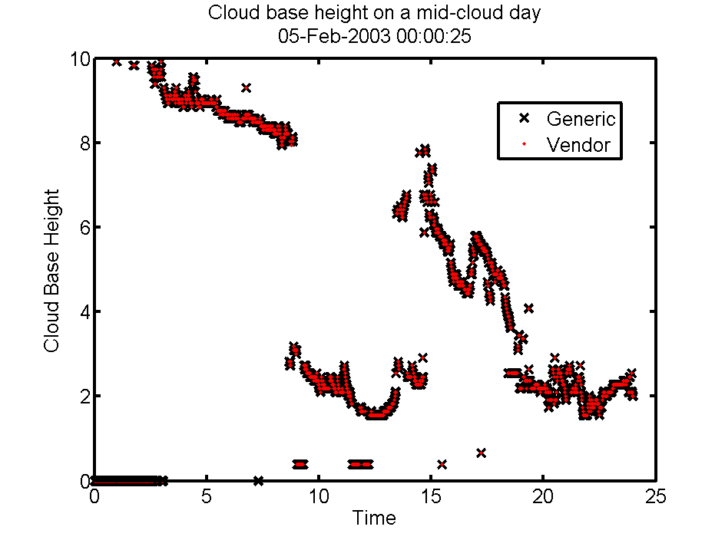
Instrument-specific Corrections for MPL Profiles:
Impact on Scientifically Relevant Quantities
Chitra Sivaraman, Connor Flynn
Pacific Northwest National Laboratory
Objective:
A main objective of the Micropulse Lidar Normalized (MPL NOR) Value-Added Product is to account for and remove all known instrumentation artifacts that have been identified in the initial raw lidar data. Some of these artifacts follow a generic form common to essentially all lidar, but others reflect details of the specific instrument and are uniquely determined for each installation.
Methodology: An analysis was done on the vendor supplied installation-specific correction. A generic correction was derived from the analysis. This generic correction was then applied to the data and a comparison of the cloud base height and backscatter corrections was done on the data.
Absolute and relative deviation between vendor supplied correction and generic corrections.
The vendor supplied correction and the generic correction detected cloud and agreed on the detection. They agreed 100% of the time on a high cloud day.
Conclusions:
Subtle differences in the corrected lidar profiles caused no significant differences in cloud detection.
The potential impact on the physical retrievals is minimal while the benefit to data processing is enormous.
An example of a mid cloud day in February 2003. Both methods detected cloud and agreed on the detection 97% of the time on a mid-cloud day.

