Slide 1
What’s RIGHT with the CMMI?!?
Pat O’Toole, PACT
November 2005

Slide 2
Agenda
Required/Expected/Informative
Mapping Practices to Goals
Base/Advanced Practices
One Model – Two Representations
  Equivalent Staging
Using the “Constagedeous” Approach

Slide 3
Required/Expected/Informative
Required components
  Specific and generic goals
  Achieved by planned and implemented processes
Expected components
  Specific and generic practices
  Typical implementation to achieve a goal
  Practices as described or acceptable alternatives
Informative components
  Everything else
Notes:
Required, Expected, and Informative Components
The components of a CMMI model are grouped into three categories that reflect how they are to be interpreted:
Required: Specific goals and generic goals are required model components. These components must be achieved by an organization’s planned and implemented processes. Required components are essential to rating the achievement of a process area. Goal achievement (or satisfaction) is used in appraisals as the basis upon which process area satisfaction and organizational maturity are determined. Only the statement of the specific or generic goal is a required model component. The title of a specific or generic goal and any notes associated with the goal are considered informative model components.
Expected: Specific practices and generic practices are expected model components. Expected components describe what an organization will typically implement to achieve a required component. Expected components guide those implementing improvements or performing appraisals. Either the practices as described, or acceptable alternatives to them, are expected to be present in the planned and implemented processes of the organization before goals can be considered satisfied. Only the statement of the practice is an expected model component. The title of a practice and any notes associated with the practice are considered informative model components.
Informative: Subpractices, typical work products, discipline amplifications, generic practice elaborations, goal and practice titles, goal and practice notes, and references are informative model components that help model users understand the goals and practices and how they can be achieved. Informative components provide details that help model users get started in thinking about how to approach goals and practices.
When you use a CMMI model as a guide, you plan and implement processes that conform to the required and expected components of process areas. Conformance with a process area means that in the planned and implemented processes there is an associated process (or processes) that addresses either the specific and generic practices of the process area or alternatives that clearly and unequivocally accomplish a result that meets the goal associated with that specific or generic practice.

Slide 4
Required/Expected/Informative
Informative Components
  Subpractices
    Detailed descriptions guiding practice interpretation and implementation
  Generic Practice Elaborations
    Guidance on how the generic practice applies to the Process Area
  Typical Work Products
    Provide example outputs from a practice
Notes:
Subpractices
Subpractices are detailed descriptions that provide guidance for interpreting specific or generic practices. Subpractices may be worded as if prescriptive, but are actually an informative component in CMMI models meant only to provide ideas that may be useful for process improvement.
Generic Practice Elaborations
Generic practice elaborations are informative model components that appear in each process area to provide guidance on how the generic practices should uniquely be applied to the process area. For example, when the generic practice “Train the people performing or supporting the planned process as needed” is incorporated into the Configuration Management process area, the specific kinds of training for doing configuration management are described.
Typical Work Products
Typical work products are an informative model component that provides example outputs from a specific or generic practice. These examples are called “typical work products” because there are often other work products that are just as effective, but are not listed.

Slide 5
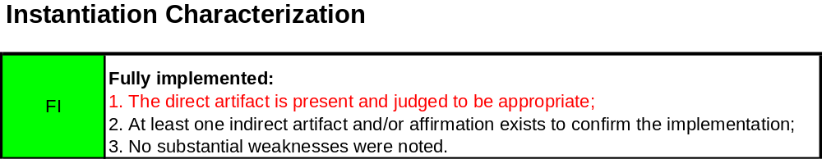
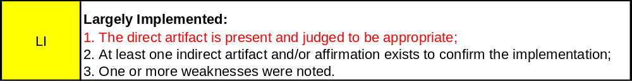
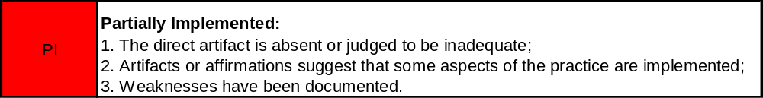

What’s (Not Quite) Right with the CMMI
Are typical work products really “informative?”

Slide 6
Agenda
Required/Expected/Informative
Mapping Practices to Goals
Base/Advanced Practices
One Model – Two Representations
  Equivalent Staging
Using the “Constagedeous” Approach

Slide 7
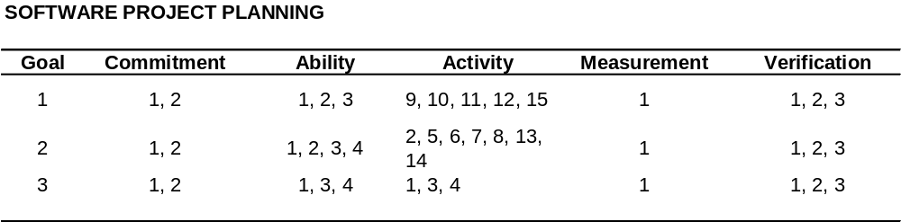
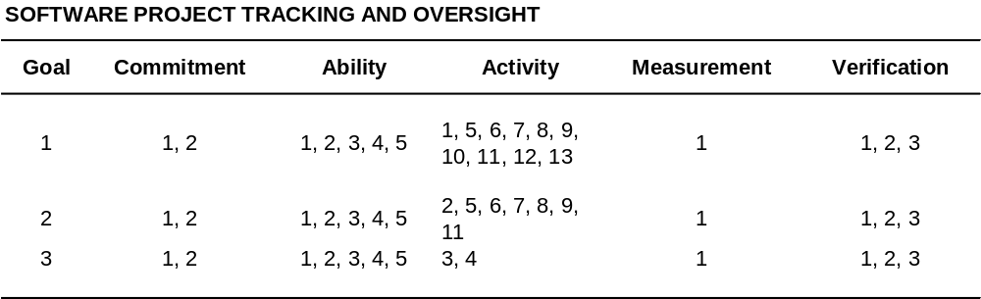
Mapping Practices to Goals - CMM

Slide 8
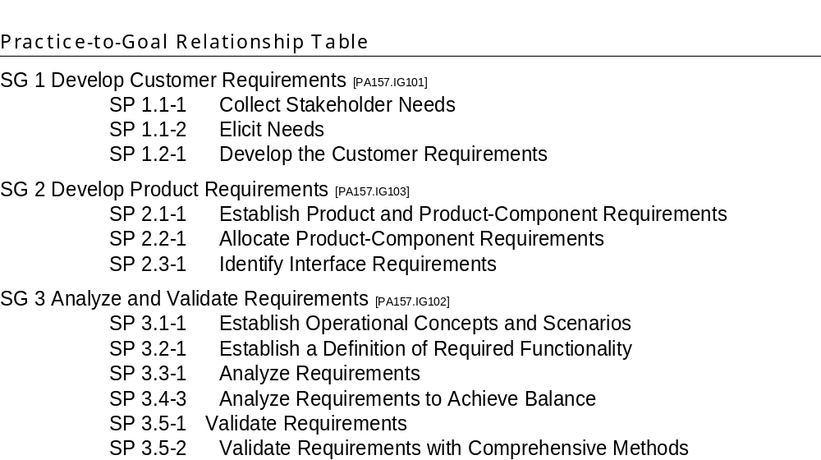
Mapping Practices to Goals - CMMI

Slide 9
Agenda
Required/Expected/Informative
Mapping Practices to Goals
Base/Advanced Practices
One Model – Two Representations
  Equivalent Staging
Using the “Constagedeous” Approach

Slide 10
Base/Advanced Practices
Base practices: associated with CL1
Advanced practices: associated with CL2 & CL3
Some advanced practices build on base practices, others do not.
There are no advanced practices at CL4 or CL5.
Notes:
Base Practices
In the continuous representation, all the specific practices with a capability level of 1 are called “base practices.”
Advanced Practices
In the continuous representation, all the specific practices with a capability level of 2 or higher are called “advanced practices.”
For example, within the Requirements Management process area, “Develop an understanding with the requirements providers on the meaning of the requirements” is a capability level 1 specific practice, whereas “Obtain commitment to the requirements from the project participants” is a capability level 2 specific practice.
Sometimes an advanced practice builds on a base practice. When this happens, the advanced practice is included in the staged representation as a specific practice, but the base practice is not. Rather, the base practice is presented as informative material after the specific practice. This informative material explains how the base and advanced practices appear in the continuous representation. Other times, an advanced practice does not build on a base practice. When this happens, the advanced practice is automatically included in the staged representation as a specific practice.
The specific practice numbering scheme identifies these conditions. In the continuous representation, specific practices are numbered so that the reader can identify to which specific goal the practice is mapped, its sequence number and its capability level. For example, in the Requirements Management case above, the first specific practice of the first specific goal will be numbered 1.1-1 and the second will be 1.2-2. In the case where a specific practice builds on another, the sequence number will be the same for both specific practices, that is, 1.1-1 and 1.1-3. In the staged representation, only the number 1.1 appears.

Slide 11
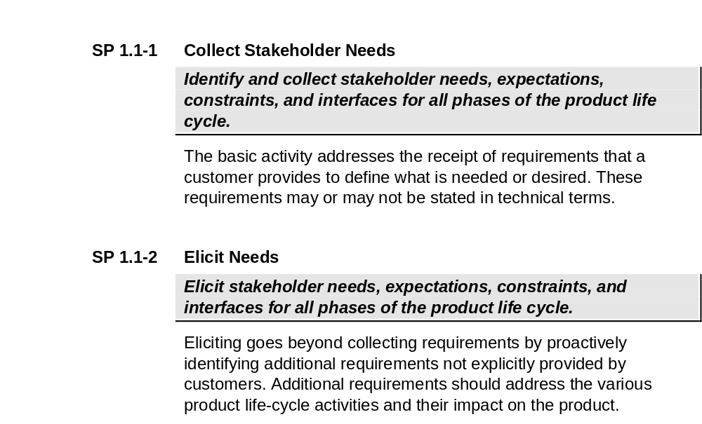
Base/Advanced Practices

Slide 12
Agenda
Required/Expected/Informative
Mapping Practices to Goals
Base/Advanced Practices
One Model – Two Representations
  Equivalent Staging
Using the “Constagedeous” Approach

Slide 13
One Model, Two Representations
Staged Representation
  Same as CMM for Software
  Prescriptive ordering of improvement areas
  Organizational Change Model
  “Maturity Levels” – group of process areas
Continuous Representation
  Same as System Engineering CMM
  Basic vs. advanced process areas
  “Capability Levels” – each process area individually

Slide 14
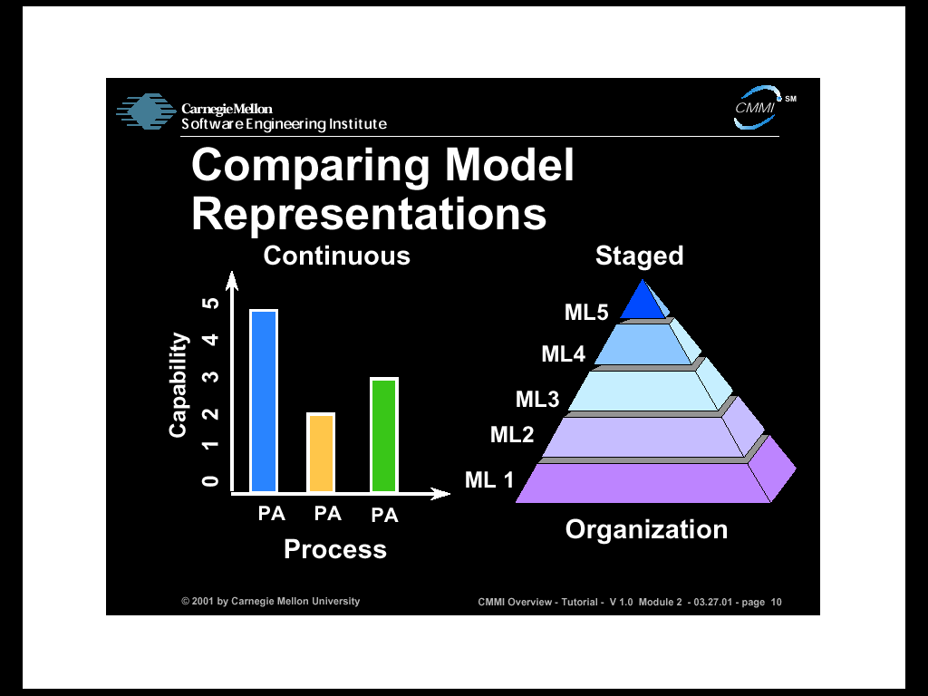
Notes:
Staged Representation
Provides a pre-defined roadmap for improvement based on proven grouping and ordering of processes
Continuous Representation
Provides flexibility for organizations to focus and measure improvement on their highest priority process areas
Both representations provide the same essential content but organized in different ways
Legend: PA = Process Area ML= Maturity Level
Note: Maturity Level refers to organizational maturity as measured in the staged representation
Capability Level refers to process capability as measured in the continuous representation

Slide 15
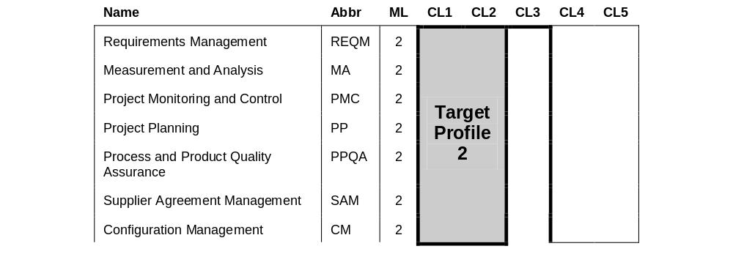
Equivalent Staging – ML2
Notes:
Equivalent staging is a target staging that is equivalent to the maturity levels of the staged representation.
The table above and on the next slide shows the target profiles that must be achieved when using the continuous representation to be equivalent to a maturity level 2 and 3 when using a staged representation.
The columns of the figure have the following meanings:
· “Name” is the full name of the process area.
· “Abbr” is the acronym corresponding to the “Name.”
· “ML” is the maturity level assignment of the process area in the staged representation.
· “CL1,” “CL2,” “CL3,” “CL4,” “CL5” are headings for the columns assigned to capability levels in the continuous representation.
The shaded areas in the capability level columns indicate target profiles that are equivalent to maturity levels in the staged representation.
· To achieve target profile 2 (and thereby be equivalent to maturity level 2), the process areas to the left of target profile 2 must have satisfied capability levels 1 and 2.
· To achieve target profile 3 (and thereby be equivalent to maturity level 3), the process areas to the left of target profiles 2 and 3 must have satisfied capability levels 1, 2, and 3.
· To achieve target profile 4 (and thereby be equivalent to maturity level 4), the process areas to the left of target profiles 2, 3 and 4 must have satisfied capability levels 1, 2, and 3.
· To achieve target profile 5 (and thereby be equivalent to maturity level 5), all of the process areas must have satisfied capability levels 1, 2, and 3.
CONT’d

Slide 16
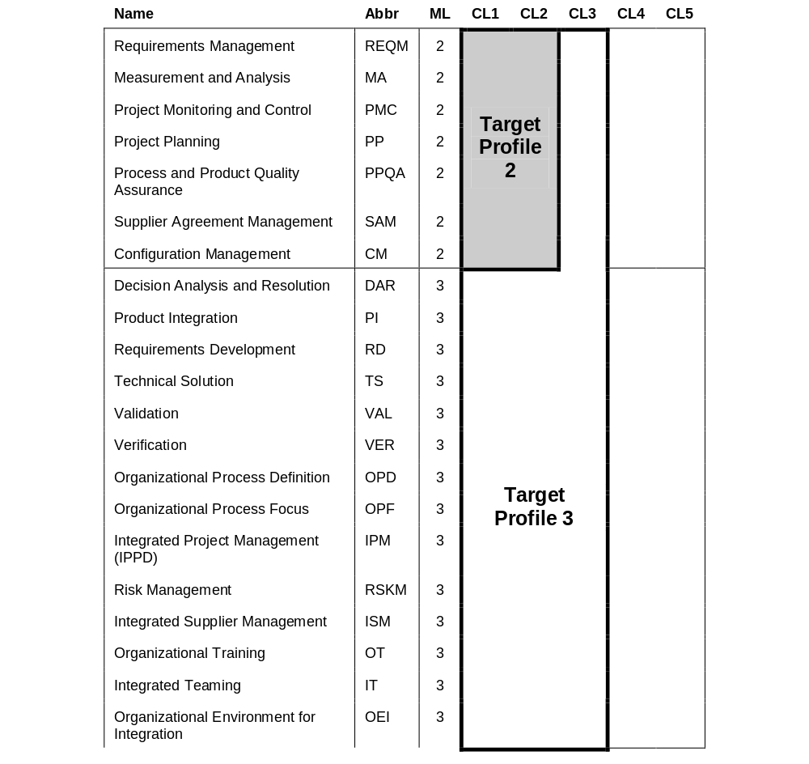
Equivalent Staging – ML3
Notes:
A general rule for equivalent staging:
· To achieve ML2, all process areas assigned to ML2 must achieve CL2 or above.
· To achieve ML3, all process areas assigned to MLs 2 and 3 must achieve CL 3 or above.
· To achieve ML4, all process areas assigned to MLs 2, 3, and 4 must achieve CL3 or above.
· To achieve ML5, all process areas must achieve CL3 or above.
The above rule and table for equivalent staging is complete, but a question that is often asked is “why don’t target profiles 4 and 5 extend into the CL4 and CL5 columns?” The maturity level 4 process areas describe a selection of the subprocesses to be stabilized based, in part, on the quality and process-performance objectives of the organization and projects. Not every process area will be addressed in the selection and the model does not presume in advance which process areas might be addressed in the selection. The achievement of capability level 4 for process areas cannot be predetermined because the choices will be dependent upon the selections made by the organization in its implementation of the maturity level 4 process areas. Thus, the table above does not show target profile 4 extending into the CL4 column although some process areas will have achieved capability level 4. The situation for maturity level 5 and target profile 5 is similar.
The existence of equivalent staging should not discourage users of the continuous representation from establishing target profiles that extend above capability level 3. That target profile would be determined in part by the selections made by the organization as described in the previous paragraph.

Slide 17
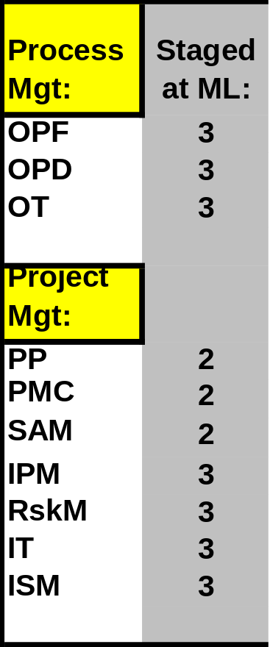
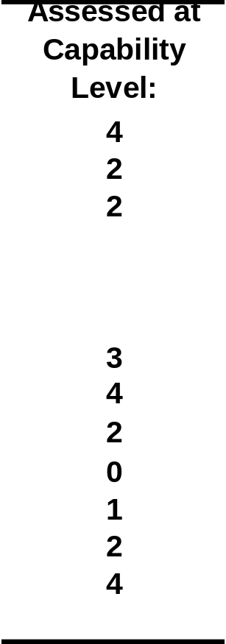
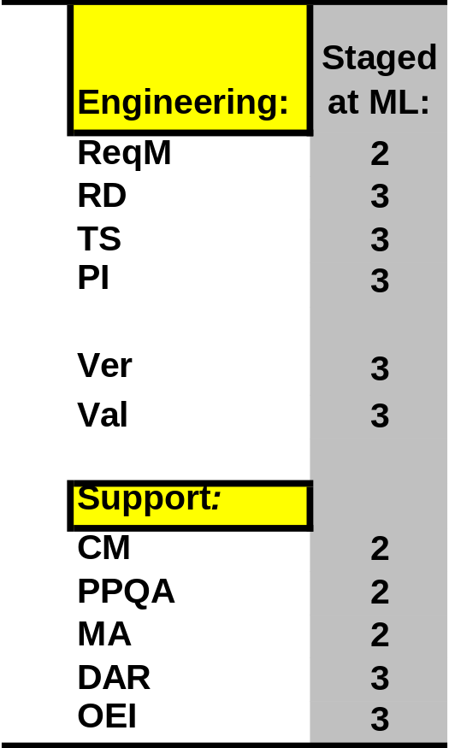
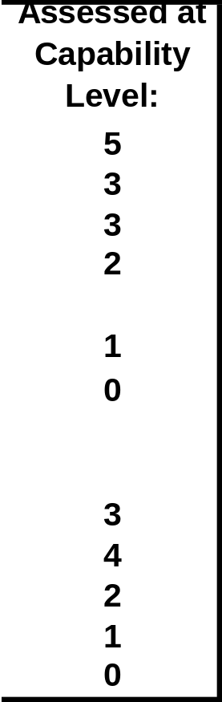
Staged Equivalence - 1

Slide 18

Staged Equivalence - 2

Slide 19
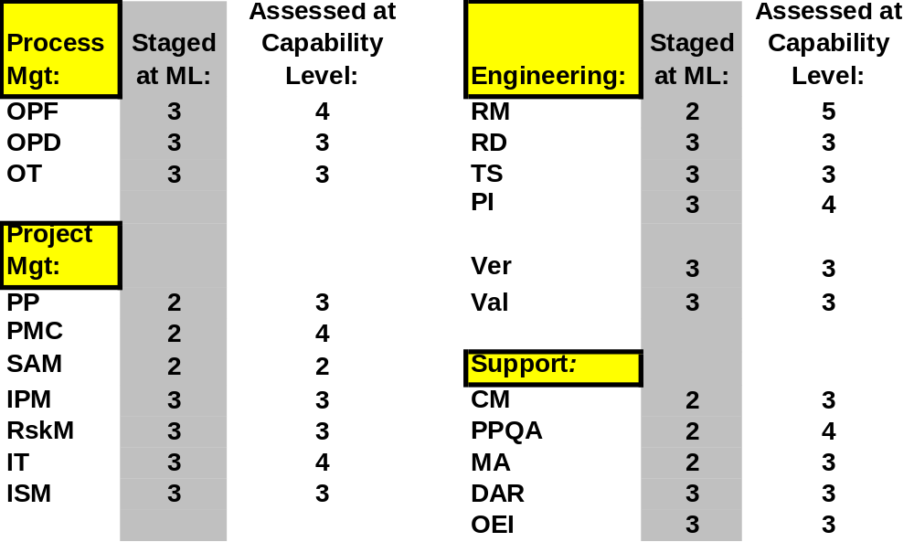
Staged Equivalence - 3
Notes:
Same setup as the previous Scenarios.
What is the equivalent maturity level of this organization?

Slide 20

Staged Equivalence - 4
Notes:
Same setup as the previous Scenarios.
What is the equivalent maturity level of this organization?
- - - -
QUESTION: Could this organization be performing at Level 4? That is, if the Process Areas staged at Maturity Level 4 were included in the assessment, but are going to be displayed on the next chart (or so we are pretending!), is it possible that this organization could be rated Maturity Level 4?

Slide 21
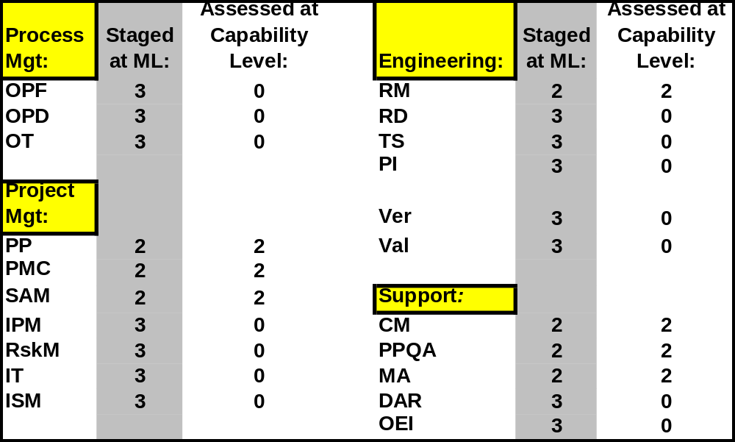
Staged Equivalence - 5

Slide 22

Staged Equivalence - 6

Slide 23
Agenda
Required/Expected/Informative
Mapping Practices to Goals
Base/Advanced Practices
One Model – Two Representations
  Equivalent Staging
Using the “Constagedeous” Approach

Slide 24
Using the Constagedeous Approach
Staged Representation
  Management and customers love it: 1 simple number
  Organizational Change Model
Continuous Representation
  Different organizations have different needs/pains
  Finer level of planning and tracking improvements
  There are 14 process areas at maturity level 3!
Hybrid Approach
  Use Staged to establish long range goal.
  Used Continuous to plan, execute, and track.

Slide 25
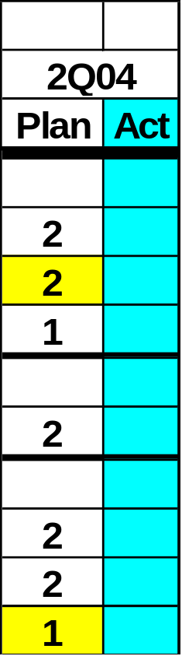
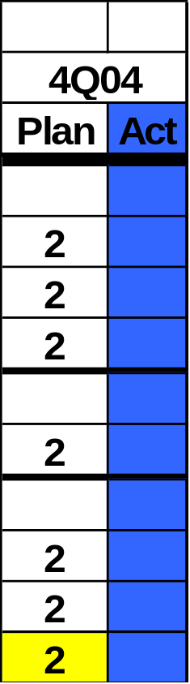
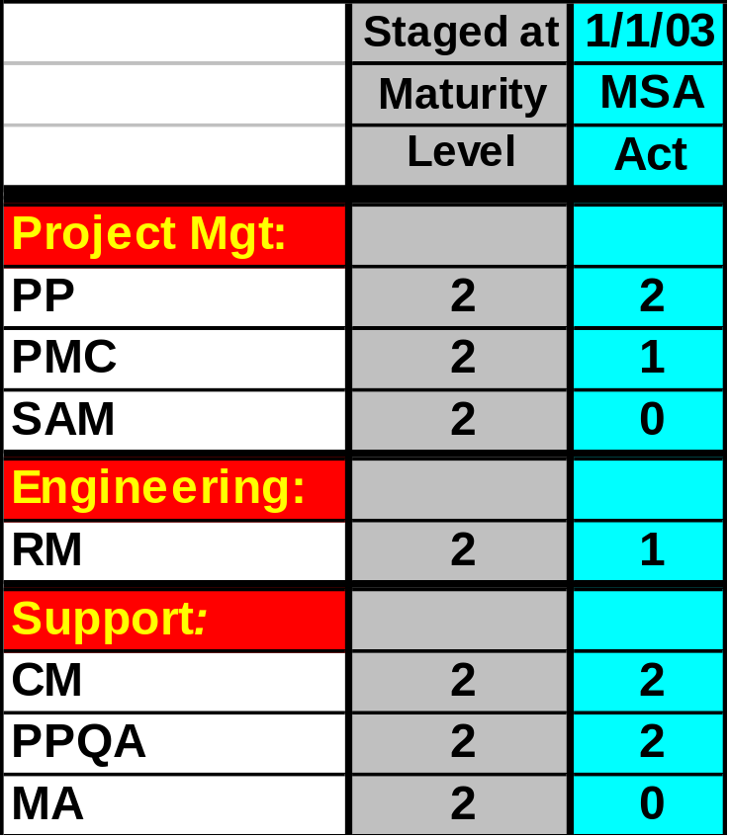
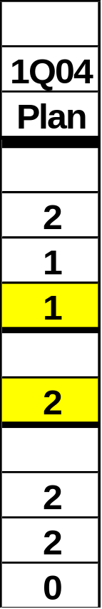
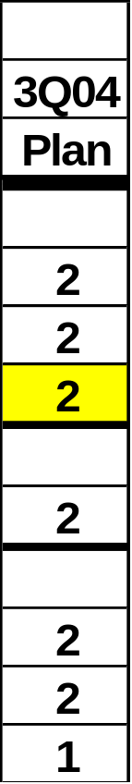
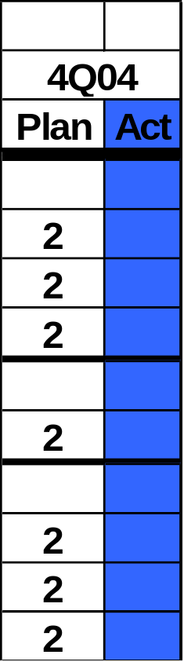
Maturity Level 2 Example

Slide 26
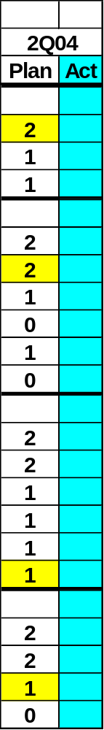
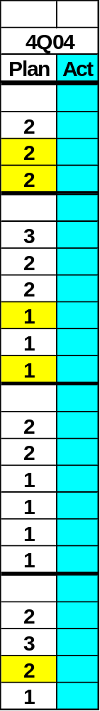
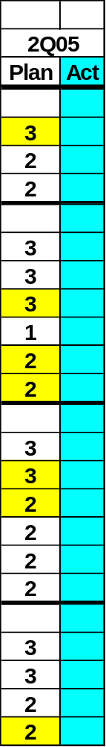
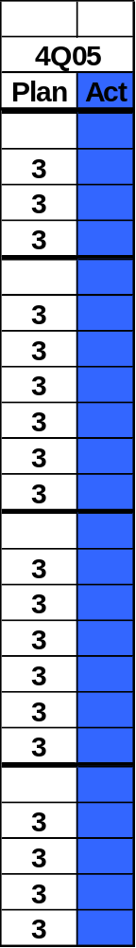
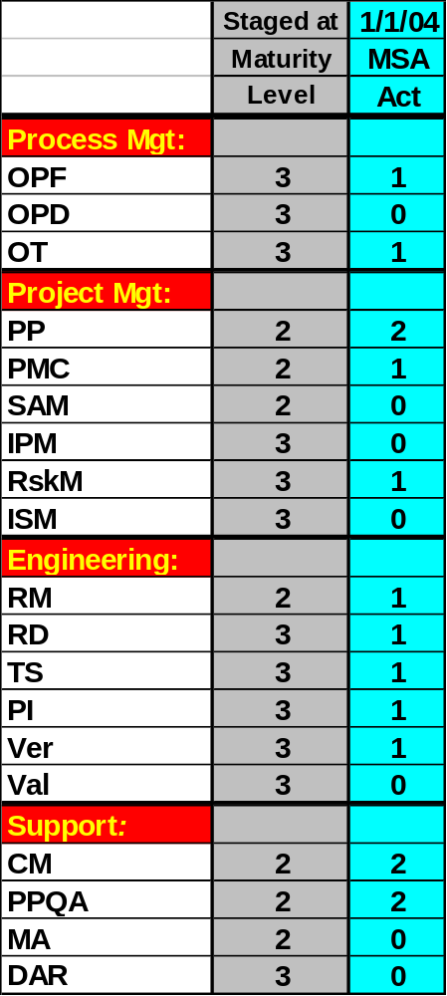
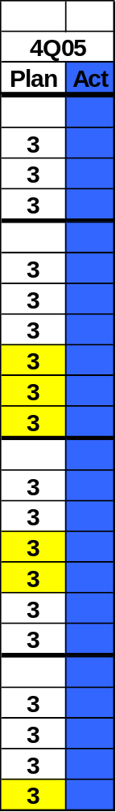
Maturity Level 3 Example

Slide 27
Questions?
Pat O’Toole
PACT.otoole@att.net

