Slide 1
Proton Source 2/2/07
Operational Issues
Ion Source Notching Status: Moehs
Booster Corrector Sign Conventions: Prebys + discussion

Slide 2
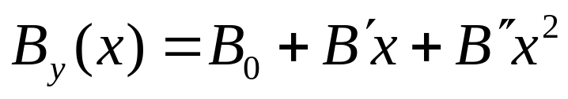
General
My only requirement:
  All corrector packages will be wired with the same polarity, and this is the polarity that the MTF will use
Two possible conventions:
  “Generic” (a la Syphers and Edwards)
    For normal elements, at y=0, positive currents give positive coefficients for
    Skew elements rotated half a pole counterclockwise from normal elements (as seen from beam)
  Determined by beam behavior
    Traditionally by effect in horizontal plane

Slide 3
Proposal
A “positive” current for each elements will do the following:
  “Horizontal” dipole: bend beam outward
  “Vertical” dipole: bend beam up
  Normal quad: horizontally focusing (increase horizontal tune)
  Normal sextupole: positive horizontal chromaticity
  Follow traditional convention between normal and skew elements
    Rotate skew quadrupole 45 degrees counterclockwise
    Rotate skew sextupole 30 degrees counterclockwise

Slide 4
Dipoles (beam view)
y
y
beam
x
“Horizontal” dipole
“Vertical” dipole
B
B
Bend outward (+x)
Same as now
Same as generic
Bend upward (+y)
Opposite now
Opposite generic

Slide 5
Quads
y
y
beam
x
Opposite “generic”
Same as now
Positive horizontal tune change
Negative vertical tune change
S
N
B_{y}
Normal:
x
N
S
N
Skew:
S
S
x
B_{x}
N

Slide 6
Sextupole
y
y
beam
x
Normal:
Opposite “generic”
Same as now (?)
Positive horizontal chromaticity
Negative vertical chromaticity
S
x
N
N
S
S
B_{y}
N
B_{x}
y
S
N
Skew:
N
S
S
N

