Slide 1

PKI in Today’s
Government
Mary Dixon
Director, Access Card Office
29 November 2001
Notes:
Good morning, I am here to talk about the DoD Common Access Card.
Topics
Original Tasking
PKI Infrastructure
Background DEERS & RAPIDS
Smart Card Solution
Organizational Usage
With integrated Lessons Learned

Slide 2
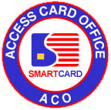
Background
Pilots / Studies since 1993
Long list of benefits
No “real savings” to pay for program
Data-centric smart card
  Synchronization issues

Slide 3
Background
(cont.)
Killer application - PKI
  Needed hardware-based token
  Securing our networks
  Non-repudiation for e-business
    Legally accepted
    Paperless contracting
Added Benefit: PKI facilitates moving from a data-centric to web-centric model

Slide 4
The Decision
Common Access Card
I.D. card for:
  Active military
  Selected Reserves
  DoD civilians
  “Inside the wall” contractors
Physical and logical access
  Authentication keys
Military ID card infrastructure
November 10, 1999
MEMO FROM:
Dr. John Hamre
(Deputy Secretary of Defense)
Create a Common Access Card
Notes:
Authentication Keys : Public Key Infrastructure was the killer application which justified the cost of the smart cards. 35 million dollars just to buy the cards.
Class 3 = Unclassified But Sensitive data.
DMDC was given one year to bring up a production system, and then two years to issue approximately 4.3 million cards.

Slide 5






Issuance Process
(Business Process Re-engineering)
RAPIDS
LRA
Kiosk or Client PC
ID Cards
Avg. 10 Minutes
PKI Registration
Avg. 15-20 Minutes
Download Certificates
Avg. 15-20 Minutes
Integrated
One Stop CAC Issuance
10-15 Minutes and
Going Down!
CAC-Enabled
RAPIDS

Slide 6
Why A Smart Card?
Facilitate E-commerce (non-repudiation)
Use PKI and the Internet to
  Reduce paperwork
  Decrease transaction / business process
  time
  Access legacy databases (with strong authentication and security)
Improve / re-engineer business processes
Improve security of physical access
Improve security of unclassified networks

Slide 7
Development Strategy
Incremental - do what can be done today; defer other issues
Backward Compatible - do not obsolete tomorrow what we did today
Keep up with emerging standards
Migration with technology
Adherence to best commercial practices

Slide 8
Card Architecture Goals
Goals
Security
Multi-application
Multiple vendors
Interoperability
Post issuance
Best commercial practices
COTS
Cost effective
Requirements
Java 2.1
Global platform
Interoperability Specification (BSI)
32K EEPROM
FIPS 140-1 Level 2 Certification
RESULTED
IN

Slide 9
Strengthens Authentication of Identity
Checks Credentials vs. DEERS (Not Source Database)
  Biometric
  Data from Component Personnel Systems
Identity management - key ingredient in PKI

Slide 10
Strengthens Security of Issuance Process
Card to be issued & checked vs. Card Management System
  DoD Card
  Provided to that RAPIDS site
VOs need:
  CAC present
  Registered w/ access at site logging in
  Biometric verified vs. DEERS
No Access granted by VOs (split function)
Rules-based system

Slide 11
System Audits
Security
  Servers govern access list for RAPIDS log on
  and privilege level for each user
Fraud Prevention
  Servers audit data for potential fraud analysis (date of
  birth changes, lost or stolen ID cards, and invalid issuance)
Card Production
  Servers audit number and type of card produced ;
  sorted by site, service, personnel status, card type, and
  user
  Server card production data is rolled up to the main frame
  level for summaries at site, Service, and system wide
  levels

Slide 12
Initial Uses of Card
Core PKI Functions
Authentication
Encryption
Signing
PK-Enabled Applications
Defense Travel System
Wide Area Workflow
Electronic Document Access

Slide 13
What Else Have We Accomplished?
PKI Requirements
  Certificate Practice Statement
  Certificate Acceptance Form
CAC Policy Memo / Working on Directive
OT&E / Interoperability Testing
Middleware Specifications
Two Developers Conferences / Developers Guide
Card Management System

Slide 14
Where Are We Today?
246 Workstations in 113 Locations
107,719 Cards Issued as of 19 Nov
(issuing about 1,400 cards per day)

Slide 15
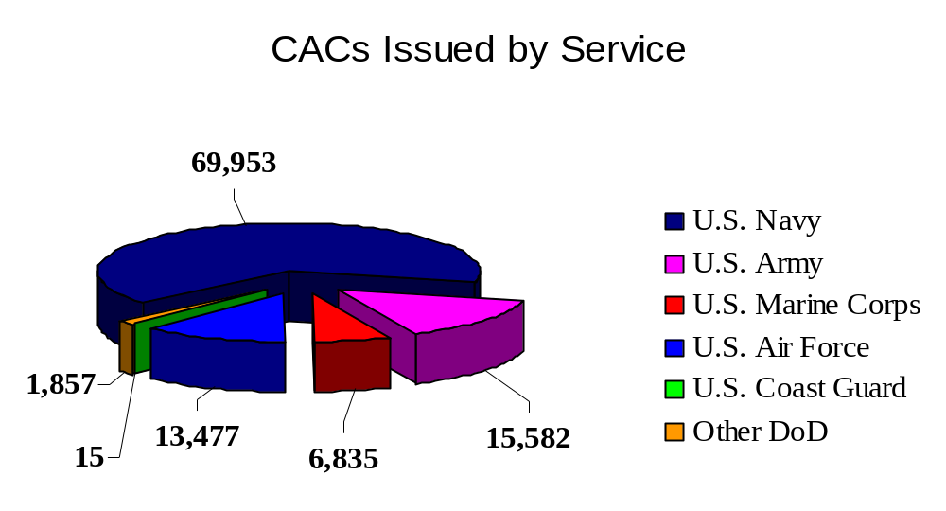
Where Are We Today?
(cont.)
Average Issuance Time < 15 minutes

Slide 16
Where Are We Today?
(cont.)
Began 15-month fielding of production system 5 Nov 2001
Military Services deploying readers / middleware and mass issuing of cards
FIPS 140-1 Level 2 certified card
First uses of chip on card
  core PKI functions
  warfighter support
  e-business applications

Slide 17

Issuance Infrastructure
Issuance Portal
https Server
Installation
Communications
Issuance API
Directories
NIPRNET
NIPRNET
RAPIDS
Issuance
Station
CA
NIPRNET
Legend
= What We Can Control
DEERS
= What We Can’t Control

Slide 18

Distributed Issuing
DEERS
Issuance API
Issuance Portal
https Server
HSM
HSM
RAPIDS Station
HSM
HSM
Netscape Cert Server
DISA

Slide 19
Verification Officer Authentication to DEERS
DEERS
Issuance API
Issuance Portal
https Server
HSM
HSM
RAPIDS Station
HSM
HSM
Netscape Cert Server
DISA

Slide 20
SSL v3 Session to DEERS
DEERS
SSL v3
Issuance API
Issuance Portal
https Server
HSM
HSM
RAPIDS Station
HSM
HSM
Netscape Cert Server
DISA

Slide 21
SSL v2 Session with Issuance Portal
DEERS
SSL v3
Issuance API
Issuance Portal
https Server
HSM
SSL v2
HSM
RAPIDS Station
HSM
HSM
Netscape Cert Server
DISA

Slide 22
VO Authenticates to CA
DEERS
SSL v3
Issuance API
Issuance Portal
https Server
HSM
SSL v2
HSM
RAPIDS Station
SSL v3
HSM
HSM
Netscape Cert Server
DISA

Slide 23
OP Secure Channel to New Card
DEERS
SSL v3
Issuance API
Issuance Portal
https Server
HSM
SSL v2
OP Secure Channel
HSM
RAPIDS Station
SSL v3
HSM
HSM
Netscape Cert Server
DISA

Slide 24
Card Application Managers (CAMs)
DEERS
SSL v3
Issuance API
Issuance Portal
https Server
HSM
SSL v2
OP Secure Channel
HSM
RAPIDS Station
SSL v3
HSM
ID
Generic
Container
PKI
Card Application Managers (CAMs)
HSM
Netscape Cert Server
DISA

Slide 25
Create Card Applets - ID
DEERS
SSL v3
Issuance API
Issuance Portal
https Server
HSM
SSL v2
HSM
RAPIDS Station
SSL v3
HSM
ID
Generic
Container
PKI
Card Application Managers (CAMs)
HSM
Netscape Cert Server
DISA

Slide 26
Create Card Applets – Generic Containers
DEERS
SSL v3
Issuance API
Issuance Portal
https Server
HSM
SSL v2
HSM
RAPIDS Station
SSL v3
HSM
ID
Generic
Container
PKI
Card Application Managers (CAMs)
HSM
Netscape Cert Server
DISA

Slide 27
Create Card Applets - PKI
DEERS
SSL v3
Issuance API
Issuance Portal
https Server
HSM
SSL v2
HSM
RAPIDS Station
SSL v3
HSM
ID
Generic
Container
PKI
Card Application Managers (CAMs)
HSM
Netscape Cert Server
DISA

Slide 28
Instantiate ID Applet
DEERS
SSL v3
Issuance API
Issuance Portal
https Server
HSM
SSL v2
HSM
RAPIDS Station
SSL v3
HSM
ID
Generic
Container
PKI
Card Application Managers (CAMs)
HSM
Netscape Cert Server
DISA

Slide 29
Instantiate Generic Container Applet
DEERS
SSL v3
Issuance API
Issuance Portal
https Server
HSM
SSL v2
HSM
RAPIDS Station
SSL v3
HSM
ID
Generic
Container
PKI
Card Application Managers (CAMs)
HSM
Netscape Cert Server
DISA

Slide 30
Instantiate PKI Applet
DEERS
SSL v3
Issuance API
Issuance Portal
https Server
HSM
SSL v2
HSM
RAPIDS Station
SSL v3
HSM
ID
Generic
Container
PKI
Card Application Managers (CAMs)
HSM
Netscape Cert Server
DISA

Slide 31
Profile, Parameters, PIN Data
DEERS
SSL v3
Issuance API
Issuance Portal
https Server
HSM
SSL v2
HSM
RAPIDS Station
SSL v3
HSM
ID
Generic
Container
PKI
Card Application Managers (CAMs)
HSM
Netscape Cert Server
DISA

Slide 32
Generic Container Data
DEERS
SSL v3
Issuance API
Issuance Portal
https Server
HSM
SSL v2
HSM
RAPIDS Station
SSL v3
HSM
ID
Generic
Container
PKI
Card Application Managers (CAMs)
HSM
Netscape Cert Server
DISA

Slide 33
Encryption Key
DEERS
SSL v3
Issuance API
Issuance Portal
https Server
HSM
SSL v2
HSM
RAPIDS Station
SSL v3
HSM
ID
Generic
Container
PKI
Card Application Managers (CAMs)
HSM
Netscape Cert Server
DISA

Slide 34
First Signature Key
DEERS
SSL v3
Issuance API
Issuance Portal
https Server
HSM
SSL v2
HSM
RAPIDS Station
SSL v3
HSM
ID
Generic
Container
PKI
Card Application Managers (CAMs)
HSM
Netscape Cert Server
DISA

Slide 35
Second Signature Key
DEERS
SSL v3
Issuance API
Issuance Portal
https Server
HSM
SSL v2
HSM
RAPIDS Station
SSL v3
HSM
ID
Generic
Container
PKI
Card Application Managers (CAMs)
HSM
Netscape Cert Server
DISA

Slide 36
Print Card
DEERS
Issuance API
Issuance Portal
https Server
HSM
HSM
RAPIDS Station
HSM
HSM
Netscape Cert Server
DISA

Slide 37
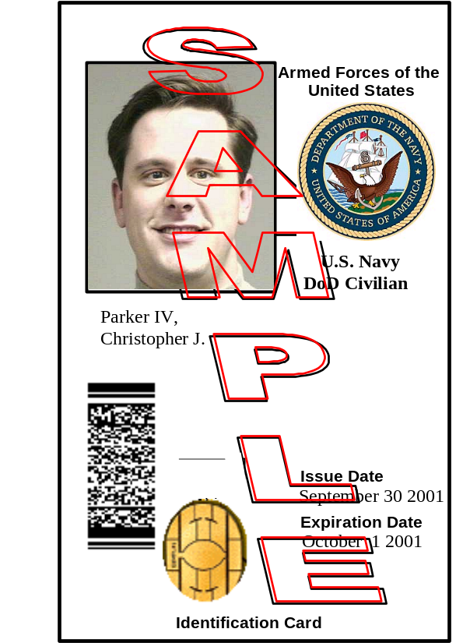
Print Card
DEERS
Issuance API
Issuance Portal
https Server
HSM
HSM
RAPIDS Station
HSM
HSM
Netscape Cert Server
DISA

Slide 38
Interoperability
Most interoperable solution in industry
Standards subject to interpretation
Industry participation

Slide 39
In Development
Biometrics
Physical Access
Warfighter support
Card maintenance
Centralized issuance process

Slide 40
Questions?
Mary Dixon
(703) 696-7396
dixonmm@osd.pentagon.mil
www.dmdc.osd.mil/smartcard/

