Slide 1
ATLAS Distributed Analysis and proposal for ATLAS-LHCb system
ATLAS-LHCb-GANGA Meeting
David Adams
BNL
March 22, 2004

Slide 2
Contents
Definitions
Architecture
AJDL
  Application
  Task
  Dataset
  Job
High-level services
  Analysis service
  Job management service
  Catalog services
Implementation Strategy
Effort providers
  ARDA
  Role of GANGA
Connection to LHCb
More information

Slide 3
Definitions
Analysis (not necessarily distributed)
  Supports the manipulation and extraction of summary data (e.g. histograms) from any type of event data
    AOD, ESD, …
  Supports user-level production of event data
    e.g. MC generation, simulation and reconstruction
Distributed analysis
  Extends the extraction and production support to include distributed users, data and processing.
  Natural extension of non-distributed analysis
  Easily invoked from any ATLAS analysis environment
    including Python, ROOT, command line
    easily ported to any future environment (e.g. JAS)

Slide 4
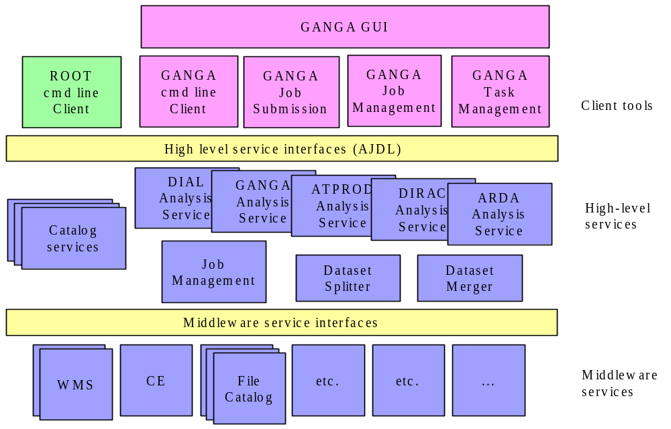
Architecture

Slide 5
AJDL
Acronym: Analysis Job Definition Language
Used to define interfaces for high-level services
Components include:
  Application – executable to process data
  Task – user configuration of application
  Dataset – describes input and output data
  Job – Activity to perform on (or off) the grid
    Typical: app, task and input dataset ➔ output dataset
Following diagram shows typical component interactions

Slide 6
Dataset 1
Dataset 2
Result
9. create
Job 1
7. create
Dataset
6. split
10. gather
Analysis
Service
4. select
e.g. ROOT
Analysis
Framework
1. Locate
5. submit(app,tsk,ds)
e.g. athena
2. select
3. Create or select
Job 2
Application
Task
Result
9. create
exe, pkgs
scripts, code
ADA/DIAL user interface

Slide 7
AJDL (cont)
Components must be extensible
  Use subtypes
    E.g. HistogramDataset, EventDataset, AtlasEventDataset
  Generic interface
    For use by (shared) generic high-level services
  Experiment-specific interface
    For application and users
Nature of components
  Persistent representation of data (e.g. XML)
  Classes to interpret this data (C++, Python, java,…)
    Language bindings or re-implementations
  Service or resource (as in WSRF)

Slide 8
Application
Application specifies executable used to process data
Two entry points
  Extract and build task
  Process input dataset to produce output dataset
    Application + Task = Dataset transformation
Carries enough information to
  Locate entry points
    Or carry the corresponding scripts
  Enable installation of all required software
    E.g. list of packages for use with package management system
    Might be subtypes for different package management systems

Slide 9
Task
Task carries the user configuration for an application
  E.g. runtime configuration or code for shared library
  Nature of the task specified by the corresponding application
  At present the task is a collection of embedded text files
Task plus application (transformation) should specify the content of input and output datasets
  Enable users and processing system to
    Verify transformation is suitable for given input dataset
    Avoid staging unneeded parts of input dataset
    Predict the content of output dataset

Slide 10
Dataset
Provides data view
Generic properties for use in high-level services:
  Location of data (files, DB, …)
    So data can be staged
  Content
    E.g. for ATLAS events: event ID’s and type-keys (e.g. good electrons) for each event
    EventDataset is an important generic subtype
  Constituents for compound dataset
    Natural boundaries for dataset splitting
Subtypes provide interface for users and applications to access the data

Slide 11
Job
Interface enables users (and high-level services) to monitor and manage jobs on the grid
Generic properties
  State: running, succeeded, failed, paused, …
  Input parameters (e.g. application, task and dataset)
  Result (e.g. output dataset) after completion
Management
  Pause/resume
  Kill
  Update status
  Job management service to implement these

Slide 12
High-level services
High-level services use AJDL components
  Middleware does not
Typically high-level services are generic
  Only use generic properties of AJDL components
  Same service for different applications and datasets
  Different experiments or realms can share services
    E.g. LHCb and ATLAS
Examples
  Analysis (transformation) service
  Job management
  Catalogs

Slide 13
Analysis service
Transformation service might be a better name
Provides means to create a concrete dataset
Interface functions
  Request dataset
    Input is application, task and dataset
    Output is job ID
    Associated job carries ID for output dataset
  Fetch job description
    Input is job ID
    Output is job

Slide 14
Analysis service (cont)
Example scenario for processing a high-level job
  Input is application, task, dataset and job configuration
  Map input virtual dataset to concrete representation
  Split into sub-datasets
  Create sub-job for each sub-dataset
  Stage files for each sub-job
  Locate and possibly install application
  Build (e.g. compile) task
  Run sub-jobs
  Gather and merge results to create output dataset
  Register output dataset (including replica)
  Job provides connection to output dataset and detailed job provenance

Slide 15
Job management service
Provide means to manage jobs
  Analysis service creating the job provides this
  May also want this functionality elsewhere
Accessed from job interface to implement management functions
  Might create job service (OGSI)
  Or job is a resource (WSRF)

Slide 16
Catalog services
Repositories
  Store AJDL components indexed by ID
Selection (metadata) catalogs
  Help user to select input data, task , …
VDC – Virtual Dataset Catalog
  Prescriptions for creating datasets
    Application, task input dataset
DRC – Dataset Replica Catalog
  Mapping between virtual and concrete datasets
Job catalog
  Detailed provenance for concrete datasets

Slide 17
Implementation strategy
Define AJDL
  Components, nature, interfaces
Implement catalogs
  Tables in AMI
  Programmatic interface
    (C++ with Python binding)
Analysis services
  Start with existing services or analogs
    DIAL, ATCOM, Capone, GANGA, …
  Different implementations for different strategies
  At least one using ARDA middleware

Slide 18
Implementation strategy (cont)
User interface
  Programmatic interface to high-level services and AJDL components
    C++, python and eventually java bindings
  GANGA will provide python binding and use it to deliver a GUI
    Extensible design: client tools plug into python bus
Middleware
  Whatever works to begin
  ARDA services will be used in that context
    Like to see better integration with other middleware efforts

Slide 19
Implementation strategy (cont)
Web service infrastructure
  Short term use independent persistent services
  Mid-term follow ARDA strategy
    GAS – grid access service
  Long term follow standards such as WSRF
    Dataset and job become resources?
Releases
  Deliver working prototype in May
    Robust enough for average physicist
  Regular releases adding functionality, improving performance and incorporating new middleware

Slide 20
Effort providers
Look to the following for effort:
  GANGA for user interface and more
  DIAL for interactive analysis service
  ARDA integration team for ARDA analysis service
  ARDA/EGEE and US grid projects for middleware
  POOL for datasets and metadata?
  SEAL for python-C++ integration
    Later java as well?
  ATLAS physics and computing groups for ATLAS-specific pieces
    ATLAS applications and datasets
    System testing and evaluation

Slide 21
ARDA
ARDA begins April 1
Two areas in LCG:
  Middleware development (1st report delivered)
  Integration team
ATLAS ARDA prototype
  Collaboration in context of integration team
  Deliver at least one analysis service base on ARDA middleware
  We would also like to collaborate on AJDL and other high-level services

Slide 22
Role of GANGA
Look to GANGA to provide
  Python binding (or implementation) for AJDL
  Client tools
    Job submission
    Job monitoring and management
    Task management
      Including JOE
  Comprehensive graphical analysis environment
    Including the above client tools
  LCG analysis service?
  Help with system integration and testing
  And more…

Slide 23
Connection to LHCb
To be determined
  This meeting?
My ideal is that ATLAS and LHCB share a system
  Along lines of the architecture described here
  Most GANGA effort directed toward delivering generic high-level services and client tools
Implications
  Most of the effort expended by GANGA developers is directly usable by both experiments
  Easy for others outside GANGA to contribute pieces
  Use by two experiments validates the idea of generic tools and services

Slide 24
More information
ADA home page:
  http://www.usatlas.bnl.gov/ADA
  This page has links to other projects

