Slide 1
AUTONOMY LEVELS FOR UNMANNED SYSTEMS (ALFUS)
OVERVIEW

Slide 2
BACKGROUND AND NEEDS
Forum
Autonomy Levels for Unmanned Systems (ALFUS)
An Ad Hoc Working Group

Slide 3
ALFUS OBJECTIVES
User Needs
From what we heard from Army users, they need approach for them to specify auto vhs, std vacab & std def for auto lvls.
army, af wanting to specify or evaluate ums. Helpful if there are std def and/or methods to set up metrics
Standard terms and definitions for characterizing the levels of autonomy for unmanned systems.
Metrics, methods, and processes for measuring autonomy of unmanned systems.

Slide 4
Participation
MOTIVATION, NEEDS, OBJECTIVES
DOD – AATD*, AFRL, AMRDEC*, ARL*, MANCEN*, CERDEC*, DARPA, NAVAIR, NRL, OSD/JPO, TARDEC*, TRADOC*, UAMBL*, …
DOC – NIST
DOE – HQ, INEEL
DOT – FHWA
Collaborations with JAUS WG, NASA, PerMIS, …
Documents provided for AIAA, NATO, American Helicopter Society, …
*U.S. Army

Slide 5
ALFUS FRAMEWORK
Autonomy
huang:
perceive, analyze, plan, decide, act, not ants and bugs
A UMS’s own ability of sensing, perceiving, analyzing, communicating, planning, decision-making, and acting, to achieve its goals as assigned by its human operator(s) through designed Human-Robot Interface.

Slide 6
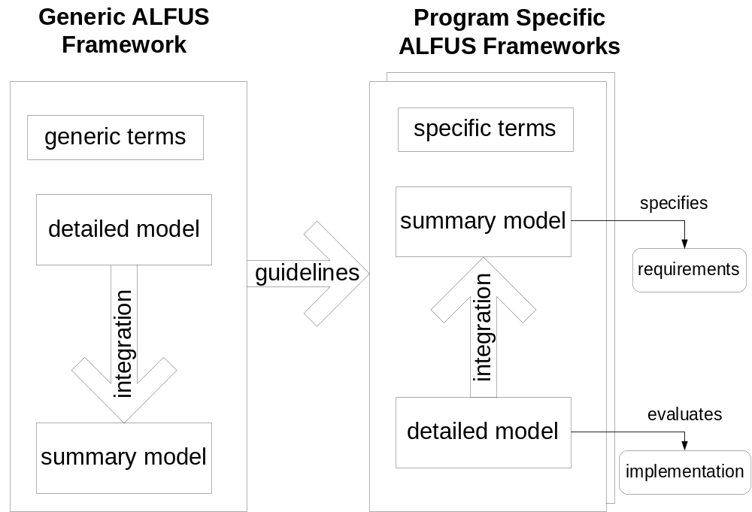
ALFUS FRAMEWORK
hhuang:
For prgs, some mtrcs more important

Slide 7
ALFUS FRAMEWORK SCOPE
Generic framework covering all UMSs.
From remote control through full autonomy.
From single UMS tactical behavior to joint missions.

Slide 8
Workshop Accomplishments
Inaugural Workshop (July 18, 2003, NIST)
Established Working Group Objectives
Second (September 11, 2003, BWI)
Identified Terms and Started Definitions
Third (November 22, 2003, SRS Tech., Arlington, VA)
Identified Metrics, Terminology Published
Fourth (February 25-26, 2004, Titan Sys., Huntsville, AL)
Identified Summary Model Representation

Slide 9
Workshop Accomplishments
Fifth (May 3-4, 2004, Atlanta Airport, GA)
Metrics and Measures Presented. Began Interaction with FCS
Sixth (July 28-29, 2004, FCS LSI, Huntsville, GA)
Tool Conceptualized. Exit Strategy Plan.
Seventh (October 19-20, 2004, AFRL, Dayton, Ohio)
Tool Updated. Began Summary Model.

Slide 10
ALFUS PRODUCTS
Volume 1: Terminology
Volume 2: Framework White Paper
Volume 3: Executive/Summary Model: Definitions, Descriptors, Guidelines
Volume 4: Detailed Model: Tool and Manuals

Slide 11
TERMINOLOGY
Autonomy Levels for Unmanned Systems
(ALFUS) Framework
Volume I: Terminology
Version 1.1
NIST Special Publication 1011

Slide 12
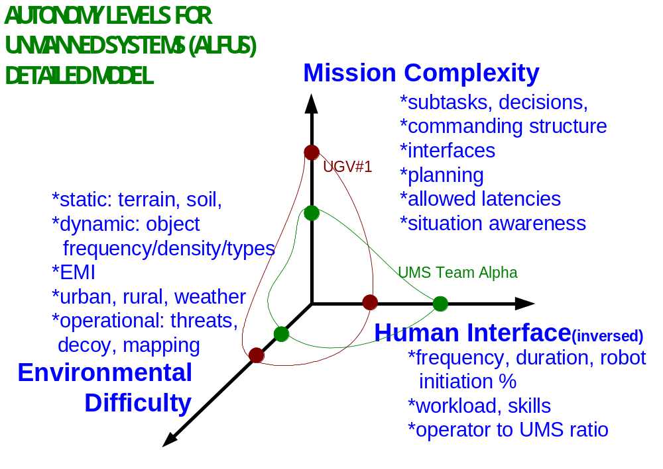
AUTONOMY LEVELS FOR UNMANNED SYSTEMS (ALFUS) FRAMEWORK
huang:
UMS pf, level or general, can be measured with 3 aspects, types of env it can operate in, mission that it can perform, and human interaction levels.
hidden behind the simple scales needs a complex model FACTORS AFFECTING ALFUS
huang:
not ready to conclude that less HRI necessarily correspond to higher level of autonomy, HRI may enhance autonomy
http://www.isd.mel.nist.gov/projects/autonomy_levels/

Slide 13
DETAILED MODEL TOOL
Headed by Charlie Bishop of LSI.
Compute autonomy level in spreadsheet based on metrics.
Use ANS as an example.
Apply the NIST scenario.

Slide 14
GENERIC ALFUS FRAMEWORK
Summary Model
A 0 – 10 (or 1 – 10) scale indicating Autonomy Levels.

Slide 15
SUMMARY MODEL FORMAT
(draft)
Level and descriptor
Metrics and Definition
Capability
10 –
Full, adaptive autonomy
Completes all assigned missions with highest complexity; understands, adapts to, and maximizes benefit/value/efficiency while minimizing costs/risks on the broadest scope environmental and operational changes; capable of total independence from operator intervention.
Any mission assigned to UMS, individual or team, in its native environment
HRI Metrics:
Requiring approaching zero human interaction after assigning mission.
Mission Complexity Metrics:
• All required missions for SoS, highest level of subtasking and collaboration throughout organization.
• Full, self, efficient, real-time planning and execution, highest precision and success rate, maximizes/minimizes on values/cost, benefit/risk.
• Self-sufficient SA and KB, highest fusion/perception levels.
Environmental Difficulty Metrics:
• Generate and assimilate highest fidelity map for mission, infer highest res info from low res
• Adaptable to extreme terrain and climate variations and obstacle density and frequency.
• Independence to comm. link with operator.

Slide 16
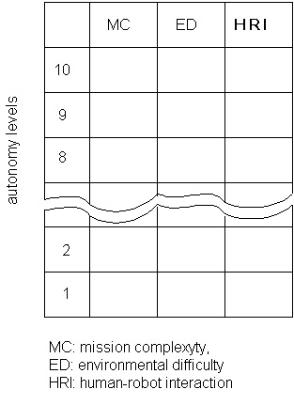
ALFUS Framework Summary Model
huang:
from 3 sets of detailed metrics, there needs to be processes that integrate them to form summarized indices.

Slide 17
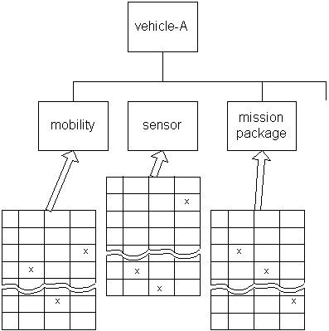
ALFUS FRAMEWORK
Illustrative Application

Slide 18
SUMMARY MODEL alternative 2:
The summary model becomes focused largely on the mission complexity or another axis that fits the Program requirements best.

Slide 19
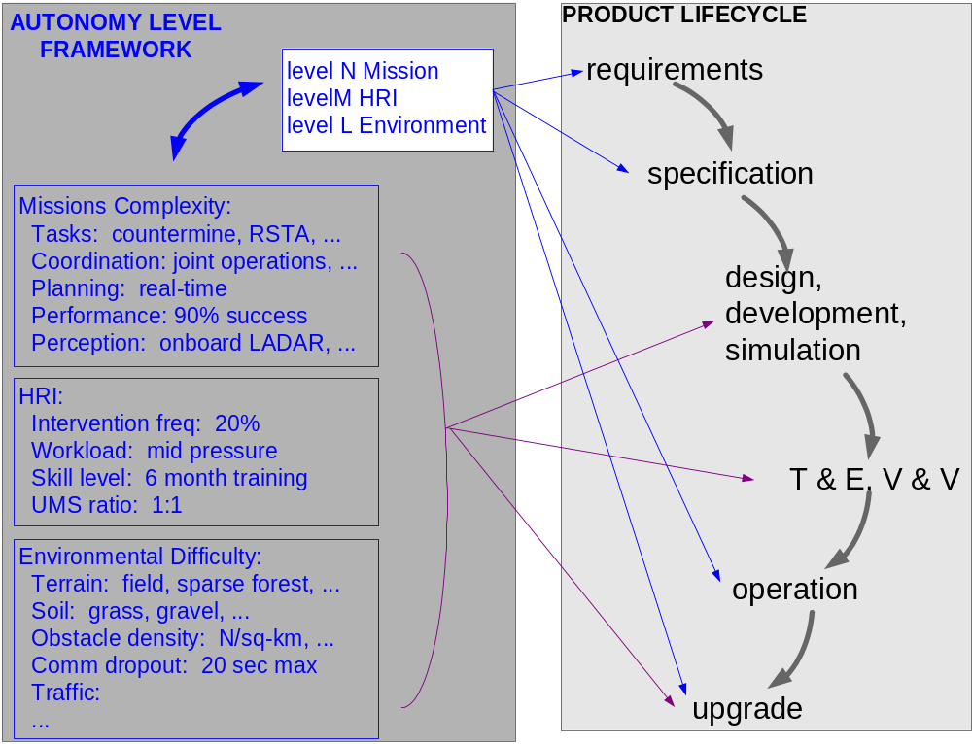

Slide 20
Some possible, additional uses of the framework
Classify environments, HRI systems, or missions
Missions can be certified with the other two axes, e.g., perform mission A in level N environment, mission B is designed to operate with level M HRI, etc.
Detailed metrics could be used as general performance metrics for intelligent, unmanned systems.

Slide 21
SUMMARY
Generic framework covering all UMSs.
From remote control through full autonomy.
From single UMS to team to joint missions.
End products to be mission/goal/task/system specific.
http://www.isd.mel.nist.gov/projects/autonomy_levels/
hui-min.huang@nist.gov

Slide 22
backups

Slide 23
EXISTENT WORK
Essential Foundations
OODA -- Observe, Orient, Decide, Act.
4D/RCS Reference Architecture
  Generic Node consistent with OODA
  System Hierarchy harmonizes many, many OODA nodes.
  Hierarchical Task Decomposition organizes missions of different complexity.

Slide 24
EXISTENT WORK
huang:
you see general corrspndnces among
issue is whether a generic suporting all, whether a gen model for people developspecific levels
Intelligent tactical behavior
Cooperative behavior
Payload mission behavior
O.A.
Off-road mobility
Road following
Mission control (operator)
Remote control
Full autonomy, human level pf
Collaborative operations
Coordinated operations
On/off road, moving objects
O.A.
Pre-planned missions
Remote control
Full autonomy
Battlespace (Bsp) swarm cognizance
Bsp cognizance
Bsp knowledge
multi vh cooperation
multi-vh coordination
Event adaptive
Preplanned mission
Remote control
high
low

Slide 25
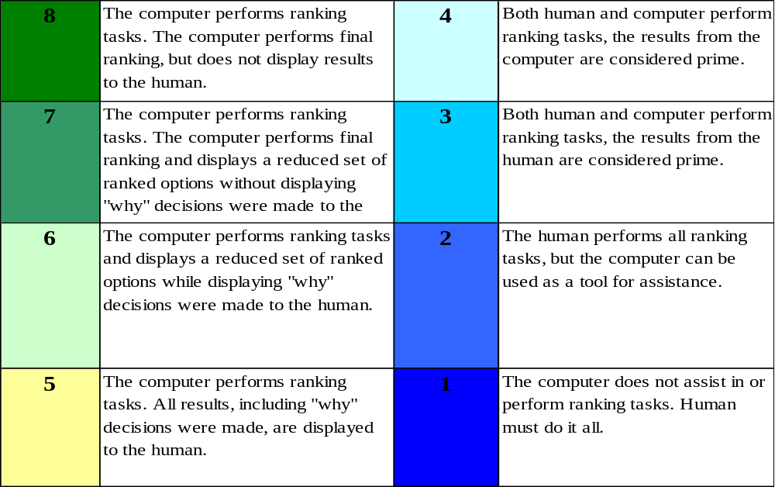
Existent Work--NASA SMART
Each Level of Autonomy Scale is broken into 8 levels. The levels for the Decide functions are shown.
More Autonomy
Less Autonomy

Slide 26
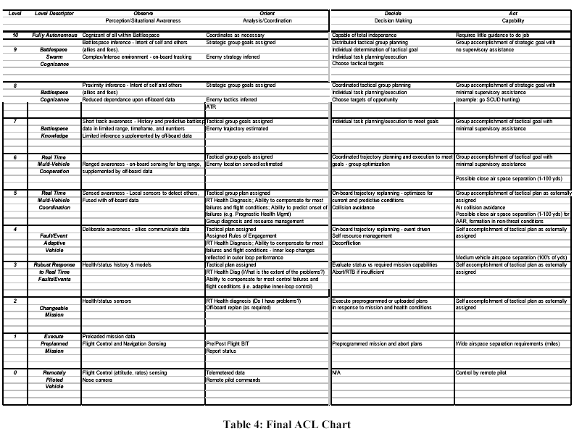
EXISTENT WORK

Slide 27
EXISTENT WORK
“Sheridan” Model
1) Computer offers no assistance, human must do it all.
2) Computer offers a complete set of action alternatives, and
3) narrows the selection down to a few, or
4) suggests one, and
5) executes that suggestion if the human approves, or
6) allows the human a restricted time to veto before automatic execution, or
7) executes automatically, then necessarily informs the human, or
8) informs him after execution only if he asks, or
9) informs him after execution if it, the computer, decides to.
10) Computer decides everything and acts autonomously, ignoring the human.

Slide 28
EXISTENT WORK
Army Science Board Study
0. Manual remote control, like a remote controlled toy
1. Simple automation
2. Automated tasks and functions, like a Hunter
3. Scripted mission, like an Shadow or Predator UAV
4. Semi-automated missions with simple decision making, like an Cruise Missile
5. Complex missions-specific reasoning
6. Dynamically mission adaptable
7. Synergistic multi-mission reasoning
8. Human-like autonomy in a mixed team
9. Autonomous teams with unmanned leader or mission manager
10. Autonomous conglomerate.

Slide 29
Existent Work
Level
Level Description
Observation
Perception/ Situation Awareness
Decision Making
Capability
Example
1
Remote Control
Remote camera images viewed by operator
None
Remote operation in relatively simple stationary environments
Basic teleoperation
2
Remote Control w/vehicle State Knowledge
Local pose, dash-board sensors, and depth image display for operator
Basic health and vehicle state reporting
Remote operation in relatively complex stationary environments
Teleoperate with operator knowledge of geometry of environment
3
Pre-Planned mission or
retro-traverse
INS/GPS waypoints, collision avoidance
ANS commanded steering based on planned path
Basic path following with operator help
Pre-planned path, retro-traverse, or operator waypoint selection
4
On-board processing of sensory images
Perception of simple surfaces and shapes
Negotiation of simple environment
Robust leader follower with operator help
Follow foot soldiers on road march or easy cross-country
5
Simple obstacle detection and avoidance
Local perception and map database
Real-time path planning based on hazard estimation
Basic cross country semi-autonomous navigation
Cross country with frequent operator intervention
6
Complex obstacle detection and avoidance, terrain analysis
Perception and world model representation of local environment
Planning and negotiation of complex terrain and objects
Cross country with obstacle negotiation with some operator help
Cross country in complex terrain with limited intervention
7
Moving object detection and tracking, on-road and off-road autonomous driving
Local Sensor fusion with a priori maps of road network, representation of moving objects
Robust Planning and Negotiation of Complex Terrain, Environmental Conditions, hazards and objects
Cross country with obstacle avoidance with little operator help
Cross country in complex terrain with full mobility speed with limited intervention
8
Cooperative operations, convoy, intersections, on-coming traffic
Real-time fusion of data from external sources, broad knowledge of rules of the road
Advanced decisions based on shared data from other similar vehicles
Rapid effective execution of on-road driving tasks with minimal operator input
On-road operations under normal road conditions with little supervision
9
Collaborative operation, traffic signs and signals, near human levels of driving skill
Perception in bad weather and difficult environmental conditions
Collaborative reasoning for cooperative tactical behaviors
Accomplish complex collaborative missions with some operator oversight
Effective combat mission accomplishment with little supervision
10
Full autonomy with human levels of performance or better
Data fusion from all participating battlefield assets
Total independence to plan and implement to meet defined objectives
Accomplish complex collaborative missions with no operator intervention
Fully autonomous combat missions accomplished with results equal to or better than with human soldiers
➢ As Autonomy increases capabilities include or replace items from lower levels
➢ The same Behavior operating in different Terrain and/or Environmental conditions may result in different level of autonomy

Slide 30
GENERIC ALFUS FRAMEWORK
Terminology
Generic
  autonomy, environment, fusion, human robot interface (HRI), mission planning, mode of operation, perception, robotic follower, situation awareness, task decomposition, unmanned system
Domain Specific
  cooperative engagement, sensor to shooter, unattended ground sensors (UGS)

Slide 31
ALFUS GENERIC FRAMEWORK
Detailed Model
Characterization of Mission Complexity
Tactical Behavior
  subtask types, commanding levels
  decision points
Coordination/Collaboration
  teaming
  interfaces--data types,frequencies, interdependency/idling time
Performance
  planning capability, prior/during/post mission
  allowed latencies and errors, success rate
Sensory Processing/World Modeling
  situation awareness required
  information dependency

Slide 32
ALFUS GENERIC FRAMEWORK
Detailed Model
Characterization of Human-Robot Interaction
Intervention frequency/duration
Robot initiation percentage
Operator workload
Operator to UMS ratio
Operator Skill

Slide 33
hhuang:
Show its file
ALFUS GENERIC FRAMEWORK
Detailed Model
Characterization of Environmental Difficulty
static: terrain, soil, water,
dynamic: frequency/density/types of objects
electronic/electromagnetic
urban: traffic, road, barriers, controlling devices
rural: vegetation, biologics,
weather: climate, lighting, temperature,
operational: threats, decoy, mapping, mobility,

Slide 34
ALFUS FRAMEWORK
Clarification
huang:
based on def, are the two same?
mission complexity, not understanding types of clothes, spinning cycles, detergent consumption rates, etc.
Autonomy vs. Automation
- washing machine vs. scouting mission
- human-less operation vs. human-like performance

Slide 35
JOINT MISSIONS
high
autonomy levels
mission integration
low
mobility
scan
maritime reconn
RSTA
react to threats
sub track and trail
UGV
UAV
UUV
MISSION TYPES

Slide 36
Examples of Levels of Discourse and Independence
Make sure that the campus is secure
Multiple vehicle cooperation, high level of task knowledge, high tasking uncertainty, large spatial and temporal scope
System of Systems
Go behind building 202 and keep a lookout for intruders coming through fence
Single vehicle, multiple subsystems, medium level of task knowledge, high uncertainty, medium spatial and temporal scope
Single Vehicle
Goto_waypoints (UTM1, UTM2, …UTMn)
Scan_direction(UTMa, UTMb, dwell)
Single subsystem, low level of task knowledge, medium-low uncertainty, medium-small spatial and temporal scope
Subsystem
Teleoperation
Single subsystem, no task knowledge, very low uncertainty, small spatial and temporal scope
Servo

