Slide 1
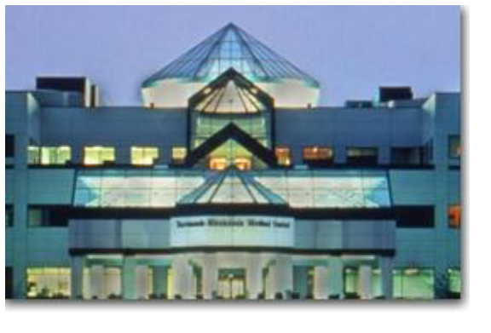
Safer, Cheaper and Just as Good:
Making Sterile, 7-Day Platelets a Reality
James P. AuBuchon, MD
E. Elizabeth French Professor and Chair of Pathology
Dartmouth-Hitchcock Medical Center
Lebanon, New Hampshire

Slide 2
Safer, Cheaper and Just as Good:
Making Sterile, 7-Day Platelets a Reality
1: Why we are interested in this
2: Whether it is feasible

Slide 3
Comparison of Residual Risks
1:100
Transmission risk, per unit
HIV
1:1000
1:10 000
HBV
1:100 000
HCV
1:1 000 000
1984
1986
1988
1990
1992
1994
1996
1998
2000
Updated from: Goodnough LT e t al. NEJM 1999;341:126-7

Slide 4
Comparison of Residual Risks
1:100
Transmission risk, per unit
HIV
Bacterial
Contamination
(platelets)
1:1000
1:10 000
HBV
Septic
Fatalities
(platelets)
1:100 000
HCV
1:1 000 000
1984
1986
1988
1990
1992
1994
1996
1998
2000
Updated from: Goodnough LT e t al. NEJM 1999;341:126-7

Slide 5
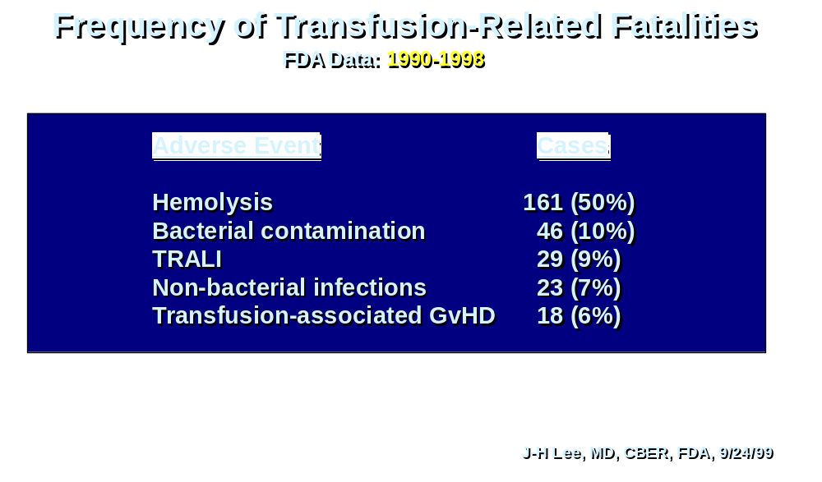

Slide 7
What Are You Transfusing?
Red Blood
Cells
200 mL red cells
30 mL plasma
110 mL additive solution
Platelets
4 x 10¹¹ platelets
300 mL plasma

Slide 8
What Are You Transfusing?
Red Blood
Cells
200 mL red cells
30 mL plasma
110 mL additive solution
10⁹ Yersinia per mL + endotoxin
Platelets
4 x 10¹¹ platelets
300 mL plasma
10⁸ Staph per mL

Slide 9
The Problem with Platelets…
Bacterial contamination is
- frequent
- initially at very low concentration
- very difficult to detect
- in unit
- in patient

Slide 10
Bacterial Contamination Risks
Unit Transfused Risk per Million Units
Confirmed Report of Fatality
Bacterial Contamination
Red Blood Cells 6.0 1.0
Plateletpheresis units 32 7.1
TOTAL, all units 7.4 1.1
Perez P et al. Transfusion 1999;39:2S.

Slide 11
Bacterial Contamination Risks
Unit Transfused Risk per Million Units
Confirmed Report of Fatality
Bacterial Contamination
Red Blood Cells 6.0 1.0
Plateletpheresis units 32 7.1
TOTAL, all units 7.4 1.1
1/140,000
Perez P et al. Transfusion 1999;39:2S.

Slide 12
U.S. Bacterial Contamination Estimates
Based on BaCon Preliminary Data
Clinical cases of post-transfusion sepsis 162 - 288 per year
Fatalities 4.5 - 18 per year
BaCon Report, 1999 AABB Annual Meeting.
Kuehnert et al. Transfusion 2001;41:1493-9.

Slide 13
Frequency of Contamination
Other Reports
Platelet contamination rate:
US 670/million units (Transfusion 1999;39:36S)
Germany 1300 (Transfusion 1999;39:34S)
Spain 320 (Transfusion 1999;39:75S)

Slide 14
Frequency of Contamination
Other Reports
Based on Johns Hopkins’ Data
Plt Conc SDP
Post-transfusion sepsis 402/million 75/million
Fatalities 62/million 14/million
Ness PM et al. Transfusion 2001;41:857-61.
Recalculation: LJ Dumont.

Slide 15
Detecting Bacteria in Platelets: Inspection
Changes Associated with Contamination
Clots
Discoloration
Gas bubbles

Slide 16
Detecting Bacteria in Platelets: Microscopic Review
Sensitivity:
Gram stain 10⁵ - 10⁶/mL
Acridine orange 10⁴ - 10⁶/mL
Barrett et al. Transfusion 1993;33:228-4.

Slide 17
Detecting Bacteria in Platelets: Microscopic Review
Sensitivity:
Gram stain 10⁵ - 10⁶/mL
Acridine orange 10⁴ - 10⁶/mL
But: Significant false positive rate
Barrett et al. Transfusion 1993;33:228-34.

Slide 18
Detecting Bacteria in Platelets: Biochemical Changes
GLUCOSE
ACID + CO₂
Decreased glucose
Decreased pH
Decreased/absent swirling
Direct detection

Slide 19
Detecting Bacteria in Platelets: Biochemical Changes
GLUCOSE
ACID + CO₂
Decreased glucose
Decreased pH
Decreased/absent swirling
Direct detection
• Automated testing
• Biochemical strips
• Sensitive labels
• Automated culture

Slide 20
Detecting Bacteria in Platelets: Biochemical Changes
CO₂-sensitive labels on platelet bags:
No change with Staph. epi
Staph. aureus
Ps. aeruginosa
Bacillus cereus
Change only with Ent. aerogenes
• at > 10⁶ CFU/mL
• sensitivity = 20%
Specificity problem: Platelets produce CO₂ also.
Hogman CF, Gong J. Vox Sang 1994;67:351-5.

Slide 21
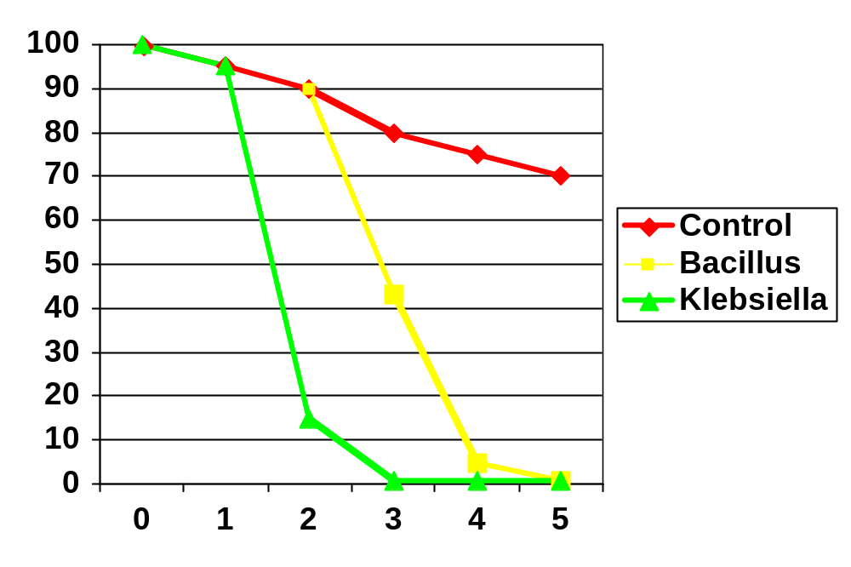
Detecting Bacteria in Platelets: Biochemical Changes
Glucose, % Day 0
Storage Time, d
data from Burstain JM et al. Transfusion 1997;37:255-8.

Slide 22
Detecting Bacteria in Platelets: Biochemical Changes
Glucose, % Day 0
-2 SD
Storage Time, d
after Burstain JM et al. Transfusion 1997;37:255-8.

Slide 23
Swirling
Alignment with flow
No alignment with flow
Low pH
Metabolic disturbance

Slide 24
Detecting Bacteria in Platelets: Biochemical Changes
Swirling to detect contamination
Sensitivity Specificity
S. epi. 25% (Day 5) 75%
S. aureus 100% (Day 2-3) 100%
Salmonella 75% (Day 3-5) 100%
Leach MF et al. Vox Sang 1998;74(suppl 1):1180.

Slide 25
Detecting Bacteria in Platelets: Biochemical Changes
False positive rates (sterile units)
Glucose: 5%
pH: 4%
Swirling: 5%
based on ±2 SD reference intervals
Wagner SJ, Robinette D. Transfusion 1996;36:989-93.

Slide 26
Detecting Bacteria in Platelets: Future Developments
PCR
EIA
%O₂
Others….
Brecher et al. Transfusion 1993;33:450-7.
Fenwick et al. Lancet 1991;337:496-7

Slide 27
Detecting Bacteria in Platelets: Culturing
Traditional Concept
Day 2 or 3
BLOOD CENTER
HOSPITAL
Culture: Day 1
Hold until negative

Slide 28
Detecting Bacteria in Platelets: Culturing
Traditional Concept
Day 2 or 3
BLOOD CENTER
HOSPITAL
Culture: Day 1
Hold until negative
- Currently in routine use in blood centers in Belgium
and the Netherlands
- Potential difficulties with recall, outdating.

Slide 29
Detecting Bacteria in Platelets: Culturing
New Concept: Hospital-Based Verification of Sterility

Slide 30
Detecting Bacteria in Platelets: Culturing
New Concept: Hospital-Based Verification of Sterility
ENTRY INTO INVENTORY
DAY 2: CULTURE
(5 mL via SCD)
BacT Alert
TRANSFUSION ORDER:
RELEASE UNIT

Slide 31
Detecting Bacteria in Platelets: Culturing
Organisms Involved in Blood Unit Contamination
1998 - 2000
Gram-positive (60%) Gram-negative (40%)
Staph. epi* (8) E. coli (5)
Staph. aureus (4) Serratia marcescens* (3)
Staph. agalactiae (2) Serratia liquifaciens* (2)
Grp G Strep. (1) Enterobacter aerogenes (1)
Staph. lugdensis (1) Enterobacter cloacae (1)
Staph. saprophyticus (1) P. rettgeri (1)
Bacillus cereus (1) Y. enterocolitica (1)
E. faecalis (1)
Strep. pneumoniae (1)
*includes isolates from RBCs
Kuehnert et al. Transfusion 2001;41:1493-9.

Slide 32
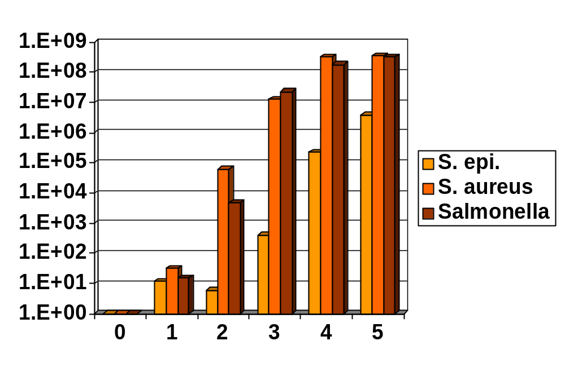
Detecting Bacteria in Platelets: Culturing
Bacterial Growth Kinetics in Platelets
Bacterial concentration/mL
Inoculation:
1 CFU/mL
Storage time, d
Leach MF et al. Vox Sang 1998;74(suppl 1):1180.

Slide 33
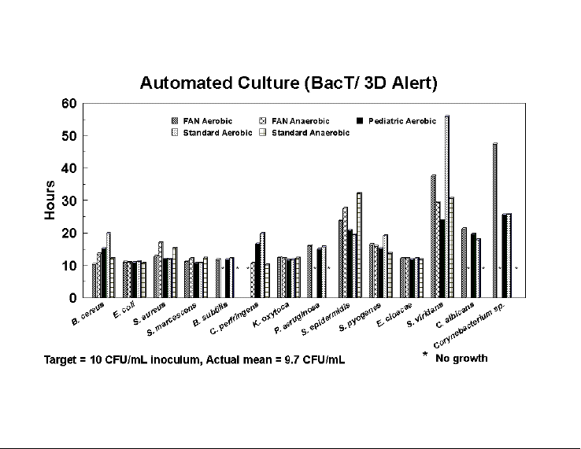
Detecting Bacteria in Platelets: Culturing
Time to Detection in an Automated Culturing System
Inoculum: 4 mL
Brecher M et al. Transfusion 2001;41:477-82.

Slide 34
Detecting Bacteria in Platelets: Culturing
New Concept: Hospital-Based Verification of Sterility
ENTRY INTO INVENTORY
DAY 2: CULTURE
POSITIVE AUTOMATED
CULTURE
Interdiction of release
BacT Alert
TRANSFUSION ORDER:
RELEASE UNIT

Slide 35
Detecting Bacteria in Platelets: Culturing
New Concept: Hospital-Based Verification of Sterility
ENTRY INTO INVENTORY
DAY 2: CULTURE
POSITIVE AUTOMATED
CULTURE
Interdiction of release
BacT Alert
TRANSFUSION ORDER:
RELEASE UNIT
Providing:
Assurance of sterility
Storage to 7 days
Storage after pooling
Reduced cost for leukoreduction

Slide 36
Practical Application of Culturing
in a Transfusion Service Laboratory
Experience in first 2 years:
2,569 units cultured
(5 mL into aerobic bottle, BacT/Alert automated system)
16 initial positives (0.6%)
11 not confirmed on repeat culture
5 not able to be recultured
(1: positive after transfusion)
May, 1999 - April, 2001

Slide 37
Practical Application of Culturing
in a Transfusion Service Laboratory
Recent experience:
Split double SDP unit received (external source)
Day 2: Culture
Day 3 AM: Split A’s culture growth
(recultured)
Day 3 PM: Split B’s culture growth
Same Staph. epi. in each unit.
July, 2001

Slide 38
Practical Application of Culturing
in a Transfusion Service Laboratory
Costs:
Material costs: $11.05/plateletpheresis unit
Tech time: 7 minutes
Workup of positives: $50-100
Cooper L et al. Transfusion 1999;39:119-20S.

Slide 39
Practical Application of Culturing
in a Transfusion Service Laboratory
Cost (for 100 units):
Material costs: $1105
Tech time: 700 minutes $467
Workup of positive: $75
$1647
Units not outdated:
15 @ $500 $7500

Slide 40
Practical Application of Culturing
in a Transfusion Service Laboratory
Potential payback: Outdate extension
Units expiring Units requested
on next day
2.4±1.4 4.8±2.4
(1-5) (2-9)
In all cases, more units were requested than expired.

Slide 41
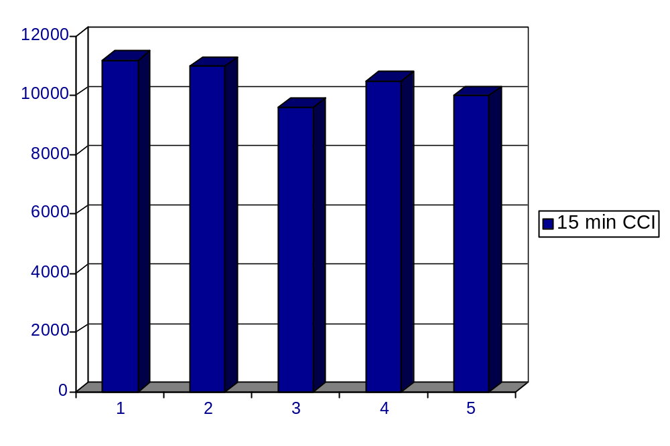
BUT: Do 7 day old platelets survive and function?
Storage Time (d)
Leach MF, AuBuchon JP. Transfusion 1993;33:661-4.

Slide 42
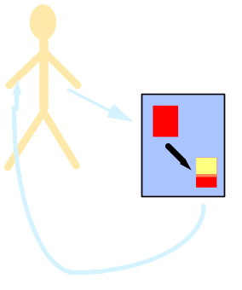
A Controlled Trial of 5 vs. 7 Day Platelet Storage
Dartmouth-Hitchcock Medical Center American Red Cross, Norfolk
James P. AuBuchon, MD John B. Nobiletti, MD
Louise Herschel, BS, MLT(ASCP), CCRC Deanna A. McNeil,MLT(ASCP)
Jill Roger, MT(ASCP), CCRC Sherrie L. Sawyer, MS
Adrienne Johnson, BS
Gambro Pamela H. Whitley, MT(ASCP)SBB
Larry Dumont
Art Hamstra
Tania VandenBroeke, MT(ASCP)
Flatbed agitation, 22-24°C
Day
1
Day
5
Day
7
LR SDP
Trima™
Spectra™ LRS Turbo
X
X
X
X
X
X
X
X
Biochemical assays
Functional assays
⁵¹Cr/¹¹¹In recovery
and survival

Slide 43
A Controlled Trial of 5 vs. 7 Day Platelet Storage
Unit contents
Platelets: 4.1±1.1x10¹¹
Leukocytes: 5.0x10⁴ (median)
Volume: 269±68 mL
Mean ± 1 SD

Slide 44
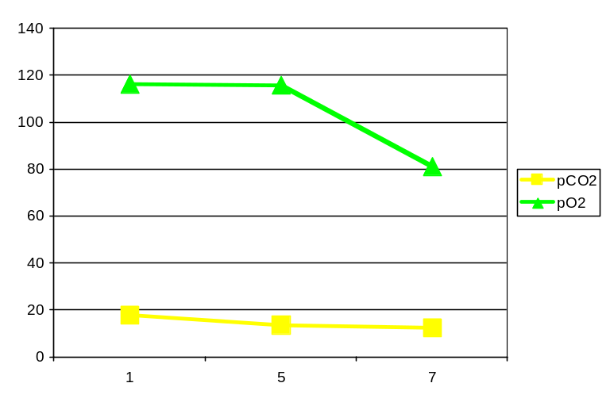
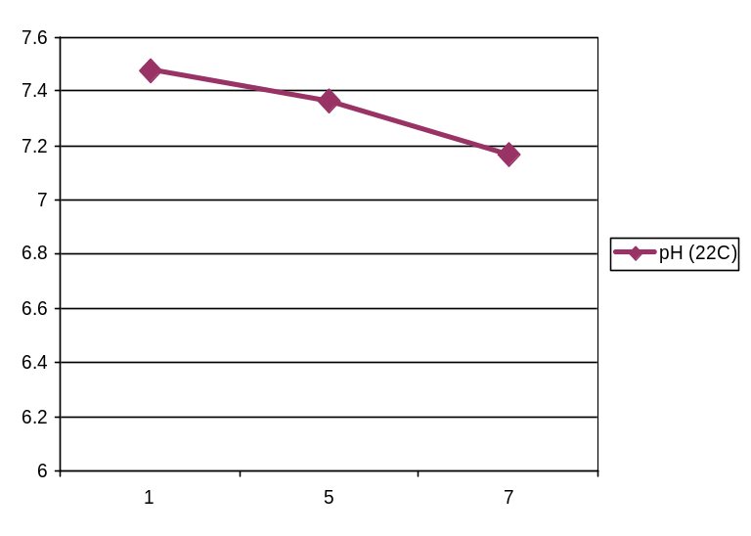
A Controlled Trial of 5 vs. 7 Day Platelet Storage
pO₂
*
mm Hg
pCO₂
Storage Time (d)
*
pH (22°C)
Storage Time (d)

Slide 45
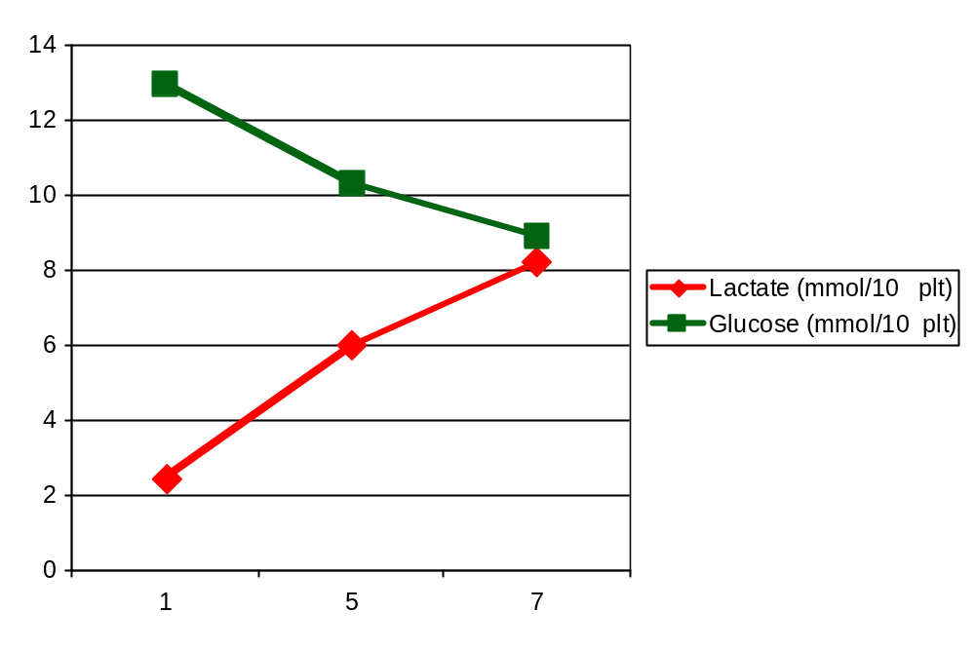
A Controlled Trial of 5 vs. 7 Day Platelet Storage
Gluc, Lact, Rate
*
Rates: No difference
12
*
12
Storage Time (d)
Mean± 1 SEM

Slide 46
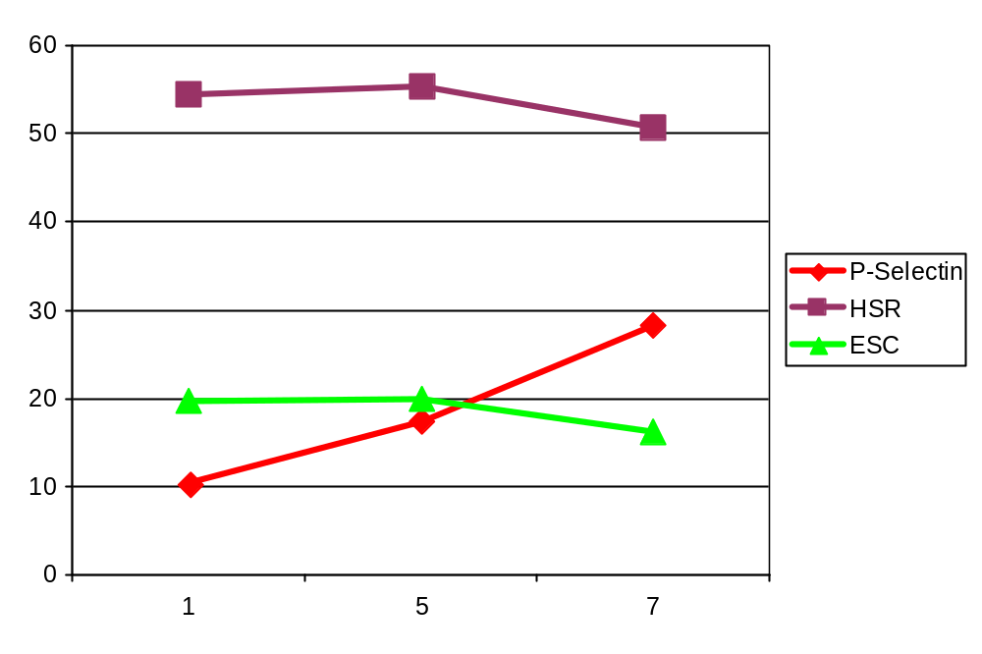
A Controlled Trial of 5 vs. 7 Day Platelet Storage
*
%
*
*
Storage Time (d)
Mean± 1 SEM

Slide 47
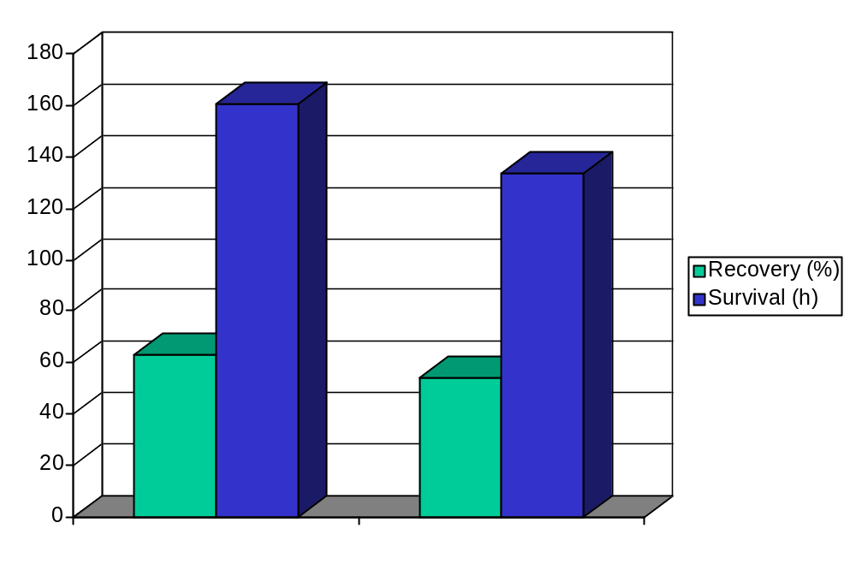
A Controlled Trial of 5 vs. 7 Day Platelet Storage
*
*
Day 5
Day 7
Mean± 1 SEM

Slide 48
A Controlled Trial of 5 vs. 7 Day Platelet Storage
5 Days 7 Days
Recovery
This study 63±11% 54±14%
Archer et al., 1983 59±17% 46±8%
Survival
This study 6.7±1.6d 5.6±1.9d
Archer et al., 1983 3.4±1.5d 2.7±0.5d
Mean ± 1SD
Archer et al. Vox Sang 1982; 43:223-30.

Slide 49
A Controlled Trial of 5 vs. 7 Day Platelet Storage
5 Days 7 Days
Recovery
This study 63±11% 54±14%
Archer et al. 59±17% 46±8%
Survival
This study 6.7±1.6d 5.6±1.9d
Archer et al. 3.4±1.5d 2.7±0.5d
6
THIS STUDY:
Better results than
accepted previously
Mean ± 1SD
Archer et al. Vox Sang 1982; 43:223-30.

Slide 50
A Controlled Trial of 5 vs. 7 Day Platelet Storage
5 Days 7 Days
Recovery
This study 63±11% 54±14%
Archer et al., 1983 59±17% 46±8%
Survival
This study 6.7±1.6d 5.6±1.9d
Archer et al., 1983 3.4±1.5d 2.7±0.5d
14 vs. 22%
6
THIS STUDY:
Better results than
accepted previously
18 vs. 21%
THIS STUDY:
Less reduction
D5 D7
Mean ± 1SD
Archer et al. Vox Sang 1982; 43:223-30.

Slide 51
Practical Application of Culturing
in a Transfusion Service Laboratory
LR
SDP
Flatbed agitation, 22-24°C
Day
2
Day
5
Day
6
Day
7
Day
8
OUTDATE
Transfuse
if no other
units
available
pH and
swirling
checks
Determine
CCI

Slide 52
Practical Application of Culturing
in a Transfusion Service Laboratory
Day 8 analysis (n = 91)
Swirling: 96%
pH: 6.86±0.245
> 6.2 in 97%
Max = 7.26
All units collected on Spectra™ LRS Turbo

Slide 53
Practical Application of Culturing
in a Transfusion Service Laboratory
Transfusions beyond Day 5 (n=40)
All with expected clinical results
Stable patients with 10-60 min CCI: 21
All units collected on Spectra™ LRS Turbo

Slide 54
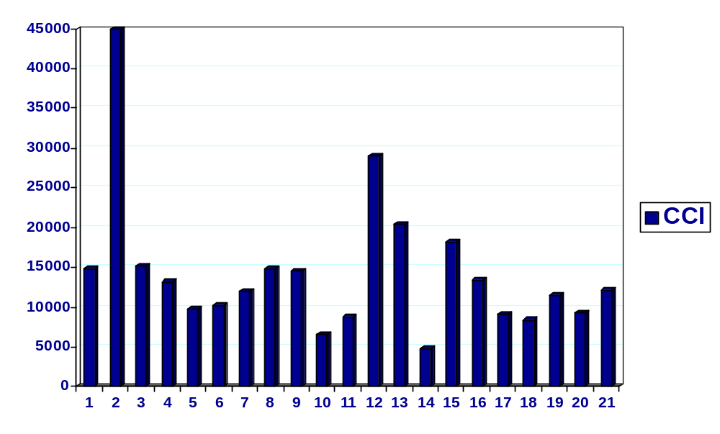
Clinical Effect of Transfusing Platelets Beyond Day 5
CCI at Day 6-7: 14,400±8,800 Median: 12,191 (n=21)

Slide 55
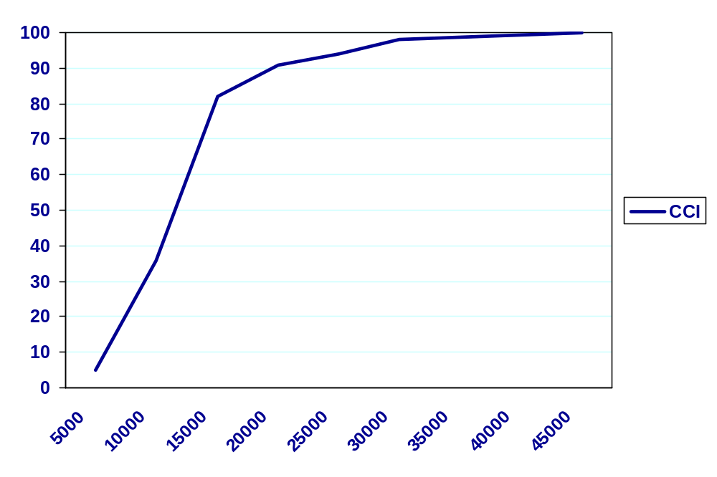
Clinical Effect of Transfusing Platelets Beyond Day 5
Cumulative Proportion (%)
90% > 7,500
(All but 1: > 5,000)

Slide 56
What if 7d platelets aren’t quite as good?
Plt HIV Septic Total Units’ Culturing Total Direct
Trxn Risk Mortality Risk Cost Cost Cost
10
11
NO
CULTURE
CULTURE
+ 7d

Slide 57
What if 7d platelets aren’t quite as good?
Plt HIV Septic Total Units’ Culturing Total Direct
Trxn Risk Mortality Risk Cost Cost Cost
10 10
11 11
NO
CULTURE
CULTURE
+ 7d
Risks expressed per million
Per-unit HIV risk: 1/1,000,000

Slide 58
What if 7d platelets aren’t quite as good?
Plt HIV Septic Total Units’ Culturing Total Direct
Trxn Risk Mortality Risk Cost Cost Cost
10 10 70 80
11 11 0 11
NO
CULTURE
CULTURE
+ 7d
Risks expressed per million
Per-unit HIV risk: 1/1,000,000
Septic mortality: 1/140,000

Slide 59
What if 7d platelets aren’t quite as good?
Plt HIV Septic Total Units’ Culturing Total Direct
Trxn Risk Mortality Risk Cost Cost Cost
10 10 70 80 $5,000 0 $5,000
11 11 0 11 $5,500 $220 $5,720
NO
CULTURE
CULTURE
+ 7d
Risks expressed per million
Per-unit HIV risk: 1/1,000,000
Septic mortality: 1/140,000
Per-unit costs:
SDP: $500
Culture: $20

Slide 60
What if 7d platelets aren’t quite as good?
Plt HIV Septic Total Units’ Culturing Total Direct
Trxn Risk Mortality Risk Cost Cost Cost
10 10 70 80 $5,000 0 $5,000
11 11 0 11 $5,500 $220 $5,720
NO
CULTURE
$65/unit
CULTURE
+ 7d
Risks expressed per million
Per-unit HIV risk: 1/1,000,000
Septic mortality: 1/140,000
Per-unit costs:
SDP: $500
Culture: $20

Slide 61
What if 7d platelets aren’t quite as good?
Plt HIV Septic Total Units’ Culturing Total Direct
Trxn Risk Mortality Risk Cost Cost Cost
10 10 70 80 $5,000 0 $5,000
11 11 0 11 $5,500 $220 $5,720
NO
CULTURE
$65/unit
CULTURE
+ 7d
Risks expressed per million
OUTDATE
REDUCTIONS
Per-unit HIV risk: 1/1,000,000
Septic mortality: 1/140,000
Per-unit costs:
SDP: $500
Culture: $20

Slide 62
Other applications of culturing + 7d dating --
Prestorage pooling of platelet concentrates
- simplicity for transfusion service
- prestorage leukoreduction
- reduction in filtration cost
- sterility assessment in highest-risk component
- reduced outdating

Slide 63
Safer, Cheaper and Just as Good
Making Sterile, 7-Day Platelets a Reality
Therefore -
Platelet storage for 7d is feasible
- Adequate maintenance of function
- Expected recovery and survival
- Adequate clinical efficacy
indistinguishable from shorter storage
- Bacterial culturing to reduce septic risk
- Reduction in overall risk
- No increase in cost -- therefore practical

