Slide 1
The Scorecard
EMS focus

Slide 2
Review - Where is the Federal Government?
First scorecard was 2002 – agency focused
2005 still agency data
  2378 “appropriate facilities”
  967 or 41% had self declared conformance to EO 13148
  142 or 6% had declared based on 2nd or 3rd party review of the EMS

Slide 3
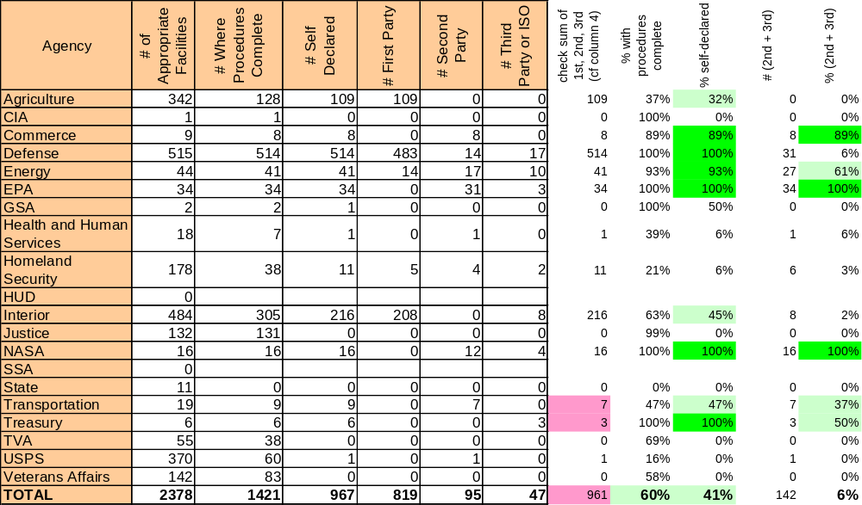
2005 EMS Data

Slide 4
2006 Report Questions
First year to gather data at the facility level – assumed that the agency had done all it could
Progress on implementation - scored
Impact of EMS on Facility (Programmatic)
Impact of EMS on Environmental Issues
Barriers, Successes, Best Practices, Benefit to Mission

Slide 5
Aspects
ENVIRONMENTAL ASPECTS.
A. Significant environmental aspects were not identified during this reporting period or previously.
B. Significant environmental aspects were identified during this reporting period or previously; an established procedure was not used for this process.
C. An established procedure was used to identify significant environmental aspects during this reporting period or previously; however, previously identified significant environmental aspects were not reevaluated during this period.
D. Environmental aspects identified in a previous year were reevaluated during this reporting period using an established procedure and updated (added/deleted/modified) as appropriate.

Slide 6
GOALS, OBJECTIVES, AND TARGETS
GOALS, OBJECTIVES, AND TARGETS.
A. Measurable environmental goals, objectives, and targets were not identified, reviewed, and updated as appropriate during this reporting period.
B. Measurable environmental goals, objectives, and targets were identified, reviewed, and updated as appropriate; 0-49% of targets were on schedule during this reporting period.
C. Measurable environmental goals, objectives, and targets were identified, reviewed, and updated as appropriate; 50-79% of targets were on schedule during this reporting period.
D. Measurable environmental goals, objectives, and targets were identified, reviewed, and updated as appropriate; 80-100% of targets were on schedule during this reporting period.

Slide 7
OPERATIONAL CONTROLS
OPERATIONAL CONTROLS.
A. Documented operational controls to address significant aspects consistent with goals, objectives, and targets were not established during this reporting period or previously.
B. Documented operational controls to address significant aspects consistent with goals, objectives, and targets were established during this reporting period or previously and have been partially implemented
C. Documented operational controls to address significant aspects consistent with goals, objectives, and targets were established during this reporting period or previously and are fully implemented.
D. During this reporting period, previously documented operational controls to address significant aspects consistent with goals, objectives, and targets were fully implemented; in addition, they were reviewed during the year, and/or updated (i.e. supplemented, revised, deleted) as appropriate.

Slide 8
ENVIRONMENTAL TRAINING
ENVIRONMENTAL TRAINING. [Note: These metrics pertain to competence training for those whose tasks have the potential to cause significant environmental impacts]
A. Training requirements to ensure individual competence and responsibility were not been identified during this reporting period or previously.
B. Training requirements to ensure individual competence and responsibility were identified during this reporting period or previously but training was not available and/or carried out.
C. Training requirements to ensure individual competence and responsibility were identified during this reporting period or previously and training was available and carried out, and recorded during this reporting period.
D. Training procedures were established to ensure that training requirements for individual competence and responsibility were identified; training was available and carried out during this reporting period; training is recorded and tracked; and training requirements are monitored, revised, and refresher training provided, as appropriate, to maintain competence.

Slide 9
CONTRACTS
CONTRACTS. [Note: An appropriate contract is one whose actions may have potential impact on the environmental aspects identified by the applicable EMS. Appropriate contracts may include legal arrangements with concessionaires.]
A. Facility has not carried out a process to identify appropriate contracts in which to include EMS requirements.
B. Facility has carried out a process to identify appropriate contracts, but has not modified appropriate contracts to include EMS requirements.
C. All new and renewed appropriate contracts were in the process of including EMS requirements during this reporting period; contractors were required to fulfill defined roles and specified responsibilities.
D. EMS requirements were included in all appropriate contracts and contractors fulfilled defined roles and specified responsibilities during this reporting period.

Slide 10
EMS AUDIT/EVALUATION PROCEDURES
EMS AUDIT/EVALUATION PROCEDURES.
A. EMS audit/evaluation procedures were not established during this reporting period or previously.
B. EMS audit/evaluation procedures were established during this reporting period or previously but no audit was conducted during this reporting period.
C. EMS audit/evaluation procedures were established during this reporting period or previously; an audit was conducted during this reporting period; nonconformities are not yet being addressed or corrected.
D. EMS audit/evaluation procedures were established during this reporting period or previously and an audit was conducted during this reporting period; nonconformities are being were addressed or corrected.

Slide 11
MANAGEMENT REVIEW
MANAGEMENT REVIEW.
A. Senior leadership review of the EMS was neither planned/scheduled nor conducted during this reporting period.
B. Senior leadership review of the EMS was planned/scheduled, but was not conducted during this reporting period
C. Senior leadership review of the EMS was conducted during the current reporting period: recommendations for continual improvement were not addressed by top management during this reporting period.
D. Senior leadership review of the EMS was conducted during this reporting period and top management responded to recommendations for continual improvement.

Slide 12
BENEFIT OF EMS ON THE FACILITY
Reduced risk to facility mission
Improved fiscal efficiency or cost avoidance
Greater understanding of environmental issues at all levels of the organization.
Greater empowerment of individuals to contribute to improving the organization’s environmental footprint
Greater integration of environment into organizational culture or operations
Greater integration of environment into real property asset management
Improved community relations
Improved effectiveness in overall mission
Improved cooperative conservation with other groups

Slide 13
ENVIRONMENT AND ENVIRONMENTAL ISSUES
Improved overall compliance management
Improved overall personnel health and safety
Improved overall pollution prevention
Improved water quality
Improved air quality
Improved hazardous material management
Improved hazardous waste management
Improved solid waste management
Improved conservation of natural resources
Improved conservation of energy in facilities
Improved conservation of fuel in vehicles
Improved conservation of water
Reduced number of permits needed to operate

Slide 14
ENVIRONMENTAL MANAGEMENT SYSTEM EXPERIENCES
EMS BENEFITS/SUCCESSES
EMS BEST PRACTICES/LESSONS LEARNED
EMS CHALLENGES:
EMS BENEFITS TO AGENCY MISSION

Slide 15
What will be done with the data?
Implementation progress will identify areas for improvement or where help is needed
Benefits to facility responses will provide evidence of programmatic effects
Benefits to environment responses will identify how well EMS is working at addressing environmental issues
Challenges, successes and best practices will inform decision makers of necessary assistance and provide information to assist others in implementation

Slide 16
2006 status report
Based on 7 EMS metrics developed by interagency group
  Metrics reflect elements of EMS framework
  Each appropriate facility responds to metrics
  Facility implementation reflects agency progress
Facility scores reflects progress towards fully implemented EMS elements
    A= “inactive” to D= “deployed”
Agency scores reflect combined facility scores

Slide 17
Facility-Level Rating
Constant From 2006-2008
For Green, a Facility Needs:
At Least 5 D’s
No More than 1 B
No A’s at all
←OR→
At Least 4 D’s
No B’s at all
No A’s at all
For Yellow, a Facility Needs:
At Least 4 C’s (or D’s)
No More than 1 A
For Red, a Facility is:
Neither Green nor Yellow

Slide 18
Department-Level Rating
A Sliding Scale – More Stringent Each Year
G
At Least 70% of Facilities are Green
No More than 5% of Facilities are Red
2006
Y
No More than 20% of Facilities are Red
R
Neither Green nor Yellow
G
At Least 75% of Facilities are Green
No More than 5% of Facilities are Red
2007
Y
No More than 15% of Facilities are Red
R
Neither Green nor Yellow
G
At Least 80% of Facilities are Green
No More than 5% of Facilities are Red
2008
Y
No More than 10% of Facilities are Red
R
Neither Green nor Yellow

Slide 19
2006 Agency EMS scores
Seven REDS
Seven YELLOWS
Three Greens

Slide 20
Challenges
New EMSs at something other than facility level
Conformance - updating EMSs to the new standard
Adequate ability across Federal community for 2nd party review
Ability to track progress for all facilities and organizations – for EMS and other practices

Slide 21
THANKS !
Will Garvey
202-564-2458
Garvey.will@epa.gov

