Slide 1


Veterans Employment Coordination Service
(VECS)
Be A HERO. Again.
Dennis O. May, Director
Greg Alleyne, Deputy Director
Office of Human Resources & Administration
Office of Human Resources Management

Slide 2


Background
Veterans comprise approximately 31% of VA’s 260,000 employees, and 7.8% are service-connected disabled veterans
VA ranks first among non-Defense agencies in the hiring of disabled veterans; second only to the Department of Defense in overall number of veterans
VA has established a strategic goal of 33% veteran workforce
  National Veterans Employment Program (NVEP)
    Established June 2001
    Established VA as Agency Leader on Veteran Employment
    Established NVEP model as a best in government
    Established VA National Presence at Military Career Events

Slide 3
Background
    Established local Veterans Employment Coordinators (VEC)
    Lead non-DOD agency in the employment of 30 percent or more disabled veterans
    Lead non-DOD executive federal agency in VRA and VEOA appointments
    Veterans Employment Coordination Service (VECS)
    Acting VA Secretary announced the hiring of 10 full-time Regional Veterans Employment Coordinators (VECs) in November 2007
    Veterans Employment Coordination Service (VECS) was established January 2008

Slide 4
VECS Mission
VECS mission is to attract, recruit, and hire veterans into the VA, particularly severely injured veterans.
VECS will open opportunities to veteran employment and ensure that veterans are able to successfully enter VA’s workforce.
VECS will help ensure that VA managers and supervisors are thoroughly familiar with the use of special hiring authorities to hire veterans.

Slide 5
VECS ORGANIZATIONAL CHART
Director
Dennis May
Deputy
Director/
Regional
VEC (DC)
Greg Alleyne
Regional
VEC
(CA)
Jennifer
Reichard
Regional
VEC
(CO)
Mark
Berninger
Regional
VEC
(GA)
Annette
Taylor
Regional
VEC
(KY)
Steve
Clark
Regional
VEC
(NC)
Thomas
Green
Regional
VEC
(NY)
Andree
Sutton
Regional
VEC
(TX)
Allison
Wilson
Regional
VEC
(WA)
Bob
Mortenson

Slide 6
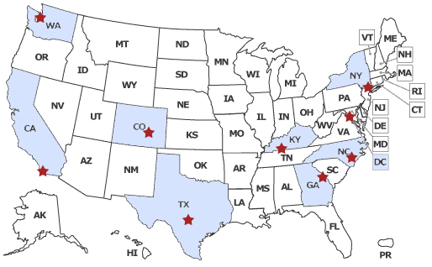
Regional VEC Locations
*Plus Over 160 Local VECs at HR offices Nationwide

Slide 7
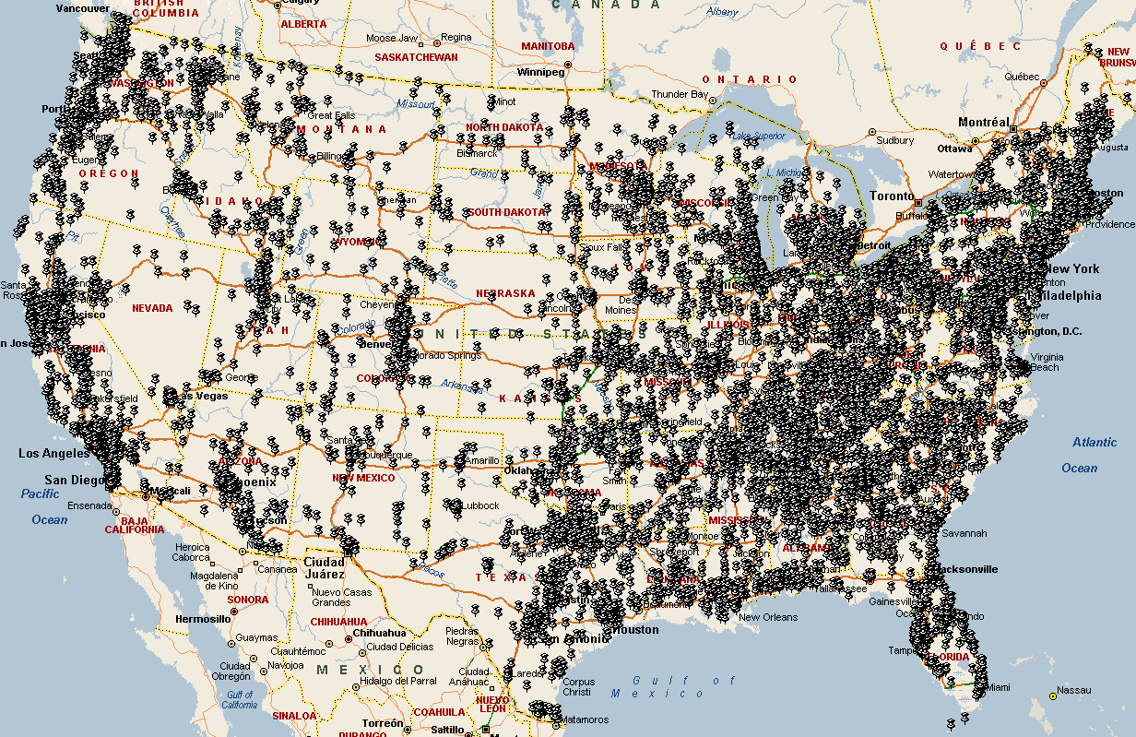
LOCATION OF CARE MANAGEMENT CANDIDATES

Slide 8

VECS Activities
Promote VA career opportunities
Outreach to veterans, particularly severely injured veterans from Iraq and Afghanistan
Maintain a constant presence at:
  Military career fairs
  Transition assistance centers
  Outreach events
Manage Local VECs and assist in their efforts to establish partnerships and collaborate with:
  Vocational Rehabilitation & Employment Services
  Marine Corps’ Wounded Warrior Regiment
  Army’s Warrior Transition Programs
  Veterans Service Organizations
  Other veteran stakeholders
  Bottom line: Get Vets Hired!!

Slide 9
Contact Information
Dennis May, Director
Veterans Employment Coordination Service
Dennis.May@va.gov
(202)461-5063
Greg Alleyne, Deputy Director
Veterans Employment Coordination Service
Greg.Alleyne@va.gov
(202)461-6997
To contact VECS, send email to: VECS@va.gov
For more information visit: www.va.gov/VECS

