Slide 1
Airport Improvement Program (AIP) 102
Warren Ferrell
Financial Programs Manager
FAA, Airports Division

Slide 2
Presentation Overview
FAA Airports Division – who we are and what we do
Brief history of important events and legislation
Explaining the ACIP process
Financial Considerations

Slide 3

Who We Are & What We Do

Slide 4





We Are The Hub Of The System
Homeland Security
FS/FPO/AVN
AT
AF/ANI

Slide 5
Airports Division Services
Airport Planning
Airport Development
Environmental Compatibility
Airport Safety & Certification
Airport Standards

Slide 6
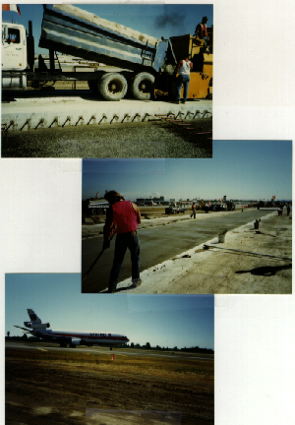
In A Nutshell
We slap down pavement
We ensure the pavement is safe
We ensure the surrounding area is safe
We ensure that the operations around the pavement are safe

Slide 7
How Do We Do It?
Via conferences/seminars/briefings
Via joint planning conference
Via compliance inspections
Via certification inspections
Via site visits
Via financial assistance

Slide 8
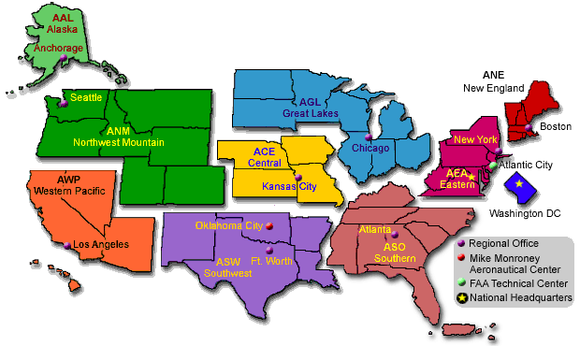
How Are We Organized?

Slide 9

Who Is Your Main Contact?
Each of our Airport District Offices (ADOs) have program management responsibilities:
  Denver ADO:
    Colorado
    Utah
    Wyoming
  Seattle ADO:
    Oregon
    Washington
    Idaho
  Helena ADO:
    Montana

Slide 10

History of Important Events

Slide 11
Key Aeronautic Events
December 17, 1903 – Kitty Hawk
1914 – WWI civil aviation development ceases
May 15, 1918 establishment of a regular mail route between NYC and DC
1920 “the new railroad” 145 municipally owned airports nationwide
May 20, 1926 – Air Commerce Act to promote development and stabilize commercial aviation
June 23, 1938 – Civil Aeronautics Act established in one administrative body
  Civil Aeronautics Authority – carrier regulation
  Air Safety Board – accident investigation
  Administrator – construction & operation of the airway system

Slide 12
Key Events continued…
May 13, 1946 – Federal Airport Act provided for a system of airports under the CAA and provided 50% for airport construction (FAAP – Federal Aid to Airports Program, Part 151)
August 14, 1957 – Airways Modernization Act established in response to mid-air collision over the Grand Canyon. It provided for the national system of navigation and traffic control
August 23, 1958 – Federal Aviation Act repealed previous aviation legislation, and established the Federal Aviation Agency
October 15, 1966 – DOT was established and the Federal Aviation Agency became the Federal Aviation Administration

Slide 13
Key Events continued…
May 21, 1970 – Airport and Airway Development Act established a Trust Fund to pay for development (ADAP – Airport Development Aid Program, Part 152)
October 24, 1978 - Airline Deregulation Act eliminated government regulation of air markets
September 3, 1982 - Airport and Airway Improvement Act established the AIP (Airport Improvement Program)
April 5, 2000 - Aviation Investment and Reform Act for the 21st Century (Air 21) established unprecedented levels of funding
November 19, 2001 - Aviation Transportation Security Act established TSA

Slide 14

Explaining The ACIP Process

Slide 15
The Role Of Planning
Planning is a critical element in airport development
It is not a necessary evil
It is the beginning point of all good projects
It is the basis of the ACIP

Slide 16

4 FAA Plans That Affect You
Terminal Area Forecast (TAF)
National Plan of Integrated Airport Systems (NPIAS)
Regional Airport Plan (RAP)
Airport Capital Improvement Plan (ACIP)

Slide 17
The ACIP
What it is
What it isn’t
3 year plan of what we think is reasonable to accomplish
An agreement between the sponsor and FAA on what should be done, and when it is planned to be accomplished.
As a planning document, it is deliberative (not public)
A collaborative effort to accommodate regional needs within a national context
A simple compilation of sponsors CIP’s
It is not a commitment to fund
Something I concoct in my office

Slide 18
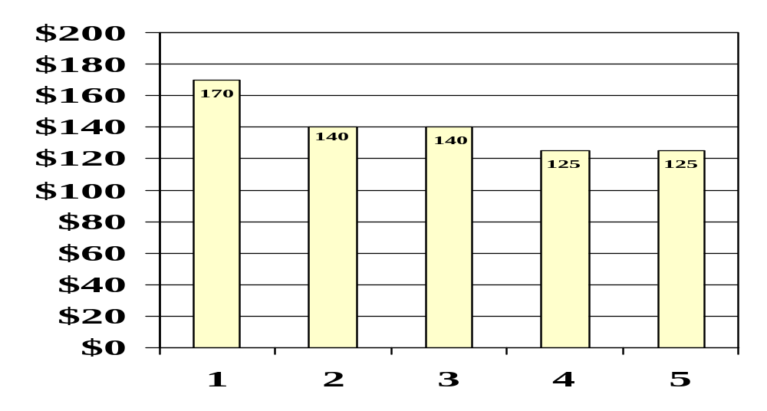
FAA ACIP Process
Look at 5 years to make 3 – goal is to limit wholesale plan changes
Slack in years 2 & 3 to allow for unfunded ACIP projects to slide to top of list
If AIP exceeds planning ceiling, top of next years ACIP is considered
Higher (95%)
Degree of Confidence
Lower (50%)
Planning Ceiling
Million
Year

Slide 19

Key Time Frames
9/30 Project Schedules for upcoming fiscal year candidates are due
12/1 Deadline for 5 year ACIP-Disc$
Dec. ADO prioritizes Disc$
Jan. 3 year Disc$ ACIP is developed
5/1 Grant Applications Due
6/1 ACIP is locked for next fiscal year

Slide 20
ACIP Critical Elements
To make the system work:
People: ability to transmit critical need in a timely manner
Funds: availability and prioritizing competing needs
Selling/communicating the plan

Slide 21

Demystifying The ACIP Process
ADO’s are given target planning ceiling
ADO’s meet to prioritize projects and update database
ACIP Development Team meets and synthesizes data (and checks for compliance with the RAP)
ACIP is submitted to Management for evaluation
Regionally approved ACIP is forwarded to Headquarters
National priority threshold is established and funds for regions are allocated

Slide 22

Financial Considerations

Slide 23
Financial Program Encompasses
Fiscal Component
Eligibility Component
Political Component*

Slide 24

Financial Component
Airport Funding Mechanisms
Commonly Used:
Revenue Bonds
Concessions (parking lots, auto rental, stores)
Landing Fees
Local funds (e.g state grant/general fund)
Federal Grant
Passenger Facility Charges
Not Commonly Used:
General Obligation Bonds
Special Facility Bonds (non-airport beneficiaries)
Bank Loan
3rd Party Development

Slide 25

Airport Financial Distribution
Airports require heavy infrastructure investment
The smaller the airport the greater the need for federal financial assistance
Salaries & benefits
(25%)
Other
Supplies (25%)
Labor
Power
Capital

Slide 26
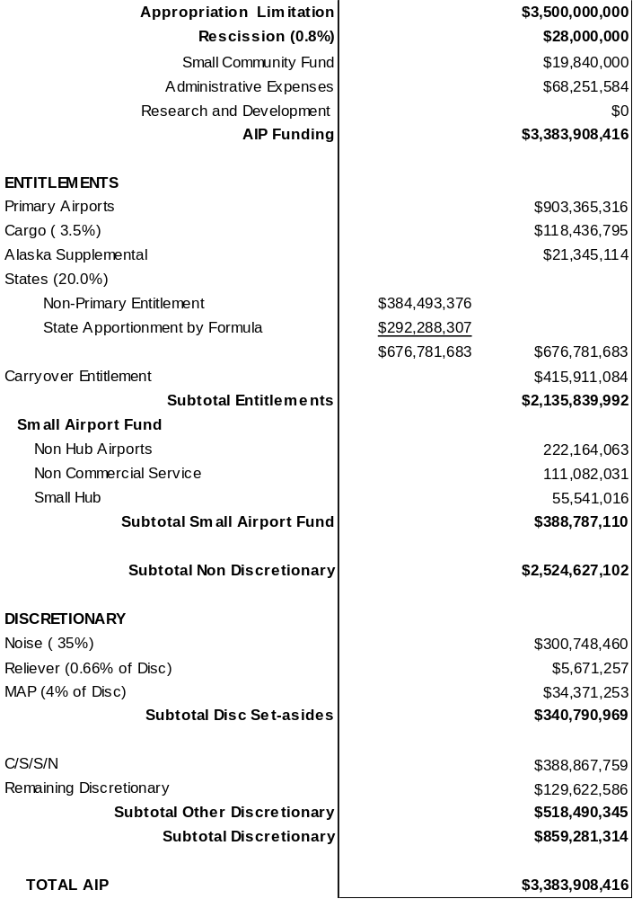
AIP Component Overview

Slide 27
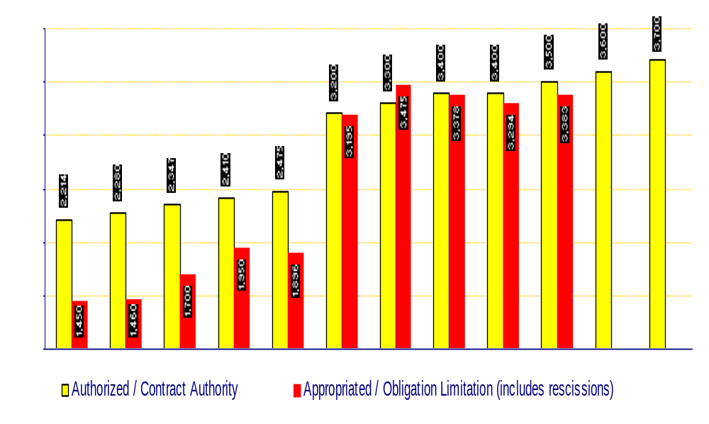
AIP Funding History ($M)

Slide 28
AIP Grant Steps
Input proposed project into the National Plan of Integrated Airport Systems (NPIAS)
Identify appropriate time for funding - Airport Capital Improvement Plan (ACIP)
Await Annual AIP Appropriation from Congress
Project application approval
  Civil Rights (DBE & Title VI pre/post grant requirements)
  Ensure airspace and environmental reviews are approved
  BCA, if necessary
Award contract based on bids
Issue Grant
Make timely payments
Close grants in a timely manner

Slide 29
How To Achieve Success
Work toward target dates
Construction should be done in the summer (early bids = better prices)
Ensure formulation work is started early
  Benefit Cost Analysis
  Design
  Environmental
Delayed Authorization is a great time to work with us on these issues

Slide 30
Eligibility Component
Why do we have these rules?
To establish a framework of unity from which we can work
To provide background and documentation about program decisions
How are these rules developed?
Statute
Policy
Legal Opinion
Litigation

Slide 31
6 Simple Rules of Eligibility
Airport must be in the NPIAS
Project must be in the NPIAS-ACIP
Consult Order 5100.38B (AIP Handbook)
If it’s not in the Handbook, it does not automatically make it ineligible
Eligibility does not equal fundability
Don’t ask me, unless you really want the answer

Slide 32
Eligibility Generalities
Project must relate to movement of passengers and baggage
Project must be on the airport
Project can not provide preferential benefit
If it’s not related to creating, upgrading, or rehabilitating pavement or the operations around it, or on it, you might want to ask whether you can do it with federal funds

Slide 33

Political Component
It is a reality: Congressional inquiries; place names (earmarks); response to events
Ignoring it will not make it go away
Professionalism should keep it to a minimum (that includes not only our expertise, but our ability to show good reason for doing, or not doing something)
Impacts our planning efforts
Someone will always be unhappy with whatever decision is made

Slide 34

One Last Point: OST Clearance
Office of the Secretary of Transportation, Office of Congressional Affairs
  Notify Congress of intent to grant funds
  Occasionally, projects are held to coincide with a dignitary visit
Sponsor may not be told of project approval prior to OST clearance
When asked, the appropriate FAA response is that the project is in process

Slide 35

The End

