Slide 1



Type 1
Incident Management Teams
US Department of Agriculture
Forest Service
Notes:
There are various types of disaster response teams in the US. Teams are “typed” based on the complexity of the incident. Incidents range from Type 5 to Type 1. Local incidents that have a very localized affect, such as an overturned truck with a hazmat component, will be handled by a Type 5 Incident Commander and a few other people. As the incident escalates in complexity, a local Type 3 Incident Management Team will be deployed until the complexity exceeds their capability. Generally, as a disaster grows in size and complexity the management baton is passed upward till it reaches the Type 1 level. Type 3-5 teams, or Incident Commanders, are local resources used for initial response: Type 2 teams are called in for the next level of response and Type 1 teams for very complex large scale responses. The Type 1 teams are routinely called on for major disasters such as floods, hurricanes, insect control, terrorist attacks (9/11 response), volcanoes and, particularly wildfires.
I will focus this discussion on Type 1 teams with a specific mission of the management of disasters within the the US.
I will talk about how the teams are formed, how they are used and their internal functions.

Slide 2
Advantages of Pre-Established Teams
Local “teams” and first responders often become “victims” of large disasters.
Standing teams have the advantage of experience based effectiveness and efficiencies.
Standing teams maintain a “core knowledge” by ensuring that no more than a 20% turnover of team members per year.
Rapid mobilization through “one call”.

Slide 3
Advantages of Pre-Established Teams (cont.)
Pre-established Teams ensures availability when the need exists.
Background of diversity and experiences in incident management leads to knowledge – knowledge leads to wisdom – wisdom leads to the ability to anticipate and meet the needs of the Responsible Official, those affected, and the public.
Ability to meet “Commander’s Intent”.
Development of teamwork through years of experiences in working together on complex, challenging assignments.

Slide 4
Type 1 Incident Teams in the US
There are currently 17 Type 1 teams in the US.
The teams are formed in Geographic Areas according to a number of factors:
  Availability of team members.
  Location to recurring disasters.
  Ability of the Geographic Area to support Type 1 Teams.
Notes:
The type 1 teams are strategic locations throughout the US
They are assigned to a geographical area according to a number of factors
First is the availability of team members to participate on a team
Then the proximity in an area close to recurring disasters
Then the ability of the area to support a team

Slide 5
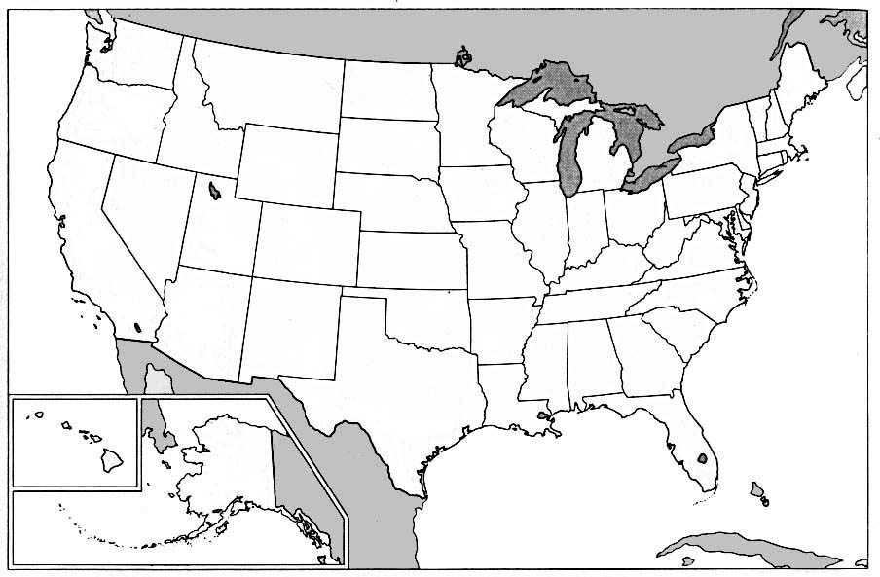
US Map with Team Locations
2
2
1
2
5
2
2
1
Notes:
In the US the teams currently are located in the following areas.
1 Alaska
2 Pacific Northwest
5 California
2 Northern Rockies
2 Great Basin
2 Southwest
1 Central Rockies
1 Southeast
The Type 1 teams are coordinated from the National Headquarters office in Boise, Id.

Slide 6
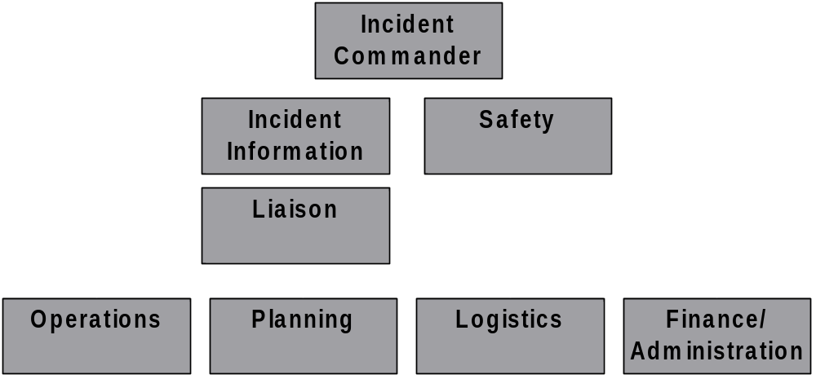
Functional Positions of Type 1 Teams
Notes:
The organizational structure for the type 1 Teams start with the command and general staff positions.
Command and general staff positions are the core positions that would be needed to respond to a disaster.
Each functional position such as planning, ops, logistics, and finance oversees a section that is considered essential for the management of a disaster.
The team is directed by and reports to the responsible official. This is done through a delegation of authority to the Incident Commander from the that official.
In the management of the disaster the team is responsible for carrying out the strategies as stated in the delegation of authority.
The team operates independently and is self reliant and will not additional impact the limited ability of the local area to support their needs. Most of the resources needed will come from outside the region in support of the team and the disaster area.
It is most important to know that the structure of the team under the command and general staff positions is flexible in the skills and numbers of positions needed and it can be configured to meet the needs of the disaster.

Slide 7
Type 1
Incident Management Teams
Selection
Mobilization
Rotation
Meetings
Commitment
Training/Qualifications
Notes:
The management of Type 1 teams consists of first the selection of the team.
Then mobilization, team rotation, required meetings and finally commitment to participation.

Slide 8
Team Selection
Incident Commanders are selected by Geographical Area Committees.
Incident Commanders select the Command and General Staff.
Command and General Staff, in consultation with the IC, select positions under their area of responsibility.
Notes:
In the selection process the IC are selected by Geographical Area committees in their respective regions.
Once the IC are selected then they intern will select the members of the Command and General Staff through a competitive process.
Individuals who are qualified and approved to participate then may apply for the positions.
Once the command and general staff positions are filled then it is the responsibility of each member to recruit and fill the positions under their functional area of responsibility.

Slide 9
Team Rotation
Type 1 Teams have established rotation schedules at both the Geographic and the National level.
Geographic Area Rotation:
  Teams are usually on 24/7 24 hr. standby for two week periods.
  Geographic Area can assign up to two Type 1 Teams from their Area without using the National rotation.
Notes:
Every type 1 team must be on 24/7 call one week out of 15 throughout the year. This allows for team members personal time when not on standby.
All teams must have at least one assignment before the next rotation starts, allowing for participation of all of the teams.

Slide 10
Team Rotation
National Rotation:
  Each Team is on a 24/7 standby for a two hour mobilization one week out of every 16 weeks.
  The Geographic Areas with more than one team will determine the “eligible” team that responds to a National call.
  Goal is to provide a minimum of two assignments per team per year.

Slide 11
Team Mobilization
The established timeframe for a Team to mobilize to an incident is 2 hours.
It is the responsibility of the Command and General Staff to ensure that all of their staff is available and prepared to respond.
  If a team member is unavailable:
    The team member finds a qualified replacement, OR
    A replacement is ordered
Notes:
There is a 2 hour response time for the team members.This means they must be on route to the nearest mobilization facility for transportation.
The team members must be available ,packed and ready to go at the time they are notified of and assignment from the national response center.
The responsible officer will provide an oral and written briefing to the team on expectations for management of the disaster. This is done through briefings and the delegation of authority.
The team must then take action to develop a daily tactical plan for management of the disaster.

Slide 12
Team Meetings
Once the teams have been selected they are required to have at least one Pre-incident meeting annually.
Post-incident meetings occur after each assignment.
The meetings are important for developing and improving team work, communication, and overall incident management.
Notes:
Once the team members are selected each team is required to have a pre-disaster meeting and a post disaster meeting. The teams must have a post meeting after every disaster and close out with the responsible official.
It is the responsibility of the Incident Commanders to insure that all meetings are scheduled and attended.

Slide 13
Team Meeting Objectives
Pre-Incident
    Establish team expectations.
    Develop relationships both within the functional group and with the rest of the team.
    Develop/revise team handbooks.
    Develop inter-functional working agreements.
    Define mobilization procedures.
    Gain knowledge of changes in policy or regulations that affect incident management.
Notes:
The purpose of the first meeting (pre-disaster) will be to develop team skills, good working relationships, and team expectations.
Pre disaster team meeting
Also, to develop inter-functional working agreements between all members of the command and general staffs. An example would be how the ops section would provide authorized use of overtime for the finance section, or what are the standard logistical orders when the team is dispatched
Post disaster team meeting (close-out)
To evaluate effectiveness the team will meet after each disaster and will focus on how well the team did and what areas need to be corrected for future performance.
This an opportunity to recognized those staffs or individuals that have achieved outstanding performances during the disaster.

Slide 14
Team Meeting Objectives (continued)
Post-incident meetings
    Improve team effectiveness.
    Focus on lessons learned from the assignment - what “Went Well” and “Areas to Improve” performance.
    Recognize and award outstanding performances.

Slide 15
Team Commitment
Team members commit, with their supervisors approval, to a tenure of three-five years.
Commitment to an Incident Management Team includes:
  A commitment to being available 24/7 during periods when the team is on call in the GA and or Nationally.
  Being prepared for a possible dispatch 24/7 365 days a year (tempered by the potential for a disaster to occur).
Notes:
The commitment for Type 1 team members is 3-5 years, depending on the area. After this period the cycle for teams starts over again. In areas where there are more than one team then this cycle is staggered.
During this tenure each team member commits to being available when called and ready to respond.
It is important and critical that all members meet the commitment preparedness and readiness.

Slide 16
Training
Training to standard qualifications for each functional position is required:
  Requirements are rigorous for Command and General Staff (25-30 years to become a Type 1 IC).
Geographic Areas provide class-room required functional training.
Teams provide opportunities for On-The-Job training during incidents.
Notes:
National standards and qualifications are set for each functional position on the team. All team members must meet the qualifications for their position. It is the responsibility for the Command and General staff to insure that all members of the team meet the minimum standards.
The Geographical provinces provide the required training for the functional positions and the national headquarters provide the training for the Type 1 teams.
It is important for each team to provide on-the-job training opportunities for individuals during a disaster.

Slide 17
Team “Esprit de Corps”
Type 1 teams are recognized as the elite for disaster management.
Type 1 teams consist of the highest qualified and most experienced individuals available for disaster assignment.
It is considered an honor to be selected for a Type 1 team.
Membership assists in upward mobility for future placement.
Notes:
Type 1 teams are recognized as the elite for disaster management because of the competitive selection process the best individuals are selected for the teams. They are the ones with the most experience and training in disaster manager for their respective positions.
It is and honor to be selected and participate as a member of a Type 1 team. As a member of the team working in a stressful environment there are always long term friendships developed.
The skills and experience gained from participation on a Type 1 team are recognized and may assist in future placement and upward mobility in the federal or state organizations. In addition there is a sense of personal pride in assisting communities in time of disaster.

Slide 18
QUESTIONS?

