Slide 1

Agency EMS Metrics –
A Peek at 2009 and Beyond
Mike Green (NASA)
Steve Woodbury (DOE) for the
Metrics Workgroup of the
Interagency Environmental Leadership Workgroup
Federal Environmental Symposium East & West
June 3, 2008 June 19, 2008

Slide 2
Overview of Metrics
Subgroup Activities
EMS Metrics 2006-2008
New Metrics for 2009 and Beyond
  Review and revise previous EMS
  metrics elements
  Propose new EMS metrics elements
  for 2009 and beyond
New data collection questions
The EMS Reporting Process
Agency Scores and OMB Scorecard

Slide 3
Overview of
Metrics Subgroup Activities
EMS metrics 2006-2008
The EMS reporting process
New scorecard metrics for 2009 and beyond
  Review and revise previous EMS metrics elements
  Propose new EMS metrics elements for 2009 and beyond
New data collection questions

Slide 4
EMS Metrics – 2006-2008
Assume Initial EMS Implementation
Developed by metrics subgroup, starting 2004
Intended to:
  Be clearly and fully defined
  Be tough but attainable
    Must pass OMB scrutiny
    No “cream puff” metrics
  Give facilities feedback on
  how they are doing
  Provide agencies overall feedback
  Provide data on value/benefit of the EMS
  Support continual improvement
Notes:
Intended to be consistent for three years; previous EMS metrics had changed every year leading up to 2005 deadline

Slide 5
Challenges
Define the metric
Establish a performance level
Make clear what the data represents (not a scaled response)
  Not every ‘C’ is equal, but establishes a performance level for the particular metric area
  In all cases, ‘D’ is the preferred response
Establish metrics applicable across the Federal government, considering not all departments are of equal size or have the same number of facilities

Slide 6
Metrics Elements
Focus on individual EMS (facility-level or organization-level), not on Agency
Seven EMS Elements
  Environmental Aspects
  Goals, Objectives And Targets
  Operational Controls
  Environmental Training
  Contracts
  EMS Audit/Evaluation Procedures
  Management Review

Slide 7
Additional Information Questions 2005-2008
Impact of EMS on your organization
Impact of EMS on the environment
Open-ended questions
  Best practices
  Lesson-learned
  Challenges

Slide 8
Understanding
The Color Rating
Green: All elements of the EMS are in place and working
Yellow: Most elements are in place, but one or two areas need focused attention
Red: Two or more elements are not functioning or may not be present

Slide 9
Facility Metrics Roll Up to
Department Metric
EMS metrics are addressed at the level
of the individual EMS
(facility or organization-level)
Responses roll up to a green/yellow/red score for each EMS
These scores then roll up
to give a green/yellow/red score
at the Department level

Slide 10
EMS Reporting Process
Annual Agency EMS Report is due to EPA
in December for previous fiscal year
  Provides summary data (not facility-specific)
  Data are used
    OMB Scorecard
    Biennial report to the President (data and narratives)
Site reporting options:
  Facilities enter data electronically into FedCenter site for Agencies to ‘roll up’ for Agency report to EPA
  OR
  Agencies collect and tabulate data on their own

Slide 11
EMS Status in OMB Scorecard
OMB issues scorecards semi-annually
to each Agency in these areas:
  Environmental Sustainability
  Energy
  Transportation
EMS is currently one of five elements in the ‘Environmental Sustainability’ scorecard

Slide 12
Developing EMS Metrics for 2009 and Beyond
OMB Scorecard Metrics
  Review and revise previous EMS metrics elements
  Propose new EMS metrics elements for 2009 and beyond
Propose new data collection questions

Slide 13
Revise and Retain 7 Previous
EMS Metrics Elements
Environmental Aspects
Goals, Objectives and Targets
Operational Controls
Environmental Training
Contracts
EMS Audit/Evaluation Procedures
Management Review
minor changes
minor changes
minor changes
minor changes
revised to reflect new wording in CEQ Instructions
replaced
minor changes
  annual senior leadership review
  reflect ISO 14001:2004

Slide 14
Proposed New EMS Metrics for 2009 and Beyond
New metrics address three new requirements in EO 13423
Managing compliance
Integrating sustainable practices into EMS
(including energy, water, fleet)
Conducting external audit, and declaring EMS
to be “fully implemented”
The Metrics Subgroup will also propose an updated protocol for aggregating individual responses into red/yellow/green score for the Agency as a whole, for the OMB scorecard

Slide 15
Proposed New EMS Metrics
Each metric has statements ranging from
  A (least implemented) to
  D (fully implemented)
The following slides
  Identify the new requirements
  List the ‘D’ or ‘best response’ criterion from the proposed metric

Slide 16
Managing Compliance –
New Requirements
E.O. 13423 requires each agency to establish
a program for environmental compliance review and audit [§ 3.(c)]
The CEQ Instructions establish that the EMS shall be used to support compliance with environmental and energy regulations [§ II.A.(1)]
ISO 14001:2004 established a new element
for “Evaluation of Compliance” [¶ 4.5.2]

Slide 17
Managing Compliance –
Proposed New Metric
Best Response:
Facility/organization has established and implemented an environmental compliance program … AND
  Facility/organization has identified applicable legal and other requirements … AND
  The facility/organization has completed evaluations of compliance with applicable legal and other requirements for the entire facility/organization, in accordance with the established frequency. AND
  Corrective actions have been initiated or have been scheduled …

Slide 18
Sustainable Practices in EMS –
New Requirements
E.O. 13423 requires that EMSs shall address the environmental aspects of agency transportation and energy functions.
The agency shall implement sustainable practices for
  Improvement in energy efficiency and reduction in greenhouse gas emissions,
  Use of renewable energy
  Reduction in water consumption
  Sustainable acquisition
  Reduction of the use and disposal of toxic and hazardous chemicals and materials
  Waste prevention and recycling programs
  High performance and sustainable buildings
  Vehicle fleet management
  Electronics stewardship.

Slide 19
Sustainable Practices in EMS –
Proposed New Metric
Best Response:
Facility/organization has established and implemented requirements/ procedures to address all applicable sustainable practices as required by Executive Order 13423 through the facility/organization’s EMS, including setting objectives and targets as appropriate, monitoring, training, and management review;
AND
Facility/organization has reviewed performance of these sustainable practices through their monitoring and management review process.

Slide 20
New Requirements for
‘Fully Implemented’ EMS
Proposed metric addresses the requirements in the CEQ Instructions for what constitutes a ‘fully implemented’ EMS under EO 13423 [§ II.C.(1)]
  Formal outside EMS audit
  conducted within 3 years
  Audit findings recognized
  by appropriate management
  Declaration of conformance issued
  by appropriate senior manager

Slide 21
Proposed Metric for
‘Fully Implemented’ EMS
□ Not Currently in Conformance
The EMS … has not been declared “fully implemented” in accordance with the requirements of the CEQ Implementing Instructions
OR
The EMS has been declared “fully implemented”… BUT The date of initial conformance declaration was more than three years ago, and the EMS has not had been audited within the past three years by a qualified party outside the control or scope of the EMS

Slide 22
Proposed Metric for
‘Fully Implemented’ EMS (cont.)
□ Currently In Conformance
The EMS is “fully implemented” in accordance with the requirements of the CEQ Implementing Instructions
AND
If the date of initial conformance declaration was more than three years ago, then the EMS has been audited within the past three years by a qualified party outside the control or scope of the EMS, and the conformance declaration has been renewed as appropriate based on agency guidance.

Slide 23
Reporting the
‘Fully Implemented’ EMS Metric
This metric is different from the others, and the Metrics Subgroup has recommended that it be tabulated and scored separately

Slide 24
Additional Information Collection 2009 and Beyond
The Metrics Subgroup proposes new information questions (non-scorecard) to address integration of 10-12 specific environmental aspects into the EMS
  Does this aspect exist at your facility/organization?
  Is this aspect included in your list of ‘significant aspects’?
  Have you established objectives and targets for this aspect?
  Are these objectives and targets included in your EMS?
  Have you implemented plans / programs to address this aspect?
  Are these plans and programs included in your EMS?

Slide 25
Information Questions from Previous Years
New questions on integration of sustainable practices into EMS reflect the thrust of EO 13423
For 2006-2008, the information questions addressed
  Impact of EMS on environmental performance
  Impact of EMS on the organization
The Interagency workgroup is reviewing whether the new questions should replace or supplement the previous questions

Slide 26
Narrative Questions
The Metrics Subgroup recommends retaining the open-ended narrative questions addressing
EMS benefits/successes
EMS best practices
EMS lessons learned
EMS challenges
EMS benefits to agency mission

Slide 27
In Conclusion
EMS metrics
continue to evolve to reflect new requirement
are intended to measure progress, but also to support implementation of key elements
are developed by a participatory inter-agency process
are reflected in OMB scorecards to Agencies
Go Green! – Score Green!

Slide 28
For More Information:
Mike Green
National Aeronautics and Space Administration
202-358-1097
michael.j.green-1@nasa.gov
Steven Woodbury
Department of Energy
202-586-4371
steven.woodbury@hq.doe.gov
Notes:
[review CEQ Instructions] Each Agency is encouraged to designated a cross-functional support team consisting of
* procurement
* legal
* budget
* facility and energy management
* technical support, and
* others as appropriate

Slide 29
Backup Slides

Slide 30
Metrics Subgroup Members
Subgroup Members:
TJ Granito, USCG/DHS
Mike Green, NASA
Eric Haukdal, DOE (previously HSS)
Marc Hewett, DOD
John Lewis, USDA/USFS
Ed Pfister, HHS
Russelle McCollough, EPA
Karen Waldvogel, USDA
Pete Wixted, DOC
James Wozniak, DLA
Steven Woodbury, DOE
With the support of:
Ed Pinero, OFEE (previously)
Will Garvey, USEPA

Slide 31
Managing Compliance –
Proposed New Metric
A. Facility/organization has not established procedures for an environmental compliance program through the facility/organization’s EMS as required by Executive Order 13423.
B. Facility/organization has:
  1. Established an environmental compliance program as part of the facility/organization’s EMS that includes
    (a) procedures to identify and account for applicable legal and other requirements,
    (b) protocols to periodically evaluate compliance with those applicable legal and other requirements, including the frequency of compliance evaluations, and
    (c) a system for implementing corrective action. AND
  2. Identified applicable legal and other requirements. BUT
  3. Has not implemented the protocols to evaluate compliance, or the system to implement corrective actions.

Slide 32
Managing Compliance –
Proposed New Metric (cont.)
C. Facility/organization has established an environmental compliance program
  as described in B.1. above. AND
  Facility/organization has identified applicable legal and other requirements, as described in B.2. above. AND
  The facility/organization has conducted evaluations of compliance with applicable legal and other requirements. BUT
  The facility/organization has not completed the evaluations for all of the facility/organization in accordance with the established frequency, or has not initiated corrective actions for completed evaluations.
D. Facility/organization has established and implemented an environmental
  compliance program as described in B.1. above. AND
  Facility/organization has identified applicable legal and other requirements, as described in B.2. above. AND
  The facility/organization has completed evaluations of compliance with applicable legal and other requirements for the entire facility/organization, in accordance with the established frequency. AND
  Corrective actions have been initiated or have been scheduled (as appropriate, considering technical and budgetary constraints).

Slide 33
Sustainable Practices –
Proposed New Metric
A. Facility/organization has not established requirements/procedures to address applicable sustainable practices as required by Executive Order 13423 through the facility/organization’s EMS.
B. Facility/organization has established requirements/procedures to address applicable sustainable practices as required by Executive Order 13423 through the facility/organization’s EMS, including procedures for setting objectives and targets as appropriate, monitoring, training, and management review, but has not implemented the requirements/procedures.

Slide 34
Sustainable Practices –
Proposed New Metric (cont.)
C. Facility/organization has established and implemented requirements/procedures to address applicable sustainable practices as required by Executive Order 13423 through the facility/organization’s EMS, including setting objectives and targets as appropriate, monitoring, training, and management review. AND
The facility/organization has incorporated at least one of the applicable sustainable practices through the EMS. AND
The facility/organization has established an implementation schedule to complete incorporation of the remainder of the applicable sustainable practices through the EMS.
D. Facility/organization has established and implemented requirements/ procedures to address all applicable sustainable practices as required by Executive Order 13423 through the facility/organization’s EMS, including setting objectives and targets as appropriate, monitoring, training, and management review. AND
Facility/organization has reviewed performance of these sustainable practices through their monitoring and management review process.

Slide 35
Facility-Level Rating
(Constant from 2006-2008)
For Green, a Facility Needs:
At Least 5 D’s
No More than 1 B
No A’s at all
←OR→
At Least 4 D’s
No B’s at all
No A’s at all
For Yellow, a Facility Needs:
At Least 4 C’s (or D’s)
No More than 1 A
For Red, a Facility is:
Neither Green nor Yellow

Slide 36
Department Level Scoring
(More Stringent Each Year, 2006-2008)
G
At Least 70% of Facilities are Green
No More than 5% of Facilities are Red
2006
Y
No More than 20% of Facilities are Red
R
Neither Green nor Yellow
G
At Least 75% of Facilities are Green
No More than 5% of Facilities are Red
2007
Y
No More than 15% of Facilities are Red
R
Neither Green nor Yellow
G
At Least 80% of Facilities are Green
No More than 5% of Facilities are Red
2008
Y
No More than 10% of Facilities are Red
R
Neither Green nor Yellow

Slide 37
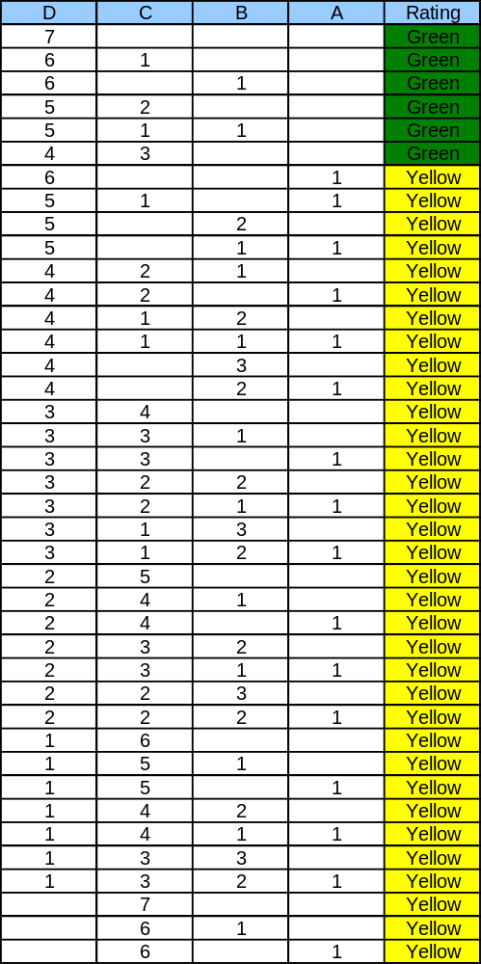
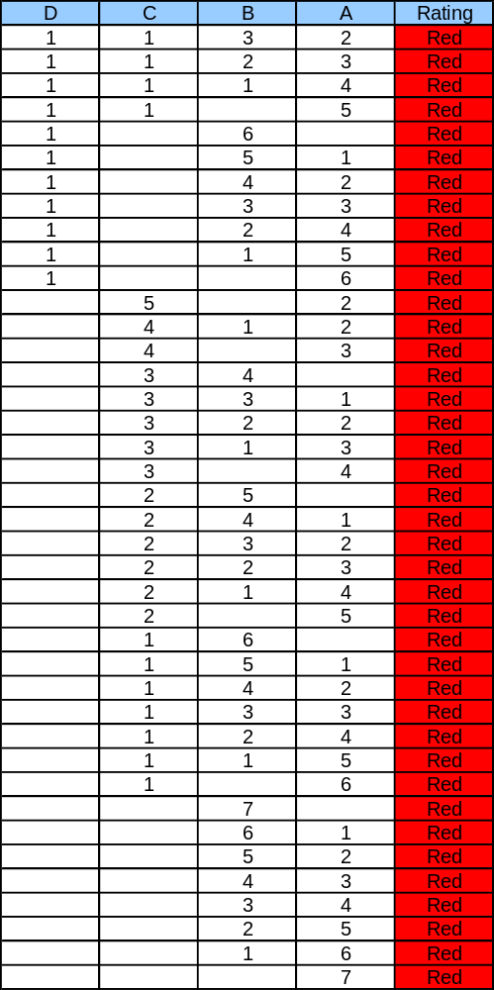
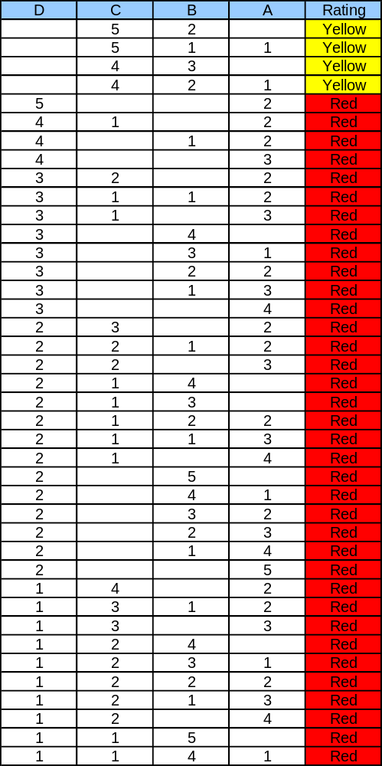
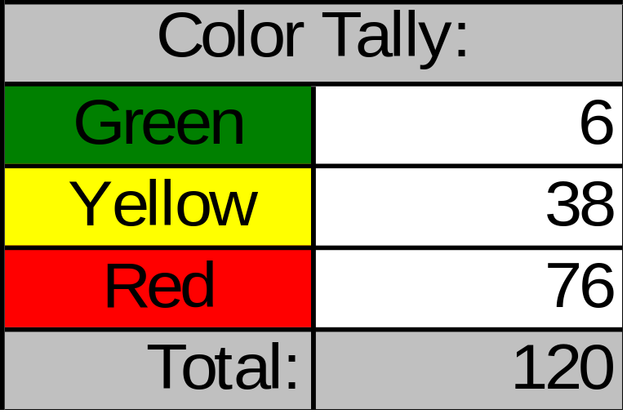
Possible Scoring Combinations
(2006-2008)

