Slide 1

Experience of Peace and Conflict Resolution Education in Schools of Gyumri
Armenia
Second Annual Conference
on
Conflict Resolution Education
September 28th - October 1st, 2005
Columbus, Ohio USA

Slide 2
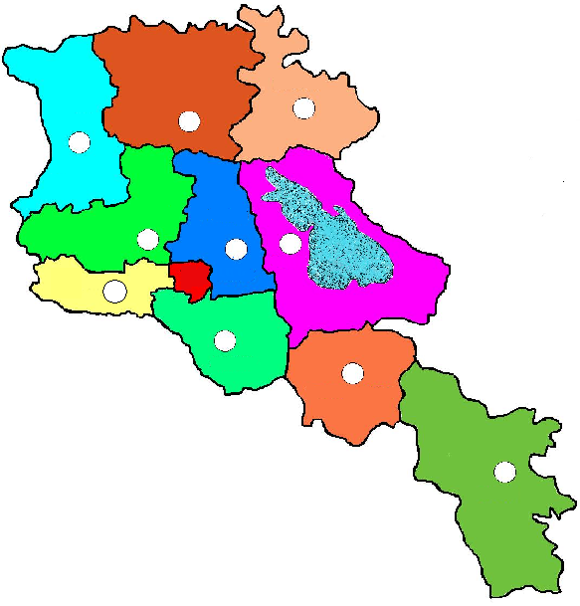

Republic of Armenia
Ð²Ú²êî²Ü
Territory: 29 800 km²
Population: 3 313 000

Slide 3
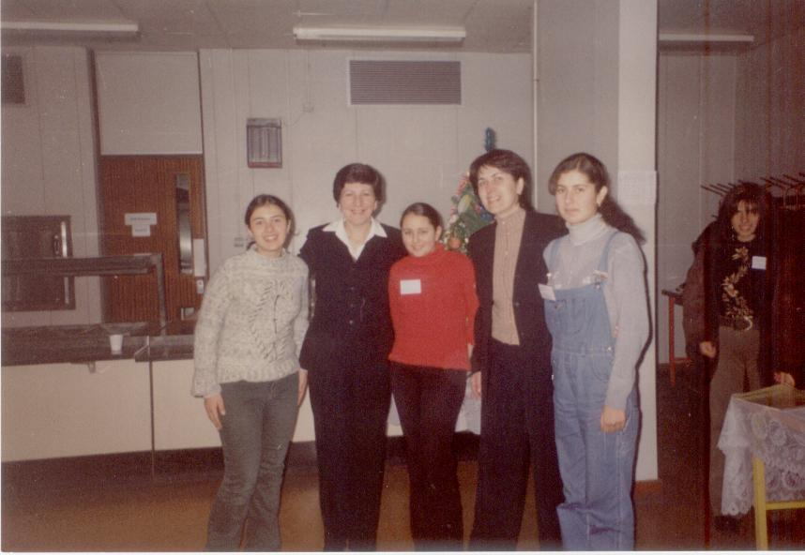
Armenia
EPCRE in Schools of Gyumri
Organization: NGO Women for Development was established in 1997 in Gyumri, Armenia
Mission: To promote to the process of democratic reforms and development through enhancing women’s role in the spheres of social, educational, health, human rights protection and the establishment of peace in the region.
.

Slide 4
Armenia
EPCRE in Schools of Gyumri
Goal of the project:
  Formation of peace culture and conflict resolution
  ideas among teachers pupils, aiming to involve
  peace education in the secondary school curriculum
  of Armenia latter.

Slide 5
Armenia
EPCRE in Schools of Gyumri
Implementation phases:
  1 year pilot project – development of the training course and conducting it in the “Peace Center”, established in the pilot school (2002-2003)
  Research and analyses of the pilot school experience, and spreading it in the “Peace Centers, established in 4 other Gyumri schools (2003-2004)

Slide 6
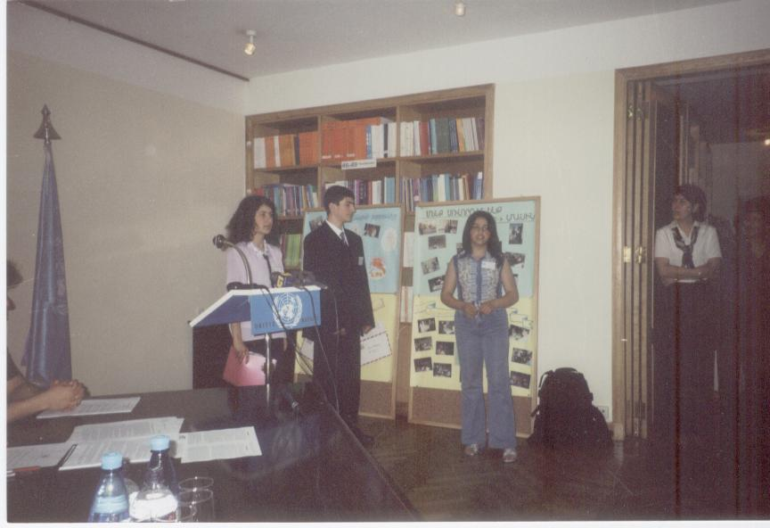
Armenia
EPCRE in Schools of Gyumri
Topics of the training course:
Conflicts and their causes
Conflict Escalation
Analyses of conflicts
Skills of conflict resolution
Conflict mapping/analyzing
A Special topic was dedicated to the issues of peace and human rights with the purpose to aware children about their rights and responsibilities, which will help them to resolve conflicts easily.
May 29, 2003, The International Day of Peacekeepers in the UN Armenian Residency. Members of the Peace center of school #20 presented their activities to the guests

Slide 7
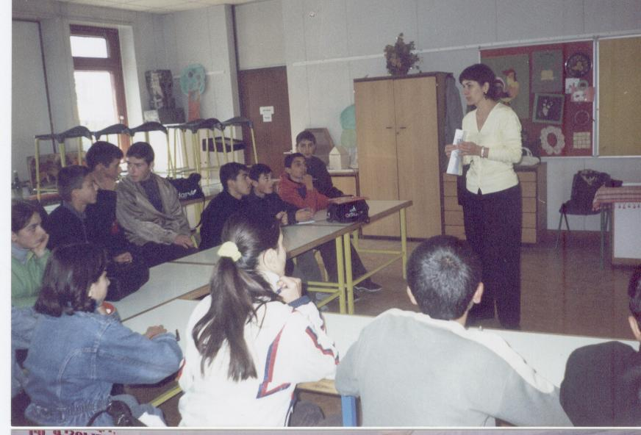
Armenia
EPCRE in Schools of Gyumri
Topics of the training course:
A Special topic was dedicated to the issues of peace and human rights with the purpose to aware children about their rights and responsibilities, which will help them to resolve conflicts easily.
Training of the members of Peace Education centers

Slide 8
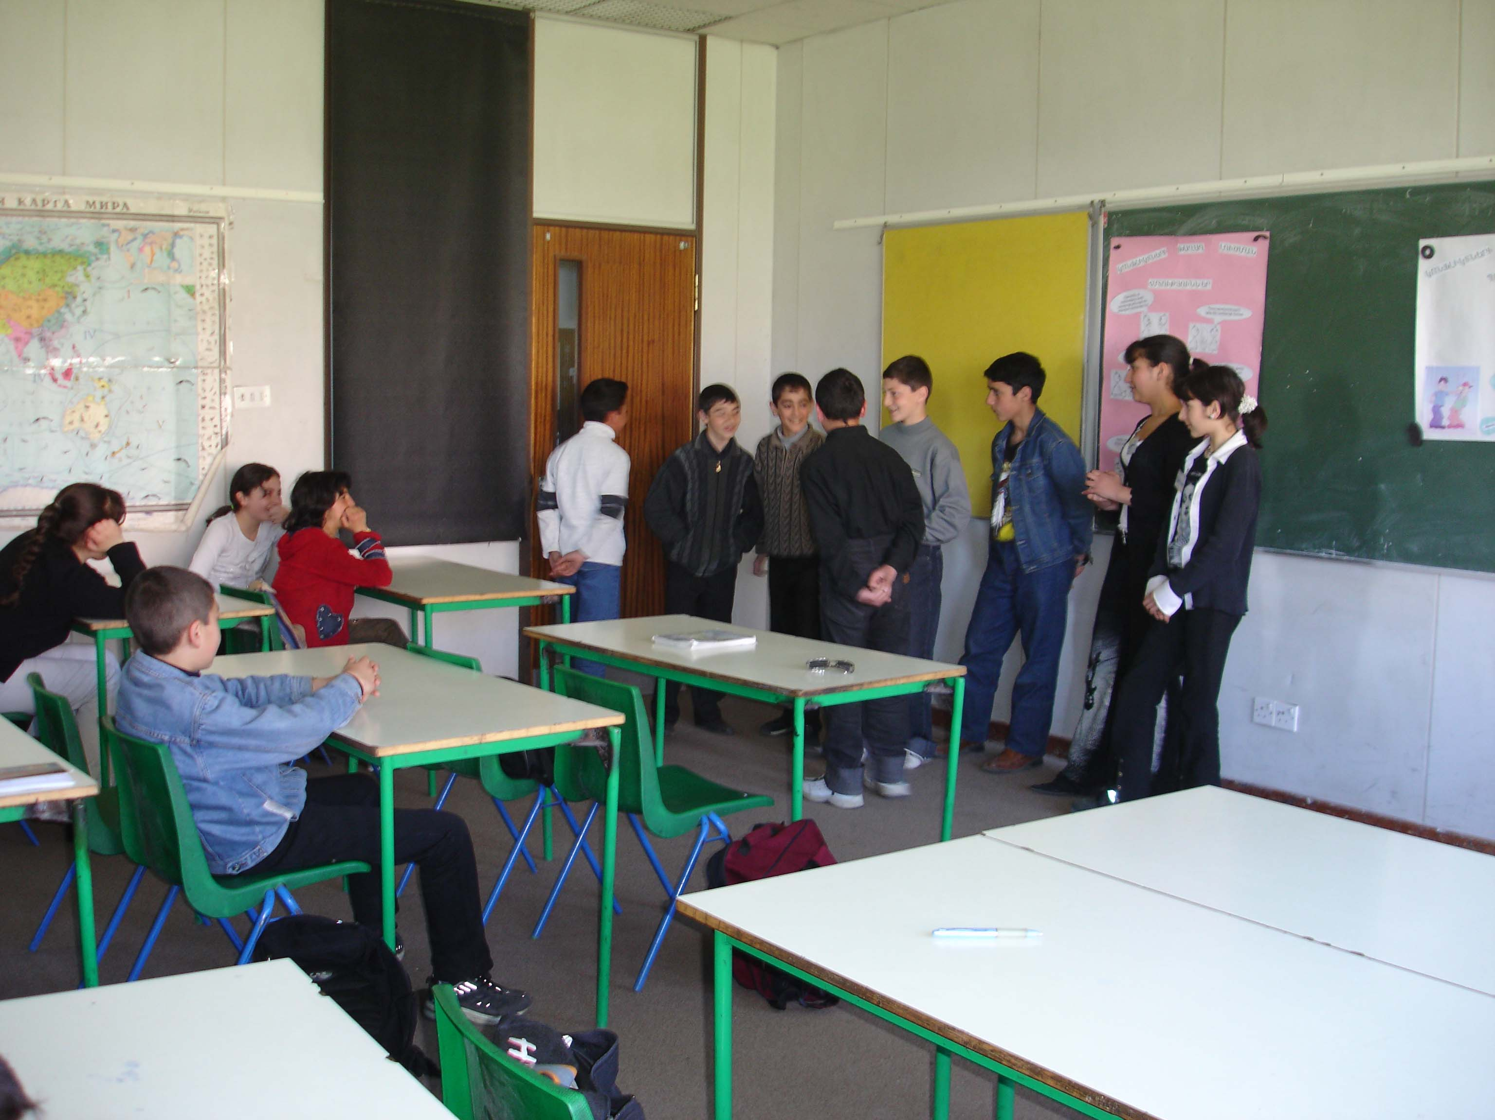
Armenia
EPCRE in Schools of Gyumri
Achievements during 2003-2004:
Developed PECRE pilot training course
5 “Peace Education” centers were established in 5 schools of Gyumri
“Month of Peace”, during which the pupils of the Centers conducted open classes for their schoolmates, demonstrated their skills and knowledge by peer-to-peer method.

Slide 9
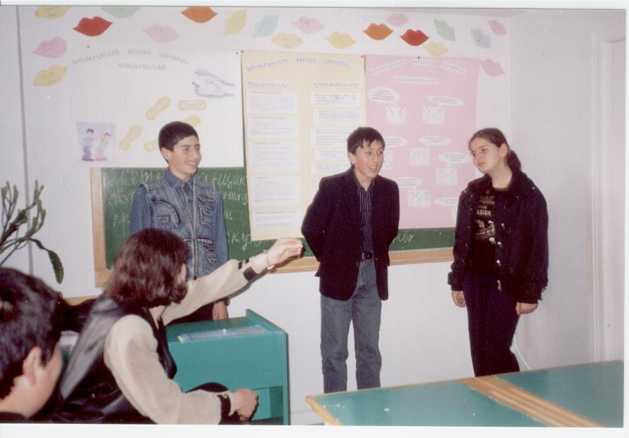
Armenia
EPCRE in Schools of Gyumri
Achievements during 2003-2004:
50 teachers and more than125 students of 7-9th are direct stakeholders
25 mediators were trained, who are ready to help their friends in conflict resolution, to spread their knowledge and skills in schools and in the community
“Month of Peace”, during which the pupils of the Centers conducted open classes for their schoolmates, demonstrated their skills and knowledge by peer-to-peer method.

Slide 10
Armenia
EPCRE in Schools of Gyumri
Achievements during 2005:
“Peace Network” of schools has been created: each school with its Peace Center cooperates with 2-3 network member schools
A special course on the theme PECRE is being conducted for undergraduate students from Pedagogical institute of Gyumri
In 2005, “Peace Education” center was established at the pedagogical Institute

Slide 11
Armenia
EPCRE in Schools of Gyumri
Next steps for 2005-2007:
The program will be continued in 10 schools of Shirak marz,
The program will be introduced in the curriculum of the Gyumri State Pedagogical Institute after M. Nalbandyan

Slide 12
Armenia
EPCRE in Schools of Gyumri
Perspective:
  Including the PECRE in the secondary school curriculum of Armenia
  Spread the gained experience in all schools of Armenia by using the resources are created.
Partners:
  Cooperation with the National Institute of Education at the MoES of Armenia,
  Partnership with the International and the local organizations
Needs:
  Financial, methodical, organizational and technical support

Slide 13
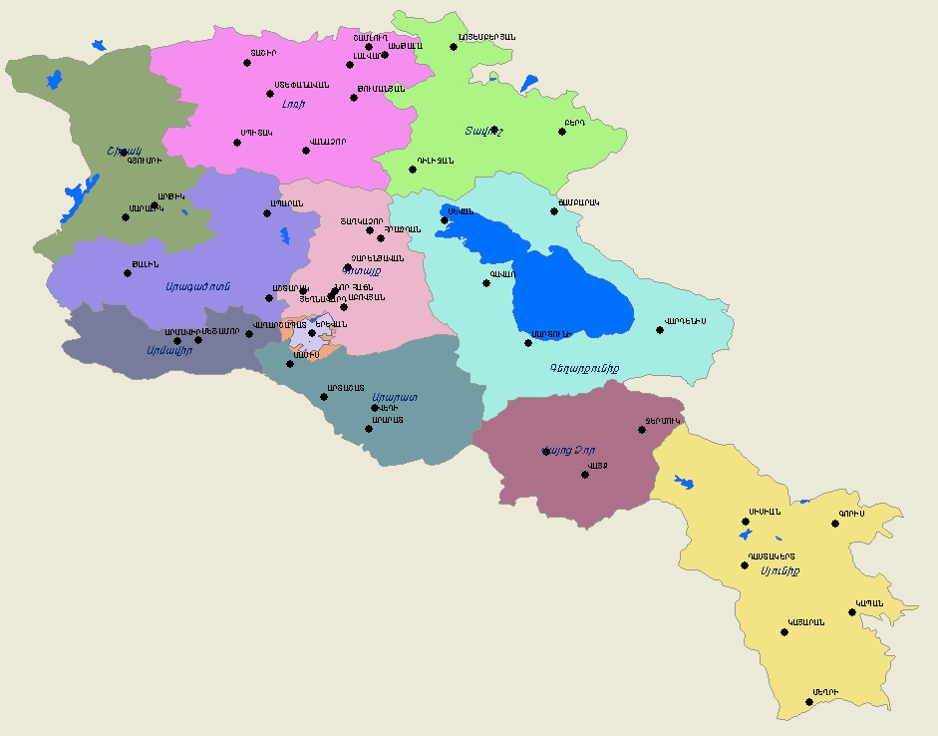
Armenia

