Slide 1

Virginia’s Alternative Assessments
OVERVIEW

Slide 2
Alternative Assessments
NCLB states that “an alternate assessment is an assessment designed for the small number of students with disabilities who are unable to participate in the regular State assessment, even with appropriate accommodations.”
Further, that “alternate assessments may be needed for students who have a broad variety of disabling conditions; consequently, a State may employ more than one alternate assessment. An alternate assessment may be scored against grade level standards…”

Slide 3
Virginia Grade Level Alternative
(VGLA) and
Virginia Substitute Evaluation Program (VSEP)
Both the VGLA and VSEP are grade level alternative assessment options allowing a student to demonstrate individual achievement and proficiency on Virginia’s Standards of Learning through a collection of student evidence.
The VGLA is available at grades 3 – 8 in all content areas.
The VSEP is available for ALL End-of-Course tests at the high school level and/or the Modified Standard Diploma requirements for numeracy and/or literacy.

Slide 4

Participation

Slide 5
Procedures 101:
VGLA and VSEP
A student’s IEP team/504 committee examines the participation criteria established for the VGLA OR VSEP and finds that a student meets the criteria for participation.
The student’s properly composed IEP team/504 committee makes the determination of which assessment program/accommodation(s) are appropriate for a student with a disability.

Slide 6
VGLA: Grades 3 - 8 Participation Criteria
  The student must have a current IEP/504-plan;
  As a result of a disability, the student demonstrates his/her individual achievement of SOL content through means other than multiple-choice formats;
  As a result of a disability, the student is unable to demonstrate his/her individual achievement on the SOL test for the assigned course or grade level using available accommodations and formats.

Slide 7
VSEP:
EOC and Modified Standard Diploma Students at Grades 9-12 : Participation Criteria
  The student has a current IEP or 504 plan.
  The student is enrolled in a course or has passed a course that has a Standards of Learning End-of-Course test and/or the student is pursuing a Modified Standard Diploma and seeking certification for having met the literacy and/or numeracy requirements.
  The impact of the student’s disability demonstrates to the IEP team or 504 committee that the student will not be able to access the Standards of Learning assessments even with accommodations and therefore requires a substitute evaluation.

Slide 8
VGLA/VSEP Modified Standard Diploma Options
If a student, as an 8th grader, has passed the grade 8 Reading and/or mathematics test(s) using the VGLA; he or she may use the scores earned during that administration to meet the requirements for literacy and/or numeracy when identified as seeking an MSD;
Scores awarded VGLA submissions by local scoring teams are acceptable for MSD purposes. Student VGLA submissions do NOT have to be submitted to the Department for review.
Students in ninth grade or above earning an MSD who did not participate in the VGLA in eighth grade are required to participate in the VSEP to meet the MSD literacy and numeracy requirements.

Slide 9

The Process

Slide 10
VGLA Procedures
The student and teacher follow established local procedures to identify collection components to demonstrate individual achievement of SOL for the grade level and content area(s) considered for the VGLA.
  examine the addressed SOL for the grade level assessments being considered (blueprint).
  select appropriate work samples that demonstrate content stated in the blueprint.
  reflect demonstration of student knowledge and skills related to the specific SOL.
  complete a collection that represents the student's level of individual achievement.

Slide 11
VGLA Recommendations
VGLA entries are now scored holistically, so it is important to remember that students must defend ALL SOL statements, including all bullets.
Local school divisions may want to store data collected in electronic formats or systems.
Data used to assign ratings of student performance must be maintained until after the end of the official audit window and in accordance with established Library of Virginia Records Retention Schedules.

Slide 12
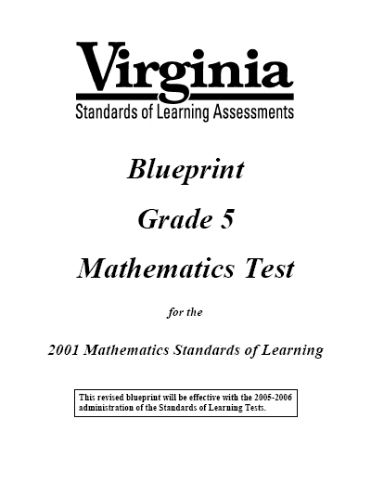
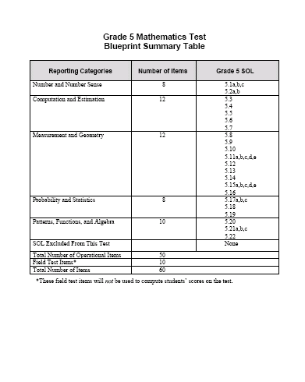

Slide 13
VSEP Procedures
Complete the Intent to Submit a Substitute Evaluation Form and Evaluation Plan
  The Intent form must be completed during an IEP/504 meeting and must include a justification statement.
  Examine the addressed SOL for the EOC and/or literacy and/or numeracy assessments being considered (Blueprint).
  Create an evaluation plan that explains how the student will demonstrate proficiency on the specific Standards of Learning addressed in the course, with the exception of those standards excluded from the test blueprints.
  Submit the Intent to Submit Form and the Evaluation Plan to the Virginia Department of Education, Division of Assessment and Reporting.

Slide 14
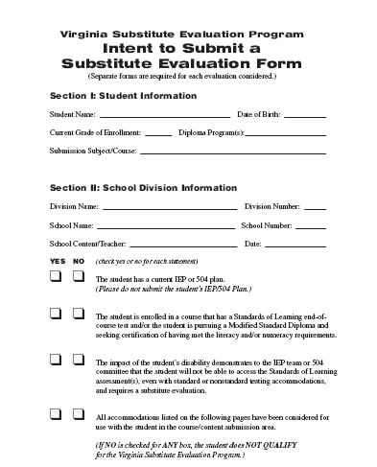
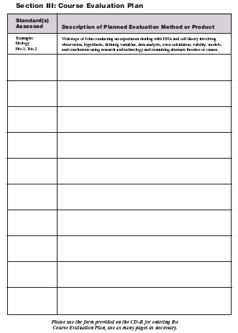
NOTE: There are more
pages to both examples.

Slide 15
VSEP Procedures
The student and teacher use established procedures to identify collection components to demonstrate individual achievement and proficiency of SOL for the EOC grade level and content area(s) (and/or numeracy and/or literacy) considered for the VSEP.
  examine the addressed SOL for the assessment(s) being considered (Blueprint).
  select appropriate work samples that demonstrate content stated in the blueprint.
  reflect demonstration of student knowledge and skills related to the specific SOL.
  complete a Course Work Compilation that represents the student's level of individual achievement and proficiency.

Slide 16
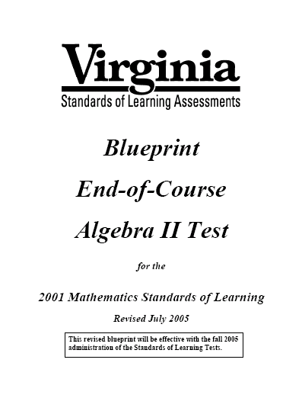
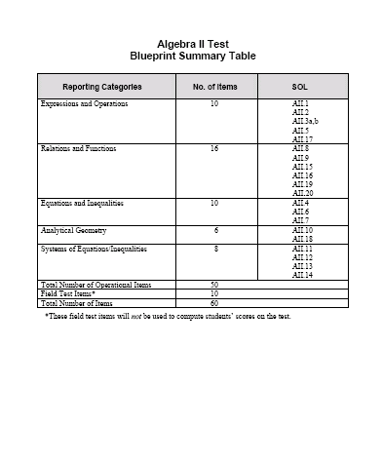

Slide 17
VSEP Procedures
The student and teacher MUST use a Course Work Compilation form to indicate evidence submitted for scoring.
  The CWC should mirror the Evaluation Plan submitted and approved by the VDOE.
  Additional evidence may be submitted using the CWC, but a CWC MUST contain evidence indicated and approved from the original Evaluation Plan
  Evidence should demonstrate the student’s level of individual achievement and proficiency with EOC SOL

Slide 18
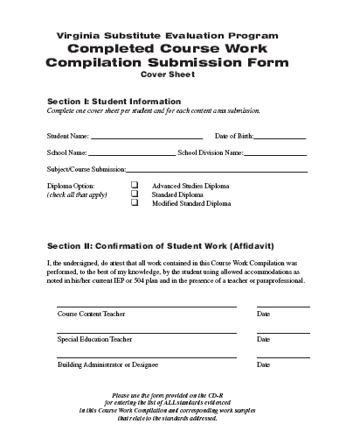
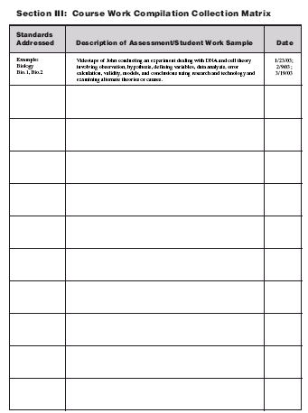

Slide 19

Evidence Submitted

Slide 20
VGLA and VSEP Procedures
A signed affidavit must accompany each VGLA/VSEP area submission stating that the work is that of the student alone using his/her accommodations.
  Work samples submitted must be solely that of the student.
  In the presence of a teacher and/or paraprofessional.
  Affidavit states that “I did not:
    fabricate, alter, or modify student work samples, products, or data,
    describe student behaviors that provide a negative image of the student, or
    provide any accommodation/assistive device that is not a regular part of the student’s daily instruction.”

Slide 21
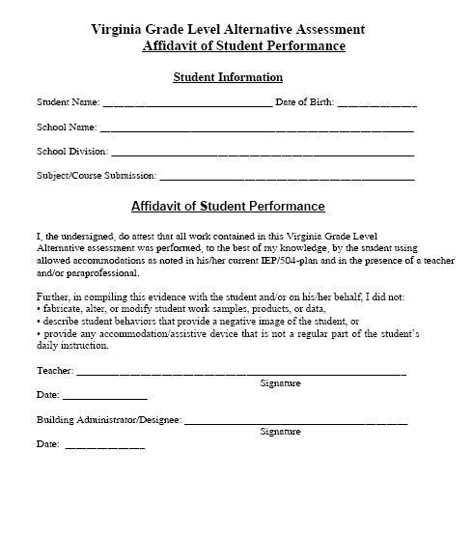

Slide 22
Affidavit Considerations
Hand over hand instruction is NOT evidence of student performance
Copying notes or information from other sources does not demonstrate individual student achievement of the content, but rather the students ability to copy information
Information gained or restated during open-book, internet research, or guided reading activities does not demonstrate individual achievement with the content

Slide 23

Types of Evidence

Slide 24
Types of Evidence
A collection may consist of any of the following types of evidence:
Work sample
Audiotape
Videotape
Anecdotal Record
Interview
Charts/Graphs

Slide 25
Evidence Continued
Evidence must demonstrate knowledge and/or skills in the SOL addressed.
Students should submit evidence for all of the SOL assessed from the test blueprints.
Evidence may prove more than one SOL.
All evidence must be solely the student’s work completed in the presence of a teacher or authorized school personnel.

Slide 26
Evidence:
Data Identification System (DIS) stickers
DIS stickers are REQUIRED to be placed on each piece of evidence submitted for the VGLA and VSEP.
DIS stickers will be provided based on enrollment counts to your DDOT
Evidence without DIS stickers will NOT be considered in scoring entries.

Slide 27
Data Identification System (DIS) Sticker
Content Area being submitted
Standard of Learning being defended
Bullet of SOL being defended (if applicable)
Check one or both
VGLA/VSEP DIS
Content Area:
SOL:
Bullet:
Inferred: Demonstrated
VGLA/VSEP DIS
Content Area: Mathematics
SOL: 8.14
Bullet: c
Inferred: Demonstrated
Example:
✓
✓

Slide 28

Contents of a Submission

Slide 29
VGLA Collection Components
A VGLA collection submitted for scoring to the local scoring team must contain the following:
A signed VGLA Affidavit of Student Performance that demonstrates the student’s sole ownership/authorship.
Types of evidence that demonstrate individual achievement on all SOL addressed.
A Virginia Grade Level Alternative (VGLA)
Assessment Worksheet to be used for scoring.

Slide 30
VSEP Collection Components
A VSEP Course Work Compilation submitted for scoring to the Virginia Department of Education must contain the following:
A signed VSEP Affidavit of Student Performance that demonstrates the student’s sole ownership/authorship.
A completed Course Work Compilation Form indicating evidence and SOL associations.
Types of evidence that demonstrate individual achievement on all SOL addressed.

Slide 31

Scoring VGLA and VSEP Submissions

Slide 32
VGLA Procedures
The student’s VGLA collection and the signed affidavit confirming that the work is that of the student alone are submitted to the LEA scoring committee.
  A complete collection that provides evidence for all SOL from a given content/grade level that the student has addressed during the course of study must be submitted.

Slide 33
VGLA Scoring Teams
Scoring teams must consist of at least three members.
At least one or more members must have knowledge of the content area being scored.
Scoring teams must come to consensus on score points assigned for each Standard Of Learning contained within the blueprint for a specific test.
Scores for individual Standards Of Learning are weighted based on the general Blueprint established for each test.

Slide 34
VGLA Procedures
Based on the documentation and collection review, the school division scoring team will assign the appropriate scores based on the scoring rubric identified by the Virginia Department of Education.
  The Division Director of Testing is responsible for maintaining a local scoring team.
  After receipt of all required materials, documentation, and collection evidence, the local scoring team will set up a date for review of submitted VGLA entries.
  The local scoring team will use the online scoring system to rate student individual achievement in each SOL addressed for specific content/grade level VGLA submitted collection.

Slide 35
VSEP Scoring
VSEP entries are scored during scoring events throughout the school year.
Trained scorers will read and review each submitted entry.
All entries are scored at least twice by different scorers with content area expertise.
Scores for individual Standards Of Learning are weighted based on the general Blueprint established for each test.

Slide 36
VSEP Procedures
The student’s VSEP Course Work Compilation form, evidence, and the signed affidavit confirming that the work is that of the student alone are submitted to the school division Director of Testing based on the established testing date(s) for each division.
  A complete Course Work Compilation provides evidence for all SOL from a given EOC and/or literacy and/or numeracy blueprint that the student has addressed during the course of study.

Slide 37
VSEP Procedures
Based on the documentation and Course Work Compilation review, trained and authorized scorers will assign appropriate scores based on the scoring rubric.
  The Division of Assessment and Reporting and Pearson Educational Measurement will establish a scoring institute.
  All VSEP entries will be scored during the scoring institute, dates to be determined.
  The VSEP Scoring System will weight and calculate proficiency levels.

Slide 38

Reporting

Slide 39
VGLA Reporting
The online scoring system provides scoring and reporting for the Local School Division and directly to the Division of Assessment and Reporting.
Division Directors of Testing will be given log on information and procedures for accessing and reporting scores for VGLA Administrations during spring score training.

Slide 40
VSEP Reporting
The computerized scoring system used during the scoring event provides real-time scoring to Department of Education authorized scoring teams.
Pearson Educational Measurement will print out Official Score Reports during the scoring event.
Scorers will sign Official Score Reports.
Division Directors of Testing will receive Official Score Reports for VSEP students at the close of the scoring event.

Slide 41

Auditing

Slide 42
VGLA Procedures
All school divisions will be subject to VDOE audits to monitor program implementation, scoring, and application of participation criteria.
  10 to 15 percent of student submissions.
  provide VDOE audit staff with evidence used to establish ratings.
  agreement or non-agreement between submitted evidence and ratings provided.
  School divisions may appeal scores and/or audits through an established appeals process.

Slide 43
VGLA Procedures
Divisions will receive audit rosters from Pearson.
Student entries identified for audits should be set aside and maintained until instructed to send to the Division of Assessment and Reporting VGLA Audit Institute
DDOTs will receive shipping materials, instructions, and labels prior to the audit institute.

Slide 44
VSEP Procedures
VSEP entries will not be audited.
Each VSEP will be scored by state identified, trained, and authorized scorers.
Each VSEP entry will be scored by two scorers.
Inter-rater reliability will be established by examining the first and second scores on proficiency assigned to each VSEP entry.
If required, VSEP entries will be read a third time by a third scorer to resolve disagreements in proficiency levels.

Slide 45

Questions

