Slide 1
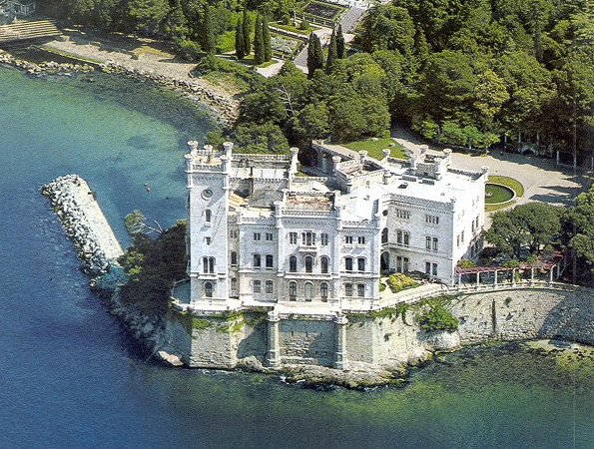
100 Years of Science
Dick Carrigan
Fermilab

Slide 2

Nancy Carrigan’s cosmology
can I unweave the
gauzy fabric of stars?
can I untangle the
matted carpet of earth?

Slide 3
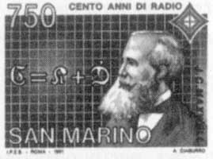
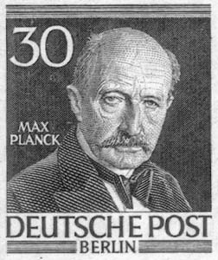

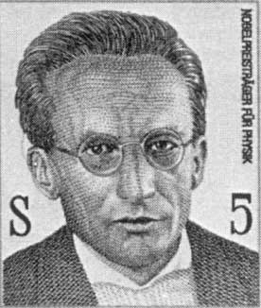
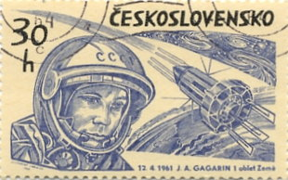
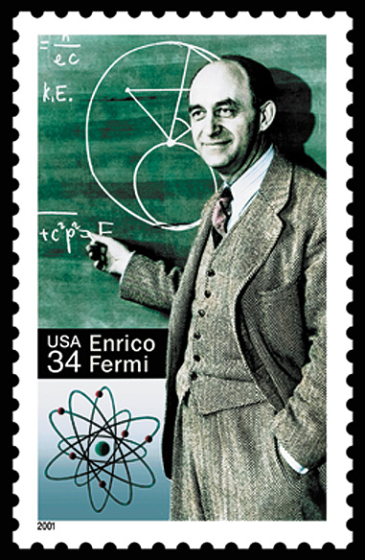
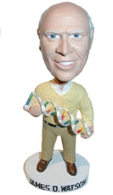
What 100 years are we talking about?
Maxwell 1873 to 1973 – no fun
Planck – 1900,
Einstein 1905 but that’s last century
Schrödinger 1926
or maybe 1944 “What is Life?”
Take start as 1944 to get 1950s explosion: rocket science, mesons, DNA, BB
Notes:
Maxwell?
Planck?
Birth Of QM?
1950s with explosion of HEP, DNA, Rocket sceince?
Does it matter – wellyes for this lecture, we need to guess future to set direction, facilites

Slide 4
Definitions
PARTICLES/
ACCELERATORS
PARTICLES
COSMOLOGY
COSMOLOGY
SPACE/
ASTRONOMY/
PLANETARY SCIENCE
SPACE
DNA =
ALL BIOLOGY
DNA
COMPUTING/
ELECTRONICS/
MATH
COMPUTING
Notes:
NOT ON CHART-Geology. May be something else. Also accelerators.
Two missing links – cosmology to DNA (anthropic), particles to space.
I assume particles means accelerators also.
Space includes astronomy
This is a slide I will keep coming back to.

Slide 5

Technical revolutions of the last half century
PARTICLES
Notes:
NOT ON CHART-Geology. May be something else. Also accelerators.
Two missing links – cosmology to DNA (athropic), particles to space.
I assume particles means accelerators also.
Space includes astronomy
This is a slide I will keep coming back to.

Slide 6
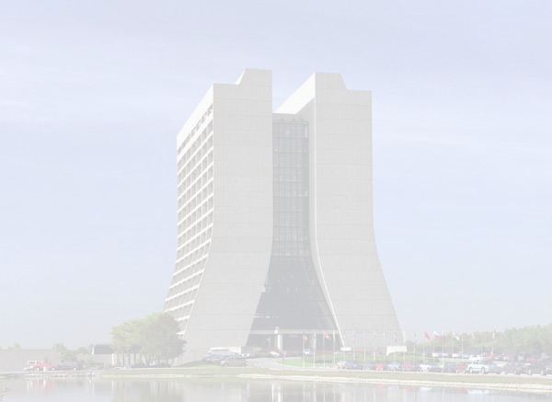
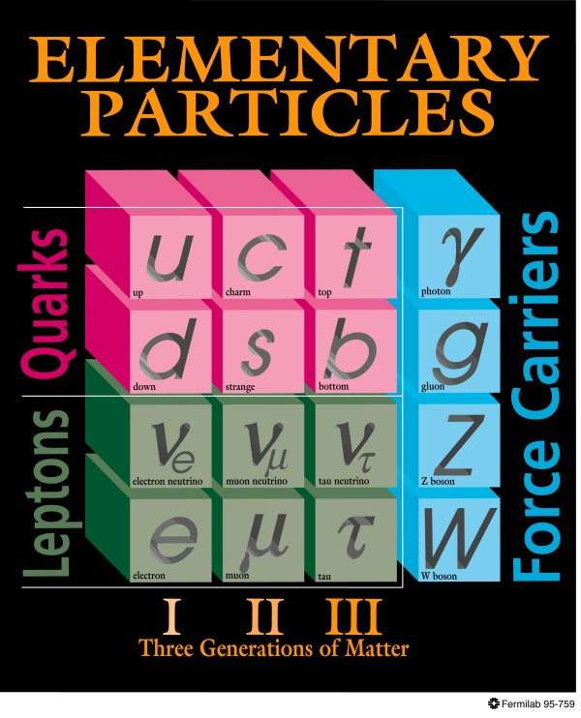
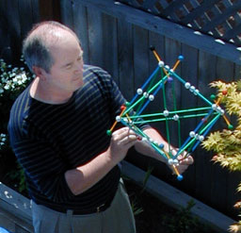
Particle physics
Notes:
Mixture of accelerators, cr from start
Note that there are puzzles that are glossed over on the left
Left behind is Higgs, etc
Chris Quigg looking for new “wall charts”

Slide 7
Chronology – mostly experimental discoveries
1897 Using a cathode ray tube Thomson discovers the electron at the Cavendish
1931 Anderson discovers the positron at Cal Tech
1934 Fermi develops theory of beta decay
1937 Neddermeyer and Anderson discover the muon in a cosmic-ray experiment
1951 First observation of strange particles in cosmic-ray experiments.
1955 Segre and Chamberlain discover the antiproton at Berkeley.
1956 Cowan and Reines detect the first neutrino at Savannah River.
1956 Gell-Mann explains kaon lifetime with the strangeness
1964 At Brookhaven Cronin and Fitch find kaons violate CP symmetry
1974 Physicists at SLAC and BNL independently discover charm quark
1977 The upsilon, a particle containing a bottom quark, is discovered at Fermilab
1979 Gluon observed at DESY.
1983 W and Z bosons observed at CERN
1995 CDF and D0 discover top quark at Fermilab
Notes:
Anti particles
Mesons
Quarks
Gluons
SM
Neutrino mass
A key ingredient - accelerators

Slide 8
The future for particle physics
Some of Quigg’s April 28, 04 “Questions for the Future”
1. Are quarks and leptons elementary?
2. What is the relationship of quarks to leptons?
3. Are there right-handed weak interactions?
4. Are there new quarks and leptons?
5. Are there new gauge interactions linking quarks and leptons?
6. What is the relationship of left-handed & right-handed particles?
7. What is the nature of the right-handed neutrino?
8. What is the nature of the new force that hides electroweak symmetry?
9. Are there different kinds of matter? Of energy?
10. Are there new forces of a novel kind?
11. What do generations mean? Is there a family symmetry?
12. What makes a top quark a top quark and an electron an electron?
13. What is the (grand) unifying symmetry?
From Quigg http://www.fis.puc.cl/~rlineros/research/cdmexico/talks/BeyondSM/BSM1.pdf
Notes:
Beyond the SM
Extra dimensions
Something else

Slide 9
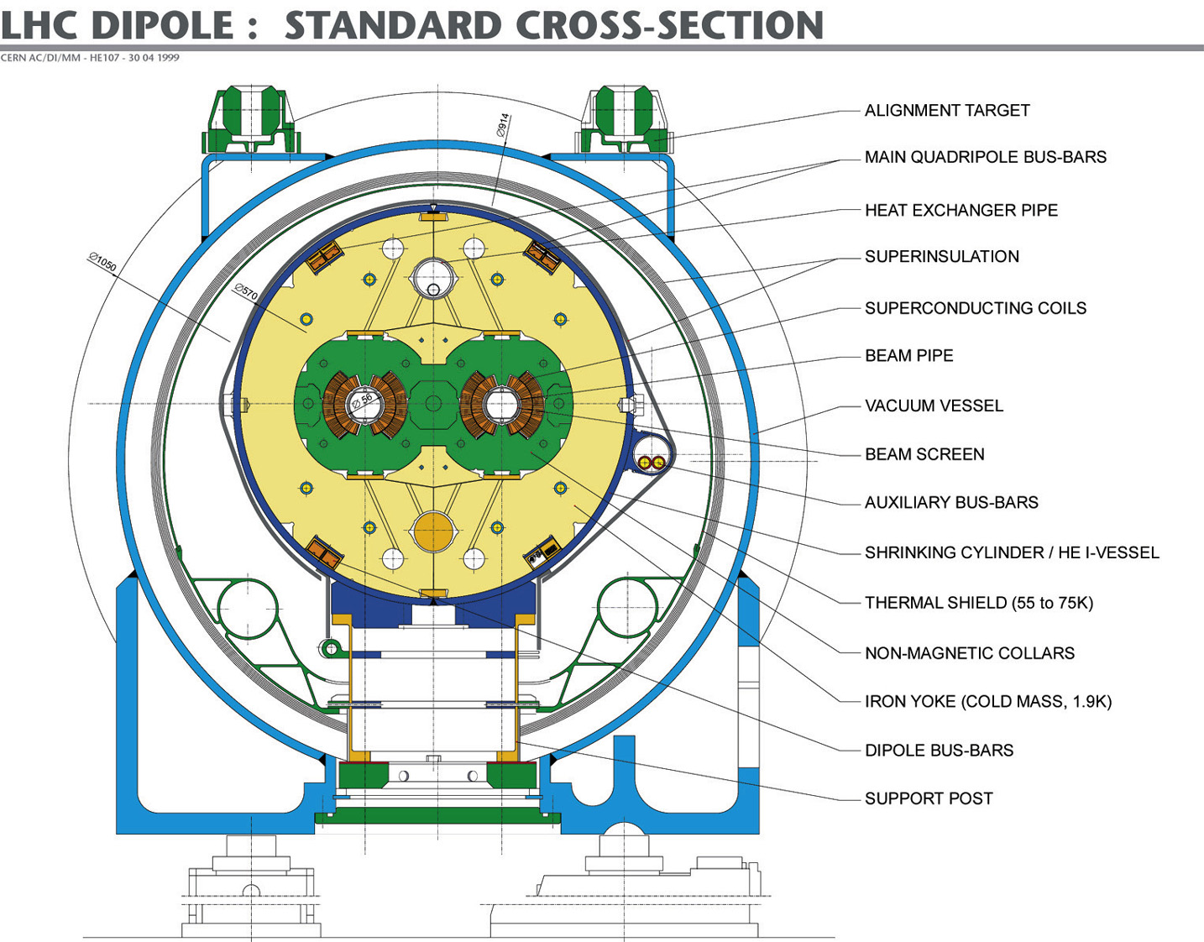
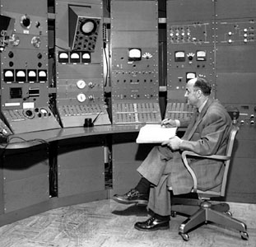
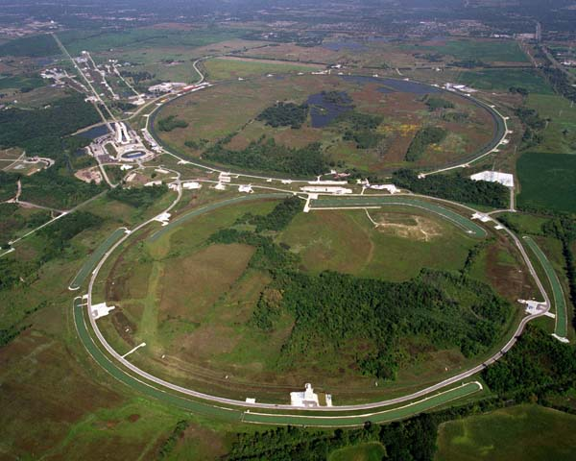
Accelerators
Fermi at Chicago
Synchrocyclotron - 1951
Notes:
Pictures of cyclotron, Fermilab, LC,
Need to work in the future.

Slide 10
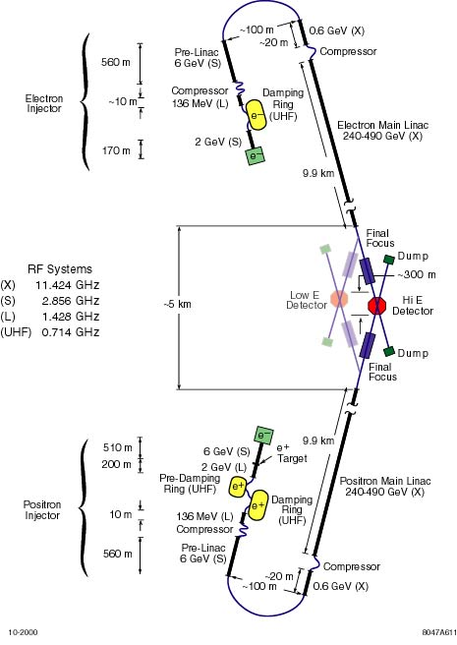

Accelerators beyond LHC – everything has problems
NLC
or Plasma wake field
acceleration
G= 0.96(n0)½ (V/cm) n0 is electron density
  RF cavity 0.0005 GV/cm
  gaseous plasma 1 GV/cm
  solid state plasma 100 GV/cm
Notes:
Both have problems – NLC cost lots, exotic accelerators are unproven and advancing too slowly

Slide 11
Technical revolutions of the last half century
COSMOLOGY
PARTICLES
Notes:
NOT ON CHART-Geology. May be something else. Also accelerators.
Two missing links – cosmology to DNA (athropic), particles to space.
I assume particles means accelerators also.
Space includes astronomy
This is a slide I will keep coming back to.

Slide 12
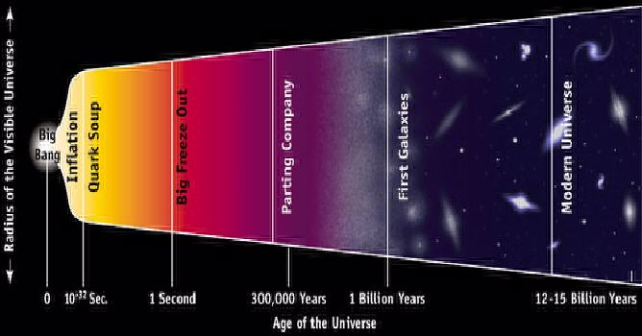
The Big Bang
PARTICLE
PHYSICS
From http://ist-socrates.berkeley.edu/~phy39/stellarE/starshine.html
Big bang explained what came afterwards
but not the big bang itself
Notes:
Make point that this links to particle physics. Also need links to various parts of physics eq Higgs, quarks, nucleons, etc.

Slide 13
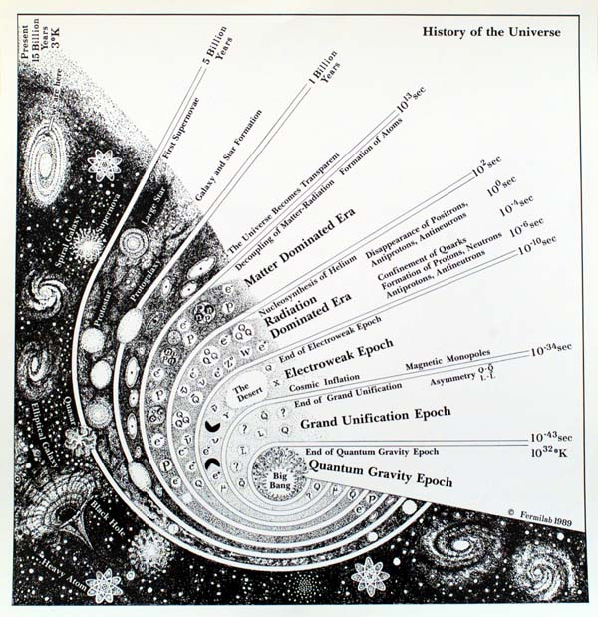
The Big Bang and the particle /cosmology connection

Slide 14
The next forty years in particle cosmology
Even more precise WMAP-type observations
Dark matter and dark energy investigations continue
Gravity waves
The fabric of space
Particle physics finds the key?
Notes:
Note that satellite observatories are key to most of these.

Slide 15
Technical revolutions of the last half century
ORIGIN
OF
UNIVERSE
COSMOLOGY
TOOLS
PARTICLES
SPACE
Notes:
NOT ON CHART-Geology. May be something else. Also accelerators.
Two missing links – cosmology to DNA (anthropic), particles to space.
I assume particles means accelerators also.
Space includes astronomy
This is a slide I will keep coming back to.

Slide 16
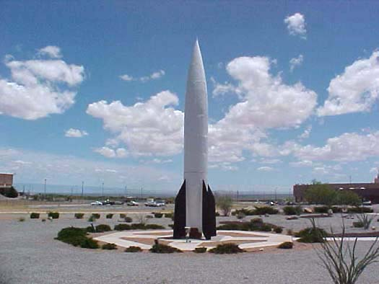
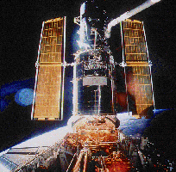
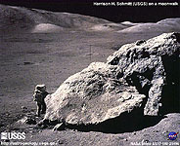

History of Space and Astronomy
V2 at White Sands
The birth of real rockets at Penemunde 1930s
First Hubble service mission in 1993
Harrison Schmitt on the Moon. NASA photo (1972)
First and only scientist on moon
NASA Rover robot on Mars 2004 looking for water
Notes:
V2, manned flight, Hubble, Mars rover
Near 'Endurance' on Sol 115
5/24/04
This cylindrical-projection view combines several frames from the navigation camera on NASA's Mars Exploration Rover Opportunity. The rover acquired these frames during its 115th martian day, or "sol," in the Meridiani Planum region of Mars, on May 21, 2004. The rover was near the edge of "Endurance Crater," which dominates the right half of this view. The crater is about 130 meters (about 430 feet) in diamete

Slide 17
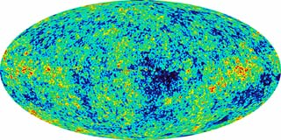
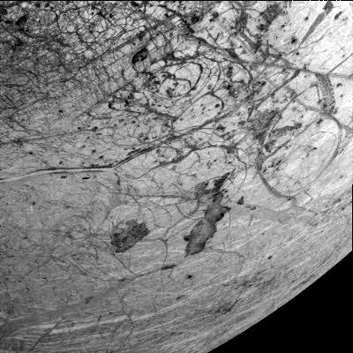
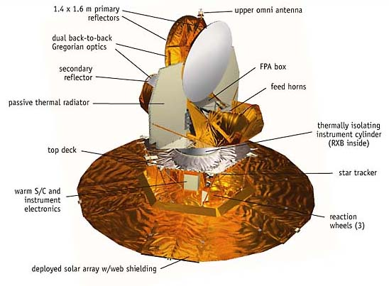
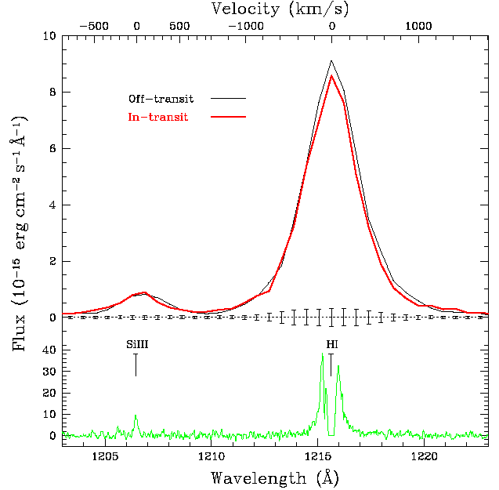
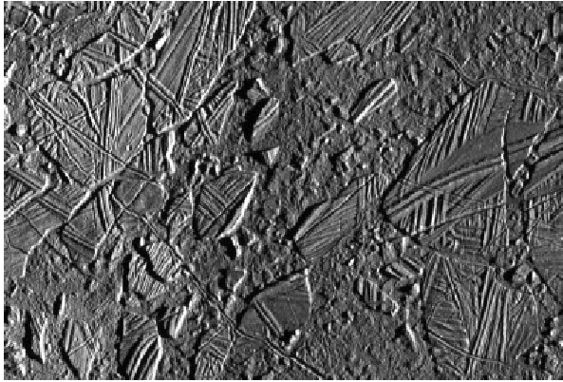
Space and Astronomy
WMAP
O and C in atmosphere of extrasolar planet HD209458 observed with the STIS spectrograph on
board Hubble (2004)
Icy surface of Europa – an abode for life?
Notes:
Want planetary science – Europa, WMAP, extrasolar planets, recent Hubble result
Ridges and lineaments crisscross the icy shell of Europa's surface. These are the most common landform on Europa and may represent either ejection of material from beneath its icy shell, or crumpling of the shell itself. Features as small as 54 meters (179 feet) across can be seen in this image, taken when Galileo was 2,550 kilometers (1,560 miles) from Europa.
Inset is Fig. 7.3 A portion of Conamara Chaos (at 40 m/pixel). Here we see rafts of older tectonic
terrain which have been slightly displaced in a lumpy frozen matrix, giving the appearance of a
site of melting of the crust followed by refreezing. Two examples of cracks with double ridges
have formed subsequently, providing examples of a widespread process by which tectonics
have obliterated chaotic terrain to various degrees.
A global view of Europa's trailing hemisphere. Visible in this view are mottled terrain, triple bands, crater Pwyll, a macula, and IR bright and dark plains. The minimum feature size visible in this image is 14 kilometers (8.6 miles). This image was taken when Galileo was 677,000 kilometers (413,000 miles) from Europa.
This image of Europa's southern hemisphere was obtained by the solid state imaging (CCD) system on board NASA's Galileo spacecraft during its sixth orbit of Jupiter. The upper left portion of the image shows the southern extent of the "wedges" region, an area that has undergone extensive disruption. South of the wedges, the eastern extent of Agenor Linea (nearly 1000 kilometers in length) is also visible. Thera and Thrace Macula are the dark irregular features southeast of Agenor Linea. This image can be used by scientists to build a global map of Europa by tying such Galileo images together with images from 1979 during NASA's Voyager mission. Such lower resolution images also provide the context needed to interpret the higher resolution images taken by the Galileo during both its nominal mission and the upcoming Europa mission. North is to the top of the picture and the sun illuminates the surface from the right. The image, centered at -40 latitude and 180 longitude, covers an area approximately 675 by 675 kilometers. The finest details that can be discerned in this picture are about 3.3 kilometers across. The images were taken on Feb 20, 1997 at 12 hours, 55 minutes, 34 seconds Universal Time when the spacecraft was at a range of 81,707 kilometers.
This high-resolution image of Jupiter's moon Europa, taken by NASA's Galileo spacecraft camera, shows dark, relatively smooth region at the lower right hand corner of the image which may be a place where warm ice has welled up from below. The region is approximately 30 square kilometers in area. An isolated bright hill stands within it. The image also shows two prominent ridges which have different characteristics; youngest ridge runs from left to top right and is about 5 kilometers in width (about 3.1 miles). The ridge has two bright, raised rims and a central valley. The rims of the ridge are rough in texture. The inner and outer walls show bright and dark debris streaming downslope, some of it forming broad fans. This ridge overlies and therefore must be younger than a second ridge running from top to bottom on the left side of the image. This dark ~2 km wide ridge is relatively flat, and has smaller-scale ridges and troughs along its length.North is to the top of the picture, and the sun illuminates the surface from the upper left. This image, centered at approximately 14 degrees south latitude and 194 degrees west longitude, covers an area approximately 15 kilometers by 20 kilometers (9 miles by 12 miles). The resolution is 26 meters (85 feet) per picture element. This image was taken on December 16, 1997 at a range of 1300 kilometers (800 miles) by Galileo's solid state imaging system.
The Jet Propulsion Laboratory, Pasadena, C
Wmap
If we make a temperature map of the Earth for the month of June 1992 we get a pattern of data that can be displayed in a colorful way to help us understand the results. If we turn our gaze upward and make a picture of the whole sky, we can display that data in a similar oval format for easy examination.
The main features of the WMAP spacecraft are shown in the following collection of diagrams and photographs. The most prominent feature is a pair of back-to-back telescopes that focus the microwave radiation from two spots on the sky roughly 140° apart and feed it to 10 separate differential receivers that sit in an assembly directly underneath the optics. Large "elephant ear" radiators provide cooling for the sensitive amplifiers in the receiver assembly. The bottom half of the spacecraft provides the services necessary to carry out the mission including command and data collection electronics, attitude (pointing) control and determination, power services and a hydrazine propulsion system. The entire observatory is kept in continuous shade by a large deployable sun shield that also supports the solar panels.
exo-solar planet with Hubble spectrograph:
DETECTION OF OXYGEN AND CARBON IN THE HYDRODYNAMICALLY ESCAPING
ATMOSPHERE OF THE EXTRASOLAR PLANET HD209458B
A. Vidal-Madjar1, J.-M. D´esert1, A. Lecavelier des Etangs1, G. H´ebrard1,
G. E. Ballester2, D. Ehrenreich1, R. Ferlet1, J. C. McConnell3, M. Mayor4,
C. D. Parkinson5
Draft version February 2, 2004
ABSTRACT
Four transits of the planet orbiting the star HD209458 were observed with the STIS spectrograph on
board HST. The wavelength domain (1180-1710°A) includes Hi as well as Ci, Cii, Civ, Nv, Oi, S i, Si ii,
Si iii and Si iv lines. During the transits, absorptions are detected in Hi, Oi and Cii (5±2%, 13±4.5%
and 7.5±3.5%, respectively). No absorptions are detected for other lines. The 5% mean absorption over
the whole Hi Lyman line is consistent with the previous detection at higher resolution (Vidal-Madjar
et al. 2003). The absorption depths in Oi and Cii show that oxygen and carbon are present in the
extended upper atmosphere of HD209458b. These species must be carried out up to the Roche lobe and
beyond, most likely in a state of hydrodynamic escape.
Subject headings: Star: individual (HD209458) – Stars: planetary systems
The diagram is Fig 2. Red is on transit. Note the adsorption. HI. SiIII shows none. Fig. 2.— Comparison of o-transit and in-transit spectra for the Si iii, Hi, Oi and Cii lines with 1- error bars. The o-transit spectrum
is the addition of the first exposure of the 1st and 3rd visits (thin lines); the in-transit corresponds to the addition of the fully in-transit
exposure of each of the four HST visits (thick lines). Absorption is clearly detected in the Hi, Oi and Cii lines. No signal is detected in
other lines (e.g., Si iii) with about the same amplitude. The bottom panels show the high resolution spectra obtained in 2001 with the echelle
grating (Vidal-Madjar et al. 2003).

Slide 18
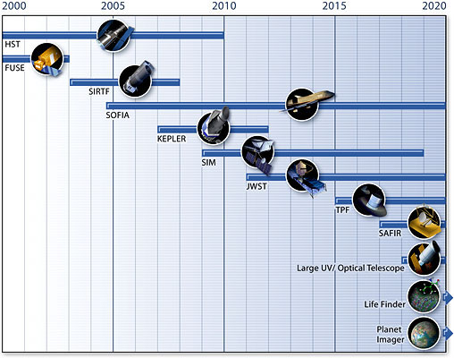
The future of space
Man has a role but for the distant future
Robotics ala the 2004 Martian landers is important
Enormous importance for astronomy and cosmology
Spitzer Infrared Telescope now in operation
James Webb 6.5 m optical telescope
LISA – constellation to look for gravity waves
SIM – interferometry to look for exosolar planets
Kepler - exosolar planets by transit
Notes:
Man has a role but for the distant future
Robotics importance
Potential of space for astronomy is enormous- list some projects, WMAP continues, special telescope, searching for extrasolar planets, perhaps gravity, study of solar planets maybe as pictures

Slide 19
Technical revolutions of the last half century
ORIGIN
OF
UNIVERSE
COSMOLOGY
TOOLS
PARTICLES
SPACE
DNA
Notes:
NOT ON CHART-Geology. May be something else. Also accelerators.
Two missing links – cosmology to DNA (athropic), particles to space.
I assume particles means accelerators also.
Space includes astronomy
This is a slide I will keep coming back to.

Slide 20

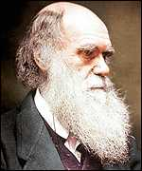
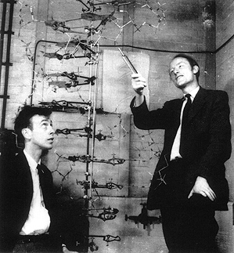
Dirt, Darwin, and DNA
The evolution of the geology of earth including impacts
and the atmosphere drives the environments
Survival of the Fittest for different environments explains evolution
DNA (~1953) Proteins have 20 amino acids. There are 4 bases in DNA (adenine[A], guanine[G], cytosine[C], thymine[T]). Combinations are AT (2 hydrogen bonds) and GC (three hydrogen bonds). The number of bits/base pair is 4.32/3= 1.44 bits/bp = ln_2(20)/3 where 3 is the number of base pairs in a codon (a triplet of base pairs). 600 Daltons for mass of a base pair with backbone and bonds. Human genome-3 billion DNA base pairs, actual information content is on the order of 0.05 Gbytes because of junk DNA. Point- lots of information per mass.
Notes:
Note that it is actually Darwin/Wallace

Slide 21
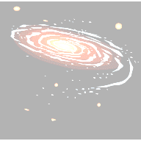

Big Bang of Biology
ORIGIN OF LIFE
RNA
(Ribonucleic
Acid)
RNA world-
Gilbert-1986
DNA
Deoxy-
ribonucleic
acid
NATURAL
ORGANICS,
AMINO ACIDS
?
COMPLEX
LIFE
GENETIC INFORMATION FLOW
RNA
(catalyst-
factory)
PROTEINS
(20 proteinogenic
amino acids)
DNA
(CD Writer)

Slide 22

Origin of life
T
Don’t know. Chirality may be a clue.
De Duve argues RNA by chance is implausible.
Needs a complex chemical environment.
Some argue catalysts are needed
but maybe not for peptides.
Maybe clays help.
Maybe a natural selection for molecules.
?
History of life on earth – the first billion years:
Birth of the Solar System 4.6 billion years ago. Hot (molten)
atmosphere of H₂O, CO₂ and CO, N₂ and H₂ until 0.1 Gyr
Rain 0.1 to 0.3 Gyr, rocky crust 0.2 to 0.4 Gyr.
Biologically processed carbon 1 Gyr (self-replicating, carbon-based microbial life)
not much free oxygen - anaerobic life
And then photosynthesis began to produce oxygen
See :Astrobiology:The Quest for the Conditions of Life- Gerda Horneck Christa Baumstark-Khan (Eds.)
Notes:
http://www.cotf.edu/ete/modules/msese/earthsysflr/geotime.html-shown as a stairway
http://www.resa.net/nasa/origins_life.htm
Chirality is important
From deDuve:
P. 60 The RNA enigma. Have not found out how prebiotic synthesis of RNA occurred. Some feel there must have been an additional step. Getting RNA by chance is chemically implausible. Also having a little RNA is not enough. RNA provides information and synthesis. Synthesis requires complex building blocks and energy. He argues RNA arose in a complex chemical environment. Suggests ATP plus AMP, GMP, CTP, UTP must have been present. They are RNA building blocks. Some argument about available energy. Each one of the building blocks provides energy for different processes.
P. 61 NTP-triphosphates, MNP-monophosphates
P. 62 Chicken or egg problem of information vs energy.
Tracing Protometabolism
P. 62 This currently seems to be a murky area. He suggests a congruence principle that protometabolism prefigured metabolism. Why the skeptics-they argue that without catalysts the constituents would not combine. But, clays can do something…
P. 64 Why not peptides which are not so sensitive to the need for catalysts? Multimers-like peptides but other than amino acids. Still closely resemble peptides. E. g. hydroxy acids. An objection is that these are small. Second objection is problem of faithful reproduction.
RNA Could be First Fruit of Natural Selection
P. 65 Could NTPs react together to make RNA?
P. 65 Why just A and U, C and C? Maybe a natural selection type mechanism took over where the particular set had more amplification.
P. 66 “Molecular "selection”. Some must have been more robust to replication or had higher amplification. This can be accomplished in the laboratory. Spiegelmann in the sixties, Eigen. Calls these molecules quasi species. First RNA or “UrGen”. Molecular phylogeny.

Slide 23



Tree of life – not your parents biology
Circa 1950
Also viruses
From http://www.ucmp.berkeley.edu/alllife/threedomains.html
Notes:
Some places Rare Earth p. 80, 81p 88 108 biology p 454

Slide 24
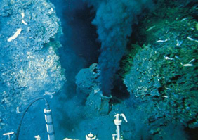
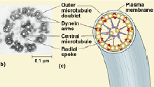
Speeding up evolution
Extremophiles
  Thermophiles-deep hydrothermal vents along mid ocean rifts -volcanic vents or "black smokers"
  Salty (halophiles)
  Cold, dry, high radiation, …
Symbiosis-Margulies-speeds up
Notes:
39] Tunnicliffe, V., 1992. Hydrothermal-vent communities of the deep sea. American Scientist, 80: 336-349
Something about Endosymbiosis, Lynn Margulies
Current picture is from http://biosci.usc.edu/documents/bisc120-6_CH_28_Eucaryote_Protistdiv.pdf
Europa as a test bed

Slide 25

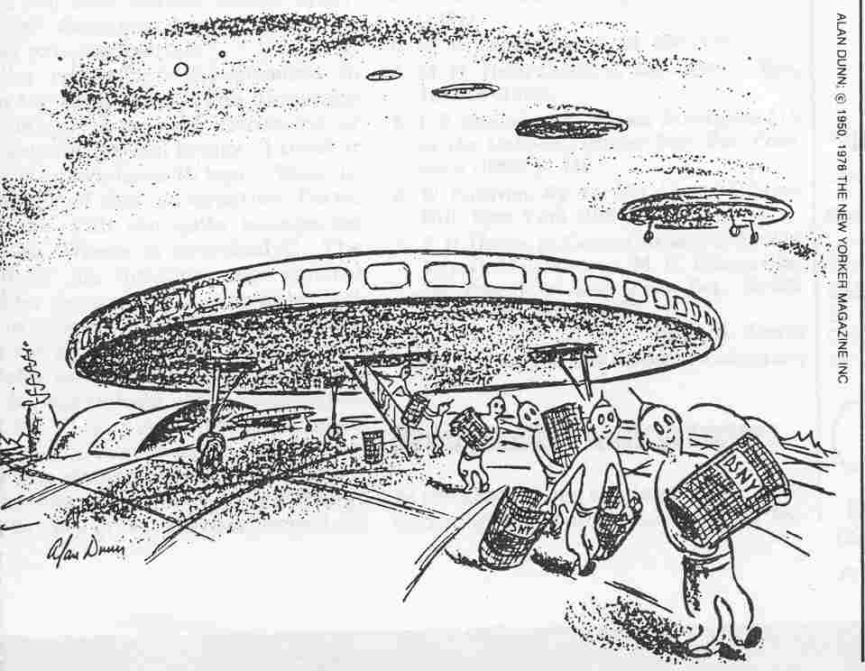
The astrobiology link
Extraterrestrial signatures of life – the next fifty years
Meteors – Antartic collection
Planets and satellites (Mars, Europa) - Rovers
Atmospheres of extrasolar planets – spectroscopy, interferometry
Planetary and galactic habitable zones
Extraterrestrial intelligence – SETI
how frequent (if at all)?
the Fermi question or paradox
From the New Yorker 20 May 1950,
Physics Today August 1985
Notes:
Panel of bullets – origin of life, dna, exoplanets, extemophiles and extension of habitable zones planetary and galactic
9THIS WILL BE A FIRST ROW WITH SMALL PICTURES, MAYBE REPEATS
Can we find signatures of life? Mars, Jovian planets like Europa (slightly related to Amanda engineering), exosolar planetary atmospheres. Second row with signatures
Fermi question and Fermi question generalized (Rare earth). SETI. Third row. In a discussion of UFO’s Fermi may have asked “Where is everybody?” His point may have been that an interstellar population explosion only takes time even with slow space travel.

Slide 26
Anthropic Principle – a perfect universe for us
Brandon Carter (73)
?
“What is Life?”
Erwin Schrðdinger (1944)
Cosmology and the standard model
James D. Bjorken*
Stanford Linear Accelerator Center, Stanford University, Stanford, California 94309
Received 21 October 2002; published 26 February 2003
PHYSICAL REVIEW D 67, 043508 (2003)
“… it is well known, … that other properties of our universe are very finely tuned and will only exist over a quite small bandwidth. We shall pay special attention to such ‘‘anthropic’’ constraints, as discussed for example in the book by Barrow and Tipler and will be interested in the bandwidth in R for which they are satisfied.”
…. Crucial to the properties of nuclear and atomic matter are the values of the fine-structure constant ~here constrained to a reasonable range of values, the ratio of electron to proton mass, the ratio of pion to proton mass, and the neutron proton mass difference
….Finally, we may consider the mechanism for producing carbon in stars. This depends upon the existence of the anthropically famous triple-alpha reaction …with the resonance in ¹²C predicted by Hoyle … together with the absence of a crucial level in ¹⁶O.”
Notes:
Our universe selects us. The universe is the way it is because we exist. A problem for me is that we can’t seem to draw conclusions.
Another factor to consider is what is “us”/, for example robots, etc. The galactic and cosmological habitable zones.
“… it is well known, … that other properties of our universe are very finely tuned and will only exist over a quite small bandwidth. We shall pay special attention to such ‘‘anthropic’’ constraints, as discussed for example in the book by Barrow and Tipler and will be interested in the bandwidth in R for which they are satisfied.”…Crucial to the properties of nuclear and atomic matter are the values of the fine-structure constant ~here constrained to a reasonable range of values, the ratio of electron to proton mass, the ratio of pion to proton mass, and the neutron proton mass difference…. Finally, we may consider the mechanism for producing carbon in stars. This depends upon the existence of the anthropically famous triple- a reaction …with the resonance in ¹²C predicted by Hoyle … together with the absence of a crucial level in ¹⁶O.” .”…Crucial to the properties of nuclear and atomic matter are the values of the fine-structure constant ~here constrained to a reasonable range of values, the ratio of electron to proton mass, the ratio of pion to proton mass, and the neutron proton mass difference…. Finally, we may consider the mechanism for producing carbon in stars. This depends upon the existence of the anthropically famous triple- a reaction …with the resonance in ¹²C predicted by Hoyle … together with the absence of a crucial level in ¹⁶O.”

Slide 27
Technical revolutions of the last half century
ORIGIN
OF
UNIVERSE
COSMOLOGY
TOOLS
PARTICLES
SPACE
ASTRO-
BIOLOGY
QUANTUM
MECHANICS,
ANTHROPIC
PRINCIPLE?
DNA
COMPUTING
Notes:
NOT ON CHART-Geology. May be something else. Also accelerators.
Two missing links – cosmology to DNA (athropic), particles to space.
I assume particles means accelerators also.
Space includes astronomy
This is a slide I will keep coming back to.

Slide 28
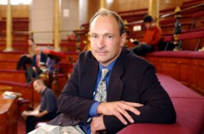
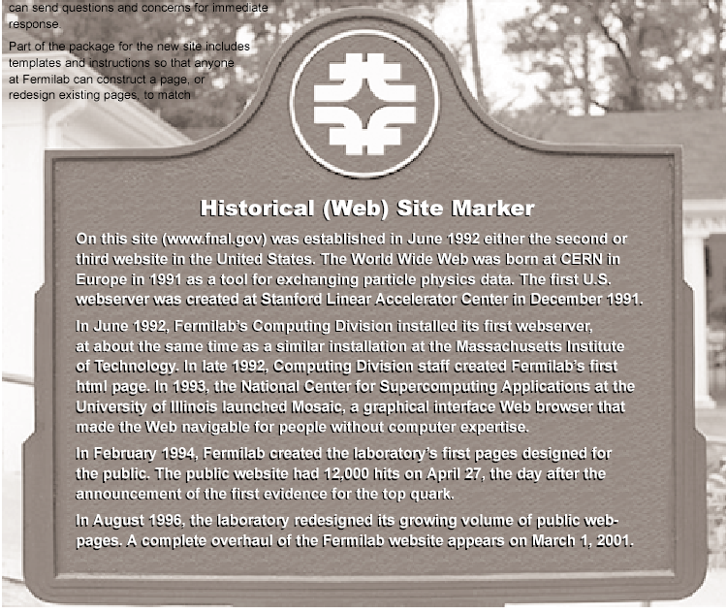
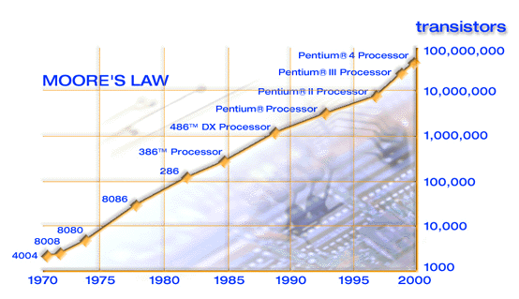
Computing
This computer – 18.5 Gbytes, 650 MHz.
Tim Berners-Lee
http://www.intel.com/research/silicon/mooreslaw.htm
Notes:
History (do as a personal history)
Moore’s law
WWW Berners-Lee, Fermi historical site
We are in the middle of this including some distressing problems like viruses.

Slide 29
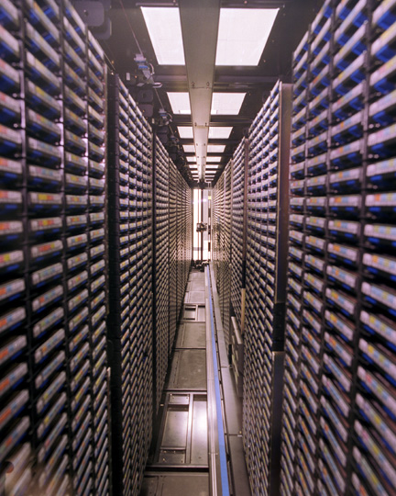
Size of some databases
Human genome-3 billion DNA base pairs, actual information content is on the order of 0.05 Gbytes (about size of Word)
Old Fermilab tape robot – 6*10⁶ Gbyte – mostly colliding beam, Monte Carlo
Sloan Telescope at Fermilab – 1000 Gbytes
10⁶ Gbytes of material printed every year
Typical education through graduate school subsumed in 1-10 Gbytes
Lifetime of images stored on DVD might be 1000 Gbytes
Knowledge base in a human brain-0.25 to 2.5 Gbyte range (10¹¹ neurons). 6*10⁹ people gives 1.5 to 15*10⁹ Gbytes to profile everyone on earth
Old Fermilab tape robot

Slide 30
Computing and the future
Computing speed
Speed of human brain - 200*10³ Giga computations/s (Kurzweil) or
10⁵ times this computer.
Kurzweil calls the crossover a singularity
(maybe better is “phase change”)
Cross over point is 2020 to 2030 at present rate of progress
QCD - 1000 Giga Flops – getting in range
Quantum computing
Problems and challenges
viruses
the approach of the Kurzweil “singularity” (or phase change)
qualifying internet and World Wide Web
qualifying programs
and …theories of computing, knowledge, mind
Notes:
SETI signals, what can be sent.
Other technologies, e. g. quantum computing

Slide 31
Technical revolutions of the last half century
ORIGIN
OF
UNIVERSE
COSMOLOGY
TOOLS
PARTICLES
SPACE
ASTRO-
BIOLOGY
QUANTUM
MECHANICS,
ANTHROPIC
PRINCIPLE?
ROBOTIC
CONTROLS
SOLVING
GENOME
DNA
COMPUTING
ORIGIN
OF
LIFE
Notes:
NOT ON CHART-Geology. May be something else. Also accelerators.
Two missing links – cosmology to DNA (athropic), particles to space.
I assume particles means accelerators also.
Space includes astronomy
This is a slide I will keep coming back to.

Slide 32
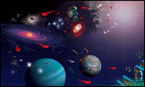
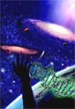
The bottom line
NASA Origins Program
Particle physics and cosmology linked - explains much of the universe
Biology has become a mathematical science
Scientific experiments have moved into space
Computers and computer science are reaching human capabilities
We may find extraterrestrial life
Notes:
Particle physics has made direct contributions, instrumentation, etc, to other fields.
…

Slide 33
Questions?

