Slide 1

From Wall Street to the Laboratory….
April 13, 2005
Dr. Howard W. Bruckner
Daniel M. Laifer
William A. Schubin

Slide 2
A lawyer, a banker and a scientist go into a bar……

Slide 3
Management Team
Dr. Howard Bruckner is the Director of Medical Oncology at Lutheran Medical Center in New York and has over 30 years experience as a clinician and researcher. He has extensively published in the area of innovative multidisciplinary chemotherapy
Daniel Laifer is an attorney with experience at several large corporate law firms and a hedge fund
William Schubin is a former investment banker who spent several years at a hedge fund

Slide 4
The Oncovation Companies
Founded in March 2004
Commercialize novel work of Dr. Howard Bruckner focusing on drug interaction and chemosensitivity
  Unique record of “bench to clinic” translational success

Slide 5
The Oncovation Companies
Oncovation Pharmaceuticals develops novel drug combinations that strategically add to the efficacy of “standard” and even “standard failed” drugs
Oncovation Laboratories is a innovative laboratory services company focusing on oncology
  individualized treatment regimens
  triage support for clinical trials

Slide 6
Viable Business
Proprietary technology
Commercially viable
Market acceptance

Slide 7
Academic Approach
Desire to publish early
Share knowledge to promote innovation
Perceived tendency to dabble

Slide 8
Success breeds success
Promoting protected technologies yields partners and further opportunities
Viable products addressing obvious needs attract substantial funding and collaborations
Developing profitable technologies creates interest for the next project

Slide 9
Work With Us
Along with novel compounds, we reposition “failed” therapeutics
Our platform is particularly robust, focusing on cytotoxins, cytostatics, signal pathway inhibitors, monoclonal antibodies and hormones
  Anti-angiogenesis therapeutics and compounds are also well-suited for our technology

Slide 10
If you build it, they will come…
We invite proposals from scientists and academics who want to commercialize their discoveries and build innovative companies with the potential to change the world (or at least part of it)

Slide 11
New Solutions for Predictive
Testing of Ex Vivo Human Tumors
For Selected Patient Practices
and Strategic Drug Development
Howard W. Bruckner, M.D.

Slide 12
Oncovation’s Approach
Five new lines of development
Clinically validated; Prospective development
Superior technology
  More questions (quantitative)
  Better questions and discover new objectives (qualitative)
Model-based realistic objectives.
  Individual and empirical
  Opportunities for rapid Phase III validation
Recommendations are supportable
  Physician/patient friendly empirical therapy with no conflicts
  Empowers drug development, rescues fallen angels
Applicability to five classes of therapeutics
  Many ideal agents, multiply success

Slide 13
Clinical Validation
Retrospective ovarian [response] Cisplatin – taxol
Retrospective breast [response]
Prospective development, empirical regimens
pancreatic, bilary, gastric, small bowel, lung (prostate), ovarian
[Response and survival, reversal of resistance]
Prospective individual ATC, gastric, colon, ovarian and breast
[Response and survival, reversal of resistance, complete remissions]
Prospective ovarian – Phase III [response (survival)]
‘too good’, oncologists abandoned standard controls early in trial

Slide 14
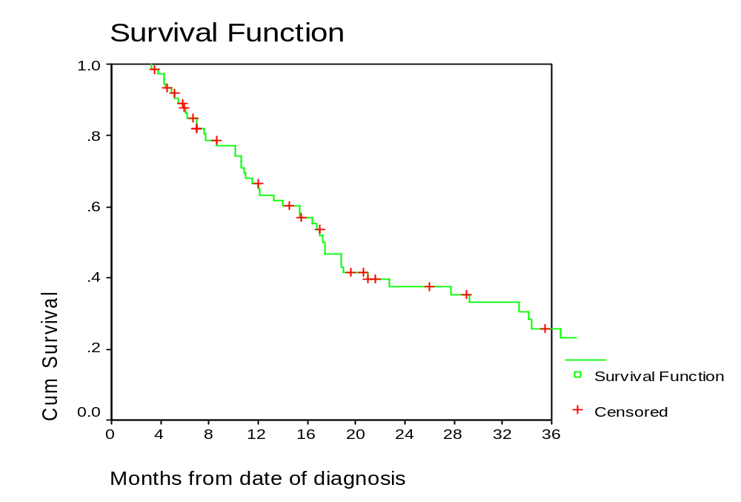
G-FLIP
Includes over 100 patients
median survival of 17 (15-22) months
Reproduced in Stage III, previously treated, also patients failing adjuvant therapy and radiotherapy, six series
Note: ~ 40% two years

Slide 15
Clinically Demonstrated
Response – 40-65% (pair) - individual
  Additional 50% vs. predicted empirical rate – disease specific
Resistance – 90% predictive
  Reversing resistance – breast, ovary, pancreatic, colon
  Drugs get a second chance
Survival – pancreatic, cholangio, gallbladder, lung, stomach
  Low dose intensity very feasible, competitive, improved quality of life
  Heterogeneity – turned to advantage only with LDT; ovary, breast, pancreatic
  ___________________
NCI ‘11% benefit’ in current empirical trials
Ex vivo 40-60% benefit and multiple choices (triage) improved
Better than a new drug for every major disease

Slide 16
Oncovation’s TCR Assay
Superior technology
Sensitivity (2-5,000 cells)
  Better standard error and dose response
  Always full dose response curves
  Added tests/samples analogue and mechanism confirmation
Sets higher threshold for discovery
  Tests true resistance
Tests at low concentrations
High yield
  90% of tumors provide information (no colonies)
Speed (6-7 days)
Separation (other cells), proprietary
  Path quality check(s) – extra wells, ability to duplicate
  Follow-up, cryopreserve and short term nude mice
  Fewer laboratory artifacts
More relevant treatment history (prior drugs)
Representative mixed tumor population

Slide 17
Better Questions; Algorithm
Turns tumor heterogeneity to an advantage
Disease specific algorithm(s)
Strategic
  Trade single best pair for multiple singles and pairs
  Recruit added drugs otherwise lost
Avoid antagonism
Synergism
  single drug activity doesn’t predict benefit in combination, 50% fail, but the drug is good with another partner
Reverses Extreme Drug Resistance
Low doses (1/4- 1/8 concentration) avoids loss of effective drug
Can focus on a specific drug
Translational priority for qualitative findings
ADM/TAXOL e.g., NOV/ADM, PT/DT, CIS/PT, LOHP/IRINO

Slide 18
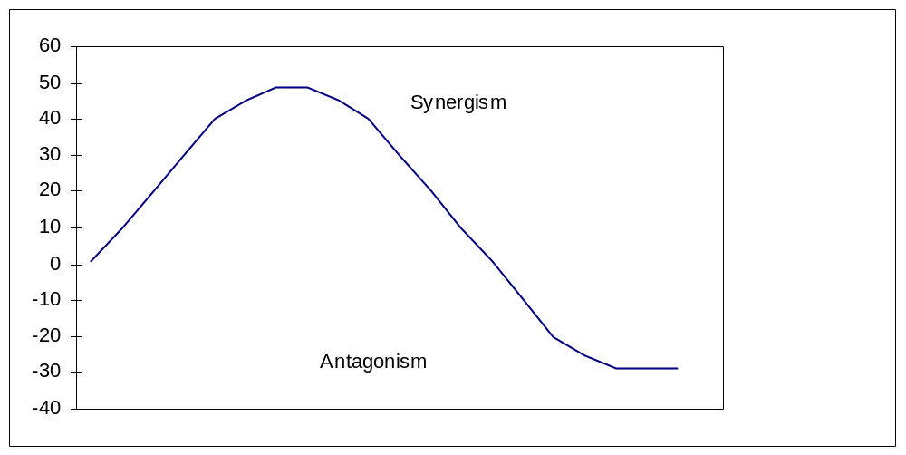
Synergism vs. Antagonism

Slide 19
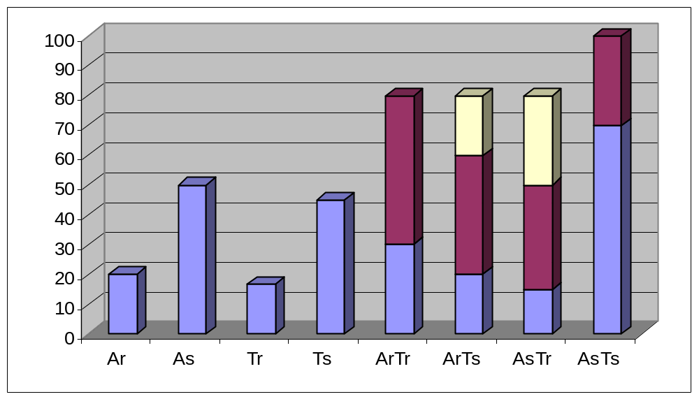
Reversing Resistance
Type I – [R¹&S²] > [R¹]+[S²] or S¹+S²
Type II – [R¹&R²] > [R¹] +[R²] or S sometimes [S¹]+[S²] or [S¹&S²]
Example - Clinical [G-FLIP] pancreatic, A/N → T/P - ovarian, breast
Metronomic approach
  Resistant Pancreatic Cancer – Avastin
  MDR Models (Kerbel)

Slide 20
Strategic Direction
Assay recruits additional drugs and sequential regimens
Better partners avoid antagonism and add potency
  95% reasonable and compatible with empirical choices
  First empirical choice/ half can be improved
  25% end stage can be improved
Compatible with metronomic, biologic therapy

Slide 21
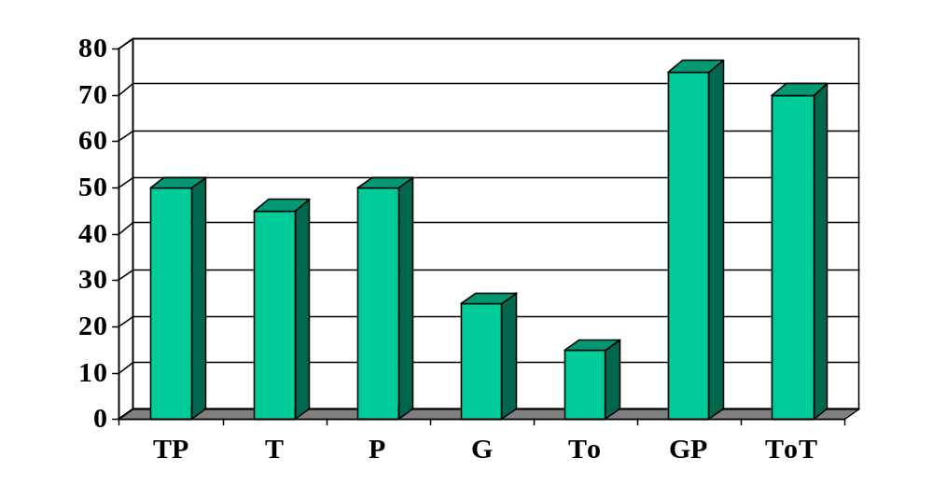
Strategic Partnering
Example: Taxol Platinum [1+] Gemcitabine [0], Taxol [1+], Platinum [1+], Topotecan [0]
Gemcitabine Platinum [2+]
Topotecan, Taxol [2+]

Slide 22
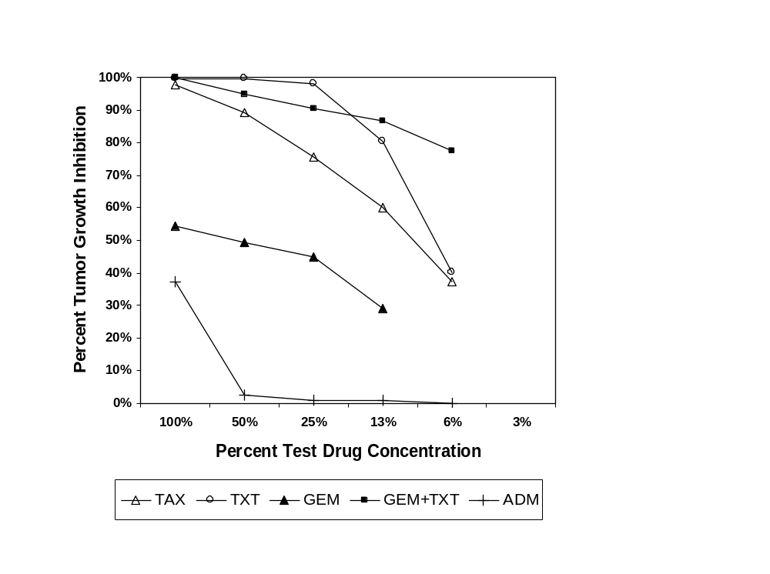
Breast Cancer Dose Response Curve
TXT > A
G not alone
TXT > TAX (?)
GT not strategic

Slide 23
Disease Specific Panel Positions
Position (Ex vivo)/Response Rates (empirical)
Translation ratios – 6 point dose response curves
Best 30th percentile can beat best 20th percentiles:
  30/50 vs. 20/20
50% inhibition can beat 70% inhibition
40/60 vs. 20/20

Slide 24
Mathematical Modeling
Identifies Highest Yield Applications
Individual – when empirical prospects are intermediate
  < 30-40% response, median < 1 year survival
  Many competing options exist – heterogeneity –
  Ideally 3 options @ 20% each: ε 40 + 12 + 12 + 12
  For example: GOLF, TAG, G-FLIP
Choice of research, triage to clinical trials, Phase I, II, III
  Efficiency and safety
Rapid development, design, prioritization tool, tests can parallel ongoing trials [five trials in one, avoid losers]
Assays improve therapy for the majority of cancer patients

Slide 25
Phase III Rapid Validation Priorities
< 30-40%, response survival < 1 year MST; crossover option ≥ 3
Examples with five options
BREAST – secondary response
[ADM/TAX] [XELODA/TAXOTERE] GEM, NAV, HERC, CISP, TOPO
GASTRIC – primary
[FU/CISP] TAXOL IRINOTECAN EPIRUBICIN MITOMYCIN TAXOTERE
LUNG – primary or secondary
[TAX/CISP] GEM, NAV, IRINOTECAN, IPX, MMC
Each more than 100,000 patients per year per disease application

Slide 26
Model Selected Objectives
(rapid < 12 months, 18 months)
Prospective randomized trial – Primary objectives
  Response rate 40 → 64-76%
  Relative risks (0.66), improve survival, median 12+ months
Secondary objectives - Solutions to heterogeneity and crossover choices
  Stable disease
  Added test of development options (look ahead)
  Validation assay, drug disease specific
  (20 → 30-40%)
Triage assistance
  Ex vivo and clinical 10-20% → 40%, 40% → 60%
  Phase II individual trials or consortium
  Phase I consortium of trials
  Parallel testing of new drugs, regimens, next options (look ahead)

Slide 27
Realistic Objectives
• Empirical plus options
  Limited questions simplify, biopsy volume ↓ size
  Disease and prior therapy specific
Selected development options – look ahead
  Support selected practices (criteria), Multi-disciplinary, Uniform feedback, Assistance, Customized protocols
  High Volume - 50-100 (disease and protocol specific)
Rescue fallen angels
Academic Leadership
Orphan Diseases
Pediatric Leadership
Individual Care, Disease Specialists
Spin-off development parallel tests, specific assays, genetic support, tissue pathology, micro assays, signal phosphorylation apoptosis

Slide 28
New Era for Drug Development
New Drug Questions and Opportunities
Cytotoxins Concentration; schedule; interactions; select best partner
Cytostatics Impact on cytotoxins
Biologics Impact alone and on cytotoxins (added methods)
Hormones Impact on cytotoxins, (added methods, polypeptide, steroid)
Antibodies Impact alone and on cytotoxins (interaction), Erbitux, Herceptin
Micro gell electrophoresis assays
Micro apoptotic assays
Agonist – antagonist interactions +/- Erbitux
_____________
New drugs, many chances to pick a winner,
New methods, powerful and qualitatively different
Cannot do it the old fashioned way, unique questions

Slide 29
Top 10 List of Benefits of Oncovation Methods
Combination therapy errors corrected
Reverse high dose resistance, solutions to EDR
Mathematical models and evidence-based development
Counterintuitive solutions for clinical translation
Better clinical support, physician-friendly goals
Parallel development evidence base looks forward
Clinical protocols facilitate use of findings
Clinical success translation hierarchy criteria
Improve market share of second line drugs, second chances
Efficient triage for individuals and drug development

Slide 30
Thank You
Please feel free to contact us with any questions or comments
Oncovation LLC
74 Broad Street
New York, NY 10004
212-514-2422
info@oncovation.com

