Slide 1

A Tale of Two Integrated Science Centers
Your Logo
Here
The Florida Integrated Science Center
and the
Alaska Science Center

Slide 2
Conversations with FISC staff have made it clear we need to know more about the situation at the Alaska Science Center (ASC)—the other large-scale attempt to develop an integrated science center, and one that pre-dates the FISC.
Conversations with the Alaska Center Director and some of the staff indicate clearly that the integrated center there has not failed. Change has been difficult for some, and others have resisted change. But many have embraced or accepted change and are moving forward.
The following is a comparison of the two centers. The comparisons are not one to one. They are two different centers in personality, size, distribution and mission.
Questions about the Alaska Science Center

Slide 3
Purpose of the Integrated Science Center
ASC: Create a single USGS organization where there were four in order to better address for the natural resource issues & hazards assessments in Alaska & circumpolar regions, with emphasis on those important to the DOI.
FISC: Bring together Florida-based units of the USGS in ways that will provide better natural science to the DOI and the people of Florida, the Southeast, and the Nation.

Slide 4
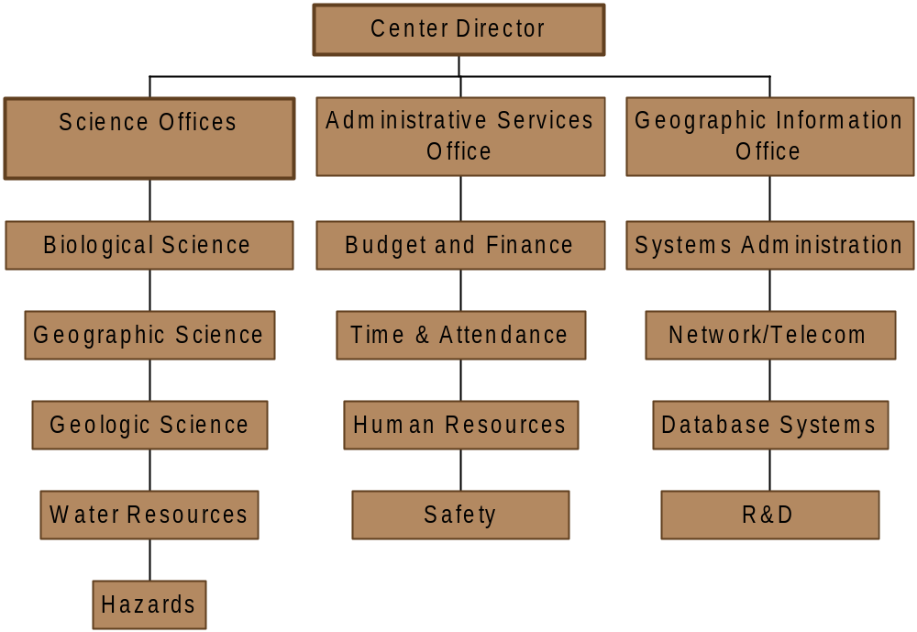
Organizational Structure: ASC 236 employees, 7 locations
ASC has Office Chiefs instead of Deputy Directors.
Facilities and Warehouse are part of Administrative Services.

Slide 5
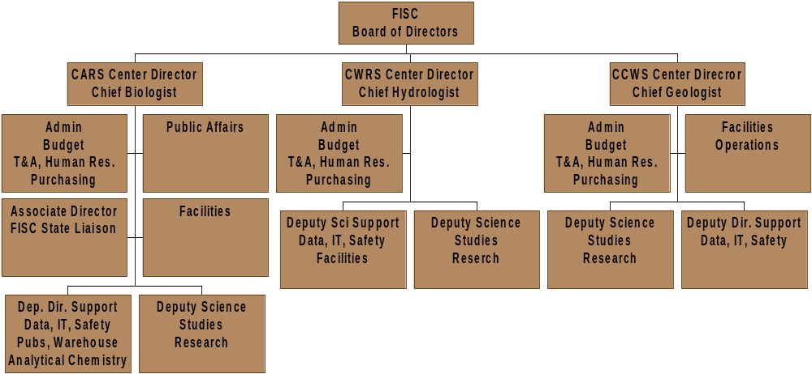
Organizational Structure FISC 480 employees, in 12 locations

Slide 6
Identified Hurdles to be Overcome
ASC
Most scientists & support staff in Anchorage located in two buildings several miles apart
Cultural differences among the four disciplines
Few common business practices
Differing levels of admin. support for the disciplines
No centralized line authority
No major ongoing efforts in integrated science
FISC
Scientists & support staff in 12 locations across 480 miles
Cultural differences among our three disciplines
Few common business practices
Differing levels of admin. support for the disciplines
No common vision
Consolidating IT, Pubs and Outreach

Slide 7
Communication Musts: ASC
The Center Director is officially a Deputy Regional Director and a member of Western Leadership Team
DRD/Center Director is senior USGS official in AK; meets regularly with senior DOI officials; provides scientific leadership for Secretary & DOI bureaus in AK
Office Chiefs (OC) represent ASC at discipline meetings & with cooperators
DRD/CD represents Secretary on North Pacific Research Board
Engage Western Region External Affairs to highlight USGS activities and products
Create fledgling ASC website
Create a new ASC fact sheet & poster

Slide 8
Communication Musts:FISC
A single Regional Executive represents FISC to the Regional Leadership Team
We must use mechanisms (e.g. e-mail aliases) to communicate same information to all FISC staff at the same time
We must continue to use our Intranet site to provide up-to-date information that is easily accessible to everyone
We must constantly improve all forms of communication, outreach, and information technology
We must identify roles and responsibilities and sources of directives and requests: Reston, FISC, CARS, CWRS, CCWS
We must expedite development of FISC fact sheets for partners and the public
We must try harder!!!

Slide 9
Ongoing and Future Directions: ASC
Enhance the effectiveness & efficiency of the ASC’s admin services to ASC staff
Implement USGS common business practices
Capitalize on opportunities to more fully integrate USGS science in AK
Participate in the USGS science planning process to increase the width & depth of USGS science in AK
Finalize draft ASC strategic plan
Develop plan for construction of new science building
Increase public awareness of utility of USGS science in AK & the Arctic
Detail the product models available and list specific prices for each model and additional options.

Slide 10
Ongoing and Future Directions:FISC
Enhance integrated science activities underway where needed;
Identify other needs and opportunities for integrated science;
Develop more effective ways of working together across disciplinary boundaries;
Apply a greater range of expertise to priority issues and problems;
Acquire a fuller understanding of natural systems and their responses;
Seek effective partnerships with universities that give us access to specialized expertise and scientific support services and help us to meet our facility needs;
Continue to provide our customers and constituents with traditional services and make them aware of our enhanced capabilities in interdisciplinary and integrated science.

Slide 11
Lessons Learned: ASC
Communicate
Team Build
Strive for consensus
Be flexible
Think “out of the box”
Empower subordinates
Get & maintain strong support from top USGS leaders
Think integration
Exercise “organizational patience”

Slide 12
Lessons Being Learned: FISC
Communicate the vision of the FISC
Listen to and heed what staff have to say
Strive for consensus, but don’t shrink from making hard decisions when necessary
Break out of the box
Think integration when looking for science needs and opportunities
Win and maintain the support of regional and national USGS leadership
Develop a strategic science plan as soon as possible so decisions can be evaluated in terms of science goals
Find ways to increase efficiency of support services while delivering more effective services to scientists

Slide 13
Rules for Success: ASC
The ASC was created for the good of the bureau
Line supervision through disciplinary supervisors to the DRD; in consultation with Regional Executives (REXs)
Staffing decisions of disciplinary supervisors will be collaborative between DRD and REXs
Programmatic leadership & responsibility will be the responsibility of the REXs; in consultation with DRD
Historic responsibilities will be honored
Relationships to customers, clients, & partners will be fostered by the ASC, not impaired
The Western Region will continue to find opportunities for increased program support in AK for all USGS scientists

Slide 14
Rules for Success: FISC
Remember that the FISC was created for the good of the bureau and for the public it is committed to serve.
Do nothing unless it will benefit our PEOPLE, our PROGRAMS, and our PARTNERS; we must make:
  new opportunities for career development and enhancement;
  excellence and relevance of science a major goal in all decisions;
  ever better products for our customers.
Empower our scientists to make important decisions concerning the future of our organization.
Be prepared to change course when mistakes are made
Continue to rely on the Eastern Region to find opportunities for increased program support of the FISC and our scientists.

