Slide 1
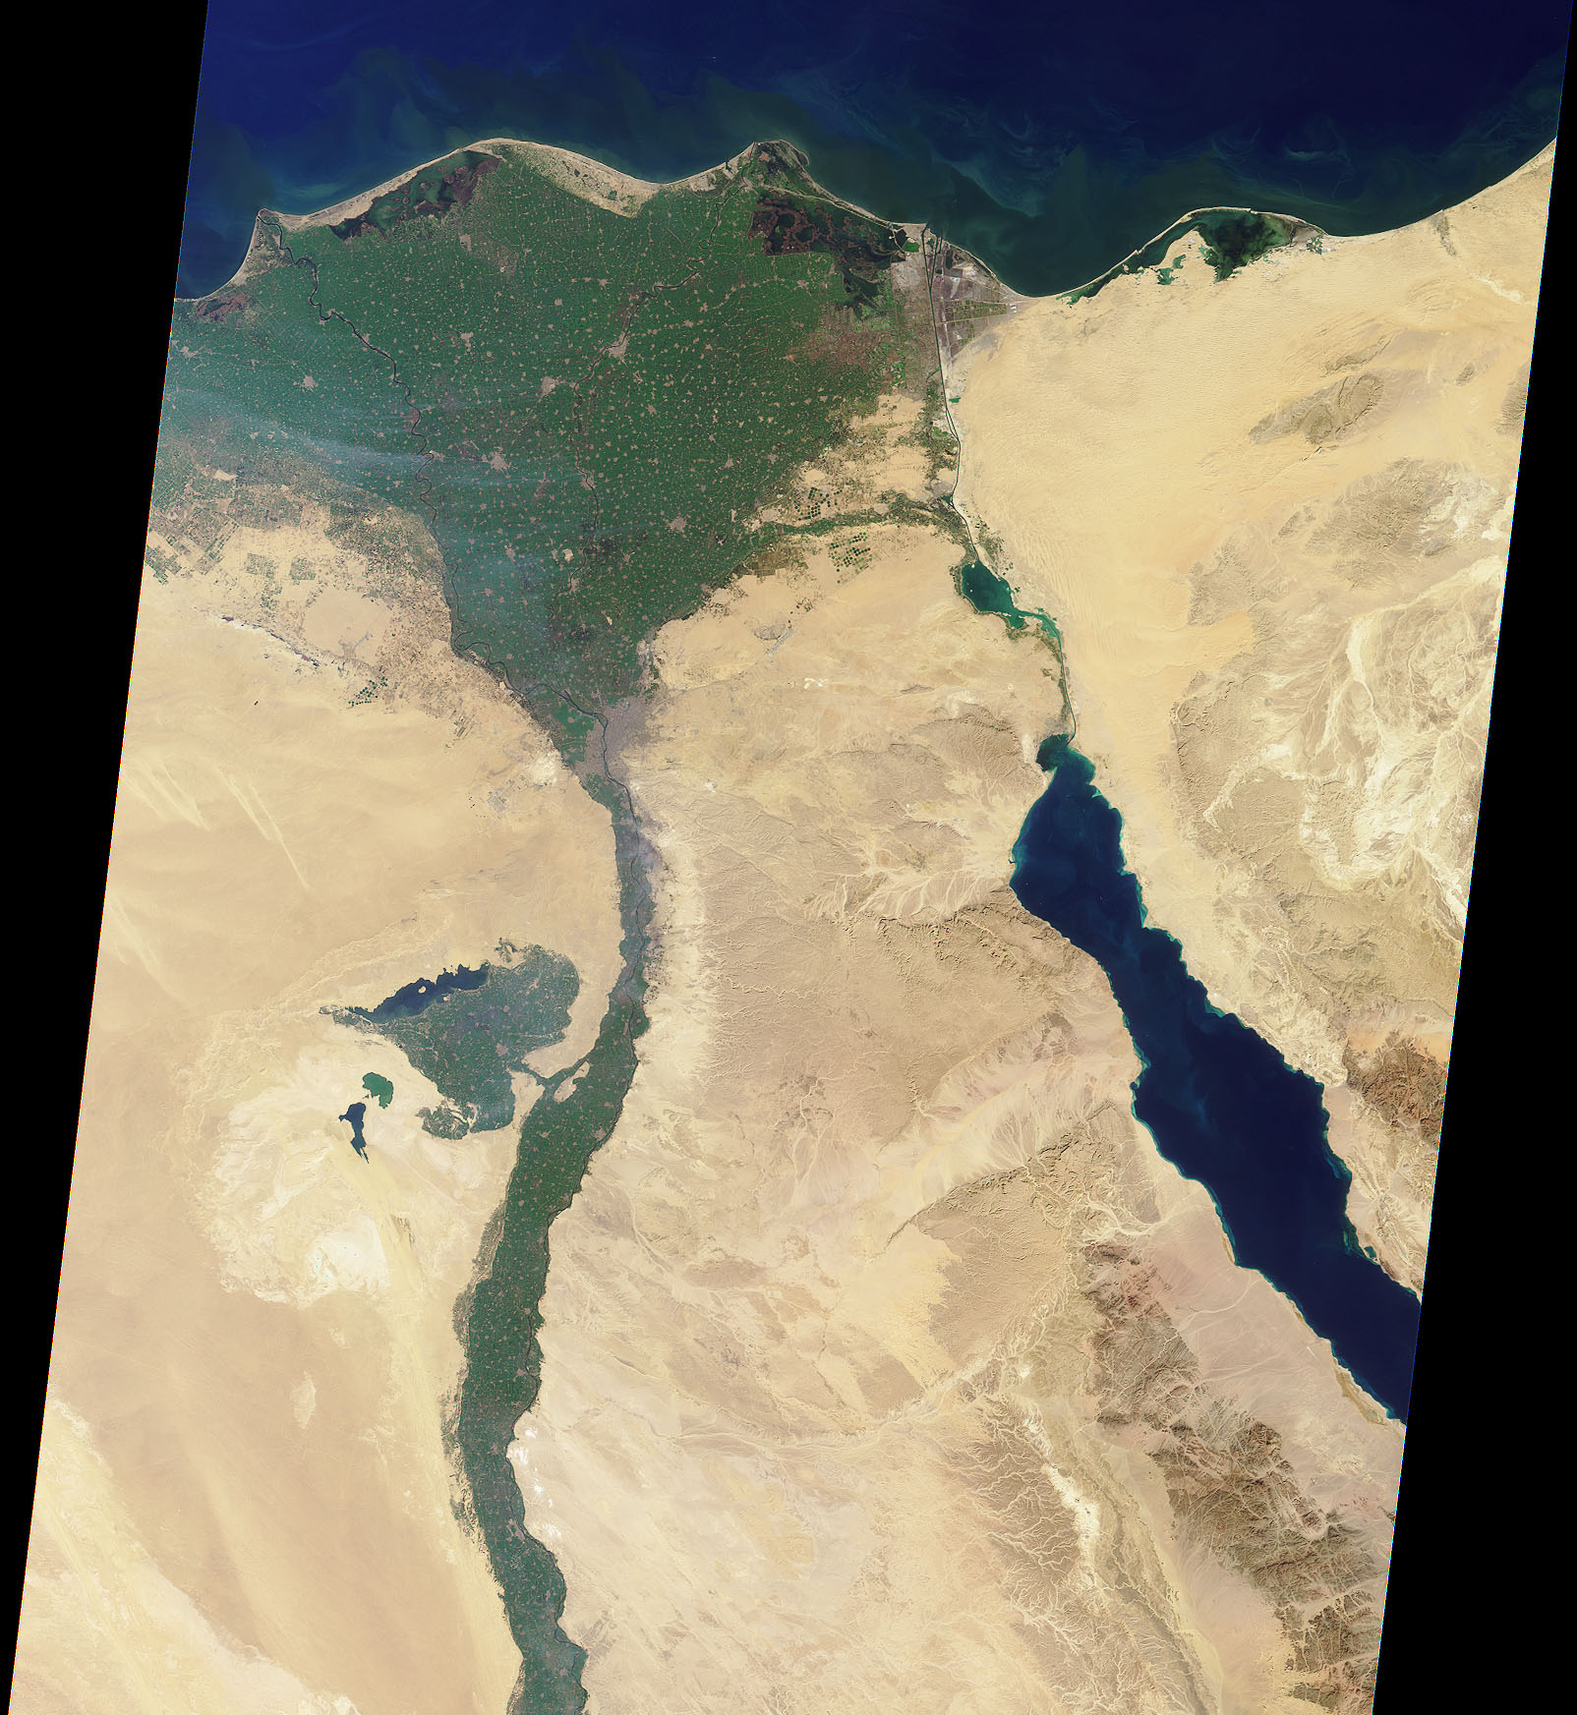

The
Nile
30 January 2001
Image credit:
NASA/GSFC/LaRC/JPL
MISR Team
Notes:
This image of the northern portion of the Nile River was captured by MISR's nadir camera on January 30, 2001 (Terra orbit 5956). The Nile is the longest river in the world, extending for about 6700 kilometers from its headwaters in the highlands of eastern Africa.
At the apex of the fertile Nile River Delta is the Egyptian capital city of Cairo. To the west are the Great Pyramids of Giza. North of here the Nile branches into two distributaries, the Rosetta to the west and the Damietta to the east.
Also visible in this image is the Suez Canal, a shipping waterway connecting Port Said on the Mediterranean Sea with the Gulf of Suez. The Gulf is an arm of the Red Sea, and is located on the righthand side of the picture.

Slide 2
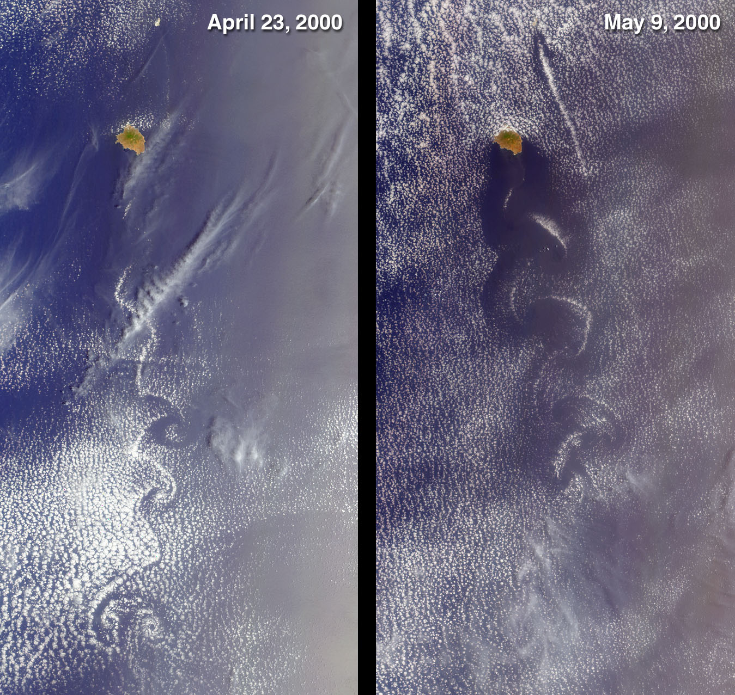
Swirls of
Lace
Image credit:
NASA/GSFC/LaRC/JPL
MISR Team
Notes:
These MISR nadir-camera images from April 23, 2000 (Terra orbit 1855) and May 9, 2000 (Terra orbit 2088) show cloud swirls, like delicate lace, forming patterns known as von Karman vortex streets. The turbulent atmospheric eddies form in the wake of an obstacle, in this instance the 1050-meter-high summit on the island of Socorro, Mexico. The surrounding clouds make the vortex patterns visible. To the northeast, much subtler disturbances are associated with the tiny Isla San Benedicto. Both islands are part of a group known as the Revillagigedo Archipelago, and are located about 400 kilometers equatorward of the southern tip of Baja California.
Each of these images is approximately 180 kilometers wide and 350 kilometers long. The von Karman vortices are named for aerodynamicist Theodore von Karman, one of the founders of the Jet Propulsion Laboratory.

Slide 3
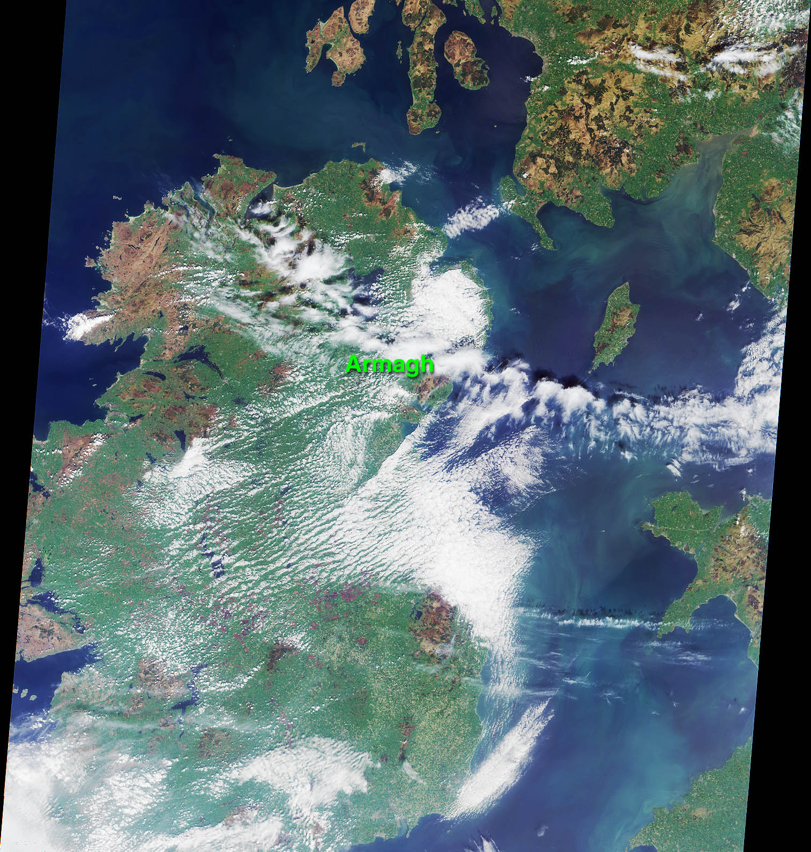
An Irish Tale:
One City,
Two Asteroids
5 May 2000
Image credit:
NASA/GSFC/LaRC/JPL
MISR Team
Notes:
This MISR nadir-camera image of Ireland was acquired on May 5, 2000 during Terra orbit 2026. The location of the town of Armagh in Northern Ireland is marked. Armagh is the site of the 200-year-old Armagh Observatory. The observatory's contributions to astronomical research were recently commemorated by the official naming of two asteroids, "ArmaghObs" and "Ardmacha". The latter is the ancient Gaelic name for the town, which was founded in 445 A.D. by St. Patrick.
The asteroids were discovered in July 1987 by planetary astronomer Eleanor Helin, Principal Investigator of JPL's Near-Earth Asteroid Tracking (NEAT) program. The new names were published in the January 2001 Minor Planet Circular of the International Astronomical Union.
The Irish Sea and the Isle of Man are located on the right-hand side of this image. Southwestern Scotland is visible in the upper right corner, and portions of northwestern Wales can be seen in the lower right.

Slide 4
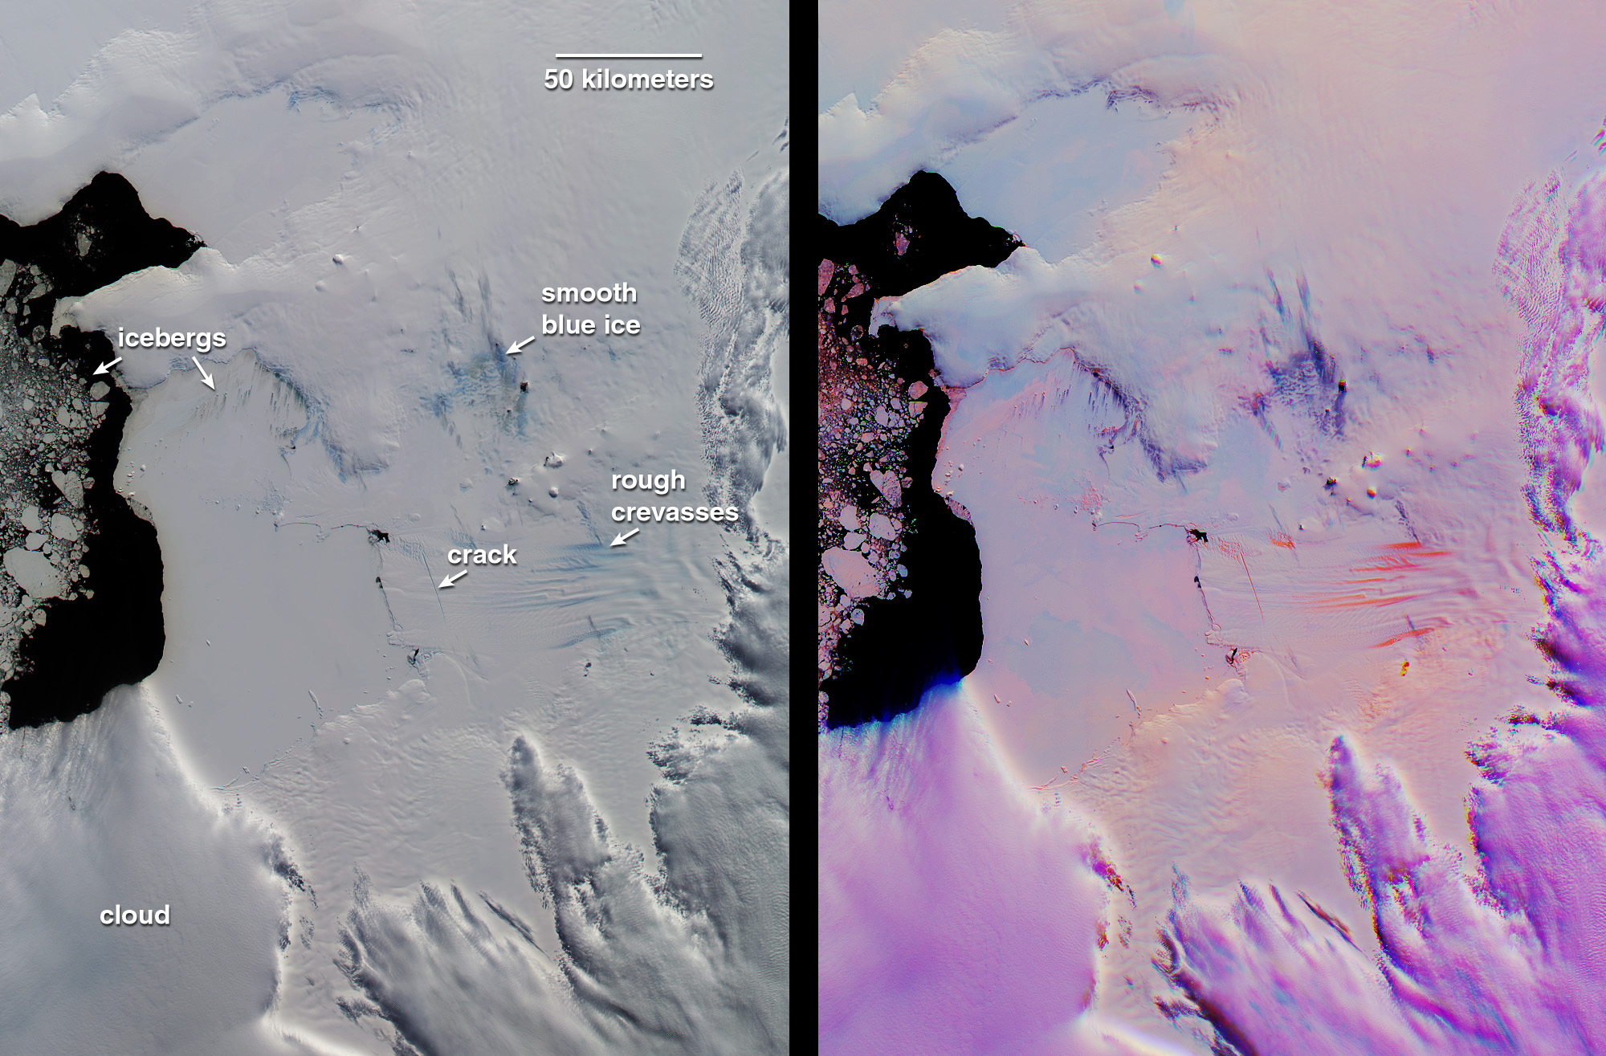
Pine Island Glacier, Antarctica
12 December 2000
Image credit:
NASA/GSFC/LaRC/JPL
MISR Team
Notes:
This pair of MISR images of the Pine Island Glacier in western Antarctica was acquired on December 12, 2000 during Terra orbit 5246. At left is a conventional, true-color image from the downward-looking (nadir) camera. The false-color image at right is a composite of red band data taken by the MISR forward 60-degree, nadir, and aftward 60-degree cameras, displayed in red, green, and blue colors, respectively.
Color variations in the left (true-color) image highlight spectral differences. In the multi-angle composite, on the other hand, color variations act as a proxy for differences in the angular reflectance properties of the scene. In this representation, clouds show up as light purple. Blue to orange gradations on the surface indicate a transition in ice texture from smooth to rough. For example, the bright orange "carrot-like" features are rough crevasses on the glacier's tongue. In the conventional nadir view, the blue ice labeled "rough crevasses" and "smooth blue ice" exhibit similar coloration, but the multi-angle composite reveals their different textures, with the smoother ice appearing dark purple instead of orange. This could be an indicator of different mechanisms by which this ice is exposed. The multi-angle view also reveals subtle roughness variations on the frozen sea ice between the glacier and the open water in Pine Island Bay.
To the left of the "icebergs" label are chunks of floating ice. Additionally, smaller icebergs embedded in the frozen sea ice are visible below and to the right of the label. These small icebergs are associated with dark streaks. Analysis of the illumination geometry suggests that these streaks are surface features, not shadows. Wind- driven motion and thinning of the sea ice in the vicinity of the icebergs is one possible explanation.
Recently, Robert Bindschadler, a glaciologist at the NASA Goddard Space Flight Center discovered in Landsat 7 imagery a newly-formed crack traversing the Pine Island Glacier. This crack is visible as an off-vertical dark line in the MISR nadir view. In the multi-angle composite, the crack and other stress fractures show up very clearly in bright orange. Radar observations of Pine Island Glacier in the 1990's showed the glacier to be shrinking, and the newly discovered crack is expected to eventually lead to the calving of a major iceberg.

