Slide 1
Improved aerosol retrieval from combined
OMI-MODIS observations
S.K. Satheesh¹, O. Torres³, L.A. Remer²
S. S. Babu⁴, V. Vinoj¹, T.F. Eck^{5,2} , R.G. Kleidman^{6,2} and B.N. Holben²
¹Indian Institute of Science, Bangalore, India.
²NASA Goddard Space Flight Center, Maryland, USA
³Department of Atmospheric and Planetary Sciences,
Hampton University, USA
⁴Space Physics Laboratory, Vikram Sarabhai Space Centre,
Thiruvananthapuram, India
⁵ Goddard Earth Science and Technology, UMBC
⁶ Science Systems and Applications Inc.

Slide 2
A tale of 2 sensors…
OMI: hyperwavelength capability from the VIS to the UV
standard aerosol retrieval uses 354 and 388 nm
13 x 24 km (nadir) pixel size
aerosol signal is deviation from Rayleigh scattering
sensitive to aerosol layer height
sensitive to aerosol absorption
MODIS: 36 wavelength channels from 441 nm to thermal infrared
traditional aerosol retrieval uses 7 channels 466 to 2130 nm
500 m (nadier) pixel size
aerosol signal is derived from deviation from assumed
surface reflectance
sensitive to aerosol particle size
not sensitive to either layer height or absorption

Slide 3
Sensitivity study
Work by
Viktor Zubko
base
Δρ
ω_{ο}
Particle
size
0.4
0.6
0.8
1.6
1.8
2.0
2.2
wavelength
The UV is sensitive to absorption. The midIR to size.
We will combine OMI and MODIS to cover this range.

Slide 4
Standard OMI retrieval:
Retrieves aerosol optical depth (AOD)
and aerosol single scattering albedo (ω_{o})
For 5 different assumptions of aerosol layer height
z1 | AOD1 | ω_{o}1
z2 | AOD2 | ω_{o}2
z3 | AOD3 | ω_{o}3
z4 | AOD4 | ω_{o}4
z5 | AOD5 | ω_{o}5

Slide 5
Standard OMI retrieval:
Then assumes an aerosol layer height from climatological
considerations, and returns the most likely
AOD and single scattering albedo
z1 | AOD1 | ω_{o}1
z2 | AOD2 | ω_{o}2
z3 | AOD3 | ω_{o}3
z4 | AOD4 | ω_{o}4
z5 | AOD5 | ω_{o}5

Slide 6
Combined OMI-MODIS retrieval:
We will fix the AOD from the MODIS retrieval and return
the aerosol height and single scattering albedo
z1 | AOD1 | ω_{o}1
z2 | AOD2 | ω_{o}2
z3 | AOD3 | ω_{o}3
z4 | AOD4 | ω_{o}4
z5 | AOD5 | ω_{o}5

Slide 7
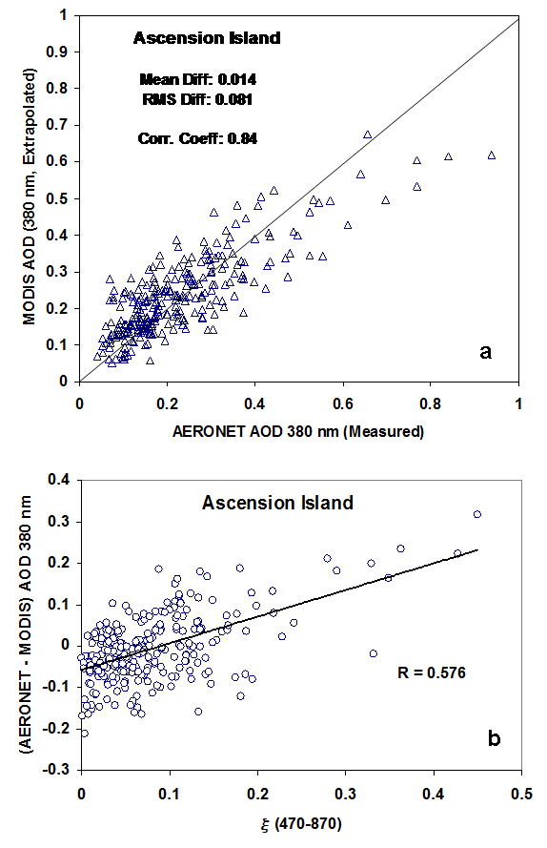
Ascension Island
First, can MODIS AOD retrieval
(466 to 2130 nm) be extrapolated
to the UV wavelength of 388 nm?
MODIS extrap 380 nm AOD
Linear extrap
Simple linear extrapolation (log-log)
is good, but not adequate.
Deviations from linear can be
explained by the difference in
AOD at 440 and 870 nm
AERONET measured 380 nm AOD
AERONET - MODIS AOD 380
Satheesh et al. (to be submitted)
AOD470 -AOD870

Slide 8
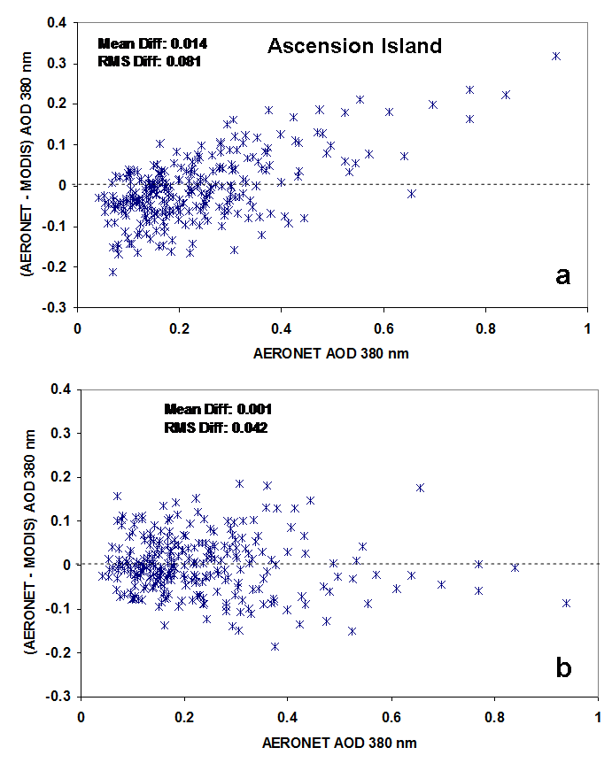
Linear extrapolation
With curvature correction
Satheesh et al.
(to be submitted)

Slide 9
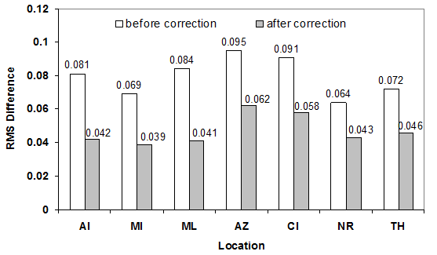
RMS difference between MODIS extrapolation and AERONET
At 7 island stations
Satheesh et al. (to be submitted)

Slide 10
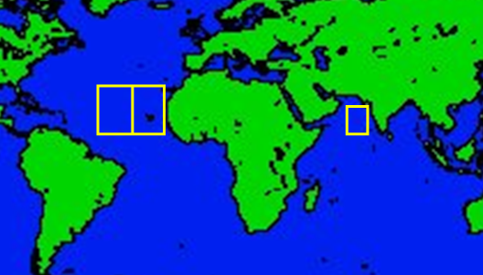
Areas of study
Satheesh et al. (to be submitted)

Slide 11
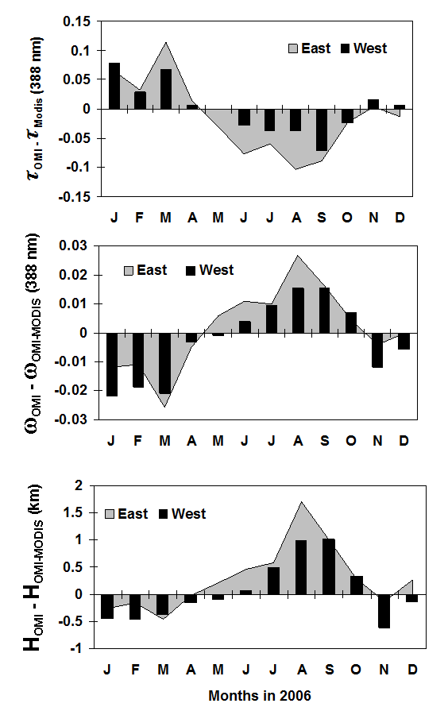
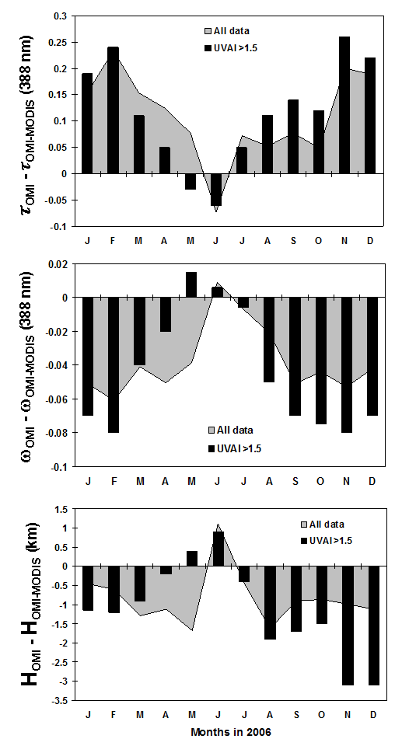
Atlantic Ocean
Arabian Sea
0.15
0.3
All data
AOD380
OMIstd - OMIMOD
ω_{o}380
OMIstd - OMIMOD
-0.03
-0.1
2
Height (km)
OMIstd - OMIMOD
-3.5
Months in 2006
Months in 2006

Slide 12
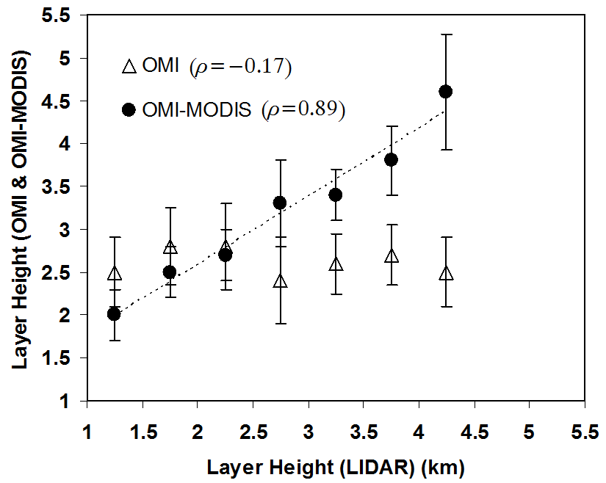
Validating height retrieval
In Arabian Sea

Slide 13
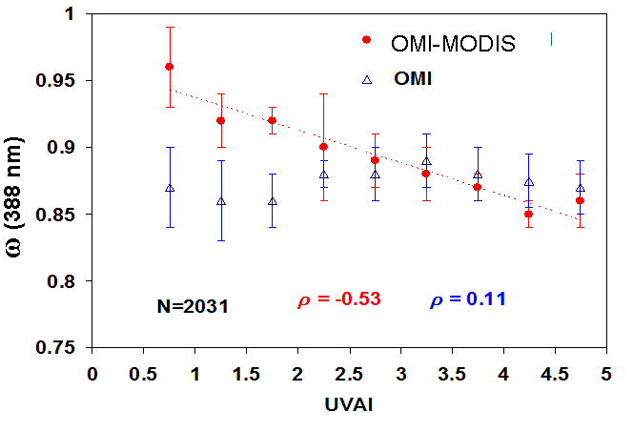
No similar validation of ω_{o} but higher correlations with absorbing index using joint absorption than with OMI alone.
Satheesh et al.To be submitted

Slide 14
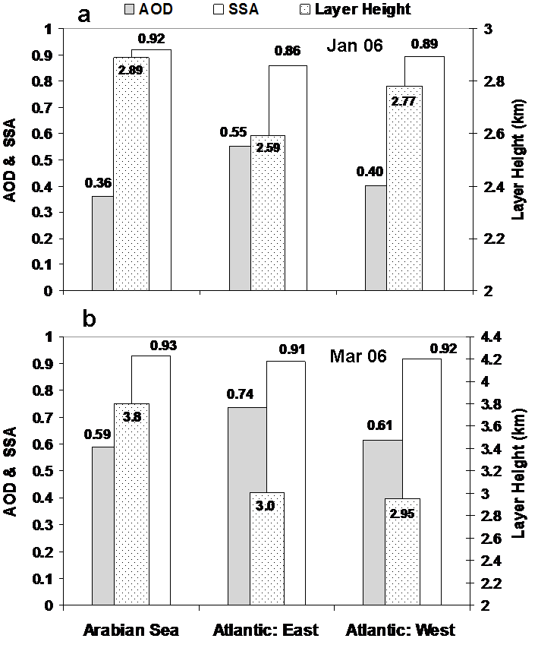
Monthly mean values
of AOD, ω_{o} and layer
height for the months
of Jan 06 and Mar 06
for the 3 regions
Satheesh et al.
To be submitted

Slide 15
Constraining the OMI retrieval with MODIS AOD
Results in a better retrieval of aerosol absorption
and height
Next step,
Further constrain OMI with information of aerosol type,
(determine if aerosol is dominated by dust or smoke)

Slide 16
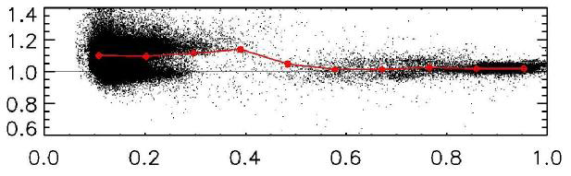


Ratio of OMI to MODIS reflectance
As a function of MODIS reflectance (MODIS band 3)
OMI/MODIS
MODIS spatially collocated
To OMI footprint
OMI spectrally convolved
To MODIS band 3
MODIS Reflectance
3
Aqua-MODIS
Spectral response
Systematic offset for darker
targets

Slide 17
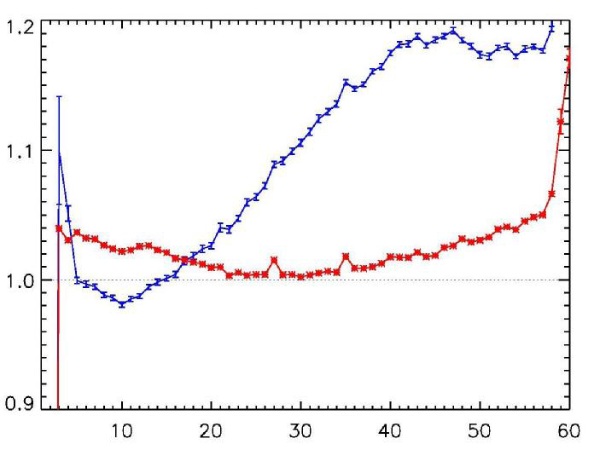
Refl <0.4
OMI/MODIS
Refl > 0.4
OMI cross track position (not view angle)

