Slide 1


Association for Community
Health Improvement
Michael Bilton, Executive Director
Association for Community Health Improvement
Health Research and Educational Trust
HCAP Grantee Meeting
January 21, 2004
Washington, D.C.

Slide 2
Value
Information, tools and relationships that help you to be more effective
Programmatic value
Collaborative value
Policy/advocacy value
Bridge for common issues among sectors

Slide 3
Who We Are
  National individual membership association for community health/healthy communities
  Peer networking and educational resource
  A program of the Health Research and Educational Trust
  Successor to the Coalition for Healthier Cities and Communities

Slide 4

Who We Are

Slide 5
Who We Are
Our Vision:
Community leaders everywhere creating health where people live, work and play.
Our Mission:
To strengthen community health through education, peer networking and practical tools.

Slide 6
Who We Are
  350+ members in 43 states, D.C. and Canada
  Members work in:
    Hospitals and health centers
    Public health departments, associations
    Community partnership organizations
    Foundations
    Local government
    Universities
  We are a bridge between sectors

Slide 7
Who We Are
  Community Services Director, Martin County Board of County Commissioners, Stuart, FL
  Community Outreach Director, St. Joseph Hospital/Peace Health
  Bellingham, WA
  Chair, Lighthouse Health Access Alliance
  Barnstable, MA
  Executive Director, Montgomery Area Community Wellness Coalition, Equality, AL
  Director of Community Health Services, Scottsdale Healthcare
  Scottsdale, AZ

Slide 8
www.communityhlth.org
Annual Membership Dues
  $195, if you work for an organization with a budget of $5 million or greater
  $100, if you work for an organization with a budget of less than $5 million or are self-employed
  $70, if you are a student or retired

Slide 9
Services & Activities
  Web site with news, events, tools, people
  Educational audio conference series
  Annual conference
  Weekly E-newsletter (1,400 subscribers)
  Interest Groups
  Searchable member database

Slide 10
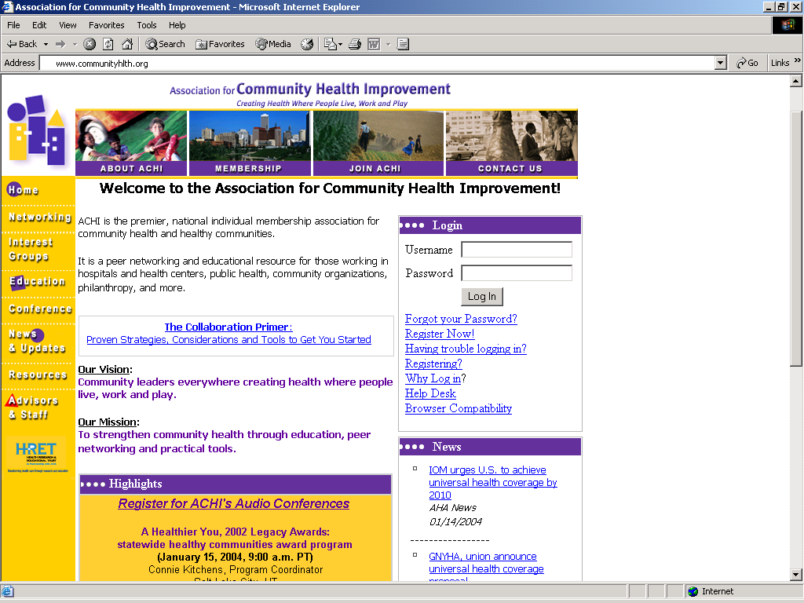

Slide 11
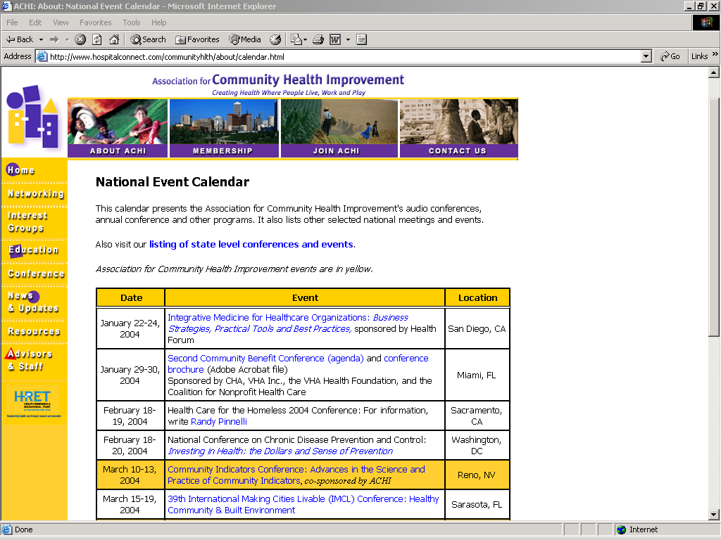

Slide 12
Services & Activities
  Educational audio conference series
    Healthy Community Awards Addressing Policy, Infrastructure and Outcomes
    Improving Children’s Health and Quality of Life: An Award Winning Tale of Commitment, Creativity and Collaboration
    Prescription Discount Program: Expanding Access in a Non-Profit Integrated Delivery System
    Linking Community Indicators to Action and Policy:
    Exploring Practical & Applied Lessons

Slide 13
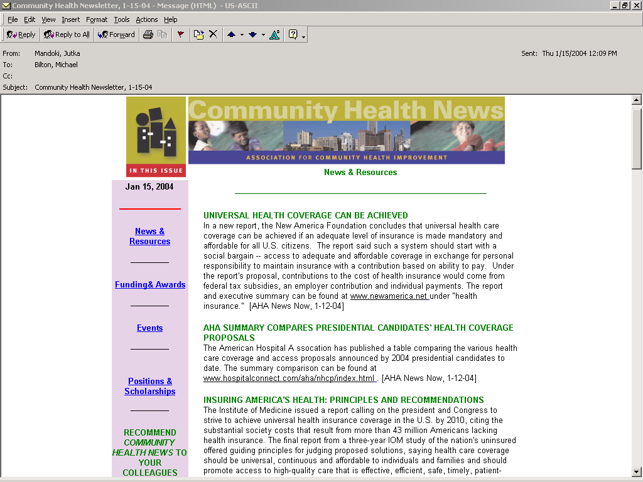
Write “please subscribe me” to communityhlth@aha.org

Slide 14
Services & Activities
Our role at the national level:
  Collect and disseminate local/state level success stories, practices, tools
  Amplify the voices of local champions
  Analyze and report on trends
  Conduct demonstration & research projects with local participants
  Convene and collaborate with state and regional associations

Slide 15
Thank you!
Michael Bilton
Executive Director
Association for Community Health Improvement
180 Montgomery Street, Suite 1520
San Francisco, CA 94104
www.communityhlth.org
415.248.8411
mbilton@aha.org

