Slide 1
Effectively Communicating with Consumers During Recalls
Caroline Smith DeWaal
Food Safety Director
Center for Science in the Public Interest
Better Communications, Better Public Health Outcomes Exercise
St. Louis, Missouri
May 16, 2008

Slide 2
2008 FDA Recalls
  Honduran Cantaloupes (Salmonella) March 18-28, 2008
  Slade Gorton & Co. "Icybay Cooked Langostinos" (Listeria monocytogenes) March 14, 2008
  Aunt Jemima Pancake & Waffle Mix Products (Salmonella) March 4, 2008
  Walker's Food Products Co. Four Bean Salad ( Clostridium botulinum) February 28, 2008
  Nutri-Foods "Organic Sesame Seeds Natural - Unhulled" (Salmonella). February 15, 2008
  Choyce Products Yellowfin Tuna (Salmonella) February 9, 2008
  New Era Canning Company Products (Clostridium botulinum bacterium spores) January 18-February 7, 2008
  Shiloh Farms Organic Unhulled Sesame Seeds (Salmonella) January 28, 2008
  Deli Chef Tri-Bean Salad (Clostridium botulinum) January 21, 2008

Slide 3
2008 USDA Recalls
  Chicken Giblets (adulterated) Mar 14, 2008
  Gourmet Boutique Meat and Poultry Products (Listeria)
  March 4, 2008
  Frozen Chicken Entrées (Listeria) Mar 4, 2008
  Frozen Chicken Entrées (Listeria) Mar 3, 2008
  Frozen Chicken Entrées (Listeria) Mar 2, 2008
  Hallmark/Westland Beef Products Feb 17, 2008
  Ground Beef Products (E. coli O157:H7) Jan 12, 2008
  Mark's Quality Meats Ground Beef Products (E. coli O157:H7) Jan 5, 2008

Slide 4

Three Classes of Recalls
Class I – There is a reasonable probability that the use of the product will cause serious adverse health consequences or death.
Class II – There may be temporary or medically reversible adverse health consequences and the probability of serious adverse health consequences is remote.
Class III – The consumption of or exposure to the product will not cause adverse health consequences.
Effective Recalls

Slide 5
What We are Seeing
There are more recalls occurring for both FDA and USDA regulated foods
Recalls are triggered from some very serious hazards in the food supply: E. coli in spinach and ground beef, Botulism in canned foods, Salmonella in peanut butter
The industry is being challenged to bring back products from multiple points in the production and retail chains
Effective Recalls

Slide 6
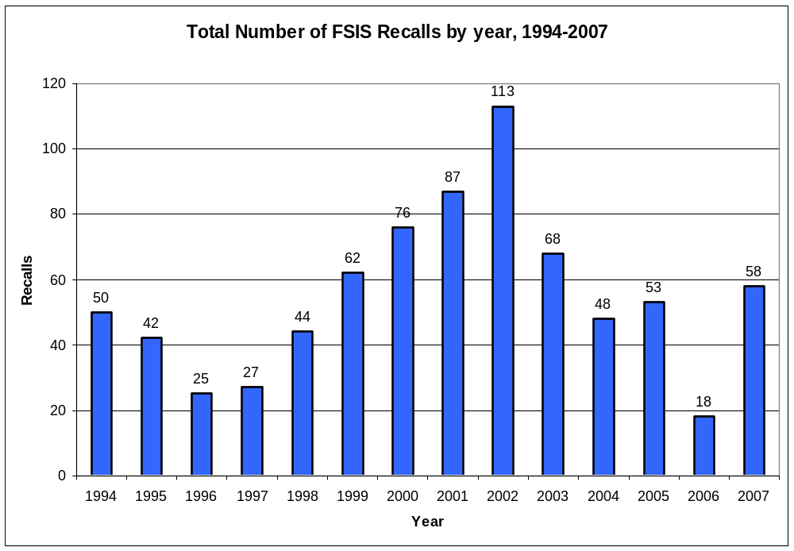

Slide 7
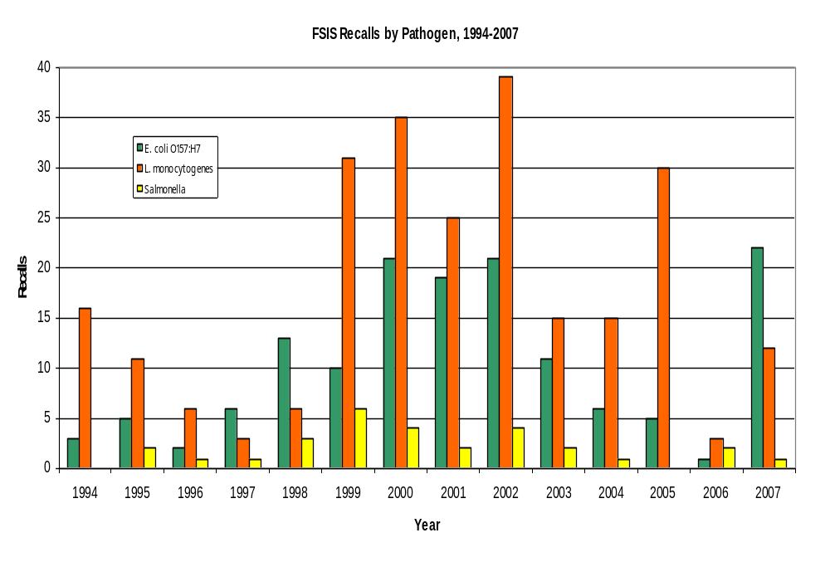
FSIS Recalls by Pathogen, 1994-2007

Slide 8
How Do We Communicate with the Public?
FDA issues multiple press releases containing recall notices issued over the span of one week for Honduran cantaloupes.
The most recent, from Dole Fresh Fruit Co., announces:
"The cantaloupes were distributed for sale ... in cardboard cartons with the brand 'Dole' and 'PRODUCT OF HONDURAS' printed on each of the side panels of the carton."
But consumers don't buy cantaloupes by the carton.
Impossible for consumers to identify whether the single cantaloupe in their refrigerator is part of the recall
Illustrates the need for better traceback and labeling on individual produce items

Slide 9
USDA Example: Westland/Hallmark
USDA Press Release: "Hallmark/Westland Meat Packing Co., . . . , is voluntarily recalling approximately 143,383,823 pounds of raw and frozen beef products that FSIS has determined to be unfit for human food because the cattle did not receive complete and proper inspection.“
Illustrates the paradox of a voluntary recall when a government agency has determined that a product is unfit for human consumption

Slide 10
USDA Example, cont’d
The 2 full pages of product listings and 65 published labels do not provide consumers with information to identify products in their freezers-- the packaging information included is bulk packaging for companies.
Establishment number is included, but that number often doesn’t make it to the consumer... Urging consumers to look for "EST. 336" doesn’t tell consumers whether recalled beef is in their freezers.

Slide 11
Communication Challenges
Voluntary System
  USDA and FDA Cannot Order Recalls.
  Industry Negotiates Terms of Recall.
  Delays Result in Less Product Recovery.
Effective Recalls

Slide 12
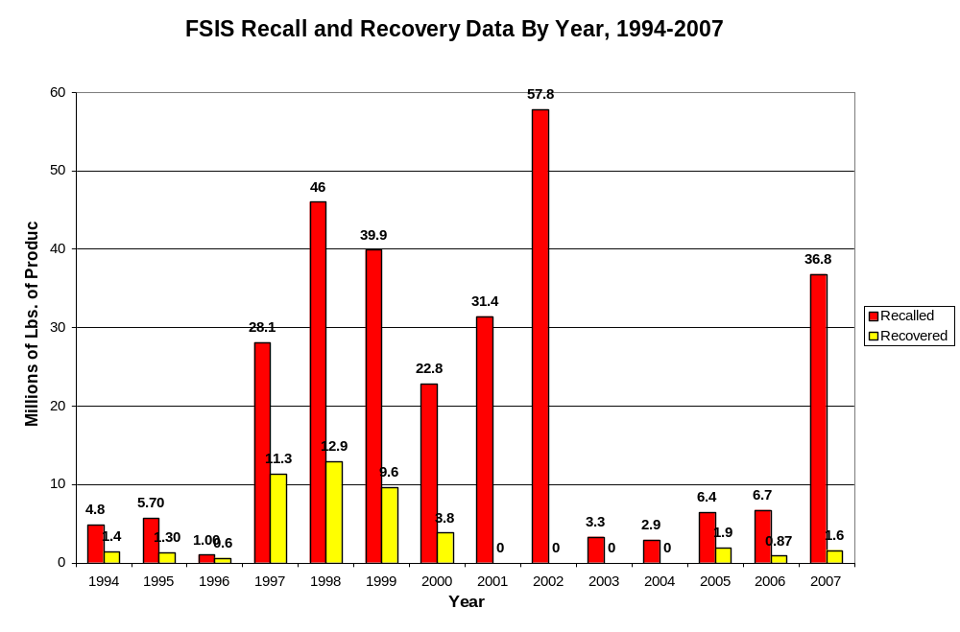

Slide 13
Mandatory Recall
A Tale of Reversible Positions
1998 – FSIS Supports Mandatory Recall Authority; FDA Does Not!
“We need to have mandatory recall and notification authority. The current system of voluntary industry recall is simply not reliable enough.” Sec. of Agriculture Dan Glickman 2000.
2007 – FDA Supports Mandatory Recall Authority; FSIS Does Not!
“FDA is seeking mandatory recall authority…. Although FDA has the authority to seize adulterated or misbranded food, this is not the most efficient option when contaminated product has already been distributed to hundreds or thousands of locations.” Asst. Comm. for Food Safety David Atchison 2007.
Effective Recalls

Slide 14
Communication Challenges
Inadequate Disclosure
  Retailers shielded from responsibility for getting products back after they are sold
  Consumers can’t determine if products they have already purchased are part of the recall: produce, ground beef
Effective Recalls

Slide 15
The Retail Consignee Rule
Two Agencies/Two Positions
USDA and FDA Do Not Release Consignee Lists – Why’s that Important?
  Consignees are often retailers who are in closest contact with consumers.
  Consumers know where they shop, but may not know who produced a recalled product.
USDA Changing its Policy (2006 NPRM)
  Two Years Later, Who’s Holding Up the Rule?
FDA Continues to Shield Retailers
Effective Recalls

Slide 16
Other Factors
Weak Enforcement
  No Civil Penalties to Induce Violators and Their Consignees to Conduct Adequate Recall.
Effective Recalls

Slide 17
Civil Penalties
“Civil fines serve as a deterrent and can be imposed more quickly than criminal penalties or the withdrawal of inspection. They can be appropriately tailored to the nature and scope of the violation, as well as to the size and type of business . …But, USDA does not have this authority for food safety.”
USDA Rel. 0346-97
FDA Can Only Impose Civil Fines for Food Safety Violations of Pesticide Residue Limits.
USDA Can Only Impose Civil Fines for Food Safety Violations of Egg Products Inspection Act.
Effective Recalls

Slide 18
Changes to Improve Recalls
Give Regulators Authority to Order Recalls
Provide Adequate Notice to Consumers
Civil Penalties for Failing to Conduct Recalls
Effective Recalls

Slide 19
Mandatory Recall Legislation
S. 654/H.R. 1148, the Safe Food Act.
S. 1274/H.R. 2108, Human and Pet Food Safety Act.
S. 2081, Food and Product Responsibility Act.
H.R. 3484, the SAFER Meat, Poultry and Food Act.
H.R. 3610, the Food and Drug Import Safety Act.
H.R. 3624, the Consumer Food Safety Act.
H.R. 3937, Food Import Safety Act.
Effective Recalls

Slide 20
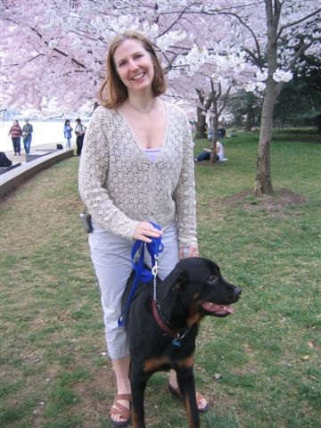
Questions?
Effective Recalls

