Slide 1
Aqueous Solutions
Concentration / Calculations
Dr. Ron Rusay
Spring 2002
© Copyright 1995-2002 R.J. Rusay

Slide 2
Solutions
Homogeneous solutions are comprised of solute(s), the substance(s) dissolved, [The lesser amount of the component(s) in the mixture], and
solvent, the substance present in the largest amount.
Solutions with less solute dissolved than is physically possible are referred to as “unsaturated”. Those with a maximum amount of solute are “saturated”.
Occasionally there are extraordinary solutions that are “supersaturated” with more solute than normal.

Slide 3
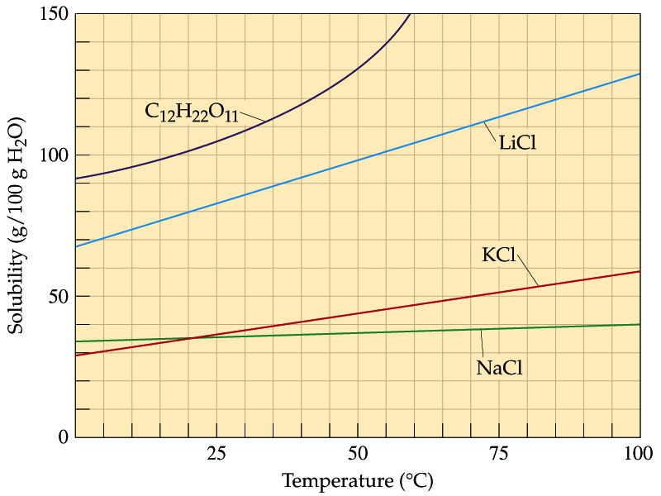
Concentration and Temperature
Relative Solution
Concentrations:
Saturated
Unsaturated
Supersaturated

Slide 4
DHMO, dihydromonoxide :
“The Universal” Solvent
http://www.dhmo.org

Slide 5
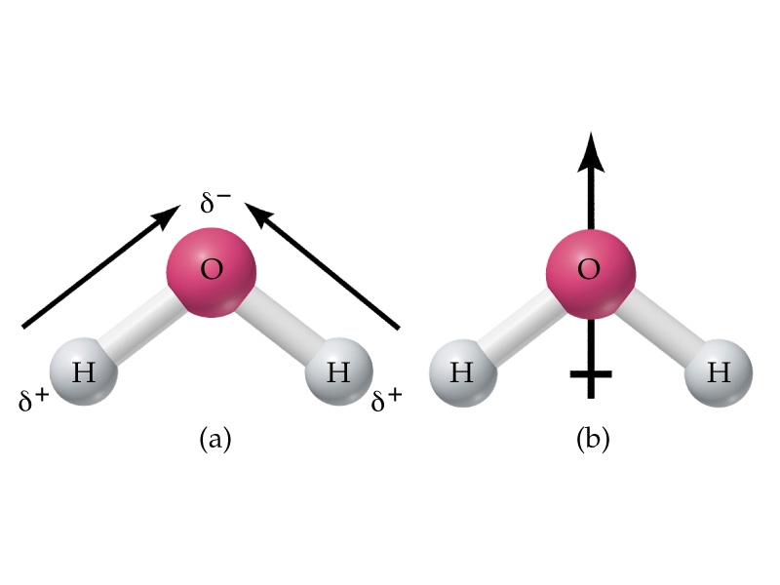
Water : “The Universal” Solvent
The oil (nonpolar) and water (polar) mixture don’t mix and are immiscible. If liquids form a homogeneous mixture, they are miscible.
Generally, likes dissolve likes, i.e. polar-polar and nonpolar-nonpolar. Polar and nonpolar do not mix , eg. oil and water

Slide 6
Aqueous Reactions & Solutions
Many reactions are done in a homogeneous liquid or gas phase which generally improves reaction rates.
The prime medium for many inorganic reactions is water which serves as a solvent (the substance present in the larger amount), but does not react itself.
The substance(s) dissolved in the solvent is (are) the solute(s). Together they comprise a solution. The reactants would be the solutes.
Reaction solutions typically have less solute dissolved than is possible and are “unsaturated”.

Slide 7
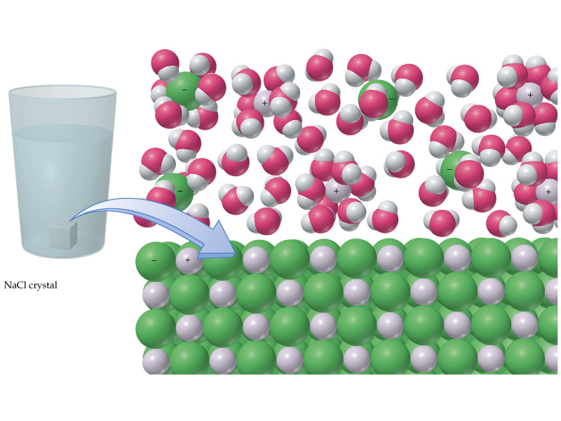
Salt dissolving in a glass of water

Slide 8
Solution Concentration
A solution’s concentration is the measure of the amount of solute dissolved.
Concentration is expressed in several ways. One way is mass percent.
Mass % = Mass solute / [Mass solute + Mass solvent ] x100
What is the mass % of 65.0 g of glucose dissolved in 135 g of water?
Mass % = 65.0 g / [65.0 + 135]g x 100
= 32.5 %

Slide 9
Solution Concentration
Concentration is expressed more importantly as molarity (M).
Molarity (M) = Moles solute / Liter Solution
An important relationship is M x V_{solution}= mol
This relationship can be used directly in mass calculations of chemical reactions.
What is the molarity of a solution of 1.00 g KCl in 75.0 mL of solution?
M _{KCl} = [1.00g _{KCl} / 75.0mL ][1mol_{KCl} / 74.55 g _{KCl} ][ 1000mL / L]
= 0.18 mol_{KCl} / L

Slide 10
Solution Concentration
The following formula can be used in dilution calculations:
M₁V₁ = M₂V₂
A concentrated stock solution is much easier to prepare and then dilute rather than preparing a dilute solution directly. Concentrated sulfuric acid is 18.0M. What volume would be needed to prepare 250.mL of a 1.50M solution?
V₁ = M₂V₂ / M₁
V₁ = 1.50 M x 250. mL / 18.0 M
V₁ = 20.8 mL

Slide 11
Solution Applications
A solution of barium chloride was prepared by dissolving 26.0287 g in water to make 500.00 mL of solution. What is the concentration of the barium chloride solution? M_{BaCl2} = ?
M_{BaCl2} =
= [26.0287g _{BaCl2} / 500.00mL ][1mol _{BaCl2} / 208.23g _{BaCl2} ] [1000mL / L]
= 0.25000 mol / L

Slide 12
Solution Applications
10.00 mL of this solution was diluted to make exactly 250.00 mL of solution which was then used to react with a solution of potassium sulfate. What is the concentration of the diluted solution. M₂ = ?
    M_{BaCl2} = M₁
    M₂ = M₁V₁ / V₂
    M₂ = 0.25000 M x 10.00 mL / 250.00 mL
    M₂ = 0.010000 M

Slide 13
Solution Applications
  20.00 mL of the barium chloride solution required 15.50 mL of the potassium sulfate solution to react completely. M_{K2SO4} = ?
BaCl₂(aq) + K₂SO₄(aq) → ? + ?
BaCl₂(aq) + K₂SO₄ (aq) → 2 KCl(aq) + BaSO₄ (s)
?M_{K2SO4} = [M_{BaCl2}x V_{BaCl2} / V_{K2SO4} ] [? mol_{K2SO4} / ? mol_{BaCl2} ]
0.010000 mol_{BaCl2} x 0.02000 L_{BaCl2} x 1 mol_{K2SO4}
L_{BaCl2} x 0.01550 L_{K2SO4} x 1 mol_{BaCl2}
?M_{K2SO4} =
?M_{K2SO4} = 0.01290 mol_{K2SO4} / L_{K2SO4} = 0.01290 M_{K2SO4}

Slide 14
Solution Applications
How many grams of potassium chloride are produced?
BaCl₂(aq) + K₂SO₄(aq) → ? + ?
BaCl₂(aq) + K₂SO₄ (aq) → 2 KCl(aq) + BaSO₄ (s)
1
?g_{KCl} = 0.010000 mol_{BaCl2} / L_{BaCl2} x 0.02000 L_{BaCl2} X 2 mol_{KCl} / 1 mol_{BaCl2} X
74.55 g_{KCl} /mol_{KCl}
= 0.02982 g_{KCl}

Slide 15
Solution Applications
If 20.00 mL of a 0.10 M solution of barium chloride was reacted with 15.00 mL of a 0.20 M solution of potassium sulfate, what would be the theoretical yield of barium sulfate?
BaCl₂(aq) + K₂SO₄ (aq) → 2 KCl(aq) + BaSO₄ (s)
Which is the Limiting Reagent?
Mol_{BaCl2} = M_{BaCl2}x V_{BaCl2}
= 0.10 mol_{BaCl2} / L_{BaCl2} x 0.02000 L_{BaCl2}
1 mol_{BaCl2}
= 2.0 x 10⁻³
Mol_{K2SO4}= M_{K2SO4}x V_{K2SO4}
= 0.20 mol_{K2SO4} / L_{K2SO4} x 0.01500 L_{K2SO4}
1 mol_{K2SO4}
= 3.0 x 10⁻³
2.0 x 10⁻³ < 3.0 x 10⁻³
2.0 x 10⁻³ mol is limiting

Slide 16
Solution Applications
If 20.00 mL of a 0.10 M solution of barium chloride was reacted with 15.00 mL of a 0.20 M solution of potassium sulfate, what would be the theoretical yield of barium sulfate?
BaCl₂(aq) + K₂SO₄ (aq) → 2 KCl(aq) + BaSO₄ (s)
Must use the limiting reagent:
0.10 mol_{BaCl2} x 0.02000 L_{BaCl2} x 1 mol_{BaSO4} x 233.39 g _{BaSO4}
L_{BaCl2} 1 mol_{BaCl2} mol_{BaSO4}
=
= 0.47 g

