Slide 1
Analysis of Hydrodynamic and Interfacial Instabilities During Cooperative Monotectic Growth
G.B. McFadden, NIST
S.R. Coriell, NIST
K.F. Gurski, NIST
B.T. Murray, SUNY Binghamton
J.B. Andrews, U. Alabama, Birmingham
Cooperative monotectic growth
Sources of flow with a fluid-fluid interface
Regular solution model of the Al-In miscibility gap
Modes of instability for a growing fluid-fluid interface
Compute the morphological stability of a fluid-fluid interface during directional growth
        NASA Physical Sciences Research Division

Slide 2
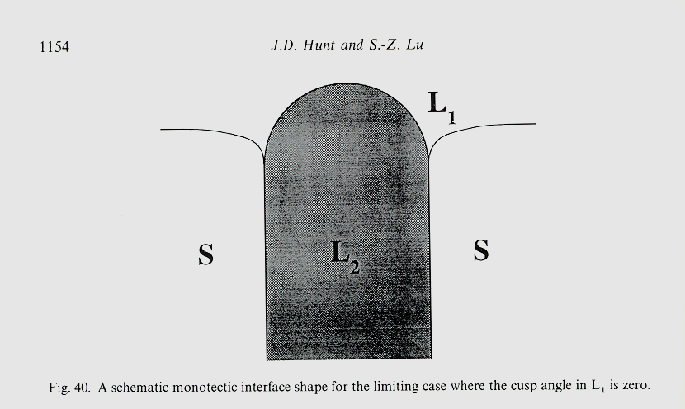
Notes:
Fern and Antii – matrix plot of sequences up to 10 proteins long – GENBANK
Fern and Tony – reconstructing a genetic sequence from an incomplete sequence with gaps and deletions

Slide 3
Modeling Flow Effects During Monotectic Growth:
Difficulty: Cooperative growth is a complex process with three phases in a complicated geometry. Typical theoretical approaches involve rough order-of-magnitude estimates or full-scale numerical calculations in 2-D or 3-D.
Idea: Idealize to two phases (fluid-fluid) in a simplified geometry (planar interface) where flow effects can be assessed quantitatively by their effects on linear stability.
Related Work: Directional solidification of liquid crystals; convective stability of liquid bi-layers.
Notes:
Fern and Antii – matrix plot of sequences up to 10 proteins long – GENBANK
Fern and Tony – reconstructing a genetic sequence from an incomplete sequence with gaps and deletions

Slide 4




Sources of convection with a liquid-liquid interface:
Thermosolutal convection (Coriell et al.)
Density-change convection
Thermocapillary convection (Ratke et al.)
Pressure-driven convection (Hunt et al.)
Notes:
Fern and Antii – matrix plot of sequences up to 10 proteins long – GENBANK
Fern and Tony – reconstructing a genetic sequence from an incomplete sequence with gaps and deletions

Slide 5
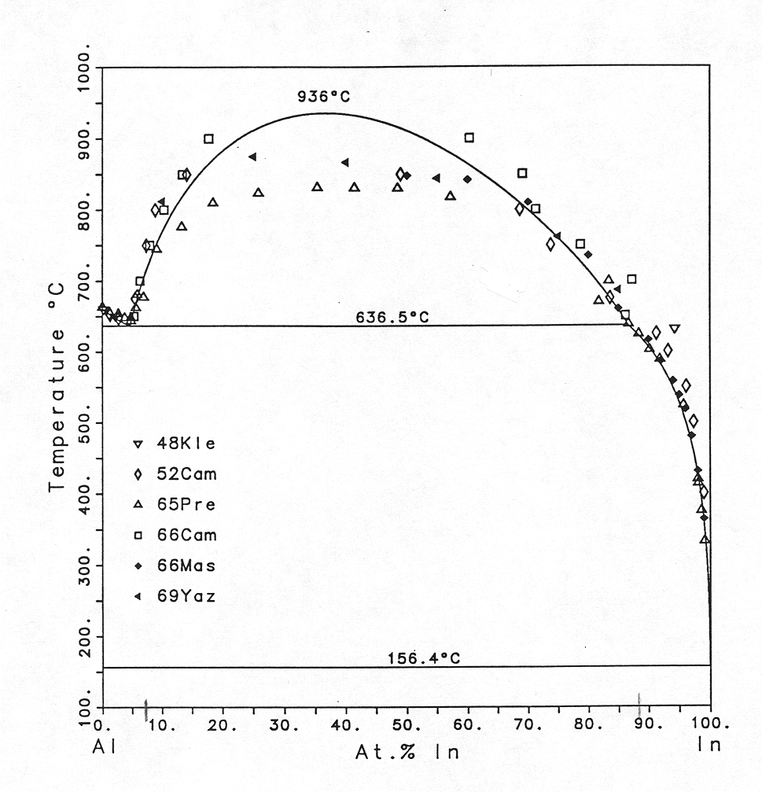
Al-In Phase Diagram
C.A. Coughanowr, U. Florida (1988)
Notes:
Fern and Antii – matrix plot of sequences up to 10 proteins long – GENBANK
Fern and Tony – reconstructing a genetic sequence from an incomplete sequence with gaps and deletions

Slide 6
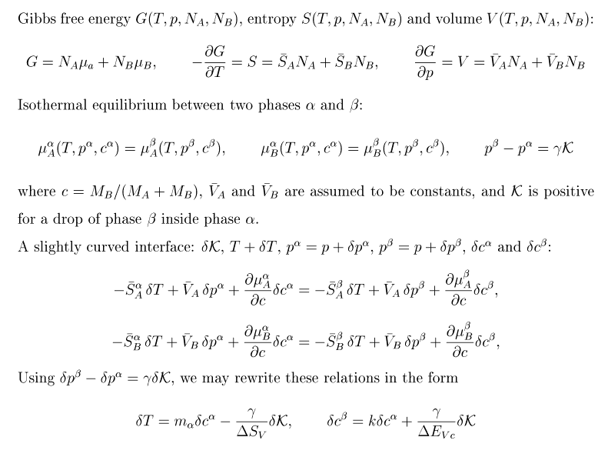
Equilibrium Thermodynamics
Notes:
Fern and Antii – matrix plot of sequences up to 10 proteins long – GENBANK
Fern and Tony – reconstructing a genetic sequence from an incomplete sequence with gaps and deletions

Slide 7
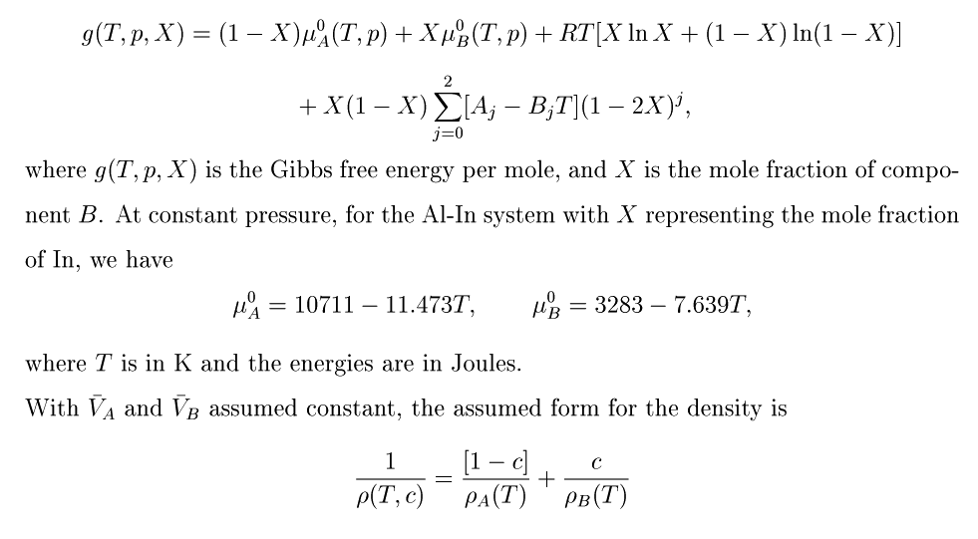
Sub-regular solution model of Al-In miscibility gap
U. Kattner, NIST; C.A. Coughanowr, U. Florida (1988)
Notes:
Fern and Antii – matrix plot of sequences up to 10 proteins long – GENBANK
Fern and Tony – reconstructing a genetic sequence from an incomplete sequence with gaps and deletions

Slide 8
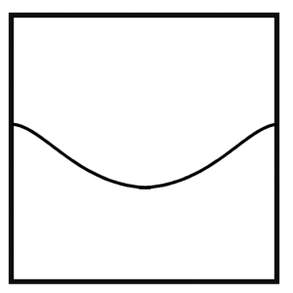
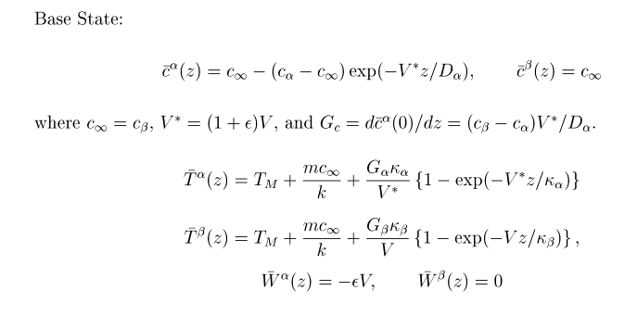
Do directional transformation of L₁ (α) phase into L₂ (β) phase
α
V
β
Notes:
Fern and Antii – matrix plot of sequences up to 10 proteins long – GENBANK
Fern and Tony – reconstructing a genetic sequence from an incomplete sequence with gaps and deletions

Slide 9
Modes of instability with a fluid-fluid interface:
Double-Diffusive instability [Coriell et al. (1980)]
Rayleigh-Taylor instability [Sharp (1984)]
Marangoni instability [Davis (1987)]
Morphological Instability [Mullins & Sekerka (1964)]
Consider the flows driven by inhomogeneities generated by morphological instability at micron-sized length scales.
Notes:
Fern and Antii – matrix plot of sequences up to 10 proteins long – GENBANK
Fern and Tony – reconstructing a genetic sequence from an incomplete sequence with gaps and deletions

Slide 10
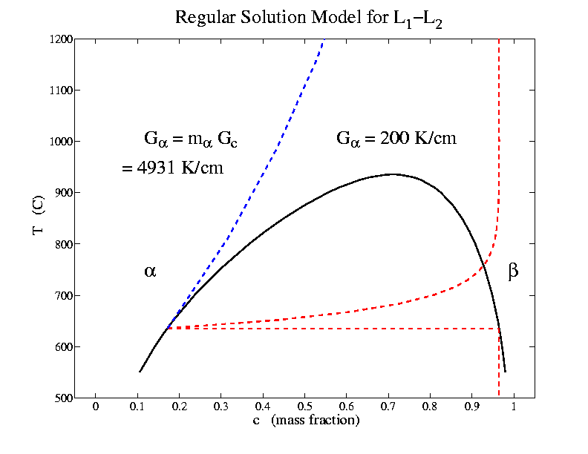
V = 2 μm/s
Notes:
Fern and Antii – matrix plot of sequences up to 10 proteins long – GENBANK
Fern and Tony – reconstructing a genetic sequence from an incomplete sequence with gaps and deletions

Slide 11
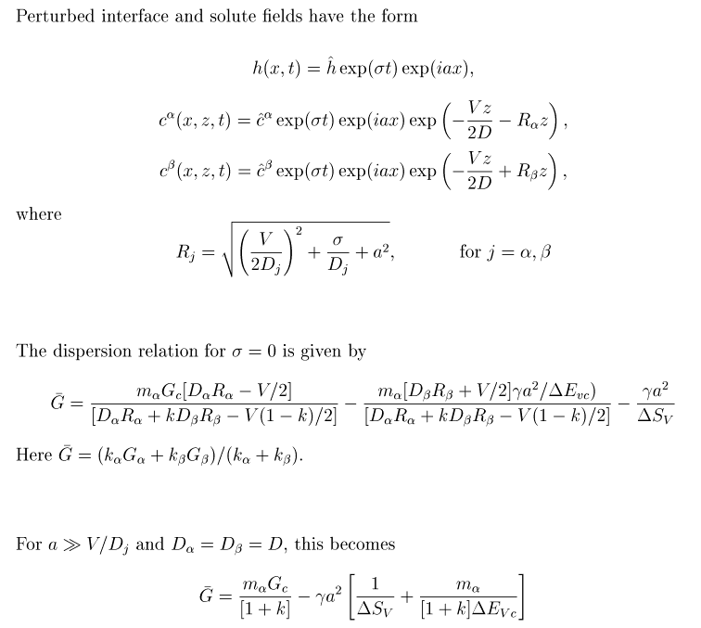
Morphological Stability Analysis with No Flow
Notes:
Fern and Antii – matrix plot of sequences up to 10 proteins long – GENBANK
Fern and Tony – reconstructing a genetic sequence from an incomplete sequence with gaps and deletions

Slide 12
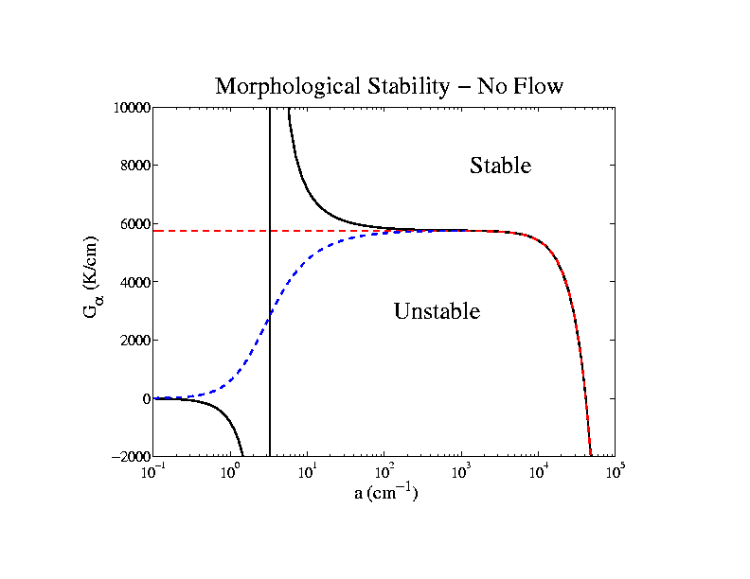
[Pole in dispersion relation for k < 0]
Notes:
Fern and Antii – matrix plot of sequences up to 10 proteins long – GENBANK
Fern and Tony – reconstructing a genetic sequence from an incomplete sequence with gaps and deletions

Slide 13
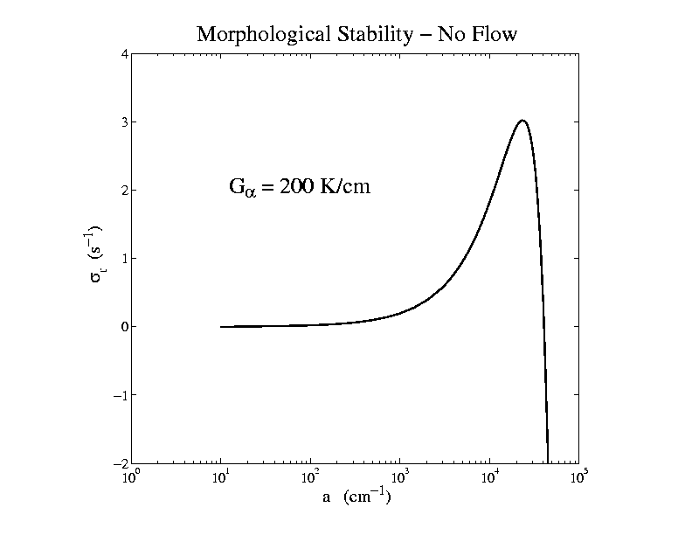
Notes:
Fern and Antii – matrix plot of sequences up to 10 proteins long – GENBANK
Fern and Tony – reconstructing a genetic sequence from an incomplete sequence with gaps and deletions

Slide 14

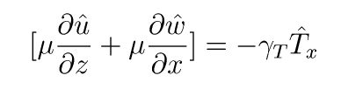

Morphological Stability Analysis with Flow
Re-introduce flow terms one at a time:
BVSUP – Orr-Sommerfeld equations + transport
H. Keller’s approach for eigenproblem
Notes:
Fern and Antii – matrix plot of sequences up to 10 proteins long – GENBANK
Fern and Tony – reconstructing a genetic sequence from an incomplete sequence with gaps and deletions

Slide 15
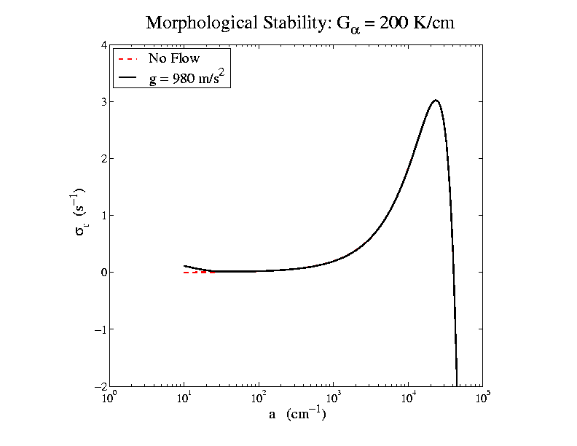
Notes:
Fern and Antii – matrix plot of sequences up to 10 proteins long – GENBANK
Fern and Tony – reconstructing a genetic sequence from an incomplete sequence with gaps and deletions

Slide 16
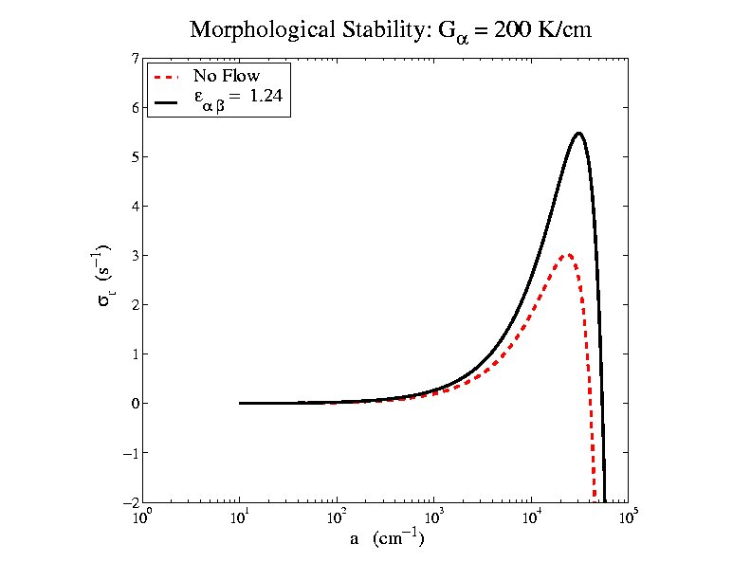
Notes:
Fern and Antii – matrix plot of sequences up to 10 proteins long – GENBANK
Fern and Tony – reconstructing a genetic sequence from an incomplete sequence with gaps and deletions

Slide 17
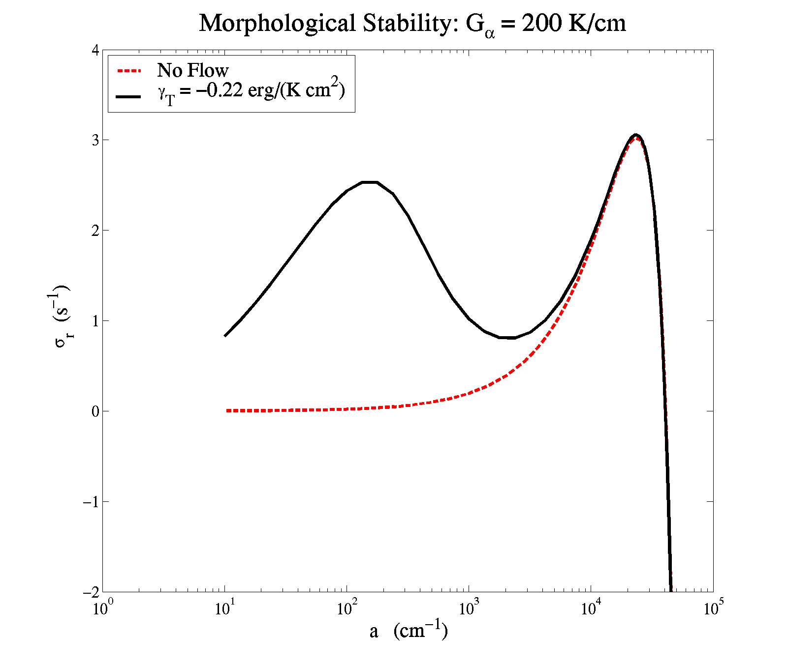
Notes:
Fern and Antii – matrix plot of sequences up to 10 proteins long – GENBANK
Fern and Tony – reconstructing a genetic sequence from an incomplete sequence with gaps and deletions

Slide 18
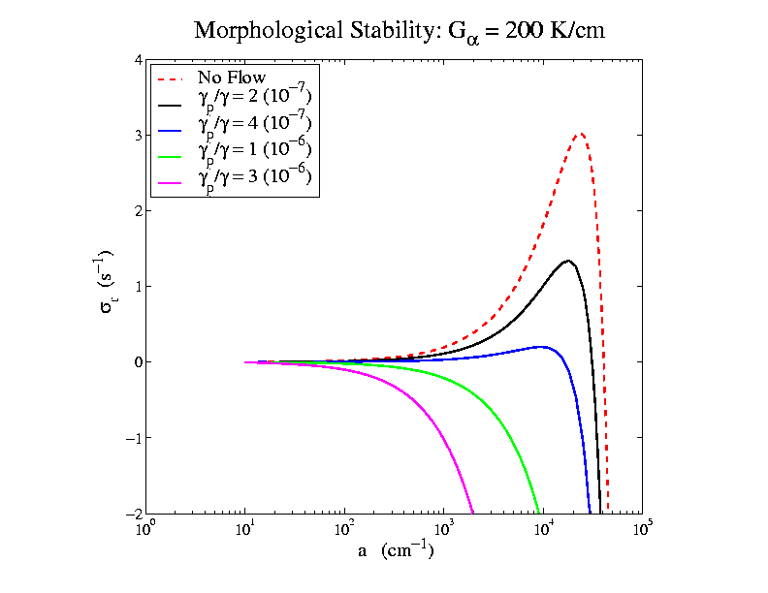
Notes:
Fern and Antii – matrix plot of sequences up to 10 proteins long – GENBANK
Fern and Tony – reconstructing a genetic sequence from an incomplete sequence with gaps and deletions

Slide 19
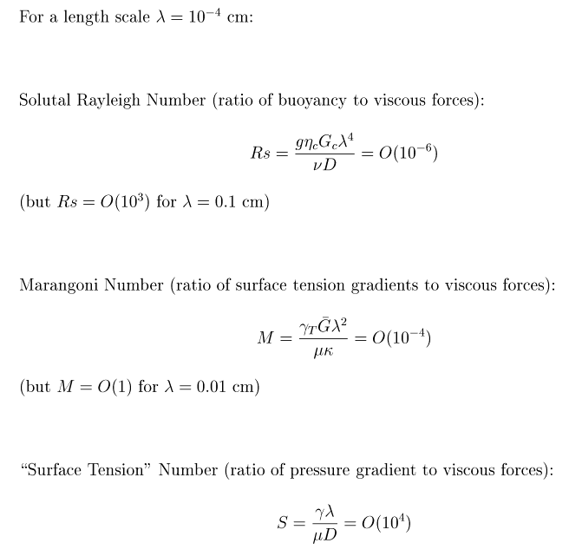
Orders of Magnitude of Flow Effects
Notes:
Fern and Antii – matrix plot of sequences up to 10 proteins long – GENBANK
Fern and Tony – reconstructing a genetic sequence from an incomplete sequence with gaps and deletions

Slide 20
Summary
The morphological instability of a fluid-fluid interface sets a micron-sized length scale [comparable to monotectic spacing widths]; other modes of instability may also be studied.
Flow interactions with the morphological mode may be computed numerically.
Buoyancy, density-driven, and thermocapillary flows interact weakly at micron scales (thermocapillary has bimodal behavior at 100 micron scale).
Pressure-driven flow shows large stabilizing effect at micron scales.
In progress: Interpretation of eigenfunctions; additional modes
Notes:
Fern and Antii – matrix plot of sequences up to 10 proteins long – GENBANK
Fern and Tony – reconstructing a genetic sequence from an incomplete sequence with gaps and deletions

