Slide 1
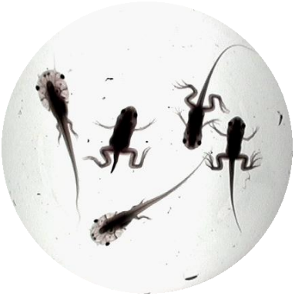
Amphibian Metamorphosis Assay
Detailed Review Paper
Endocrine Disruptor Methods Validation Subcommittee
July 2002
Leslie Touart

Slide 2

Detailed Review Paper:
AMPHIBIAN METAMORPHOSIS ASSAY FOR ENDOCRINE DISRUPTION
WORK PERFORMED BY:
Fort Environmental Laboratories, Inc.
On behalf of the United States Environmental Protection Agency
EPA CONTRACT NUMBER 68-W-01-023

Slide 3
METHODS USED IN THIS ANALYSIS
On-line Literature Search (December 2001)
  Encompassed searching of traditional literature databases, contacting specific experts in the field, and evaluating other presonal communication
  Databases included, Medline/PubMed, biological Abstracts, Chemical Abstracts, and Toxline using key word and author search strategies
  General search was performed initially using the key phrases amphibian metamorphosis and amphibian thyroid
  Search was refined to Key Words - endocrine disruptor, thyroid impairment, TH analysis, cDNA techniques, and culture methods using Boolean operators “and” and “or”
  Approximately 10000 records were refined down to 1000 papers that were reviewed

Slide 4
METHODS USED IN THIS ANALYSIS Cont.
Telephone/Email Consultations:
Drs. Tyrone Hayes, James Burkhart, Robert Denver, and Robert Granger
  Yielded 9 new documents not originally included in initial literature search
  Each were included in various sections of the DRP

Slide 5
METHODS USED IN THIS ANALYSIS Cont.
Interviews With The Following Experts:
  Dr. Robert Denver
  Dr. Brent Palmer
  Dr. Joe Bidwell
  Dr. Jim Burkhart

Slide 6
METHODS USED IN THIS ANALYSIS Cont.
External/Internal Peer Review
Dr. Joe Bidwell – Oklahoma State Univ.
Dr. Brent Palmer – U of Kentucky
Mr. Michael Blanton - Battelle
EPA Technical Experts
  (principally Mr. Joe Tietge, MED)

Slide 7
OVERVIEW AND SCIENTIFIC BASIS OF AMPHIBIAN METAMORPHOSOSIS ASSAY (ENDOCRINE CONTROL OF THYROID AXIS)
Amphibian metamorphosis is well understood and generally involves morphological, biochemical, and molecular changes
These changes result in resorption, remodeling, and creation of new tissues
Thyroid axis control of metamorphosis in amphibians involves the CNS, hypothalamus, pituitary gland, thyroid gland, TH transport proteins, TRs, and transcriptional elements
Many aspects of the thyroid axis are conserved amongst chordates at both the morphological and molecular levels enhancing the use of an amphibian as a general vertebrate model for evaluating thyroid disruption
The Amphibian Metamorphosis Assay will be useful in evaluating thyroid perturbation.

Slide 8
Overview of Metamorphic Periods in Anurans
Premetamorphosis
  Characterized as phase of embryogenesis and early tadpole growth
  Thyroid gland is developing
Prometamorphosis
  Larvae acquires TH synthesis capability and is characterized by low circulating TH levels which stimulate early metamorphic changes
Metamorphic Climax
  Characterized by peak levels of endogenous TH and rapid and drastic morphological changes (e.g., tail resorption)
Notes:
Early metamorphic changes = hindlimb elongation and differentiation, etc

Slide 9
Test Species
Anurans
  Pipids
    South African clawed frog (Xenopus sp.)
      X. laevis
      X. tropicalis
  Ranids
    Leopard frog (Rana pipiens)
  Hyperoliids
    Hyperolius sp.
Urodeles

Slide 10
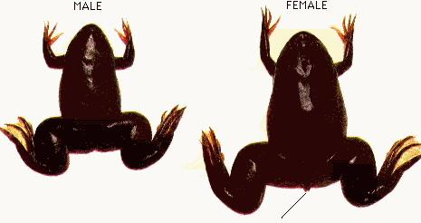
Xenopus laevis
Native to Africa, south of Sahara desert
Extensively used in scientific research and can be obtained from US vendors
Adult males are ca. 10 cm and females 15 cm in length (metamorphic tadpoles are 2-3 cm in length)
Can be kept in breeding condition all year and are bred in the lab using hCG
Females produce 1500 embryos per breeding
May be re-bred every two months and are productive for 3 to 5 years
Purely aquatic species

Slide 11
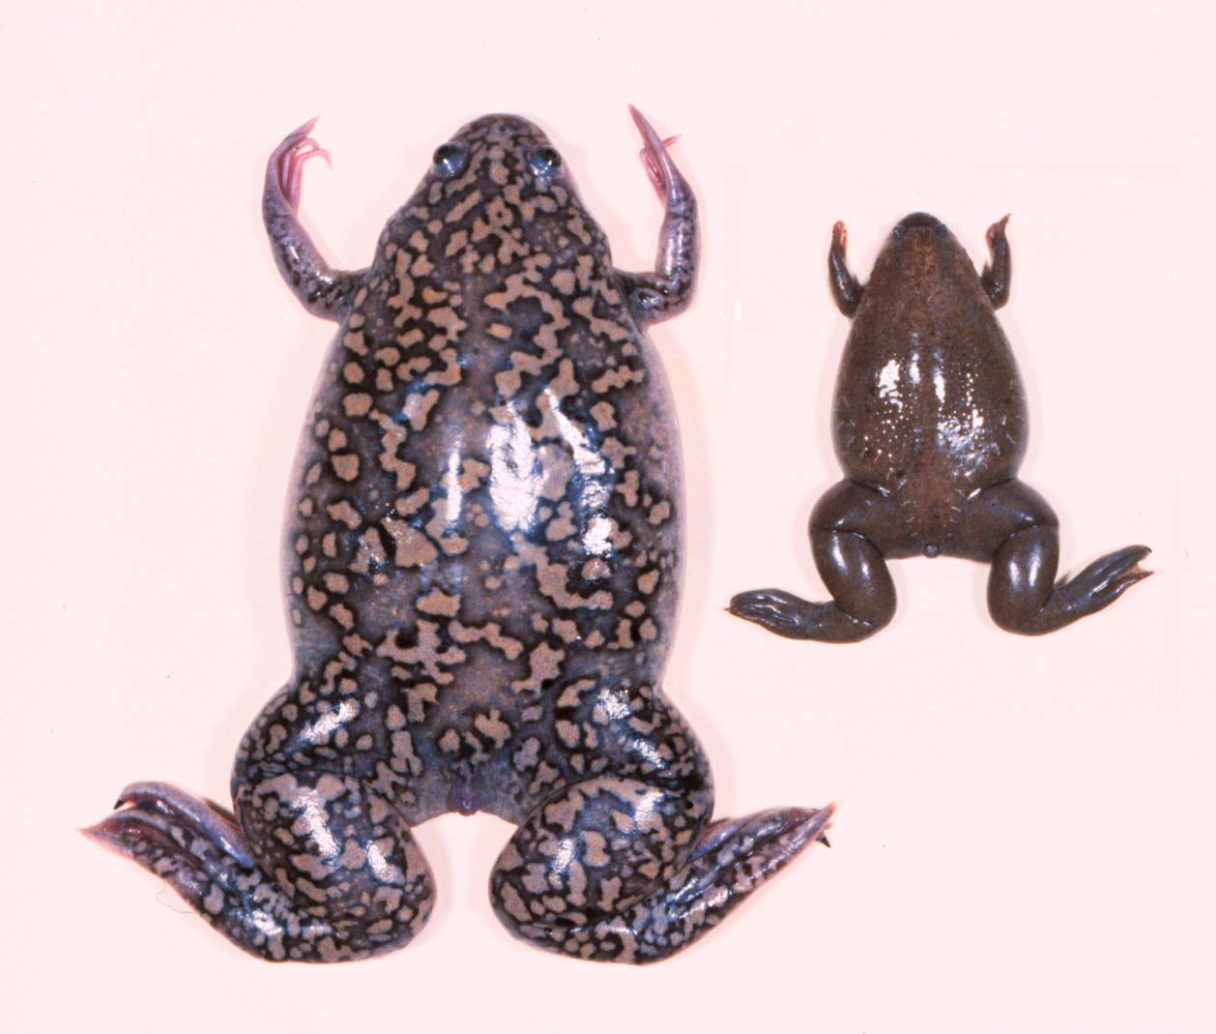
Xenopus tropicalis
Native to southern tip of Africa
Similar to X. laevis with the following exceptions:
  Physically smaller
  Develop more rapidly (can be cultured at higher temperature)
  Diploid genome
  Somewhat greater embryo production
  Reproductively mature in 4-5 months (X. laevis requires 1-2 years)

Slide 12
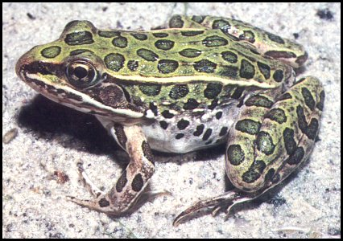
Rana pipiens
Native to North America
Breeding season ranges from March to April
Aquatic and terrestrial life phase – more difficult to raise and breed in lab
Sexual maturity in 1 to 2 years
Produces Eggs per egg masses of 1500 to 4000 in the wild

Slide 13
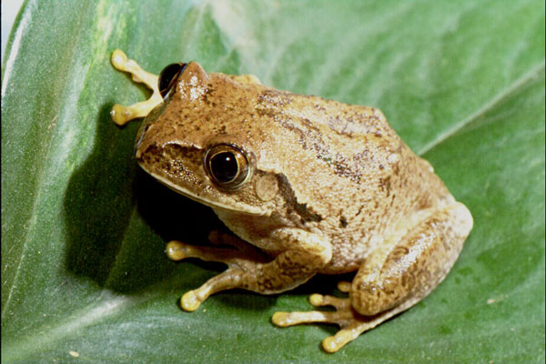
Hyperoliid sp.
Native to Africa, known as the reed frog
Undergoes ontogenic color change as the result of secondary sexual development
No commercial source of species
Limited culturing information available

Slide 14
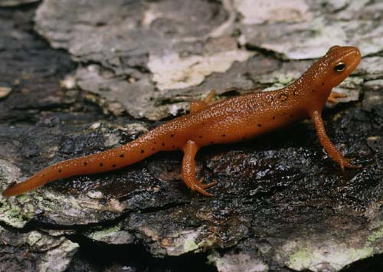
Urodeles
Includes “non-frog” species, such as salamanders, newts, and axolotls
Native to North America and other locations across the globe.
Breeding occurs in the Early Spring months depending on temperature
Produce 100-200 relatively large embryos per breeding
Limited culturing information available

Slide 15
Xenopus laevis
Strengths
Large database on all aspects of development, reproduction, metamorphosis, including information at molecular level
Ease of culture
Breeds in laboratory repeatedly with hormonal stimulus
High productivity
Mapped genome
Many laboratories are familiar with culture and testing
Weaknesses
Relatively long life cycle
Oligotetraploid genome

Slide 16
Xenopus tropicalis (compared to X. laevis only)
Strengths
Relatively short life cycle
Rapid development
Diploid genome
Good transgenic capacity
Greater breeding output
Weaknesses
More challenging animal husbandry
Less scientific information availablecs
Disease susceptibility?
Availability

Slide 17
Rana pipiens
Strengths
Native species
Reasonable database
Relatively short metamorphic period for native species
Terrestrial and aquatic life phases
Weaknesses
More difficult animal husbandry and breeding
Limited testing experience

Slide 18
Urodeles
Strengths
Represent different Order
Native species
Terrestrial and aquatic life phases
Weaknesses
More difficult animal husbandry and breeding
Limited testing experience
Limited database

Slide 19
Hyperolius sp.
Strengths
External endpoints (morphological)
Suitable animal husbandry
Connection to sexual development
Weaknesses
Availablity
Limited testing experience
Limited database
Does not directly measure thyroid dysfunction

Slide 20
Routes of Administration of Chemical Exposure
Aqueous
Dietary exposures
Parenteral
  -intravenous
  -intramuscular

Slide 21
Potential Exposure Periods
Exposure from premetamorphosis through metamorphic climax
  35+ days
Exposure from prometamorphosis through metamorphic climax
  28+ days
Exposure during prometamorphosis
  ca. 14 days
Exposure during metamorphic climax
  ca. 14+ days

Slide 22
Exposure Period Considerations
Premetamorphosis
  No thyroidal activity
  This phase only considers development of the thyroid gland
Prometamorphosis
  Potentially the most sensitive stage as the organism is acquiring thyroid activity
  Hind limb development occurs
Metamorphic climax
  Substantial morphological changes occur
  TH saturation
    May be difficult to distinguish effects due to TH saturation
    Reduced sensitivity anticipated

Slide 23
Measurement Endpoints Considered
Morphological and Histological
  Rate of Development (developmental delay)
    Must discriminate between thyroidal and non-thyroidal responses
  Hind Limb Development and Differentiation
  Tail Resorption
  Thyroid gland histopathology
    Hyper- and hypotrophy, and hyper- and hypoplasia
Biochemical
  TH
  TH precursors

Slide 24
Measurement Endpoints Considered (continued)
Molecular
  cDNA Techniques
    Single Gene Expression
      RPA
      Q-PCR (RT-PCR)
    Multiple Gene Expression
      Differential Display
      Gene Arrays
  Transgenic Lines
  Organ and Cell Culture
  Receptor binding Assays

Slide 25
MEASUREMENT OF BIOCHEMICAL ENDPOINTS
TH and TH precursors
  Radioimmunoassay (RIA)
  Enzyme-linked Immunosorbent Assay (ELISA)
  Liquid/Gas Chromatography with Mass Selective Detection (LC/GC-MS)

Slide 26
Relevant Gene Expression Techniques
    Single Gene Expression
      Q-PCR
      Genes Considered: TRbeta, ST3, transthyretin
    Multiple Gene Expression
      Gene Arrays
      Gene Familes Considered: many including those associated with synthesis, regulation, metabolism, and TH action
Notes:
Q-PCR = Real time PCR vs. reverse transcriptase (RT-PCR)
Note that Gene Arrays are not very quantitative but do qualitatively cover a wide MOA

Slide 27
Anticipated Endpoint Sensitivity
Molecular/Biochemical (most sensitive)
Histological
Morphological (least sensitive)

Slide 28
Species Selection Criteria
Species must be amenable to continuous culture in the lab
Reproduction must be continuous throughout the year or be inducible through hormonal treatments
Larvae must be able to be routinely reared to predetermined developmental stages
Relatively fast rate of development
The endpoints that will be used must be supported by a sufficient database clearly indicating their relevance

Slide 29
Additional Beneficial Criteria
Knowledge of genetic information
Biochemical information known about the endocrine axis (HPT in this case)
Metabolism information (TH homeostasis)

Slide 30
Recommended Test Species
The only species that meets the minimal criteria established is X. laevis.

Slide 31
CANDIDATE PROTOCOLS
Xenopus 28-day full metamorphosis assay (proposed by OECD, 2001)
  Note – theoretically this assay should require 50+ days
2) 14-day metamorphic climax assay (as described in Fort et al., 2000)
3) 14-day prometamorphosis assay (as described by Tietge et al., personal communication)

Slide 32
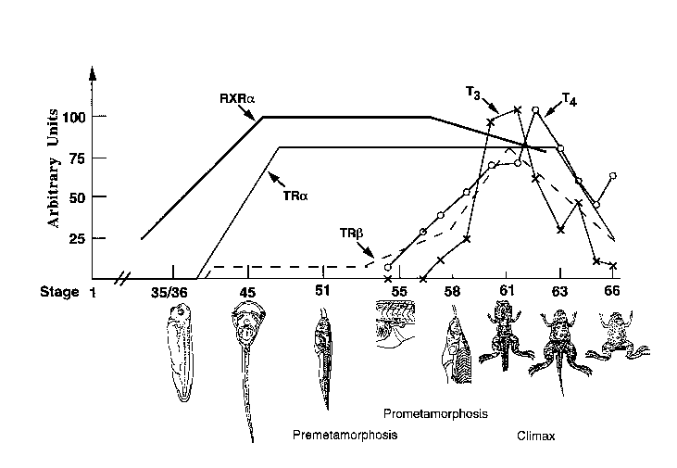
Metamorphosis in X. laevis
14-day
Prometamorphosis
Protocol
EDSTAC
Protocol
Thyroid
functional
(adapted from Shi, et.al., 1996)

Slide 33
14-Day Prometamorphosis Assay
Chemical Exposure – 14 Days through end of premetamorphosis and onset of prometamorphosis
NF Stage 51 to 54
Exposure Measurement Endpoints
  Thyroid gland histopathology, hind limb emergence (rate and normalcy), TH and TH precursor levels, and differential gene expression via gene array from tissue punch samples (i.e., TR beta family)
Interpretation of Results

Slide 34
Significant Data Gaps
Responses, at the organismal and suborganismal levels, to known thyroid agonists and antagonists
Which endpoints provide most meaningful information regarding effects due to thyroid-based mechanisms
The time course of responses
Sensitivity of the measurement endpoints
Relationship between quantitative changes in molecular activity and observed changes in thyroid homeostasis
Dynamic range of thyroid axis homeostasis and its relationship to gross morphological, histological, molecular, and biochemical changes

Slide 35
IMPLEMENTATION CONSIDERATIONS
Animal Welfare Considerations
Test Facility Capablities
Prevalidation Studies (in general accordance with ICCVAM guidelines)
  Phase I – Final definition and development of the recommended endpoints
    Most work will be required with molecular techniques including construction of the gene arrays
  Phase II – Preliminary protocol development for exposure and measurement endpoints.

Slide 36
IMPLEMENTATION CONSIDERATIONS (continued)
Prevalidation Studies
  Phase II (cont.) – Evaluate a set of three known thyroid agonists and antagonists using preliminary protocols
  Phase III – Evaluate data, review and revise preliminary protocols as necessary
  Phase IV – Test and additional set of three test substances with anecdotal or unknown information regarding thyroid axis activity
  Phase V – Review data, revise protocol accordingly to generate Final Protocol for use in interlaboratory GLP validation studies

Slide 37

Questions
Does the EDMVS agree that the Prometamorphosis Assay with Xenopus is the appropriate amphibian assay to recommend for further implementation?

Slide 38
Questions (continued)
2) Does the EDMVS agree that pre-validation efforts should be phased as described in the DRP and targeted to address the following:
establish organismal and sub-organismal responses to established thyroid agonists and antagonists,
determine which endpoints are diagnostic of thyroid-based mechanisms,
ascertain the general time course of responses,
establish the sensitivity of the measurement endpoints, and
establish the dynamic range of thyroid axis related responses?

Slide 39
Questions (continued)
3) Does the EDMVS agree with using thyroxine as a thyroid agonist and perchlorate, propylthiouracil, and amiodarone as thyroid antagonists for evaluating the performance of this assay?
4) Does the EDMVS have suggestions to improve the DRP?
Notes:
Perhaps Methimazole should be considered = MOA is synthesis inhibition via TPO inhibition

