Slide 1
Taylor-Couette Instabilities
with a Crystal-Melt Interface
Jeff McFadden, NIST
Sam Coriell, NIST
Bruce Murray, SUNY Binghamton
Rich Braun, U. Delaware
Marty Glicksman, RPI
Marty Selleck, RPI
G.I. Taylor Medalist Symposium in Honor of Steve Davis
June 28, 2001
NASA Microgravity Research Program

Slide 2
Coupled Hydrodynamic/
Morphological Instabilities
Flow in the melt modifies the thermal and solutal gradients at the crystal-melt interface that determine the morphological stability of the interface.
The shape of the crystal-melt interface modifies the fluid flow near the interface and affects the hydrodynamic stability of the melt.
S.H. Davis, Effects of Flow on Morphological Stability, Handbook of Crystal Growth, Vol. I, ed. D.T.J. Hurle (Elsevier, Amsterdam, 1993), Ch. 13.
Notes:
Fern and Antii – matrix plot of sequences up to 10 proteins long – GENBANK
Fern and Tony – reconstructing a genetic sequence from an incomplete sequence with gaps and deletions

Slide 3
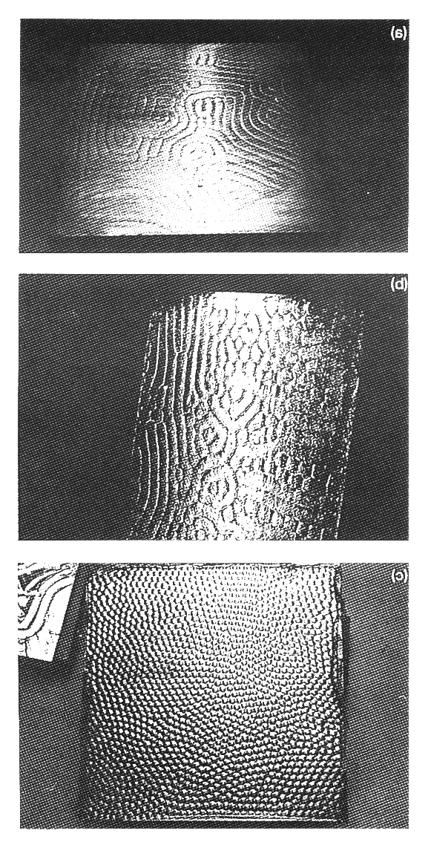
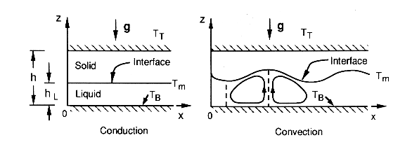
Benard Convection
The interface morphology changes from rolls to hexagons as the solid thickness is varied.
S.H. Davis, U. Muller, and C. Dietsche, JFM (1984)
Notes:
Fern and Antii – matrix plot of sequences up to 10 proteins long – GENBANK
Fern and Tony – reconstructing a genetic sequence from an incomplete sequence with gaps and deletions

Slide 4
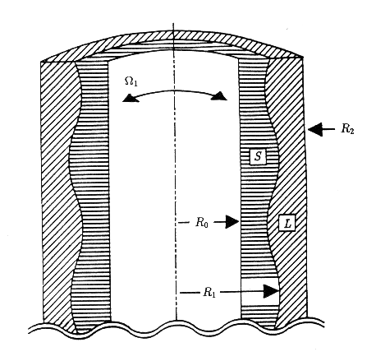
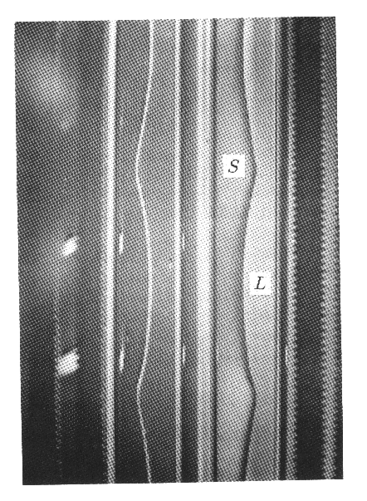
Modulated Taylor-Couette Flow
Rigidly Co-Rotating Cylinders
in Time-Harmonic Motion
Radial Temperature Gradient
Notes:
Fern and Antii – matrix plot of sequences up to 10 proteins long – GENBANK
Fern and Tony – reconstructing a genetic sequence from an incomplete sequence with gaps and deletions

Slide 5
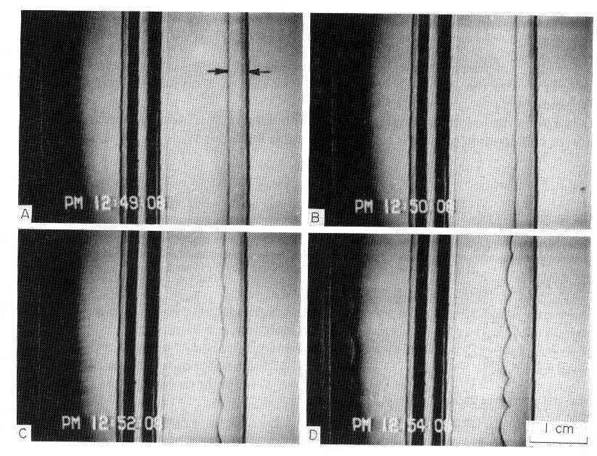
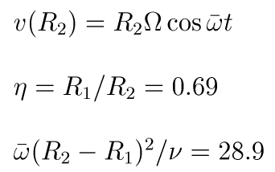
Interface Instability
Succinonitrile (SCN)
Notes:
Fern and Antii – matrix plot of sequences up to 10 proteins long – GENBANK
Fern and Tony – reconstructing a genetic sequence from an incomplete sequence with gaps and deletions

Slide 6
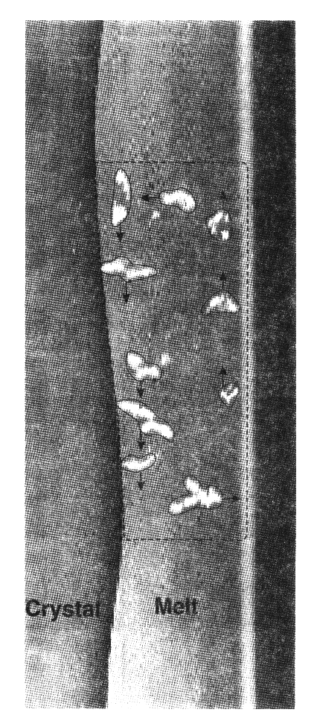
Taylor-Vortex Flow
Multiple-exposure image capturing marker particle at periodic intervals of the motion
Notes:
Fern and Antii – matrix plot of sequences up to 10 proteins long – GENBANK
Fern and Tony – reconstructing a genetic sequence from an incomplete sequence with gaps and deletions

Slide 7
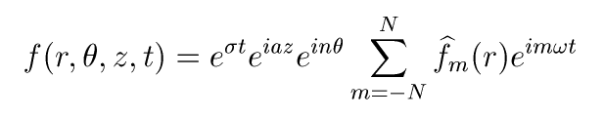
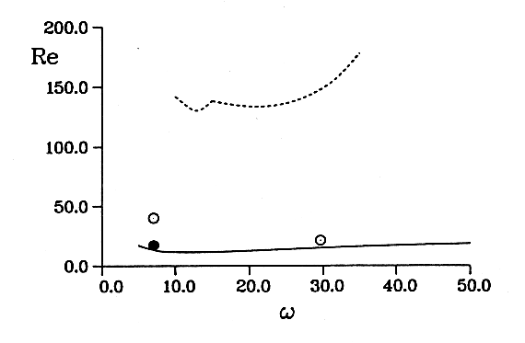
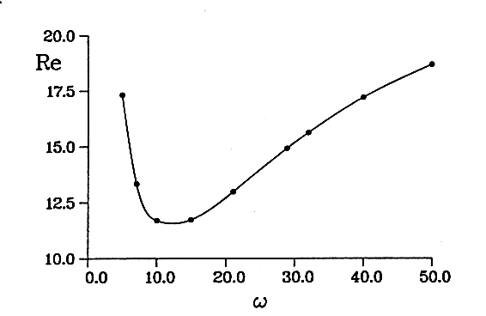

Floquet Theory
Discretize in space; solve ODEs in time over one period; or
Fourier series in time; solve spatial eigenproblem:
(rigid)
(crystal-melt)
(crystal-melt)
Notes:
Fern and Antii – matrix plot of sequences up to 10 proteins long – GENBANK
Fern and Tony – reconstructing a genetic sequence from an incomplete sequence with gaps and deletions

Slide 8
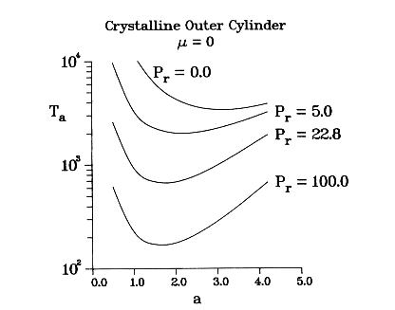
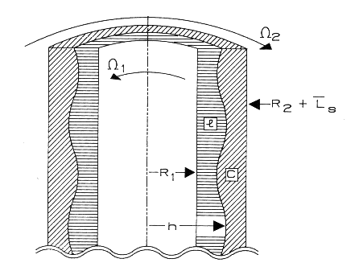
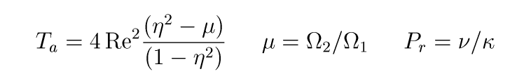
Steady Rotation
Notes:
Fern and Antii – matrix plot of sequences up to 10 proteins long – GENBANK
Fern and Tony – reconstructing a genetic sequence from an incomplete sequence with gaps and deletions

Slide 9
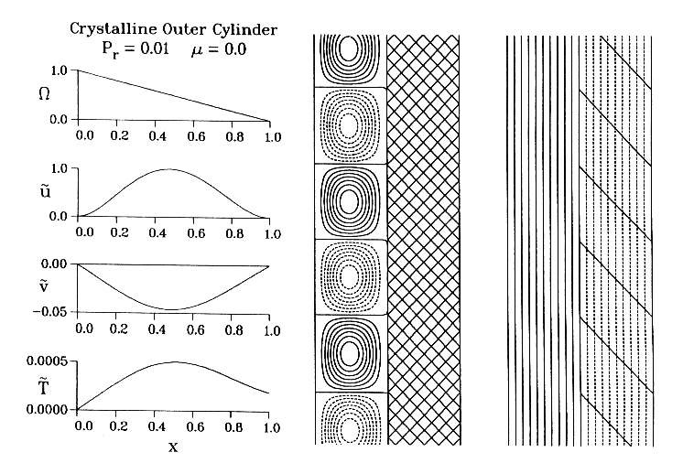
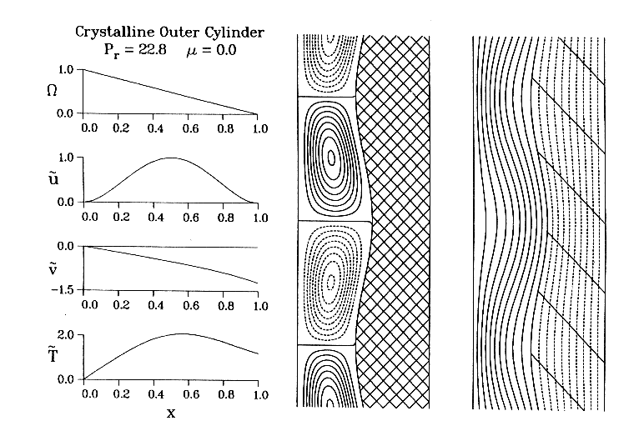
Linear Eigenmodes
Notes:
Fern and Antii – matrix plot of sequences up to 10 proteins long – GENBANK
Fern and Tony – reconstructing a genetic sequence from an incomplete sequence with gaps and deletions

Slide 10
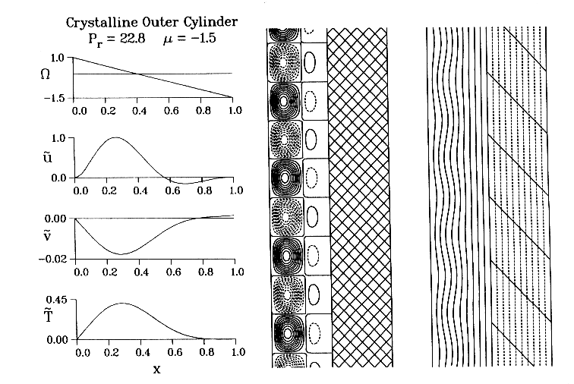
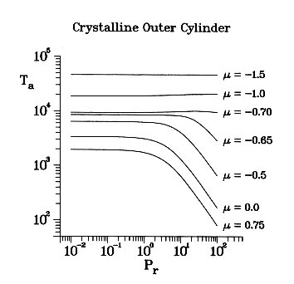
Counter-Rotating Cylinders
Instability is localized away from the interface.
Notes:
Fern and Antii – matrix plot of sequences up to 10 proteins long – GENBANK
Fern and Tony – reconstructing a genetic sequence from an incomplete sequence with gaps and deletions

Slide 11
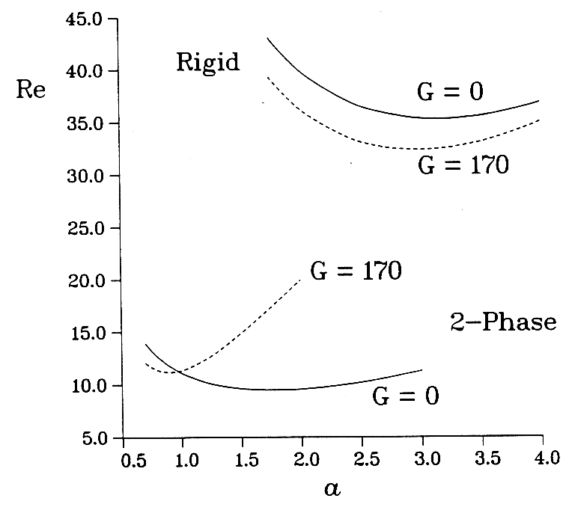
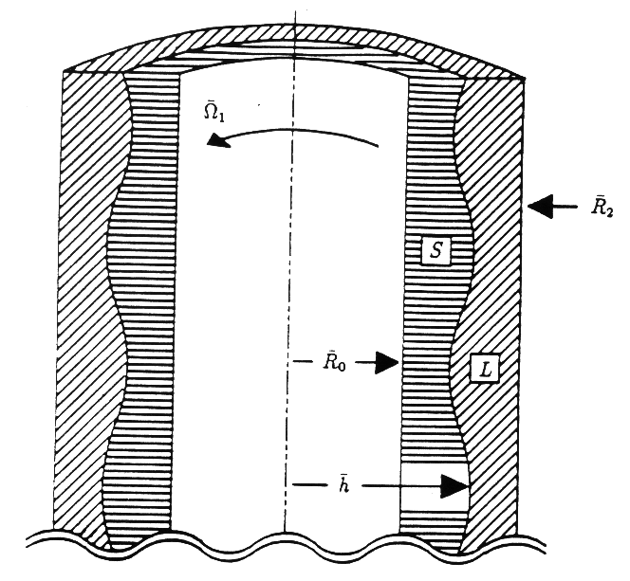
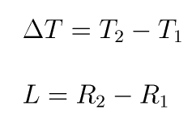

Bouyancy-Driven Flow
Notes:
Fern and Antii – matrix plot of sequences up to 10 proteins long – GENBANK
Fern and Tony – reconstructing a genetic sequence from an incomplete sequence with gaps and deletions

Slide 12
Summary
An otherwise stable interface is destabilized by the flow
Taylor-Couette flow is strongly destabilized for materials with moderate Prandtl numbers
Organics and oxides have moderate-to-large Prandtl numbers; metals and semiconductors have small Prandtl numbers. (For solute diffusion, the Schmidt number is usually large.)
Weakly-nonlinear analysis hasn’t been done for these problems
General understanding of when strong coupling will occur is lacking
Notes:
Fern and Antii – matrix plot of sequences up to 10 proteins long – GENBANK
Fern and Tony – reconstructing a genetic sequence from an incomplete sequence with gaps and deletions

Slide 13
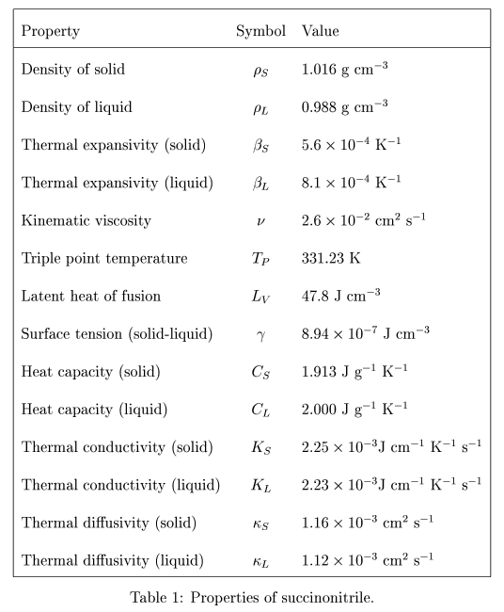
Material Properties of SCN
Notes:
Fern and Antii – matrix plot of sequences up to 10 proteins long – GENBANK
Fern and Tony – reconstructing a genetic sequence from an incomplete sequence with gaps and deletions

Slide 14
References
G.B. McFadden, S.R. Coriell, M.E. Glicksman, and M.E. Selleck, Instability of a Taylor-Couette flow interacting with a crystal-melt interface, PCH Physico-Chem. Hydro. 11 (1989) 387-409
G.B. McFadden, S.R. Coriell, B.T. Muarray, M.E. Glicksman, and M.E. Selleck, Effect of a crystal-melt interface on Taylor-vortex flow, Phys. Fluids A 2 (1990) 700-705.
G.B. McFadden, B.T. Murray, S.R. Coriell, M.E. Glicksman, and M.E. Selleck, Effect of modulated Taylor-Couette flows on crystal-melt interfaces: Theory and initial experiments, in On the Evolution of Phase Boundaries, ed. M.E. Gurtin and G.B. McFadden (Springer-Verlag, New York, 1992), pp. 81-100.
R.J. Braun, G.B. McFadden, B.T. Murray, S.R. Coriell, M.E. Glicksman, and M.E. Selleck, Asymptotic behavior of modulated Taylor-Couette flows with a crystalline inner cylinder, Phys. Fluids A 5 (1993) 1891-903.
G.B. McFadden, B.T. Murray, S.R. Coriell, M.E. Glicksman, and M.E. Selleck, Effect of a crystal-melt interface on Taylor-vortex flow with buoyancy, in Emerging Applications in Free Boundary Problems, ed. J.M. Chadham and H. Rasmussen (Longman Scientific & Technical, New York, 1993), pp. 105-119.
Notes:
Fern and Antii – matrix plot of sequences up to 10 proteins long – GENBANK
Fern and Tony – reconstructing a genetic sequence from an incomplete sequence with gaps and deletions

