Slide 1
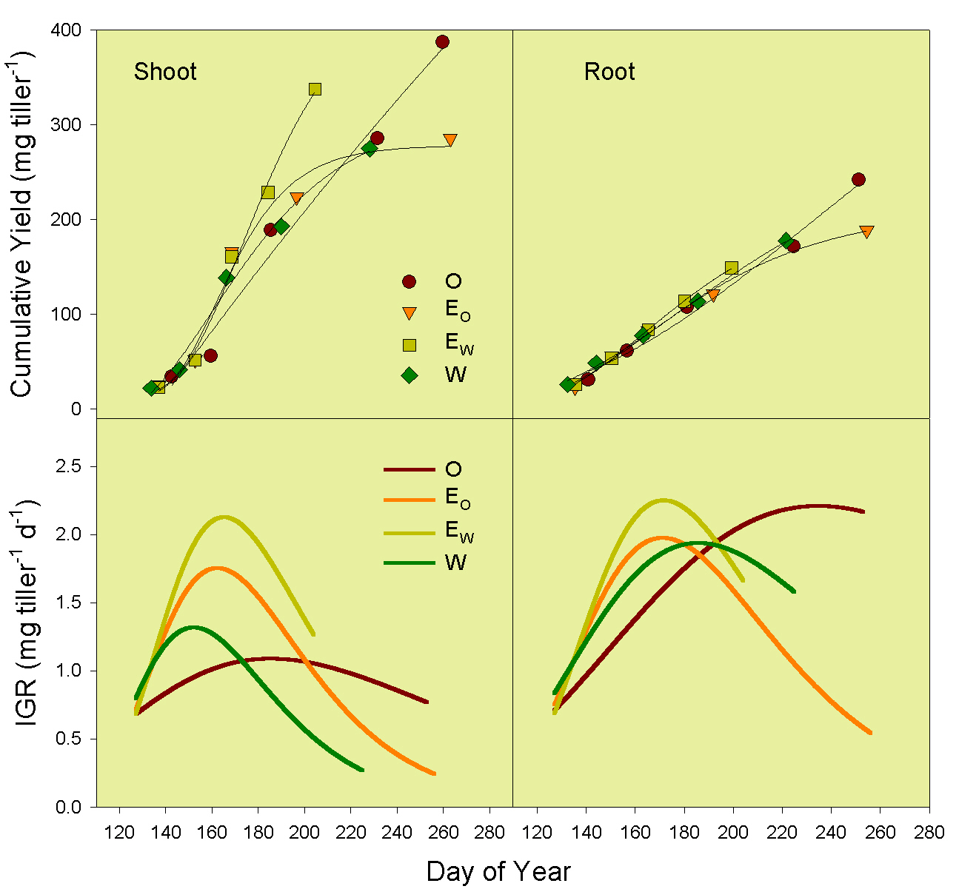
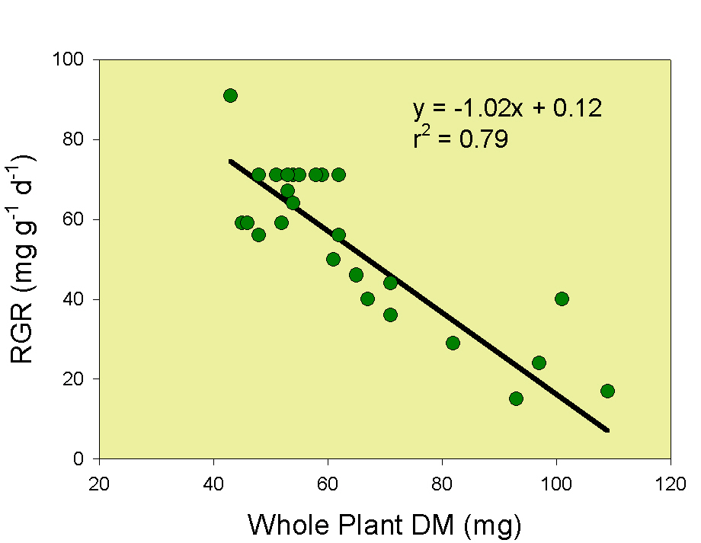
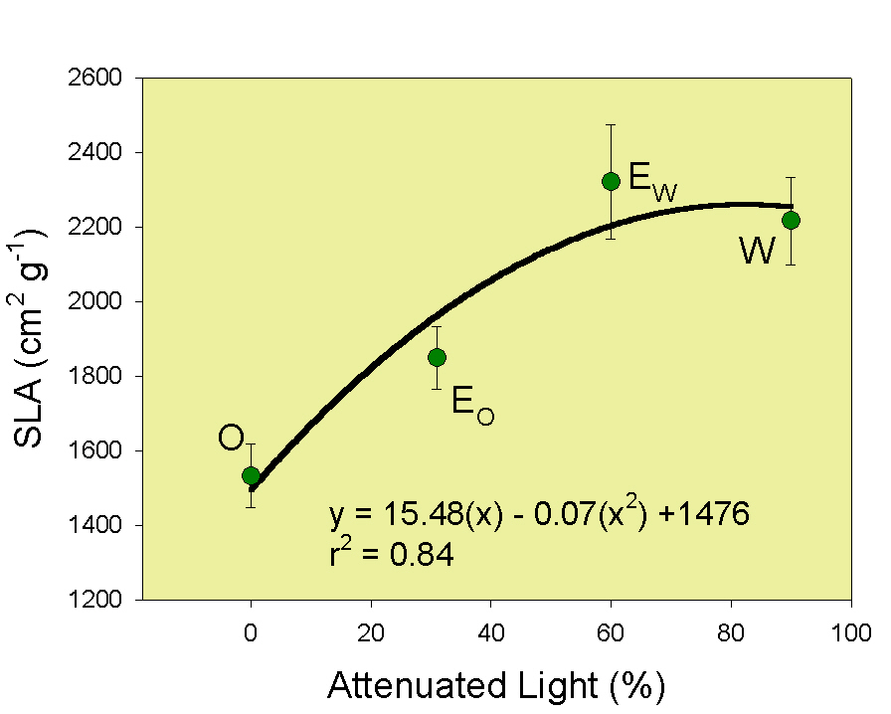
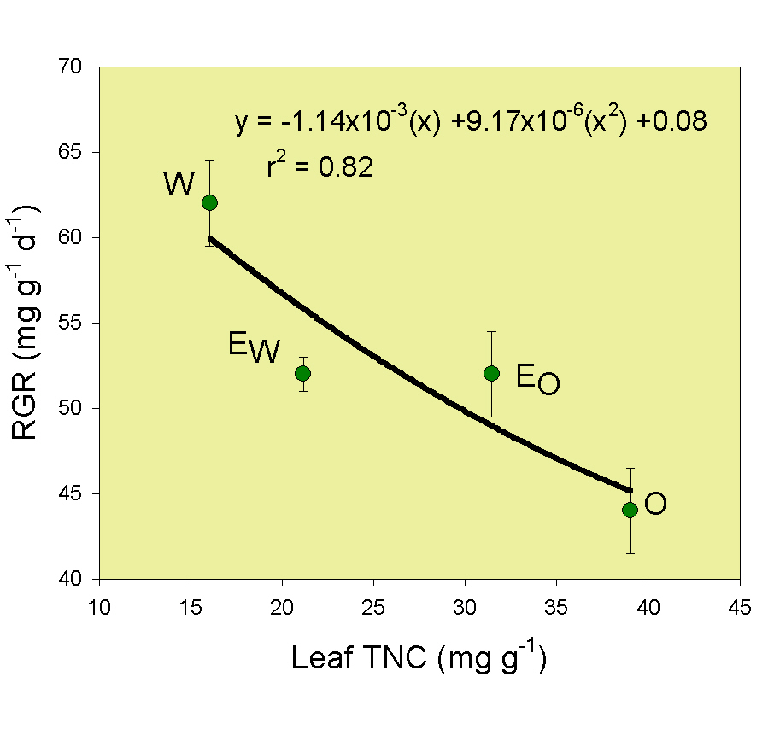
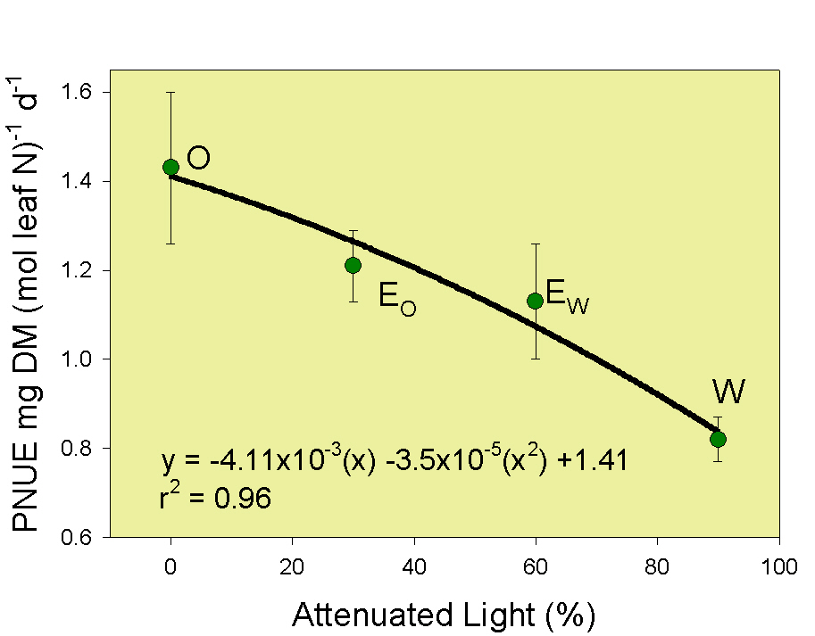
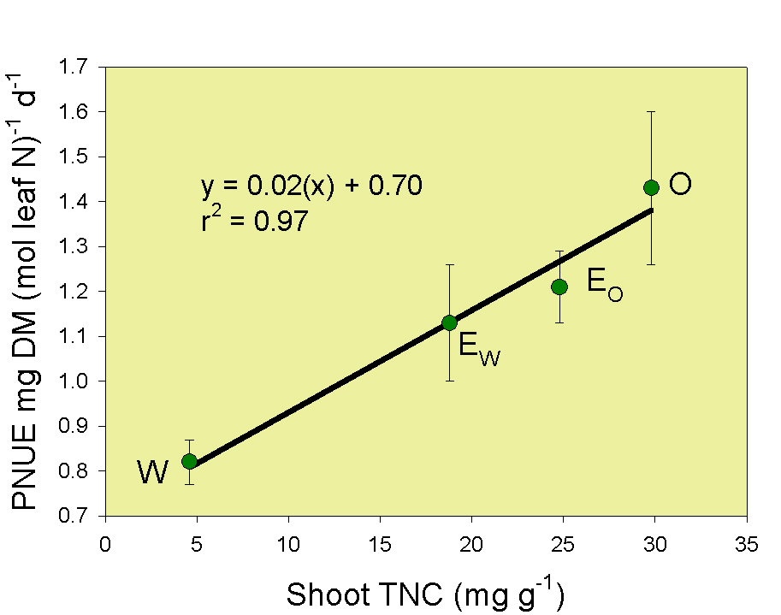
DISTRIBUTION AND RATE OF PRODUCTION
Growth intervals, based upon the time required to reach 20 cm of average canopy height varied among sites, and were 126d at the O and only 98d at the W site. Gompertz growth curves of cumulative yields show O sites producing more shoot and root over more of the growing season than W or E sites.
Shoot regrowth was rapid in W and E_{W} sites (fast-growers) early in the growing season. Maximum shoot growth rates, based on instantaneous growth rates (IGR), occurred 35 d later in the O (slow) than W (fast-grower) site.
Maximum root growth rates occurred 49 d later in the O than W site. The E_{O} and E_{W} sites achieved maximum growth early in the growing season and were similar to those for the W site.
PRODUCTION MECHANISMS
Relative regrowth rate (RGR) calculated as: RGR = NAR * LMR * (1/DMC_{L}) * A_{L}/M^{F}_{L} includes morphological and physiological attributes of RGR. RGR was inversely associated with whole plant mass, and as such regrowth rates of W were greater than O plant rates.
Specific leaf area (SLA) increased as light attenuation increased. SLA was greater in the W than O site illustrating morphological adaptation to low light conditions and contributed to greater RGR in W. Leaf DM content was less in W compared to O plants (data not shown).
Abundance of TNC in shoots exceeded CHO assimilatory capacity of N-limited plant at the O site, whereas at the W site plants had very little TNC and excess N. W plants were unable to generate leaves and tillers.
INCREASED SHADE WAS ASSOCIATED WITH:
LESS EVAPOTRANSPIRATION
SMALLER PLANTS
FEWER TILLERS
GREATER TILLER LOSS
LARGE, THIN LEAVES
SHORTER GROWTH INTERVAL
GREATER RGR
LOWER PNUE
Photosynthetic N use efficiency (PNUE; whole plant DM / mol leaf N / Δ time) decreased 43% as light attenuation increased, leading to greater herbage production at high light and relatively low N (O) compared to low light and high N conditions in W. [See Hirose and Bazzaz (1998. Ann. Bot. 82:195-202) for further interpretation of PNUE.]
PNUE and TNC are linearly and positively related. PNUE corresponds with TNC concentrations and the ability to generate TNC reserves. Relationship suggests strong light use efficiency in W relative to O where excess TNC accumulates and additional tissue development is retarded by insufficient N.

