Slide 1

ARS Floral & Nursery Crops Research Initiative
Research on Phytophthora spp. in South Carolina: 2000-2003
Steven N. Jeffers
Dept. of Plant Pathology & Physiology
Clemson University
Clemson, SC

Slide 2
Personnel Involved
Faculty
  Steven N. Jeffers—Assoc. Prof. & Ext. Specialist
  Melissa B. Riley—Associate Professor, Plant Path
  David P. Jacobs--Professor, Computer Science
Technicians
  Lynn Luszcz—Research Associate
Graduate Students
  Chun-hang Duan—Ph.D. 2002
  Jessica A. Eisenmann—M.S. 2003 (expected)

Slide 3
Highlights of Accomplishments
Potential for rapid identification of Phytophthora spp. by Fatty Acid Methyl Ester (FAME) profile analysis
Characterization of a population of Phytophthora cinnamomi associated with woody ornamental crops
Characterization of populations of P. nicotianae & P. palmivora associated with herbaceous and selected woody ornamental crops
Maintain permanent culture collection

Slide 4
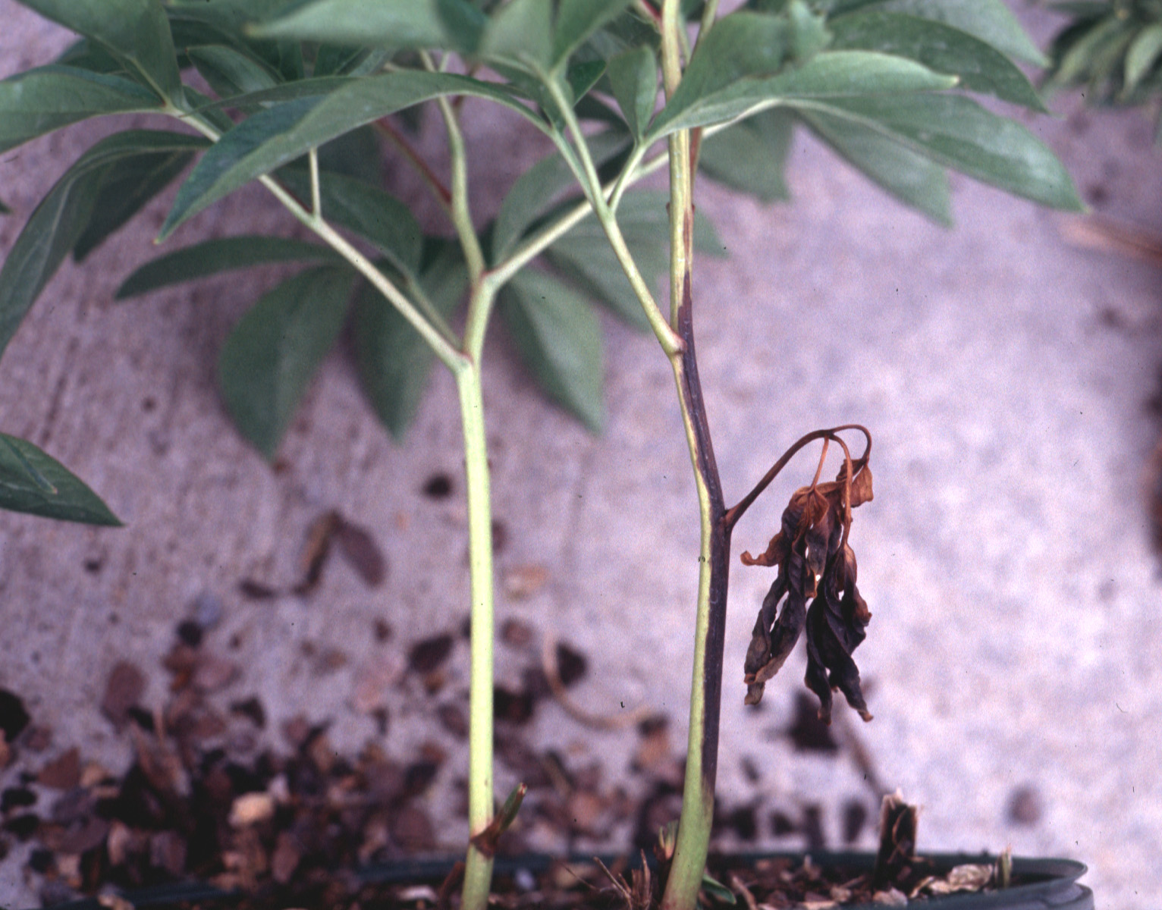
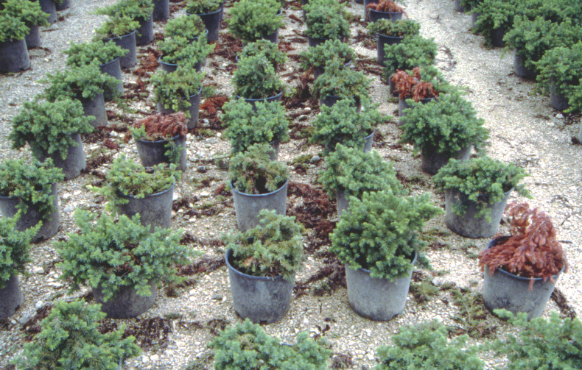
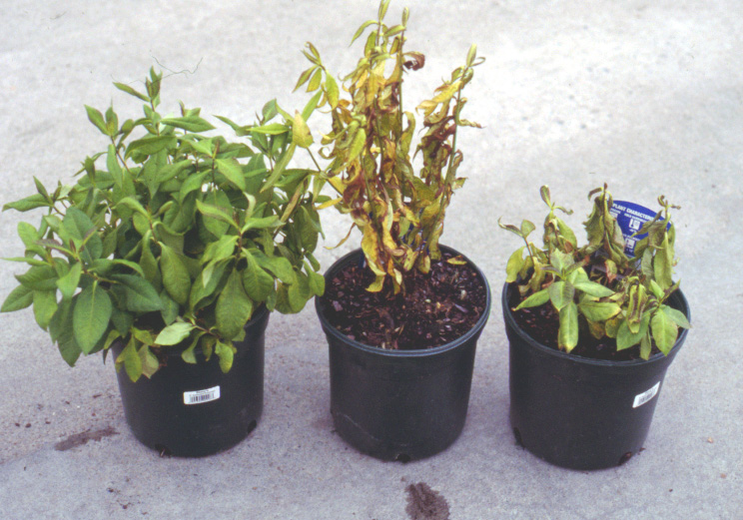
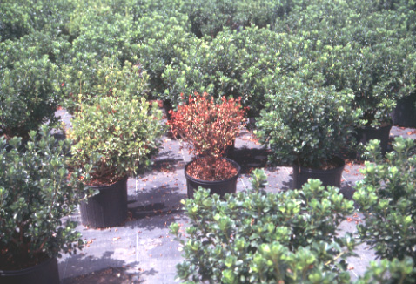
Peony—aerial blight
Shore Juniper—root rot
Floriculture Crops
Nursery Crops
Phlox—root rot
Azalea—root rot

Slide 5
Phytophthora spp. on
Ornamental Crops
Serious problems in USA & worldwide
Numerous closely-related species involved
Various sources of inoculum
Accurate identification essential
  extension—diagnosis & management
  research—etiology, ecology, epidemiology
Standard morphological identification
  not always effective and accurate
  time-consuming & labor-intensive

Slide 6
Why FAME Analysis ??
Proven technology—widely used for bacteria
Utilizes commercial hardware & software
  MIDI System—Microbial Identification, Inc.
System present and used in many diagnostic labs worldwide
FAME profile database is electronic
  easily modified, shared, transferred
30 samples processed at one time
Relatively inexpensive

Slide 7
Objectives of Project
Investigate effects of culture conditions on the production of fatty acids by selected species of Phytophthora
Develop and standardize methods for generating fatty acid profiles for Phytophthora spp.
Investigate variability in fatty acid profiles among these species

Slide 8
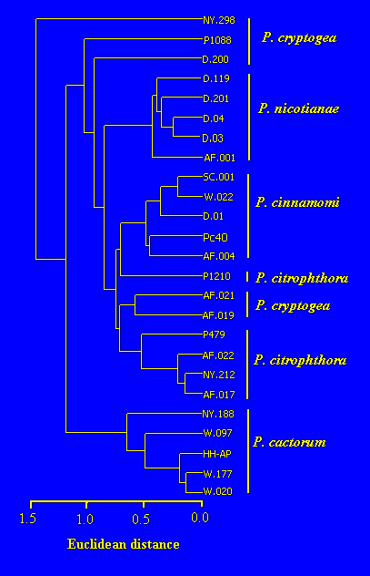
Dendrogram Based
on FAME Analysis

Slide 9
FAME Identification: Summary
Amounts of each FA varied among species
Factors affecting FA production determined
Standard procedure for FAME analysis was developed
FAME profiles appear to be effective for identification of species
AFLP analysis supported FAME utility

Slide 10
FAME Identification: Future & Value
Future Research
  confirm utility with additional species
  construct FAME database with known isolates
  validate database with “unknown” isolates
Value of Research to Stakeholders
  provide a rapid and inexpensive procedure for identification to diagnostic labs worldwide
  expedite studies on management of Phytophthora diseases

Slide 11
Why Characterize Pathogen Populations ??
Define morphological & physiological characters
  aid in identification
  sensitivity to mefenoxam & other fungicides
Occurrence & distribution of mating types
  potential for genetic variation & adaptation
Pathogenicity & virulence
  identify new hosts, expand known host range
  determine relative virulence
Ultimately—better disease management

Slide 12
Population of Phytophthora cinnamomi
Predominant species attacking nursery crops
51 isolates primarily from woody plants in SC
  recovered between 1995 & 2000 by PP Clinic
49 isolates A2 & 2 isolates A1
All isolates sensitive to mefenoxam
  EC₅₀ values: 0.04-0.20 mg/L
AFLP analyses
  isolates very similar genetically
  implications for sources of inoculum…

Slide 13
Population of Phytophthora nicotianae
Predominant species attacking bedding plants, herbaceous perennials, Buxus spp.
108 isolates collected in SC during 1995-2000
Both A1 & A2 mating types present
  A2 most common
Some isolates resistant to mefenoxam
  EC₅₀ values = 300-700 mg/L
29 potentially new hosts under investigation
Virulence among isolates appears to differ

Slide 14
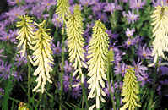
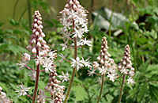
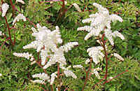
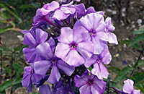
Potential “New” Hosts for P. nicotianae
Agapanthus
Aruncus
Ceratostigma plumbaginoides
Delosperma
Gaura
Hemerocallis
Hibiscus syriacus
Kniphofia
Lamium
Penstemon
Petunia
Phlox paniculata
Rodgersia
Salvia x superba
Sedum
Tiarella
Vinca minor
Viola x wittrockiana

Slide 15
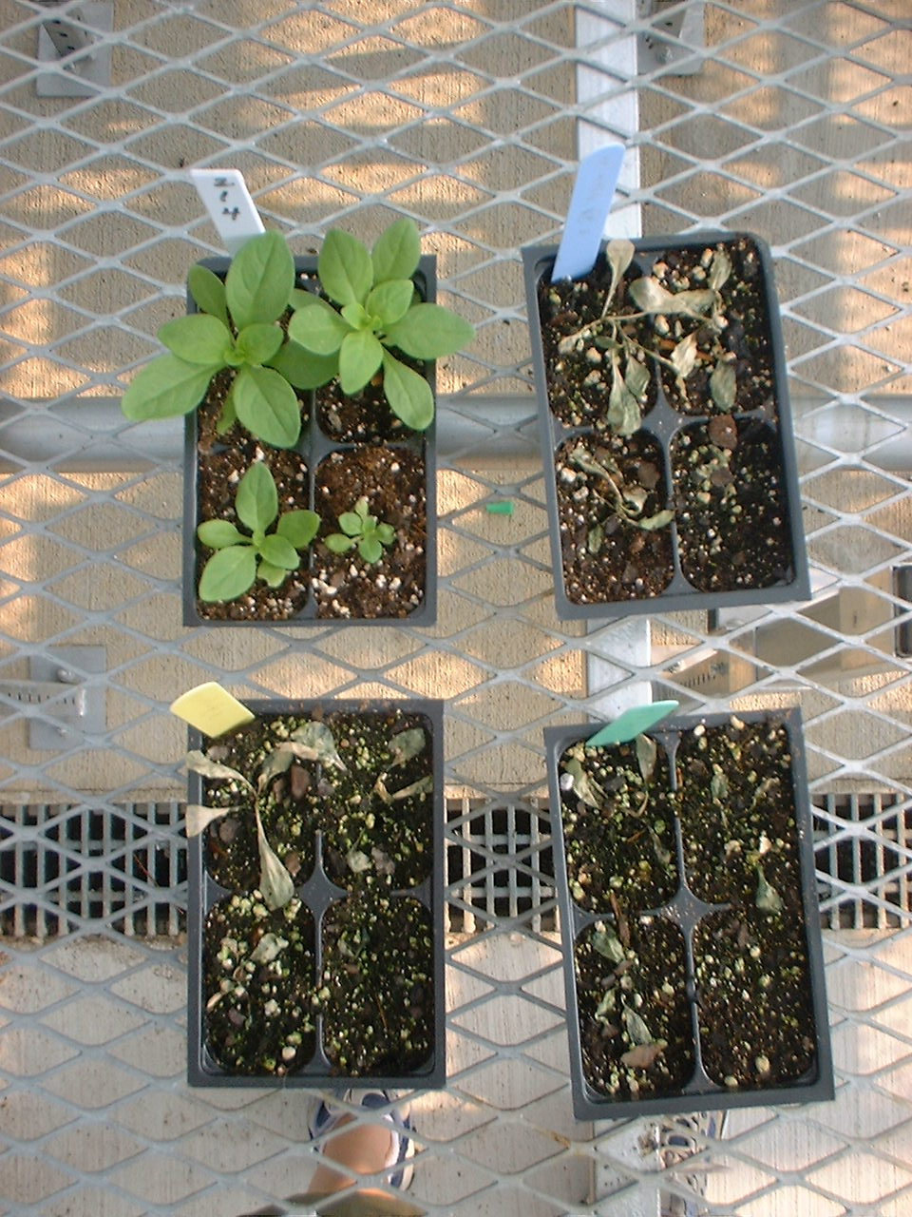
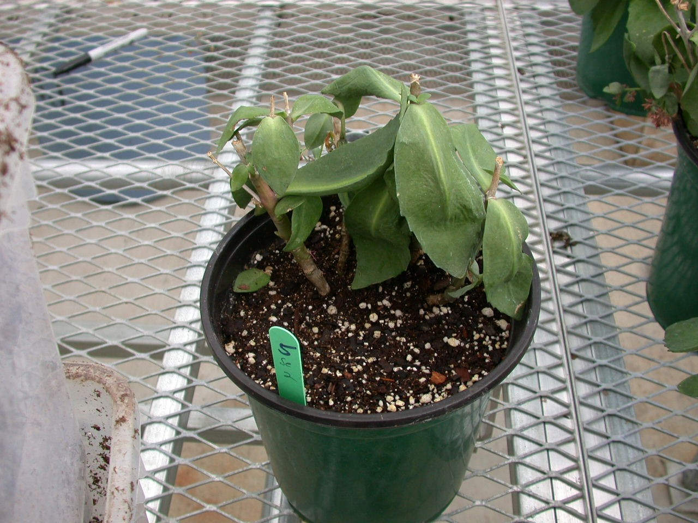
New hosts for P. nicotianae
Petunia—root rot
Sedum—root rot

Slide 16
Population of Phytophthora palmivora
Previously not found on ornamental crops in the Southeast
Primarily attacks Hedera spp. & Fatsia japonica
  both in the family Araliaceae
38 isolates collected in SC during 1995-2000
Morphologically similar to P. nicotianae
Only A1 mating type found
All isolates very sensitive to mefenoxam
  EC₅₀ values < 0.10 mg/L

Slide 17
Pathogen Populations: Future & Value
Future Research
  compare populations from ornamental crops to those from natural ecosystems
  determine virulence of isolates from different populations
  identify sources of primary inoculum
Value to Stakeholders
  identify new host species
  pinpoint sources of inoculum
  more effective disease management strategies

Slide 18
Phytophthora Culture Collection
Maintain a collection of 1000+ isolates
  valuable resource
  distribute isolates to colleagues
  receive isolates from colleagues
Constructing an ACCESS database so information is readily accessible
  in cooperation with Dept. of Computer Science
  will be posted on the web

Slide 19

Questions??

