Slide 1
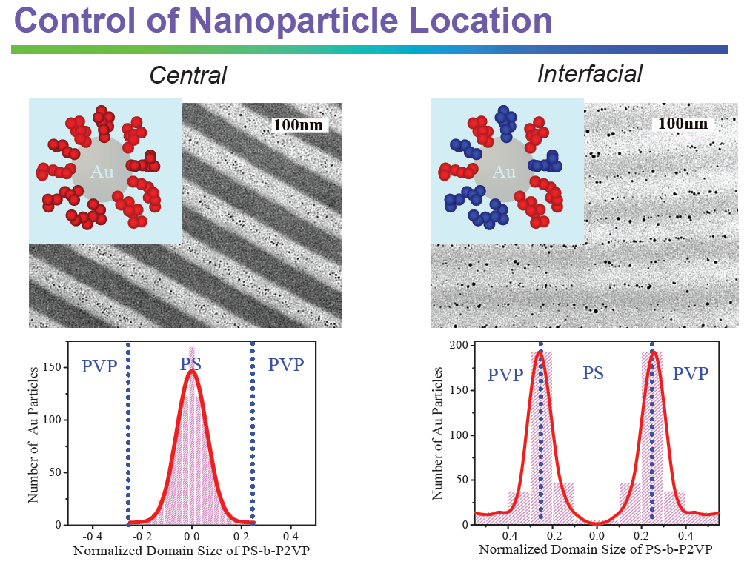
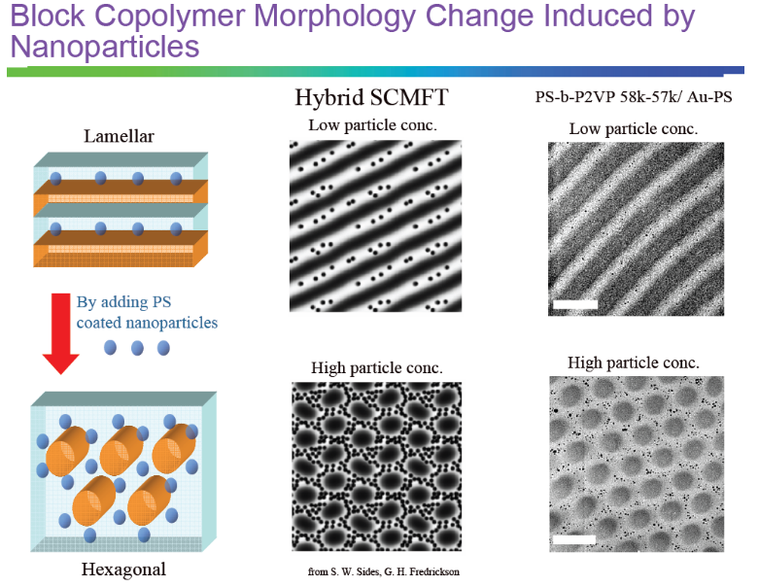
IRG-3: Soft Cellular Materials
UCSB MRSEC, DMR-0520415
Participating Faculty: L. Gary Leal (Chem. Eng./Mat.) and Glenn Fredrickson (Chem. Eng/Mat.) - IRG co-leaders; Craig Hawker (Mat./Chem.), Edward Kramer (Mat./Chem. Eng.), George Homsy (Mech. Eng.), Todd Squires (Chem. Eng.), James Langer (Physics/Mat.), J. Israelachvili (Chem. Eng./Mat.)
Bumjoon Kim (Chem. Eng.), working with Kramer, Hawker, Pine, and Fredrickson, has shown that nanoparticles can be directed to interfaces or domain interiors of block copolymer mesophases by appropriate surface treatment
Increasing particle concentration can produce morphological transitions in agreement with hybrid self-consistent field simulations

