Slide 1

Isolation of West Nile Virus from Mosquitoes and the Importance of Specific Vector Identification
Harry M. Savage, PhD
Research Entomologist
Centers for Disease Control and Prevention
Ft. Collins, CO

Slide 2
Data needed to assess vector status
Field infection rate
  Correct identification and pooling
  Wide taxonomic coverage of taxa processed
Vector competence - Transmission rate
Blood host preference
Species abundance and longevity

Slide 3
Mosquito surveillance, June – October 2000: number of WN virus positive mosquito pools by state with date of first positive, n = 480
New York – 358 pools (75%), July 7
New Jersey – 58 pools, July 18
Pennsylvania - 46 pools, August 29
Connecticut – 14 pools, July 11
Massachusetts – 4 pools, August 8

Slide 4
Mosquito Species Positive for WN virus, June – October, 2000, 14 nominal species, 17 taxa in 5 genera, n = 480
428 isolates (89%) from Culex mosquitoes
  226 from Cx. pipiens/restuans
  131 from Cx. pipiens
  36 from Cx. salinarius
  11 from Cx. restuans
  24 from Culex spp.
52 isolates (11%) from other genera

Slide 5
Mosquito Species Positive for WN virus,
June - October, 2000
52 isolates (11%) from non-Culex mosquitoes
Aedes vexans - 16 isolates
Ochlerotatus japonicus - 9 isolates
Oc. triseriatus - 9 isolates
Oc. trivittatus - 8 isolates
Culiseta melanura - 3 isolates
Ae. albopictus, Anopheles punctipennis, Oc. atropalpus, Oc. canadensis, Oc. cantator, Psorophora ferox - 1 isolate each

Slide 6
Mosquito species yielding more than a single WN virus isolate from five NE states, 2000
Taxa | No. isolates | No. tested | GMIR | 95 % C.I.
Cx. pipiens | 131 | 93,728 | 1.4 | 1.2-1.7
Cx. restuans | 11 | 20,167 | 0.5 | 0.3-1.0
Cx. salinarius | 36 | 26,370 | 1.4 | 1.0-1.9
Ae. vexans | 16 | 56,446 | 0.3 | 0.2-0.5
Oc. japonicus | 9 | 8,137 | 1.1 | 0.6-2.1
Oc. triseriatus | 9 | 4,560 | 2.0 | 1.0-3.8
Oc. trivittatus | 8 | 40,342 | 0.2 | 0.1-0.4
Cs. melanura | 3 | 30,596 | 0.1 | 0.0-0.3

Slide 7
Taxa | GMIR | Transmission rate* | Bloodmeal hosts
Cx. pipiens | 1.4 | 20% | Avian
Cx. restuans | 0.5 | 67% | Avian
Cx. salinarius | 1.4 | 54% | Mammal/Avian
Ae. vexans | 0.3 | 8% | Mammal
Oc. japonicus | 1.1 | 64% | Mammal/Avian?
Oc. triseriatus | 2.0 | ND | Mammal
Oc. trivittatus | 0.2 | ND | Mammal
Cs. melanura | 0.1 | ND | Avian
* Experimental data from M. Turell et al. USAMRIID

Slide 8
Comparison of Molecular and Morphological Identification of 45 blood-fed, field collected Culex specimens from NYC
Morphological Identification
Mol. ID | Cx. salinarius | Cx. pipiens | Cx. restuans
Cx. salinarius | 10 | 0 | 0
Cx. pipiens | 0 | 20 | 0
Cx. restuans | 0 | 3 | 12
Overall proportion correct (42/45) – 93 %
pipiens vs. restuans proportion correct (32/35) – 91%

Slide 9
Conclusions
Field infection rates for each species are essential
  Improve quality of mosquito identification
  Increase taxonomic coverage of taxa tested
Delineation of epizootic and epidemic vectors
Better control strategies

Slide 10
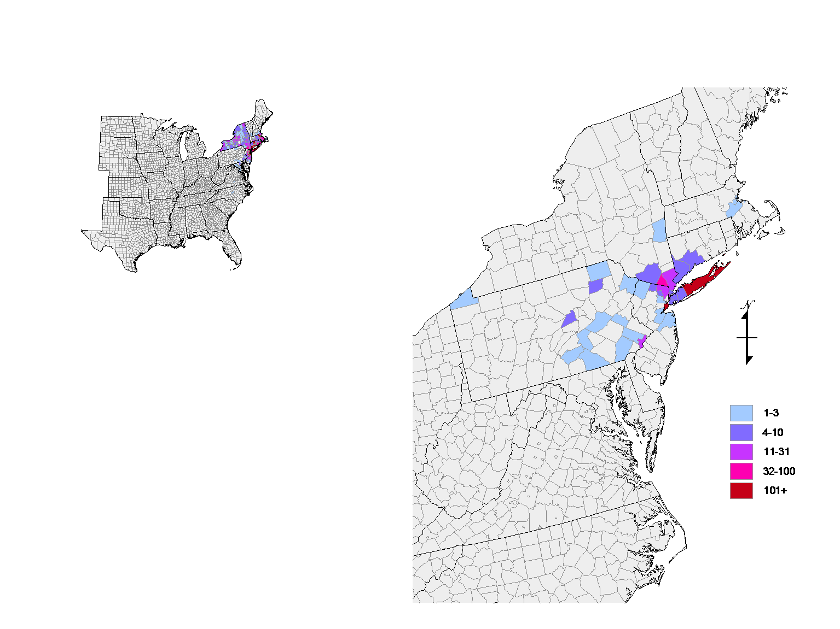
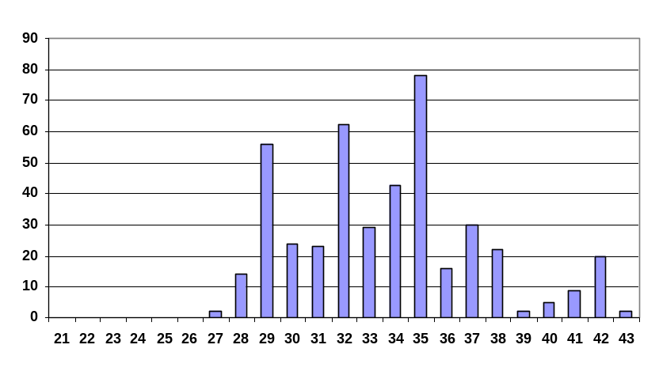

West Nile Virus Isolates from Mosquitoes in the U.S., 2000
Disease Week

